Slide 1
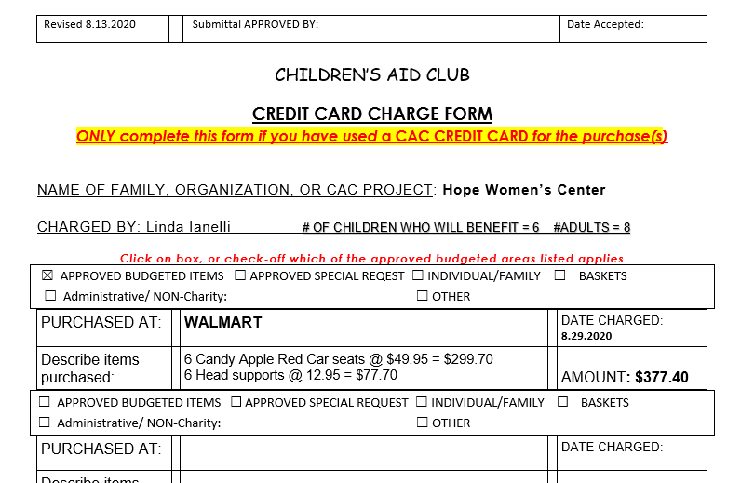
CREATING A CREDIT CARD CHARGE FORM
TOP OF PAGE
1.Enter the Family name if Individual Family, OR Name of Organization, OR Name of Project.
2. Enter your name as charged by and # 0f CHILDREN & ADULTS that will benefit from this funding.
3. Select the appropriate funding category and click on the box.
4. Complete filling in the information requested within this area.

Slide 2
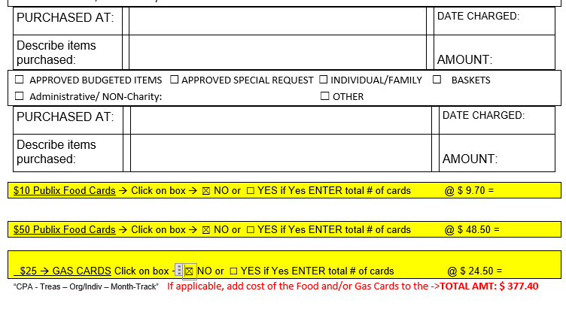
CREATING A CREDIT CARD CHARGE FORM
BOTTOM OF PAGE
1. Complete filling in the information When required within this area when applicable. If no Food or Gas Cards are required click the NO box and enter the Total Amount of the transaction.

