Slide 1
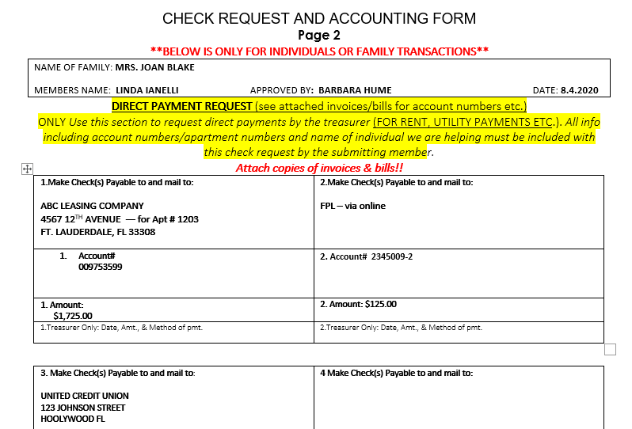
CREATING CHECK REQUEST Page 2 > FOR DIRECT PAYMENTS for INDIVIDUAL’S BILLED TRANSACTIONS
TOP OF PAGE
There are six available entries that can be made within the form.
1.Enter the Family name
And complete with Members Name Approved by and the Date. There are six available entries that can be made within the form.
FOLLOW IMPORTANT
INSTRUCTIONS
2. Enter the name of the company the checks are payable to with the address that it is to be mailed.
3.Enter the correct Account # and amount listed on the invoice or bill in these areas
4. Continue filling in the information requested within each area required to pay the approved invoices/bills submitted.
5. Once completed submit this form to the Individual Chair, with Copy to Welfare Chair.

