Slide 1
HOW TO ADD DATA TO
THE ORGANIZATION TRACKING FORM GOOGLE SHEET

Slide 2
ORGANIZATION TRACKING FOR DONOR FUNDRAISING
GUIDLINES
This information is critical in keeping out donors aware of how many children and adults we reach through our organization’s during any fiscal year.
When we purchase approved budgeted items for an organization we create a Check Request, or a Credit Card Charge. In completing the header of the forms each liaison is to enter the number of children & adults who will benefit from the purchase. These are the numbers that are to get transferred to the Organization Tracking for Donor Fundraising Google sheet.
It is critical to only account for the number of children & adults that are impacted by the particular purchase. Example: Birthday parties. 5 Birthday children and 20 classmates sharing the cake at the celebration. Even though the school may have 90 students. The count would be 25, or 5+20=25. That is the number you will need to enter in the Google sheet. The next three pages show you how to enter the date, name of organization, columns identifying number of children & adults, and the amount spent for the items, which have headers listing the various approved budgeted items.
It is best to enter the data at the time you are completing the Check Request or Credit Card charge. What is most important is actually entering the data to the Google sheet. Please contact me directly if you do not use a computer. 954-536-2034 or caclindaianelli@gmail.com

Slide 3
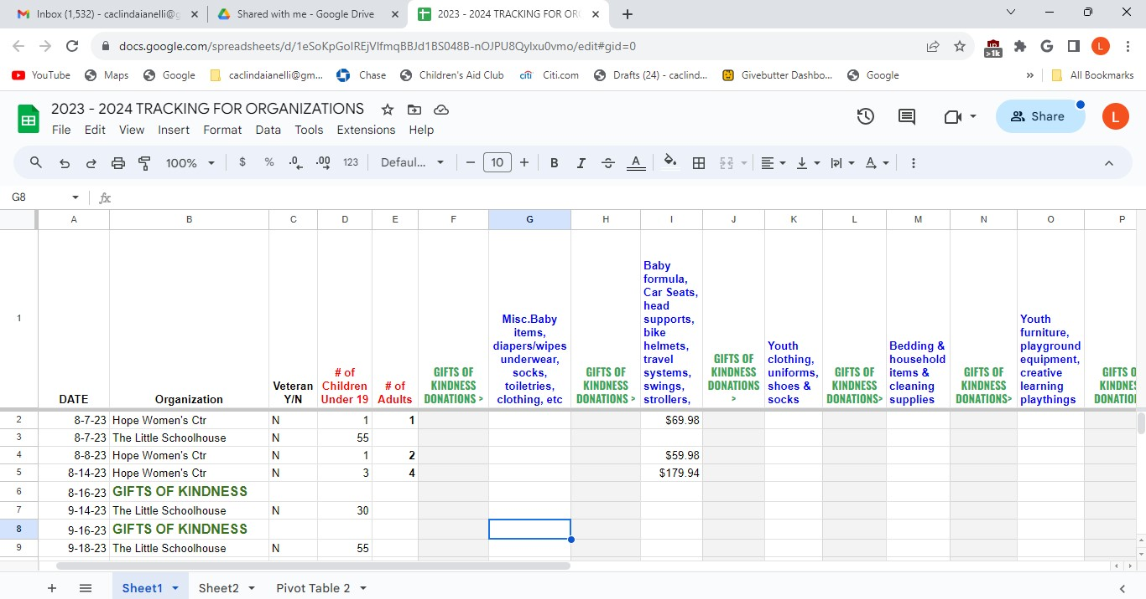
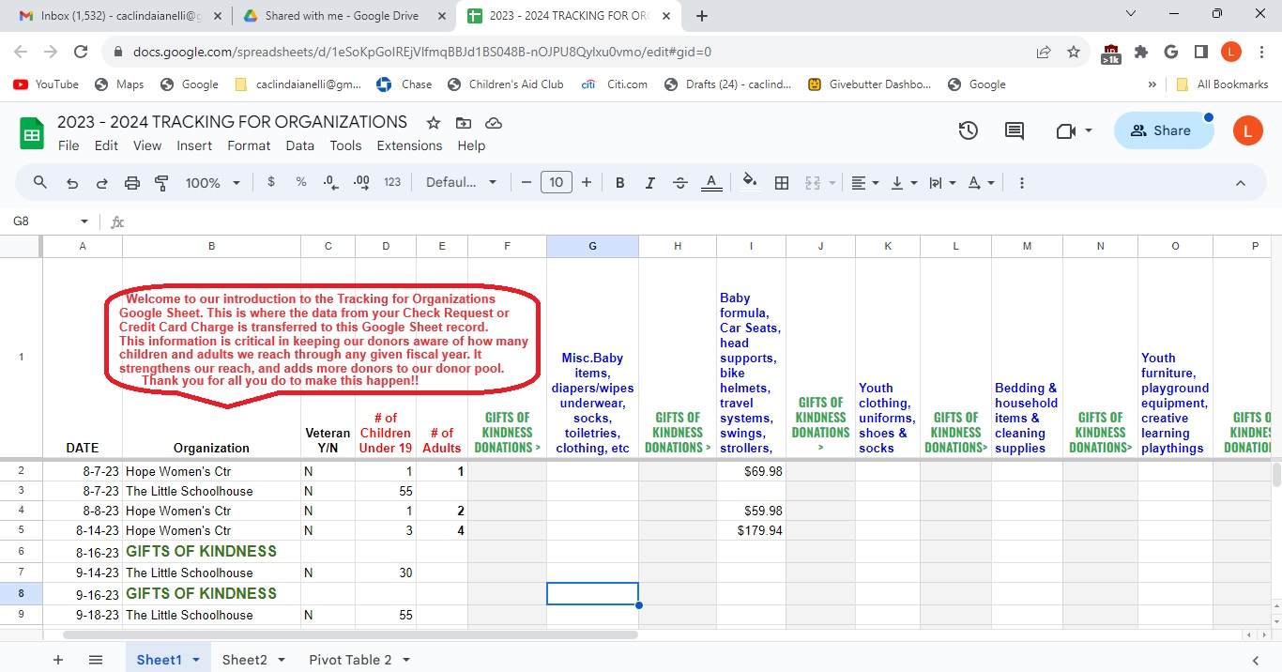

Slide 4
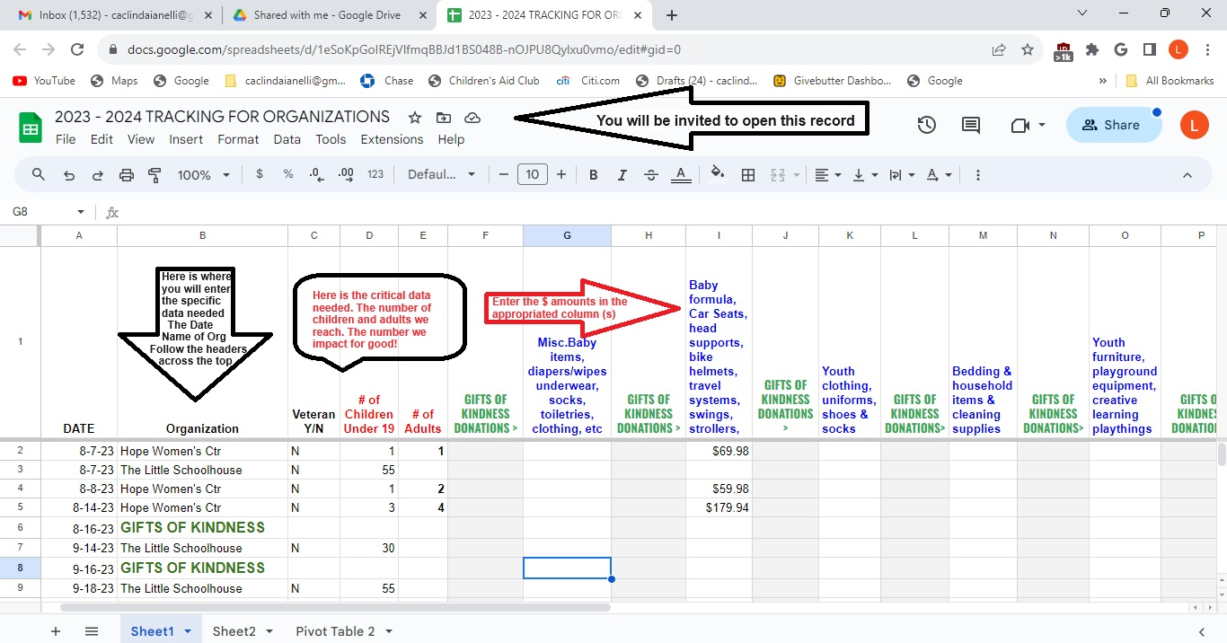

Slide 5
