Slide 1
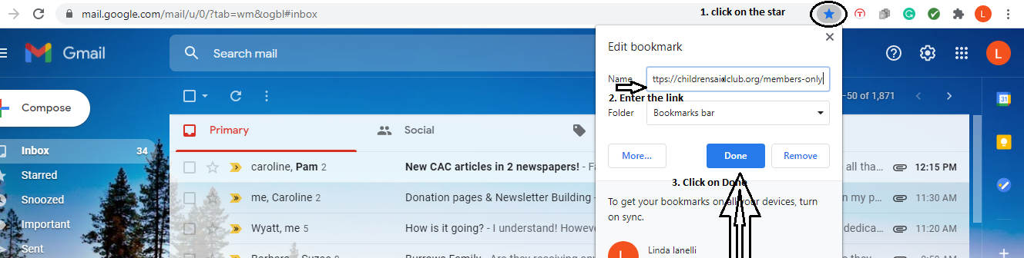
HOW TO SAVE A LINK – MEMBERS ONLY ON CAC WEBSITE – https://childrensaidclub.org/members-only
THE FOLLOWING IS AN EXAMPLE FOR THE ABOVE. HOWEVER, THIS IS HOW TO SAVE ALL YOUR LINKS
There are 2 screens to help demonstrate the steps to take. It is very simple! The first screen is opening up your email mailbox.
Please follow steps 1, 2, and 3.
The second screen will provide 3 more steps and your done.

Slide 2
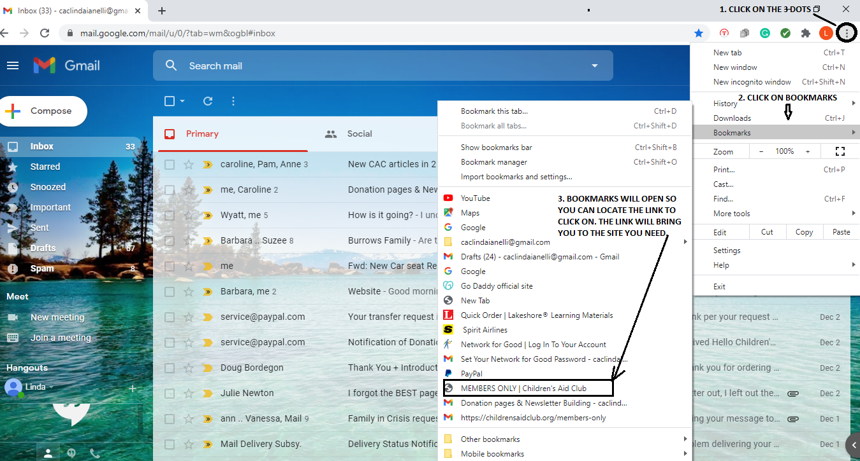
HOW TO SAVE A LINK – MEMBERS ONLY ON CAC WEBSITE –
Please follow steps 1,2 and 3 shown below.

