Slide 1

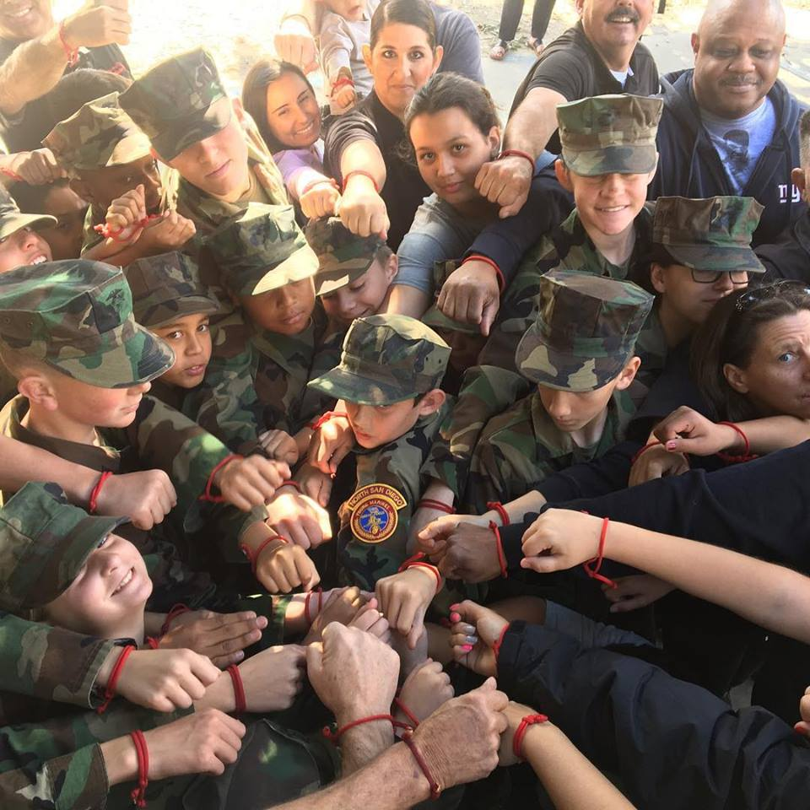
Starting a Unit
Program Introduction
What we do
Drug Demand Reduction
Community Service
Starting a Unit
Where we meet
Adult Volunteers
Recruit Training
We Believe In
Adult Training
Uniforms

Slide 2
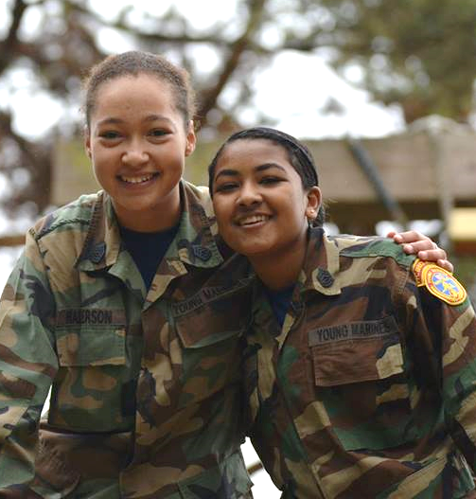
Program Introduction
Mission
The mission of the Young Marines is to positively impact America's future by providing quality youth development programs for boys and girls that nurture and develop its members into responsible citizens who enjoy and promote a healthy, drug-free lifestyle.
Vision
We remain dedicated to our legacy to continue to be the premier youth drug demand reduction organization in America.
Core Objectives
Advocating a healthy drug-free lifestyle through education
Instilling honesty, fairness, courage, respect, loyalty, dependability, and patriotism
Stimulating interest and respect for academic achievement and American history
Promoting physical fitness

Slide 3
What We Do
The Young Marines do a wide variety of activities. The list keeps expanding as new ideas form:
Close Order Drill (marching) Camping
Class Work (knowledge) Field Trips
Physical Training (PT) Team Building Exercises
Fundraising Parades
National Adventures Leadership Schools
CPR/First Aid Certification Color Guards
Community Service Veterans Appreciation
We teach drug prevention education primarily focused around gateway drugs.
We teach discipline, respect, history, patriotism, teamwork, camping skills, land navigation, leadership, pride, self-esteem, and responsibility.

Slide 4


Drug Demand Reduction
Minimum required DDR training hours for every Young Marine
Board of Directors supported to emphasize DDR focus
3 hours per quarter—12 hours per year
Closing the Gate on Drugs
Only youth organization that has created its own drug demand reduction program
Based on theory that if we can prevent youth from abusing the “Gateway Drugs” they will never make the leap to harder drugs
Created with support from American Legion-Child Welfare Foundation
Project ALERT
Mandatory curriculum that ensures consistency and standardized training throughout the program
Fulfills minimum hours as emphasized by Board of Directors
Allows for leadership and mentorship component as older Young Marines and registered adults can become certified to teach younger Young Marines
Presentations and projects initiated by Young Marines and Registered Adults

Slide 5
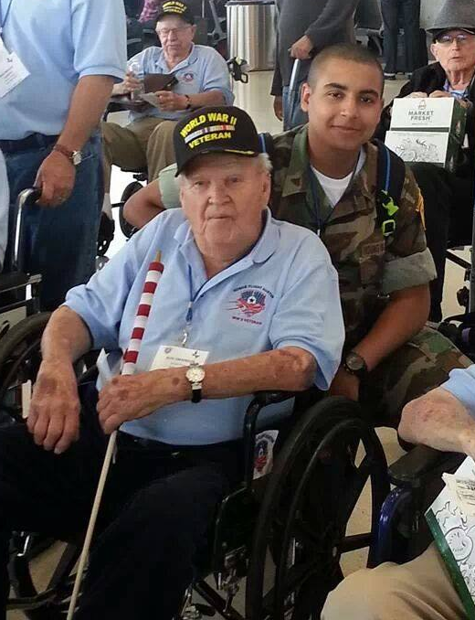
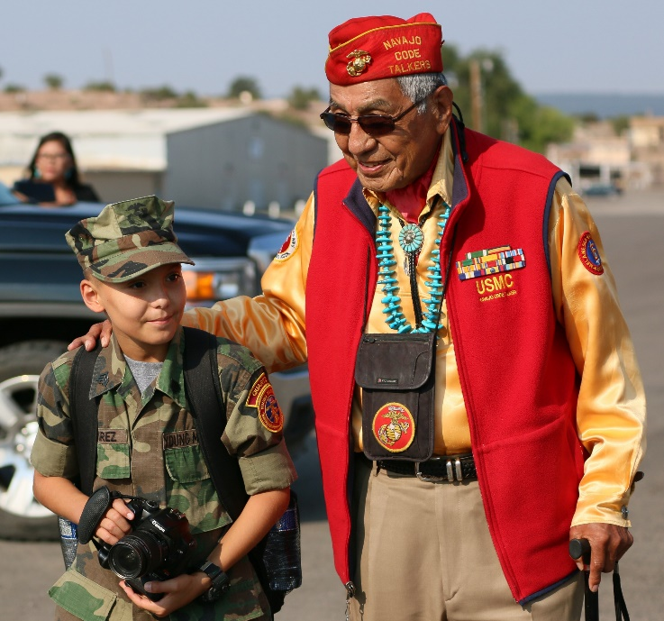
Community Service
Our Young Marines and Registered Adult Volunteers perform a wide variety of service to our veterans and the community.
Over 2.4 million hours served in the past four operating years
595,529 hours were dedicated to volunteering in the last operating year alone
2,500 average hours per unit each year
Some Examples:
Veterans History Project w/Library of Congress
Veterans appreciation activities
Navajo Code Talker Day events
Toys 4 Tots
Flag placement & Wreaths Across America
Community Clean-up
Ramps for wheelchair access
Honor Flight Color Guards
Volunteer mentoring of program members

Slide 6
Starting A Unit
There are a few basic things needed to start a unit:
A place to meet regularly (usually 6pm to 8pm on a weekday or during a day on weekends)
Three (3) Adult Volunteers willing to dedicate time and energy to helping kids
$35 per adult or youth member annually
Complete a new unit application package and submit to Headquarters Young Marines (HQYM) with Adult Volunteer Applications
Local fundraising will be needed to purchase ribbons, patches, camping equipment, etc.
Time – The Unit Commander and Adjutant can expect to spend time each week training, planning, and documenting.

Slide 7
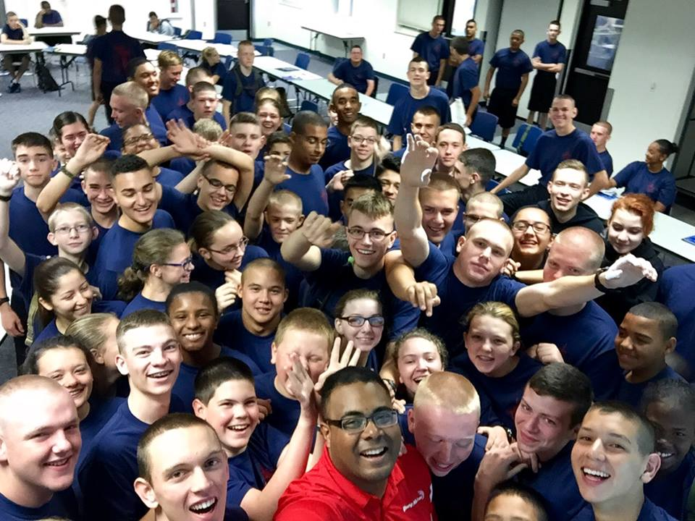
Where We Meet
Young Marines units meet in a variety of locations. While planning to start a unit, contact these type of organizations in your area:
VFW
American Legion
Marine Corps League
National Guard
Military Reserve Center
Military Base
Police Department
Schools
Church
Elks Lodge

Slide 8
Adult Volunteers
3 Adult Volunteers needed to start a unit (Military Vets, Law Enforcement, EMS, School Teachers, Parents, etc.)
They must register with headquarters and have an NCSISafe.com (National Center for Safety Initiatives) background check completed
The four main billets in a unit are:
Unit Commander (UC) – elected position, 25 years old or older, Marine (Active, Reserve, Vet). Waiver can be requested. Sets the example, plans ahead, stays involved
Executive Officer (XO) – elected position, good execution skills, motivated, dedicated, good planning skills
Adjutant – Appointed by the UC, good paperwork and computer skills
Paymaster – Appointed by the UC, not living with or related to the UC, good with numbers

Slide 9
Recruit Training
Recruit Training is 26 hours minimum to complete required objectives
They will learn Young Marines history, rank structure, close order drill, customs and courtesies, teamwork, jargon, physical fitness, healthy eating, dangers of drugs and drug abuse, General Orders, and Young Marines Obligation
Our goal is to guide and mentor youth
Recruit Training and the program as a whole is:
Not recruiting for the military
Not a place to live out the “Glory Days” of your military past
Not “In Your Face”
Not a “Scared Straight” program
Not a baby-sitting service
Not a Boys and Girls Club
Not a Rambo Outfit (no warfare or tactics)
No Profanity

Slide 10
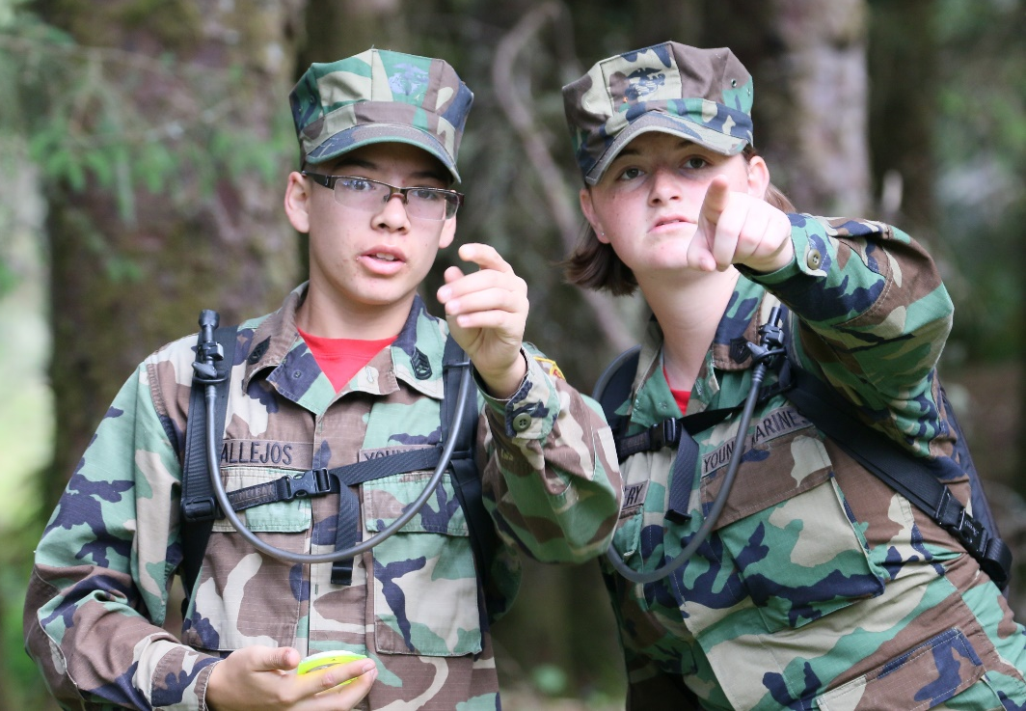
We Believe In
Respecting parents, teachers, elders, ourselves, and others
Community Service
Staying away from drugs and drug abuse
Leading by Example
Teamwork
Physical Fitness
Positive Mentorship
Pride in Appearance
Self-Discipline
Academic Achievement
Our Country
“Yes Sir” and “Yes Ma’am”

Slide 11
Adult Training
There are opportunities for Registered Adults to receive training.
Young Marines University (YMU) – this is a free, on-line university to allow adults to learn right from their own home.
Adult Leaders Conference (ALC) in May – This is an annual conference where adults from all over the U.S. (about 400) come to one place for a few days of training and fun. The last night is a Black-Tie banquet to announce the National Young Marine of the Year.
Unit Management Course (UMC) – The UMC events move to different cities each year. There is usually one per division (region) annually. These are small events (20 to 90 people) who spend a Saturday session in training
Leadership Academy for Volunteer Adults (LAVA) – LAVA is intended for new Adult Volunteers with little military background to teach them the basic skills needed to perform training

Slide 12
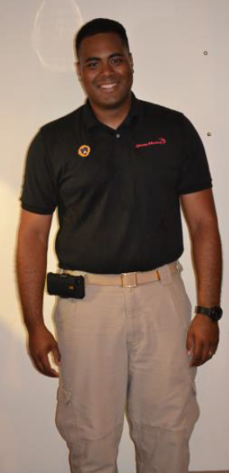
Uniforms
The official Young Marines uniform is the woodland camouflage uniform. This can be purchased at local military surplus stores or in our on-line gear store
The official Adult Volunteer uniform is khaki pants with a black staff shirt or black polo.
Digital Camouflage is NOT authorized
Campaign covers (Smokey bears) are not authorized.
Some units purchase all the uniforms for Young Marines and pass the charge to the parent, while others have the parents purchase the uniforms themselves.

Slide 13
What’s next?
Get your team together
Hold staff meetings to plan for unit start-up and recruiting.
Using your browser go to this website https://youngmarines.org/public/page/StartAUnit
Print and fill out “Adult Volunteer Registration Application”
Fill out “Young Marines Unit Application”, print, sign, and mail to Young Marine National Headquarters along with all Adult Volunteer Applications and fees.
Request the following “Adult Volunteer Manual”, “By Laws”, “Commander’s Manual”, “Adjutant’s Manual”, “Training Officer’s Manual”, and “Paymaster’s Manual”

Slide 14

Questions?
For questions or more details, please contact Headquarters Young Marines at
800-717-0060 x215 or michael.hoff@youngmarines.org

