Slide 1









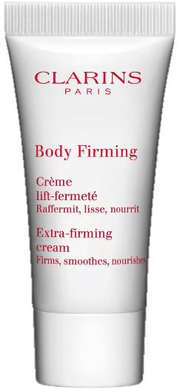



VON MAUR GIFT WITH PURPOSE
*Sachets Bonus – do not include in gift count

Slide 2


GIFT WITH PURPOSE DISPLAY
*Work in Progress
Notes:
SR = 53%
EF = 29%
MA = 18%

