Slide 1
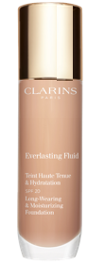
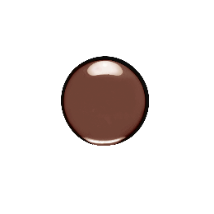

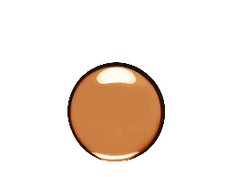

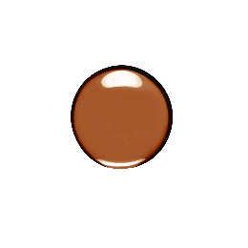

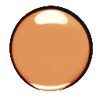
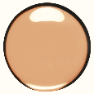

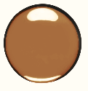
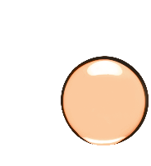
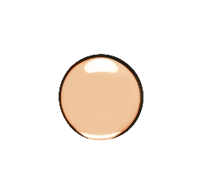
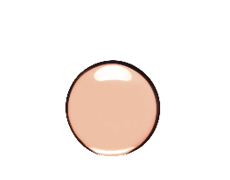

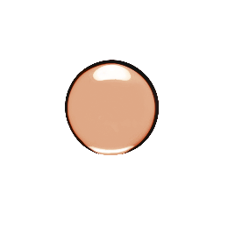


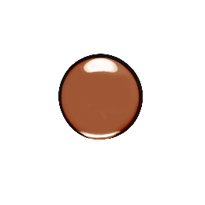

LIGHT - 9 SHADES
MEDIUM - 12 SHADES
DEEP– 14 SHADES
1
CHOOSE
THE INTENSITY
OF YOUR SKIN TONE
VERY LIGHT TO LIGHT
LIGHT MEDIUM
MEDIUM
DEEP
VERY DEEP
FOUNDATION
NEW
COOL BEIGE
NEW
2
100C
lily
102.5C
porcelain
107C
beige
109C
wheat
112C
amber
113C
chestnut
115C
cognac
119.5C
truffle
120C
espresso
WARM BEIGE
NEW
NEW
NEW
NEW
NEW
NEW
NEW
NEW
DEFINE
YOUR SKIN’S
UNDERTONE
100.5W
cream
101W
linen
108W
sand
105.5W
flesh
108.5W
cashew
112.7W
macchiato
114.5W
sepia
117.5W
pecan
118.3W
cocoa
119W
mocha
110.5W
tawny
112.5W
caramel
114.3W
walnut
116.5W
coffee
NEUTRAL
NEW
100.3N
shell
103N
ivory
105N
nude
106N
vanilla
108.3N
organza
110N
honey
111N
auburn
112.3N
sandalwood
114N
cappuccino
117N
hazelnut
118N
sienna
118.5N
chocolate
NEW
NEW
NEW
NEW
NEW
ANTICERNES
00
01
02
02.5
03
04
05
06
VERY
LIGHT
LIGHT
LIGHT
MEDIUM
MEDIUM
MEDIUM DEEP
DEEP
VERY
DEEP
EXTRA
DEEP
Notes:
PROPOSED ACTIVITIES
Identify 5 people (1/intensity)
First, ask participants to find the intensity of the skin tone which corresponds to the 5 people selected (from very light to light, light medium, medium, deep, very deep).
2. Once the intensity of the skin tones has been determined, ask participants to define the undertone (warm, cool and neutral).
3. Select the shade of the Foundation and Concealer to each of the 5 people.
To find the corresponding undertone, look at the skin on the neck, décolleté and inner forearm.
Practice: participants are placed in teams for the selection of foundations and concealers.
REMINDER:
COOL: undertones of pink, red and blue. Usually corresponds to people who have a tendency to burn (skin turns red) when in the sun.
WARM: yellow, golden or peach undertones. Usually, this skin type tans easily.
NEUTRAL: this is the most common undertone! Usually, this skin also tans rather easily.
COOL undertones are specific and meet a lesser demand. This is why there are more NEUTRAL and WARM undertones available which are suitable to a greater number of skin tones.

