Slide 1
CLARINS USA
Sephora Monthly Call 4.2.25

Slide 2
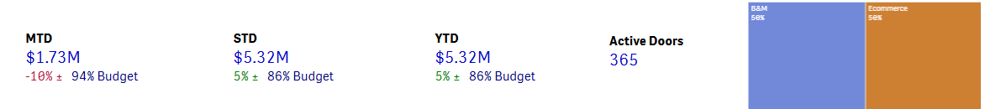



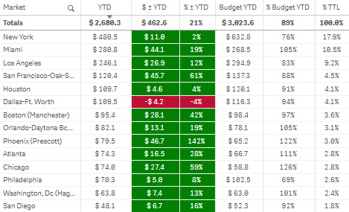
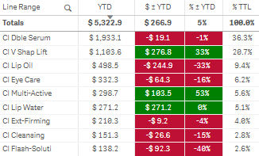
March Highlights:
Comp Doors -% to LY, Productivity Score 72.3%
TOP Market Growth: Miami, SF, Phoenix, LA, NYC (event driven)
Water Lip Stain App Preview: $24k, +67% forecast. Bestseller Nude
Up Next:
BI Sale 4/2-4/22, Rouge 20% off : 4/4 – 4/14 VIBs 15% off: 4/8 – 4/14 Insiders 10% off: 4/8 – 4/14
3/16 – 4/30: Meta Collab Campaign - Lip Oils and Water Lip Stain
5/1 – 6/30: $1M Media Campaign - Double Serum, Double Serum Light
454 Retail Sales Reporting thru Feb WK 4

Slide 3
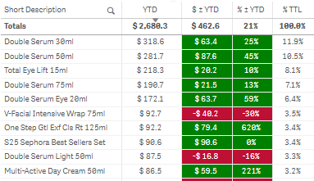
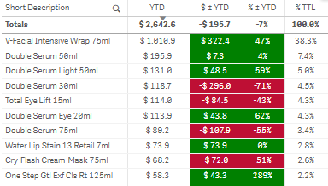
B&M TOP 10
COM TOP 10
B&M HIGHLIGHTS​
Double Serum +98%, back in stock Q4
Multi-active +90%, 7.3% of TTL versus Ly 6.5%
Comp Door deficit driven by TEL-19% and Lip Oils-43%
COM HIGHLIGHTS​
Double Serum +49% with growth driven by 50mL, Light and 75mL.
Water Lip Stain App Preview: $24k, +67% forecast; MTD sales: $44k, 8% of sales, Nude Water #6 SKU MTD.
Multi-Active +48% with Day & Night moisturizers in top 10.
Total Eye Lift -41% since up against media and Cryo -48%.
Spring sets went live later on COM: Lip Oil Trio set -$25k and Anti-Aging Skincare Essentials Set -$21k.
454 Retail Sales Reporting thru Feb WK 4

Slide 4

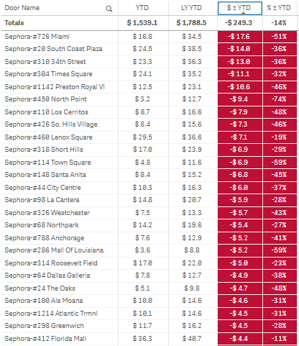


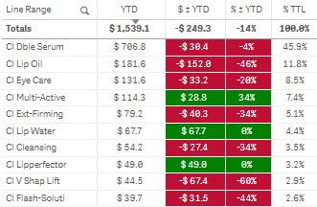
Comp doors

Slide 5
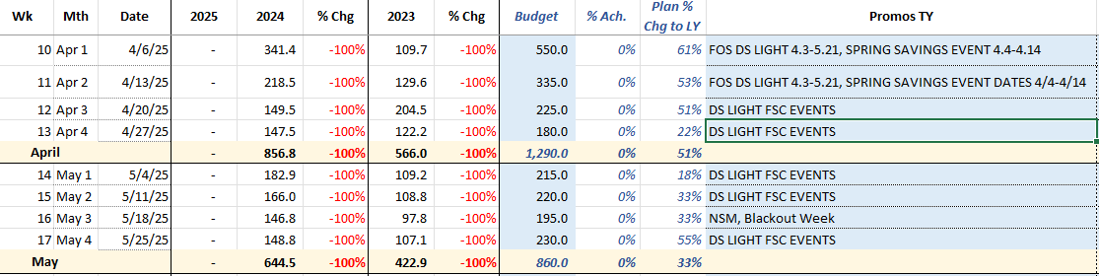

April/may sales plans

Slide 6











FSC EVENTS: BEAUTY LAB
April Skincare FOS Animation from 4/3/25 to 5/21/25
H@S
PLACEMAT
TOA
GIFT

Slide 7

FSC EVENTS: BEAUTY LAB
APRIL fsc events: $70K,-25% plan
APRIL FSC PLAN: $70k +150% to LY, SEVERAL DOORS STILL IN APPROVAL PROCESS
FSC CHECKLIST 4-6 WKS:
KICK-OFF MEETING
PTM SUPPORT
INVENTORY BUILD
EVENT SET UP & TOA
RECAP EMAIL & THANK YOU

Slide 8
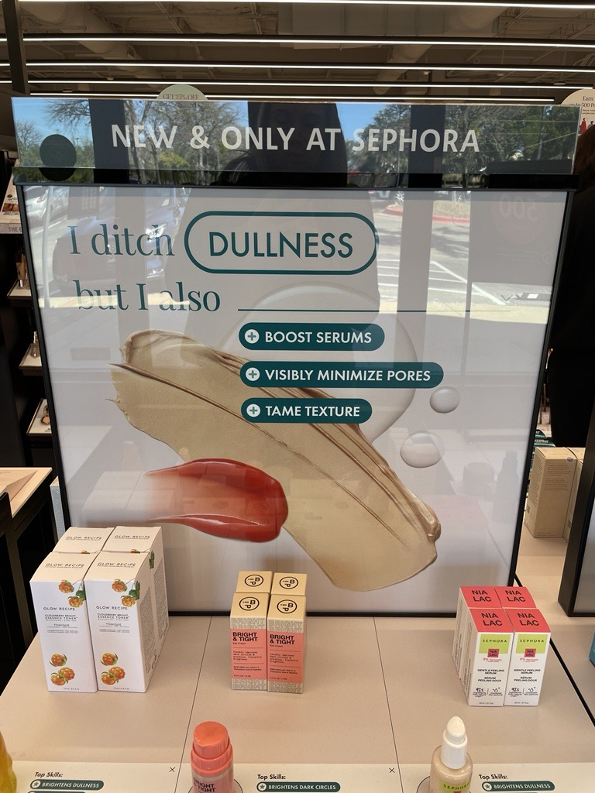

may fsc events: $111K +34% plan

Slide 9

June FSC EVENTS: $126.5K PLAN

Slide 10
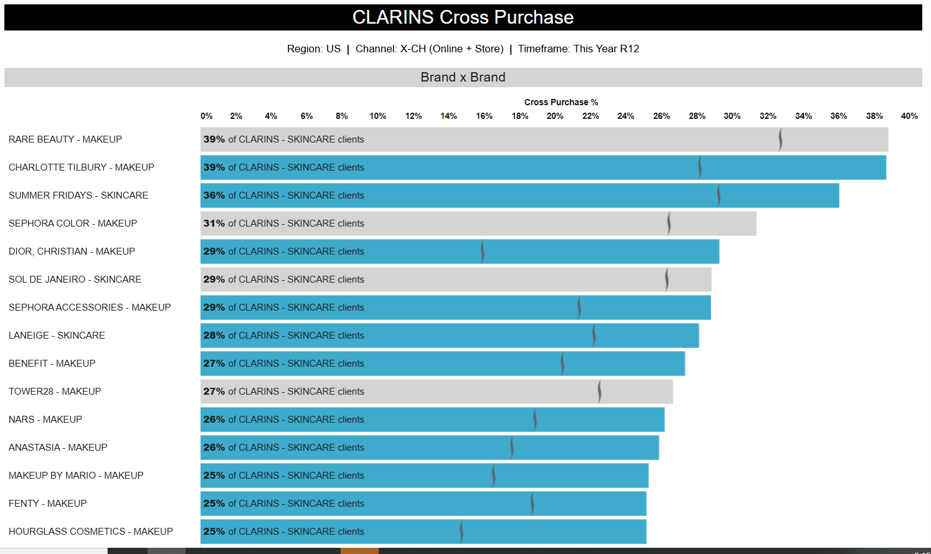
Multi-world partners

Slide 11
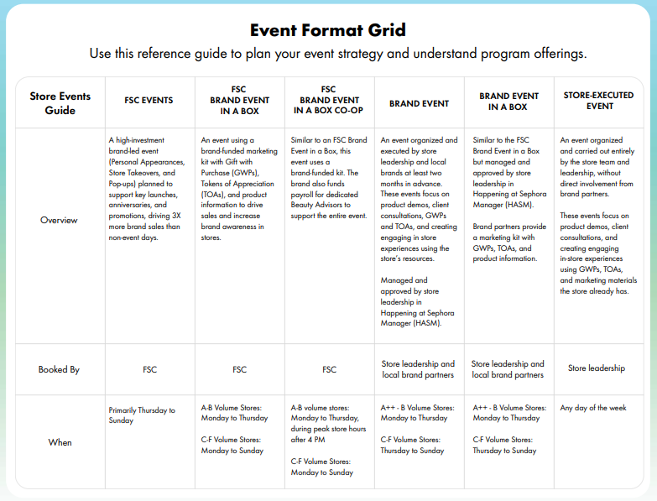
117
Event Month | Kickoff Email Sent by Store Events Category Managers | FSC Event Checklist Deadline
January | Tuesday, September 3, 2024 | Monday, September 23, 2024
February | Monday, September 30, 2024 | Monday, October 28, 2024
March | Monday, November 4, 2024 | Monday, November 25, 2024
April | Monday, December 2, 2024 | Monday, December 23, 2024
May | Monday, January 6, 2025 | Monday, January 27, 2025
June | Monday, February 3, 2025 | Monday, February 24, 2025
July | Monday, March 3, 2025 | Monday, March 24, 2025
August | Monday, March 31, 2025 | Monday, April 28, 2025
September | Monday, May 5, 2025 | Monday, May 26, 2025
October | Monday, June 2, 2025 | Monday, June 23, 2025
November | Monday, June 30, 2025 | Monday, July 28, 2025
December | Monday, August 4, 2025 | Monday, August 25, 2025

Slide 12

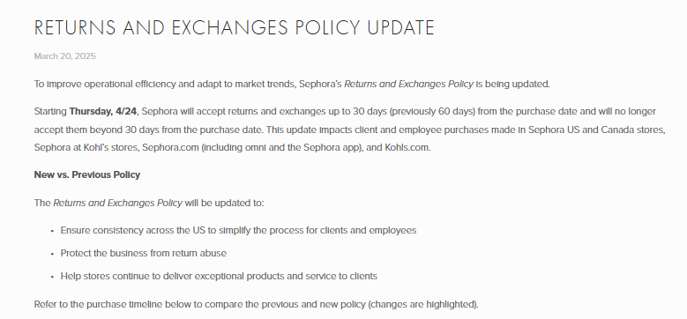
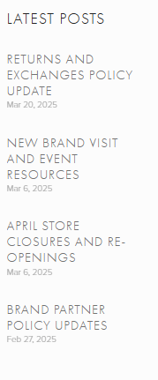
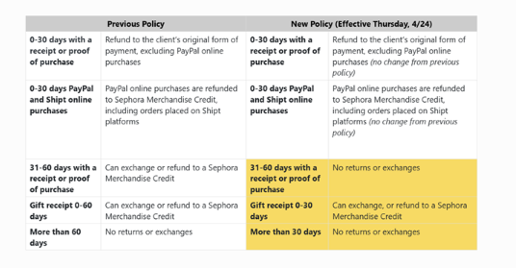

Slide 13
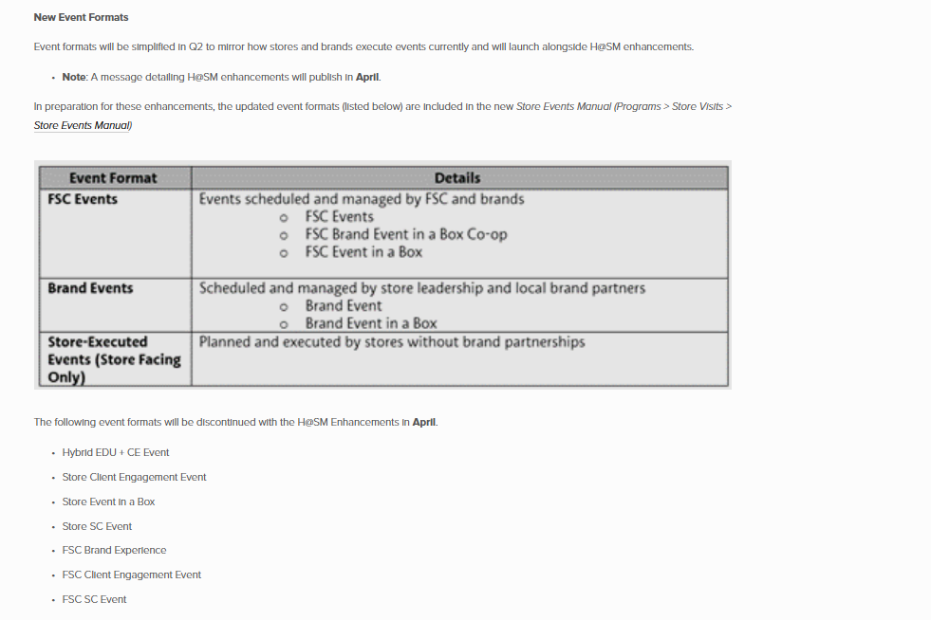

Slide 14
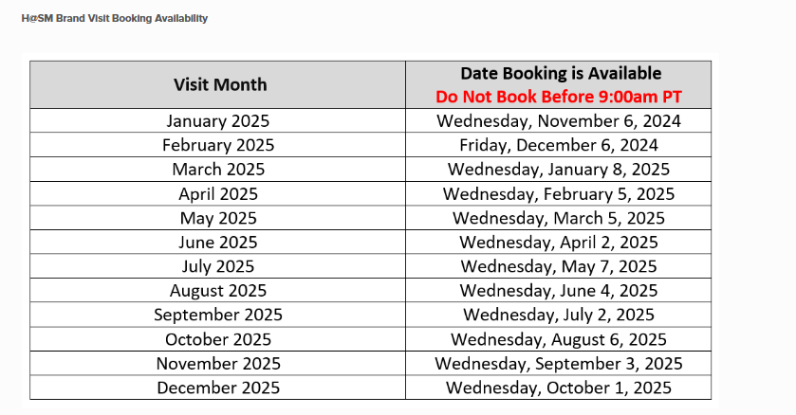
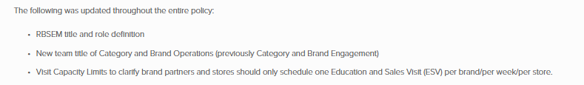
h@sm portal

Slide 15
THANK YOU

