Slide 1
Team Conveyer Technology
9/18/2023
TCIP Micro LLC
145 4th Street Del Mar CA 92014
858 254-2915

Slide 2
What is Team Conveyer?
Team Conveyer (TC) is revolutionary new robotics for moving things more simply in automation systems. Team Conveyer for clinical analyzers combines the following features under the control of a central computer processor:
1. Items required for clinical lab tests inside an automated TC analyzer are stored on conveyers (sic), as opposed to being moved to and from fixed locations by pick-and-place robotic arms and other very complex robotics.
2. Team conveyers (sic) are specialized patented conveyors that under the control of a central processor, are bidirectional, move at variable speeds, stop and start at precise locations, move items en masse, yet can deliver individual carried items to selected locations, at selected times in short one-dimensional moves
3. Conveyers are moved by a rack and pinion driven by a stepper motor; simple, fast, reliable, precise, inexpensive.

Slide 3
What is Team Conveyer?
4. The Team Conveyer system control processor ‘knows’ which item it has to move, what item it is, where that item is on which conveyer, as well as when and where to move the item.
5. Items to be moved remain on moving storage conveyers (sic, patented) as opposed to being and moved by robotic arms from one fixed location to another.
6. All locations within the conveyance system, all passenger items and their locations at particular times, all conveyers, and all system modules, all events, are identified, without barcoding, by Place-Time Identification (PTID), a patented 6-dimensional matrix.
7. All events such as item moves, pipettings, result readings, incubations, etc., are recorded in an event table which directs and optimizes the entire daily workflow

Slide 4
What is Team Conveyer?
7. Each stored item, each location in the system, each component of the system, each robotic action, is tagged with a patented place-time identifier (PTID) that both identifies it and characterizes it.
8. PTID allows simple autonomous one-dimensional transfers items and fluids between conveyers yet preserving PTID identification on the next conveyer, enabling unprecedentedly powerful robotic sortation of items.
9. Multiple intelligent TC conveyers can cooperate to perform single complex tasks moving many germane items to where they must go at the same time.

Slide 5
Selected Claims for Team Conveyer Analyzers to be Verified by Automation Engineers
Team Conveyer enables extreme simplification of clinical lab analyzers and TLA systems.
Team Conveyer Technology promises more-powerful clinical lab analyzers and TLA automation, easier-to-build with faster test throughput.
Advanced automated clinical chemistry, immunoassay, blood bank, analyzers can be built with < 20 standard parts costing less than $5000.
A case study shows a concept TC blood bank analyzer doing robotic moves in 14 seconds that take Bio-Rad's IH1000 blood bank analyzer 18 minutes. This case study is described in this white paper.

Slide 6
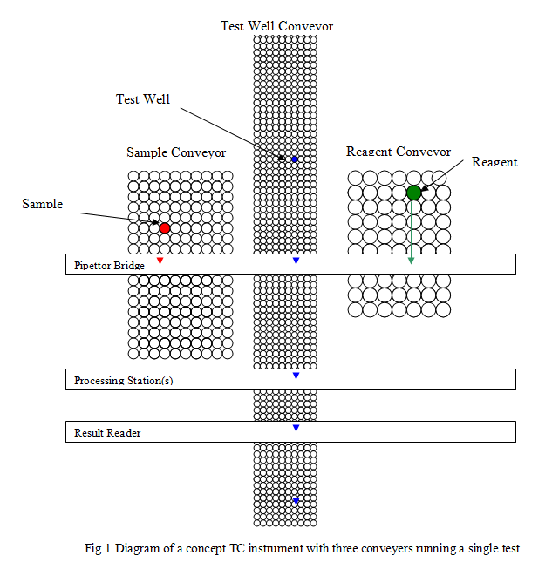
The Basic Team Conveyer Analyzer
Format for running tests by a single method, say chemistry, comprises three independent conveyers; one single test well conveyer, one sample conveyer and one reagent conveyer.
The 5˚ reagent conveyer brings a selected identified reagent container under the Pipettor Bridge.
Simultaneously the 5˚ sample conveyer brings a selected identified sample under the Pipettor bridge
Simultaneously the 37˚ Test Well conveyer brings an identified selected test well under the Pipettor Bridge.
The pipette aspirates the reagent and adds it to the test well.
The pipette aspirates sample and adds it to the test well, mixing sample and reagent.
The Test Well Conveyer moves the test well to a mixing station.
The Test Well Conveyer moves the test well under more processing bridges if required, and on to the result reader bridge, satisfying precise a incubation time.

Slide 7
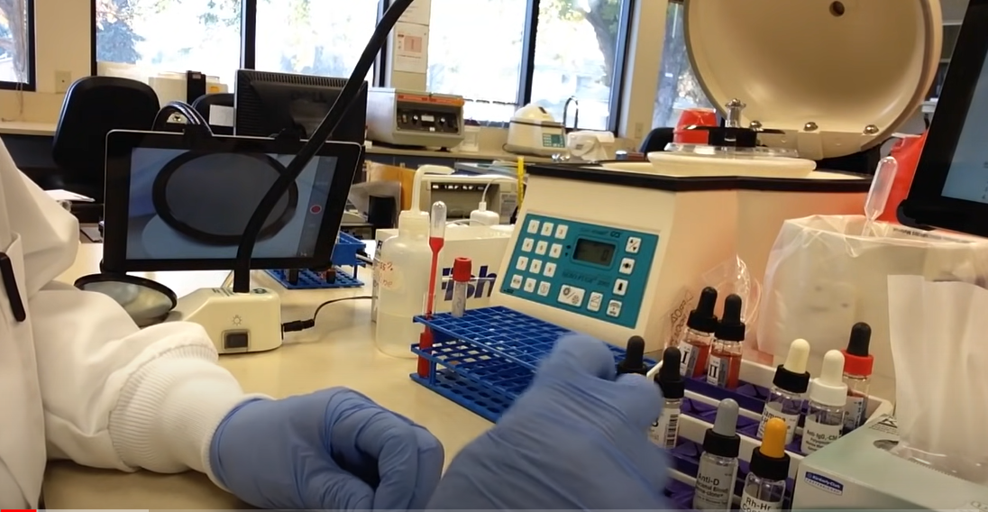
The Three Eras of the Clinical Lab Era 1: Back in the Day.
A clinical lab with many technologists working at lab benches, manually centrifuging, decapping and resealing sample tubes, placing sample tubes in racks, making aliquots, fetching reagents and fluid containers, cuvettes - single and in racks or microplates, and pipette tip racks from the cabinets, pipetting reagents and samples into cuvettes, washing particles and red cells manually, moving cuvettes to and from incubators and centrifuges, moving cuvettes to result readers and recording results, etc.

Slide 8
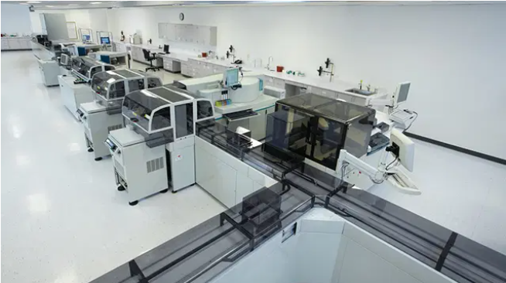
The Three Eras of the Clinical Lab Era 2: A Clinical Lab Today
Today, a lab full of large expensive, floor standing analyzers like the Roche Cobas 3800, with an Inpeco track system distributing samples to them. A large hospital lab measures as many as 200 analytes by eight main analytic methods: Urinalysis, Hemostasis, Immunology, Allergy, Chemistry-ISE, Hematology, and Molecular. Each analytic method requires its own dedicated automated $250K analyzer that requires considerable daily human care. A ~$4M investment in total for a typical hospital clinical lab.

Slide 9
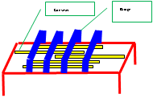
The Three Eras of the Clinical Lab Era 3: TableTop
All the tests now run by the multiple analyzers of today’s labs can be run by a single TableTop analyzer.
TableTop

Slide 10
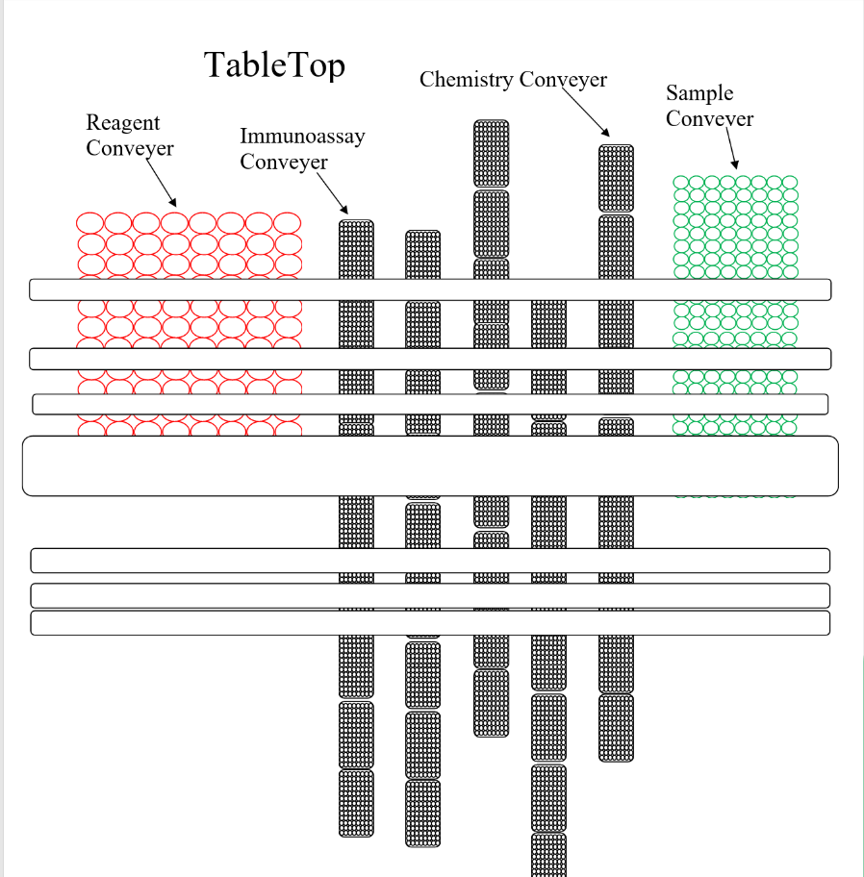
TableTop Viewed from Above

Slide 11
The Role of TableTop in Clinical Labs
Team Conveyer Technology TableTop is a new patent pending architecture for total clinical lab automation (TLA) that will transform the clinical lab as we know it.
TableTop is the most significant innovation since the dawn of clinical lab automation more than 60 years ago.
Once diagnostic instrument manufacturers and clinical labs grasp the power of Team Conveyer TableTop, there will be a sea change in the design of automated diagnostic instruments, a turning point, a watershed moment, after which things will never be the same.
In the future we believe all automated diagnostic instruments will have ‘TC inside’. Like the smartphone format becoming the standard mobile phone.

Slide 12
TableTop
A TableTop analyzer comprises a set of parallel cooperating team conveyers, each individual conveyer replacing a floor standing analyzer in the lab.
Conveyers store items and carry individual items longitudinally to any location where the item is required.
Conveyers are crossed by multiple parallel bridges with moving operator modules on board: pipettor, test reader, sample decapper etc.
Operator modules move laterally precisely over any item brought under a bridge by a conveyer, to perform specific operations on specific items.

Slide 13
TableTop
TableTop is a complete Total-Lab-Automation (TLA) system using Team Conveyer technology comprising a compact unified system of multiple conveyers and transverse bridge stations on a table surface about 10 feet square in size.
It has the capability of running hundreds of analytes, by any of the 8 methods. It can perform all the tests now done by all the multiple floor-standing automated analyzers in current clinical laboratories, as well as be an advanced TLA track system

Slide 14
TableTop
A format for running tests by a multiple methods on the same analyzer, say chemistry, ISE, immunoassay, hemostasis etc., comprising multiple test well conveyers served by one sample and one reagent conveyer with no floor standing analyzers in the lab.
Table-top TLA is very high throughput system capable of completely autonomously receiving orders from LIS, centrifuging, decapping, and resealing sample tubes, making aliquots, pipetting reagents and samples into cuvettes, washing particles and red cells, incubating test wells, moving test wells to result readers.
It can measure analytes by all eight analytical methods and records results in the LIS, etc.
It is preloaded with all the reagent containers, controls, test wells, pipette tips, fluids, and all accessories that may be required for every test for several days.

Slide 15
TableTop
A single reagent conveyer and a single sample conveyer can serve multiple test well conveyers.
Multiple bridge stations crossing the conveyers carry standard operator mechanisms, e.g. pipettors, readers etc., that can perform any action on any item brought up on any conveyer as required by any one of the test modalities.
Each single test well conveyer can match the work of and replace a large automated analyzer in the lab.

Slide 16
TableTop
Each of the test well conveyers may be dedicated to a specific test method, say chemistry, immunoassay, or hemostasis. For example, the chemistry conveyer brings its test wells under a series of bridges where the operations required to run a chemistry test are performed serially on them. The same for the other method test well conveyers.
It is difficult to overstate the degree of simplicity that this system confers on the robotics of an automated clinical laboratory.

Slide 17
Unprecedented Control of Daily Lab Workflow
Patented Place Time Identification (PTID) enables the central processor to maintain an event table of robotic-actions that lists and manages all the item moves, pipetting actions, reading events etc. to be performed on the TableTop for an entire workday.
Thereby, PTID of items and of robotic actions enables unprecedented control of daily lab workflow by a central processor.
It is impossible now for a central processor to know, even less control, what is going on in multiple stand-alone automated analyzers.

Slide 18
Cost Savings
80% in Capital Costs
In today’s clinical labs each analytic method requires its own dedicated automated $250K analyzer, an investment totaling ~$4M for a typical hospital. All of these automated analyzers will be replaced by a single test well conveyer on a ~$250K TableTop analyzer with very simple reliable robotics.
80% in Labor Costs
Team Conveyer is an advanced TLA that as well as samples, automatically delivers all supplies to analytic processing bridges from a single common location. A TableTop can run one week without any user intervention except for loading and removing PTID identified samples in 100-400 sample trays. It will eliminate 80% of the labor now employed in daily manual servicing multiple analyzers with reagents, test wells, vessels, pipette tips, and fluids etc.
80% in Analyzer Service Costs
Service costs for one TableTop analyzer with simple ultra reliable robotics will be a fraction of service costs for 20 large complex analyzers.

Slide 19
Summing Up
TableTop is patented technology that will transform the clinical lab as we know it as described in the above slides, and in many white papers.
It is part of our business plan to transfer at no cost equal shares in TCIP Micro LLC patents to the top manufacturers of clinical laboratory analyzer equipment: Siemens, Abbott, Roche, Beckmann Coulter.
Tests performed by TC analyzers will generate $3.5 trillion in revenues by 2039, creating $140 billion in royalties for the patent acquiring corporations.
The four manufacturers acquiring TCIP Micro patents will reap these royalties once they launch clinical lab automation with just some TableTop intellectual property embedded and operate an extensive marketing and sales campaign. Then other automation manufacturers will have to follow or lose market share.
By 2039 virtually all clinical lab analyzers will have some TCIP intellectual property on board their analyzers that are now generating royalties for TCIP Micro.

Slide 20
TCIP Patents
TableTop (Provisional Filing)
COORDINATED CONVEYERS IN AN AUTOMATED SYSTEM 9/28/2922
COORDINATED CONVEYERS IN AN AUTOMATED SYSTEM 9/28/2922

