Slide 1
FOUNDATIONS OF ANGEL WING (SELF-MASTERY—PERSONAL TRANSFORMATION – HUMAN UPLIFTMENT)
AUDIOBOOK BY:
CHETANA KRIPALU, MD
CEO/FOUNDER OF THE ANGEL WING, LLC
www.TheAngelWing.com

Slide 2
WHAT IS THE “SELF?”
Is the SELF, your body?
Is the SELF, your thoughts?
Who are YOU?
What is the SELF?
We need to ask these questions before we can explore SELF MASTERY.

Slide 3
explore how you are identifying yourself
This Photo by Unknown Author is licensed under CC BY-NC-ND
This Photo by Unknown Author is licensed under CC BY-SA-NC

Slide 4
Types of identification
NAME
PROFESSION
POSITION IN CAREER
POSITION IN FAMILY
PAST AND CURRENT RELATIONSHIPS
This Photo by Unknown Author is licensed under CC BY-SA

Slide 5
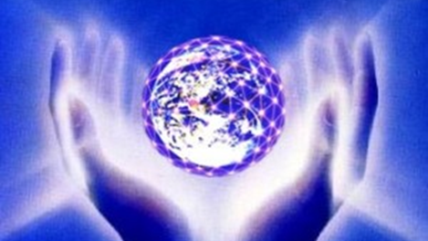
IS THERE SOMETHING MORE?
WE NEED TO EXPLORE IF THERE IS SOMETHING MORE TO OUR BEING THAN THE TYPES OF IDENTIFICATION

Slide 6
WHAT ARE THE OBSTACLES & BLOCKS TO KNOWING OUR REAL SELF?
FALSE IDENTIFICATION WITH LIFE’S EXPERIENCES & CIRCUMSTANCES
AM I THE SUM OF MY EXPERIENCES?
(RELATIVELY TRUE, BUT IS IT ABSOLUTELY TURE?)
DISCOVERY OF THE REAL SELF
WHAT IS THE REAL SELF???
QUIET THE MIND AND
THE SOUL WITH SPEAK

Slide 7
OVERCOMING LIMITATIONS AND DISCOVERING THE REAL SELF
ROLE OF RESPONSIBILITY
100% RESPONSIBILITY OF STAYING IN STEADINESS
SELF-CREATED STEADINESS
ANCHORING ONESELF IN SELF-CREATED STEADINESS
RESULT: BETTER DAILY FUNCTIONING

Slide 8
TOOLS
UTILIZE ANGEL WING’S 30-DAY WORKBOOK

Slide 9
HEALING POWER
PHYSICAL HEALING
EMOTIONAL HEALING
ENERGETIC HEALING
WHY ARE WE STUCK IN PROBLEMS?
RECOGNIZE ONE’S ONE YARDSTICK
RECOGNIZE SUPPOSITIONS
BREAKING OF MYTHS
RECOGNIZE COLLECTIVE ISSUES
TRANSCENDING THE RATIONAL HUMAN MIND AND DISCOVER THE SELF
MASTERY OF ONE’S STEADINESS

Slide 10
INCREASED AWARENESS OF ONE’S OWN DIFFICULTIES
BECOME MORE AWARE OF “WHAT BOTHERS ME, WHAT HURTS ME, ETC.”
WHAT AM I “SENSITIVE?”
WHY AM I TAKING THINGS PERSONALLY?
DO MY DIFFICULTIES HAVE TO BE “PERSONAL?”
SELF-AWARENESS: SEEING DIFFERENT FACETS OF OUR MIND
USING EXPERIENCES FOR PERSONAL GROWTH TOWARDS SELF-MASTERY
STOP LIVING IN THE WOUND
RECOGNIZE WHAT PULLS ONE DOWN
CREATION OF BELIEF SYSTEMS DUE TO CIRCUMSTANCES AND SITUATIONS

Slide 11
Go beyond false layers
We have created our own FALSE LAYERS
Observe these layers
FUTILITY of hanging on to layers
Freedom from false layers leads to SELF-MASTERY
Getting to SOME POINT OF SELF-MASTERY leads to PERSONAL TRANSFORMATION
Not depending on your mind leads to WHOLENESS
One’s fragmented mind DOES NOT dictate how your life goes
Feeling good about oneself & NOT depending in other people’s acknowledgement

Slide 12
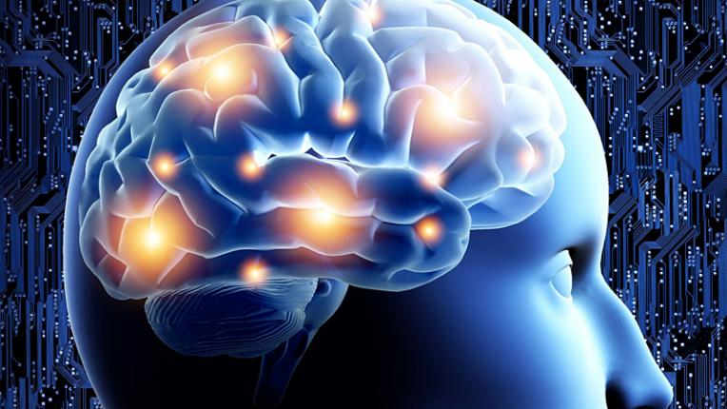
The first discovery is: the mind is not the self
WE LIVE IN THE MIND (THIS IS THE 1ST DISCOVERY)
WE IDENTIFY OURSELVES THROUGH THE MIND
ATTEMPT TO STAY IN THE STATE OF THE SELF
MEMORIES-DESIRES-THOUGHT FORMS-THE PAST, ETC.
AWARENESS OF THE STRUCTURE AND FUNCTION OF ONE’S THOUGHT FORMS
This Photo by Unknown Author is licensed under CC BY-SA-NC

Slide 13
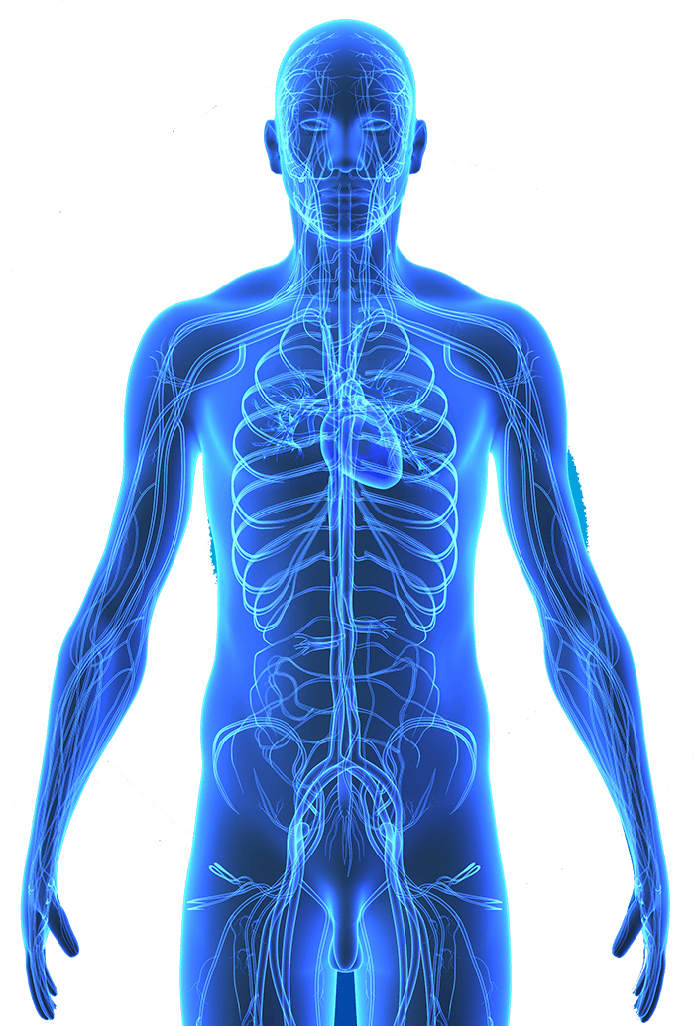
THE BODY FOLLOWS THE MIND
PHYSICAL DISEASES OCCUR (PARTLY) DUE TO MIND NOT FUNCTIONING IN A HEALTHY MANNER
BODY IS CLOSELY CONNECTED TO THE MIND (NEUROPHYSIOLOGY, ETC.)
MIND IS THE ROOT OF MISERY AND ILLNESS
OBSERVING ONE’S MIND WITHOUT JUDGEMENT
NOT GETTING INTO THOUGHT LOOPS
REALIZING HOW ONE’S MIND IS TRIGGERED AND HOW IT BEHAVES
EXPLORE THE ROOT: SUBCONSCIOUS BELIEF SYSTEM
MIND FUNCTION IS THE CAUSE OF INTERNAL SUFFERING
This Photo by Unknown Author is licensed under CC BY-NC
This Photo by Unknown Author is licensed under CC BY-ND

Slide 14
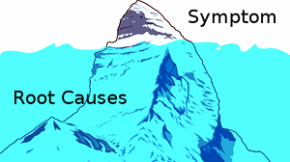
OBSERVING WITHOUT CHOICE (CHOICELESS AWARENESS)
Seeing oneself without bias
Not pursuing a thought process
Looking at the mind to understand the function of the mind
Goal: Learn about one’s own self
Understanding of the mind’s functions reduces reactions
You are the MASTER of your mind
Body suffers due to mental reactions
Fight or flight stress response
Body is a receptacle for mental processes: Body hurts!
We pay attention to symptoms…we want symptom relief…the complete root cause of physical problems is one’s mind
This Photo by Unknown Author is licensed under CC BY-NC-ND

Slide 15
MEDITATION ASSISTS IN GOING BEYOND THE FLUX OF THE MIND
BEING IN A STEADY STATE
NOT GETTING INVOLVED IN ONE’S MIND
ANGEL WING’S WANTS INCREASING NUMBER OF PEOPLE TO BE NOT STUCK IN THE MIND
TAKING BREAKS IN BETWEEN—NOT GETTING STUCK IN THOUGHT LOOPS
STAYING IN AN ANCHORED STEADY STATE LEADS TO MASTERY OF ONE’S MIND
This Photo by Unknown Author is licensed under CC BY-SA

Slide 16
A STATE OF FREEDOM
FREEDOM FROM BEING BOUND BY ONE’S MIND
A STATE OF PEACE AND CALMNESS THAT IS NOT AFFECTED BY EXTERNAL CIRCUMSTANCES
STABILITY AMIDST OUTWARD ISSUES: FAMILY, OCCUPATION, ENVIRONMENT, ETC.
HELPING OTHERS AROUND YOU…HELPING THE OVERALL SITUATION
FREEDOM IS A STATE OF GREAT ENERGY AWAKENING WITHIN YOU
A STATE OF CONSERVATION OF ENERGY
STOPPING THE INNER FIGHT WITHIN THE MIND
AN IMMENSE SENSE OF ENERGY CONSERVATION
ABILITY TO ENJOY LIFE BY STAYING N THE PRESENT MOMENT
THOUGHTS GOING IN THE FUTURE AND PAST (ENERGY DEBT)
THOUGHTS CAN DRAIN ENERGY THAT AFFECT THE PHYSIOLOGY OF THE BODY

Slide 17
WHAT ARE MAJOR DIFFICULTIES IN ACHIEVING SELF-MASTERY
A MAJOR PROBLEM IS SUB-CONSCIOUS PROGRAMMING
GIVING YOUR ENERGY AWAY TO OTHERS OR A SITUATION IS AN INDICATION THAT YOU ARE NOT IN A STATE OF SELF-MASTERY
CONSERVE YOUR POWER (ENERGY) – DO NOT GIVE IT AWAY!
100% PERSONAL RESPONSIBILITY – ABSOLUTE PERSONAL RESPONSIBILITY BY NOT GIVING ONE’S POWER (ENERGY) AWAY
SEEING ONE’S DEFICIENCIES
OTHERS ARE MAKING DECISIONS BASED ON THEIR STATES OF MIND
ONE’S RESPONSE CAN BE QUITE DIFFERENT IF ATTENTION IS PLACED ON ONESELF
KEEPING INTERNALLY QUIET PROMOTES SELF-MASTERY
MAINTAINING ONE’S STEADY AND CALM STATE – BEING ANCHORED WITHIN ONESELF IS SELF-MASTERY

Slide 18
SUB-CONSCIOUS PROGRAMMING
THIS PROGRAMMING HAS BEEN CREATED OVER TIME
TRIGGERS ARE REFLEXES
WE MANY NOT EXACTLY KNOW WHERE THE SUB-CONSCIOUS PROGRAMMING IS COMING FROM
YOU ARE IN CONTROL -- POSSIBILITY OF LEAVING SITUATIONS ALONE (INDEPENDENTLY)
UNDESIRABLE FEELINGS – REACTIONS OCCURRING IN THE BODY
HEADACHES – CHEST DISCOMFORT
PROGRAMMING HAS BEEN BUILT…NOT KNOWING THAT PROGRAMMING IS GOING ON
REALIZE YOUR PROGRAMMING & CONDITIONING
RELATIONSHIP BETWEEN SUB-CONSCIOUS PROGRAMMING AND SICKNESS
RECOGNIZE SUB-CONSCIOUS PROGRAMMING TO ACHIEVE A STATE OF SELF-MASTERY

Slide 19
WHAT TO DO WHEN ONE IS TRIGGERED?
Using Angel Wing tools, get into A STATE OF CALMNESS
Change ONE’S BASELINE by using tools on a regular basis
Change baseline anxiety, etc., to a STATE OF CALMNESS
Use your PREFRONTAL CORTEX to respond differently
Stressful situations & the SHORT LOOP: Erupting of the subconscious programming
DENSENESS of programming
Breath and RESPOND DIFFERENTLY via Angel Wing tools
Diffusing situations of conflict: DEESCALATE
This Photo by Unknown Author is licensed under CC BY-NC-ND

Slide 20
HOW DO WE HANDLE CONFLICTS?
Flight-Fight-Freeze RESPONSE
Outward and Internal Responses: BOTH ARE DAMAGING
Being in a STEADY STATE by using tools
Use tools REGULARLY for sub-conscious re-programming
OLD PROGRAMMING COMES in between: reaction, hiding, or freezing
Speak with a soft tone, be stern if necessary, and MAINTAIN BALANCE
ALLOW your brain (pre-frontal cortex) to open up
Be aware of TONE OF VOICE, and VOLUME OF VOICE
Prevent ESCALATION be aware of body language
This Photo by Unknown Author is licensed under CC BY-SA-NC

Slide 21
Is it possible to master the trigger?
Use the tools provided by Angel Wing
Recognize WHAT triggers YOU
A trigger is a MIRROR to look into oneself
There is sub-conscious programming that is triggering me
I AM STEADY….the outside is just a stimulus
Awareness of the STRUCTURE and FUNCTION of our mind
Eventually, the TRIGGER WILL DISSIPATE

Slide 22
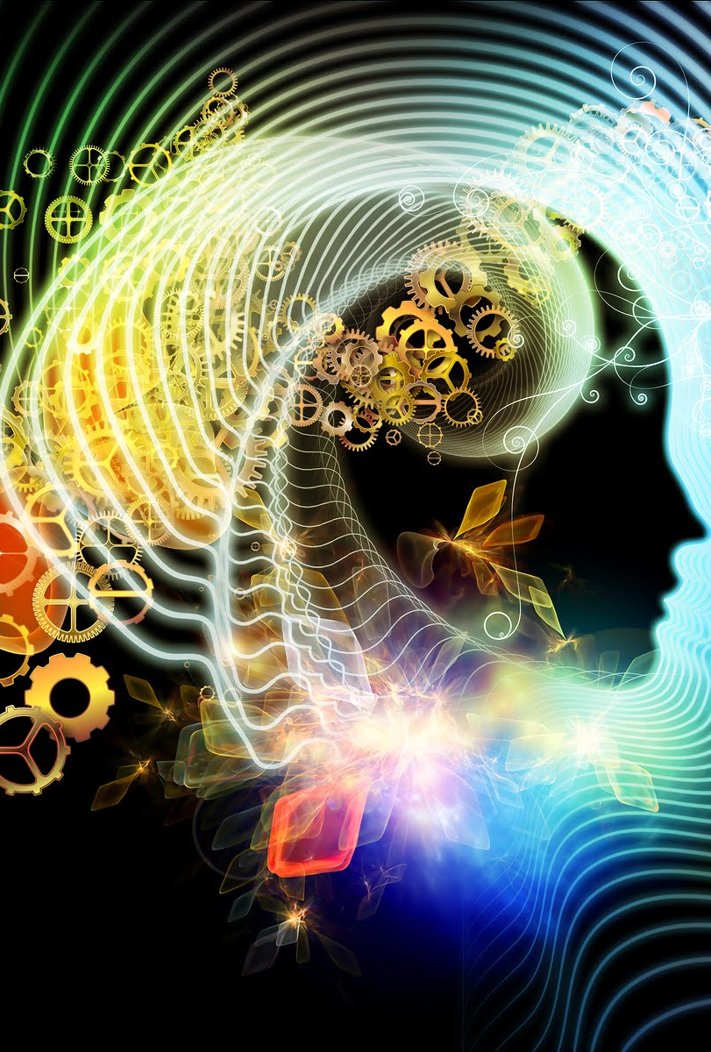
WHAT IS THE “STRUCTURE & FUNCTION” OF THE MIND?
Look at the mind as field
Thoughts originate from the subconscious recording
Appearance of thoughts and the nature of the field (of thoughts) is the structure
Function of the mind is what we do with our thoughts
Directing thoughts (the way you want) to ACHIEVE clarity
One thought leads to another thought
Observation of thought
Deliberately stopping fragmentation
This Photo by Unknown Author is licensed under CC BY-SA

Slide 23
WHAT IS IDENTIFICATION OF THE MIND?
We have a personal history (be AWARE of it)
ACCUMULATION of memories in one’s mind
SUMMATION of life’s experiences: recorded in the brain
Harmful aspects of IDENTIFICATION….
Societal normal, belief systems, and comparison…
Living in one’s mind is ALL we usually know how to do…
You could be SEPARATE from your mind/body…be open to this possibility
Mind RECORDS stimuli
Moving out of IDENTIFICATION… Certain belief systems are BLOCKS…
This Photo by Unknown Author is licensed under CC BY-SA

Slide 24
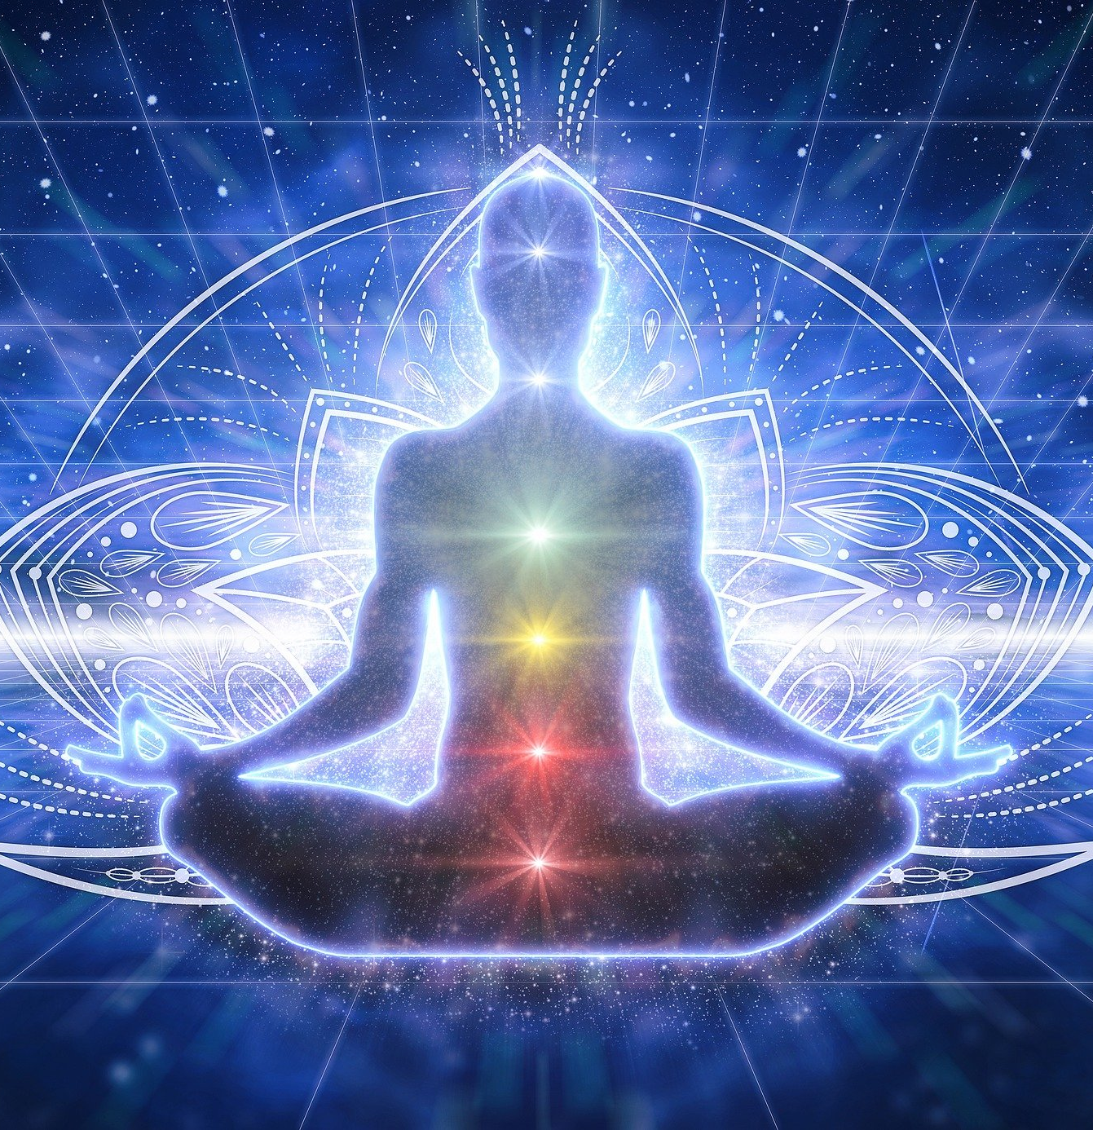
THE POWER OF VISUALIZATION
Do NOT visualize negativity or negative experience…
Living life the WAY we want…on our OWN terms…
Recognize YOUR power of manifestation…
LASER FOCUS and CLARITY – leads to manifestation…
Do NOT give importance to obstacles (move beyond them)…
SCULPTING each day…living the most empowered life…

Slide 25
HOW DOES SELF-MASTERY HELP WITH ADDICTIONS, TRAUMAS, DEPRESSION, SUICIDAL IDEATION ETC.?
Each person’s life journey is different…
We FEEL that our problems are paramount…
Expectation: If I live a good life, nothing bad is going to happen to me…
“I need to be fixed…I need to be treated…I need problems to go away…etc…etc…” – THESE ARE BELIEF SYSTEMS
Going beyond belief systems: Importance of ACCEPTANCE
We are all COLLECTIVELY RESPONSIBLE…
Not having the need to be FIXED… Recognize FALSE PERCEPTIONS…
How do we PERCEIVE things? NEUTRALIZE our perceptions…
I have the POWER to respond differently to situations…
I will GROW FROM WITHIN
(inward growth & potential)
Victim mentality NEVER works
All of us are IN IT together

Slide 26
IS SELF-MASTERY A STATE OF JOY OR CYCLICAL PLEASURE AND PAIN?
Pleasure and pain are TWO SIDES of the same coin…
Giving TOO MUCH WEIGHT to pleasure or pain…
Self-Mastery: A STEADY STATE with equal perception…
Experiencing EVERYTHING without attachment…
Stay ANCHORED in one’s own peace…

Slide 27
WHAT IS PERSONAL TRANSFORMATION?
Self-mastery is individualized…
What is think about our self is accumulated from other sources except our own…
Self-discovery and mastering one’s mind…
Mind is a field that creates a false identity of oneself…
Mastering one’s mind by going behind one’s thoughts…
Getting into the path of self-mastery…
Transformation is a state of mind itself…it is going back to one’s original state…
Awareness of stimuli changes…there is a constant flux…
Recognize the drain of charge…
Thought loops create exhaustion…Energy needs to be conserved…
State of calmness, equanimity, and homeostasis…
Being in a relaxed state allows us to navigate our life differently…

Slide 28
CHANGE VS. TRANSFORMATION
Caterpillar TRANSFORMS into a butterfly…an irreversible state
Real transformation is EYE opening…
A TOTAL awakening…
Not WANTING to revert back to one’s old state…
Transformation give you power to LIVE the way you want…
Actual transformation is EYE OPENING…it is an AWAKENING…
Realizing the TRUE SELF…who and what we really are…
Awakening from an ILLUSION…
Going beyond a STATE OF FLUX…
Power to LIVE one’s life with freedom…
This Photo by Unknown Author is licensed under CC BY-SA-NC

Slide 29
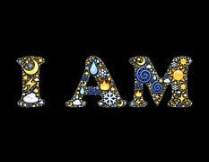
WHAT IS THE “TRUE SELF?”
We are more than our body and mind.
Watching one’s mind and thoughts. See the flow…
Observe thoughts without identifying with them…
Not to start or stop a thought…
Who is observing thoughts…?
Who are you after thoughts stop?
Empowerment to control one’s life via meditation practices…
Navigating through life with control…watching thoughts and letting them go…
Do not get overwhelmed by one’s thoughts…
Recognize the emotional charge that goes with thoughts…
Do not project past (harmful) experiences into the possible future…
Dropping into one’s calm space, periodically…
State of equanimity.
Humanity is one mass of energy. Our family is the world family…

Slide 30
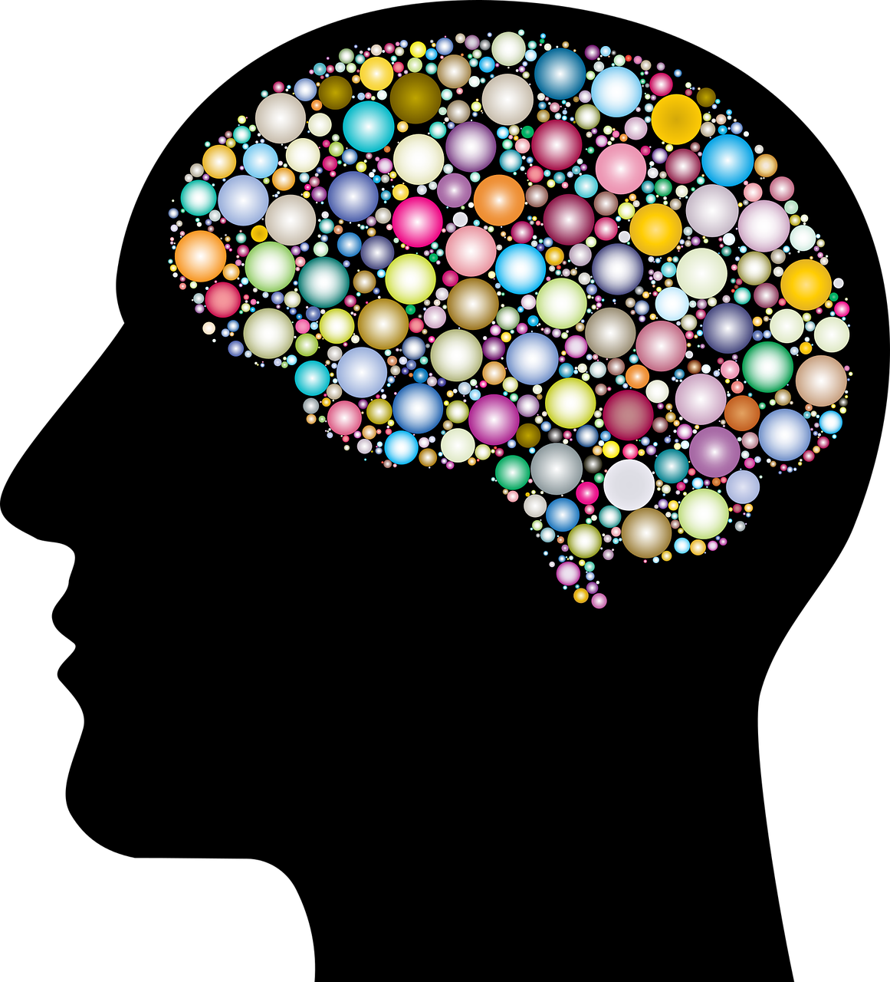
WHAT IS MASTERY OF THE MIND?
Recognize every thought that comes through in our mind.
Utilize any means to increase awareness
Calmness leads to better rationalization
Opening up of the prefrontal cortex
The mind construct of mainly for preserving humanity
Discover your OWN control over your OWN mind

Slide 31
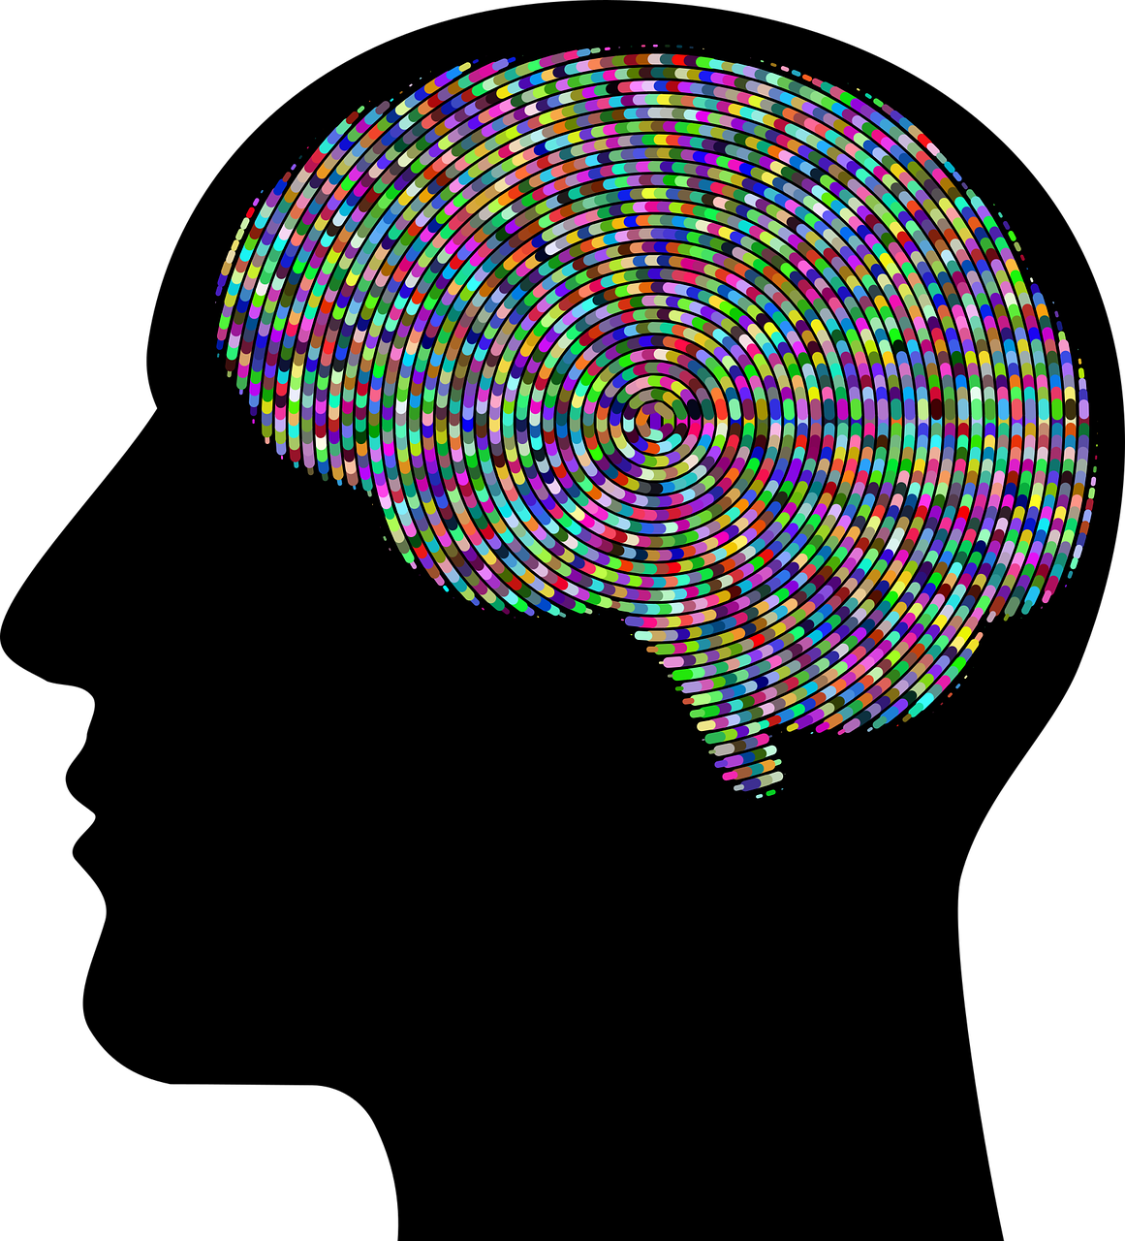
THE MIND IS A PRICELESS INHERITANCE
Difference BETWEEN human beings and all other animals…
UTILIZING one’s mind as a doorway into consciousness…
Mind is USED for enlightenment…
Use the mind to WORK for us…
Expansive ideas START with our mind…
We become SLAVES to the mind in a harmful way…
Mastering one’s mind UPLIFTS humanity…
Creativity exists within the mind…ACTIVATE IT, HONOR IT…

Slide 32
EXPLORING THE BOUNDLESS REACHES OF THE MIND
EXPLORING ONE’S MIND OPENS AN INNER PATHWAY (DOORWAY)…
OUR MINDS ARE EXTREMELY PRECIOUS…
CONFINING THE MIND TO PEOPLE, PLACES, AND THINGS…VS…MOVING OUT OF SUCH CONFINEMENT…
REALIZE THE FULL POTENTIAL OF ONE’S MIND…
WE HAVE CREATED DIVISIONS…WE ARE ACTUALLY (FUNDAMENTALLY) THE SAME…
OUR BELIEF SYSTEMS DIFFERENTIATE US…
DISCOVERY OF INCREASED SIMILARITY AND CONNECTEDNESS…
WE ARE ENERGY BEINGS.
COLLABORATIVE APPROACH TOWARDS HUMAN PROGRESS…
DECONSTRUCTION OF LIMITEDNESS LEADS TO NATURAL OPENING UP…
LETTING GO OF LIMITED BELIEFS…RATHER THAN AVOIDING/SUPPRESSING THEM…
THE SELF REVEALS ITSELF…
CREATION OF MORE SPACE IN ONE’S MIND…

Slide 33
WHY ARE WE STUCK WITH LIMITATIONS OF THE MIND?
ALL WE HAVE ARE SENSE PERCEPTIONS THAT ARE RECORDED…
CONDITIONING FROM PARENTS AND OTHERS…
THERE IS A MIX-UP OF CONTENT WITHIN THE MIND…ONE NEEDS TO BE SYSTEMATIC IN TRYING TO SORT IT ALL OUT…
WE ARE IN COMPARISON TO OUR BELIEF SYSTEMS…PULL AND PUSH PROCESS…
REALIZE THROUGH MEDITATION TO GO BEYOND THE MIND…CONTEMPLATION, INTROSPECTION, SCRIPTURES, PHILOSOPHY, ETC.
ALLOW YOURSELF TO GET OUT OF MENTAL WALLS…
MAIN PRACTICE: LEAN TO LET GO…
LEARNING TO NAVIGATE LIFE AS IT COMES TO YOU…
MAKE ROOM FOR CREATIVE/EXPANSIVE THOUGHTS…
GOING WITH THE FLOW (TAOISM)
WE ARE DIVINE… WE ARE CO-CREATORS OF IN THE UNIVERSE
BEING IN NATURE CHANGES ONE’S FREQUENCY…

Slide 34
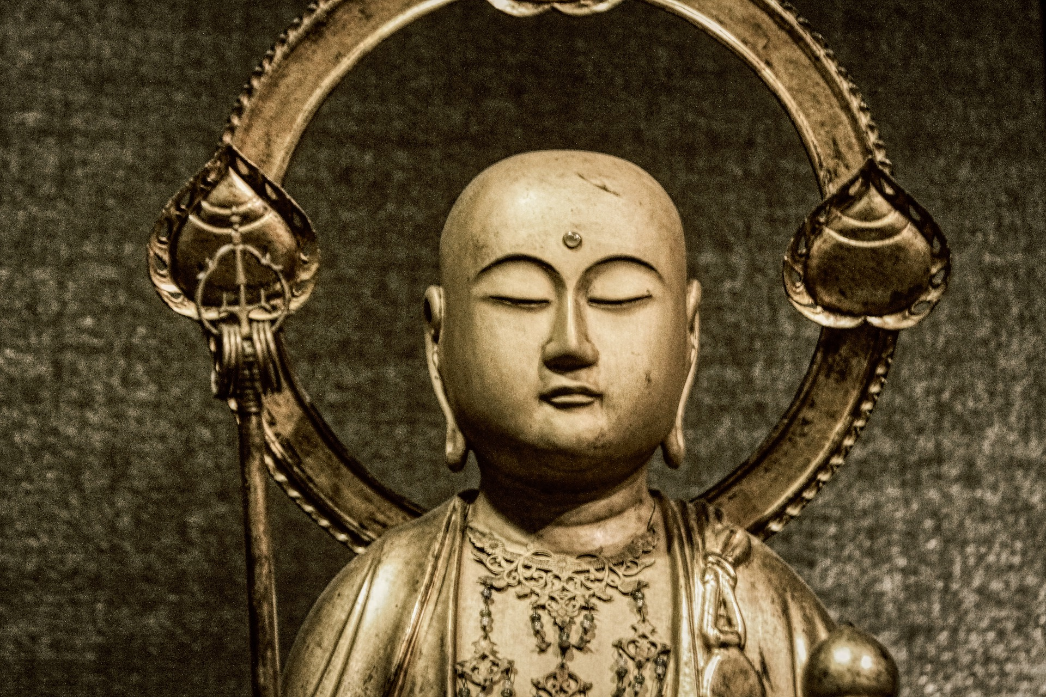
HOW TO USE MIND POWER WISELY FOR THE BENEFIT OF ALL?
GO THE BASIC QUESTION, “WHO AM I?”
REALIZATION OF CONNECTEDNESS WITH OTHERS… CONNECTING WITH EACH OTHER, SOUL TO SOUL, CREATES UNCONDITIONAL LOVE TOWARDS OTHERS.
ASSISTING OTHERS WHO ARE SUFFERING…
WE ARE TOO SELF INVOLVED…THIS CREATES LIMITATIONS IN ONE’S MIND…
HOW DO WE SEE OURSELVES IN THE RELATIONSHIP TO THE WORLD…
WHY DO TRAGEDIES BRING US TOGETHER…?
WE ARE ALL PART OF EACH OTHER ENERGETICALLY…WE DO NOT KNOW IT…
INCREASE MEDITATION, REFLECTIONS, DIALOGUES, ETC.
WE CAN BE UNSTUCK DESPITE OUR DIFFERENCES…
RECOGNIZE ONE’S SUB-CONSCIOUS BLOCKS…
WE ARE ALL INTERNALLY THE SAME…
GROUPISM VS. FREEDOM FROM GROUPISM

Slide 35
WHAT IS MEANT BY: A FELT UNITY & INTERCONNECTION
A RENEWAL of purpose and possibilities
Going into a PATH of self-discovery
DELIBERATE uncovering of obstacles and blocks and get into a state of unity
Self-discovery LEADS to self-mastery: Experiencing connectedness
LEAVING one’s conditioned identity aside
At the core, we are all the SAME innocent beings
RECOGNIZE how opinions are created
Unity IN diversity
Effort needs to be placed to LET GO of one’s harmful conditioning
Our sense of separateness CAUSES problems

Slide 36
EXPANDING ONESELF TO HELP OTHERS
Getting rid of stress, INNER WALLS, etc. (marathon analogy)
EXPANSION in different areas of life
Meditation ALLOWS one to expansive
NATURAL DROPPING of inner boundaries
the body follows the mind: ENERGIZING THOUGHTS VS. PARALYZING THOUGHTS… message sent at the cellular level
CHOOSE to act with wisdom

Slide 37
HOW DOES EXPANSION OCCUR?
Everyone has his/her OWN journey…
There is a GRADUAL progression…
There is NO END to the transformation…
The transformation occurs at DIFFERENT LEVELS…Uncovering truth…
Transformation requires PUSHING boundaries…
Going INWARDS through meditation connects you with your real self…
Stopping the CONTRADICTION of thoughts…
Mind CAUSES limits…and mind can also free itself…
Meditation allows one to WATCH the mind…
SITTING with yourself…BEING in nature… LETTING GO of thoughts…
Bring about a CHANGE from inside out… (Energy Body & Thoughts)
Many belief systems are limited and are INGRAINED in the mind…
EXPANSION leads to joy…

Slide 38
WHAT IS AN HUMAN EXPERIENCE?
We are ENERGY BEINGS having a human experience.
We have DIVERSE EXPERIENCES through our senses.
We generate LIKES & DISLIKES.
Recognize the CREATION of belief systems, leading to limitations.
UTILIZE emotions/feelings as a catalyst.
NOT placing too much value on thought.
Example of relationship development…opening up of NEW POSSIBILITIES
RECOGNIZE our conditioning and sub-conscious programming.
Be RECEPTIVE and connect with the universal reality…going with the flow…
Imagine a life WITHOUT limited beliefs…
TRANSMUTATION from limited to limitless mind…

Slide 39
WHAT IS “EMOTIONAL BLINDING?”
Emotions can BLIND us... Emotions can also FREE us…
See HOW the mind works…emotions and feelings come from thoughts…
Create tools to be WATCHFUL of our thoughts…do not increase unnecessary thoughts…
Being a WITNESS to our thoughts again and again…
There is a “movie” running in the sub-conscious… Be watchful of the 1st THOUGHT that comes through…
WEAKENING of sub-conscious programming…
There is an internal STRUCTURE and FUNCTION of one’s mind…
See how the MIND MOVIE IS created internally…

Slide 40
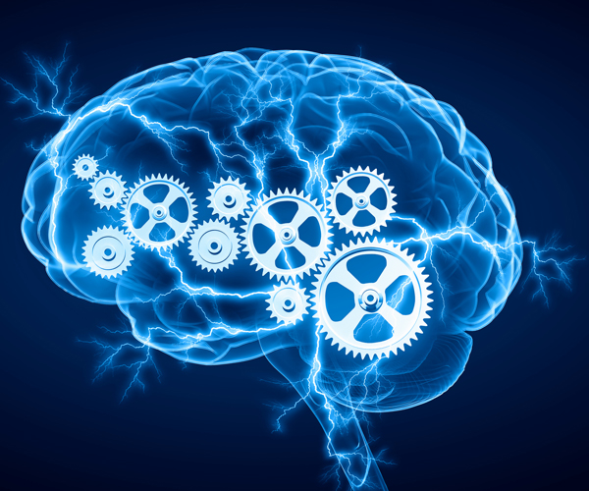
CONSTRUCTIVE VS. DESTRUCTIVE PROGRAMMING
PERFORMING WONDERFUL ACTIONS…
WHAT IS A “CONSTRUCTIVE MOVIE?”
ALL PROGRAMMING IS NOT DESTRUCTIVE…
This Photo by Unknown Author is licensed under CC BY-SA-NC

Slide 41
PERSONAL TRANSFORMATION IS DEPENDENT ON CONSTRUCTIVE PROGRAMMING
Utilize one’s conscious mind via visualization techniques
Disconnecting with one’s current identified personality
Going into a neutral field to do the new programming…increase of inner wisdom is natural in this field…
Creation of new habits…deliberately and consistently done…
Multiple tools available to do the re-programming…
Release obstacles…releasing sub-conscious issues…
Coffee table analogy…
Increasing mind-space…
Personal transformation leads to self-mastery
Self-mastery leads to personal transformation

Slide 42
HUMAN UPLIFTMENT
Self-discovery leads to self-mastery
Transcending the mind-body complex
Society at large will be different once individuals transform
The world around us is a reflection of all of us
We differential and compete with each other and are in conflict with each other
Conflicts exist at all levels: individuals, communities, nations, etc.
We do not see togetherness when we look at human civilization in general
We differentiate in many ways (community, groups, etc.)
Is it possible to have a utopian society?
Creating a society filled with wisdom
Living in sync with nature and each other

Slide 43
OUR UNIQUENESS & HUMAN UPLIFTMENT
RECOGNIZE one’s uniqueness and keep attention on self-development
SELF-CENTEREDNESS may prevent one from recognizing the SELF that is beyond the mind
The mind CHANGES in many ways
Whatever we PUT OUT is a reflection of our state of mind
Our OPINIONS change
Learning to stay in the CONSISTENCY of the real self
Mind learns to QUIETEN and brings clarity about our interconnections
Our lives are mostly in conflicts…we must GO BEYOND conflicts
Connection to the real SELF make a different world
Using one’s mind (energy) for CONSTRUCTIVE PURPOSES, leads to human upliftment

Slide 44
CAUSES OF HUMAN SUFFERING
Human suffering is on many different levels
Suffering is mostly identification with negativity
Weakening of immune system and the mind
Injection of toxins
Greed, profit, etc. damages the mass population
All ideas start in the mind: Recognize the root cause
Mind is the cause of suffering
Material possessions are transient... Reaching the SELF is most important
We need to spend time in reflection on the human condition
We think we need more than we actually need

Slide 45
PICTURE OF AN IDEAL SOCIETY
Sharing within communities: assisting each other
Starting from childhood…determining ideal values…nurturing children’s talents
Encourage each child…cultivate passion…
Working together in different areas… Everyone is taken care of
Emphasis on collaboration…working towards a greater cause
Generation of creative ideas
Modification/dismantling certain belief systems that are causing harm
People, many times, gravitate towards ideas that resonate with ingrained belief systems
Emergence of the REAL SELF is truly transformative… work on yourself

Slide 46
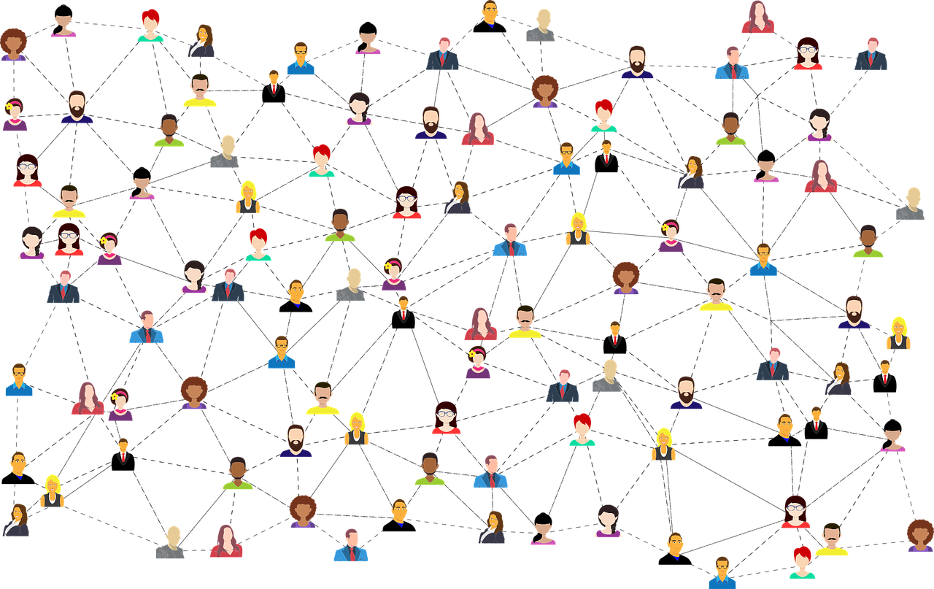
HUMAN NATURE & ENERGY
Is human nature fundamentally egotistic?
Dr. Chetana’s personal experiences
Deep rooted instilling…
Moving out of narrow perspectives into expansive perspectives
True inner freedom is necessary to discovery our actual human nature
Moving out of a “miserly” mindset from the inside…
Fear of loss (part of one’s belief system)
Importance of authenticity
Discovery of one’s spiritual path
Release of negative belief systems
Our nature is to connect with others
We are energy beings
Our identities have been acquired from the outside
Core of every human being is love
Uniqueness & Interconnection

Slide 47
WE ARE ONE MASS OF ENERGY
We are all part of an infinite mass of energy
Fighting with others is fighting with oneself
Working together breads unitive consciousness, creating a new reality
Dr. Chetana’s personal experience
Connecting at the heart/spirit level: not focusing on other’s faults
Connectedness give us a greater perspective
We can bring out the best in others
Helping others release their negativity

Slide 48
BELIEF SYSTEMS & HUMAN UPLIFTMENT
OUR BELIEFS HAVE COME FROM MANY SOURCES…
STRONG OPINIONS ARE SET IN ONE’S PSYCHOLOGICAL PROCESSES
BECOMING MORE INQUISITIVE AND A YEARNING TO GO DEEPER
ALL BELIEF SYSTEMS ARE AT THE MENTAL LEVEL
CHALLENGING ONE’S BELIEF SYSTEM
ANALYTICAL FUNCTION OF THE MIND
BELIEF SYSTEM ARE NEEDED FOR GROUNDING IN THE WORLD
AT THE SPIRIT LEVEL, THERE IS NO CONFLICT

Slide 49
HEALTHY BELIEF SYSTEMS
THERE ARE HEALTHY BELIEF SYSTEM
ANY SYSTEM THAT ASSISTS OTHERS AS PART OF A BELIEF SYSTEM CAN BE VERY HEALTHY
THERE IS ALWAYS DIVERSITY (IN MATTER) IN MANY WAYS
WE CAN APPRECIATE DIVERSITY
DIVERSITY IS ROOTED IN ONENESS
EXTERNALLY WE LOOK DIFFERENT, INTERNALLY WE ARE ALL THE SAME
COMING BACK TO THE SAME ROOT OF ONENESS
WE DO NOT WANT TO SEE ONENESS (IN MOST CASES)
KNOW ONESELF: SELF DISCOVERY LEADS TO SELF MASTERY
SEEING ALL PEOPLE AS PART OF ONESELF

Slide 50
GET IN TOUCH WITH ANGEL WING!
CONTACT INFORMATION
CHETANA KRIPALU, MD & VOLUNTEERS
https://theangelwing.com/
E-MAIL:THEANGELWING19@GMAIL.COM
PHONE: 302-283-9878
ANGEL WING’ DISCLAIMER STATEMENT
The Angel Wing, LLC program is NOT intended to provide diagnosis and/or treatment for any medical, psychiatric, psychological, sociological, economic, and/or financial problems, and participants are encouraged to contact their medical provider (or another such professional provider) if necessary. Meditation techniques and ideas presented are solely for the purpose of providing tools that may be utilized by me to enhance overall wellbeing. Additionally, any and all ideas presented by Angel Wing presenters are for my consideration only. The practice of any meditation technique is totally voluntary. There is no intention to promote and/or criticize any religious, spiritual, and/or meditative traditions. If there are any difficulties faced by me while doing any meditation techniques, please contact Angel Wing and appropriate guidance will be provided.

