Slide 1
The Probate process

Slide 2
What is probate?
Probate is the process by which a deceased person’s estate is administered. The administration of the estate involves identifying all of the estate assets, paying off the debts, and distributing the remaining assets according to the terms of the Will.
In Texas, the majority of estates are handled through the probate process. What is involved in this process will depend on the specific facts and circumstances of your case. Generally, Texas law requires executors and administrators to retain competent legal counsel on behalf of the estate. The average cost for probate of a Will for Letters Testamentary is $4500-$5500.
We understand that the need to begin the probate conversation often involves dealing with the loss of a loved one and can be emotional and difficult. We are here to walk through this with you.

Slide 3
team
Elizabeth hilbun
Dondi whigham
Joyce basford
Attorney
Legal Assistant
Legal Assistant

Slide 4
Let’s get started
At this point, we begin a 90 Day Process
Information Gathering
Before we can file anything with the court, we must have all the required information.
We will send the following:
Credit Agency Notification
Voter Registrar Notification
TX DPS Notification
We will also request a MERP (Medicaid Estate Recovery Program) Certification.

Slide 5
Drafting & review
Draft
Once all of the information has been gathered, we will draft documents that pertain to initial filings with court.
Application to Probate
The draft will be uploaded to the portal for the client to review.
review

Slide 6
Filing
File with the court
Posting time
Once the client has reviewed and approved the Application to Probate, all pre-hearing documents will be filed with the court.
The original Will will then be hand delivered to the courthouse.
Documents must be on record for a period of
10 business days
after date of acceptance before the court will set a hearing.

Slide 7
Drafting & review
Draft
Once the Application to Probate has been accepted by the court, we will draft additional documents that pertain to initial filings with court.
Appointment of Resident Agent, if applicable.
Distributee’s Consent and Waiver of Notice, if necessary
The draft(s) will be uploaded to the portal for the client to review.
review

Slide 8
Filing
File with the court
Posting time
Once the original signed and notarized Appointment of Resident Agent and Distributee’s Consent and Waiver are received in our office, they will be filed with the court.
Once these documents are accepted by the court, our office will then confirm all of the pre-hearing documents were filed and that we are ready to proceed with hearing.

Slide 9
Court hearing
Most of our hearings take place in Harris County.
Harris County judges usually allow the attorney to appear on behalf of their clients in uncontested probate matters.
However, smaller surrounding counties may require the executor to appear before the court.

Slide 10
POST hearing
Following the hearing, the Proof of Death and Other Facts document is signed in front of a notary and filed with the court. If the hearing occurred in Harris County, the attorney will sign this on your behalf.
The judge then accepts the documents and signs the Order.
The client then signs the Oath of Executor which is filed with the court.
*It is important to note, there can be up to a three (3) day delay before the court will sign the order and the client is able to sign the Oath.

Slide 11
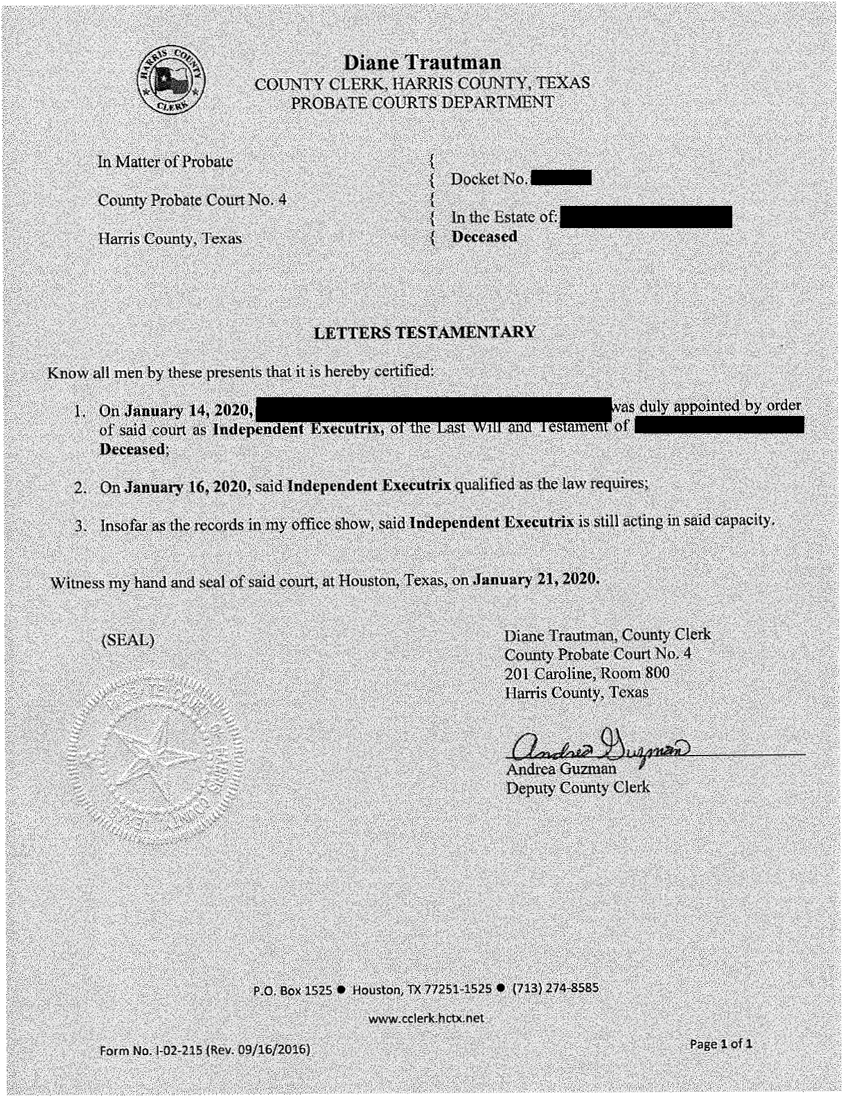
Post hearing, Continued
We will then order certified copies of the Will and Order as well as five (5) Letters Testamentary. This takes approximately 20-30 days to receive from the court.

Slide 12
Drafting & review
Draft
Once the hearing has occurred, we will proceed with drafting the necessary documents that pertain to closing out the estate.
Inventory, Appraisement and List of Claims
Affidavit In Lieu of Inventory, if applicable
Certificate of Compliance
Notice to Creditors
Notice to Beneficiaries
The draft(s) will be uploaded to the portal for the client to review.
Review and FINAL FILINGS

Slide 13
Post hearing meeting
At the Post Hearing Meeting:
Review the case and court proceeding
Sign the Inventory
Receive instructions for distribution and closing estate

Slide 14
DISTRIBUTION & ESTATE MATTERS
Our office will then reach out to you to assist you with the distribution and ancillary matters.
EIN
Vehicle Sales
Bank Accounts
Receipt and Release
Liaison with the sale of Real Property

Slide 15
SUMMARY
1. Gather all required information
Draft and file initial documents with the court.
Posting time
Draft and file supplemental documents with the court.
Court Hearing
Post Hearing Meeting
Draft, execute and file post-hearing documents.
Distribution and Estate Matters
THANK YOU

