Slide 1


Nooga Shuttles, Charters and Tours
Vehicle Type Presentation
The Passenger Professionals!
Based in Chattanooga, serving the continental US
423-896-2555 Sales@NoogaShuttles.com

Slide 2
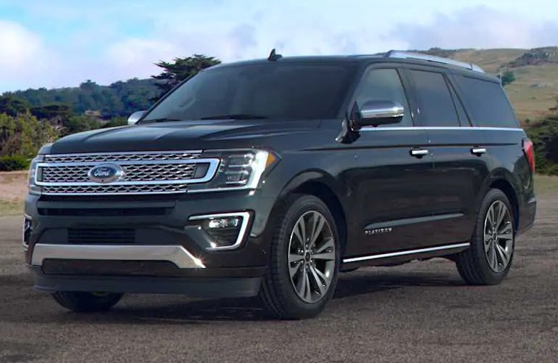
Ford Expedition SUV
  Seating for 6
  Second row captains chairs
  Leather seating
  Rear climate control
  Best in class luggage space
  Rear window tint
  Perfect for VIP Airport trips
423-896-2555 Sales@NoogaShuttles.com

Slide 3
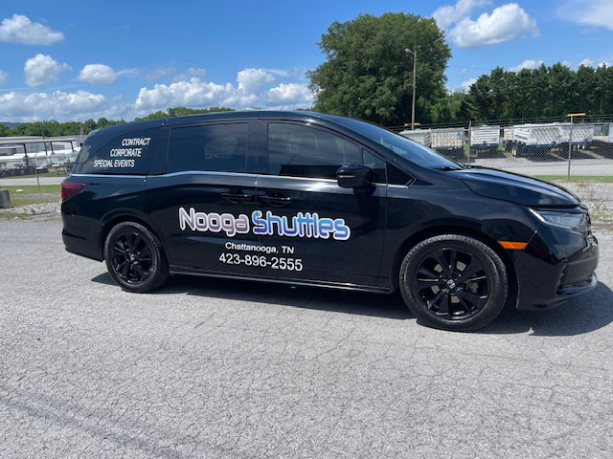
Honda Odyssey Mini Van
  Seating for 6
  Second row captains chairs
  Leather seating
  Rear climate control
  Rear window tint
  Perfect for small batch employee shuttling
423-896-2555 Sales@NoogaShuttles.com

Slide 4
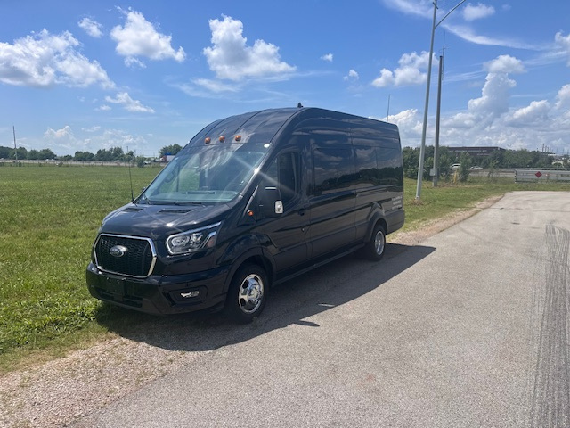
Ford Transit
  Seating for 14
  Leather seating
  Sliding door for easy access
  Rear climate control
  Rear window tint
  Dedicated luggage space
  Best for small group outings
423-896-2555 Sales@NoogaShuttles.com

Slide 5
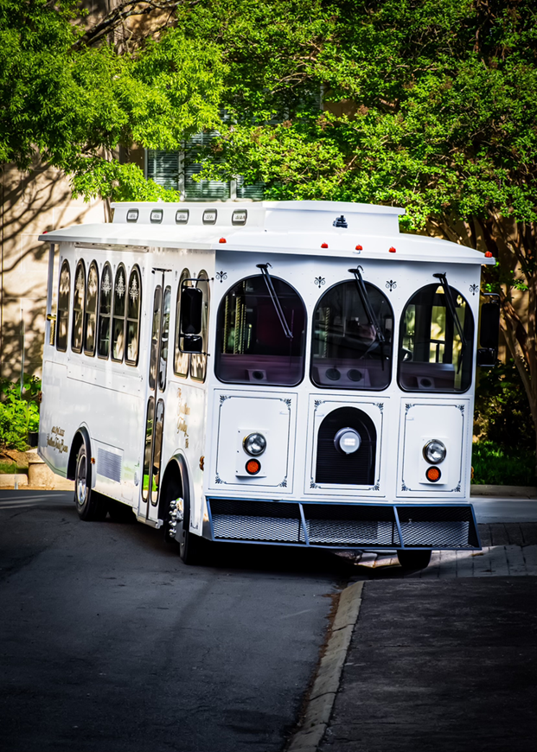
Trolley
  Seating for 22
  Air conditioned
  Great pictures!
  Wood and brass interior
  Rear platform
  Great for weddings and corporate events
423-896-2555 Sales@NoogaShuttles.com

Slide 6
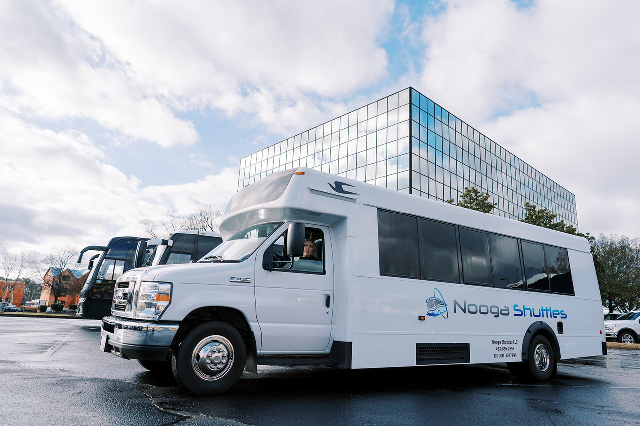
Standard Mini Bus
  Seating for 24 - 25
  Leather seating
  Easy access
  Dedicated luggage space
  Great for small sports teams and corporate events
423-896-2555 Sales@NoogaShuttles.com

Slide 7
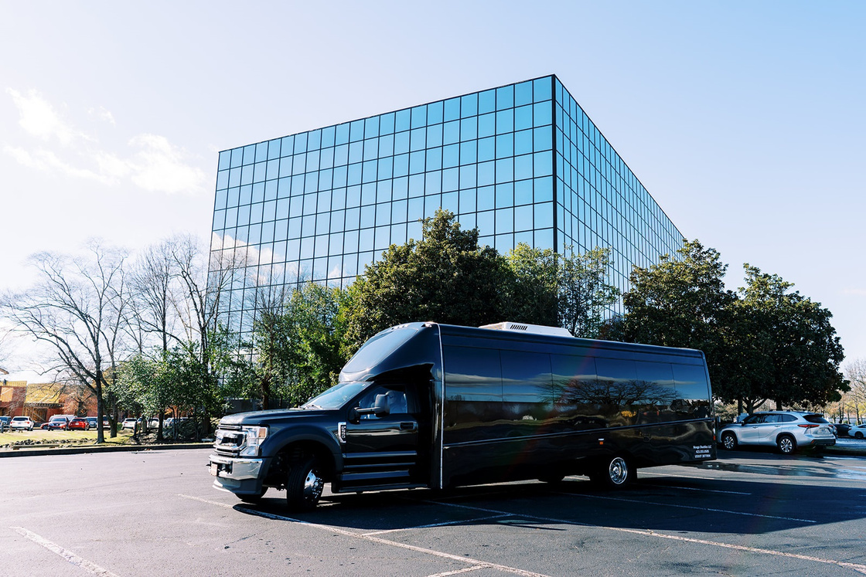
Executive Mini Bus
  Seating for 14 - 31
  Upgraded leather seating
  Easy access
  Dedicated luggage space
  Bluetooth
  Hardwood style flooring
  Window tint
  Best for C-suite tours and weddings
423-896-2555 Sales@NoogaShuttles.com

Slide 8
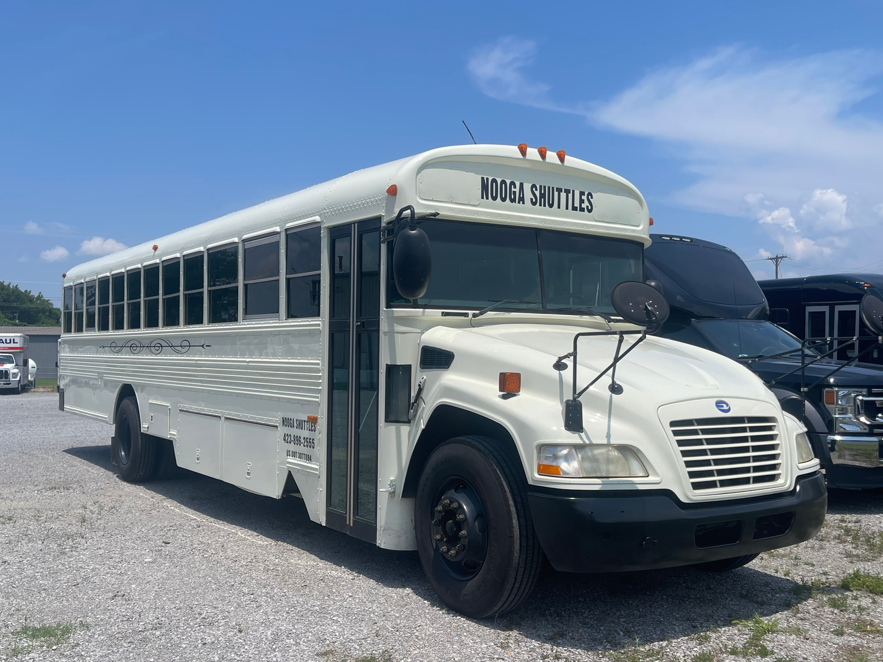
School Bus
  Seating for 48
  Affordable option for larger groups
  Air conditioned
  Upgraded appearance
  Great for church groups, student outings and wedding guests
423-896-2555 Sales@NoogaShuttles.com

Slide 9
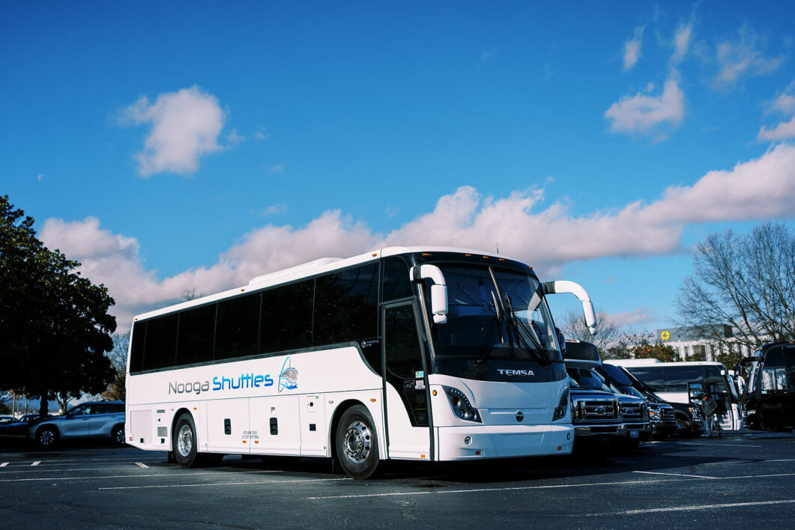
Mini Coach
  Seating for 40
  Upgraded seating
  Easy access
  Underbelly luggage space
  Bluetooth
  USB ports and outlets
  Restroom
  Smooth ride
  Good for smaller teams, senior day trips and more!
423-896-2555 Sales@NoogaShuttles.com

Slide 10
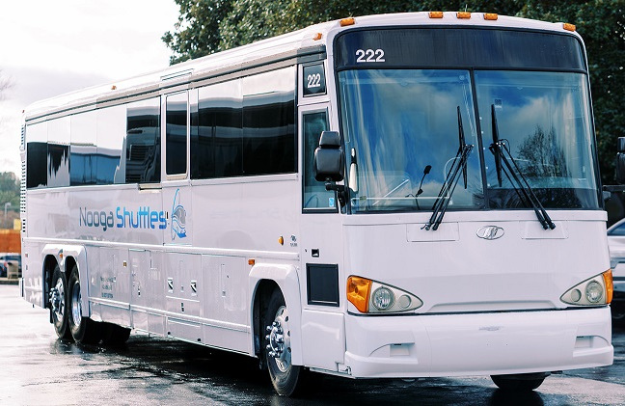
ADA Motor Coach
  Seating for 52 plus 2 wheel chairs
  Hydraulic chair lift
  Easy access
  Underbelly luggage space
  NO Restroom
  Smooth ride
  Great for day trips and group airport transfers
423-896-2555 Sales@NoogaShuttles.com

Slide 11
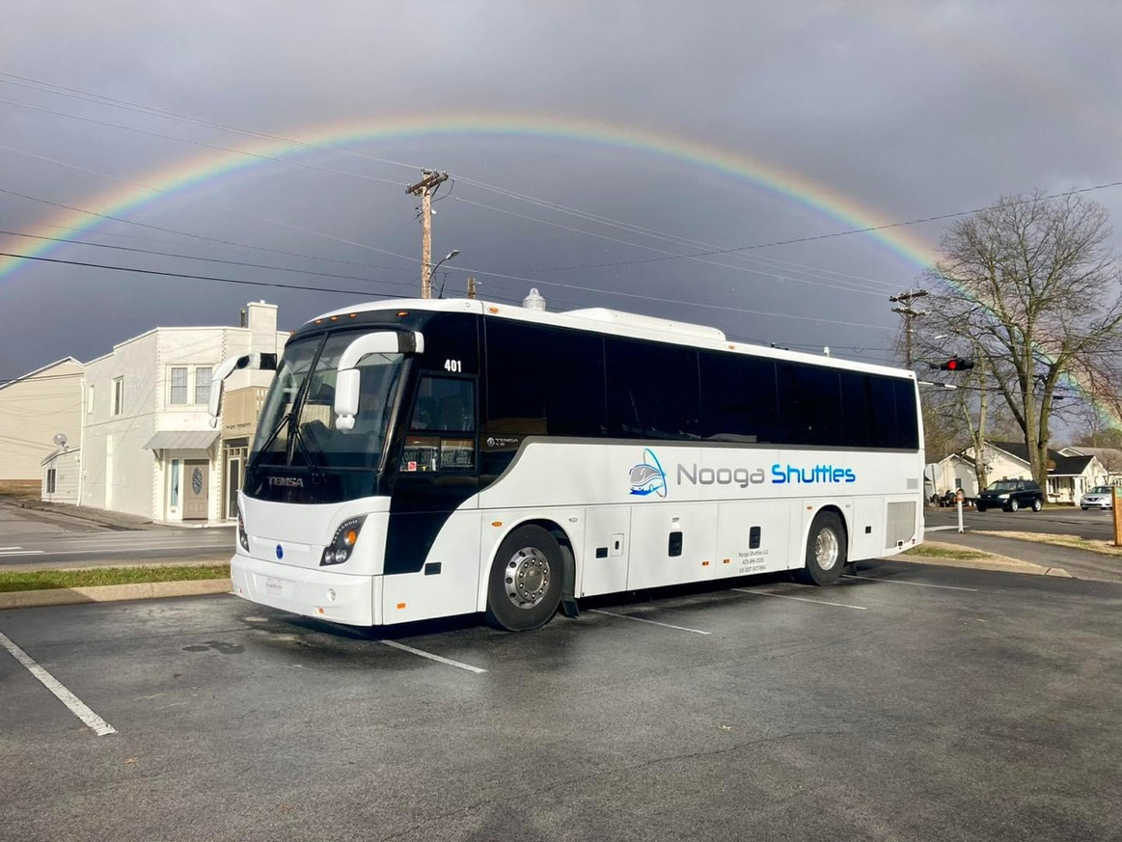
Motor Coach
  Seating for 56
  Easy access
  Underbelly luggage space
  Restroom
  Smooth ride
  DVD with monitors
  Microphone
  Wifi
  USB ports and outlets
  Best for large groups and multi-day trips
423-896-2555 Sales@NoogaShuttles.com

