Slide 1

Financial Overview
As of November 2025

Slide 2


Slide 4
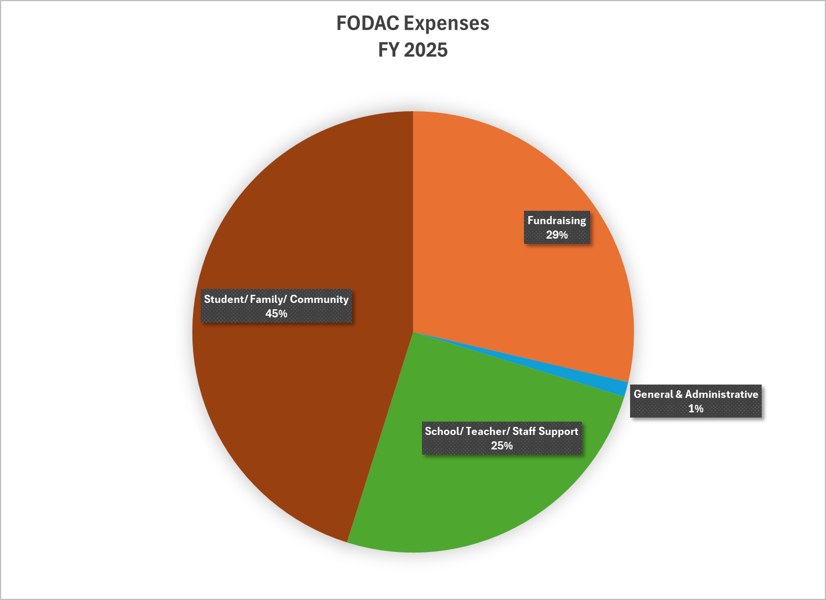

Slide 5
