Slide 1
2023-2024 Scholarship Recipients
July 1, 2023

Slide 2
The Beginning -
The Charles M. Hall Alumni Association began in 1991 with the goal of improving the quality of life in the community. To achieve this goal the Association would support the youth by providing scholarships.
In the beginning, fundraising activities were limited. As such, the Association was thrilled to be able to award and fund two (2) scholarships.

Slide 3
NOW -
Through various fundraising activities, previous contributors and current sponsors (i.e. Altar’d State, the Class of 1970 and the Peggy Miller Hill Family), the Association, is able to award ten (10) scholarships to eligible students.
We have a great group of recipients who have demonstrated an excellent academic record as well as participated in extracurricular activities at school and in the community. One recipient has “perfect attendance since kindergarten”.

Slide 4
Extracurricular Activities
Awards of Distinction, National Honor Society
“ALL ARE WORTHY”
Sport activities – Volleyball, soccer, wrestling, football, lacrosse
Musical Interest – Band (marching and concert), Chorus, Alcoa Singers
Class Presidents, Yearbook Staff, Editors
4H, Jaycees, YOKE, Scouting
Homecoming Court, Teen Board
Church activities
One recipient has already received their CNA license
Notes:
With no further delay, let’s introduce this years Scholarship Recipients -

Slide 5
Alani Black
Alani is the daughter of LaTisha Sudderth and graduated from Heritage High School. Alani will be studying to become a Dental Hygienist at Tennessee State University.

Slide 6
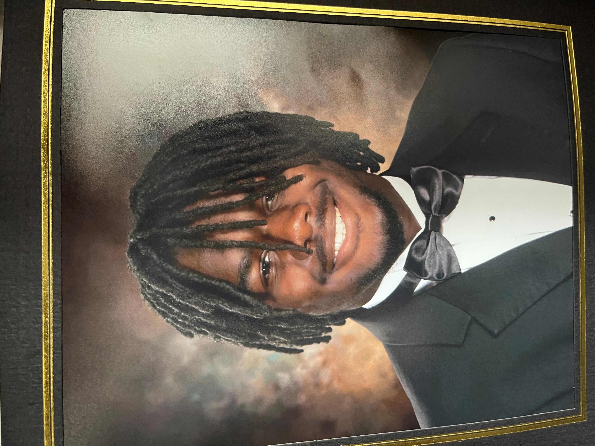
Aaron Davis
Aaron is the son of Fonda Davis and Shannon and Frenchie Mitchell and graduated from Alcoa High School. Aaron will be attending Cumberland University majoring in Computer Technology.

Slide 7
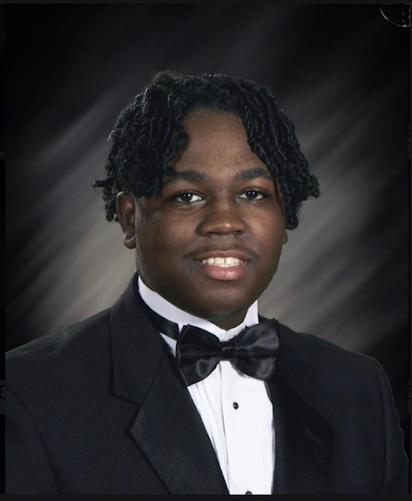
Ahmad Henderson
Ahmad is the son of William Homer Henderson and Jennifer Black and recently graduated from Alcoa High School. He will be attending Pellissippi State Community College majoring in Computer Science.

Slide 8
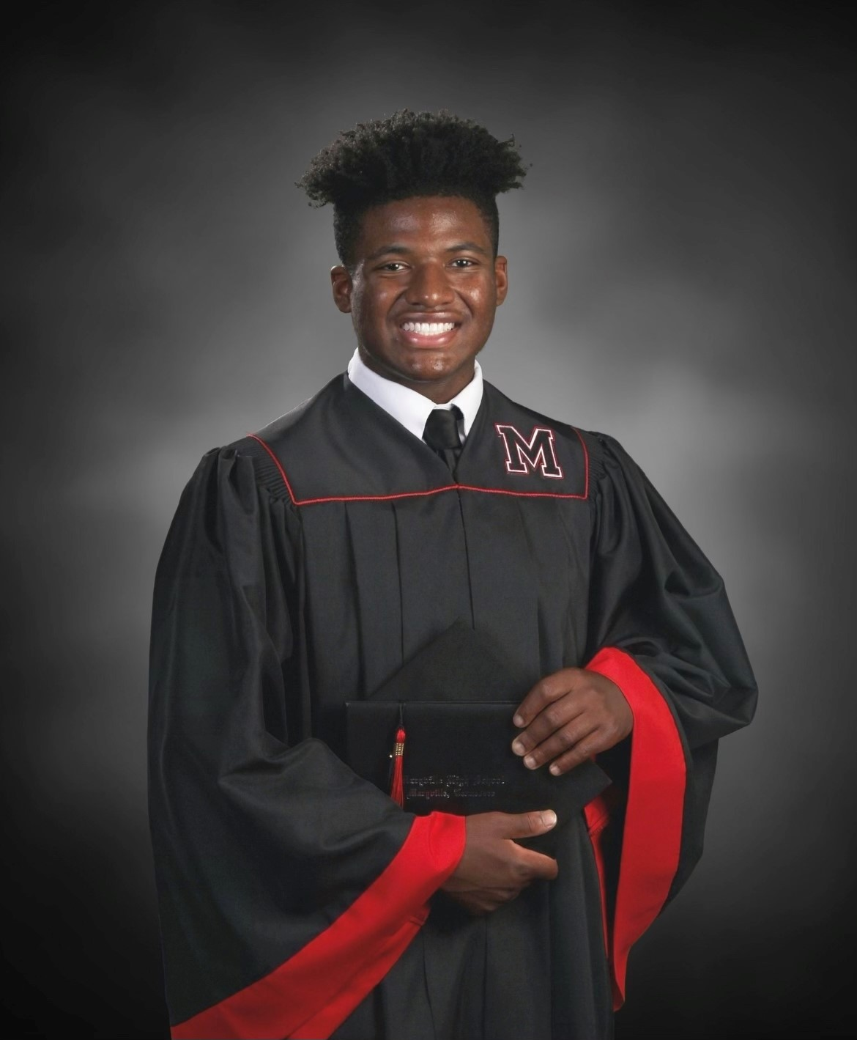
Jaydan McCord
Jaydan is the son of Adriel and Nicole McCord and graduated from Maryville High School. Jaydan will be attending the University of Tennessee at Chattanooga majoring in Business Administration with an emphasis in Marketing.

Slide 9
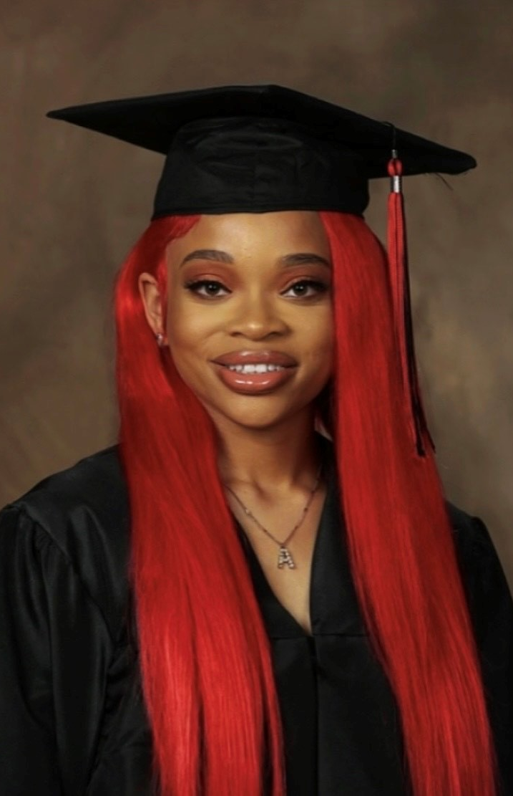
Ayanna Odems
Ayanna is the daughter of Anthony Odems and Quiana Green and graduated from Stewarts Creek High School in Smyrna, Tennessee. Ayanna will be attending Clark Atlanta University and majoring in Computer Science and Fashion Merchandising.

Slide 10
Kaylee Rowell
Kaylee is the daughter of Tiya Gilbert and graduated from Alcoa High School. Kaylee will be attending Lincoln Memorial University and majoring in Exercise Science.

Slide 11
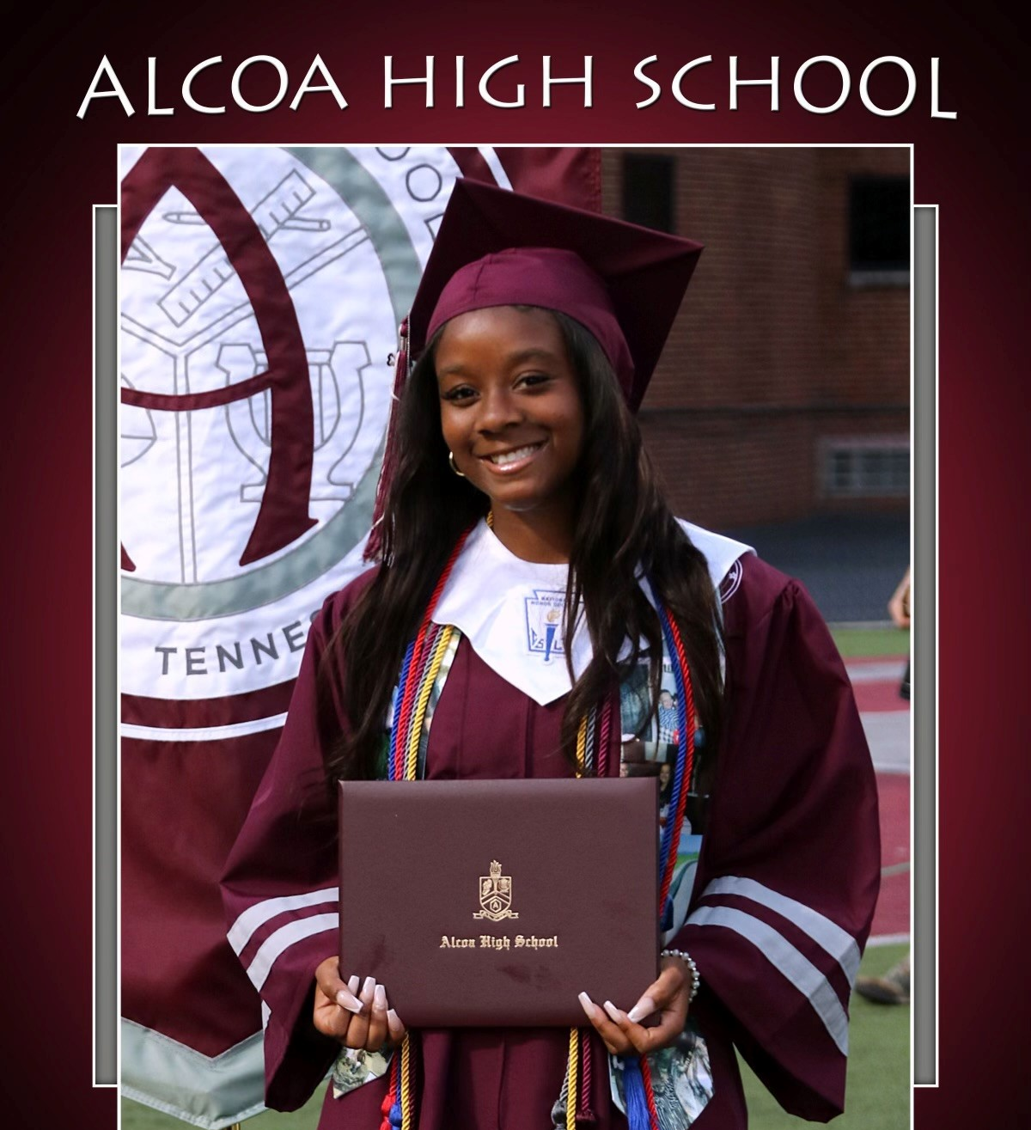
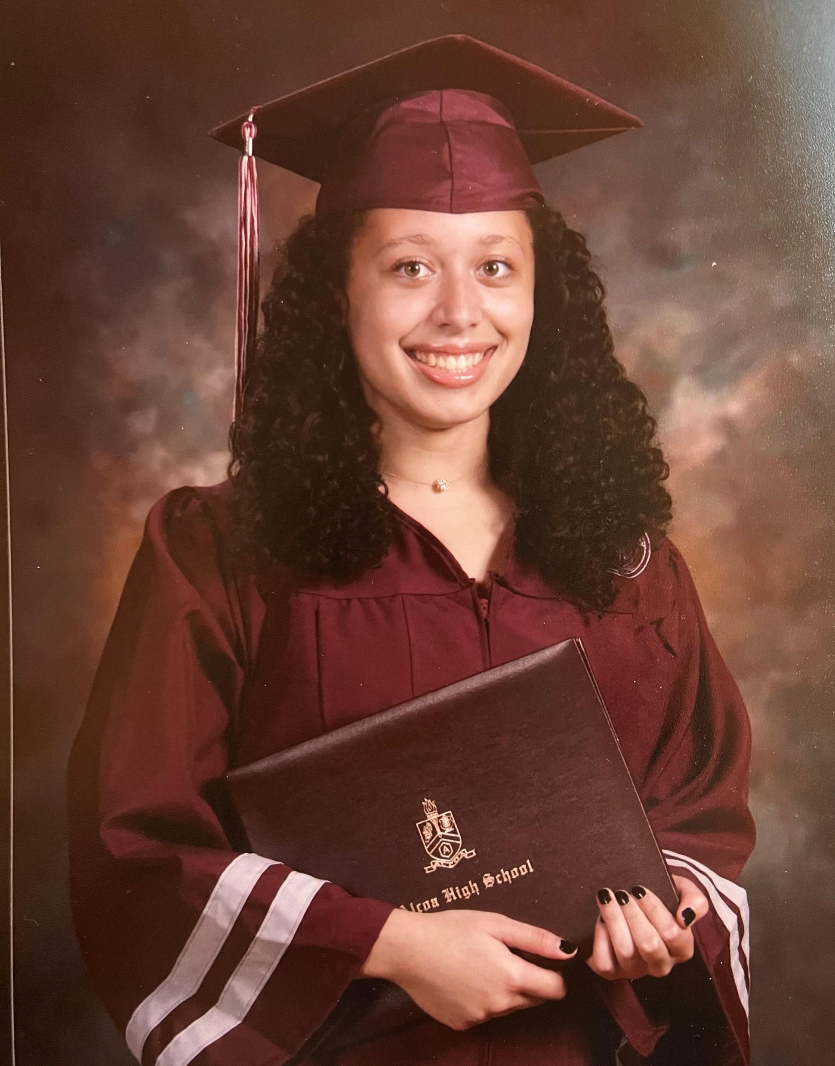
Peyton Potts
Peyton is the daughter of Laghana Walker and graduated from Alcoa High School. Peyton will be attending Berea College and majoring in Elementary Education.

Slide 12
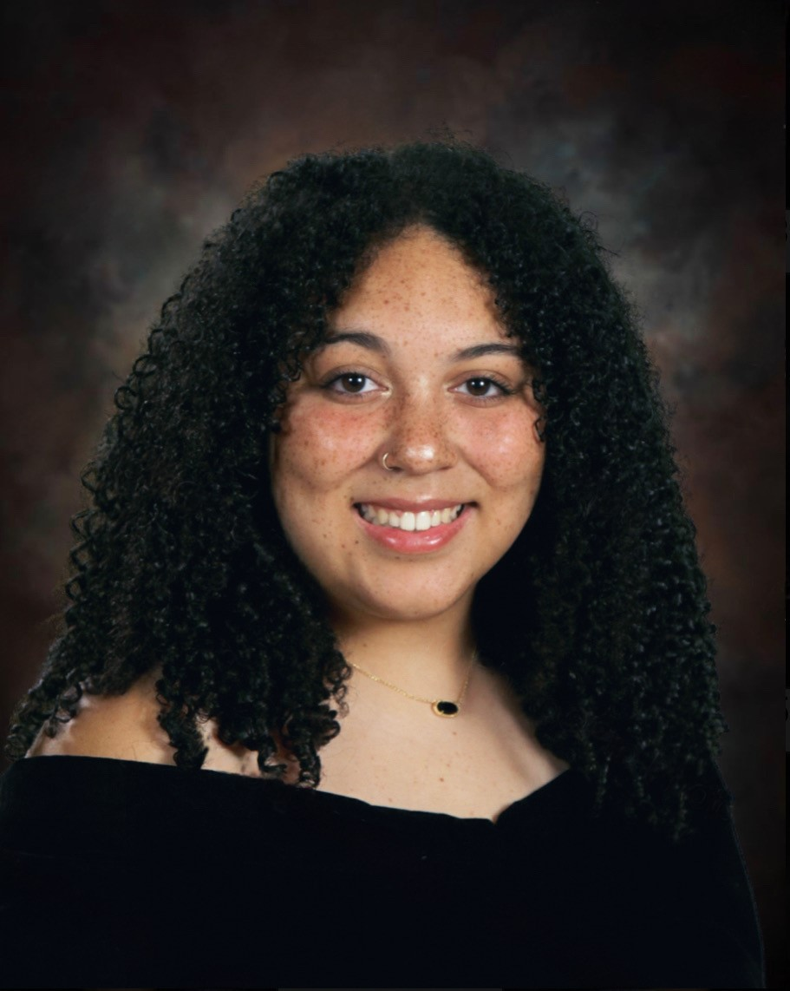
Jaedyn Sudderth
Jaedyn is the daughter of Dara and Chad Smith and graduated from Alcoa High School. Jaedyn will be attending Maryville College and majoring in English for Teacher Licensure.

Slide 13
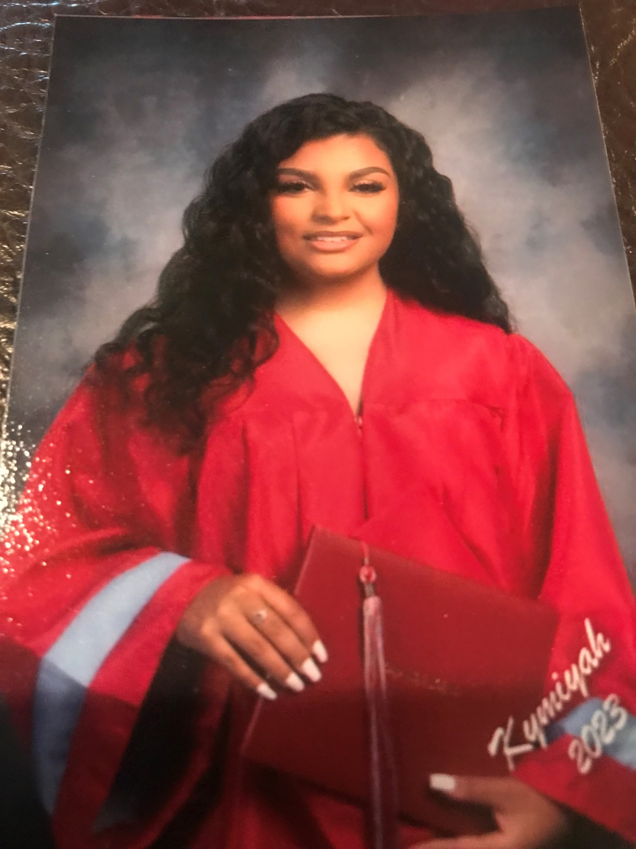
Kymiyah Turney
Kymiyah is the daughter of Richard Turney and Jessica Johnson and graduated from Heritage High School. Kymiyah will be attending Tennessee School of Beauty majoring in Cosmetology.
Notes:
Not scheduled to attend

Slide 14
Updates!!!!
Morgan Raiford is the current recipient of the four-year Peggy Miller Hill Scholarship. Morgan just finished her freshman year at East Tennessee State University.
Morgan will begin her sophomore year in the fall and major in Criminology.
(Peggy Miller Hill Scholarship Recipient)

Slide 15
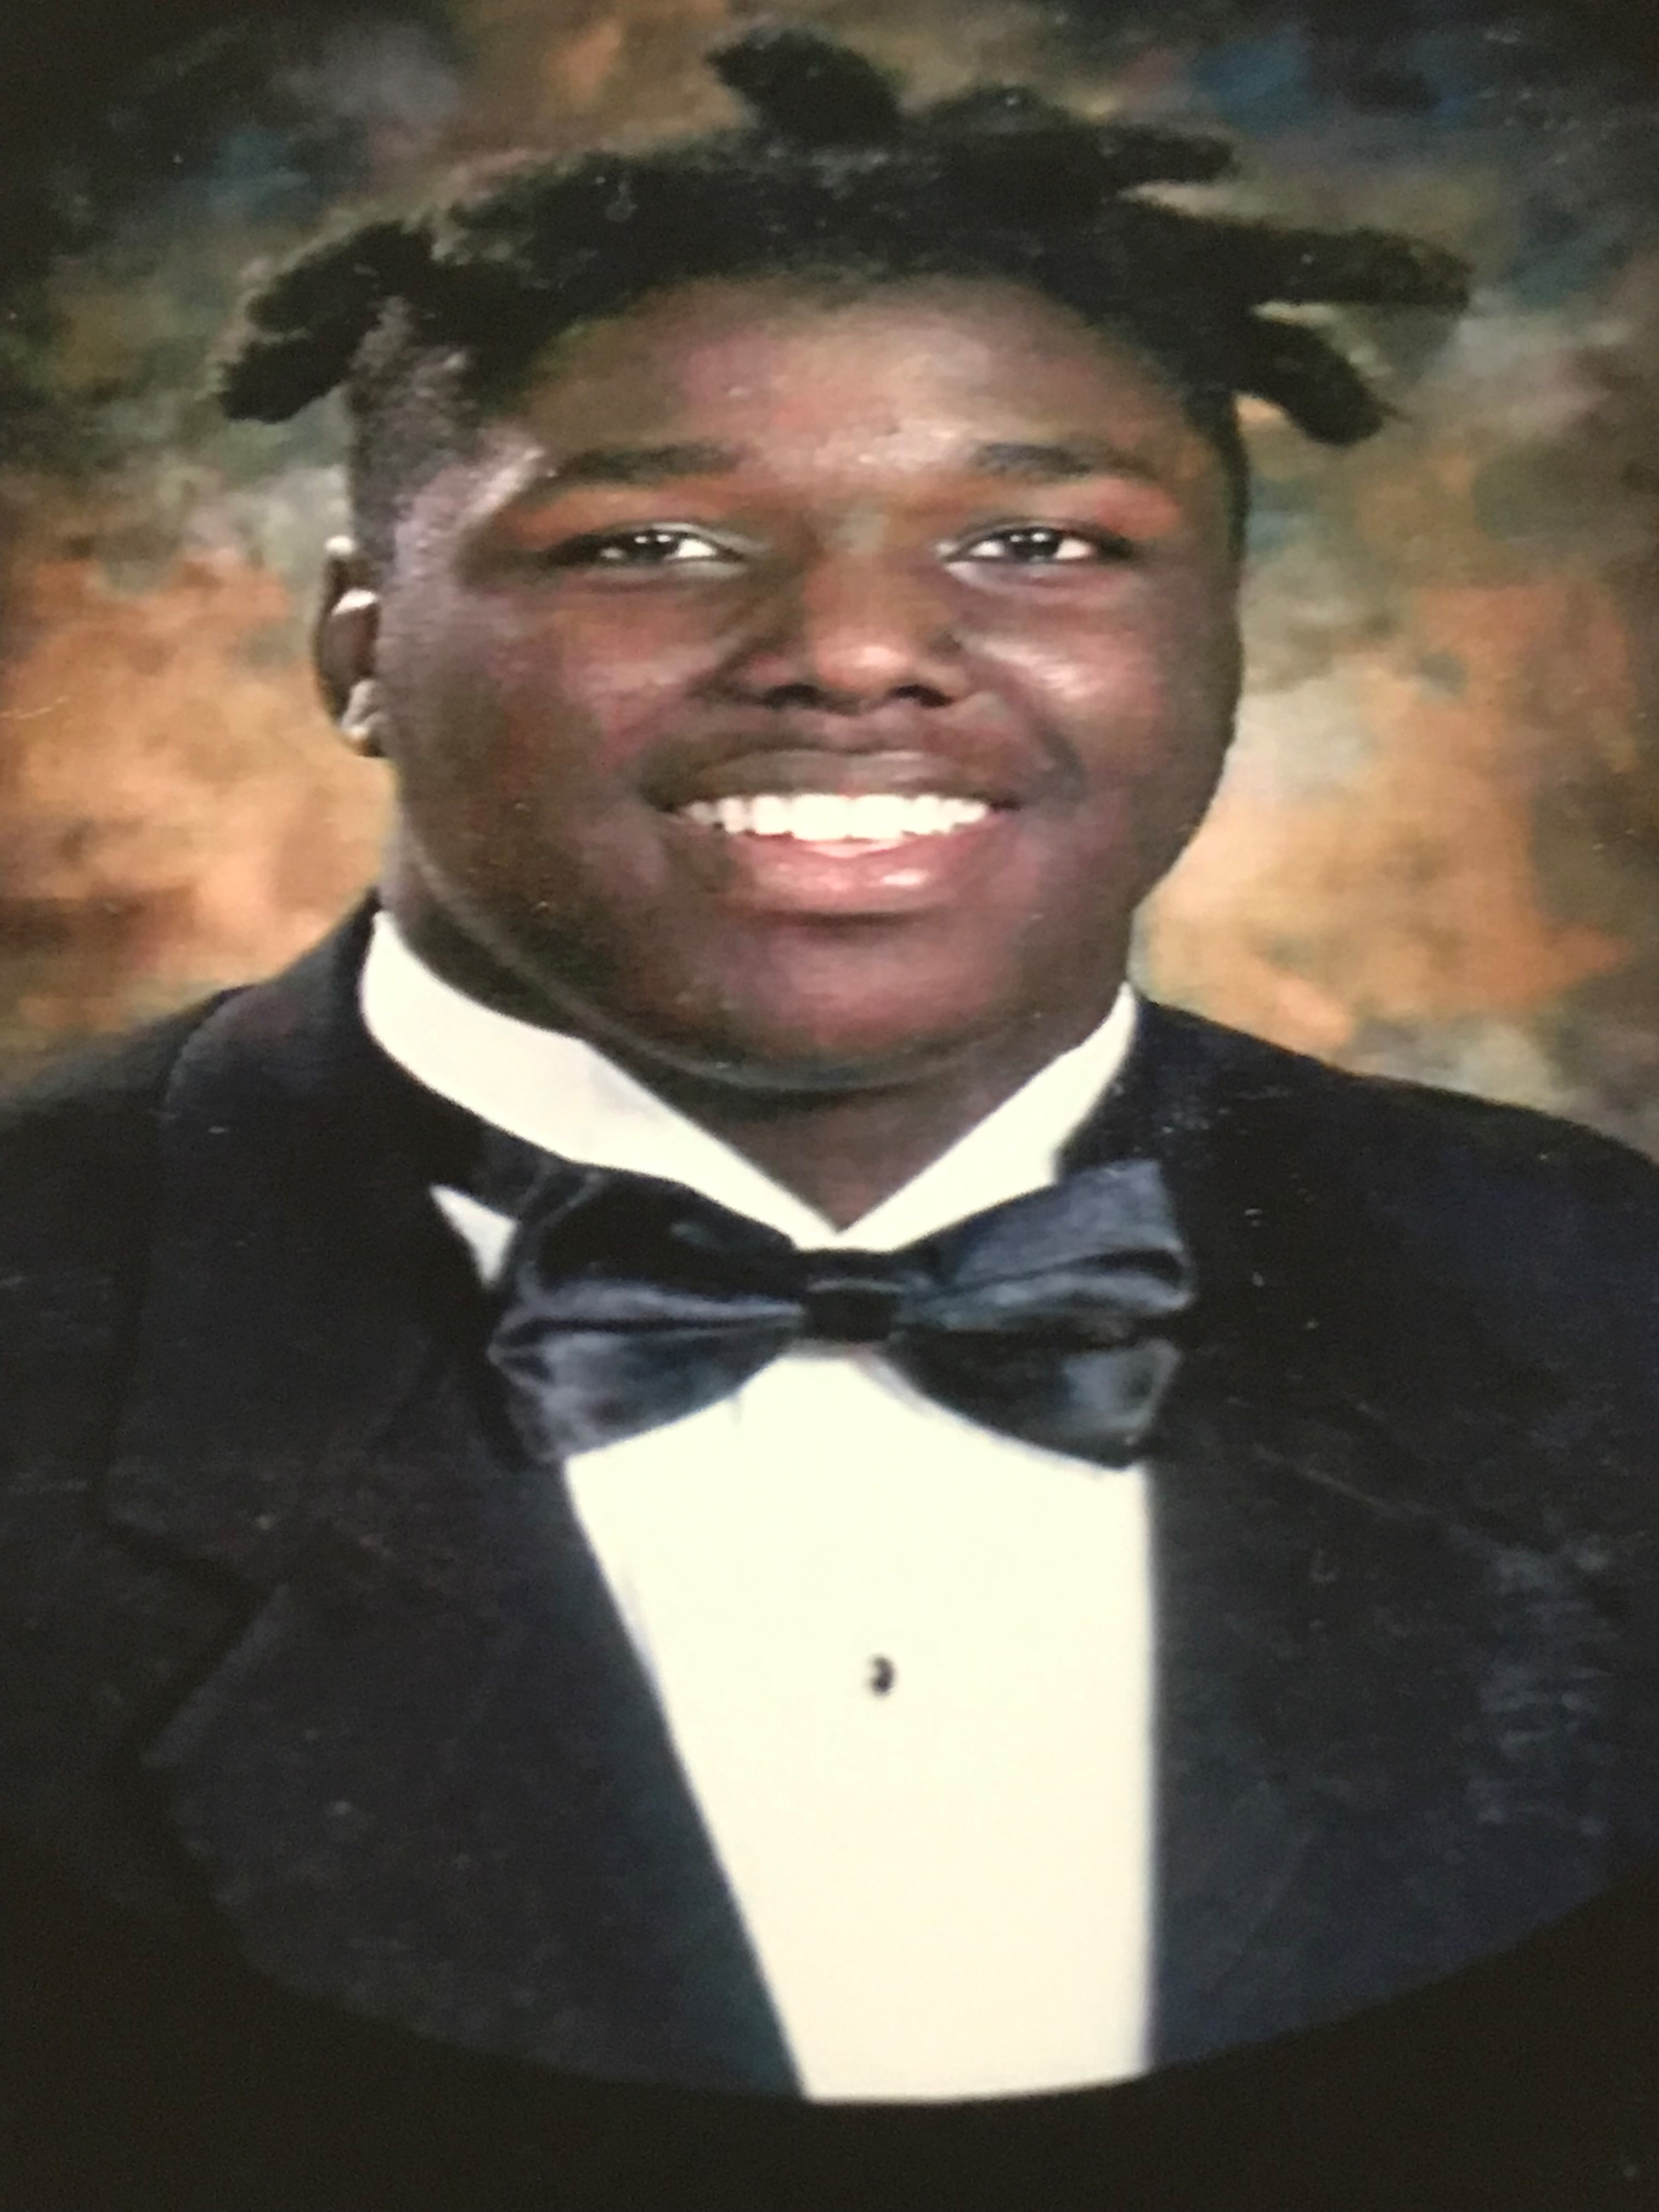
Samir Shereef
Samir is the son of Janine Shereef and graduated from Alcoa High School. Samir will be attending Austin Peay State University and majoring in Business Administration.
(Class of 1970 Scholarship Recipient)

Slide 16
This is the second year of eligibility for students that received the initial Altar’d State Scholarship Awards. Congratulations to these students on completing their freshman year!!
Attending East Tennessee State University
Asha Cole (Contemporary Music Performance & Production)
Grace Neve (Pre-Health)
Morgan Raiford (Criminology)
Gabrielle Walker (Architectural Interior Design)
Attending North Carolina A&T
Dereke Foster, Jr. (Electrical Engineering)
Notes:
Those in attendance can pickup their checks.

Slide 17
Congratulation!!!

