Slide 1
Exercise 2 – Revolved Features
Creates features that add or remove material by revolving one or more profiles around a centerline. The feature can be a solid, a thin feature, or a surface.
Sketching - Profile
Revolve – Axis of Revolution
Rounds – Radius

Slide 2
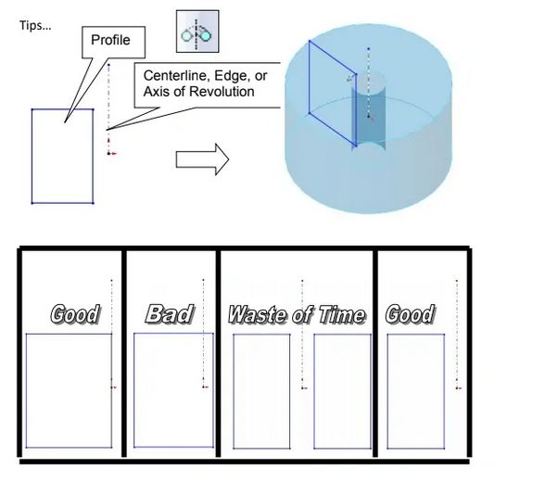
The profile should never cross over the centerline, nor should there be profiles on both sides of the centerline

Slide 3
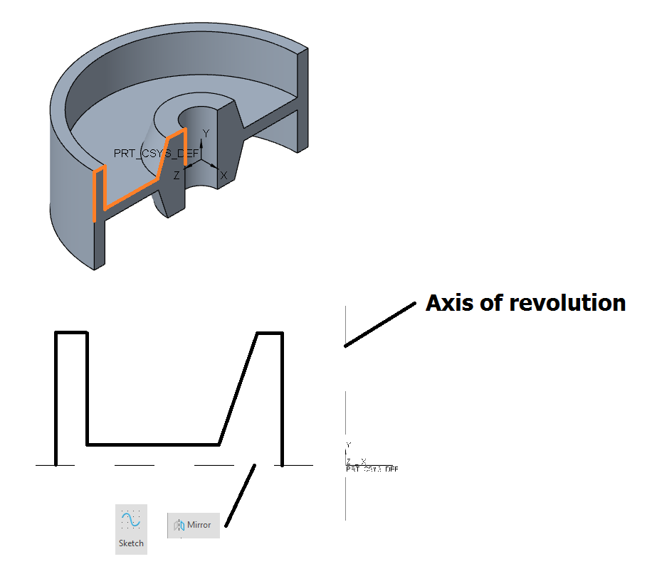

Slide 4
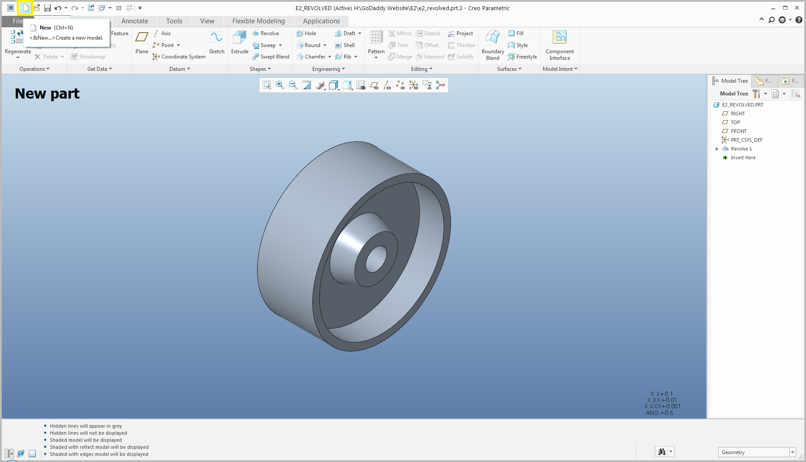

Slide 5
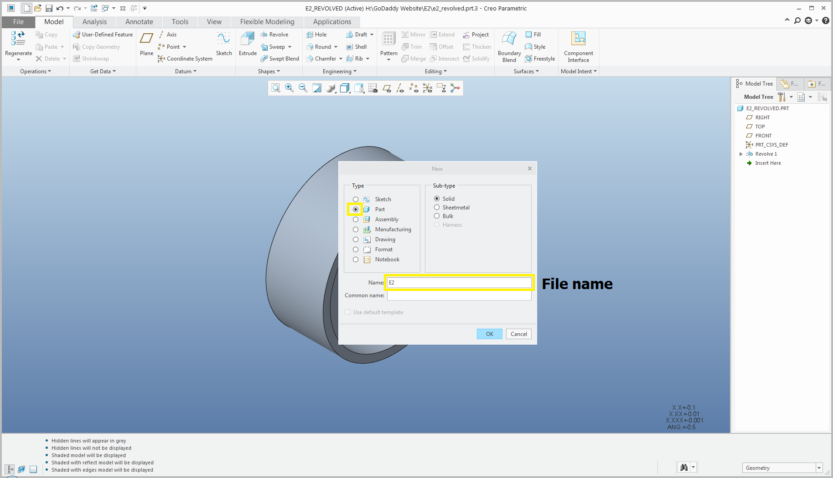

Slide 6
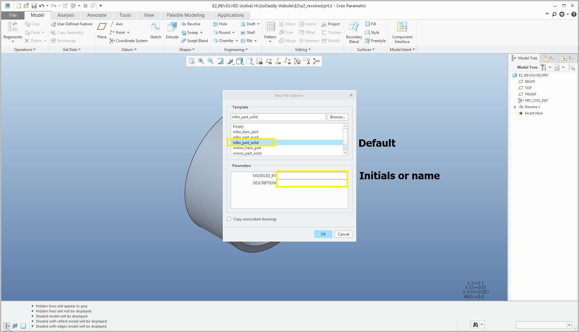
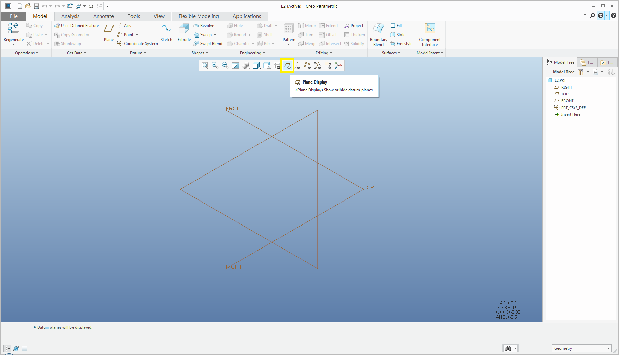

Slide 9
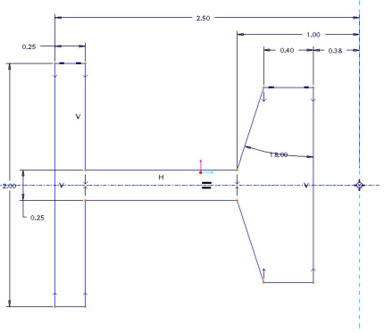

Slide 10
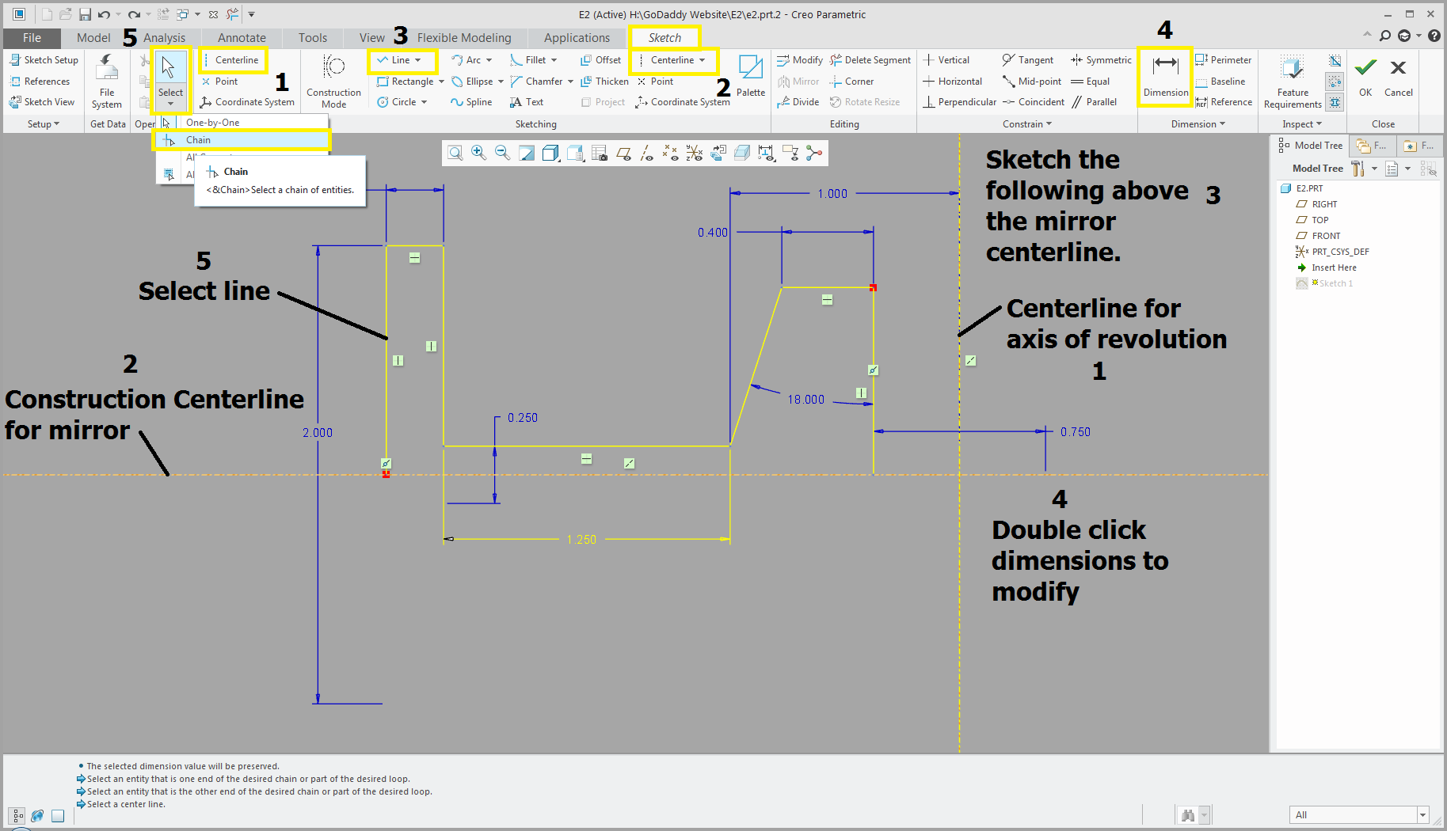

Slide 11
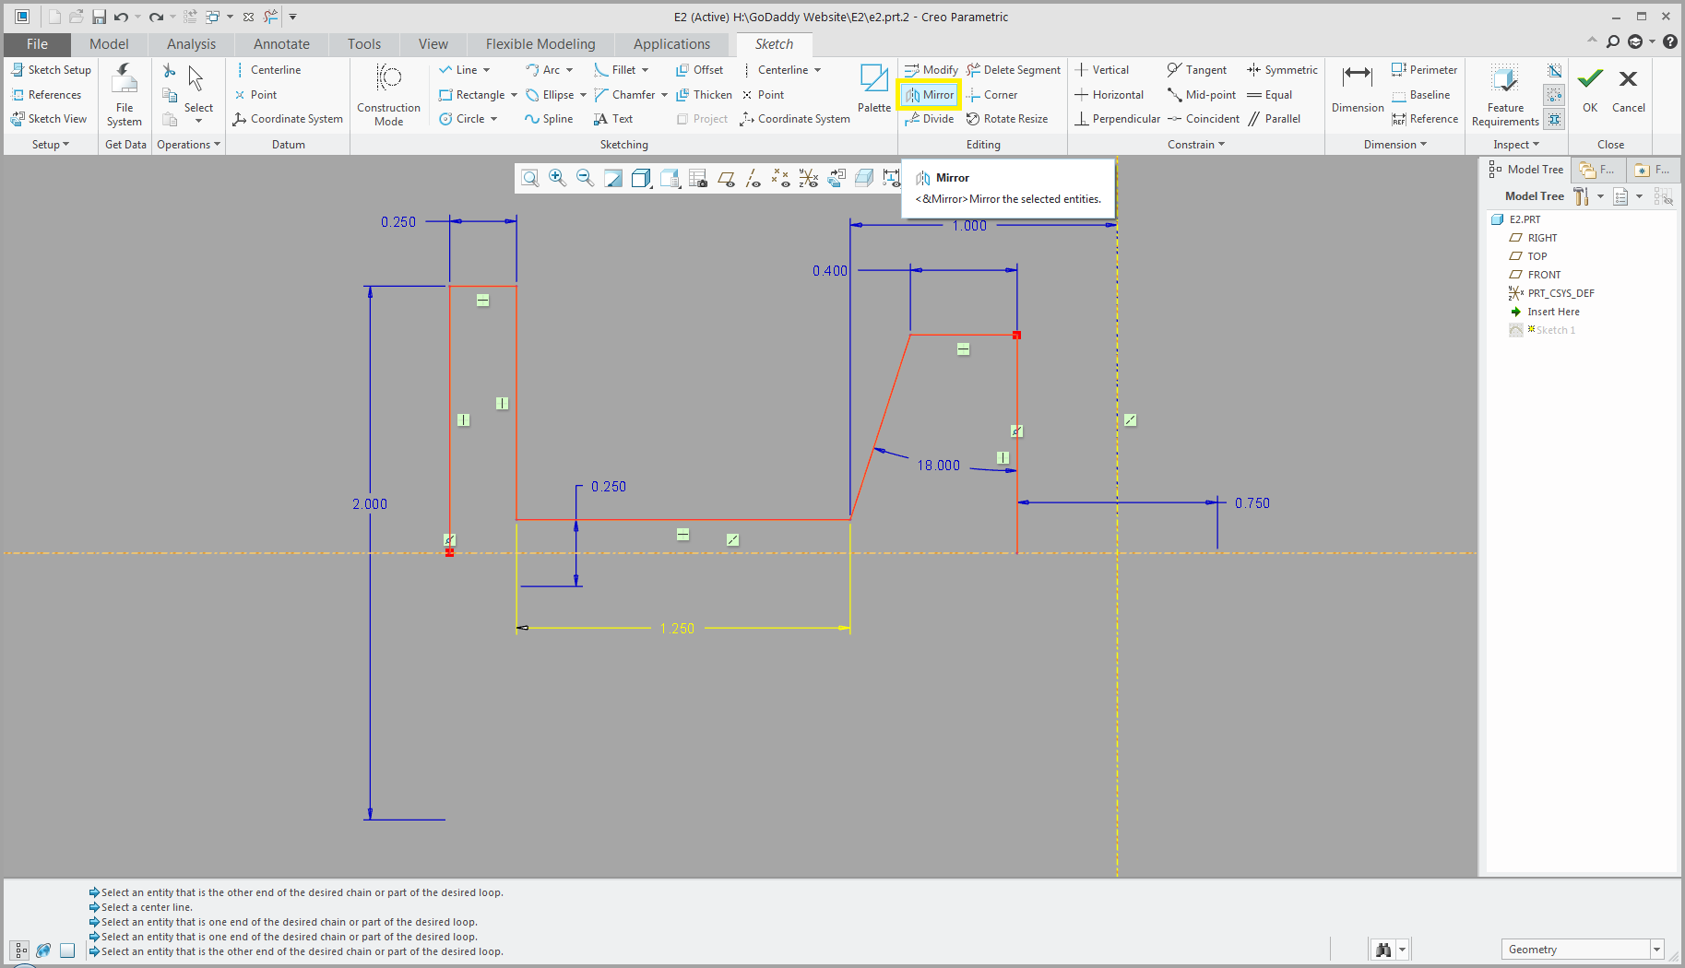
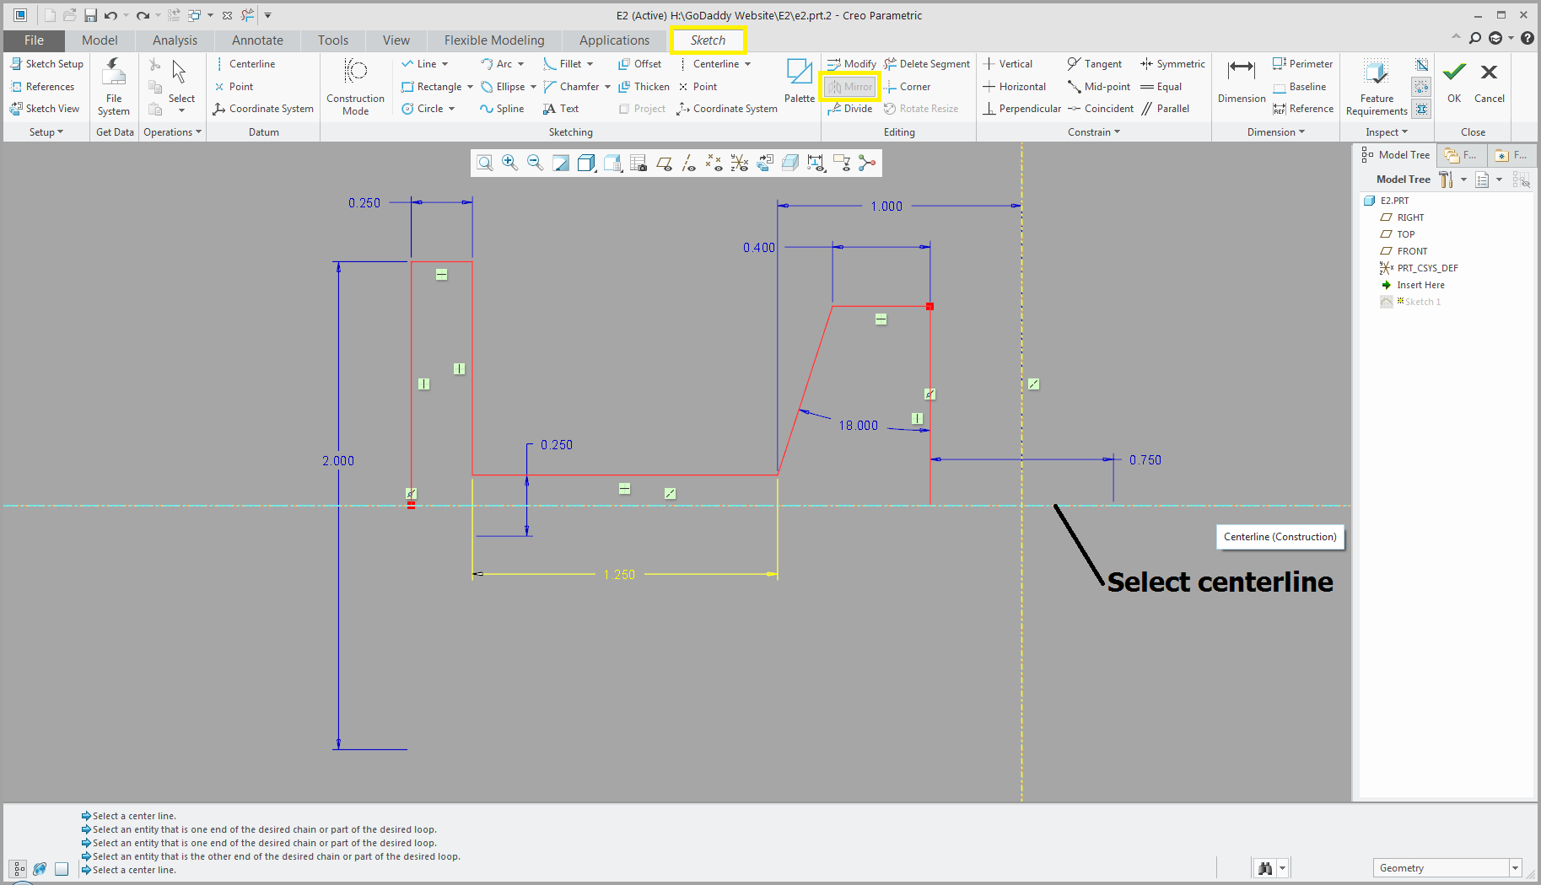

Slide 13
Middle Mouse Scroll Wheel Back To Zoom In
Movie Clip

Slide 14
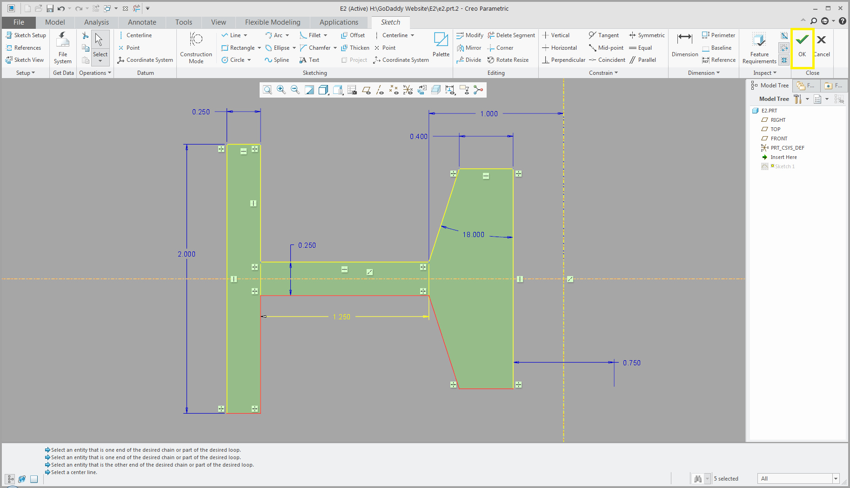

Slide 17
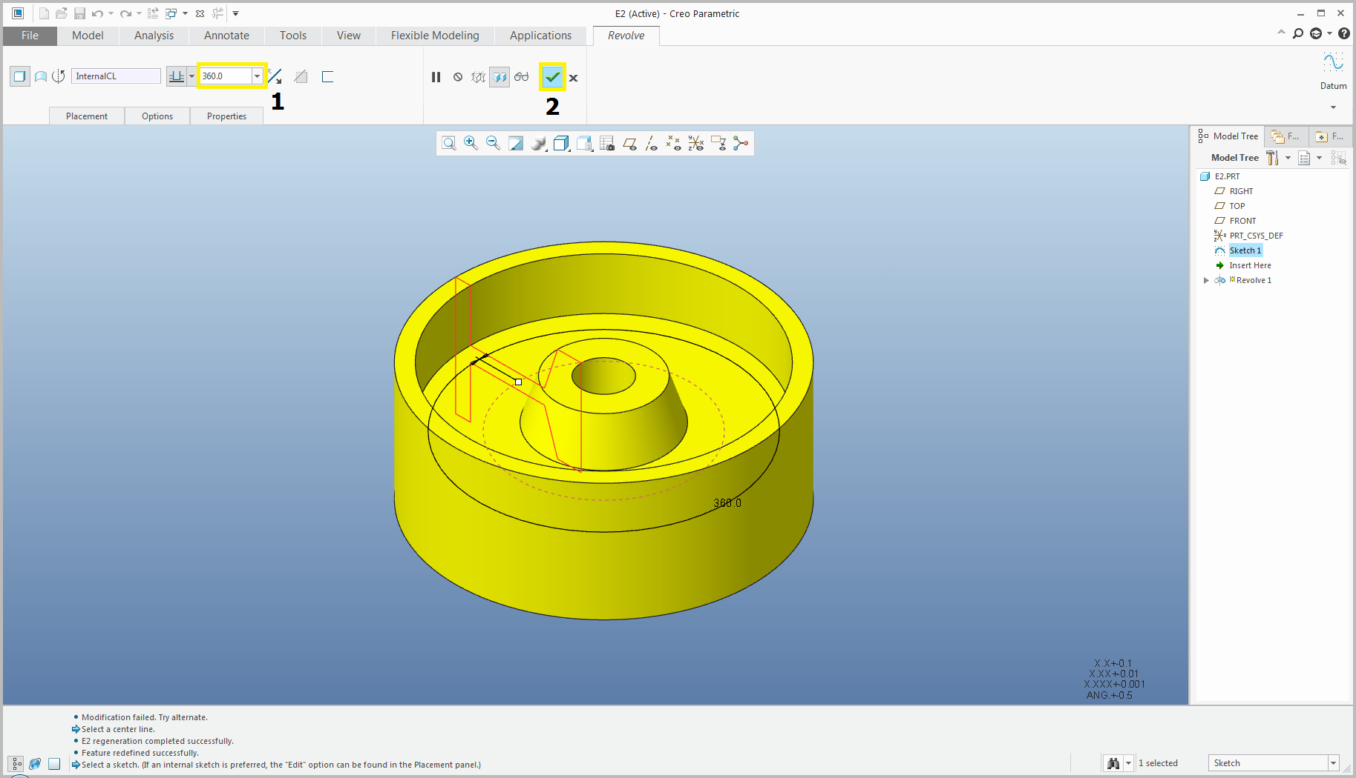

Slide 18
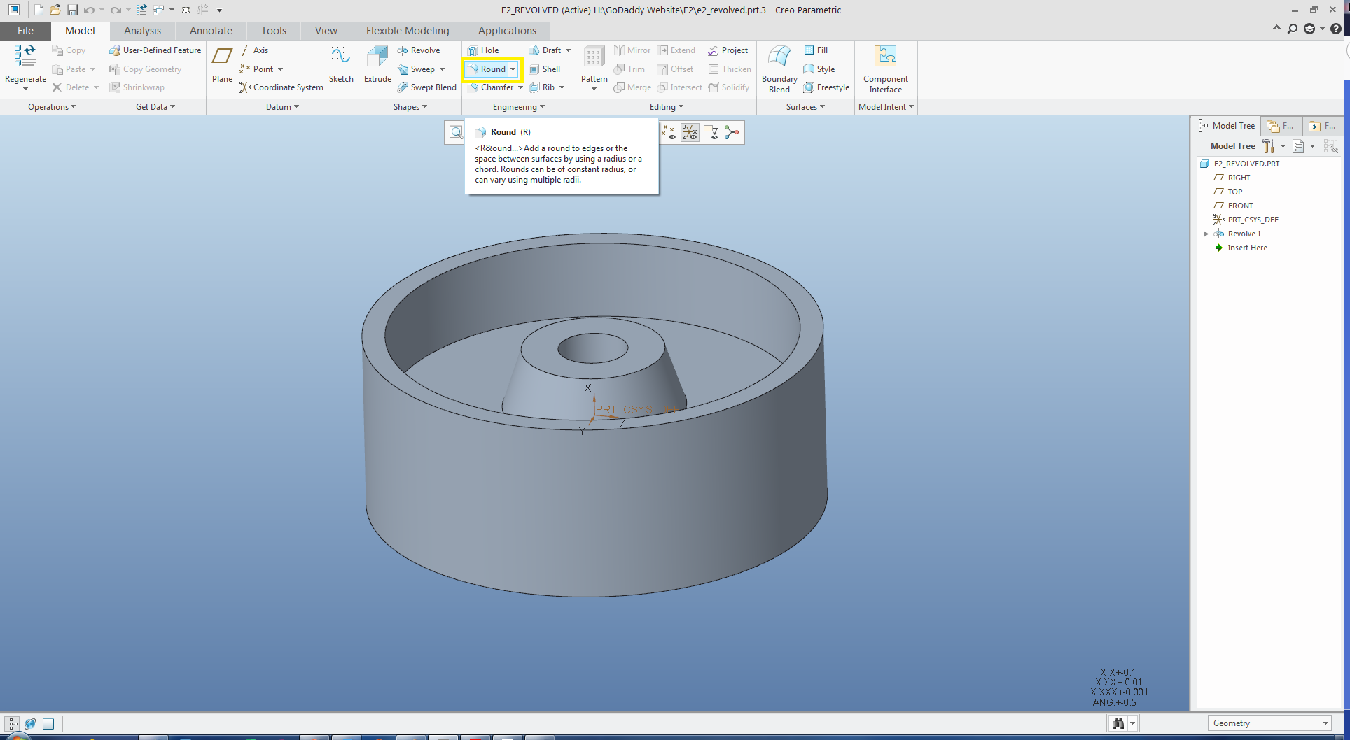

Slide 20
