Slide 1

Introduction to the CREO 4.0 Interface
Modeling Environment – Viewport, Menus and Model Tree
CREO Options – The Heart of CREO
Model Properties – Changing Material Properties
Sketching – Constraints and Dimensions
Base Feature Geometry Creation

Slide 2
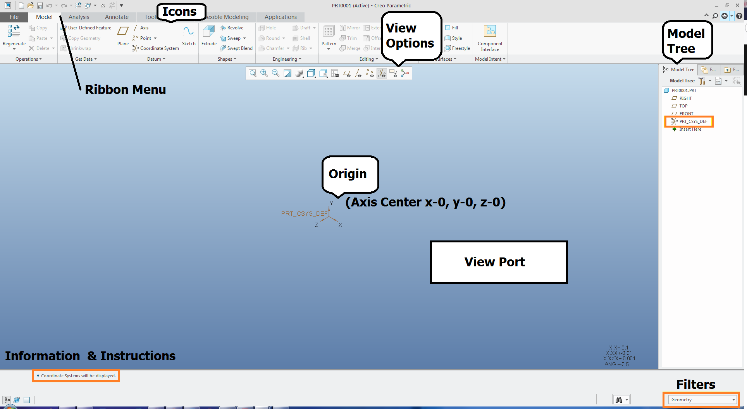

Slide 3
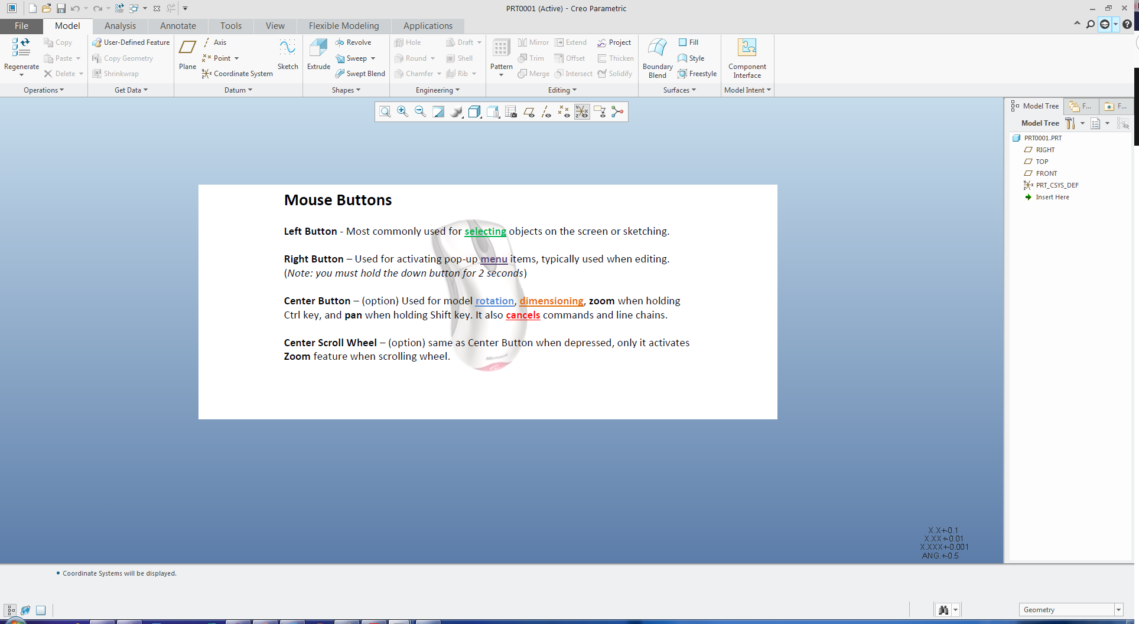

Slide 4
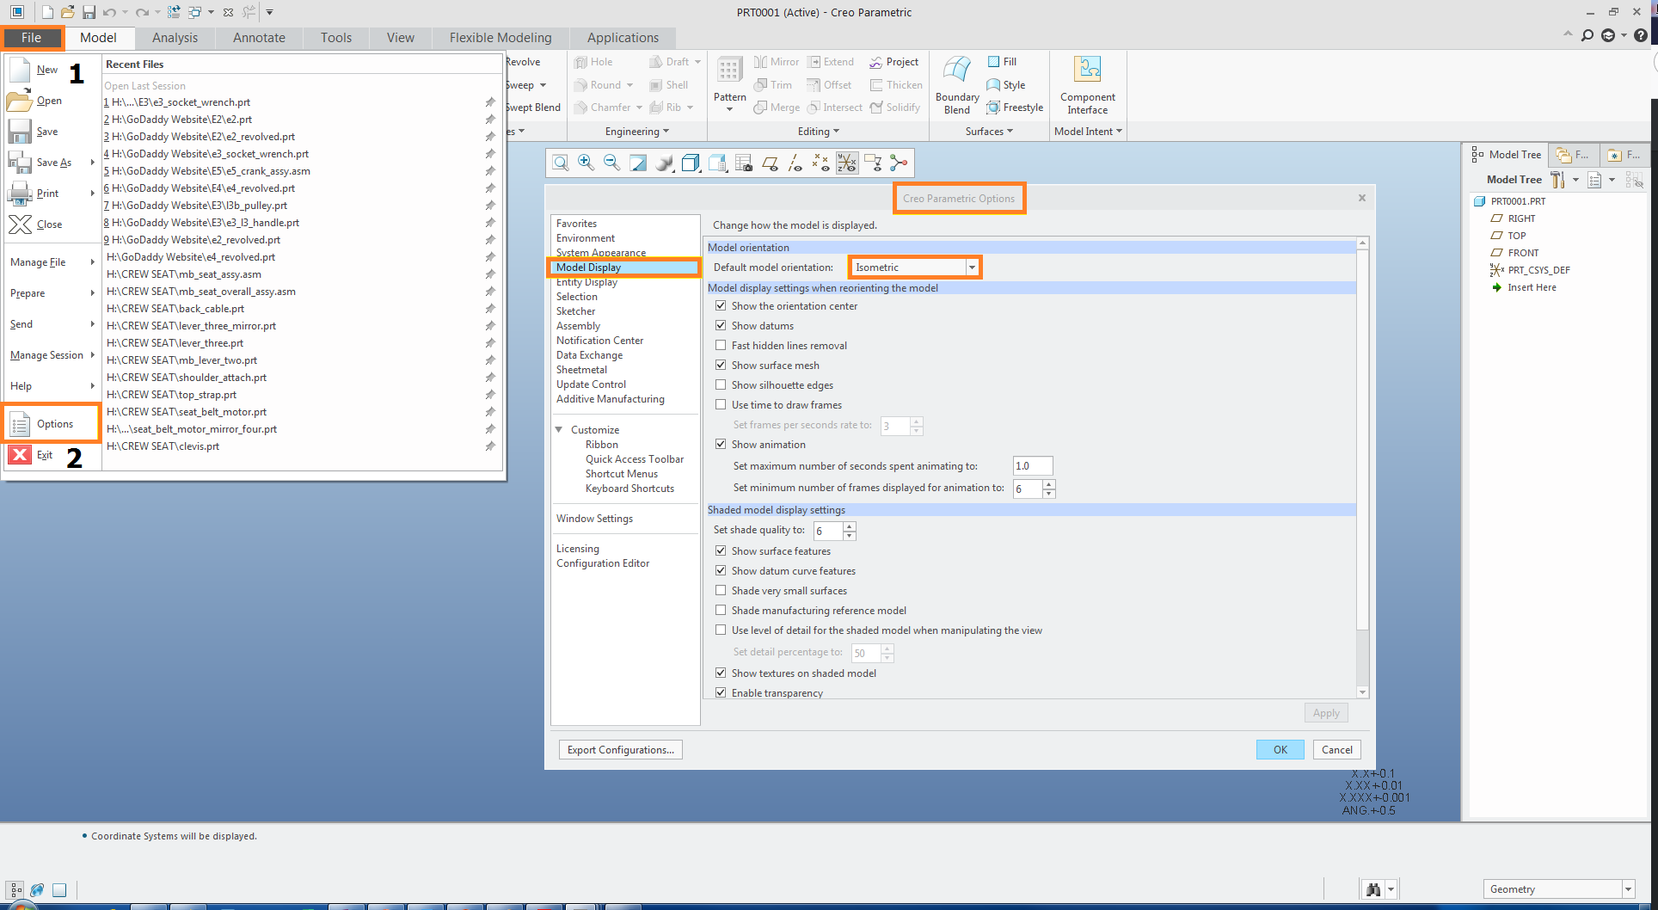
Options & Properties menus
the heart of CREO

Slide 5
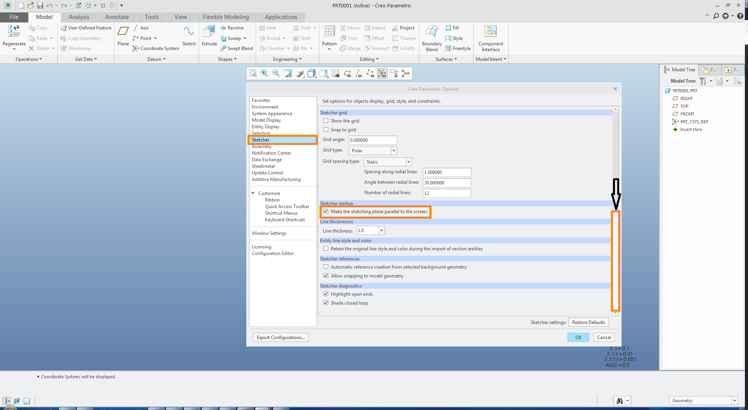

Slide 6
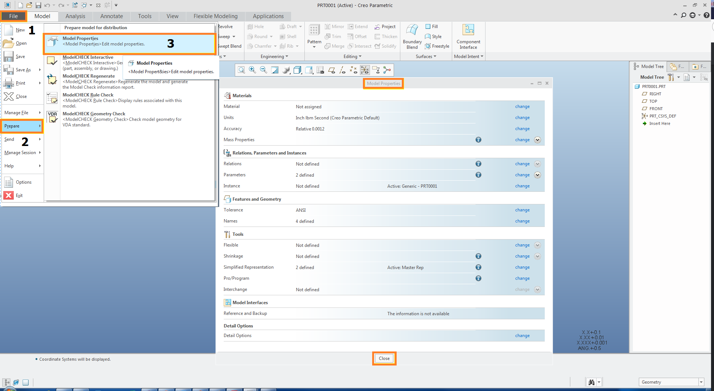
Model Properties

Slide 7
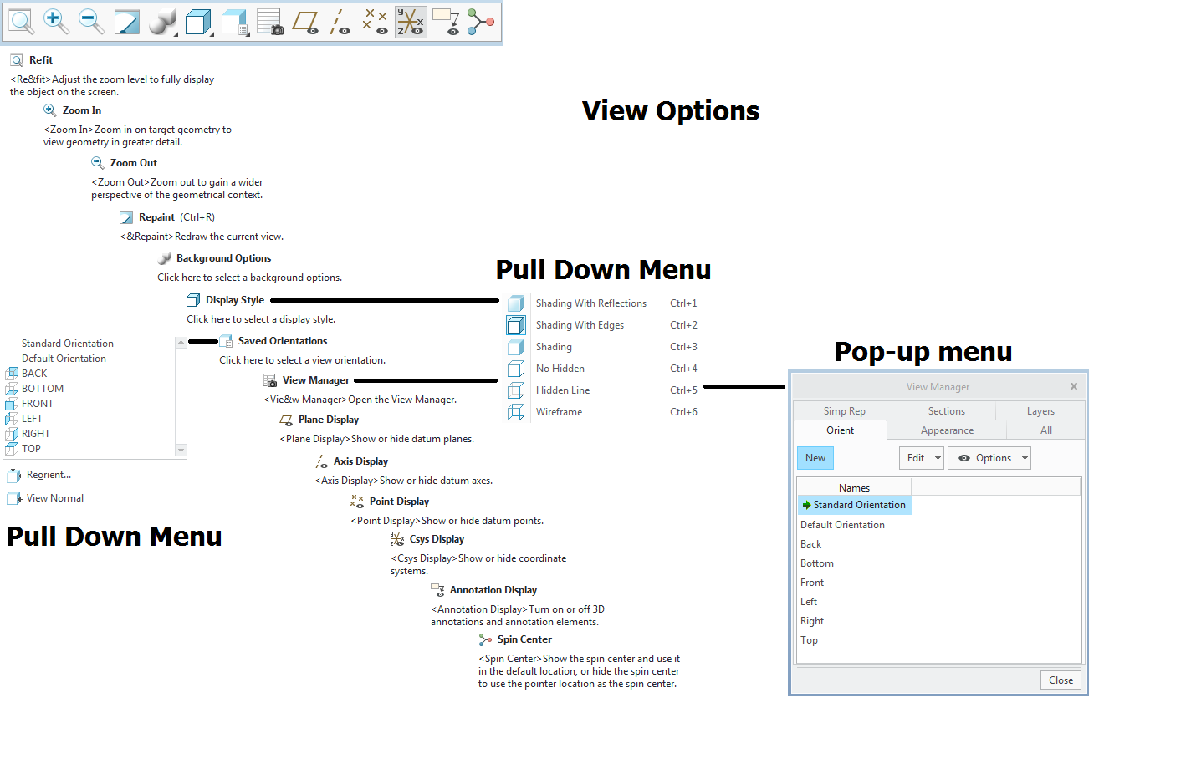

Slide 8
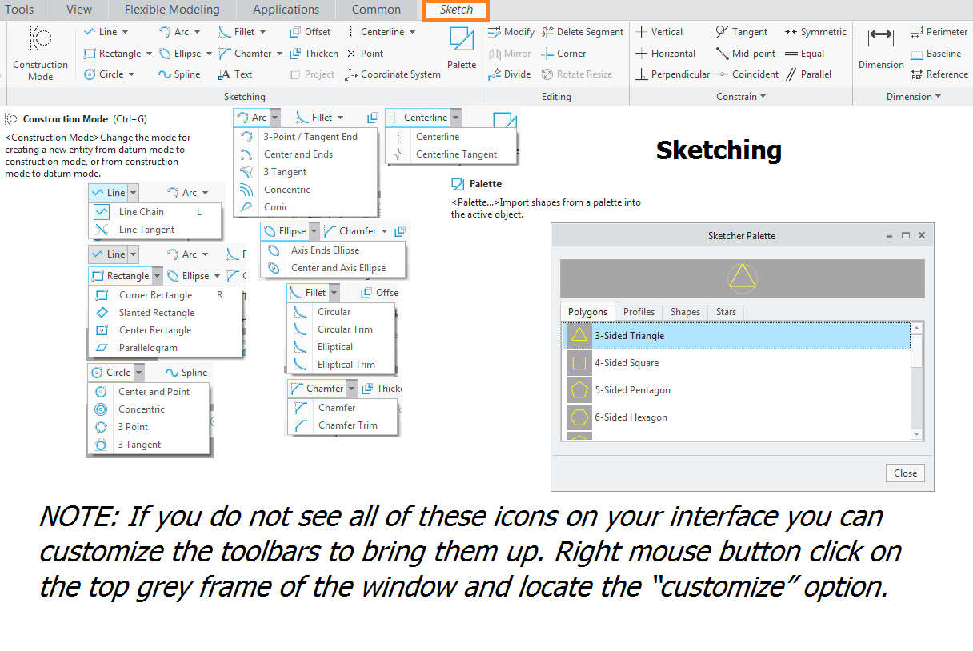

Slide 9
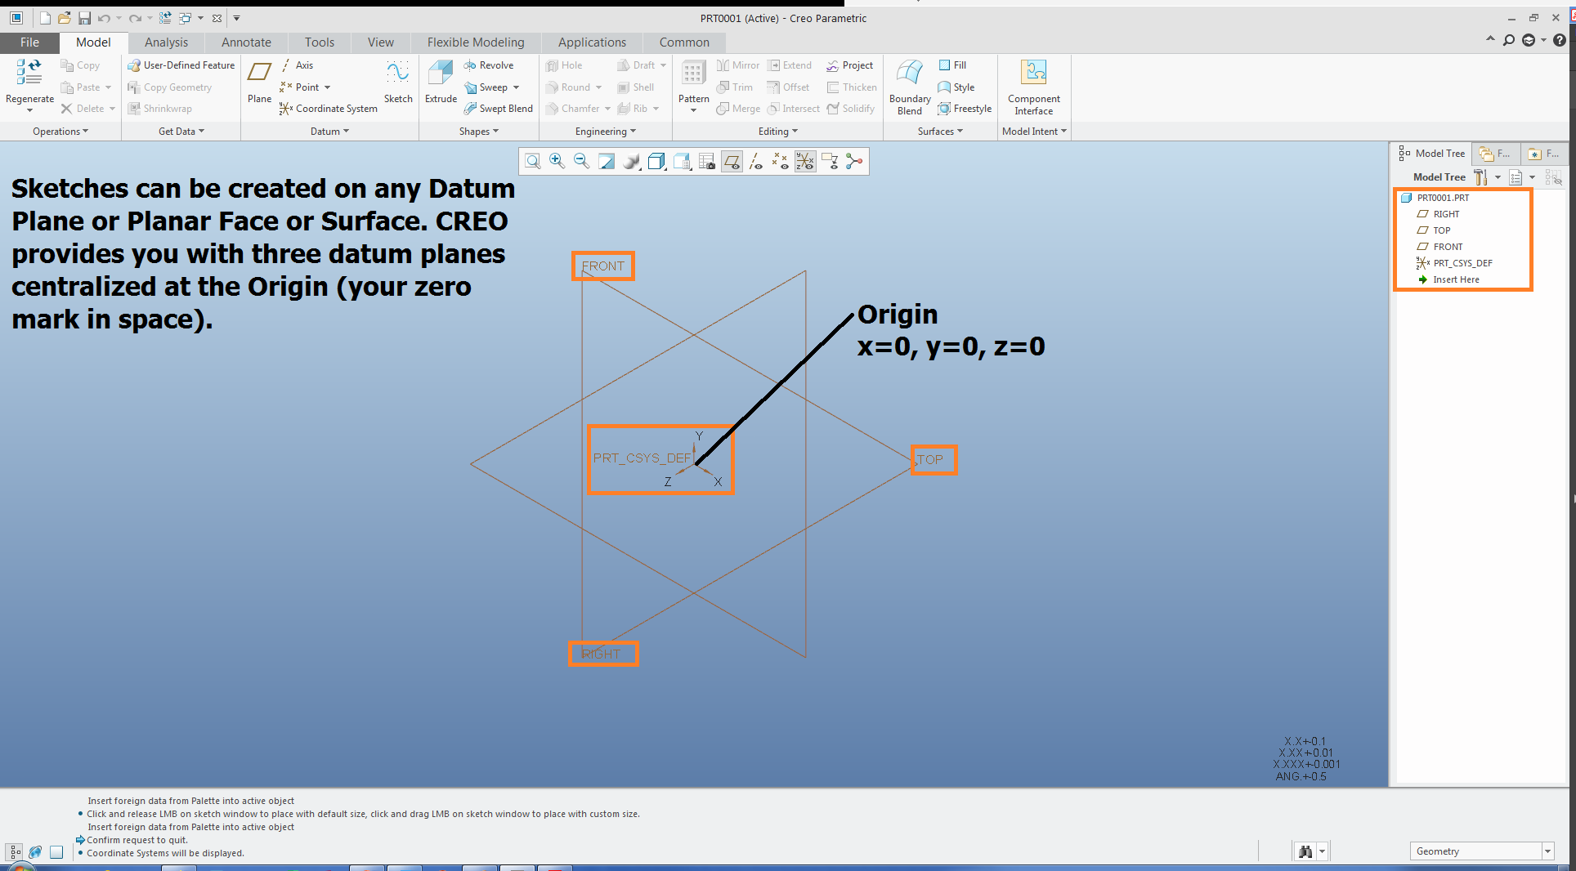

Slide 10
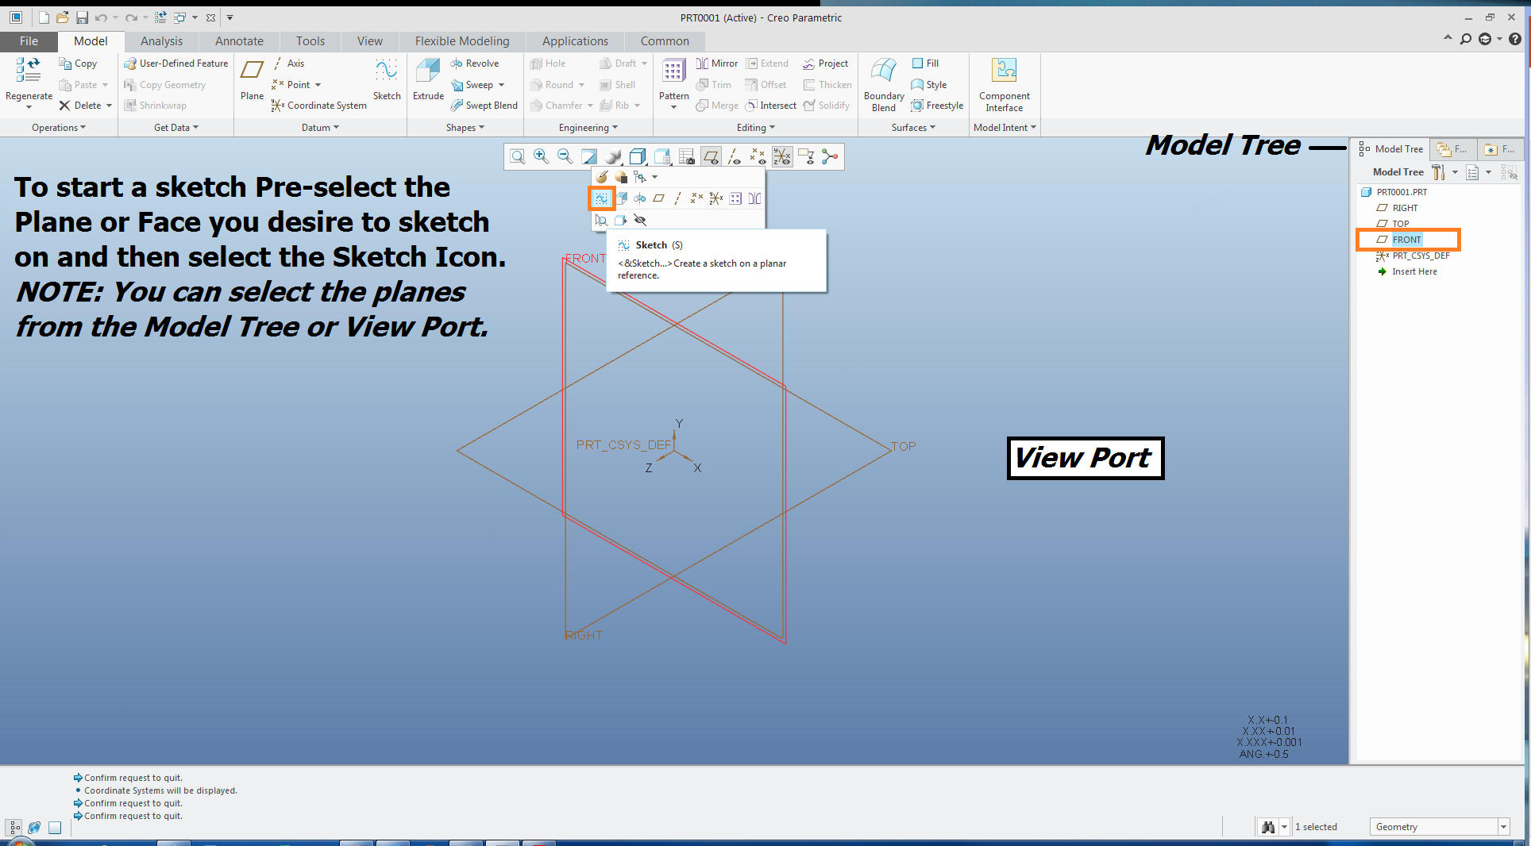

Slide 11
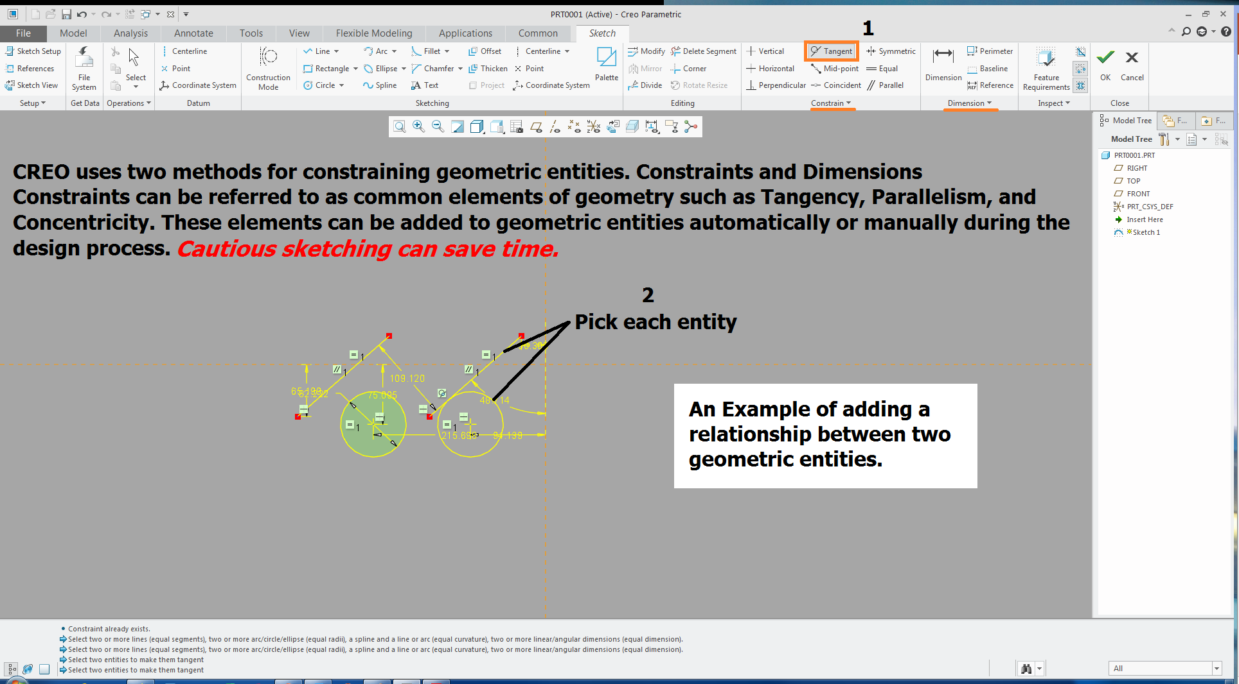

Slide 12
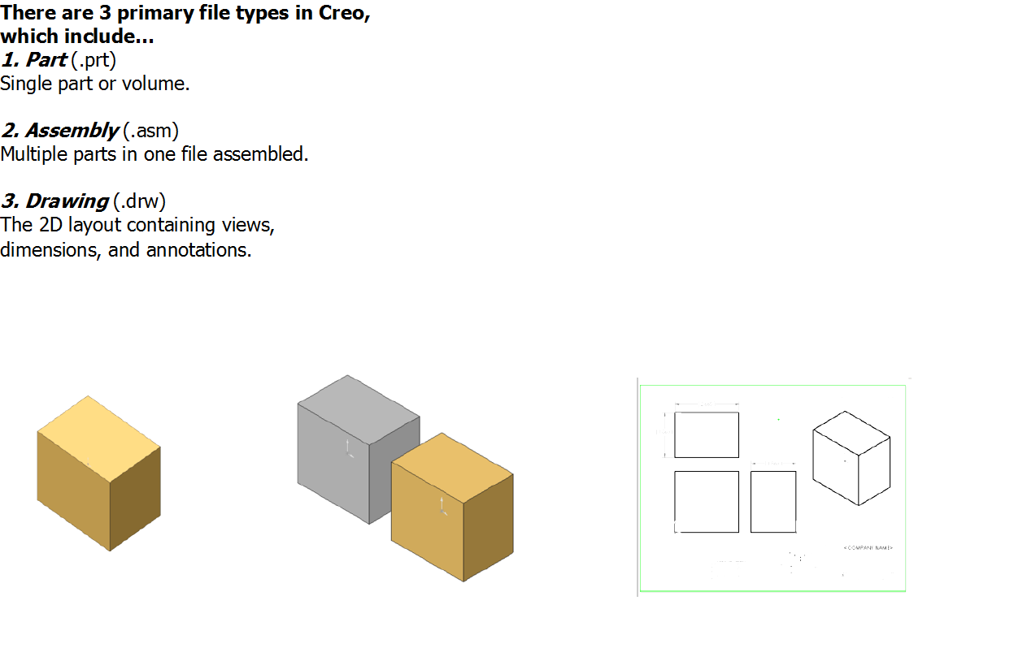

Slide 13
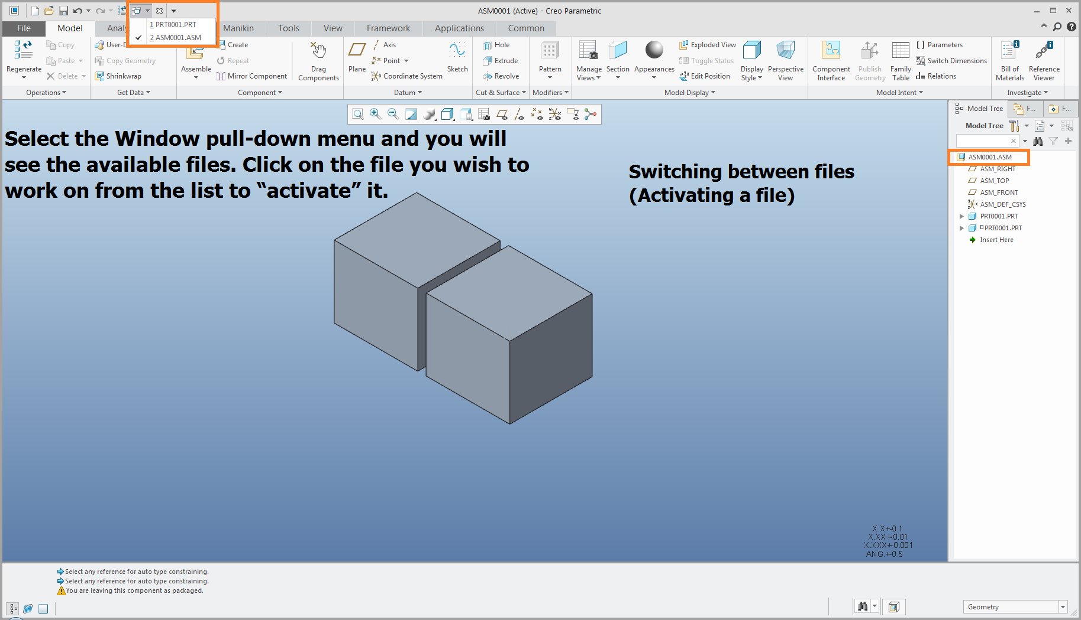

Slide 14
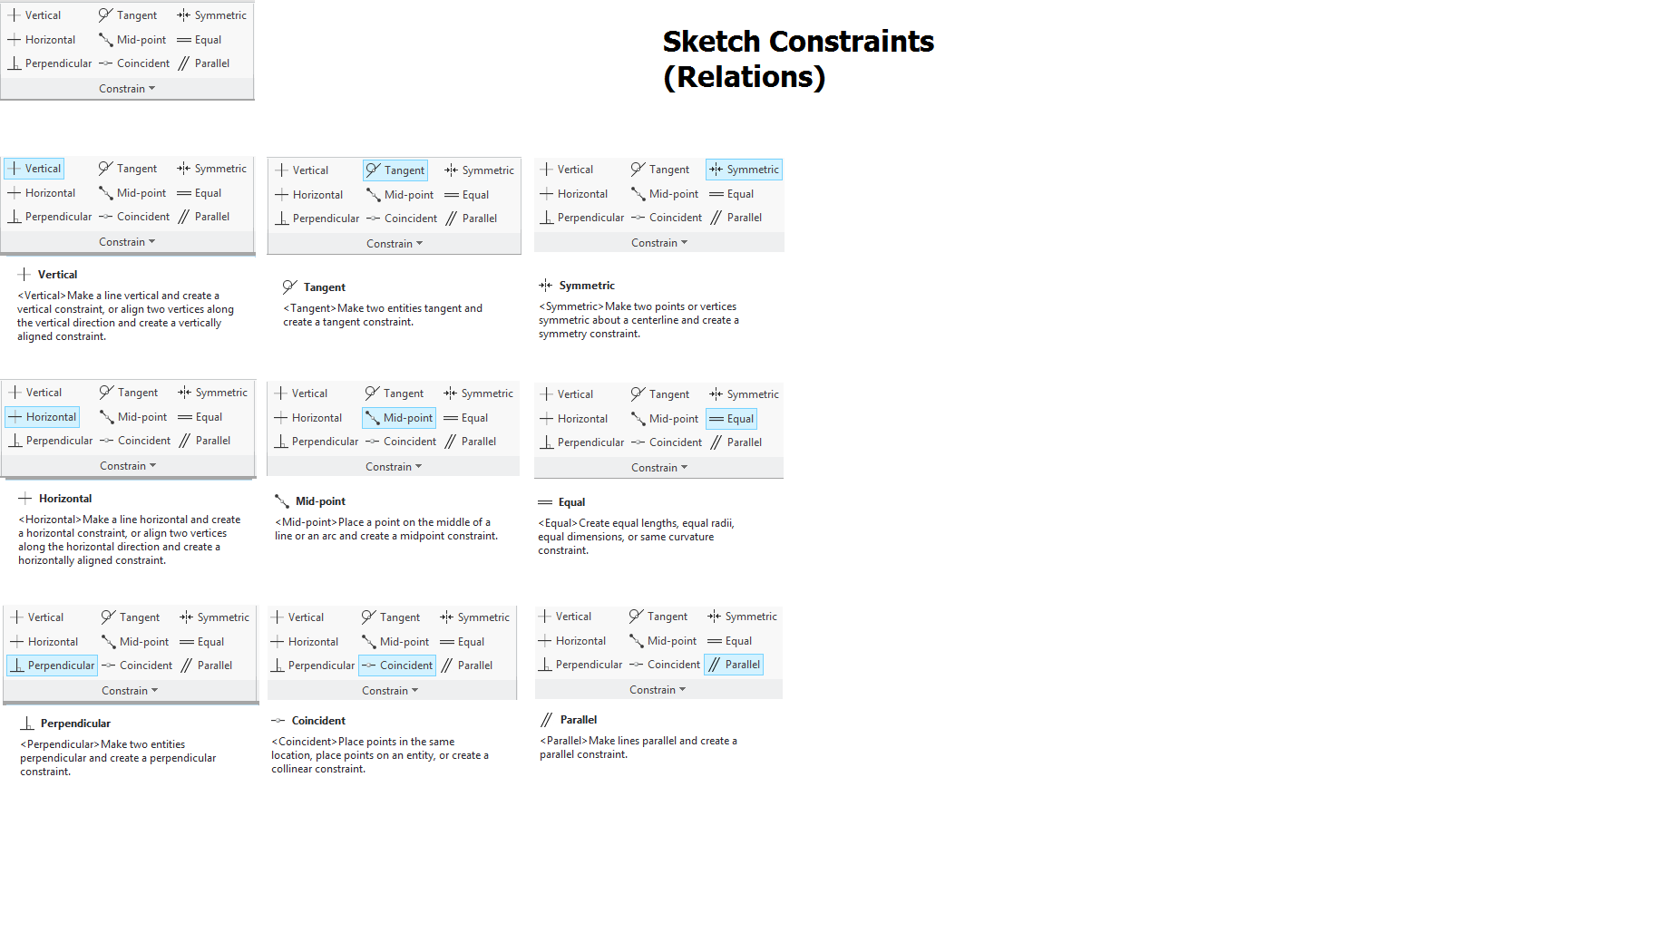

Slide 15
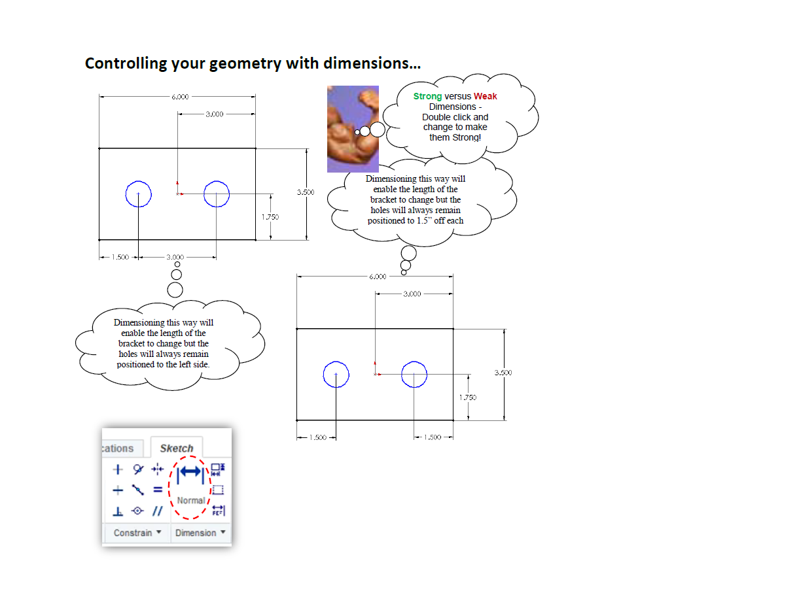

Slide 16
