Slide 1




Mindset of Heaven
By Nicole Curry

Slide 2
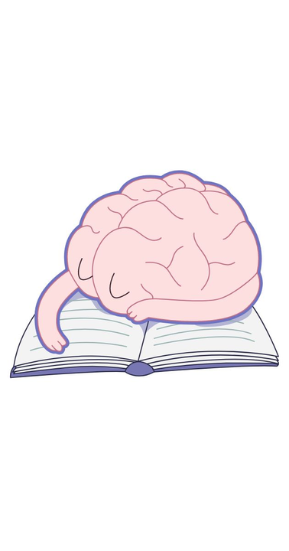

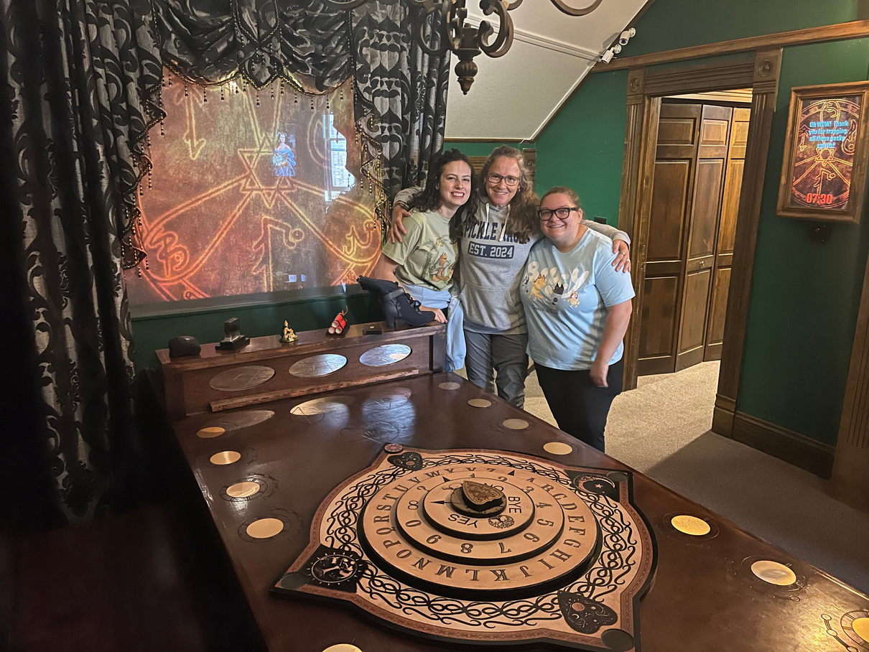
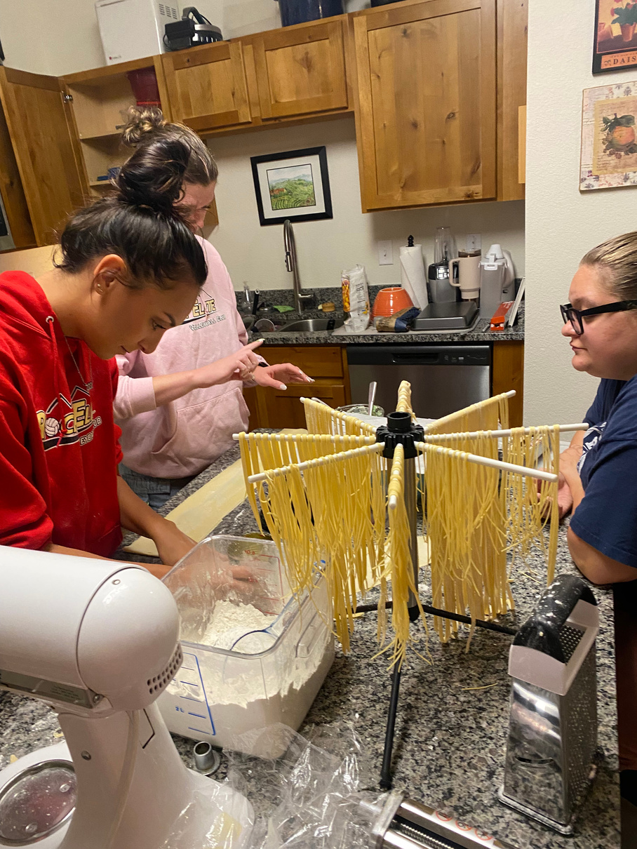


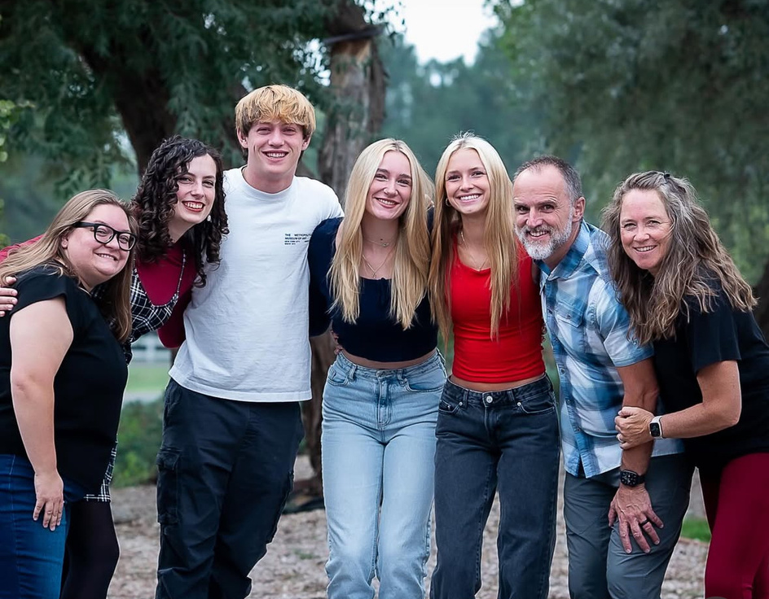
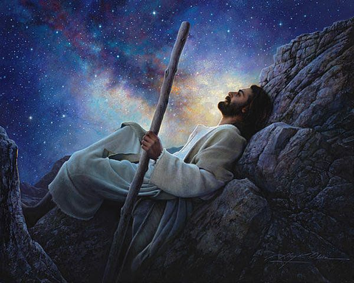
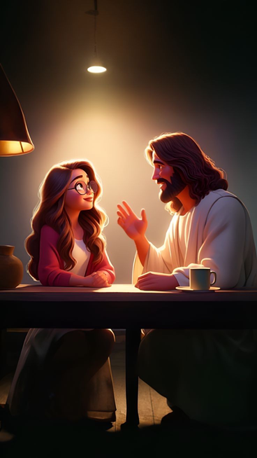


Slide 3
Video

Slide 4
Who is your Jesus? How do you build YOUR Faith in Jesus Christ?

Slide 5

D&C 121:45
“Let thy bowels also be full of charity towards all men, and to the household of faith, and let virtue garnish thy thoughts unceasingly; then shall thy confidence wax strong in the presence of God; and the doctrine of the priesthood shall distil upon thy soul as the dews from heaven.”
How do you gain such confidence in your God?

Slide 6
why are we here on the Earth?

Slide 7
why are we here on the Earth?
Heirs of eternal life, to literally become as our Heavenly Father and Heavenly Mother because we are literally made after Their Image.

Slide 8
Have we ever really considered why having a physical body is so important?
Why is a body so central to the Father’s Plan of Happiness?

Slide 9
D&C 121:45
President Nelson has asked that we take intentinal steps in gowning in our confidence before the Lord.
“Let thy bowels also be full of charity towards all men, and to the household of faith, and let virtue garnish thy thoughts unceasingly; then shall thy confidence wax strong in the presence of God; and the doctrine of the priesthood shall distil upon thy soul as the dews from heaven.”

Slide 10
Our Thoughts Create our Vision!
“The Vision that you glorify in your mind, the Ideal that you enthrone in your heart – this you will build your life by, this you will become.” As A Man Thinketh
“The weakest Soul, knowing its own weakness and believing this truth – that strength can only be developed by effort and practice, will, thus believing, at once begin to exert itself and adding effort to effort patience to patience, and strength to strength, will never cease to develop, and will at last grow divinely strong.” As A Man Thinketh

Slide 11
2 Nephi 2: 26 & 27
“26 And the Messiah cometh in the fullness of time, that he may redeem the children of men from the fall. And because that they are redeemed from the fall they have become free forever, knowing good from evil; to act for themselves and not to be acted upon, save it be by the punishment of the law at the great and last day, according to the commandments which God hath given.
27 Wherefore, men are free according to the flesh; and all things are given them which are expedient unto man. And they are free to choose liberty and eternal life, through the great Mediator of all men, or to choose captivity and death, according to the captivity and power of the devil; for he seeketh that all men might be miserable like unto himself.”

Slide 12
Will my body rule over my spirit, or will my spirit rule over my body?
Will I yield to the enticing's of the natural man or to the eternal man?

Slide 13
Creating Virtuous Thoughts

Slide 14
You don't know what you want to do with your life.
Your wasting your life away.
You are lost.
You are unworthy.
Nobody listens to you.
Your voice is not important.
Nobody understands what you are saying.
You are alone.
Nobody notices you.
doing.
You don’t know how to connect with people.
That’s to scary ...
I’m afraid...
You don’t have any friends.
You are not enough.
You are to loud.
You are annoying everyone around you.
You should stop talking.
You don’t know what you are doing.
Nobody is listening to you.
They all know you’ve got nothing important to say.
You don’t know what you are.

Slide 15
You don't know what you want to do with your life.
Your wasting your life away.
You are lost.
Nobody listens to you.
Your voice is not important.
Nobody understands what you are saying.
I am exploring what matters to me, one step at a time.
I’m using my time in ways that matter to me, even in small ways.
I may feel uncertain, and I’m finding my direction as I go.
My words matter.
What I say adds value.
If I’m not understood, I can try another way — and that’s okay.

Slide 16
Thank You

