Slide 1

B.E.T on strong kids! How to help build strong young bodies emotions and testimonies
Raising Physically, Emotionally, and Spiritually Strong Children. Luke 2:52
52 And Jesus increased in wisdom and stature, and in favor with God and man.
What is your favorite scripture about children?

Slide 2
Strong Videos
https://www.youtube.com/shorts/Q0WB7Z2EGqY

Slide 3

Elder Uchdorf

Slide 4
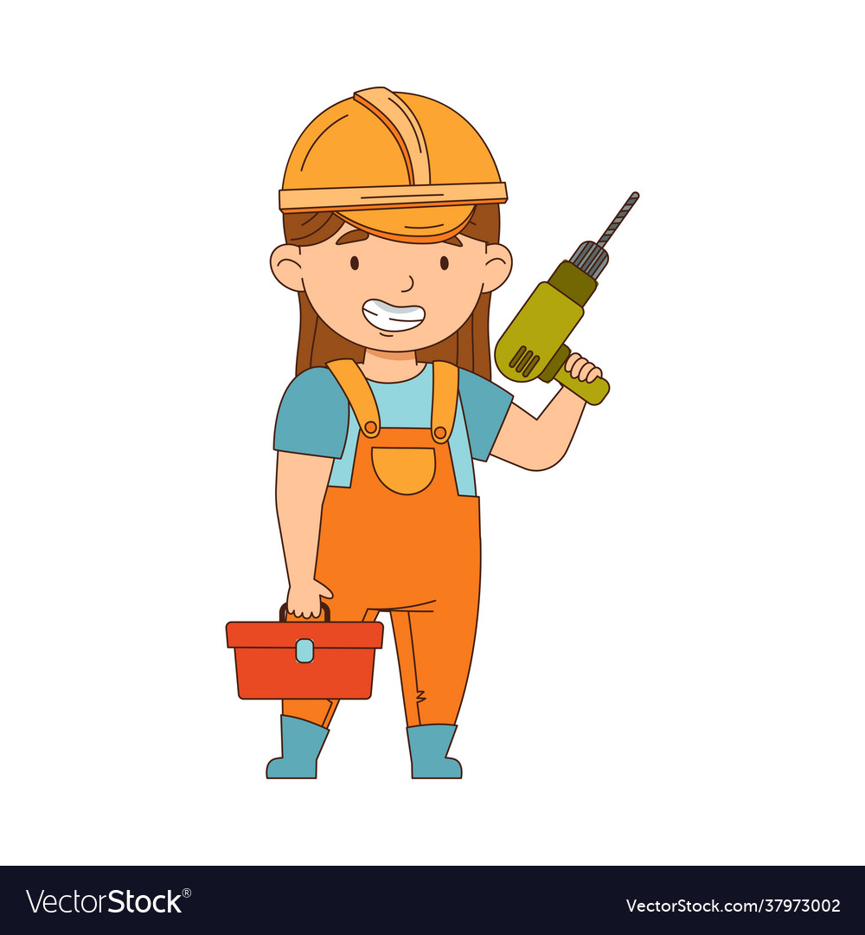
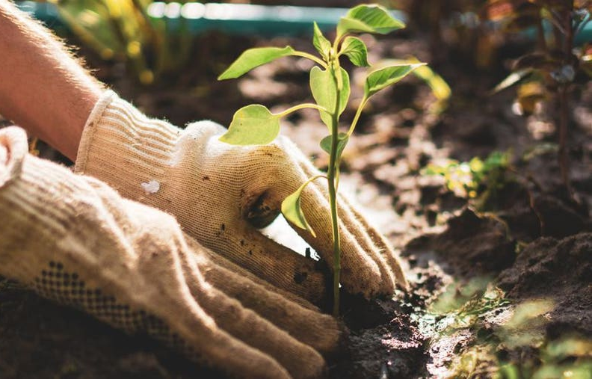
Gardener vs. Builder mentality
You can no more make your kid happy than you can make them physically emotionally and Spiritually strong- why not?
Sometimes the tomatoes still get bottom rot with good tending- just look at Sariah and Lehi, Eve and Adam, our Heavenly parents
IN FACT, if you are praying for and constantly trying to make your kids happy it will be at cross purposes with your goal to help them be strong! (think about muscle building) Instead of constantly asking yourself and the Lord if this will contribute to their (or your) happiness, ask if it will contribute to their wholeness. If you want your kids to be strong, you want your kids to struggle.

Slide 5


Health and Strength

Slide 6
How would you create an environment for growth or strength?
(Strength is a results word, we can’t plan on it, there is so much out of our control. What can we effect…)
Physical
Emotional
Spiritual

Slide 7

Best predictor of having good readers?
Regular trips to the library
Being a good reader yourself
Having a large personal library at home
Attending a highly ranked school
Enforced reading time each day
Out of six children that can read, we still have one that does not like it and is not very fast at it.

Slide 8
Physical Health
Doctrine and Covenants 88:15, 104:12-13,17
15 And the spirit and the body are the soul of man.
12 That every man may give an account unto me of the stewardship which is appointed unto him.
13 For it is expedient that I, the Lord, should make every man accountable , as a steward over earthly blessings, which I have made and prepared for my creatures.
17 For the earth is full, and there is enough and to spare; yea, I prepared all things, and have given unto the children of men to be agents unto themselves.

Slide 9

Physically Strong/fit – (volunteer for 10 pushups)
Who considers themselves in good shape/health or at least as good as you can for working within your limitations?
Factors besides just physical activity?
Are there adjustments you need to make in your own life as directed by the spirit?
Did you know that Pres. Nelson has been the same weight most of his adult life
Why do you even want to have physically strong kids?
Higher self esteem, better concentration levels, better sleep, wider range of available activities, easier to feel the spirit; yoga asana and pranayama is preparation for meditation, slower to anger. We want our bodies to be in good health, so it facilitates revelation and does not hinder it.
Are there ways to model this or encourage this without signing them up for sports all year round?

Slide 10
What is the best type of Physical activity?
Truly it is the one you/ your kids will do !
I’m biased towards dancing and dance like movement because it brings me the most joy but you may find, or your kids may find activities in nature to be the most renewing. I enjoy a combination of yoga, walking, weight-lifting, Zumba and ballet. Dance has been shown to raise mental health the most, but walking and other activities are all more effective than anti-depressants.
If your child suffers from mild depression or even moderate to severe, the first two things to focus on are to increase physical activity and decrease screen time. Being outdoors will boost the physical effect, sunshine and plant chemicals have a synergistic effect- Japanese call it a ‘mind bath’. You may need to do this in combination with counseling and medication, but they will still move the needle in the right direction.
Best thing we did for Gabe was to get him a dog, so he had to do something physical 2x a day.

Slide 11

Family Dinner, where B.E.T meet
Doctrine and Covenants 59: 16-19
16 Verily I say, that inasmuch as ye do this, the fullness of the earth is yours, the beasts of the field and the fowls of the air, and that which climbeth upon the trees and walketh upon the earth;
17 Yea, and the herb, and the good things which come of the earth, whether for food or for raiment or for houses, or for barns, or for orchards, or for gardens, or for vineyards;
18 Yea, all things which come of the earth, in the season thereof, are made for the benefit and the use of man, both to please the eye and to gladden the heart;
19 Yea, for food and for raiment, for taste and for smell, to strengthen the body and to enliven the soul.
Research suggests that having dinner together as a family at least four times a week has positive effects on child development. Family dinners have been linked to a lower risk of obesity, substance abuse, eating disorders, lower rates of depression, anxiety, tobacco use, early teenage pregnancy, and higher rates of resilience and higher self esteem and an increased chance of graduating from high school.
Teens who have frequent family dinners are more likely to have higher-quality relationships with their parents.
Be careful not to trade a “Best” thing for a merely “Good” thing

Slide 12
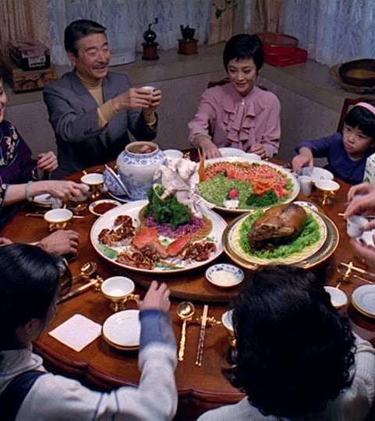
Hold family dinners!!! Dinner for 10
I feel like the Lord wants me to tell you this: Have meals as a family as often as possible.
Gather- if you need to do it early or late, still do it (families who eat together before 6:15 have been shown to spend more time with their children.)
Cook
Nice things (or things we are grateful for)
Topics of general interest (Jar?)
Games
These are the chords that bind the cohesive unit. Quality time is quantity time.
*I promise you, you will have a stronger family if you put this one thing into place.

Slide 13

Emotional Health – its crumbling (see ”Like a Broken Vessel” 2013 by Elder Holland)
Eight , Eight second hugs a day (“More hug”) : up oxytocin
Decrease screen time, especially toxic social media
Increase physical time and outdoor time
For anxiety especially, learn to MEDITATE: 5 minutes will help, 30 minutes a day will cure mild to moderate Anxiety. Start with breathing exercises and 1-2 minutes
Teach them to turn worry into prayer
Self-esteem, “Nice things”, White board “I love you because” ,
Positive self talk ( you can model) – five related statements written down, rehearsed daily outloud
General Example: “I am kind, I am smart, I am important/ valued, I am loved, I am making progress every day
Specific: “I don’t judge people based on appearance, I patiently listen to what people have to say, I don’t buy into race and gender stereotypes, I love all different kinds of people and personalities, I value diversity in God’s children, I love getting to know people"

Slide 14

Parenting, an engine building game
18 yr. of building our deck card by card
Gains momentum as your hand becomes more powerful, as you implement one prompting at a time
-Family prayer every morning followed by individual hugs x9
Home cooked Family dinners every evening
-Rotational prayers at family meals
- “Nice things” for the person who prayed (longest word game)
CFM scripture study six days a week, Zach and I rotate leading weeks
Sunday study of a conference talk
Sing a song together, say our scripture, family group hug
Bedtime hugs and songs, pray with the little ones

Slide 15
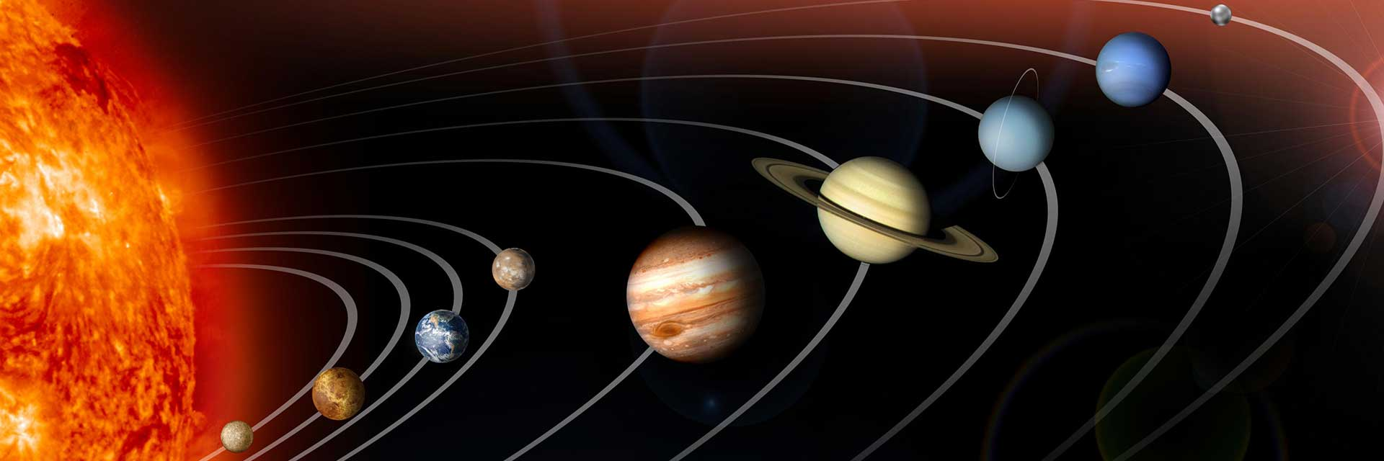
Gravity
If you think of Jesus Christ literally as the sun, He has the most power to pull your child in unless they have strayed too far out of orbit. You are trying to provide a secondary gravity strong enough to pull that child back into orbit. Large families provide more gravity. Family dinner provides gravity. Feeling sincerely loved and valued provides gravity. So can the temple, the church, and good friends.

Slide 16

Spiritual health
Jacob 2:6 “Faith unshaken”
Deuteronomy 6:9
Best predictors of long-term religious involvement and levels of faithfulness are the personal worship habits of a child. (name a few…) Church commissioned study of the best predictor of retention in the church as an active member.
We do family prayer and scripture study in large part so that they develop these personal habits.

Slide 17
What if I already have a child in “Crisis”
Listen truly, not thinking ahead to your own response
Love unconditionally (remember the hugs?)
Show love in their love language (Riley not service, not QT, but words)
Extend invitations as guided by the Spirit (probably NOT sending them scripture quotes and general conference talks at this point, no one wants a reading assignment telling them they are defective!)
Hold fast to your own personal worship habits of sincere prayer, scripture study, temple attendance ( Elizabeth Smart’s father)

