Slide 1

When Loved Ones Leave
Gospel principles for having meaningful conversations and relationships with those who have chosen to step away from the church

Slide 2


Slide 3


Slide 4
“He's not waiting for us to be perfect. Perfect people don't need a Savior. He came to save his people in their imperfections. He is the Lord of the living, and the living make mistakes. He's not embarrassed by us, angry at us, or shocked. He wants us in our brokenness, in our unhappiness, in our guilt and our grief.” (Chieko N. Okazaki, Lighten Up, p. 174)

Slide 5
“If I have to be like you, I fit in. But if I get to be myself, I belong.”
(Aliah Hall, "Being Whole and Belonging," Clinical Counselor at BYU, Referencing Brené Brown)

Slide 6


Slide 7
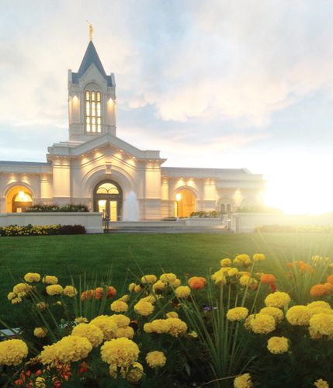

Slide 8
“[Charity] allows us to keep our hearts open without compromising our convictions. In practice, this means listening without needing to agree, showing up without needing to fix, and loving without needing to control. It means resisting the urge to “win” conversations instead of making space for relationships to breathe.”
(Tyler Andersen, "When Loved Ones Leave the Church: Holding to Faith in a Fractured Family," Public Square Magazine, Aug. 19, 2025)

Slide 9
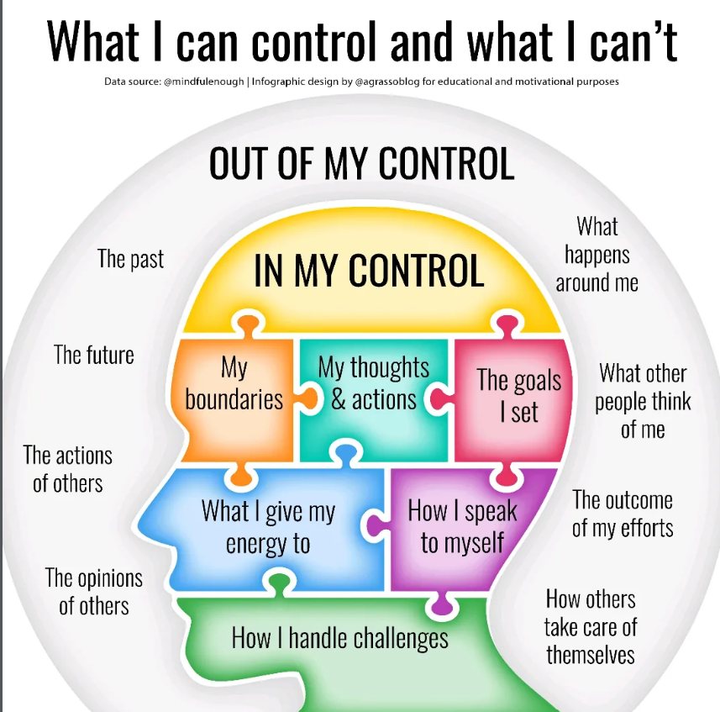

Slide 10
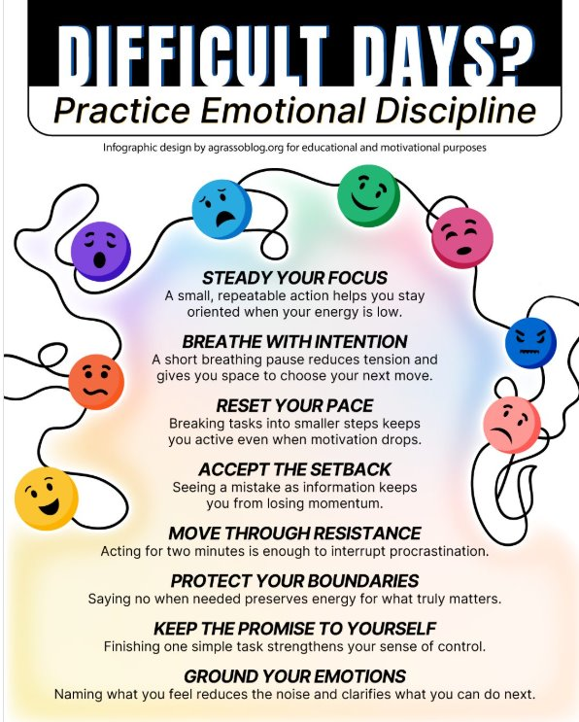

Slide 11
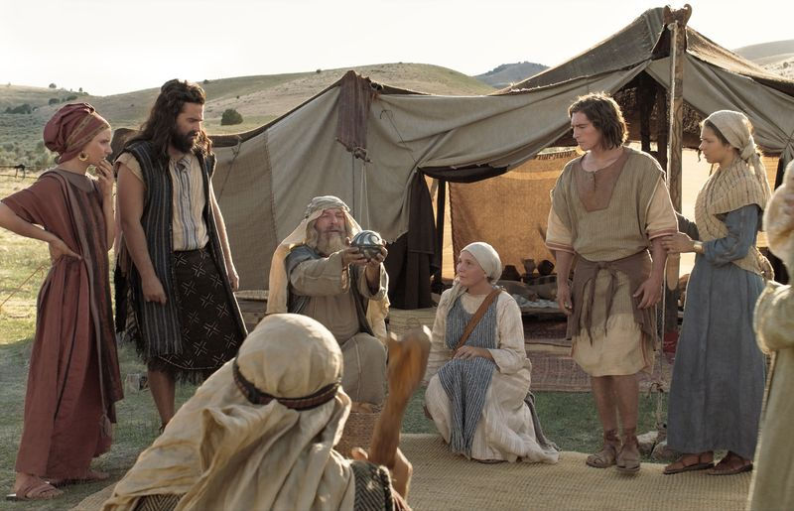

Slide 12
Grow in Unity
Elder Jeffrey R. Holland recalled, “[President Russell M. Nelson] told me once that one of the first rules of medical inquiry is ‘Ask the patient where it hurts. The patient,’ he said, ‘will be your best guide to a correct diagnosis and eventual remedy.’” When a friend or family member reaches out to you with difficult questions or concerns about the Church, take time to listen. They are reaching out to you because they trust you. Reward that trust by seeking first to understand their needs." (Topics: Helping Others with Their Questions)

Slide 13
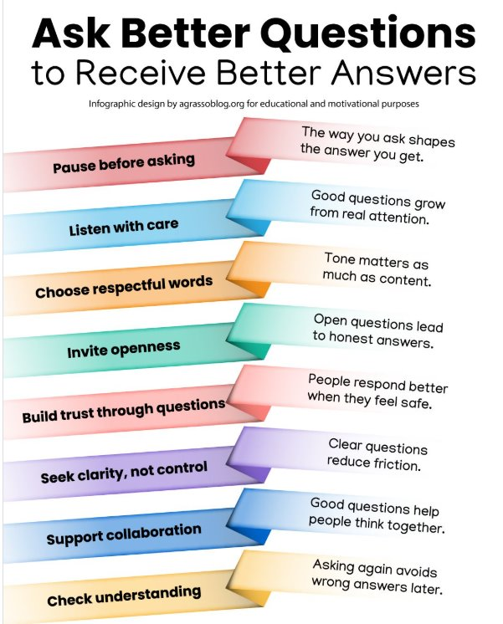

Slide 14
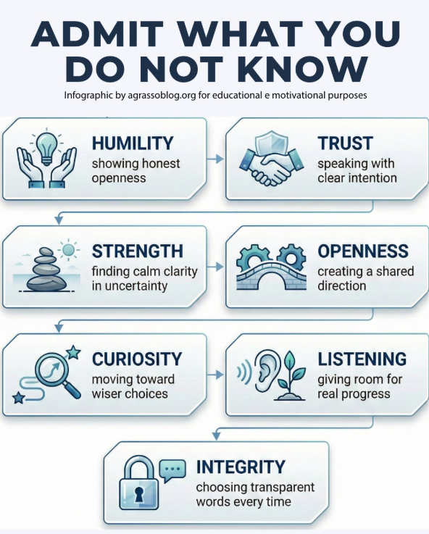
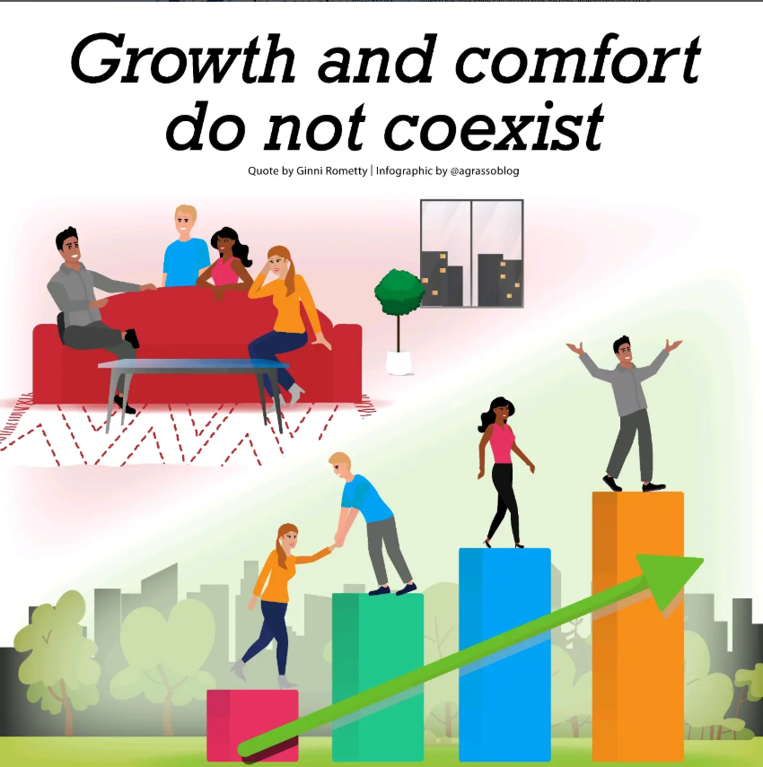

Slide 15


Slide 16
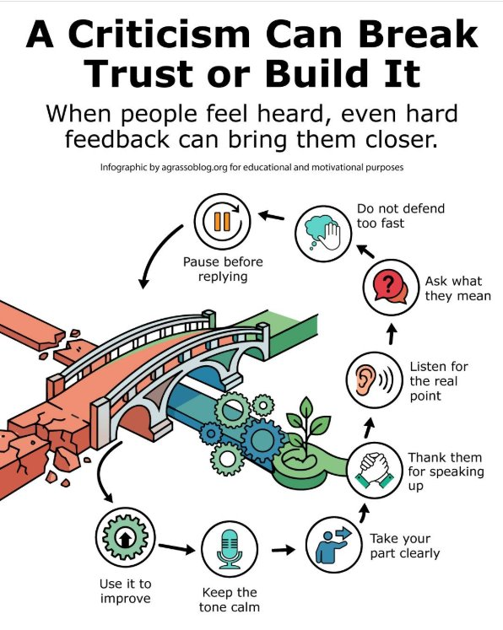

Slide 17
"Unity requires effort. It develops when we cultivate the love of God in our hearts and we focus on our eternal destiny. We are united by our common, primary identity as children of God and our commitment to the truths of the restored gospel. In turn, our love of God and our discipleship of Jesus Christ generate genuine concern for others. We value the kaleidoscope of others’ characteristics, perspectives, and talents. If we are unable to place our discipleship to Jesus Christ above personal interests and viewpoints, we should reexamine our priorities and change."
(Dale G. Renlund, “The Peace of Christ Abolishes Enmity,” Liahona, Nov. 2021, 83–85)

Slide 18
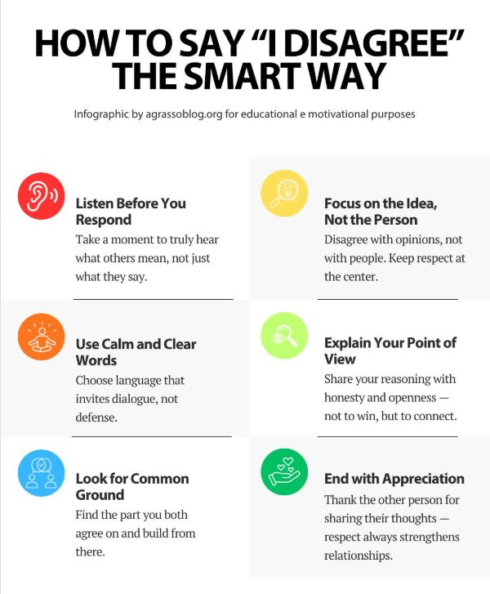

Slide 19
You won’t always get everything right, but the effort still matters.

Slide 20

“When we consecrate our meager but best effort, God magnifies it. When we sacrifice for Jesus Christ, He sanctifies us. This is the transformative power of God’s grace.”
(Steven D. Shumway, "Participate to Prepare for Christ’s Return," Liahona, May 2025)

