Slide 1
The Stakeholder Blueprint for Partner Marketing Success
Build internal champions and
secure lasting support for your
through-partner marketing initiative
Sherry Foster
President & co-founder
sherry@ascendxdigital.com
www.ascendxdigital.com

Slide 2

Cross-functional support & alignment
Corporate marketing
Coordinate campaigns, get a steady stream of content, align with marketing calendar
Product management
Product strategy & content, NPI roadmap, product training for partners
Channel Sales
Help to identify & recruit partners, getting more partners on board more quickly
Channel Ops
Include through-partner marketing into program requirements

Slide 3
Template

Slide 4
PMA Cross-functional alignment – Corporate Marketing
Internal Organization | What you need from them | What’s in it for them
 |  | Role | Their related KPIs | How TCMA/PMA benefits them
Corporate Marketing | Marketing strategy & playbooks Marketing campaign calendar & content Marketing assets (videos, brochures, images, copy)

Slide 5
PMA Cross-functional alignment – Product Management
Internal Organization | What you need from them | What’s in it for them
 |  | Role | Their related KPIs | How TCMA/PMA benefits them
Product Management | Product vision, roadmap & priorities NPI Roadmap Product training for partners

Slide 6
PMA Cross-functional alignment – Channel Ops
Internal Organization | What you need from them | What’s in it for them
 |  | Role | Their related KPIs | How TCMA/PMA benefits them
Channel Operations | Systematic integration of your through-partner marketing initiative into the overall partner program Financial support Partner incentives

Slide 7
PMA Cross-functional alignment – Channel Sales
Internal Organization | What you need from them | What’s in it for them
 |  | Role | Their related KPIs | How TCMA/PMA benefits them
Channel Sales | Support for your through-channel marketing program Encourage partners to participate

Slide 8
PMA Cross-functional alignment – Other
Internal Organization | What you need from them | What’s in it for them
 |  | Role | Their related KPIs | How TCMA/PMA benefits them

Slide 9
PMA Cross-functional alignment – Other
Internal Organization | What you need from them | What’s in it for them
 |  | Role | Their related KPIs | How TCMA/PMA benefits them

Slide 10
PMA Cross-functional alignment – Other
Internal Organization | What you need from them | What’s in it for them
 |  | Role | Their related KPIs | How TCMA/PMA benefits them

Slide 11
Examples

Slide 12
PMA Cross-functional alignment – Corporate Marketing
Internal Organization | What you need from them | What’s in it for them
 |  | Role | Their related KPIs | How TCMA/PMA benefits them
Corporate Marketing | Marketing strategy & playbooks Marketing campaign calendar & content Marketing assets (videos, brochures, images, copy) | Brand marketing | Brand awareness, Brand consistency & usage | Expansion of compliant brand across partners
 |  | Corporate comms / PR | Share of voice, Positive media coverage | Expansion of brand content across partner digital footprint
 |  | Demand gen | MQLs, Pipeline contribution | Get MQLs from through-partner marketing
 |  | Digital marketing | Awareness & reach, content engagement, efficiency & ROI | Expand awareness and engagement across partner ecosystem

Slide 13

PMA Cross-functional alignment – Corporate Marketing
Imagine if….
You could ensure that our company brand is present and always compliant across all our partners.
You could amplify our messaging immediately through hundreds/thousands of partners’ web and social channels. How would that impact our share of voice?
100 partners x 500 impressions each = 50,000 more impressions
x 1 post/week = 2.6M impressions
You could expand your campaigns through hundreds/thousands of partners and reach hundreds/thousands of their customers. How much more demand and MQLs could we create?
200 partners x 1000 Emails each = 200,000 Emails
x 2% CTR = 4000 more actively engaged buyers

Slide 14
PMA Cross-functional alignment – Product Management
Internal Organization | What you need from them | What’s in it for them
 |  | Role | Their related KPIs | How TCMA/PMA benefits them
Product Management | Product vision, roadmap & priorities NPI Roadmap Product training for partners | Directors – Product management | Product line revenue | Proactive access to more customers through partners
 |  |  | Product adoption, active users | Direct product information access through partner sites
 |  |  | Expansion of products into new markets/segments | Enables partners to ease into expanded portfolio
 |  | Product managers | Market awareness & share of voice | Exponential expansion of brand through partner co-branded PMA
 |  |  | NPI Success | Build a launch plan through all partners (web/Email/social)

Slide 15

PMA Cross-functional alignment – Product Management
Imagine if….
You could immediately access all our partners’ customers with your product information at moments you need to.
Get your product content onto hundreds/thousands of partner sites in a way that is brand-compliant and ALWAYS up to date
Make changes to product content on partner sites any time
Provide adjacent product/solution content on partner sites in a way that helps to expand partner portfolio breadth
You could extend your product launches through a network of hundreds/thousands of partners on the same day/time as the corporate launch.
Imagine how many more buyers you could reach!
How much faster could you ramp new product adoption?

Slide 16
PMA Cross-functional alignment – Channel Ops
Internal Organization | What you need from them | What’s in it for them
 |  | Role | Their related KPIs | How TCMA/PMA benefits them
Channel Operations | Systematic integration of your through-partner marketing initiative into the overall partner program Financial support Partner incentives | Channel Operations Leadership | Partner program experience/partner satisfaction | PMA is an investment in partners. Participants have higher partner sat scores
 |  |  | % of company revenue through partners | When you engage more partners, it builds loyalty and more loyal partners increases revenue potential
 |  |  | MDF ROI | MDF isn’t fully spent. Re-allocating MDF to PMA increases overall MDF ROI
 |  | Partner program managers | Active partner ratio | Automation ensures partners are always participating
 |  |  | MDF Utilization rate | When MDF is re-allocated, more partners participate and there is more return.

Slide 17

PMA Cross-functional alignment – Channel Operations
Imagine if….
You had an easy way to include more long-tail partners in the channel program without adding more Partner Account Managers.
We could give partners an entire digital marketing function as an incentive to join and participate in our channel program.
We could get a massive lift in MDF ROI with just a small re-allocation of MDF funds.
We had an automated way of keeping partners engaged in our channel programs, increasing their satisfaction every year.

Slide 18
PMA Cross-functional alignment – Channel Sales
Internal Organization | What you need from them | What’s in it for them
 |  | Role | Their related KPIs | How TCMA/PMA benefits them
Channel Sales | Support for your through-channel marketing program Encourage partners to participate | Channel sales VP/leadership | Revenue growth through partners | More active, loyal partners drive higher revenue growth
 |  |  | Partner ecosystem health | Partners feel invested in. They are more engaged. They get more leads.
 |  |  | Coverage & operational metrics | Automation enables more partners to participate and grow.
 |  | Partner Account Managers | Revenue performance of their partners | TCMA drives pipeline and partner engagement
 |  |  | Partner participation in marketing campaigns | TCMA takes the burden off completely so they can focus on sales

Slide 19

PMA Cross-functional alignment – Channel Sales
Imagine if….
You could grow more partners in your ecosystem without adding Partner Account Managers because long-tail partners now have support and resources.
You could take the burden of marketing off your PAMs so they can focus on deals.
You had a program that would drive partner loyalty (versus the competition).
You could deliver more leads to partners and increase their pipeline.

Slide 20

About AscendX Digital
The marketing agency that operates PMA/TCMA for companies globally
PMA is powerful technology, built for scale.
Unlocking value requires people + processes + technology
Companies with great intentions get stuck in content development, internal reviews, or partner onboarding logistics. It’s not a software issue… It’s a bandwidth and operational readiness issue.
PMA

Slide 21



AscendX Digital brings the expertise, the crew, and the flight plan
PMA works best when you align people, processes and the technology
Services for your PMA platform -or- get PMAaaS
Faster time to value – go live in 90 days, not 9 months (or longer!)
Better partner experiences
Predictable and scalable – pay as you go
Hands-free campaign execution
Better insights and reporting
Lower the risk
Get more for your partners – support, education, a services marketplace
PMA

Slide 22
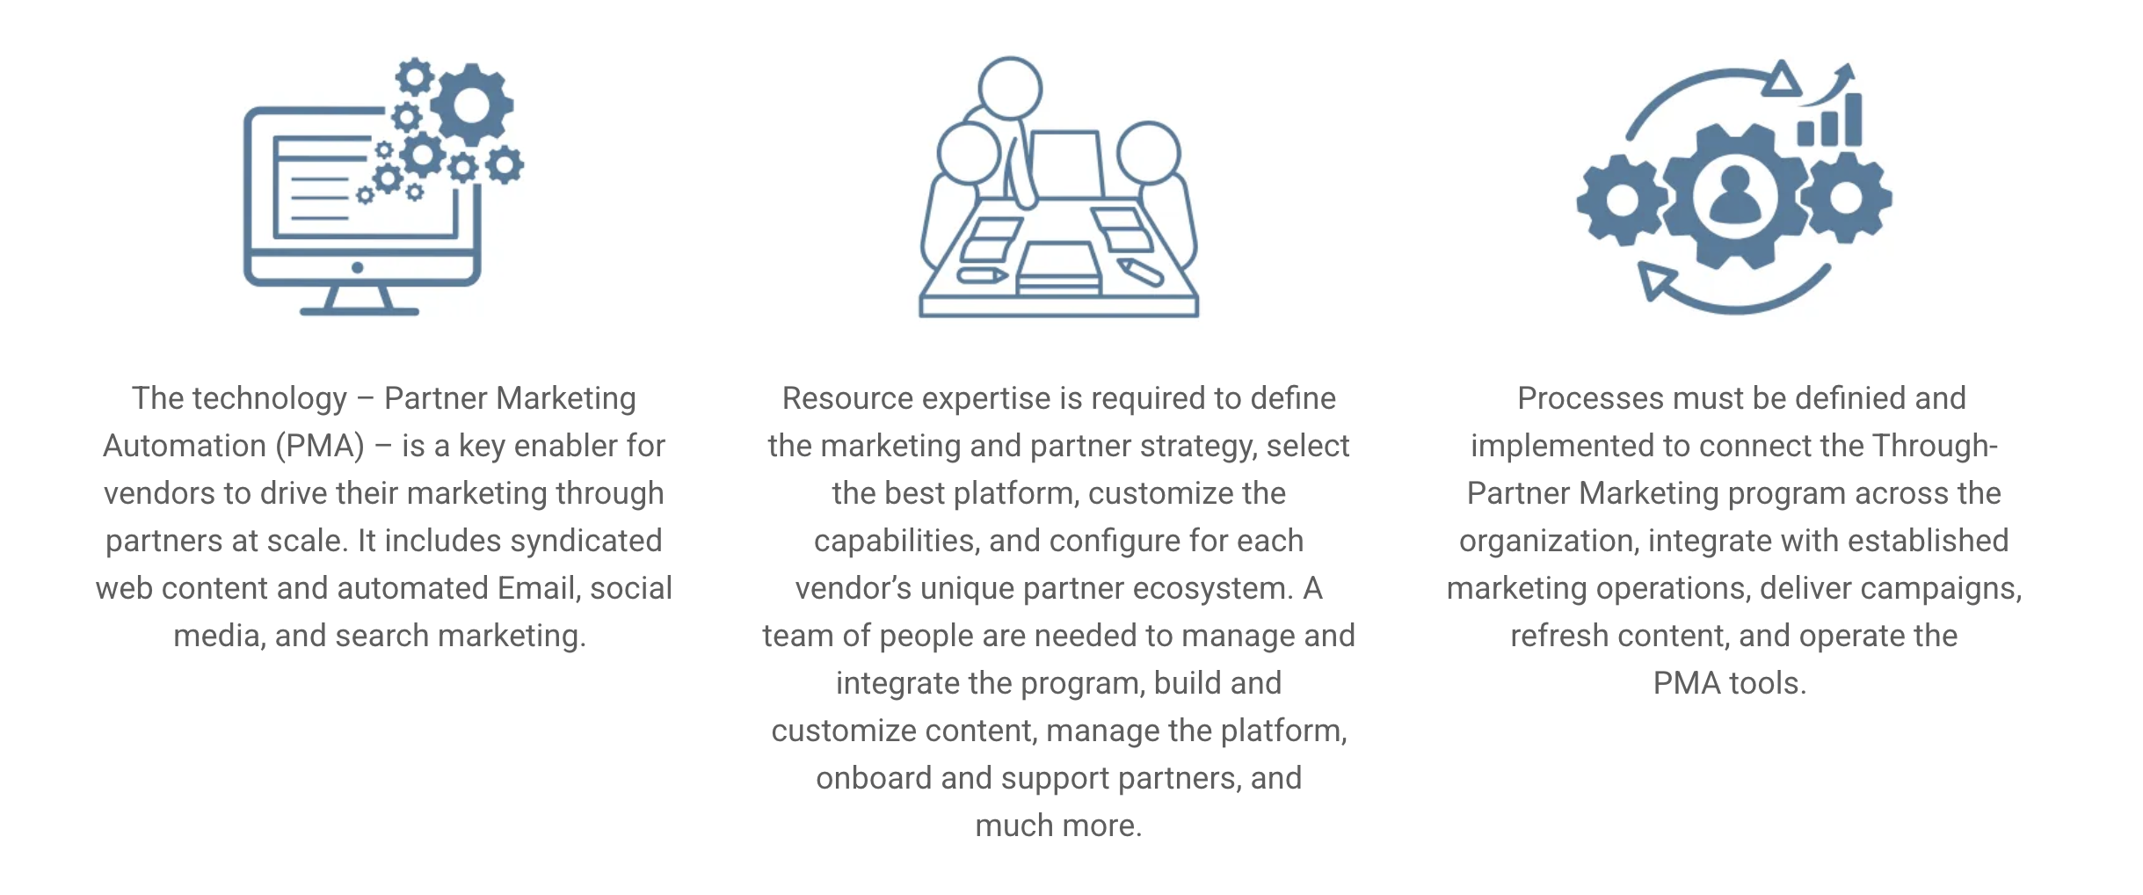


Through-partner marketing is more than just technology
PEOPLE
PROCESSES
TECHNOLOGY
Resource expertise is required to:
Define the marketing and partner strategy
Customize the platform capabilities for your unique partner ecosystem
Manage and integrate the program
Build and customize content
Manage the technology platform
Onboard and support partners
and much more.
Processes must be defined and implemented to:
Connect the Through-Partner Marketing program across the organization
Integrate with established marketing operations
Deliver campaigns
Refresh content
Operate the PMA technology
Software that enables vendors to reach more partners and more customers through automation and scale
Empowers partners to participate more fully in the digital customer journey

Slide 23
Through-partner marketing is more than just technology
THE ASCENDX FRAMEWORK FOR TCMA/PMA SUCCESS
AscendX Digital can help to transform your through-partner marketing strategy and technology into
a fully managed growth engine,
helping you launch better partner marketing programs in less time, engage more partners, reduce risk, and deliver measurable value for you and your partner ecosystem.

Slide 24
If you are ready to transform your through-partner marketing program into a growth engine, contact us today.
Sherry Foster
sherry@ascendxdigital.com
www.ascendxdigital.com

