Slide 1

Worship Service
“Here Am I, Lord”
We were glad to share not only God’s good news with you,
but also our very lives because we cared for you so much.
1 Thessalonians 2:8
Notes:
Commissioning Service
[Full screen graphics during service except during Leader’s message.
No other cameras on (audio on for speakers only)]

Slide 2
Here I am Lord
Insert music video “Here I am Lord" from: https://youtu.be/UBQlctSb3W8 (6:14 min)
Notes:
Add music video “Here I am Lord" from: https://youtu.be/UBQlctSb3W8 (6:14 min)

Slide 3

Greeting

Slide 4
Call to Worship
Leader: The Lord be with you!
People: And also with You!
Leader: Christ is risen!
People: Christ is risen indeed!

Slide 5

Liturgy: Act of Praise [Psalm 139:7-13 NRSV)
Leader: Where can I go from your spirit?
Or where can I flee from your presence?
People: If I ascend to heaven, you are there; if I make my bed in Sheol, you are there.

Slide 6
Leader: If I take the wings of the morning
and settle at the farthest limits of the sea,
People: even there your hand shall lead me, and your right hand shall hold me fast.

Slide 7
Leader: If I say, “Surely the darkness shall cover me, and the light around me become night,
People: even the darkness is not dark to you; the night is as bright as the day, for darkness is as light to you.

Slide 8

SCRIPTURE:
1After these things Jesus showed himself again to the disciples by the Sea of Tiberias; and he showed himself in this way. 2 Gathered there together were Simon Peter, Thomas called the Twin, Nathanael of Cana in Galilee, the sons of Zebedee, and two others of his disciples.
Notes:
John 21:1-2
Laura will be the reader.

Slide 9
3 Simon Peter said to them, “I am going fishing.” They said to him, “We will go with you.” They went out and got into the boat, but that night they caught nothing. 4 Just after daybreak, Jesus stood on the beach; but the disciples did not know that it was Jesus. 5 Jesus said to them, “Children, you have no fish, have you?” They answered him, “No.”
Notes:
John 21: 3-5

Slide 10
6 He said to them, “Cast the net to the right side of the boat, and you will find some.” So they cast it, and now they were not able to haul it in because there were so many fish.
John 21: 1-6
Notes:
John 21:6

Slide 11
12 Jesus said to them, “Come and have breakfast.” Now none of the disciples dared to ask him, “Who are you?” because they knew it was the Lord. 13 Jesus came and took the bread and gave it to them; and did the same with the fish. 14 This was now the third time that Jesus appeared to the disciples after he was raised from the dead.
John 21: 12-14
Notes:
John 21:12-14

Slide 12
SCRIPTURE CONTINUES:
15 When they had finished breakfast, Jesus said to Simon Peter, “Simon son of John, do you love me more than these?” He said to him, “Yes, Lord; you know that I love you.” Jesus said to him, “Feed my lambs.” 16 A second time he said to him, “Simon son of John, do you love me?” He said to him, “Yes, Lord; you know that I love you.” Jesus said to him, “Tend my sheep.”
Notes:
John 21:15-16
Melissa is the reader

Slide 13
17 He said to him the third time, “Simon son of John, do you love me?” Peter felt hurt because he said to him the third time, “Do you love me?” And he said to him, “Lord, you know everything; you know that I love you.” Jesus said to him, “Feed my sheep.
John 21: 15-17
Notes:
John 21:17

Slide 14
12 Very truly, I tell you, the one who believes in me will also do the works that I do and, in fact, will do greater works than these, because I am going to the Father.
          John 14:12
Notes:
John 14:12
Melissa continues reading.

Slide 15

Worship Message
Notes:
Background Slide for the Message
Stop sharing screen during message

Slide 16
Commissioning to Ministry
Leader: Dear friends, you have been called by God and chosen by the people of God for leadership in the church. This ministry is a blessing and a serious responsibility. It recognizes your special gifts and calls you to work among your people and for your people. In love we thank you for accepting your obligation and challenge you to offer your best to the Lord, to your people, and to our ministry in the world. Live a life in Christ and make him known in your witness and work.

Slide 17
Leader: Do you this day acknowledge yourself a faithful disciple of Jesus Christ?
People: I do.
Leader: Will you devote yourself to the service of God in the world?
People: I will.
Notes:
Leader: Pastor Michael
People: Karen

Slide 18
Leader: Will you so live that you enable your church to be a people of love and peace?
People: I will.
Leader: Will you do all in your power to be responsible to the task for which you have been chosen?
People: I will.

Slide 19
Prayer of Commissioning
Almighty God, pour out your blessings upon these your servants who have been given the ministry of congregational care. Grant them grace to give themselves wholeheartedly in your service. Keep before them the example of our Lord, who did not think first of himself, but gave himself for us all. Let them share his ministry and consecration, that they may enter into his joy. Guide them in their work. Reward their faithfulness with the knowledge that through them your purposes are accomplished; through Jesus Christ our Lord. Amen.

Slide 20
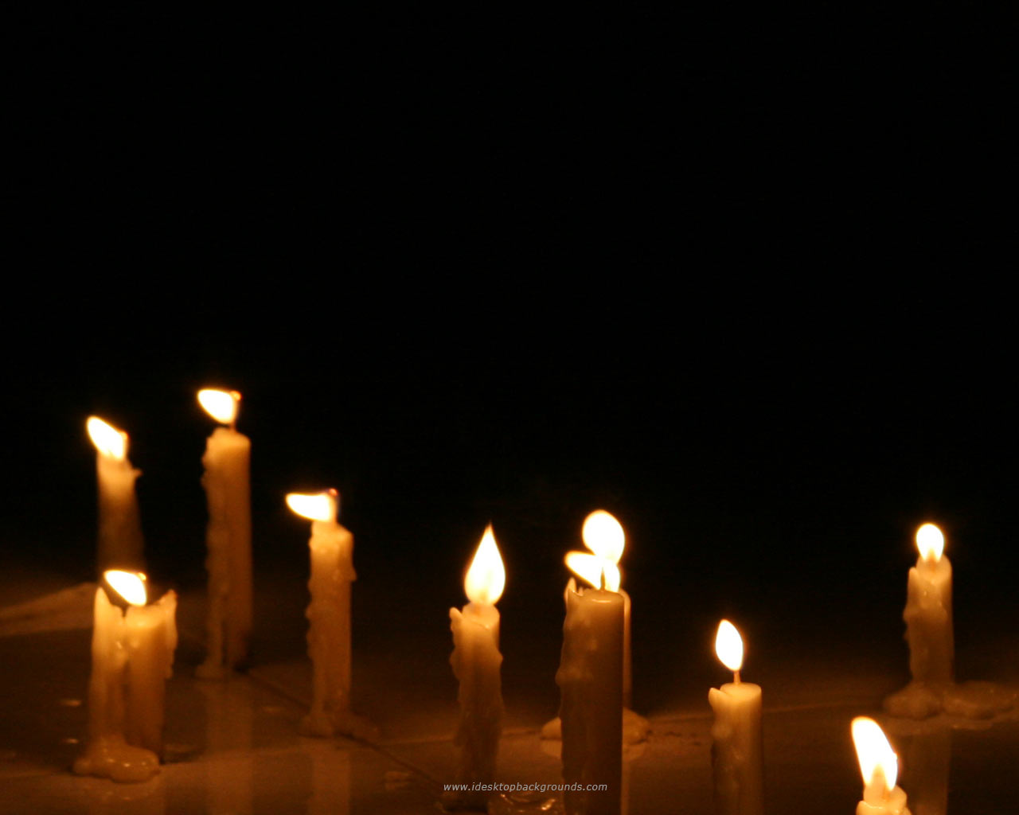
Closing Remarks & Benediction

