Slide 1


Slide 2
Meet the
Coaches
Head Varsity Coach: Jamie Suggs
Assistant Coaches: Jon Zopf, Chris Hawkins, Kenny Mallory, Jackson Peck, James Clanahan, Daniel Pulliam
Community Coaches: TBD

Slide 3
Meet the
Support staff
Booster Club President: Bill Neidert (bneidert@att.net)
Vice President: Josh Holt
Booster Club Treasurer: Elaine Vernon (ridgebsbl@gmail.com)
Sponsorship Team: Amanda Lawrence
Events Team: Anna Childress and Jana Bearden

Slide 4

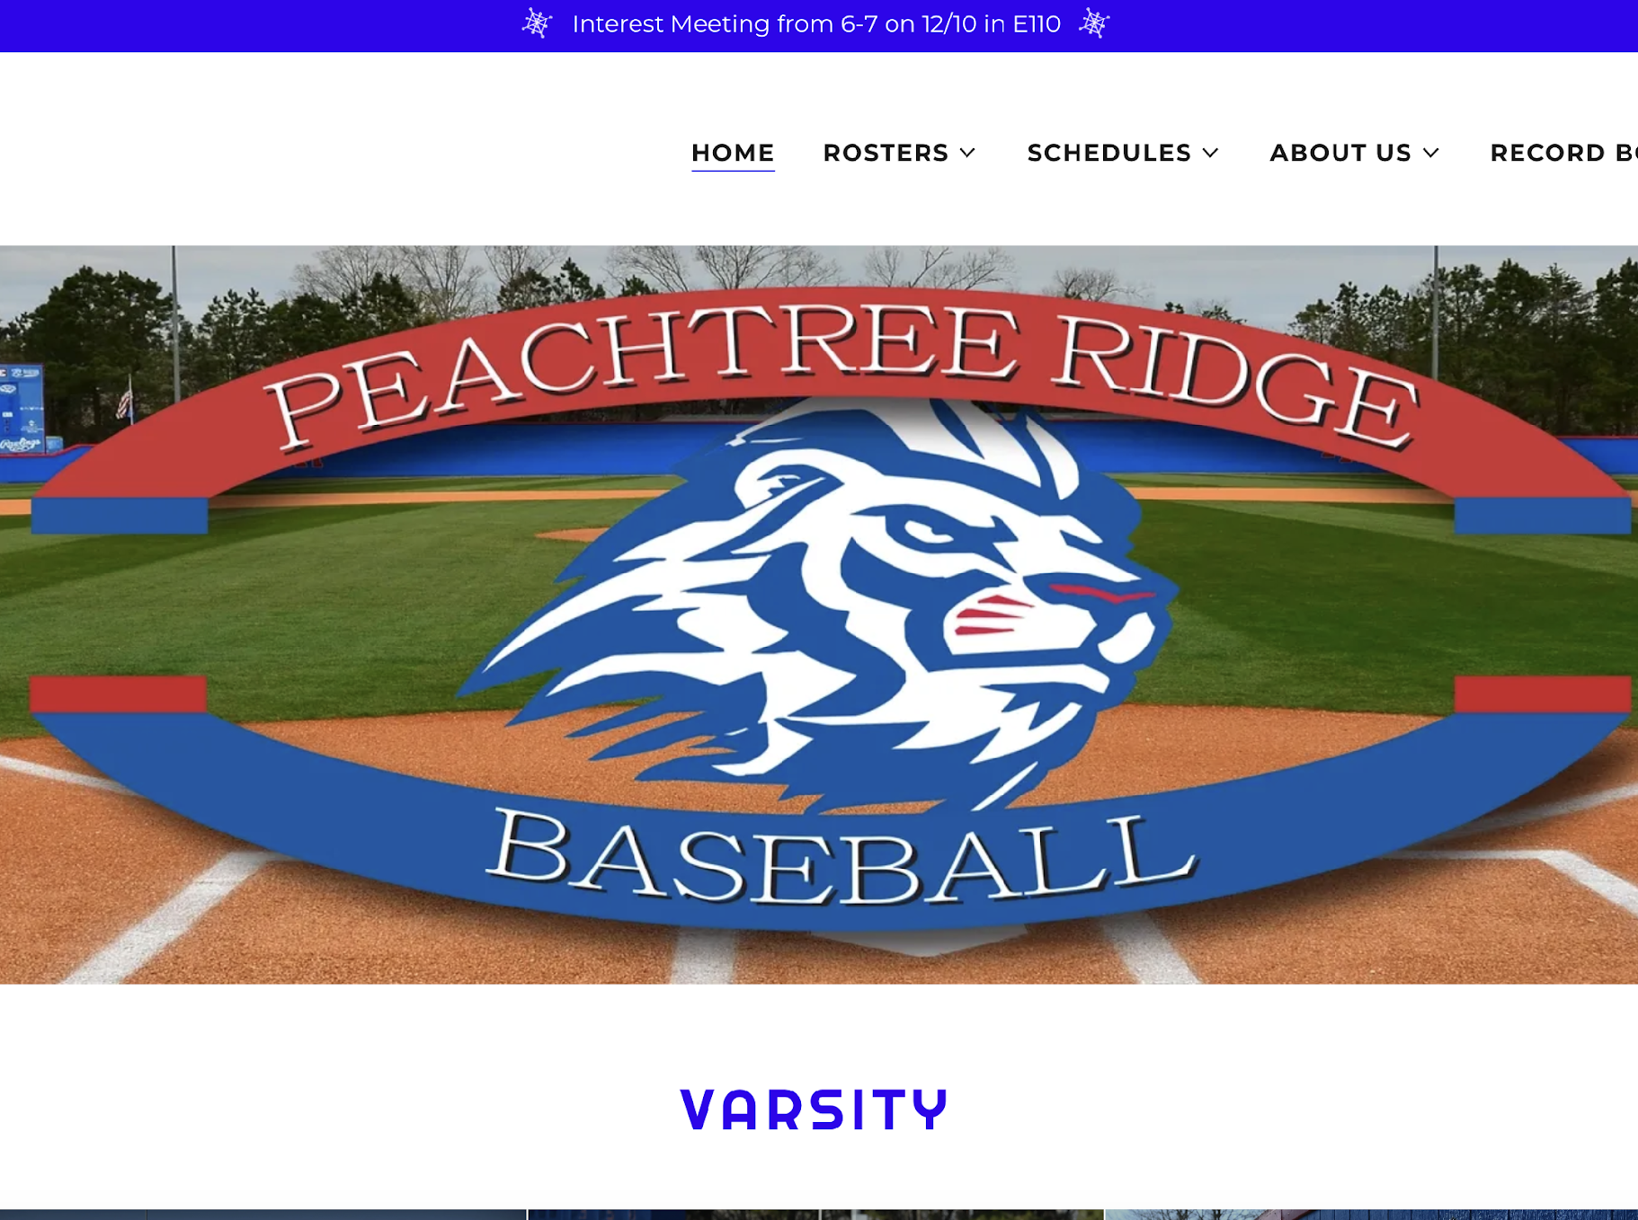

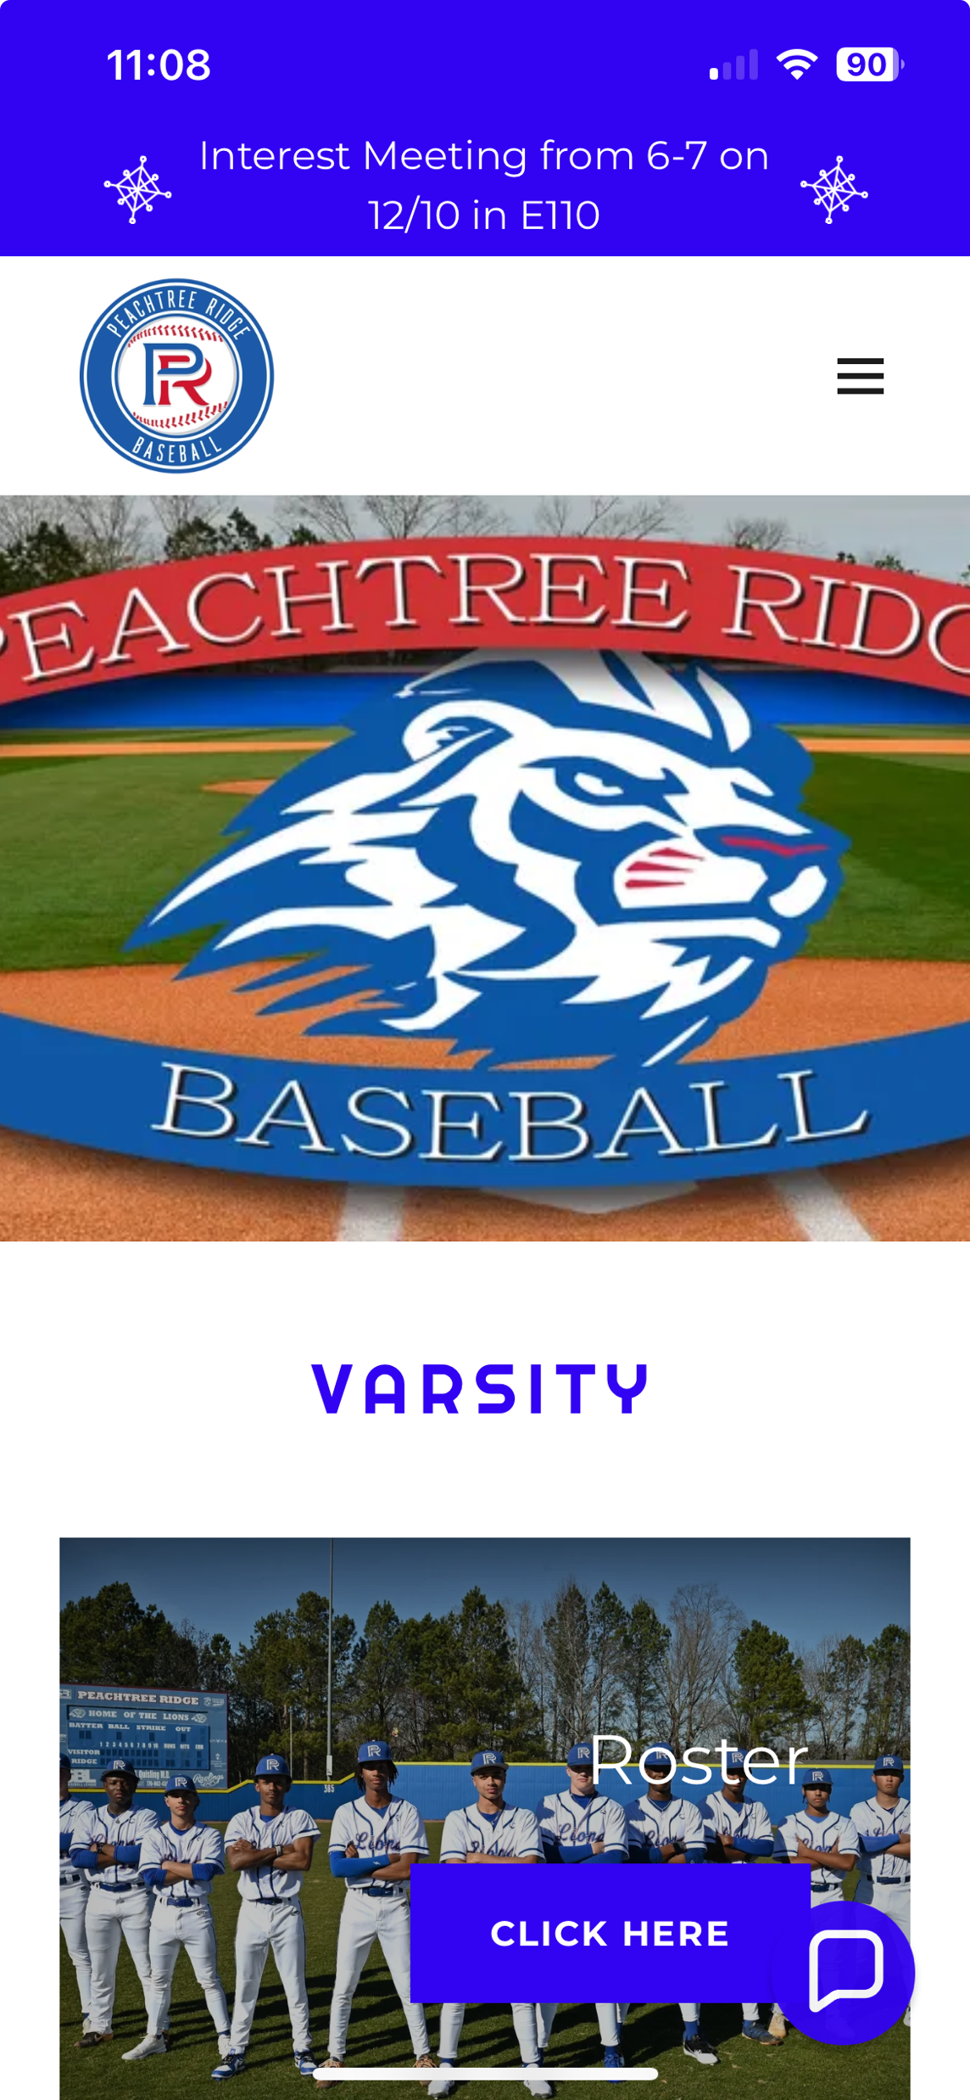
website
Prlionsbaseball.com
Schedules
Rosters
Photos from Rick Fender
Alumni
Historical information
Sponsorship information
Contact
Prospective player form
on website homepage
link

Slide 5

Rank one information
You must get this done ASAP
“How to” guide up front
Download the App
Physical and Insurance must be submitted
Continue

Slide 6
School insurance
See flyer at the front of the room
Double check RankOne when submitting school insurance

Slide 7


Expectations
Grades and Attendance
Monitored Daily
Contracts
Weight Room
Mandatory Fall AM Lifts (2X)
Mandatory Fall PM Lifts (3X)
Diets:
Water
Supplements
Protein
Throwing Program: Full Count
Summer Workouts Schedule:
Optional Hitting Everyday PG games going with coaches permission
Weight Room Open with coaches permission
(TBD) Mandatory Practices: 7/20-7/22
  (7AM-11AM)

Slide 8
2027 Season
  PSR Introduced
    https://www.ghsa.net/schedule-ranking-view
  Varsity Tournaments:
    Brunswick
    PBR
    Panama City Beach
  3 Game Region Schedule
  Sub Varsity Spring Break
    Play on Saturday Beginning/End of SB
  Summer Ball
    Pitchers should not throw over 90 pitches in a day.
    Juniors and Seniors should be playing with same graduating class
  Summer Tournaments
    Concession Signups

Slide 9
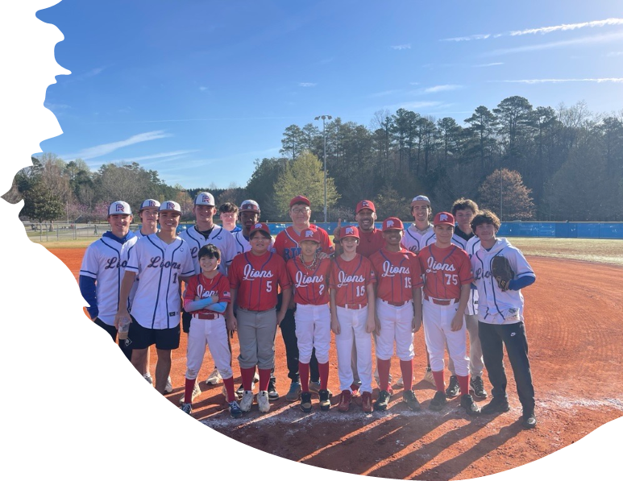
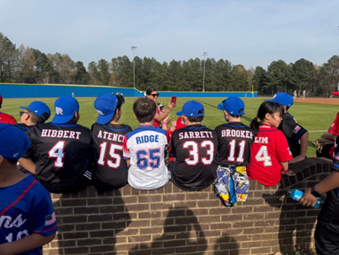
PRYAA Baseball Partnership
  Summer Sandlot Series at PR Park
    Tuesday, June 9, 6PM-8PM
    Tuesday, June 16, 6PM-8PM
    Tuesday, June 23, 6PM-8PM
  Format
    Brief Skill Sessions
    Sandlot Pickup Games
  Volunteers Needed from ‘26 PRHS Teams
    8-10 Volunteers Each Night
    Will circulate Sign Up Genius

Slide 10
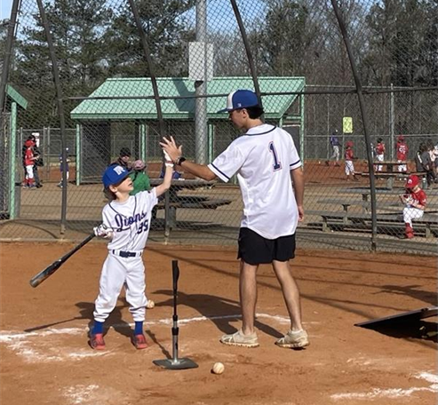
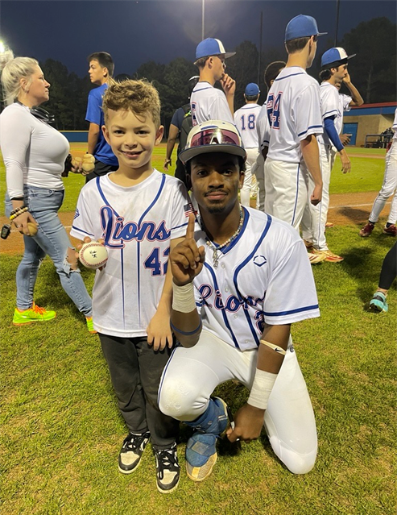
PRYAA Baseball Partnership
Continued
‘26 Varsity and JV
    Interested in providing personal lessons to PRYAA Baseball Players?
    Requirements:
      Great w/ kids
      Dependable and Responsible
      Patient and Positive
      Knowledgeable
***Email Coach Suggs if interested to discuss more information.***

Slide 11
Fundraising/
Sponsorship
Fundraiser
Fall Fundraiser: TBD
Spring: Email Fundraiser
Sponsorship Opportunities
Sponsorship kickbacks
  10% toward player dues up to $500
  20% toward player dues above $500

Slide 12
$225
gata
25 Sessions in Fall/Winter
Begins in October
Player dues
Meals
League
Gear:
  2 T-Shirts- Royal & Red
  2 Dri Fits- Royal & Red
  Shorts
  Hoody
  Pants
Field maintenance
Scoreboard
Trips
Facility Upgrades
More
$1600
C/JV
Booster club memberships
More information coming soon
PBR Tournament
Brunswick Tournament
Spring Break Trip/Tournament Expenses
Meals
Gear
$1900
Varsity

Slide 13
470-818-0703
Contact
Prlionsbaseball.org
Coach Suggs
Jamie.suggs@gcpsk12.org
1555 old peachtree rd, nw
Suwanee, ga 30024

Slide 14
Thank you
ANY QUESTIONS?

