Slide 1
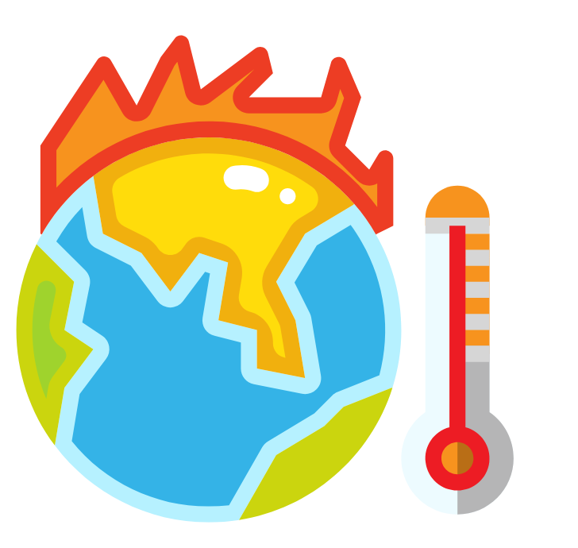
How is our climate changing?

Slide 2
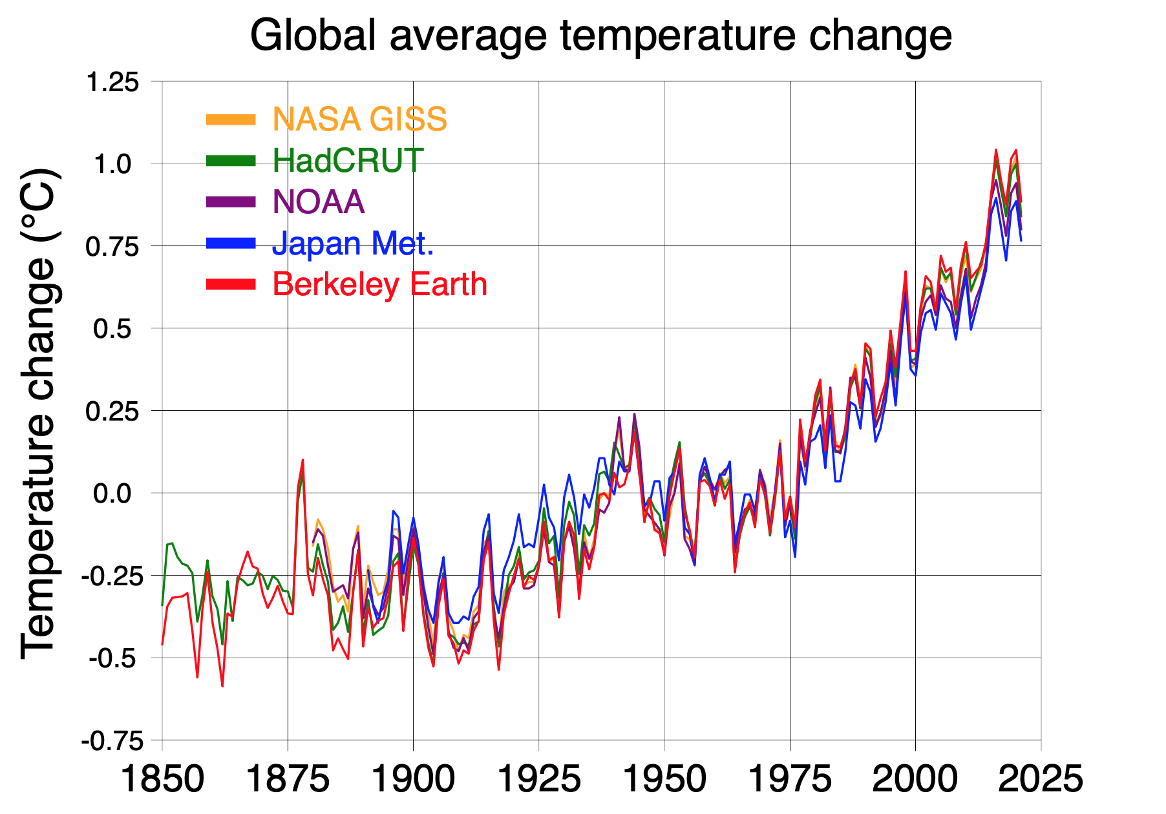
How do we know that climate change is happening?
Image: Wikimedia Commons

Slide 3
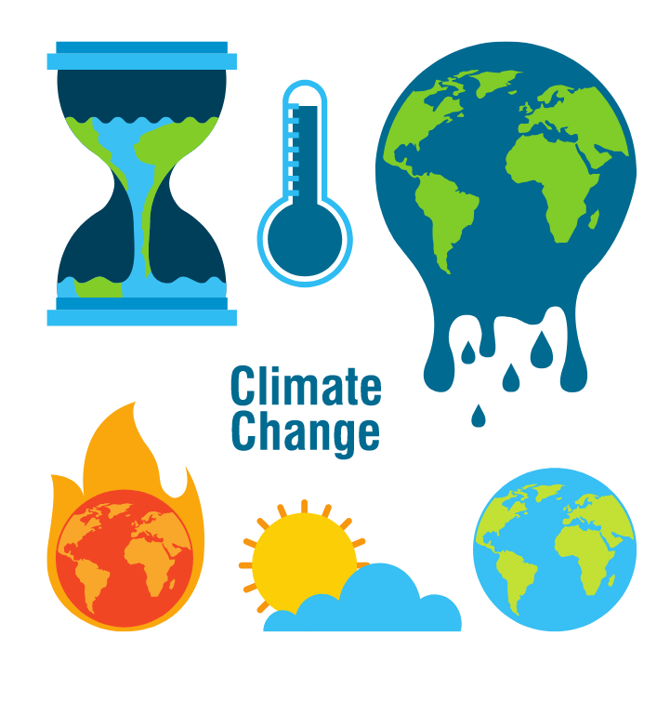
What effect is climate change having?

Slide 4
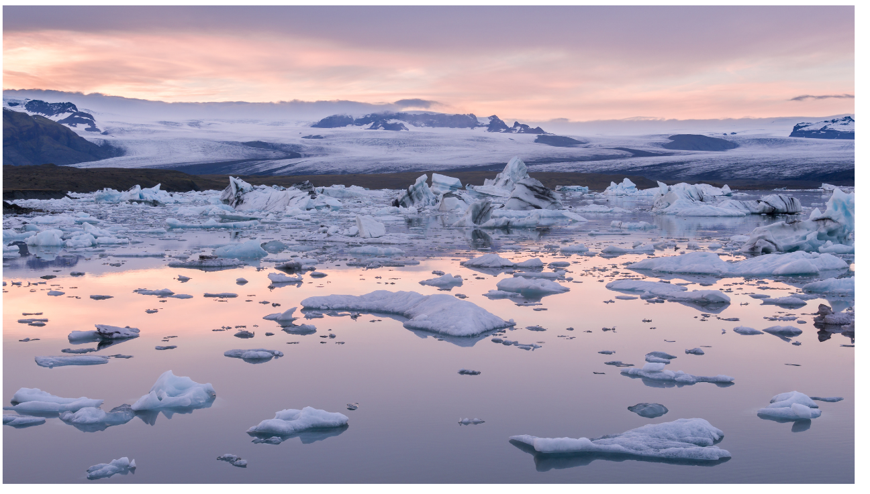
Glaciers are melting and sea levels are rising.

Slide 5
Unpredictable Weather - fire, flood and drought

Slide 6
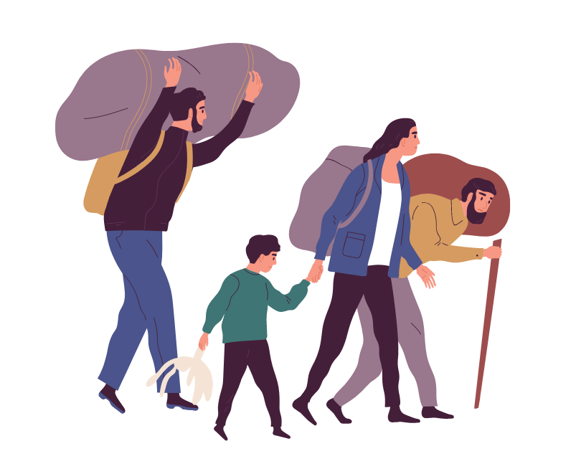
Displaced people have to flee their homes.

Slide 7
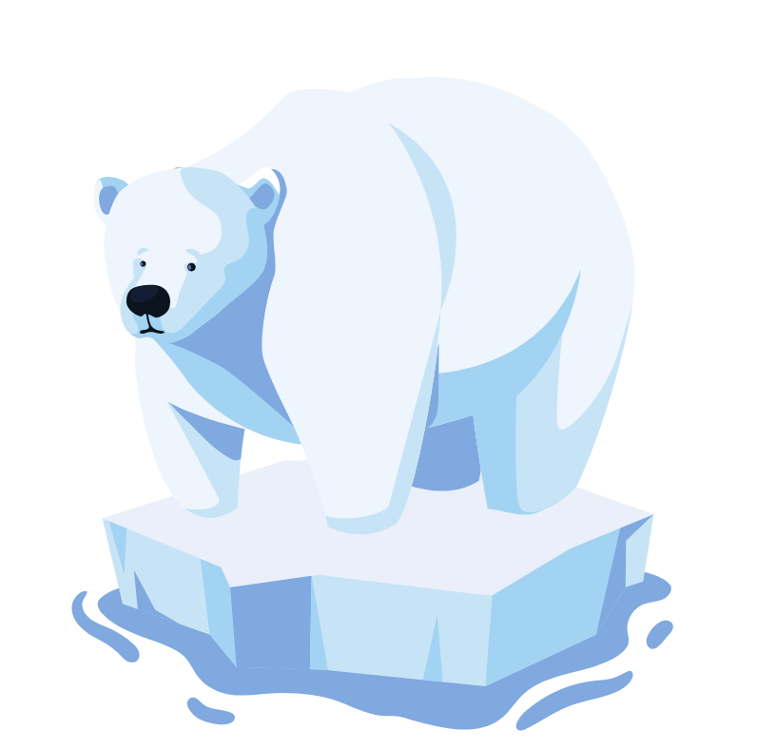
Animals are losing their habitats.

Slide 8
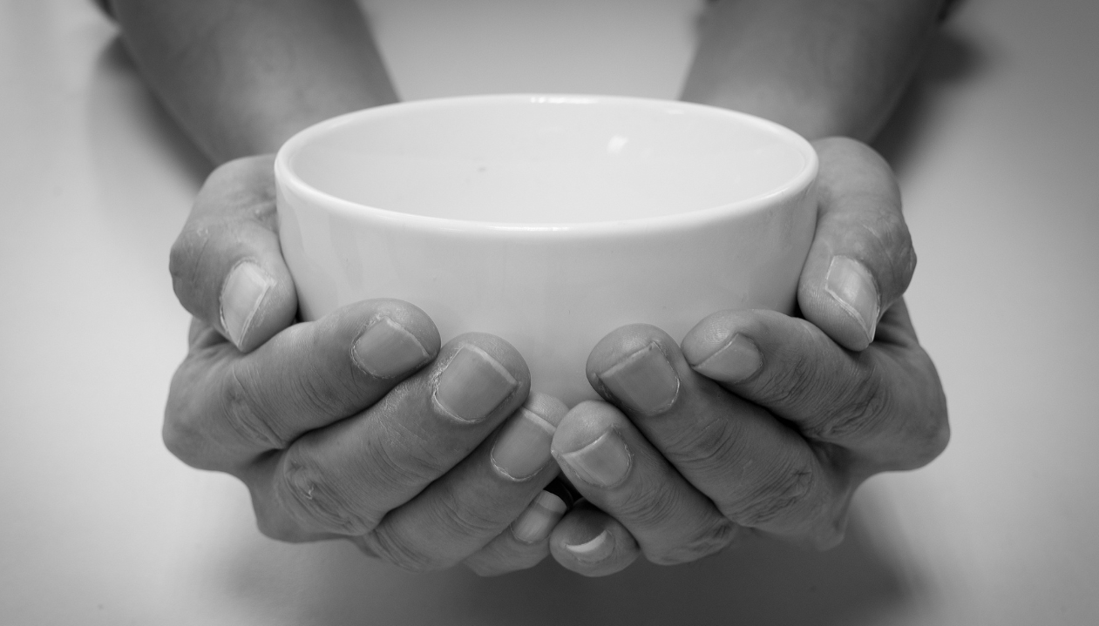
Climate change worsens global hunger.

Slide 9
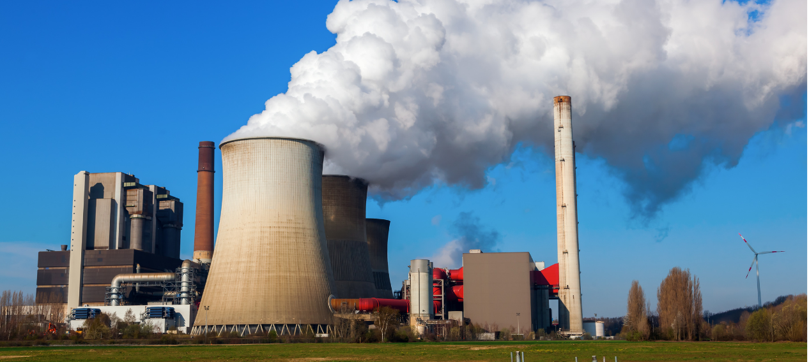
How are humans affecting climate change?

Slide 10
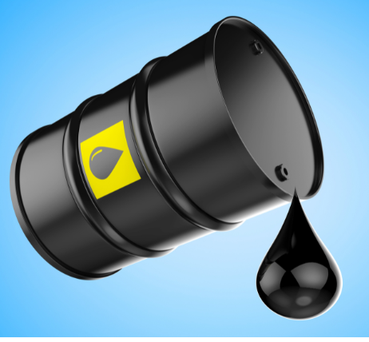
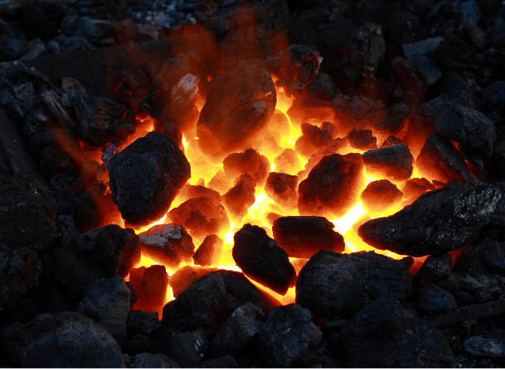
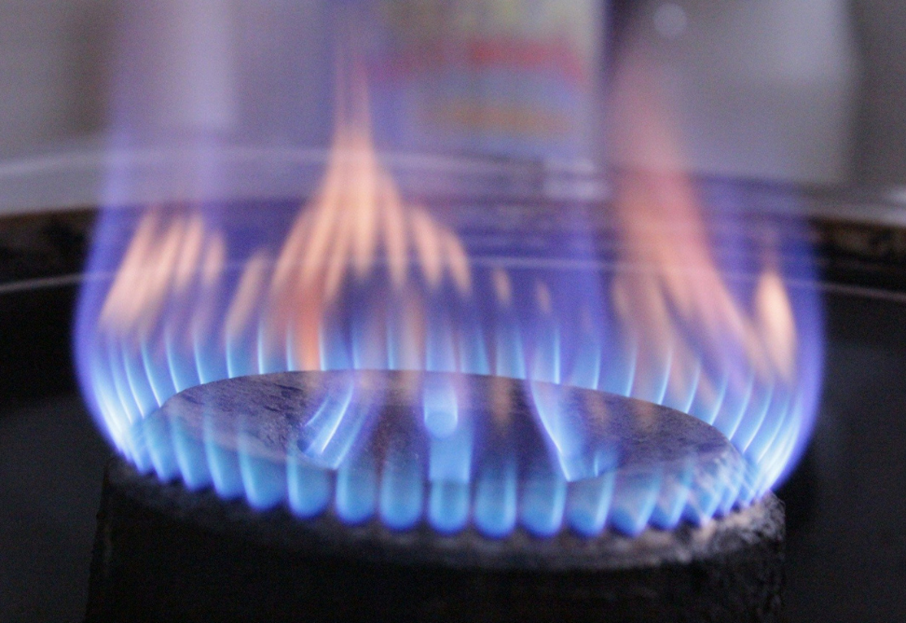
What are fossil fuels?

Slide 11

Carbon dioxide in the atmosphere causes the Earth to warm up.

Slide 12
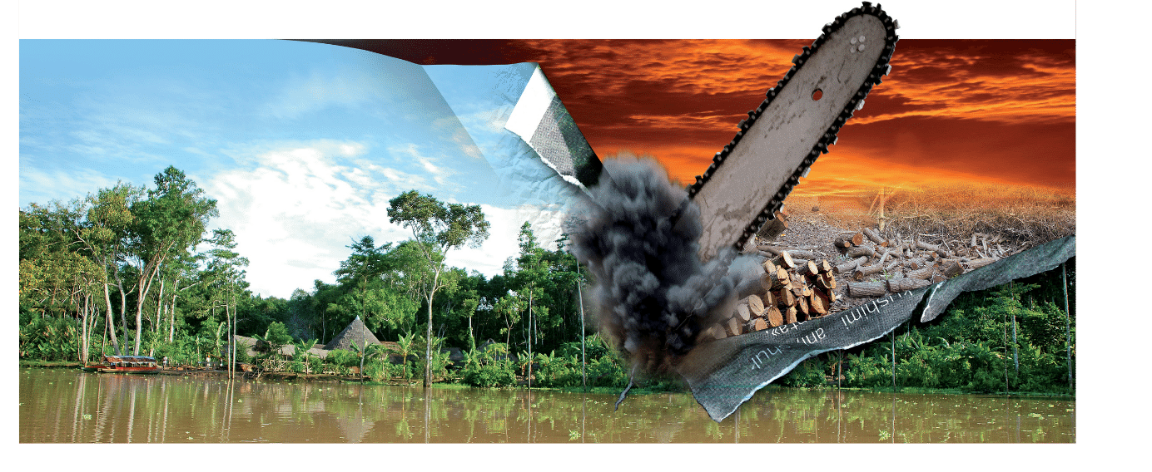
Deforestation is another cause of climate change.

Slide 13
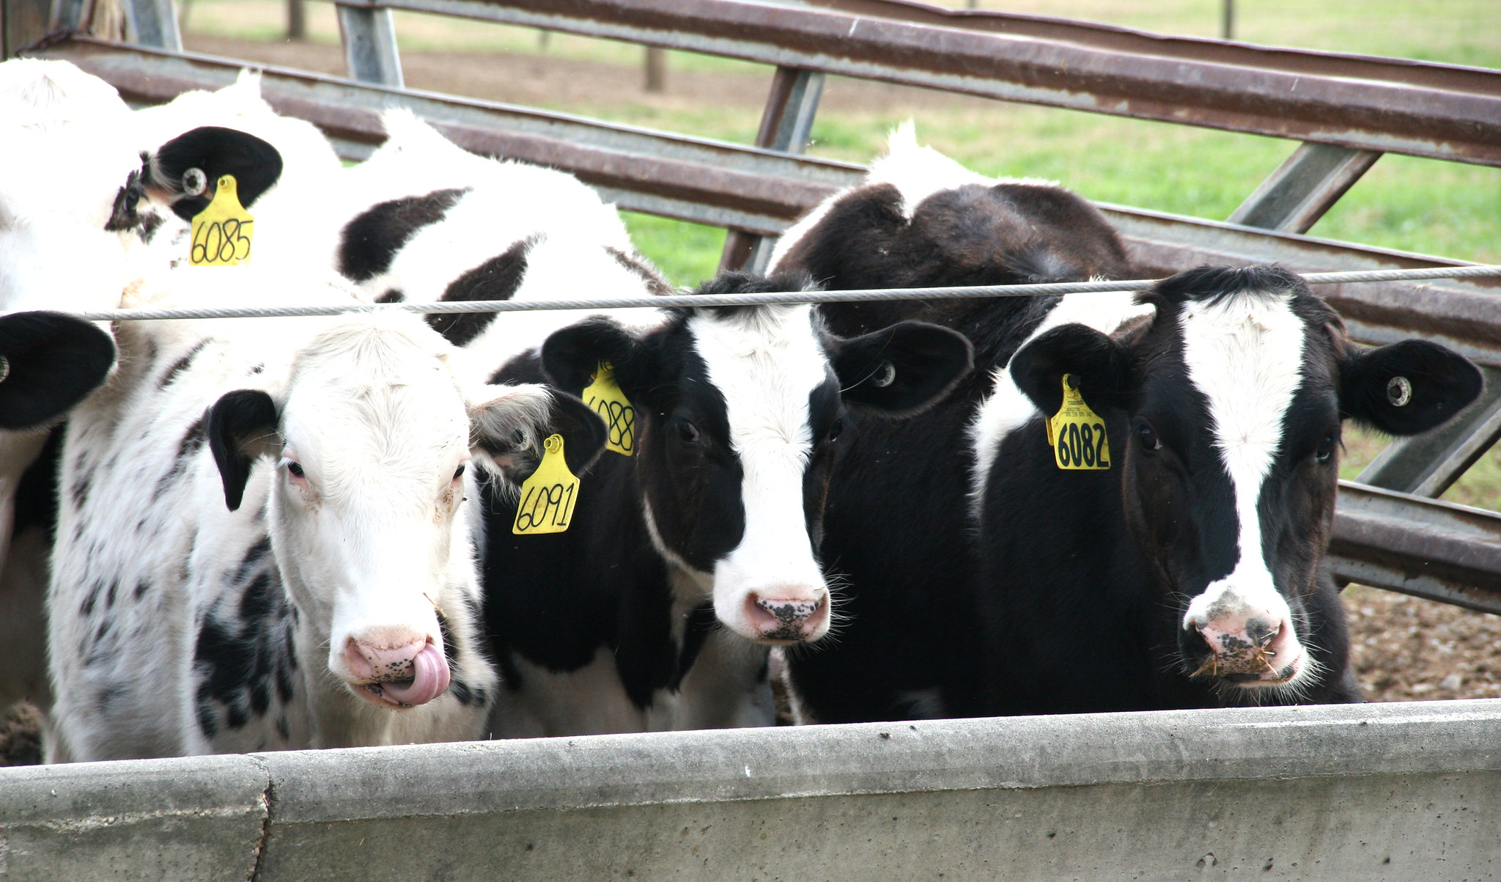
Farming causes more greenhouse gas emissions.
Photo: Clint Thompson

Slide 14
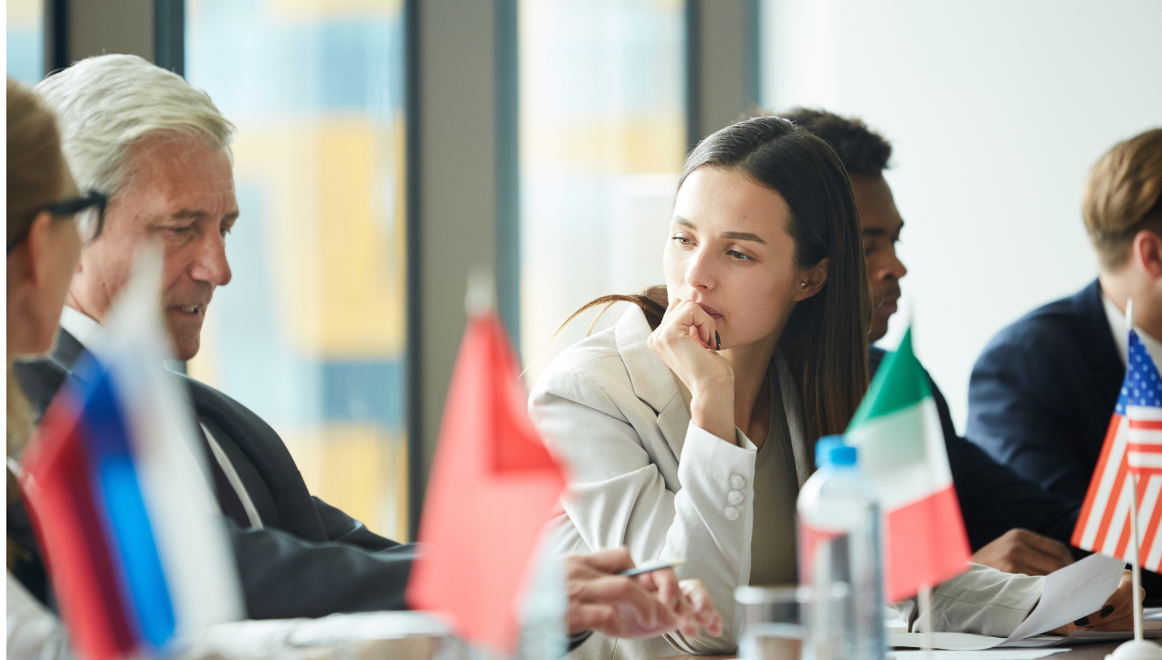
What is the COP and is it helping?

Slide 15
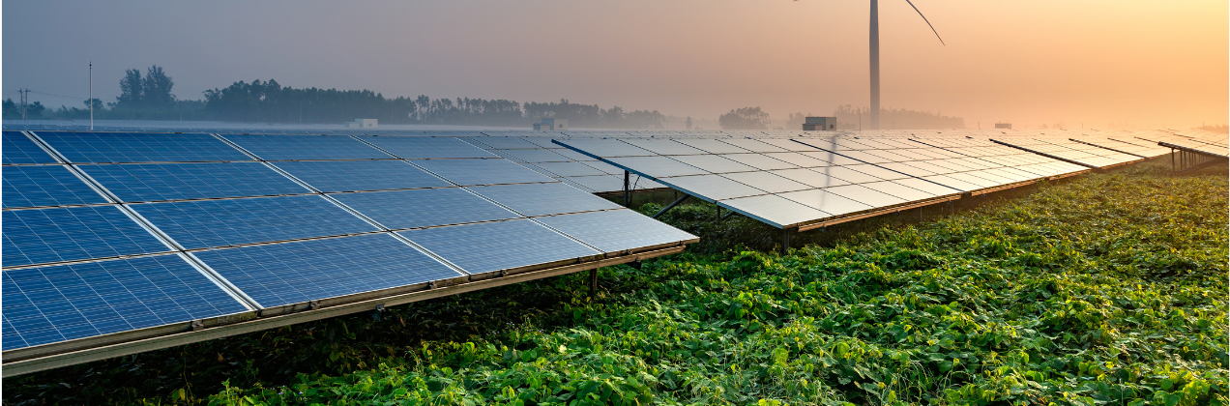
We need to find alternative sources of power.

Slide 16
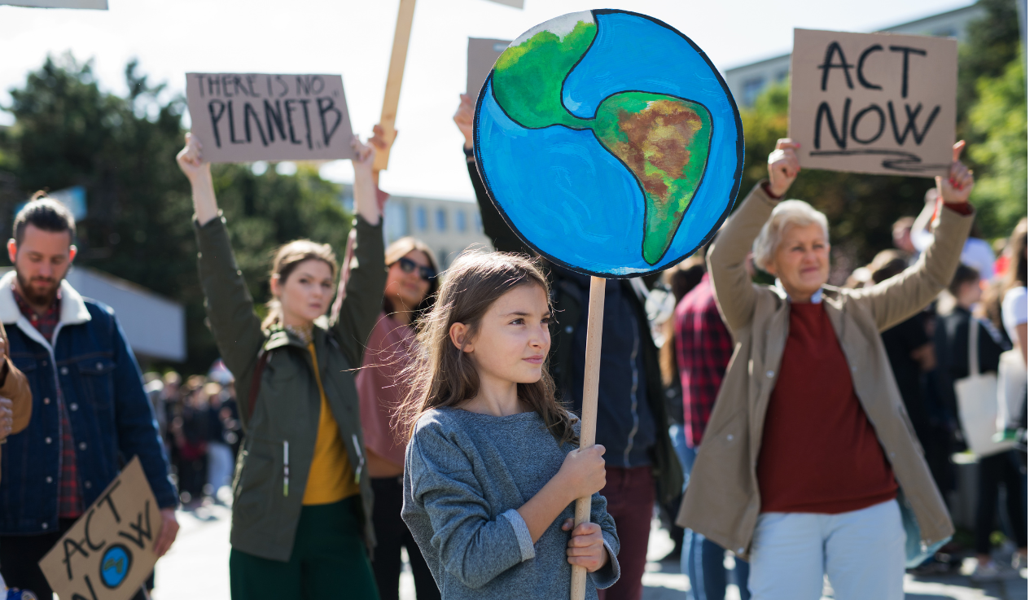
Can children have an impact?

Slide 17
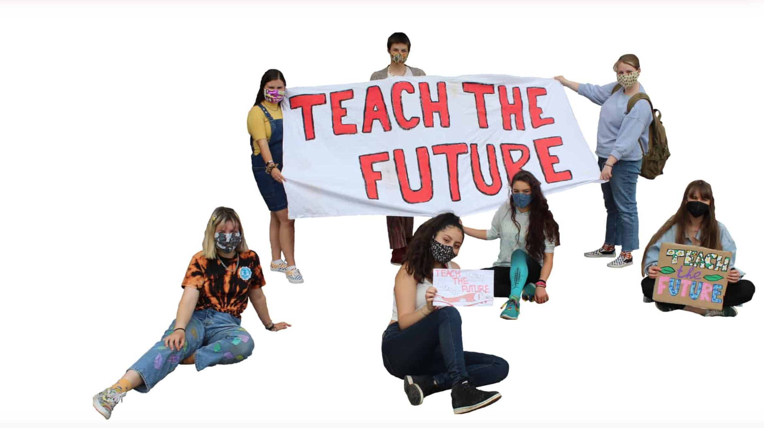
Who are Teach The Future?
Image; Teach The Future

Slide 18
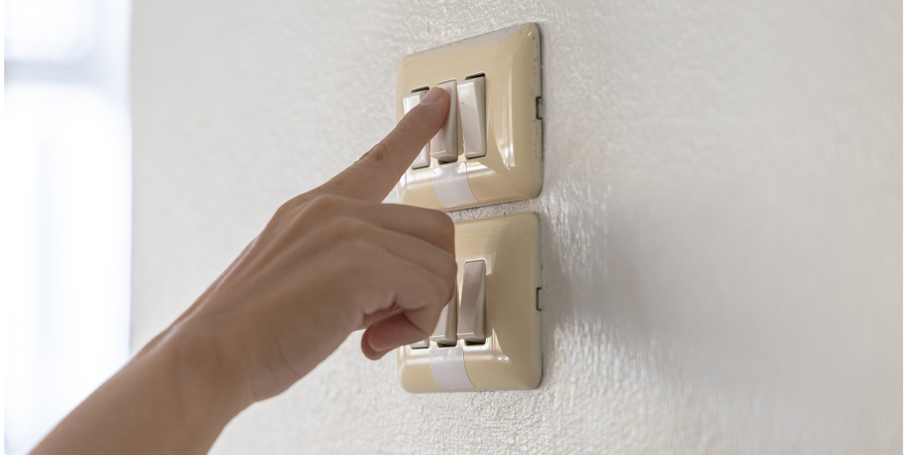
Reduce our use of electricity.

Slide 19

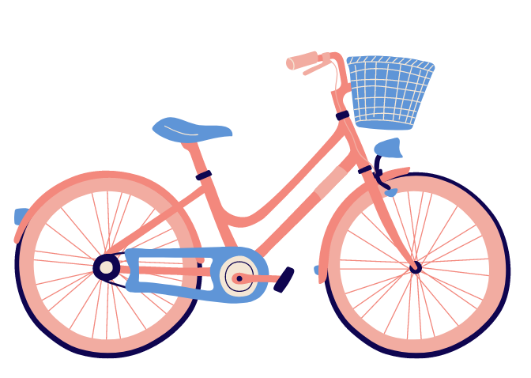
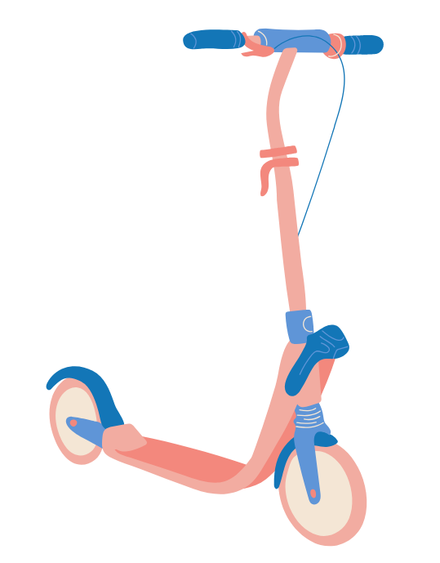

Change the way we travel

Slide 20
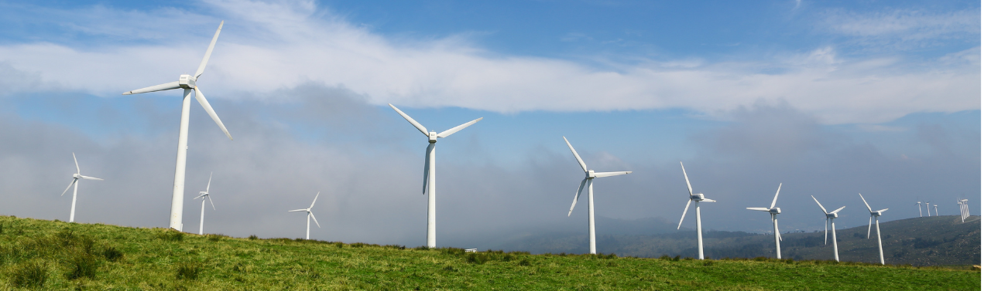
Find ways to support green energy.

