Slide 1
Stone Creek canyon 2018 annual members meeting
October 2, 2018
6:30 PM
Stone Creek Canyon Club House

Slide 2
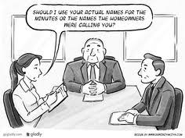
Opening remarks
Date & Time of Annual Members Meeting Provided To Home Owners
Monthly Statements
Community Website
Community Newsletter
Community Mailbox
Notes:
Presented By: Rob

Slide 3
Pulse check
NAME
Building & Unit Number
Provide Proposed Solution
Address Concern
Provide Positive Praise
WHAT IS YOUR PROPOSED SOUTION AND ITS OVERALL IMPACT TO THE COMMUNITY?
Notes:
Presented By: Rob

Slide 4
REVISIT: HOMEOWNER PRESENTATIONS
Community Flag Participation
Landscape (Grass & Trimming)
Laurie Donaldson – Flag Project
Gail Geiger – Specialized Bids
Trees & Bushes
Sprinklers
Collect Specialized Bids For Each
Notes:
Presented By: Rob

Slide 5
2018 Year in review
Notes:
Presented By: Gerald

Slide 6
accomplishments
Hired New Property Management Company
Implementation of Community Website & Newsletter
Based on 2018 Fall Survey – Action Items Roll-Out
Adopted New Pool/Hot Tub Rule to Allow For Less Enforcement & More Fun
More Transparency
Overall Feelings Within The Community – Net Promotor Score
Replacement of Road, Drive Ways/Cement Project, Grass/Trees
“Recycle Bin” Program (Junk Mail), Dog Waste Signs, Clubhouse Message Board
Audit – Expected Completion: 09/31/2018
Reserve Contributions and Owner Maintenance Obligation
Various Quarterly Community Events
1Q 2018 – Interior Design Workshop
2Q 2018 – Identify Theft Presentation
3Q 2018 – First Annual Pool Party & BBQ
3Q 2018 – Community Garage Sale
4Q 2018 --Holiday Social (Interest?)
Clubhouse Repairs/Maintenance (A/C Unit, Doors, Painting of Club House Bathrooms)
Notes:
Presented By: Gerald

Slide 7
Current projects
Updated Wasatch Reserve Analysis Study – Include Sewer
Action Item Software Roll-Out
Analyzing 2018 Fall Community Survey
Seek Volunteers To Form Sub Committees
Entrance Lighting Project
Community Face Lift Project
Bark Replacement ($12,500)
Increase Community Involvement & Participation
Increase Awareness
Needs vs. Wants Project (Begin This Evening)
Launch Communications Project
Continue To Drive Positive Net Promotor Score
Notes:
Presented By: Debbie

Slide 8
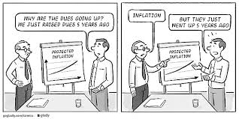
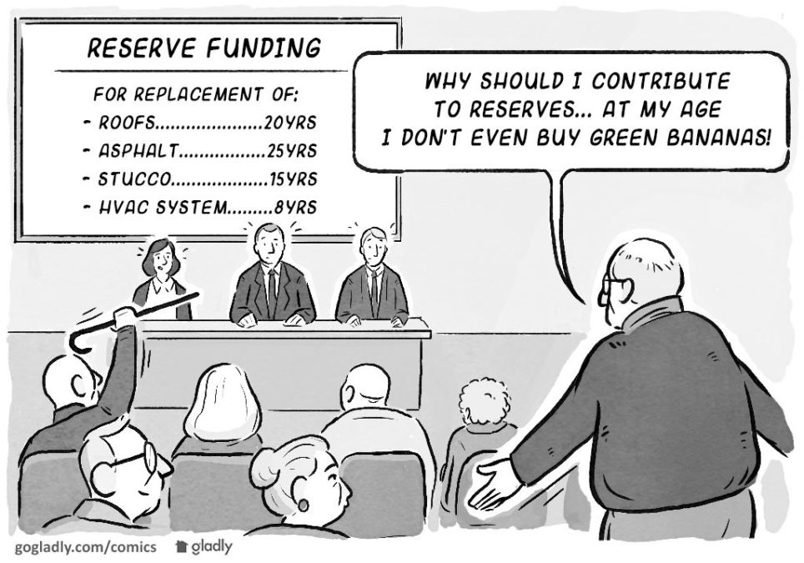
Opportunities & challenges
Community
Face-Lift
&
Other Projects
--
Home Owners Needs And Wants
Reserve Funding
HOA Dues Affordability
Currently $146.00
Is There A Maximum HOA Cap?
How Do We Maintain?
Individual Wants vs. Needs?
What If?
Plan For Un-Expected Capital Expenditures
Increased “Buy-In or Transfer Fee” From $ 200.00 to $ 500.00 – Directly To Reserves
Landscaping – Current Vendor
Services vs. Budget
Past Vendor Relationships
Trees/Bush Replacement Project
Bark Replacement Project
Sprinkler Project (Timing/Schedule)
Extension of Pool Hot / Tub Season
Notes:
Presented By: Rob

Slide 9
Stone Creek canyon
Stone Creek Canyon
Ranch View Townhomes
Black Hawk Townhomes
Stone Creek Ranch
The Meadows @ West Haven
Rose Wood Manor Condos
Royal Woods Condo Assoc
$146.00
$155.00
$198.00
$165.00
$100.00
$175.00
$25.00
No Pool/No Clubhouse
Pool Amenities
Gym Amenities
Community Club House
Garbage
Landscaping
Snow Removal
Building Insurance (Outside)
Property Management
Private Roads/Sewer
No Pool/No Clubhouse
No Pool/No Clubhouse
No Building Maintenance
No Insurance
No Pool/No Clubhouse
No Pool/No Clubhouse
No Pool/No Clubhouse
Notes:
Presented By: Richard

Slide 10
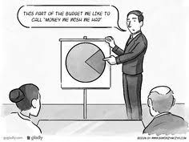
Income Statement & profit and loss statement
www.stonecreekcanyonhoa.org
Website Navigation
Notes:
Presented By: Rob

Slide 11
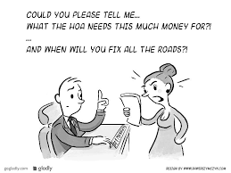
Needs & wants vs. capital expenditures Keeping monthly assessments dues at a minimum vs. unexpected special assessment
Landscaping & Snow Removal --- $$$ HOW MUCH DO WE SPEND $$$
What Do We Envision As A Community?
How Much Are We Willing To Spend To Achieve That?
What Sacrifices If Any Are We Willing To Make As A Community?
Past Landscapers / Feedback From Surveys
Extended Pool & Hot Tub ($8000 10/31/2018)
Community Landscaping Face Lift ($12,500 Bark)
Replacement of Stucco
Sprinklers (Timing/Schedule) – Re – Configuration ($10,000)
Capital Expenditures
Pool Pump, Club House A/C
Notes:
Presented By: ALL

Slide 12
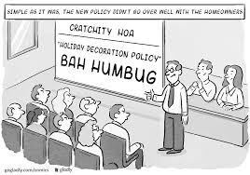
Pride within the community
Participation & Engagement
Knowing Your Neighbor
Mutual Respect
&
Trust
Not Passing Blame or Judgement
Being Part Of The Solution
Not Problem
Net Promotor Score:
The Net Promoter Score, or NPS, is a simple survey method to help you determine how loyal your customers are. NPS is a customer satisfaction metric that measures, on a scale of 0-10, the degree to which people would recommend your company to others.
Customers who answer with a 9 or 10 would most likely recommend to a friend, so they are promoters.
Customers who answer with a 7 or 8 are neutral, so they are passives.
Customers who answered between 0 and 6 most likely wouldn't recommend to a friend, so they are detractors.
0-6 27% (16 Respondents)
7-8 47% (28 Respondents)
9-10 27% (16 Respondents)
2018
0 NPS
What Are the Benefits Of A Positive Net Promotor Score?
What Are the Pitfalls of a Negative Promotor Score?
Dog Waste
Weeding
Garbage
Littering
Notes:
Presented By: Rob

Slide 13
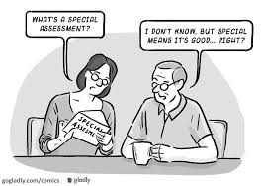
What If calculator . . .
Notes:
Presented By: All

Slide 14
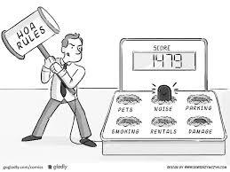
2019 proposed rule changes
Parking Pass: Add: The use of a parking pass does not allow for vehicles to be used as a storage area. Cars with a parking pass may not be parked in guest parking for longer than 7 days, without being moved.
Pool: Modify & Add: No running, jumping, or diving into the pools, or walking on the pool cover at any time.
Pool: Add: Significant pool rule infractions can bypass standard warning practices as the board see fits depending on the infraction and could result in an immediate fine and loss of pool privileges.
Collection of Fines: Add: If your account goes past due 45 days your amenity key will be deactivated until your account is brought current. An administrative fee will be charged to reactive your key fob. Please refer to the simplified fee schedule.
Notes:
Presented By: Debbie/Gerald

Slide 15
PROJECT UPDATE

Slide 16
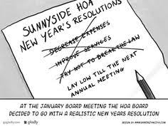
Mark your calendars
2019 Annual Home Owner Meeting
January
Q2 2019 Board Meeting
April
Q3 2019 Board Meeting
July
Q4 2019 Board Meeting
October
Adopt & Approve Operating Budget
Elect 2 New Board Members
2018 Projects
Notes:
Presented By: Rob

