Slide 1
Big Train Operator’s Club
45 Annual Convention
Bird In Hand, PA

Slide 2
45 ^{th} BTO Convention Review for
Georgia Garden Railway Society
Differences between National Railway Convention and the BTO convention
  The BTO convention is much smaller than the National Convention
  The BTO concentrates on visiting local railroad attractions rather than doing all tours of layouts
  Nightly Raffles for train cars, engines, etc.
  Nightly Trivia Contest
  Free vendor tables for club members wishing to sell items

Slide 3
45 ^{th} BTO Convention Review for
Georgia Garden Railway Society
Convention highlights include:
  Train layouts with member trains running while convention room is open.
  All Aboard Party for all registered convention attendees
  Ice Cream Social for all members
  Wine and Cheese Party for the women attending the convention
  Tim Stumps famous train draw races
  Clinics
  Open Convention room each night
  Farewell Banquet

Slide 4
Train Layouts Overview
One or two layouts in convention room
Around the pond layout
  Large pond at facility site
  Plan to put track around the pond
  Run any Member battery powered train
    Long enough to have Multiple trains on track
  Smaller track in shelter next to pond for track powered trains
  Opportunity to share hobby with locals who visit BIH and the ice cream stand next to pond.

Slide 5
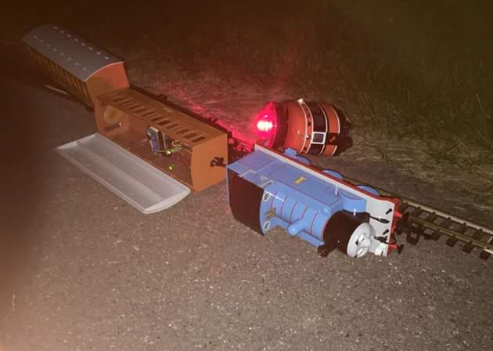
Past Experience at the pond!

Slide 6
Pond Experience
Two trains on track
  Thomas with coaches and an Eggliner
  Two different operators with Revolution running in the evening
  Eggliner ran into Thomas
  Accident investigation held neither engineer accountable due to drinking or other unacceptable behavior. Cause of accident never determined. But lots of stores around it!

Slide 7
Social Activity
Due to the number members attending provides for opportunity to socialize with other’s in the G scale world
  We will have bus service to and from the events which allows time to discuss what we will see and what we did see
  Build your own layout give members an opportunity to show off their skills and share their trains with the convention attendees
  The drag races are like going to the racetrack without the betting (at least I don’t know of any bets) Members line the length of the drag track and cheer on their favorite trains
  Convention room is open each night and is a gathering place to talk about the day’s activity and discuss plans for the next day’s activities

Slide 8
Member experience
An older couple that had never attended a BTO convention was entice to come to the convention that was held in the White Mountain retreat.
They knew no one in the cub and was hesitant about coming. They only knew myself and my wife. We insured them they would have a good time.
We had dinner with them the first night and never saw the again as they made many new friends
When they got home the first thing the wife did was look up where the next convention was to be held and told her husband they were going!

Slide 9
Summary
My wife and I have been to the last 10 conventions since joining the club. During the same time period we have attended 5 of the national conventions. The two conventions are night and day to us. We enjoy seeing all the home layouts, but the in and out of the bus while doing the tours is very tiring. And evening activities are limited.
The BTO is smaller and has only one or two events a day with one day spent at the hotel and another “free” day where you can enjoy local venues that might only interest you or at least a very small group. We have enjoyed these free days visiting interesting sites that were not on the formal schedule but were special to us
I urge you to look over the schedule on the BTO web page, make your hotel reservations and fill out the registration form and come join us for a week of fun with a great group of railroad fans!
Charles Bartel, President

