Slide 1
Cultural Bias Cuts Both Ways
Comfort Homesake Explores the Dynamics of Cultural Relevance in the Healthcare System

Slide 2
Housekeeping
This webinar is being recorded
Post questions in the chat or Q&A box at any time
Questions will be answered at the end of the presentations

Slide 3
INTRODUCTIONS
Marilyn Ababio, Moderator, Comfort Homesake, Founder
Nandi Marie Davis, Moderator, Comfort Homesake, Co-Founder
Cindy Burnett, Board Member Panelist
Chaplain DP Miller, Board Member Panelist
Dr. Jamila Dugan, Board Member Panelist
Sally Huang, Asian Network Pacific Home Care and Hospice, Panelist
Safia Quinn, Learn.Master. Change, Consultant
Notes:
Greetings attendees.

Slide 4
THE TOPIC IS NOW, HERE’S WHY
Comfort Homesake Explores the Dynamics of Cultural Relevance in the Healthcare System
Notes:
Many factors including culture and ethnicity determine thoughts about death. Let’s start with a couple definitions: Culture is a group’s worldview and values. Ethnicity is one’s self-identified group and may include subgroups that share common values. Culture shapes our healthcare choices. What do we mean by that: Well how do we decided our - preferences about life support, resuscitation and feeding tube?. How do we decide whether or not to be told one has a terminal diagnosis. Your preferences will determine whether you want to die at home, in a hospital or in a hospice. Furthermore we understand In many cultures, talking about death is taboo because it might bring sadness or hasten the demise. Our western healthcare system is also a culture that is dominant when we are hositalized. Hospitals are best a fixing broken bones, replacements, transplants, surgery, etc. The healthcare system gets high marks for repairs. However, We , the public suffer when it comes to expecting the healthcare system to support people managing chronic diseases or at end-of-life. The lack of open and culturally sensistive discussion between doctors and patients and among families often means that any patient’s choice for life support or not, and other quality of care decisions probably go undocumented and ignored. Life and death decisions are some of the most dynamic expeiences we will have yet we leave it to chance. . It is Comfort Homesake’s mission to prepare every family to understand that as we are born we are meant to die. It’s about how we live! How we want to die shoulld be thought about, talked about and documented so that your medical team and family know your wishes.

Slide 5
COME ONE, COME ALL
You are in the right place!
Notes:
We understand that everyone wants to live a healthy and happy life forever. Is that possible? (pause) A 2012 CDC study shows that most Americans will have one or more chronic disease by the time they are 50 and possibly two or more in their 70’s. There are many years in which we manage our health with the help of physicians and some on their own. In surveys Latinos held a different view about life support -⅓ opposed life support that prolonged suffering. Most Latinos were unfamiliar with hospice. Hospice serves primaily whites at 83% a few native americans 6% ; african americans 8% and latinos 3%. However at end-of-life these are the ethnic and cultural groups that are the most unprepared. Doctors ask patients and their families about life support. What do we say if we don’t know what resuscitation is? How do we choose for someone else?
At Comfort Homesake our training has a higher rate of advance directive completion than the national average among diverse communities. Why? Because our training is compassionate and speaks the language of emotion. We create space for cultural diversity and have a profound respect for your rights.

Slide 6
Let's Hear from our Panel
(3) Panelist, please share your stories
Notes:
W
We have assembled a panel each with a unique perspective on the questions of culturally diverse communities and health care. Panel members will talk to us about their experiences and stories to give us an idea of how random health care can be. Listen if you can for the low point; the rise and the decision-making or recommendation each panel member.
I will begin … My son was diagnosed with ALL at 13 years old. For 7 years he was in and out of hospitals landing at UCLA medical center at 20 yrs old where he died. We had established a very comforterable relationship with the medical team at UCLA and I dare say they liked our family. After an unsucceful bone marrow transplant his health declined and he was again hospitalized this time released in one day. That day when I came to visit he was released and I wondered why but the nurses shrugged their shoulders and told me doctors orders were to send him home. That night he was breathing so rapidly I was freightened and we returned to the hospital. He was taken to ICU and intubated. He died later that day. Why wasnt I told he was in active stages of dying? why wasnt I allowed to say goodbye and perform some of the rituals important to my family and culture? Why couldn’t he have died at home? Had we only known. If someone, our doctor had talked to me we could have done so much better for him. I will regret no having that knowledge until the day I die. So we founded Comfort Homesake wit the mission to provide advanced health care planning and document wishes so medical teams know that most patients want to know what’s going on….we plan to do this work until every family in America and the world is prepared.
Panelist tells their story in order of the “introduction” slide, This is the panelist “WHY” story. WHY are you in your profession?, WHY do you relate to Comfort Homesake mission?
Nandi, thank panelist and tell us whats next.

Slide 7
Case Study 1
- Read by Nandi Marie Davis, Managing Director

Slide 8
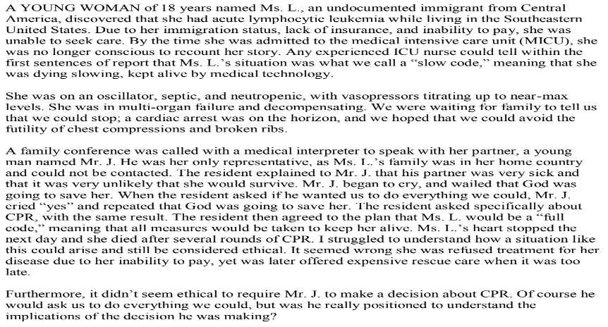
Case Study 1

Slide 9
PANELIST RESPONSES
What caught your attention about the case study?
What parts remind you of your own experience?
What appears to be the central issue or key problem area?
What does it mean to have experienced this?
Jump right in!

Slide 10
Case Study 2
- Read by Nandi Marie Davis, Managing Director

Slide 11
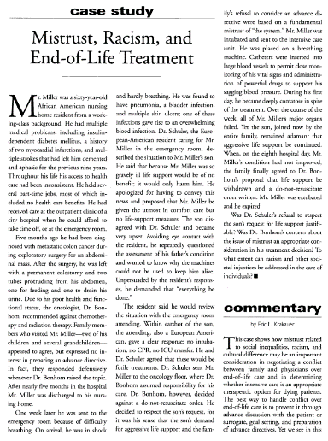
Case Study 2

Slide 12
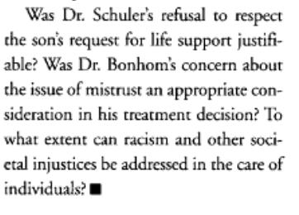
PANELIST RESPONSES
What caught your attention about the case study?
What parts remind you of your own experience?
What appears to be the central issue or key problem area?
What does it mean to have experienced this?

Slide 13
Open Discussion
Notes:
This is the Question and Answer part of the webinar. We invite attendees and panelist who wish to comment to continue the discussion. Attendees please raise your electronic hand. To be recognized.

Slide 14
The Close
Notes:
Ladies and gentlemen thank you for your participation in this webinar. There is a lot more to be said and experiened. For more than 12 years Comfort Homesake has been working in community with a number of groups that hold different views to answer the question what do you say and do when you have to make healthcare decsions for yourself or someone else. On-line training courses and in-person courses allow participants to complete an Advanced Directive. This document will answer questions about your medical preferences (personal to you ) and greatly help your doctor and medical team. Please go to ComfortHomesake.com to download a free AD.

Slide 15
To increase national awareness about aging and advance health care planning until every family is prepared
The Comfort Homesake Mission
Notes:
Comfort Homesake’s mission is:

Slide 16
#UNIVERSALCOMFORT
Discount Code: ABABIO
#Comfort Homesake: Universal Comfort: A 4-week online sensitivity training for healthcare providers, professional and at-home caregivers. Comfort Homesake’s culturally relevant training is for people serving people.
Continuing Education Units (CEU's) are available upon request. https://learnmasterchange.teachable.com/p/comforthomesake
Notes:
My name is Safia Quinn, I am the consultant that helped Comfort Homesake create and launch, “Universal Comfort”a online courses that (Big Promise Statement, below) I feel grateful to have created a national multicultural passionate about having a national message to prepared families for inevitable events
Master the tools to advocate for patients, clients and loved one before a medical emergency, hospitalization and recovery. Medical professionals can Improve the quality of life for themselves, staff, patients and their families. Our goal is to improve the quality of care we receive and impact the high cost of medical care and out-of-pocket expenses.

Slide 17
THANK YOU FOR ATTENDING!!
LIKE US ON FACEBOOK
Notes:
Join our facebook family and share your thoughts.

