Slide 1
Discover Lawrenceville, Virginia
400 North Main Street
Lawrenceville, VA
434.848.2414
https://lawrencevilleweb.us/
WE ARE LAWRENCEVILLE and TOGETHER WE WILL BUILD A NEW FUTURE

Slide 2
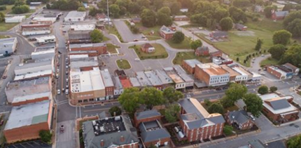
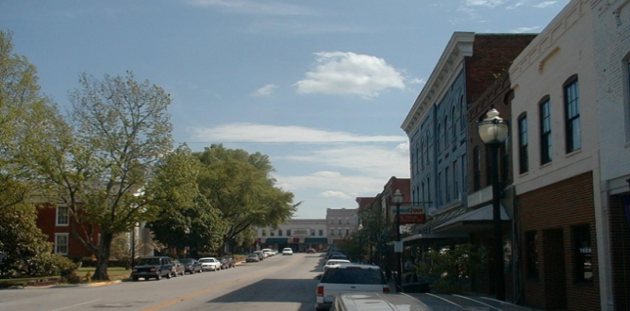
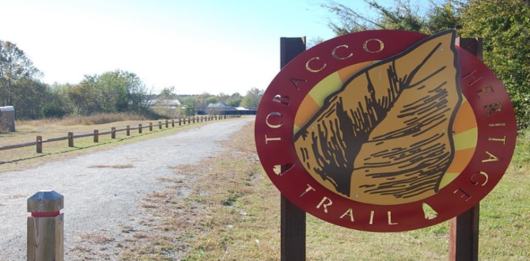
We are Lawrenceville, Virginia
And Together We Will Build a New Future
Town of Lawrenceville Vision Statement
The Town of Lawrenceville seeks to maintain its small-town character, charm, and natural beauty. The Town is intent upon revitalizing its downtown and protecting natural environmental systems. It will accomplish its objectives by:
Concentrating commercial and industrial development in appropriate areas where adequate infrastructure exists to support such development
Balancing residential and commercial land uses
Maintaining and improving its infrastructure
Seeking assistance to improve neighborhoods
Seeking sustainable economic development
Protecting and preserving the natural environment and surface and ground waters
Promoting smart growth practices and prudent land use decisions and
Assessing options to provide areas where growth can occur
Town of Lawrenceville’s Vision Statement

Slide 3
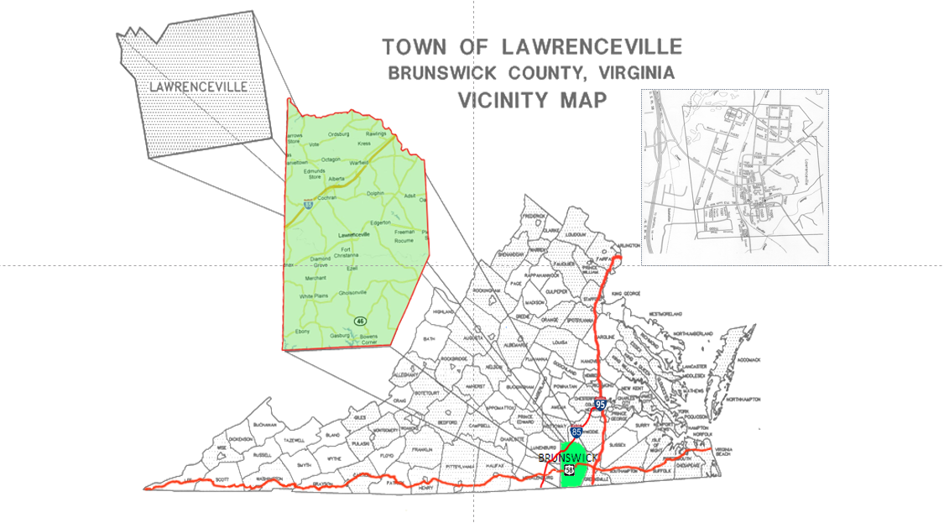
Discover Lawrenceville
D
Topography & Demographics
Lawrenceville serves as the county seat of Brunswick County, the original home of Brunswick Stew. The Brunswick Chamber of Commerce and town offices are located at 400 North Main Street, adjacent to Lawrenceville’s only traffic light. Lawrenceville is in the enviable position of being centrally located to, accessible from several major markets, and close to important transportation hubs. Lawrenceville is 75 miles from Richmond, including the Port of Richmond and Richmond International Airport; 100 miles from Norfolk with multiple Port of Virginia facilities and the Norfolk International Airport; and 85 miles from Raleigh/Durham and the Raleigh/Durham International Airport. In addition, Lawrenceville is only 115 miles from Virginia Beach; 177 miles from Washington, D.C.; 411 miles from New York, New York; and 466 miles from Atlanta, Georgia.
Lawrenceville is approximately 256 feet above sea level with elevations in Brunswick County ranging from 150 to 315 feet above sea level. The Town of Lawrenceville covers approximately 1.5 square miles, while Brunswick County reaches 579 square miles. The drainage is provided by the Meherrin, Nottoway, and Roanoke Rivers and their tributaries. The land surface slopes gradually toward the southeast. In addition, approximately 90% of the land in Lawrenceville and Brunswick County is classified 0 to 5% slope which is suited for all types of development.
In 2019, the median mortgage cost with utilities was $1,011, the median monthly owner cost without a mortgage was $379, while the median gross rent was $668. We have affordable land, housing and commercial opportunities, and are an ACT Certified Work Ready Community. We have low crime rates in our Town and County (violent crime rate is <1 per 1,000 residents and property crime rate is 5.05 per 1,000 residents). Our County is primarily made up of two racial groups: African American (Non-Hispanic-54.5%) and Caucasian (Non-Hispanic-40.7%); the median age is 43.2. Below is a table that compares the Town and County on population, housing and income data.
Town of Lawrenceville | Brunswick County
Population: 1,020 | Population: 16,231
Median Household Income: $26,369 | Median Household Income: $44,433
Per Capita Income: $14,150 | Per Capita Income: $21,732
Medium Occupied Housing Value: $97,000 | Medium Occupied Housing Value: $112,200
Real Estate: $0.34 per $100 of assessed value | Real Estate: $0.86 per $100 of assessed value
Personal Property: $1.80 per $100 of assessed value | Personal Property: $3.85 per $100 of assessed value
Discover Lawrenceville
Topography & Demographics

Slide 4
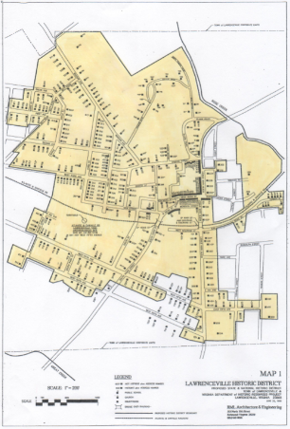
Town of Lawrenceville Incentives
D
State and Federal Tax Incentives
The Town will consider providing incentives as means of attracting suitable development including, but not limited to, waiving and reducing certain fees. Such fees include a business license fee, tap fee, water cut-on fee, and zoning permit fees. In addition, a waiver for several other fees can be negotiated. In some cases, tax credits for businesses that are part of a renovation or relocation may be available.
Under the laws of the Commonwealth of Virginia, the Town of Lawrenceville has created an Enterprise Zone in which businesses can qualify for benefits if they meet certain requirements. Businesses can apply for grants to offset the costs of employee wages and health benefits. In addition, businesses can refer directly to the Virginia Economic Development Partnership (www.vedp.org) and Virginia Department of Housing & Community Development (www.dhcd.virginia.gov)
websites for additional incentives.
Lawrenceville Historic District
A total of 431 properties have Historic District (HD) contributing designation, which makes them potentially eligible for Historic Tax Credits; these properties consist of: 423 buildings, six structures, one object, and one site).
Business Services
In addition, property owners are entitled to apply for real property investment grants to offset the cost of building facilities and approving properties for up to five (5) million dollars. The Town of Lawrenceville, through the Brunswick Chamber of Commerce, provides business promotion services such as: marketing via social media, hosting activities, promoting networking opportunities, and sending local publications to businesses.
Town Tax Incentives & Historic District
State and Federal Tax Incentives & Business Services

Slide 5
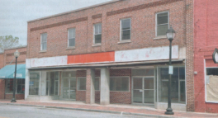
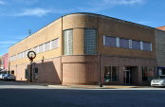
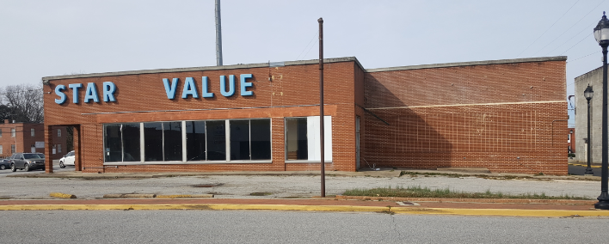
High Potential Downtown Properties
D
High Potential Downtown Properties
Corner of Hicks and Main Street
(Peebles Property)
113-115 W. Hicks Street
This 1920 two-story building is 8,320 square foot. It has been zoned as mixed-use commercial and is available for Historical Tax Credits.
305 New Hicks Street
(Star Value Property)
Peeble’s was built in 1900 and is located at the corner of Hicks and Main Street in Downtown Lawrenceville. This building has three levels, which consists of a basement that is 6,765 square feet while the two above grade levels are 13,530 square feet. This building has been zoned as mixed-use commercial and is available for Historical Tax Credits.
High Potential Property: Peebles
High Potential Properties: Hicks Street
The Star Value building was built in 1955. This property is 11,984 square feet with a 200 x 20 lot and 25,000 square foot paved section. In addition, there is a 62 x 100 square foot porch with a 10 x 10 square foot cold storage section.

Slide 6
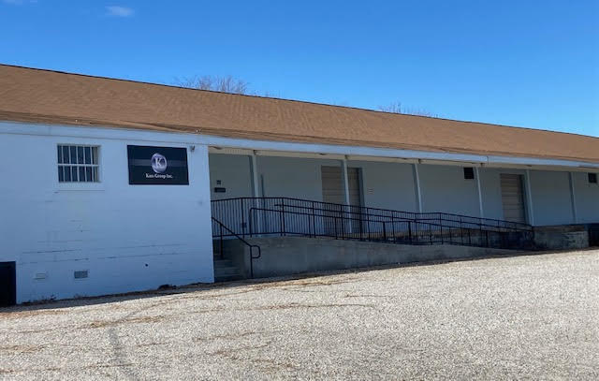
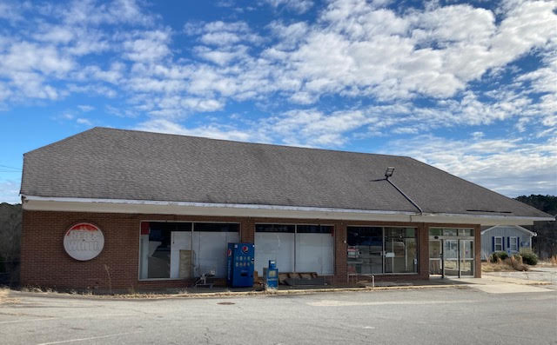
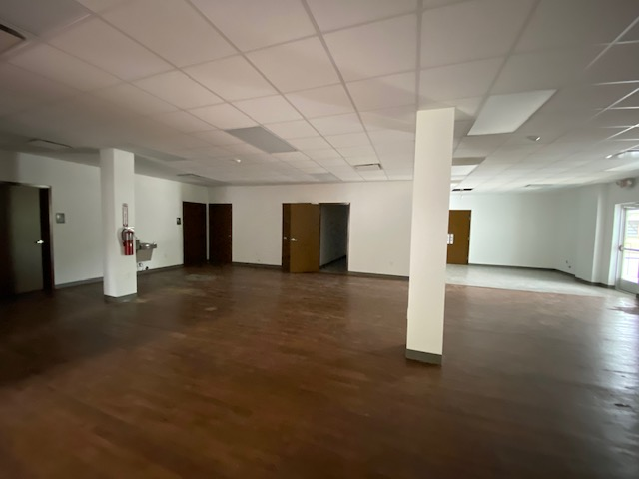
D
High Potential Properties
High Potential Properties
409 West 5th Avenue
202 Court Street
(Southern States Property)
(Red & White Property)
Red and White was built in 1964 and is currently zoned as both commercial and industrial in Downtown Lawrenceville. It is 8,768 square foot with a 728 square foot porch. This property includes two paved lots with the dimensions of
160 x 250 and 100 x 100.
High Potential Property: Southern States
This desired building was constructed in 1950 and renovated in 2019. It is 14,724 square feet and includes 1.61 acres of land. The facility is adequate for production and manufacturing and includes ample office space.
High Potential Property: Red and White

Slide 7
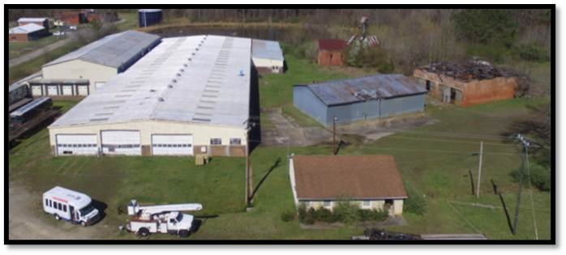
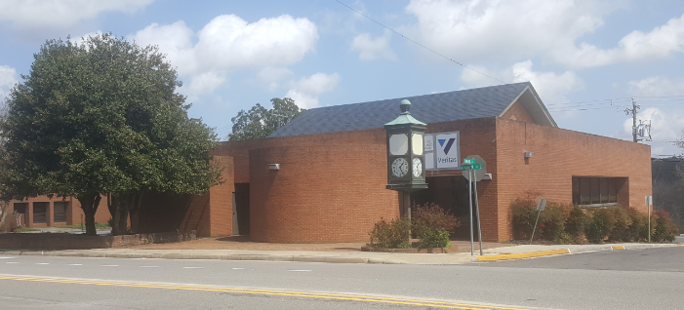
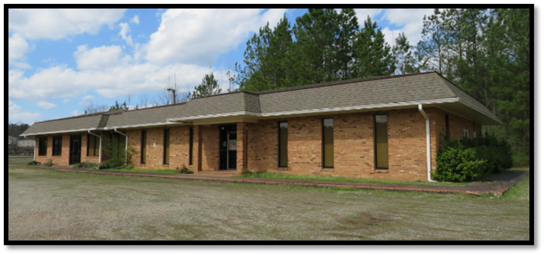
D
High Potential Properties
High Potential Properties
300 N. Main Street
1381 Brickyard Street
(Butler Lumber Property)
(Bank of America)
The Butler property includes 12 acres that is wooded/flat, has multiple structures, and is zoned industrial; the following includes the site buildings and dimensions: warehouse (45,660 sq. ft.); shop (3,000 sq. ft.); shelter (3,150 sq. ft.); and office (1,440 sq. ft.)
This beautiful Bank of America building was built in 1979 and the main level is 6,763 square feet. This unique structure has both a finished and unfinished basement; the unfinished basement is 3,381 square feet, while the finished basement is 3,382 square feet. It has a 450 square foot canopy drive thru, along with lots that are 76 x 143 and 50 x 40.
1244 Brickyard Street
(Brick and Tile Property)
High Potential Property: Bank of America
High Potential Property: Butler & Brick and Tile
This unique property comprises of 63.02 acres of land, along with office and shop structures that were constructed in 1966; the office space is 3,532 square feet, while the shop building is 3,500 square feet.

Slide 8
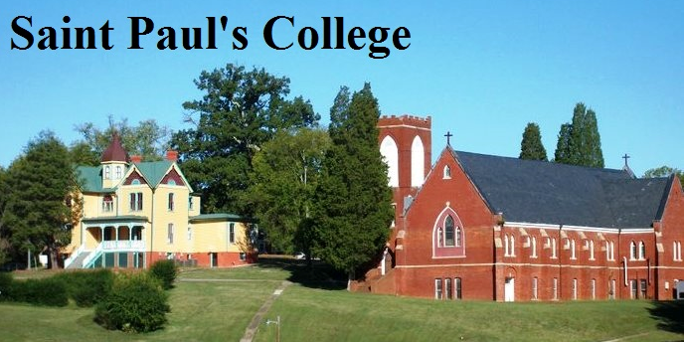
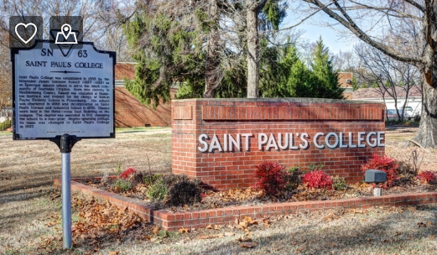
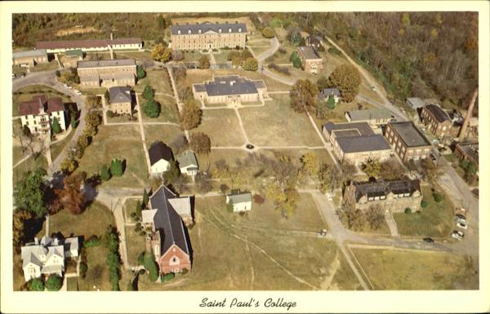
Educational/Institutional Site
D
Saint Paul’s Campus consists of 31 buildings and is situated on 135 acres in the rolling hills of Brunswick County in Southern Virginia. Founded in 1888 by James Solomon Russell as the Saint Paul Normal and Industrial School and affiliated with the Episcopal Church, Saint Paul’s College was a private, historically Black, accredited, four-year coeducational liberal arts institution of higher learning until closing in 2013.
The historic campus and architectural structures are listed on the National Register of Historic Places. In addition, 17 buildings are eligible for Historic Tax Credits.
Educational/
Institutional Site
Saint Paul’s College

Slide 9
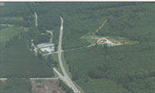
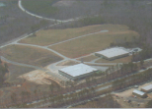
Industrial Sites Supported by Town of Lawrenceville Water/Sewer
Industrial Sites Supported by Town of Lawrenceville Water/Sewer
D
Interstate 85 Business Center Park
Brunswick County Industrial Park
The I-85 Business Center Park is a 114-acre business park located on 4-lane U.S. Route 1 and within one-half mile of Interstate 85. It is designed to provide your company with a competitive advantage, as it is located within a Business and Technology Zone and one-half mile from Southside Virginia Community College. Water and sewer are provided by the Town of Lawrenceville, electricity is provided by Dominion Energy, and fiber optics is provided by Verizon. Tracts are available from five acres to 114 acres, and the topography is level/gently rolling. This site has been designed as a Mid-Atlantic Broadband GigaPark.
The Brunswick County Industrial Park is located on 4-lane U.S 58 in a Virginia Enterprise Zone that is eligible for several State incentives for qualified businesses locating or expanding in this particular area. The Industrial Park is a fully developed infrastructural zone that includes: (1) high-speed fiber optics (provided by Verizon); (2) water and sewer (provided by the Town of Lawrenceville); (3) natural gas (provided by Columbia Gas); (4) electricity (provided by Dominion Power); and (5) the proximity to I-85 and I-95 and the Mecklenburg/Brunswick County Regional Airport. Tracts are available from five (5) to 46 acres, and the topography is level/gently rolling. This site has been
designed as a Mid-Atlantic Broadband Giga Park.
Industrial Property: I85 Business Center Park
Industrial Property: Industrial Park

Slide 10
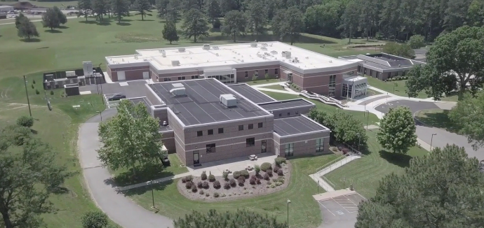
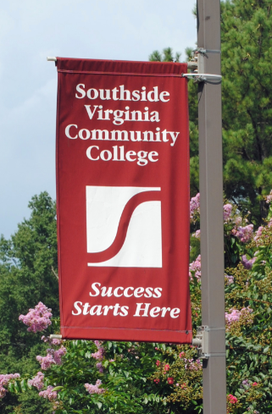
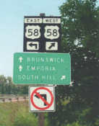
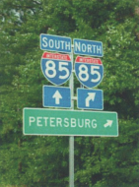
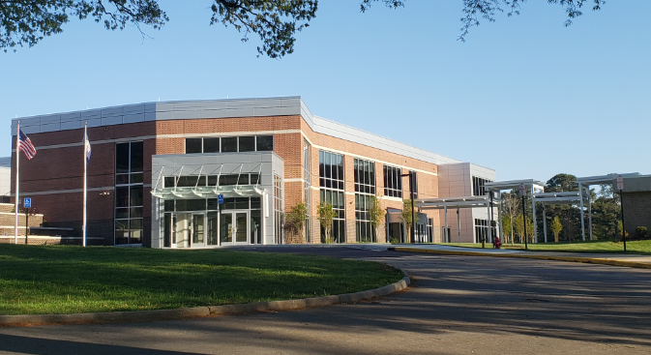
Why Lawrenceville?
D
Why Lawrenceville?
Extensive Transportation Network
Lawrenceville is fortunate to have three major US highways traverse the County. I-85 is a major interstate corridor connecting Central Virginia to the central North Carolina metro areas and Atlanta, as well as connecting to I-95 to the north. U.S. Route 58 serves as a major highway across Southside Virginia and connects points east of Lawrenceville to the ports in Hampton Roads. It also connects to I-95, 17 miles to the east, which provides easy access to the entire east coast from Maine to Florida. U.S. Route 1 parallels I-85, which provides local access to many Brunswick communities and serves as a connector to the interstate. State Route 46 serves as an important link to I-85 and as a north-south connector in the County.
Significant Education Institution
Located 7 miles from Downtown Lawrenceville, Southside Virginia Community College(SVCC), Christanna Campus, is a two-year institution of higher learning with an emphasis on dual enrollment students from local high schools, GED students, middle college students, and students needing technical training. SVCC’s workforce development services (WDS) aligns education and economic development to extend workforce development courses, training and programs into the community. WDS focuses on both customized and apprentice training opportunities.
Why Lawrenceville?
Southside Virginia Community College
Rural Small-Town Quality of Life
The Town of Lawrenceville, with its National Register Historic Downtown District, still maintains its small-town charm.

Slide 11
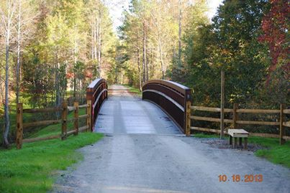
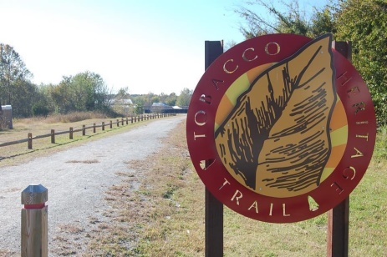
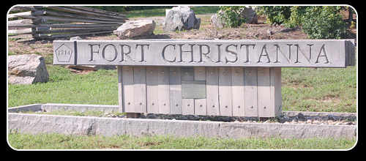
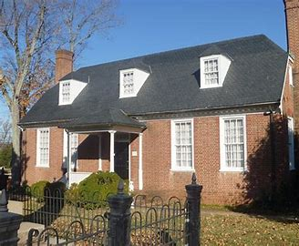
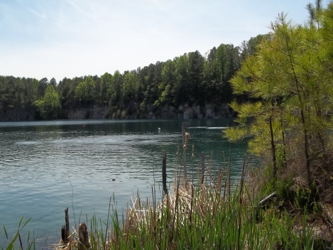
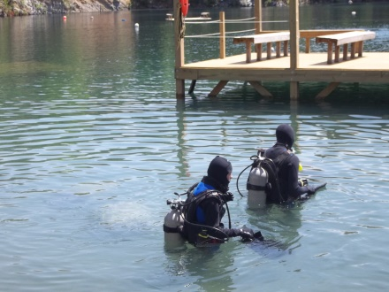
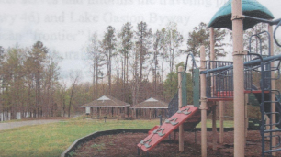
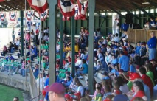
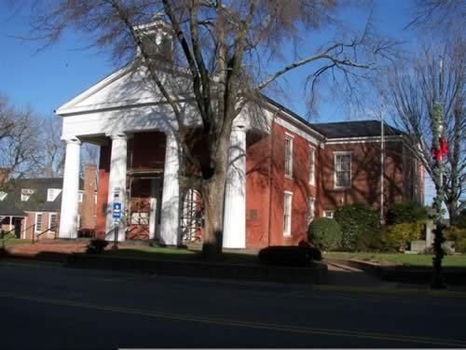
Historical Sites
D
Trails and Recreation
Brunswick County offers residents and visitors a variety of trail and recreational opportunities; these infrastructures include the following: Tobacco Heritage Trail, Civil Rights in Education Heritage Trail, Virginia Birding and Wildlife Trail, Meherrin River, Brunswick Lake, County Park at Great Creek Watershed, Lake Gaston, Lake Phoenix, and Nottoway River. The Tobacco Heritage Trail was converted from abandoned railroad beds, and Lawrenceville serves as the trailhead for the longest portion of the trail.
Lawrenceville and Brunswick County have an abundance of historical sites and other amenities. There are presently twelve sites throughout the County listed on the National Register of Historic Places; these historical sites include: Brunswick County Courthouse Square; Brunswick County Museum (on courthouse square); Fire Alarm Bell (municipal building grounds); Fort Christanna Historical Site (Fort Hill Rd.); Lawrenceville Methodist Church (W. Church St.); Oakwood Cemetery (W. 5th Ave. and Belt Rd.); Saint Paul’s College Campus; Sonny Wholey Memorial Park; South Main Street (between Main St. and town limits); St. Andrews Episcopal Church (W. Church St.); and Windsor Avenue (between W. Church St. and town limits). Gholson Iron Bridge and Valentines Post Office are additional features within the County of Brunswick.
Historical Sites
Trails & Recreation

Slide 12
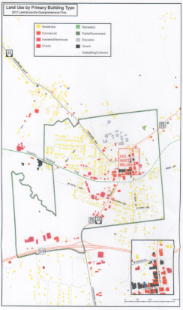
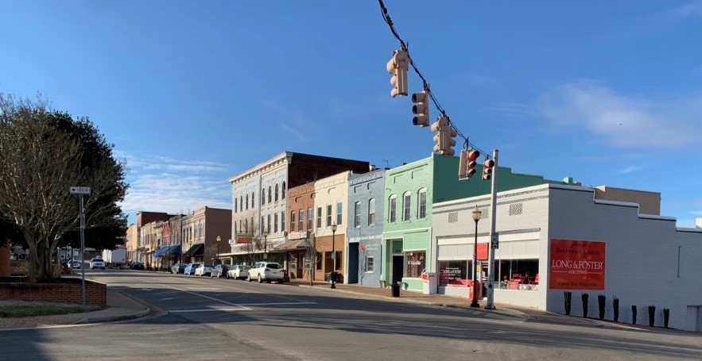
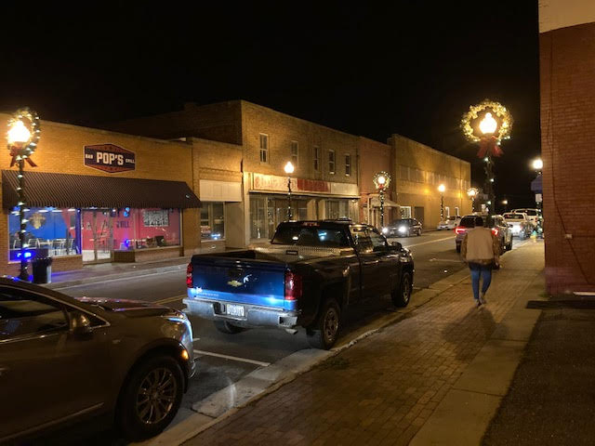
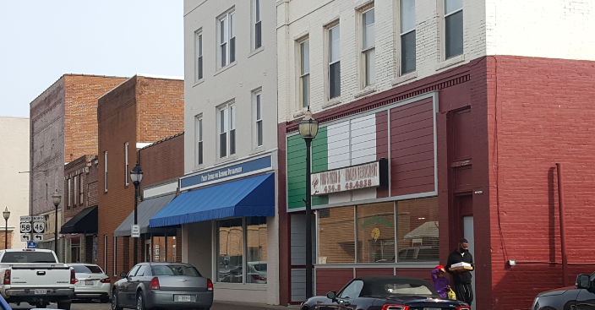
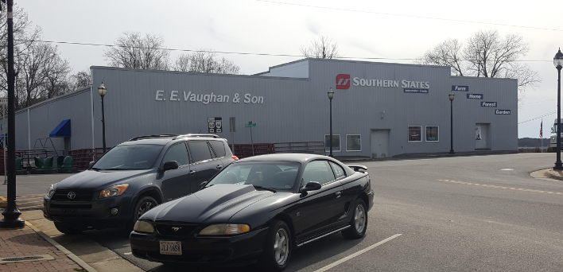
D
Existing Businesses
Land Use by Primary Building Type
The Town of Lawrenceville has a variety of prosperous businesses. Our tax incentives, location, demographics, and amenities within the surrounding areas allow businesses to grow and thrive.
Business Opportunities
Existing Businesses & Business Opportunities
There is a variety of business opportunities for prospective owners and/or developers in Downtown Lawrenceville. Lawrenceville is rich with business opportunities using existing available buildings such as: an art studio; martial arts and/or dance studio; ice cream parlor; meat market; health food store; sporting goods store; and dry cleaners.
Properties that are currently unzoned or zoned agricultural that are in the northeast and southwest parts of town and which may be suitable for commercial and industrial use will be subject for rezoning.
Land Use by Building Type

Slide 13
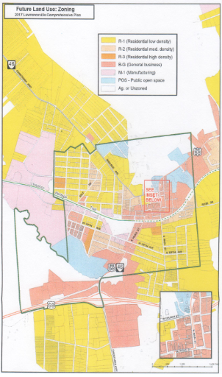
D
Resources
Future Land Use: Zoning
Below are a few resources that are available to support economic development for business owners.
Virginia Economic Development Partnership (VEDP)
https://www.vedp.org
901 E. Cary Street
Richmond, Virginia 23219
804-545-5600
VEDP encourages, stimulates and supports development and expansion of the Commonwealths economy by focusing on business recruitment, expansion and international trade. VEDP helps businesses find the resources they need to make relocation and expansion successful endeavors.
Virginia Department of Housing & Community Development (DHCD)
www.dhcd.virginia.gov
600 E. Main St., Suite 300
Richmond, Virginia 23219
804-371-7000
DHCD offers community-based technical assistance programs to support Virginia’s entrepreneurs that are geared to helping develop a new business or expanding a current business. Business incentives include Enterprise and Opportunity Zones. DHCD programs provide transformational investments, repurposing blighted structures, increasing access to telecommunications, improving foundational community services, and stimulating private investment.
Under certain circumstances and to encourage certain types of development, the Town would consider certain changes to its land use plan and zoning ordinance.
Future Land Use
Resources

Slide 14
Resources
D
Resources
Southside Planning District (SPDC)
www.southsidepdc.org
200 S. Mecklenburg Avenue
South Hill, Virginia 23970
434-447-7101
SPDC staff assist localities with grant applications, grant project administration as well as assisting with Enterprise Zone applications, obtaining grants for industrial sites, and providing GIS mapping for industrial sites and industrial prospects as needed. In addition, SPDC provides low-interest loans for qualifying companies that are creating jobs as part of new industries or expansion of an existing industry.
Virginia Growth Alliance (VGA)
https://www.vagrowth.com/
Heartland Business Park PO Box 596 200 Heartland Drive Keysville, Virginia 23947
434-265-2382
VGA's incentive programs reduce costs of opening or expanding a business facility, and the organization assists employers who choose to put down roots and grow in the Commonwealth. VGA includes the counties of Brunswick, Charlotte, Cumberland, Greensville, Lunenburg, Mecklenburg, and Prince Edward, and the city of Emporia.
Small Business Development Center - Longwood University (SBDC)
www.sbdc-longwood.com
315 W. Third Street
Farmville, Virginia 23901
434-395-2086
SBDC’s core mission is to provide education, consulting, and economic research to support potential and existing small business owners throughout Southern Virginia. The SBDC program is a partnership program with the U.S. Small Business Administration.
Virginia Tobacco Region Revitalization Commission
https://www.revitalizeva.org/
701 E. Franklin St., Ste. 501
Richmond, Virginia 23219
Resources
The mission is to promote economic development and growth in formerly tobacco-dependent communities and use the proceeds of the national tobacco settlement.
Resources

Slide 15
400 North Main Street
Lawrenceville, VA
434.848.2414
https://lawrencevilleweb.us/
We Are Lawrenceville and We Are Committed to Success

