Slide 1
#Soul’dOut

Slide 2
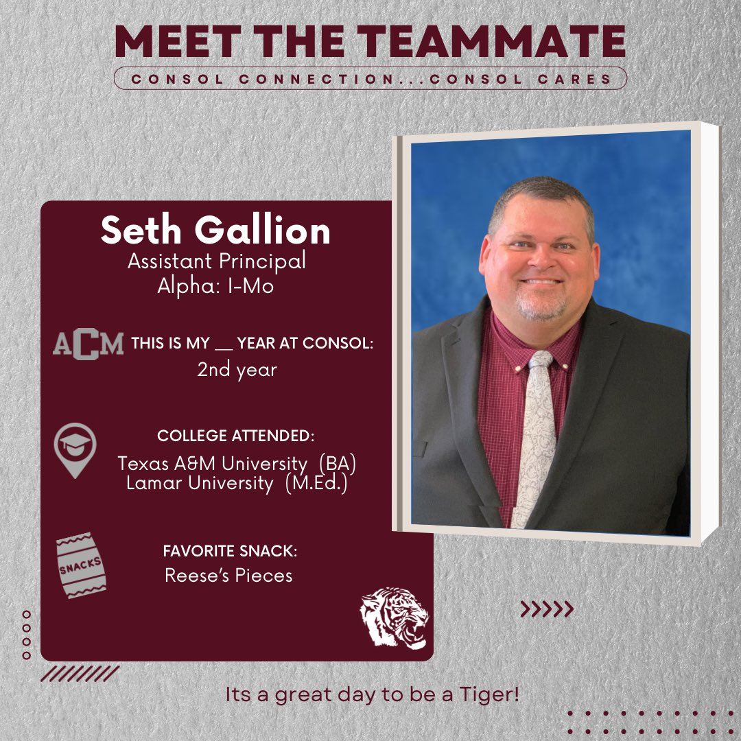
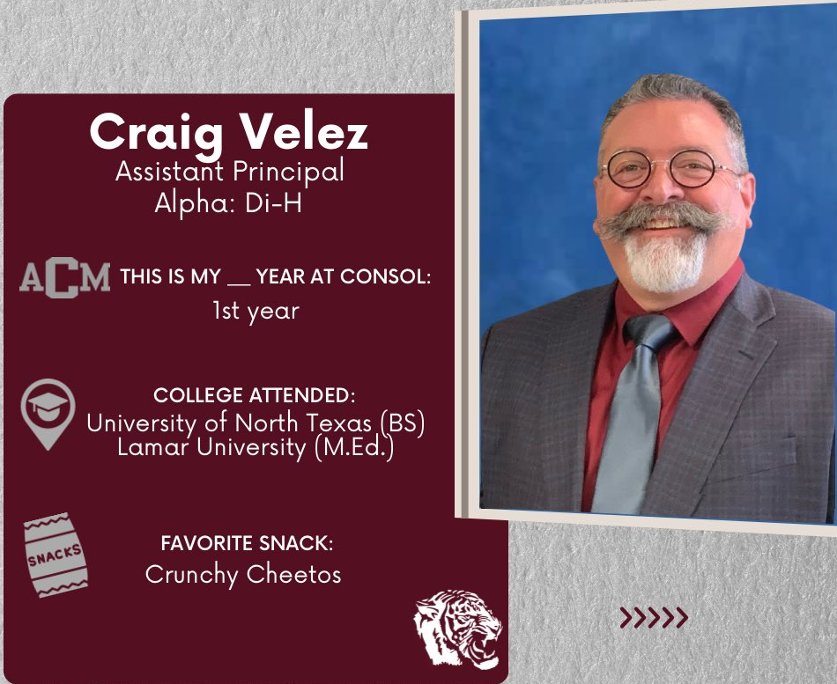
A&M Consolidated HS Administration

Slide 3
Consol High School Football Staff
Bill Robertson- Defensive Coordinator, Outside LB’s, Recruiting Coordinator, Powerlifting. wrobertson@csisd.org
Ray Kavanaugh- Inside LB’s, Track. wkavanaugh@csisd.org
David Hall- Safeties, Track dhall@csisd.org
Donn Miller- Corners, Head Powerlifting. dmiller@csisd.org
Lee Soltis- Defensive Line, Head Girls Track. lesoltis@csisd.org
Anthony Moltz- Defensive Line, Freshman, Powerlifting. amoltz@csisd.org
Jimmie Gilbert- Linebackers, Head Freshman, Basketball. jgilbert@csisd.org
Michael Taylor- Secondary, Freshman, Basketball
mtaylor@csisd.org .
Brandon Schmidt- Head Coach, Offensive Line. bschmidt@csisd.org
Gabriel Rodriguez- Offensive Coordinator, QB’s, Head Track. Academic Coordinator grodriguez@csisd.org
Aaron Edwards -Receivers, JV, Baseball.
aedwards@csisd.org
Bart Harris- Running backs, Head JV Coach, Basketball. bharris@csisd.org
Luke Calvert- H backs, JV, Baseball. lukecalvert@csisd.org
BJ Burton- QB’s/RB’s, Freshman, Baseball. wburton@csisd.org
Grant Uecker- Receivers, Freshman, Wrestling.
guecker@csisd.org
Chris Collins- Offensive Line, Freshman, Softball. ccollins@csisd.org

Slide 4
Consol High School Athletic Trainers
Elli Dinkmeyer- Licensed Athletic Trainer. edinkmeyer@csisd.org
Deion Tolliver- Licensed Athletic Trainer. dtolliver@csisd.org

Slide 5
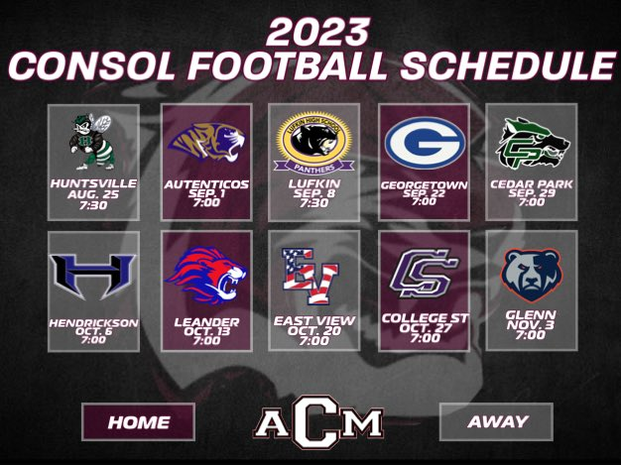

Slide 6
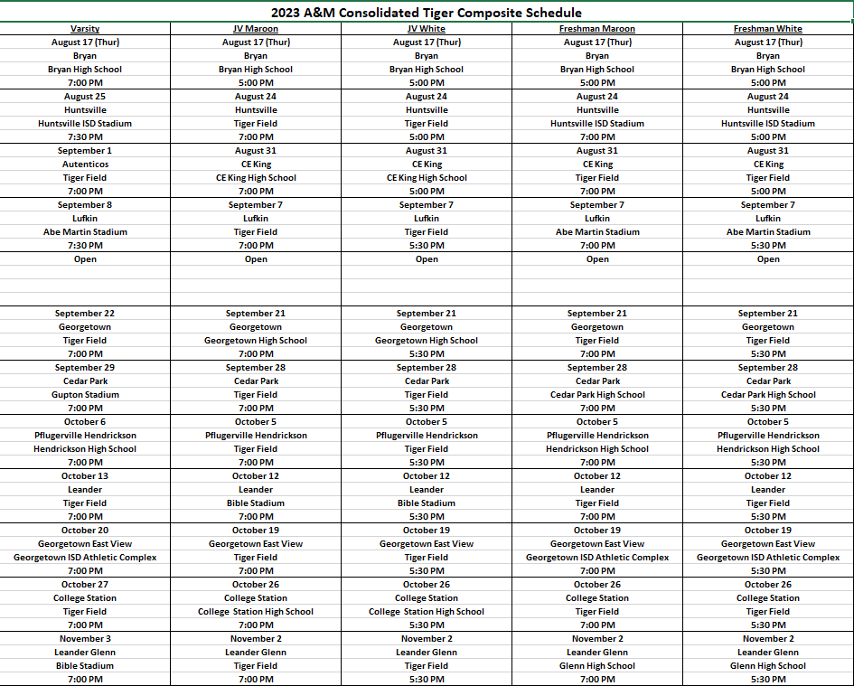

Slide 7
Consol Football Mission Statement
To Grow and Excel socially, academically, and athletically through the understanding of our 4 core values

Slide 8
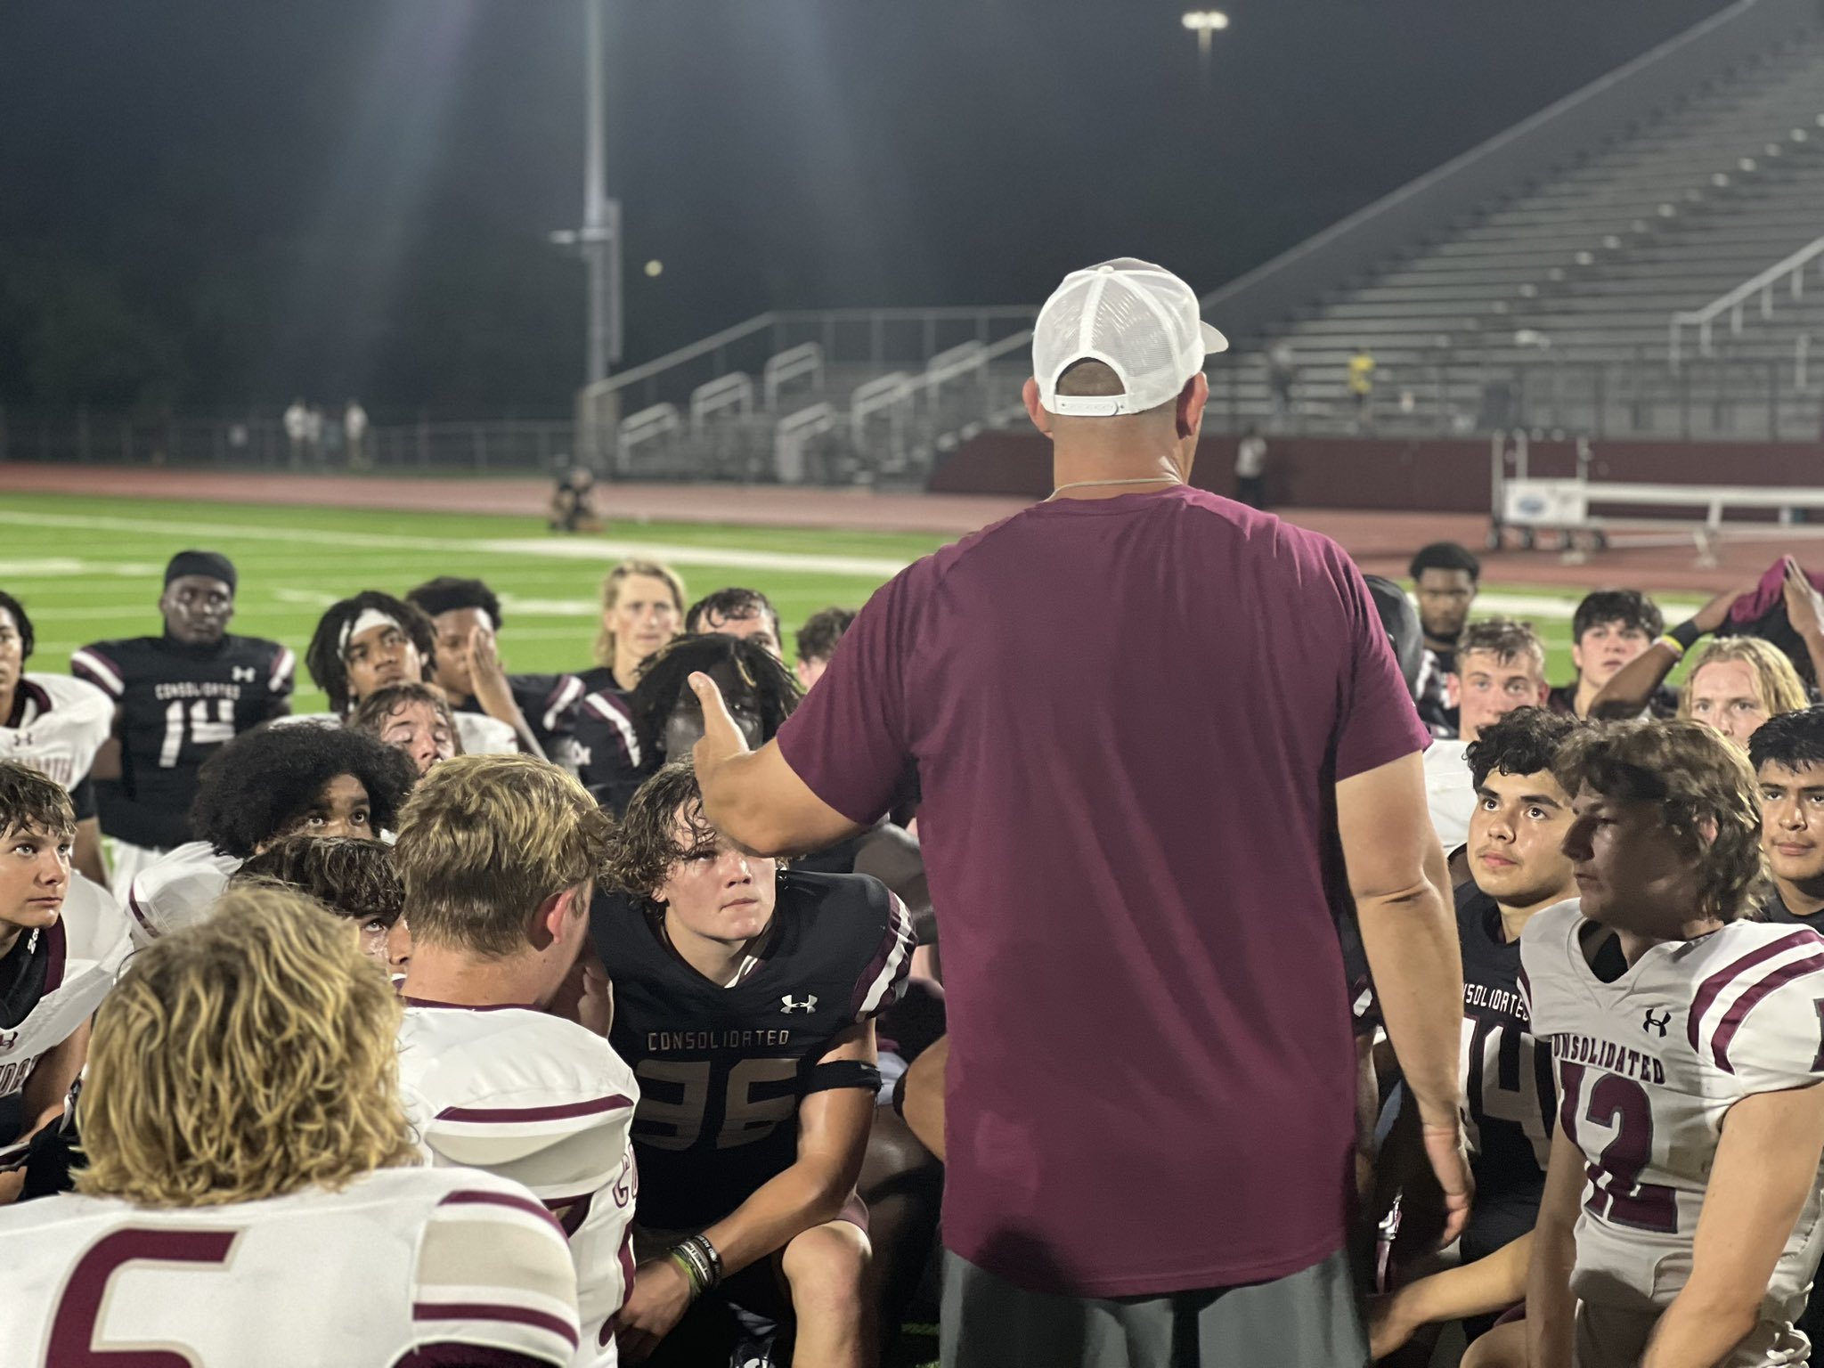
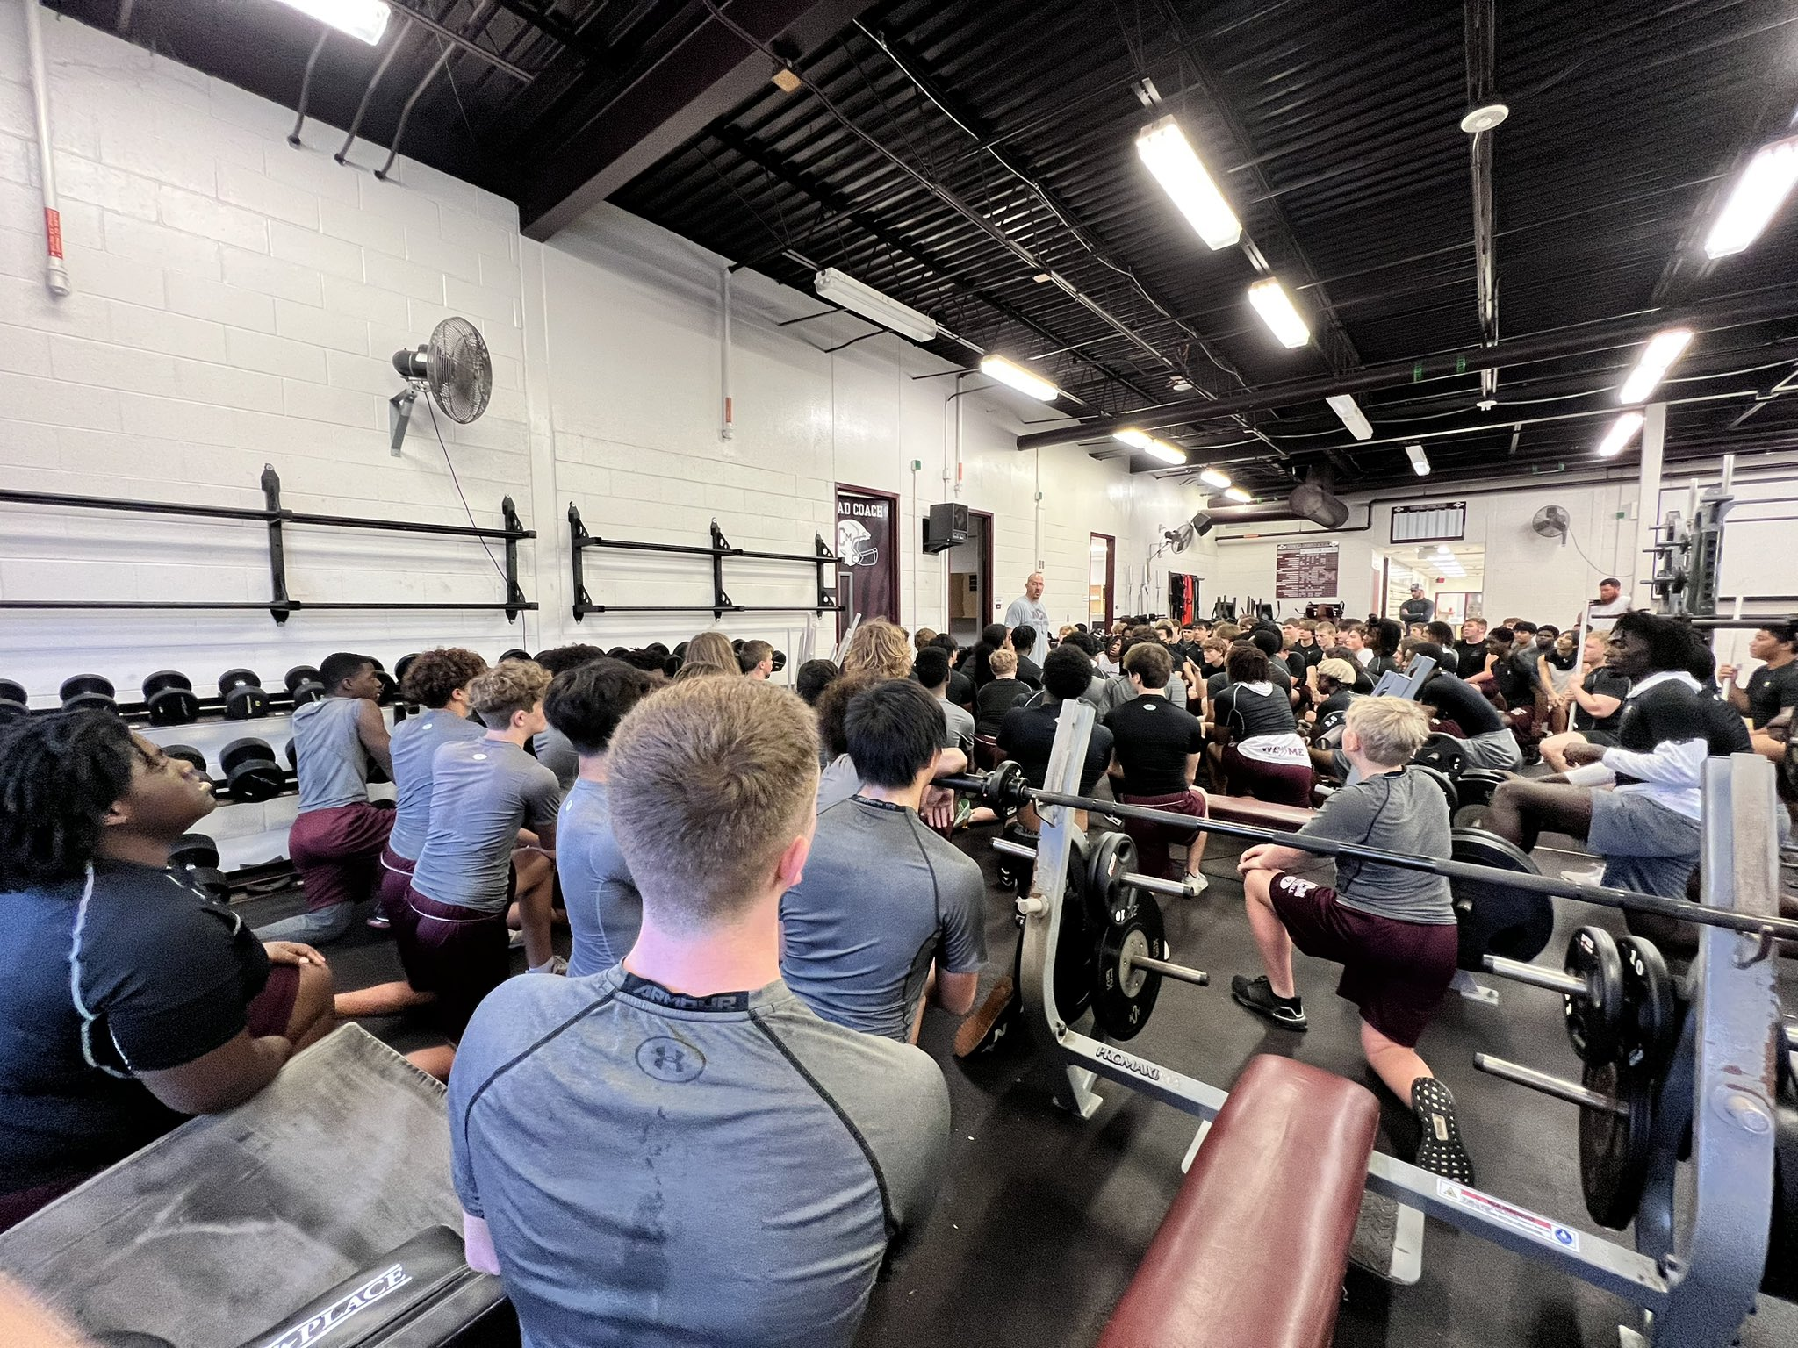
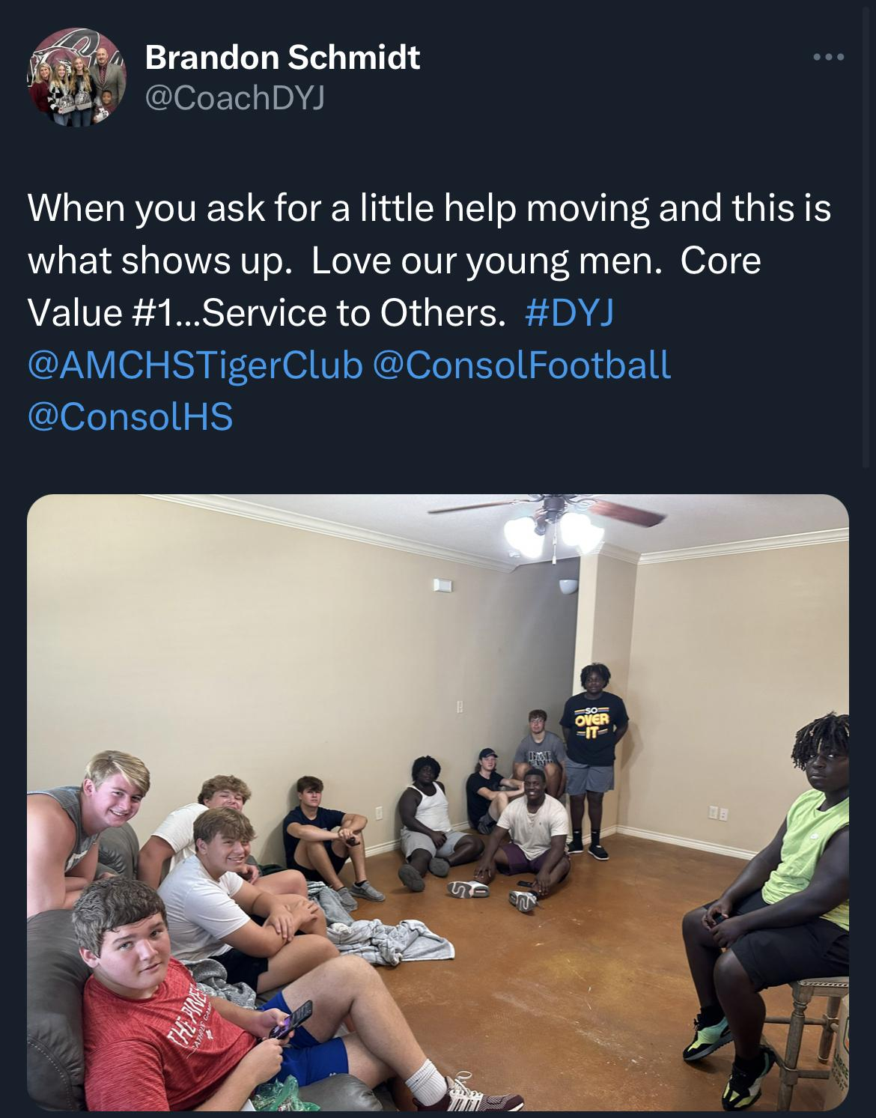
CORE VALUES
SERVICE
TO
OTHERS
HONOR
THE
TEAM
BELIEF IN
THE
PROCESS
EXPECT
EXCELLENCE

Slide 9
“DO YOUR JOB”
Love Your Teammates
Never Be Outworked
Have an Attack Mindset
Be Mentally and Physically Prepared
Play Smart

Slide 10
Educational vs Entertainment Athletics
Educational Athletics
Character Curriculum
Focus on Habits for Success
Positive Reinforcement
Learning from Losses
Positive School Culture
Promote Academic Awards
Academic Program
Productive Citizenship
Sportsmanship
Responsibility
Unified Coaching Staff
Appreciative
Overcoming Adversity
Entertainment Athletics
Teach Skills Only
Win at all Cost
Negative Reinforcement
Punishment for Losing
Disengaged Athletes
Promote only Wins
Student Athlete Failures
Disenfranchised
Poor Sportsmanship
Irresponsible Actions
Dissention in Staff
Entitled
Quitting/Giving Up

Slide 11
What Does Success Look Like?
Consistent Improvement
A’s and B’s in the classroom
High Conduct and Character at all times
Community Involvement
Interpersonal Communication Skills
Cooperative Problem Solving
Learning from Adversity as well as Success
Being a positive Leader and a Follower.
“People who avoid failure also avoid success.”---Robert Kiyosaki

Slide 16
Rank One Paperwork
Physicals and online paperwork must be completed by August 7th.
Link to Rank One Parent Portal
https://www.rankonesport.com/content/Parent/Parent

Slide 17
Previous Athletic Participation Form (PAPF)
Any student that is new to Consol High School and is participating in athletics (examples include move-ins, transfers, foreign exchange students).
Any incoming freshman that did not attend AMCMS, CSMS, or Wellborn.
We will reach out to you to initiate this process.

Slide 18
Injuries/Concussions
CSISD requires all athletes to have a physical every calendar year. Medical history is required for grades 7-12 and a completed UIL Athletic Participation Form must be on file each year before the athlete can be issued any equipment or participate in any workout.
All injuries are to be reported to the Athletic Trainer.
Injury assessments will be left to the Athletic Trainer. All return to play decisions will be made by the Athletic Trainer along with consultations by treating medical physicians.
When an athlete is under a physician’s care for an injury or illness they will not be allowed to return to competition without a written release from the attending physician.
All physicians’ instructions regarding athletes practicing or playing in games are final and will not be modified in anyway.
All information regarding the status of an injured athlete is confidential.
Concussion Protocol
UIL link to Concussion Information: http://www.uiltexas.org/health/concussions

Slide 19
Equipment
The ONLY thing we don’t provide is cleats and girdles (we do keep some extras).
If you are planning on purchasing your own helmet and/or shoulder pads see Coach Edwards first (fit/condition/age appropriate)
Visors must be clear
Team colors only; Maroon, White, gray, black.
Tights- Team Colors only
If your son loses CSISD equipment they will be responsible for paying for its replacement
We do laundry…everyday…sometimes twice a day. Your kid does not need to take his laundry home…ever.

Slide 20
Parent Communication
Website- https://consolfootball.com/
E-mail- Contact coach in charge of whatever your question is regarding (ex: recruiting, JV, SAT).
Rank One-Schedules/Locations/Results
Twitter- @ConsolFootball
HUDL- The program we use to watch film can message your kids.
Your son-Talk to your son
Sports You- Prompt Communication
Access Code: 94WQDEU6

Slide 21
RECRUITING
Recruiting Meeting in January
Update highlights weekly
Update Virtual Combine weekly
Communicate with your coaches
Tag @Consol_Recruits on Twitter in your posts
Attending college football games-excused vs unexcused.
Is it an official invite or not?

Slide 22
Rules to Know
Three unexcused absences will result in dismissal from the program.
Failing multiple grading periods consecutively could result in dismissal from the program.
An athlete that is detrimental, or could be detrimental, to the other athletes in the program will be dismissed from the program.

Slide 23
Parent Do’s
Parent Don'ts
Do Support your son and his teammates
Do keep all comments positive and appropriate
Do enjoy practices/games from the spectator area
Do have fun
Do not address officials
Do not Address/Coach athletes, including your child
Do not address Coaches
Do not enter the Track/Facility area during games/practices
Do not bring food/drink to your child during the game

Slide 24
Parent Opportunities for Involvement
Join the booster club, volunteer, & participate in booster club activities
Sub-Varsity Games
Chain crew
Scoreboard
Announcer
Varsity Mom’s Clinic-Tuesday August 8-Invitation coming soon
Dads, Dinner, and Decals (Varsity Only)- Thursday August 24 at CSISD Board Room (6:30pm)-Tentative

Slide 25
Important Dates
1st Day of Practice
Freshmen July 31
JV/Varsity August 7
Huddles and High Heels - August 8
Media/Picture Day - August 9
Welcome to the Jungle - August 11
1st Day of School - August 16
Thanksgiving Break - We have practices/games

Slide 26
Two-A-Days Schedule (August 7-12)
Monday | Tuesday | Wednesday | Thursday | Friday | Saturday
6:15am - 8:15am Var/JV Cover/Practice 6:30am - 8:00am 9th Cover/Practice 4:15pm - 5:45pm Var/JV Weights/Meetings/Special teams 4:30pm - 6:00pm 9th Weights/Meetings/Special teams | 6:00am - 7:30am All Levels Cover/Practice 4:15pm - 5:45pm Var/JV Weights/Meetings/Special teams 4:30pm - 6:00pm 9th Weights/Meetings/Special teams | 6:00am - 8:00am Var/JV Cover/Practice 6:15am - 7:45am 9th Cover/Practice 4:15pm - 5:45pm Var/JV Weights/Meetings/Special teams 4:45pm 9th Cover/Media Day 6:00pm - 7:30pm Var/JV Media Day | 6:00am - 8:00am Var/JV Cover/Practice 6:15am - 7:45am 9th Cover/Practice 4:15pm - 5:45pm Var/JV Weights/Meetings/Special teams 4:30pm - 6:00pm 9th Weights/Meetings/Special teams | 6:00am - 8:00am Var/JV Cover/Practice 6:15am - 7:45am 9th Cover/Practice 4:15pm - 5:45pm Var/JV Weights/Meetings/Special teams 4:30pm - 6:00pm 9th Weights/Meetings/Special teams 7:00pm Welcome to the Jungle | 8:00am - 10:30am Var/JV Meetings/Practice 9:00am - 11:00 9th Cover Practice

Slide 27
Varsity Weekly Schedule
Monday | Tuesday | Wednesday | Thursday | Friday | Saturday (Varsity Only)
6:00am Cover/Position Meetings 6:30am Practice 8:40am Shower/Breakfast 4:00pm Meetings/Weights | 6:00am- Cover/Position Meetings 6:30am-Practice 8:40am Shower/Breakfast 4:00pm-Meetings/Weights | 6:00am- Cover/Position Meetings 6:30am-Practice 8:40am Shower/Breakfast Nothing after school | 7:25am Cover/Position Meetings 7:50am Walk Through 8:40am Shower/Breakfast Nothing after school | 7:35am Cover/Position Meetings 8:00am Walk Through 8:40am-Shower/Breakfast 7:00pm-Kick Off | 9:00am Treatment 10:00am Cover/Weights 11:00am Team Meeting 11:30am Position Meetings 12:30pm GO HOME

Slide 28
JV Weekly Schedule
Monday | Tuesday | Wednesday | Thursday | Friday | Saturday (Varsity Only)
6:00am- Cover/Weights 6:30am Practice 8:40am Shower & Breakfast Nothing after school | 6:00am Cover/Weights 6:30am Practice 8:40am Shower & Breakfast Nothing after school | 6:25am JV Cover/Practice 8:40am Shower & Breakfast Nothing After School | 8:10am Cover/Walk Through 8:40am Shower & Breakfast GAMEDAY | 8:10am JV Cover/Weights 8:45am Shower & Breakfast Nothing After School | Nothing

Slide 29
Freshman Weekly Schedule
Monday | Tuesday | Wednesday | Thursday | Friday
Tutorials Before School if Necessary 3:05pm Practice 5:10pm Weights 5:40pm GO HOME | Tutorials Before School if Necessary 3:05pm Practice 5:10pm Weights 5:40pm GO HOME | Tutorials Before School if Necessary 3:05pm Practice 5:05pm GO HOME | Tutorials Before School if Necessary 3:05pm Walk Through GAME DAY | Tutorials Before School if Necessary 3:05pm Weights Tutorials After School if Necessary

Slide 30
Freshman Weekly Schedule PLAN B
Monday | Tuesday | Wednesday | Thursday | Friday
6:15am Cover/Practice 7:50am Shower & Breakfast 3:00pm Cover/Weights | 6:15am Cover/Practice 7:50am Shower & Breakfast 3:00pm Cover/Weights | 6:15am Cover/Practice 7:50am Shower & Breakfast 3:00pm Cover/Position Meetings | Tutorials Before School if Necessary 3:05pm Walk Through GAME DAY | Tutorials Before School if Necessary 3:05pm Weights Tutorials After School if Necessary

Slide 31
Football Policies and Contract

Slide 32
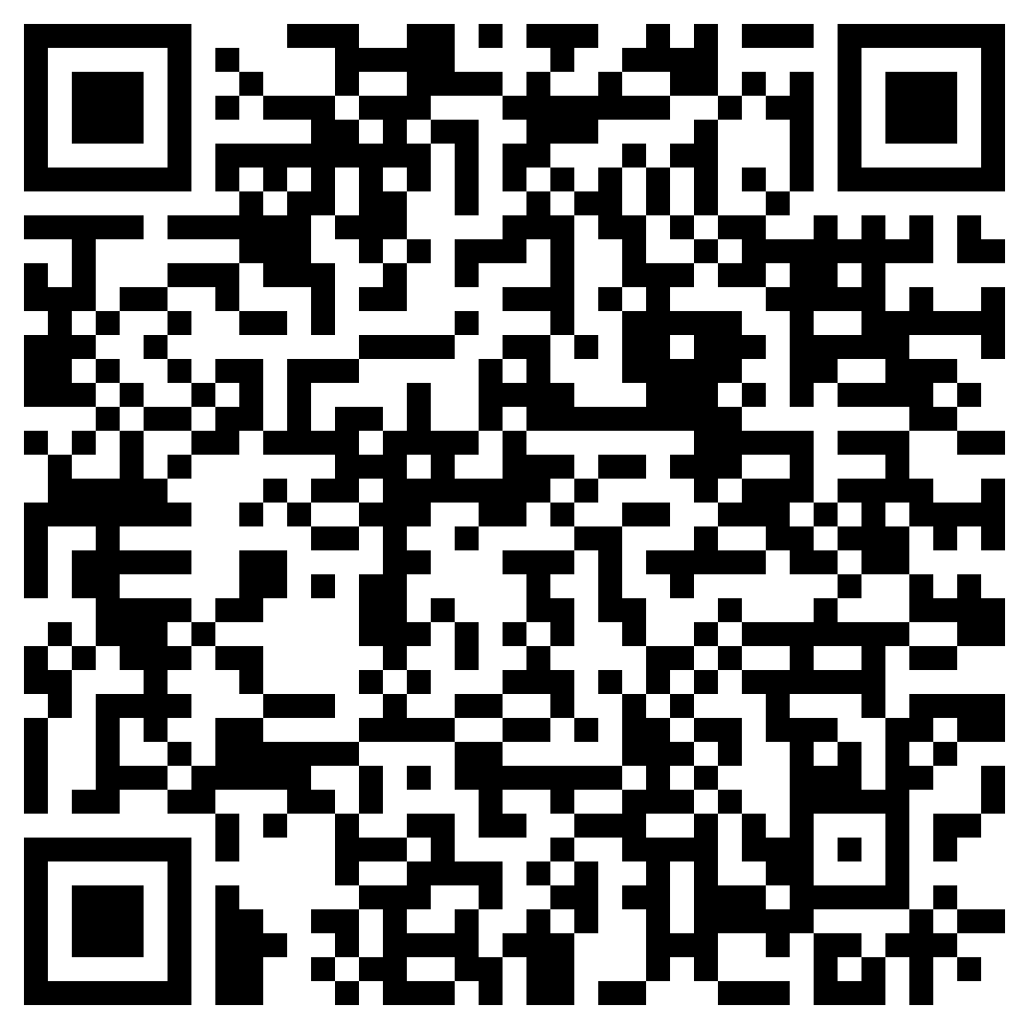
Parent Meeting Acknowledgement Form

