Slide 1
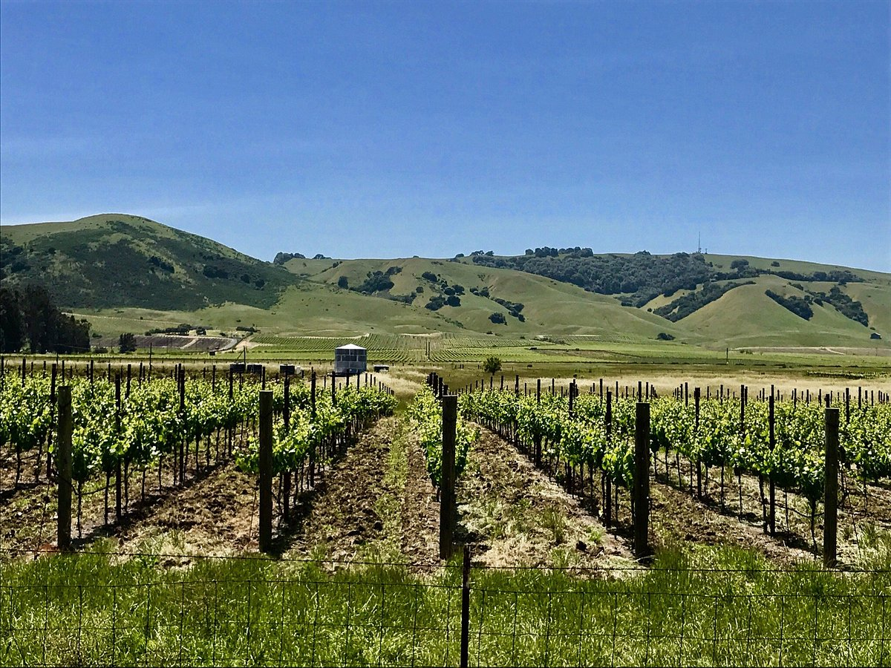
Produced for the Valley of the Moon Alliance
and a Coalition of Sonoma Valley Community Groups
by KLD Associates, 31 January 2025
Sonoma Valley
Wildfire Evacuation
Time Estimate Study
Feb 24, 2025

Slide 2
Major Findings of the SAFE Report:
This is an Independent Traffic Study. It concerns public safety in the event of an evacuation, and ONLY public safety.
It shows that Valley residents face evacuation times of 4 hours or longer on Arnold Drive and CA-12, depending on when you begin to evacuate and from what point.
Our roadways are deemed “Not Sufficient” to service the current evacuation demand.
For a vehicle traveling south from Glen Ellen on either Arnold Drive or Route 12 during the first two hours of an evacuation its average speed is between 0 and 2 mph, and during the third hour it is 2-4 mph: complete gridlock
If the Sonoma Developmental Center is built out, evacuation times on Arnold Drive and Route 12 at some intervals will increase from almost three hours to almost five hours.

Slide 3
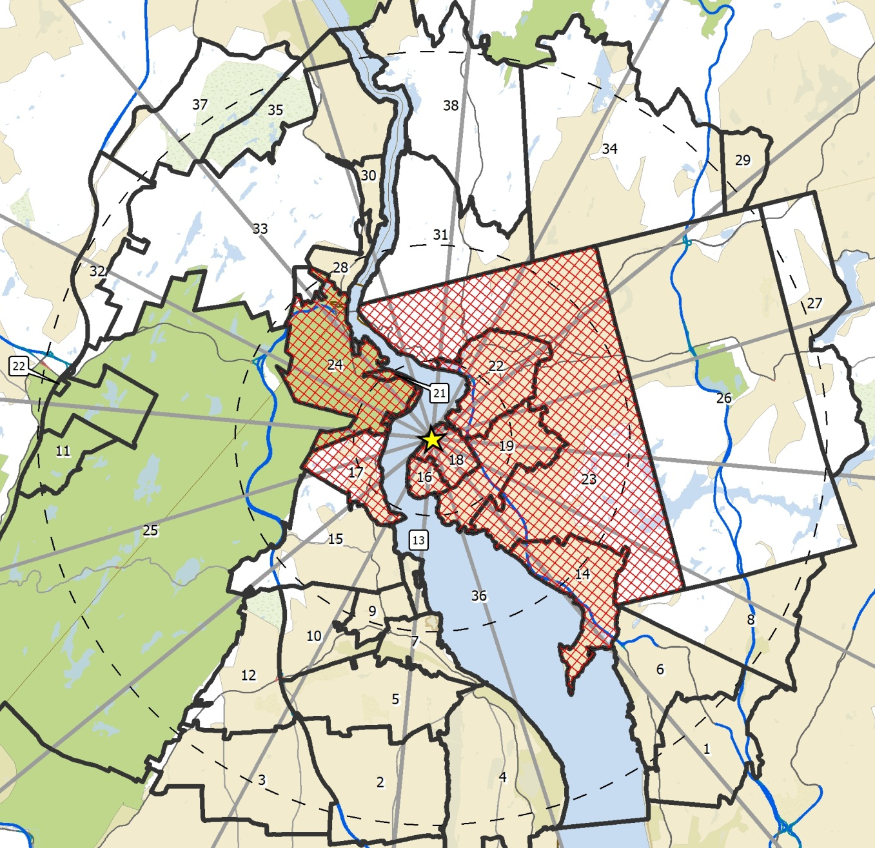
What is an Evacuation Trip?
You travel here to evacuate the area, then…
An evacuation trip generally begins at home and ends at some destination (Reception Center, Hotel, Relative’s Home) outside the area being evacuated (crosshatched area).
However, leaving the evacuated area does not necessarily mean reaching safety.
If you live here, and…
You are at risk until you leave the area being evacuated

Slide 4
1. The KLD consultants found that the existing road system is insufficient to meet traffic needs during an evacuation. The Valley’s population has increased tenfold in the past century, but the road capacity has not changed.
2. They also note that approximately 60-90 minutes after an evacuation order, travel demand exceeds road capacity and travel speeds decline rapidly to stop-and-go.
3. In this study, the term “evacuation time” means the time it takes you to get to the next adjacent safe zone. NOTE: it may take longer to get to any specific safe place.
4. The study does NOT take into account traffic hazards that may arise, e.g., vehicle accidents, downed power lines, rock slides, abandoned cars …

Slide 5
This graph shows traffic velocity (↑left axis) along Arnold Drive
at a given time (→ bottom axis) after an evacuation order is issued.
Initially (first 30 min), travel is normal but it quickly worsens, until by 60
min speeds slow to 5 mph, and they slow to half that for another 90 min.
Under present conditions, speeds gradually improve to 10 mph or more. However, if the SDC is built out, vehicles continue to travel at speeds well below 5 mph for another two hours –
That is, 4 ½ hours after the evacuation was first issued ...
to travel a distance of at most 7 miles.

Slide 6
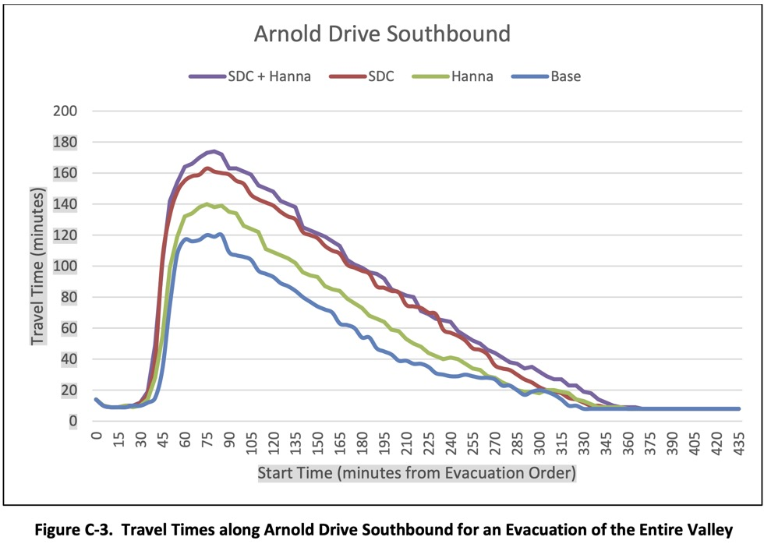
Travel Time
But if the planned SDC and Hanna developments
Are built out, that trip would take you almost three hours.
The difference gradually diminishes over the
next three hours from 60 min to 20 min, but
this means that 4 hr 15 min after the Order,
you are still taking an extra 20 min … which
normally is the time to drive from Glen
Ellen to downtown Sonoma!
Right now, if you
got on Arnold Drive
75 minutes after an
Evacuation Order, it would take you
about two hours to evacuate your Region.

Slide 7
Here is a map of the Sonoma Valley.
The dark lines show the boundaries of the Sonoma County Evacuation Zones (SCEZ), with the names of the Zones
(e.g., “SON-6C2”).
KLD’s SAFE Study grouped these
Zones into “Regions” that would
evacuate together (depending on the scenario).
Note that 6 different evacuation zones meet in Glen Ellen.

Slide 8
The next slide is a bit complex.
Sonoma County is divided into a collection of evacuation zones (SCEZ). You can find your zone by entering your address at this website:
https://socoemergency.org/get-ready/evacuation-map/
KLD uses the term “Region” to represent a set of one or more evacuation zones (SCEZ) that will evacuate at roughly the same time. They then study the evacuation characteristics for that region.
Because KLD looks at many scenarios, a specific evacuation zone may be part of several different KLD Regions.
The projected travel times and speeds at which you will evacuate are based on these regions.

Slide 9
Staged (phased) evacuation areas, ordered by safety officials,
will likely evacuate more efficiently than those in which residents
decide on their own when to evacuate …
A total of 14 Evacuation Regions were identified that encompass individual and different groupings of SCEZ.
Regions R01, R02, R03 represent combinations of SCEZ that would evacuate in stages (or phases).
Regions R04 through R13 are evacuations of combinations of SCEZ likely to be evacuated concurrently.
Region R14 is the evacuation of all SCEZ at once.
Experts say that a staged evacuation is projected to get more people to safety sooner and more efficiently than a random evacuation will.

Slide 10
Evacuation zones (SCEZ) are not “regions”: e.g., zone “SON-6E2” (yellow underlines)
is in five different “regions” (including Region R14, when the whole Valley has to evacuate)

Slide 11
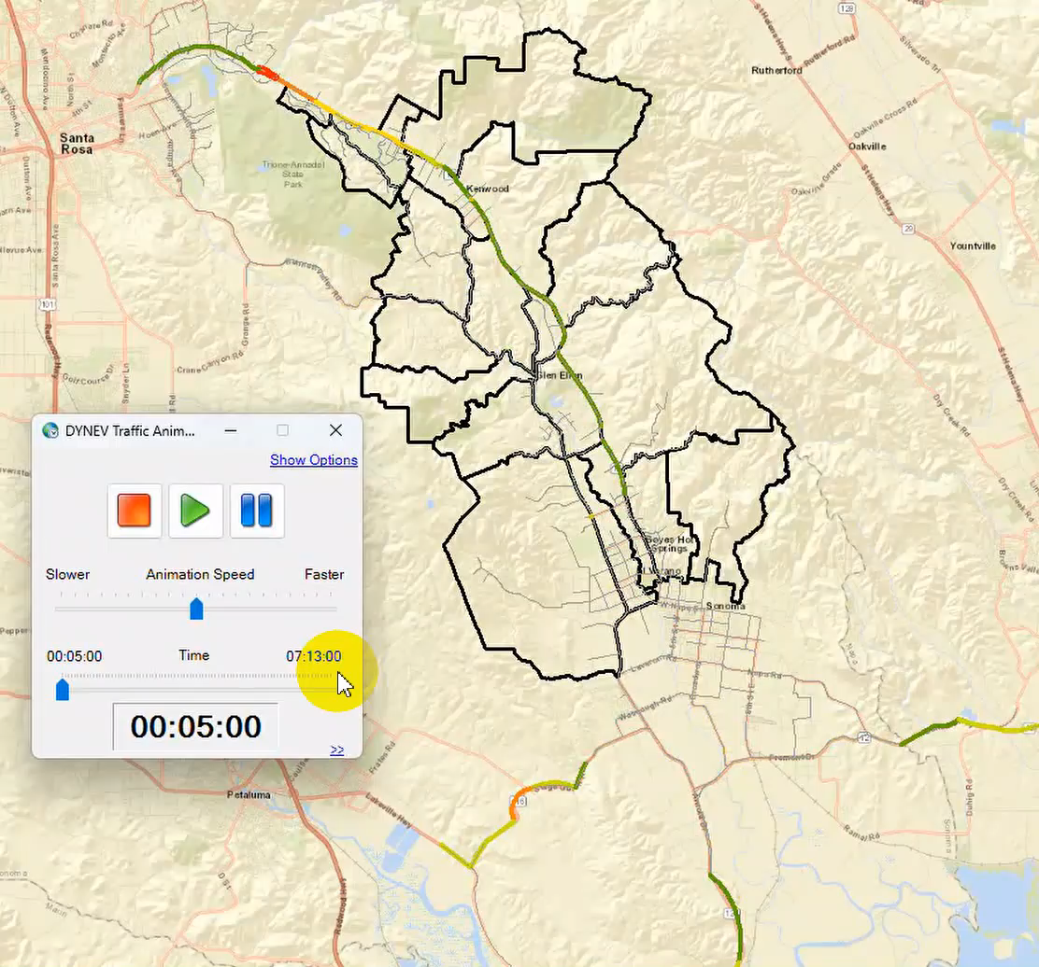
Here is an animation of how quickly
roads will become congested
if there is a major evacuation
that affects all of the Regions
north of the City of Sonoma
And south of Oakmont.
The animation begins when the
Evacuation Order is in effect.
It proceeds for just over 7 hours,
at which time most vehicles
are considered evacuated.
The degree of traffic congestion
goes from green to yellow to red.
The animation is in 5-min intervals,
so “01:30:00” is an hour and a half
after the evacuation order
is issued.
SDC
Hanna

Slide 12
Table 5-3. Time to Clear the Indicated Area of 90 Percent of the Affected Population (not typical of most residents)^{[1]}
 |  | Summer | Fall | Summer | Fall | Summer | Fall
 |  | Weekend | Midweek | Weekend | Midweek | Weekend | Midweek
Scenario: |  | (1) | (2) | (3) | (4) | (5) | (6)
Region | Description | Midday | Evening | Midday | Evening | Midday | Evening
 |  | Any Direction |  | Towards Petaluma, Napa, and/or Marin County |  | Towards Santa Rosa
R01 | Mid-Valley (Staged) | 3:10 | 3:20 | 2:55 | 3:00 | 3:35 | 3:25
R02 | South Valley (Staged) | 6:05 | 6:00 | 5:55 | 6:00 | 7:55 | 7:45
R03 | Jack London Park (Staged) | 4:35 | 4:40 | 4:45 | 4:40 | 6:30 | 6:35
R04 | Springs Specific Area | 3:25 | 3:05 | 4:05 | 3:45 | 5:15 | 5:05
R05 | Hanna Site | 3:20 | 3:15 | 3:50 | 3:35 | 4:40 | 4:45
R06 | Madrone/SDC | 2:30 | 2:15 | 2:10 | 2:10 | 3:10 | 3:20
R07 | Eastern Valley | 3:05 | 2:50 | 3:05 | 2:50 | 4:20 | 4:15
R08 | Western Valley | 4:15 | 3:50 | 5:25 | 4:55 | 6:40 | 6:30
R09 | Central Valley | 4:00 | 3:35 | 5:00 | 4:40 | 5:55 | 5:40
R10 | Eastern Ridgeline | 2:20 | 2:15 | 2:10 | 2:20 | 3:25 | 2:55
R11 | Western Ridgeline | 2:50 | 2:40 | 3:20 | 2:50 | 3:40 | 3:25
R12 | Northern Valley | 4:00 | 3:20 | 3:45 | 3:35 | 4:40 | 4:20
R13 | Southern Valley | 4:30 | 4:15 | 5:55 | 5:35 | 7:50 | 7:30
R14 | All SCEZ | 4:55 | 4:30 | 6:20 | 5:45 | 8:15 | 8:00
This table provides ETEs
(estimated time to evacuate)
for midday weekends in summer,
and for midweek evenings in Fall
– for all the Regions in the northern
Sonoma Valley – traveling in three
possible directions:
Any direction
Petaluma, Napa, Marin
Santa Rosa
Here are ETEs for:
Glen Ellen and north
Glen Ellen and south
Entire Valley
^{[1]} The ETE is measured as the time it takes evacuees to leave the area at risk and does not include the time it takes to get to a safe shelter (or other location outside the area at risk).

Slide 13
Permanent Residents - year-round population within Sonoma Valley.
Visitors – those who visit Sonoma Valley for recreational purposes.
External Traffic – vehicles whose origin and destination are outside the Sonoma Valley but pass through the study area along California Highway 12, State Route 116, State Route 121, and South Napa Vallejo Highway as part of their trip.
Shadow Evacuees – those who live outside of Sonoma Valley but may voluntarily evacuate.
Employees - those people who work within Sonoma Valley, but who live outside Sonoma Valley.
Here are the populations affected by a mass traffic evacuation in the Sonoma Valley:
How were data gathered?
KLD gathered data from local, county, state, and federal agencies regarding population, workers, commuters, etc.
VOTMA volunteers obtained additional data from surveys of local businesses, schools, jails, hospitals, wineries, tourist attractions, and assisted living facilities.
Demographic data were obtained by in-person and online surveys of the local population in both English and Spanish, carried out by VOTMA volunteers. A statistically significant number of 560 people/families responded.
KLD measured dimensions and characteristics of all roads and intersections in the Valley and used these data in the analysis of evacuation traffic behavior.
The public can have confidence in this study.

Slide 14
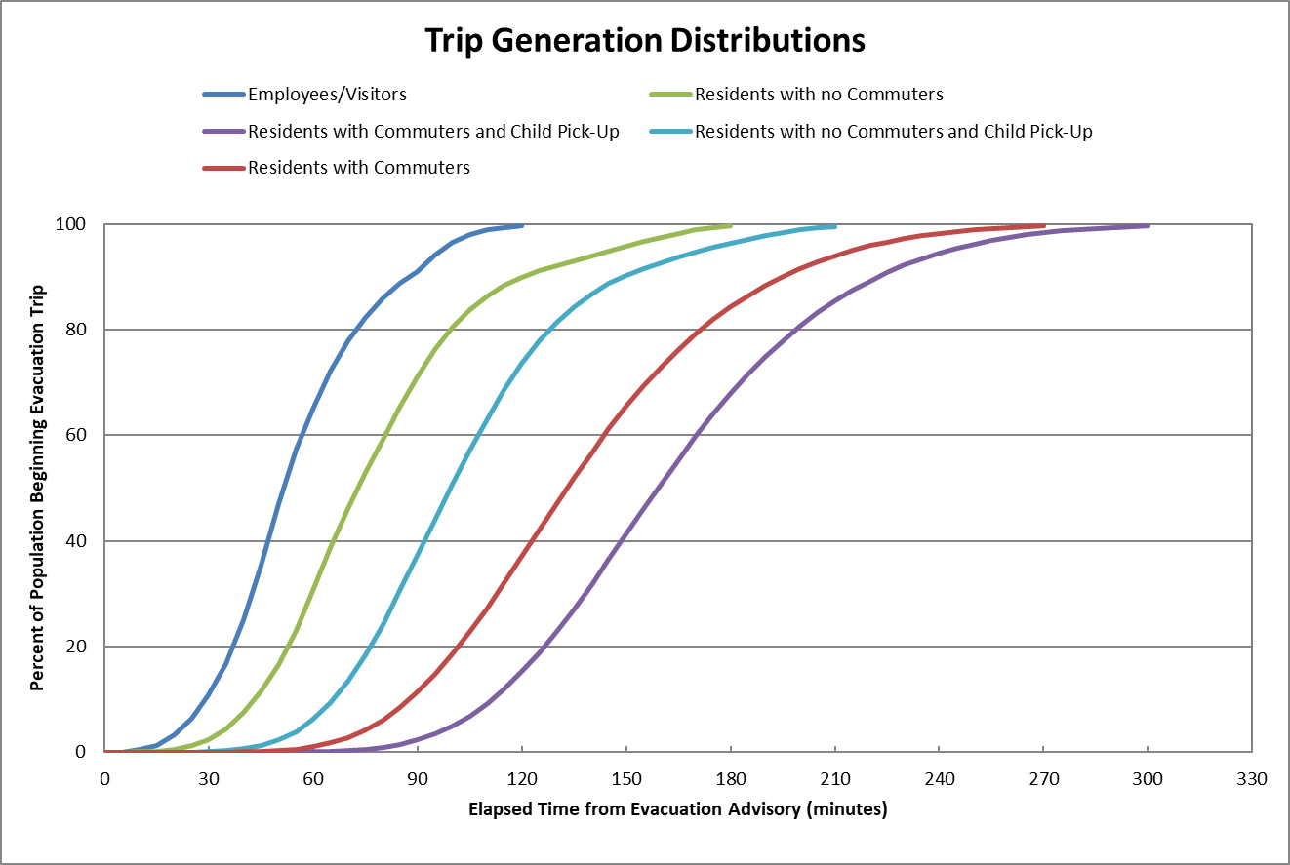
This graph shows MOBILIZATION TIME – how long to get on the road and how issues such as picking up children and waiting for a commuter to return can affect that.
For example: After 90 minutes, 90% of employees will have left, whereas only 5% of people who have to wait for a commuter to return and then to pick up a child at school will have left.

Slide 15
Fig 5-10:
mobilization
For example, if you leave 90 minutes after the evacuation order,
60% of the cars will have left by that time.
You’ll spend 105 minutes traveling if all roads are open.
You’ll spend 160 minutes traveling if you can only travel south.
You’ll spend 200 minutes traveling if you can only travel north.

Slide 16
Takeaways from the SAFE study:
Science matters. The KLD study brings state-of-the-art, peer-reviewed, world-class methods to the Sonoma Valley.
The present roads in Sonoma Valley are not capable of handling expected traffic in the event of an evacuation. Developing the SDC, Hanna, and other sites will exacerbate this.
The time you can expect to spend on the roads during an evacuation, if SDC is built out, can increase by 67% to 100%, depending on various factors, including the time you leave (see Figure C-3).
Projected evacuation times account ONLY for how long it will take you to get out of your evacuation “Region.” They do not say how long it will take you to get to “safety,” or to any other destination outside your Region.
These estimated evacuation times cannot take into account unpredictable factors such as traffic accidents, blocked roads, limited visibility, and complications related to human-caused and natural hazards.

Slide 17
Sonoma County’s SDC Specific Plan and Environmental Impact Report
In his ruling in favor of a lawsuit filed by citizens against the County’s SDC plans for its inadequate Specific Plan (including its EIR), County Judge Bradford Demeo excoriated the County’s purported mitigation measures, goals, and policies as:
    “toothless, vague, and limited to hopeful intentions … with no definition of what any of this means, no performance standards, and no clear criteria.”

Slide 18
We think our residents deserve a real plan,
With scientifically tested, state-of-the-art projections.
Our safety, and everyone’s, depends on it.

Slide 19
For this reason, VOTMA and its community allies want the Board of Supervisors and its responsible County offices to do the following:
1. Implement evacuation planning now, using reality-based evidence from the SAFE study;
2. Incorporate the evidence from the SAFE study into the evacuation assessment when the Board considers all pending and new land use applications and specific plans involving the Sonoma Valley;
3. Incorporate the data and results of the SAFE study into the upcoming General Plan housing and safety elements.

Slide 20

For more information, including the full KLD report,
visit the website of the Valley Of The Moon Alliance:
www.votma.org
And if you’d like to help fund this work, please visit the VOTMA website or scan the QR code.
All contributions are appreciated!
This study helps everyone in Sonoma Valley.

Slide 21
Thank You
Questions?

