Slide 1
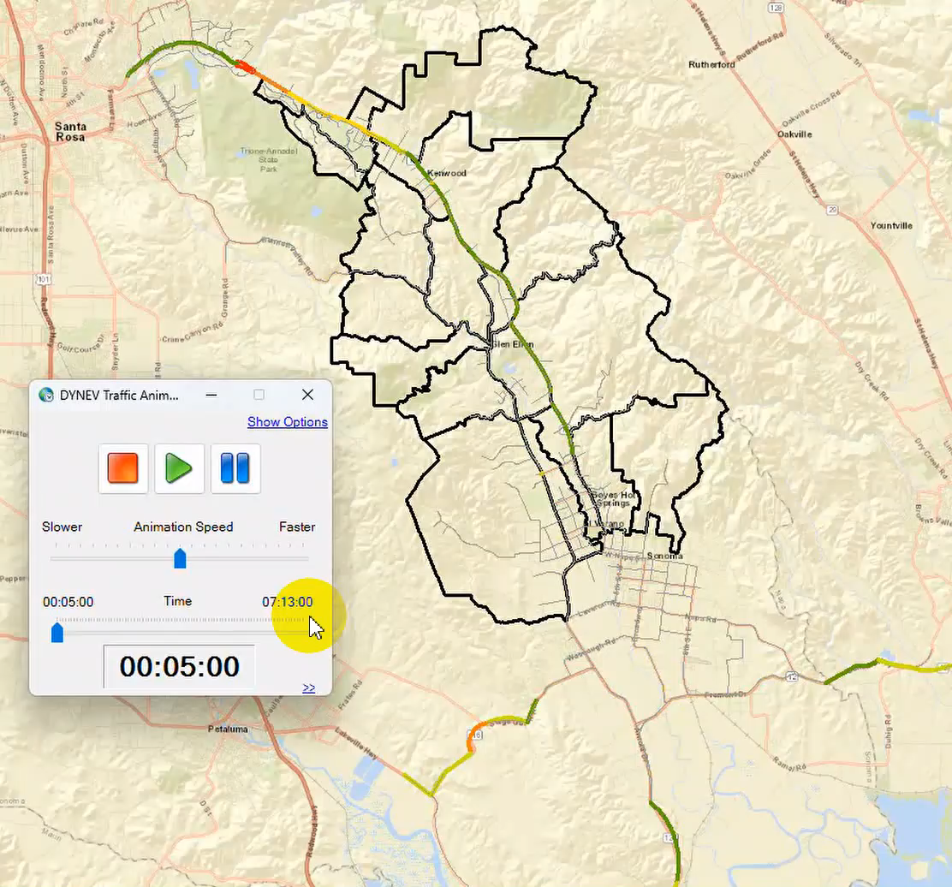
Sonoma Valley Evacuation Traffic Animation
LOS – Levels of Service
----- A - no delays
----- B - minor delays
----- C - high volumes
----- D - at capacity
----- E - over capacity, delays
----- F - 1-2 MPH
2 mi
From KLD Evacuation Time Estimate Study Jan 28, 2025

