Slide 1

Helping Students Shift from Passive Learning to Active Learning A Learning Specialist’s Framework for Parents and Educators Presented by Donovan Roy, Ed.D.

Slide 2

Passive Learning Strategies (Often Used by Struggling Students)
These strategies feel comfortable but do not strengthen higher-order thinking:
Re-reading notes
Highlighting large sections of text
Rewriting notes verbatim
Listening to lectures without engagement
Memorizing without context
Watching videos without reviewing or summarizing
Copying slides without analysis
Passive learning reinforces only:
Remembering
Identifying
Understanding
(Bottom tiers of Bloom’s Taxonomy)

Slide 3

Connection:
In-Class Instruction = Passive Learning Foundations
Classroom instruction naturally focuses on introducing information.
Teachers provide structure, explanations, examples, and demonstrations.
Students often respond by:
Listening
Copying notes
Observing
Repeating what the teacher says
These are necessary starting points, but they stay at the bottom of Bloom’s Taxonomy, where students only remember or understand content.
Without metacognitive awareness, students assume this is enough and performance plateaus.

Slide 4
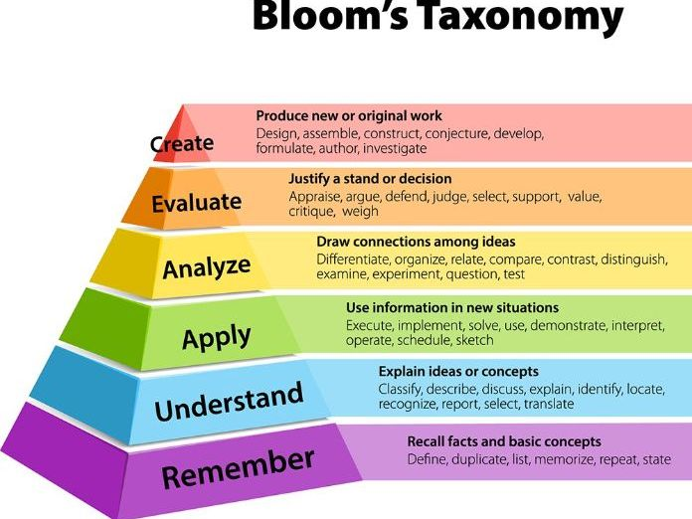
Bloom’s Taxonomy Explained
Bloom’s Taxonomy structures learning from foundational to advanced:
Remembering – recalling facts and information
Understanding – explaining ideas or concepts
Applying – using information in new situations
Analyzing – breaking material into parts and examining relationships
Evaluating – making judgments and supporting them with evidence
Creating – producing original work or solutions
Bottom Levels = Passive Learning
Top Levels = Active Learning
High-performing students excel during independent study.

Slide 5
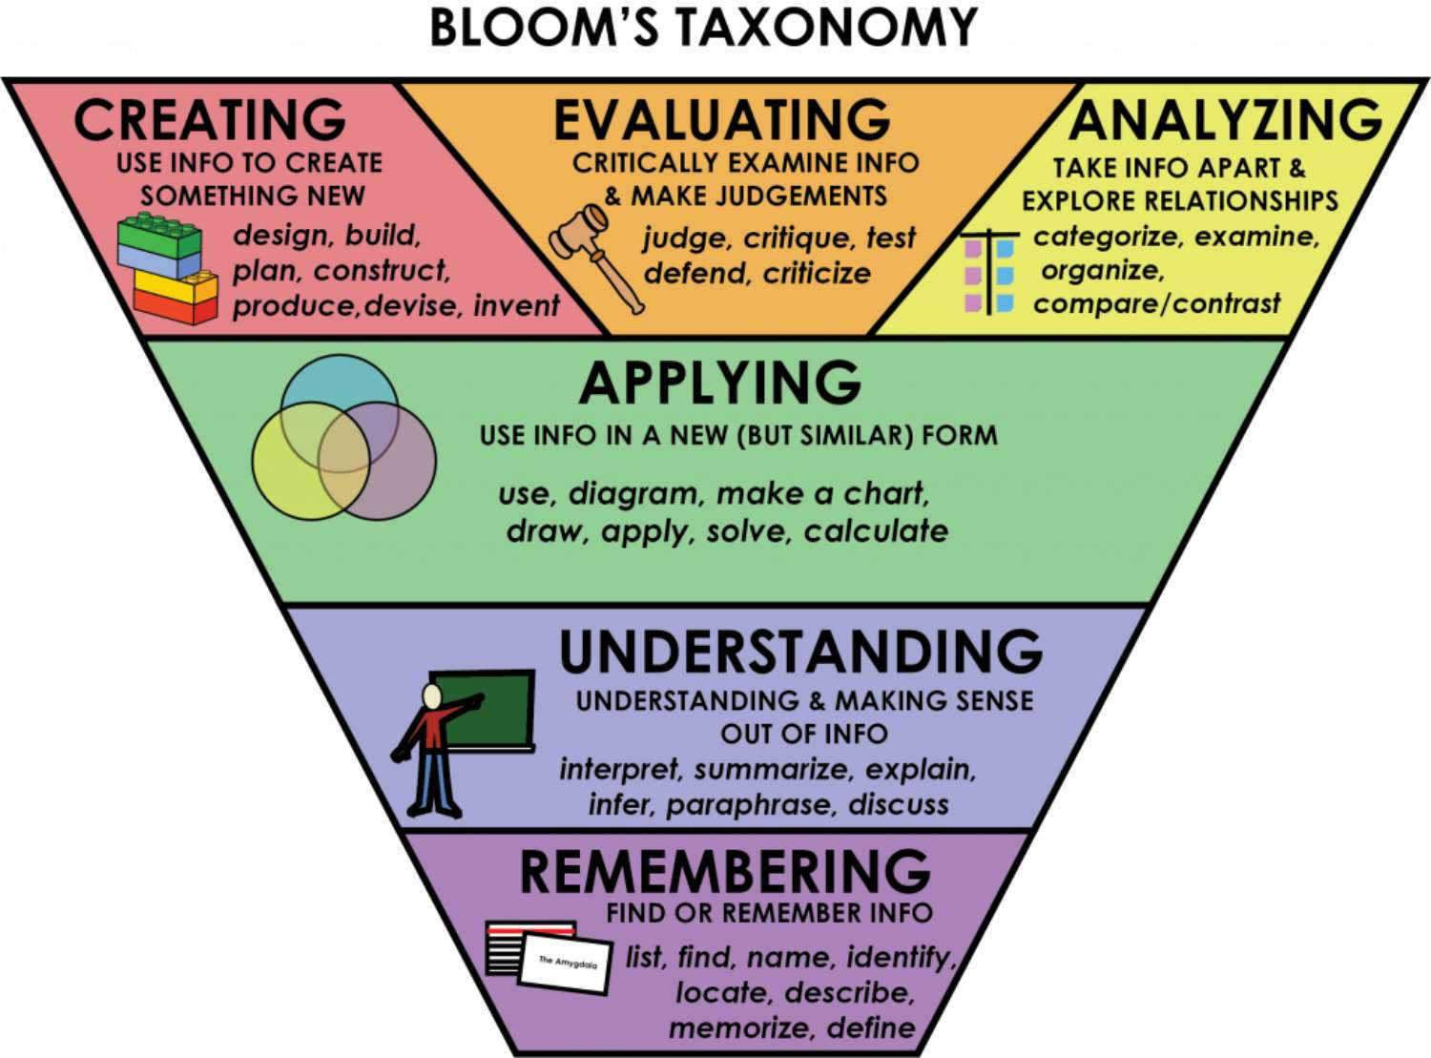
Active Learning Strategies
(Top of Bloom’s Taxonomy)
Help students strengthen evaluation, analysis, and self-assessment:
Creating concept maps from memory
Teaching content to someone else
Summarizing notes without looking
Practicing retrieval (active recall)
Self-quizzing with open-ended questions
Writing predictions or rationales
Applying concepts to real-life scenarios
Comparing/contrasting ideas
Solving problems without notes
Evaluating mistakes and revising strategies
Active learning requires metacognitive monitoring and control, strengthening long-term retention and higher-order thinking.

Slide 6
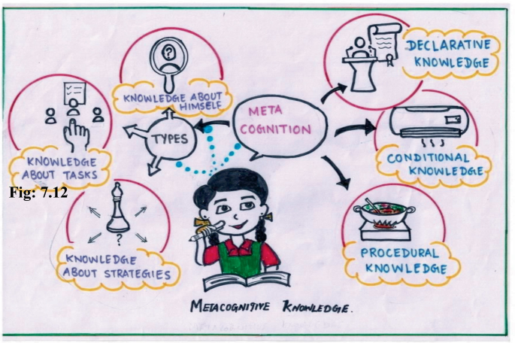
Why Deconstructing Classroom Notes is Essential
Deconstructing notes is a core indicator of active learning, because it requires students to:
Analyze information rather than copy it
Identify what they do and do not understand
Organize material into meaningful categories
Evaluate relationships, patterns, and themes
Rewrite and restructure ideas using their own words
Transform notes into active study tools
Study guides
Question banks
Concept maps
Comparison charts
This process activates analysis, evaluation, and creation, the top tiers of Bloom’s Taxonomy.

Slide 7

Metacognition + Active Learning = Academic Growth
When students deconstruct notes, they engage their metacognition by:
Monitoring their understanding
Evaluating their strategy effectiveness
Planning how to revise their study approaches
Adjusting based on performance
Reflecting on learning gaps
Anticipating the types of questions likely to appear on exams
This awareness strengthens independence, confidence, and academic resilience.

Slide 8

Why Learners Struggle Without Metacognitive Awareness
Learners often struggle because they rely on:
Passive learning strategies
Memorization over comprehension
Repetition instead of reasoning
Surface-level preparation instead of deeper engagement
Without metacognition, students cannot determine how, why, or when to shift strategies.

Slide 9

Final Takeaway for Parents and Educators
To support stronger academic performance:
Help students understand their metacognitive style
Encourage active learning routines during independent study
Teach them to deconstruct their notes after class
Reinforce the importance of reflection, monitoring, and evaluation
Focus on the top tiers of Bloom’s Taxonomy to unlock deeper comprehension
Metacognition transforms learners from passive recipients into active thinkers.

