Slide 1
Christopher J. Davidson, Esq.
Brendan Cooke, Esq.
Berluti McLaughlin & Kutchin LLP
44 School St Boston, MA 02108
T: (617)557-3030
(cdavidson@bmklegal.com)
(bcooke@bmklegal.com)

Slide 2
LEGAL DIMENSIONS

Slide 3
TOPICS
1. MORATORIUMS
2. PRIVATE TIDELANDS
3. M.G.L. c. 130, section 57
4. DOVER AMENDMENT

Slide 4
CJ HUSK
OUR CLIENT:

Slide 5
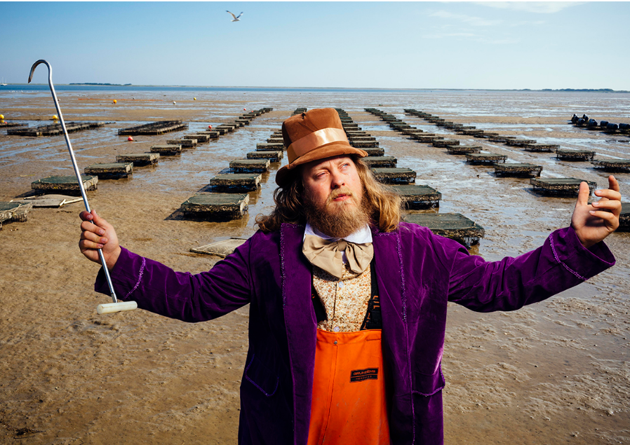

Slide 7
HUSK’S OWNERSHIP RIGHTS

Slide 8
OWNS TO MEAN LOW TIDE WATER MARK
SOURCE OF RIGHT: DEED, ESTABLISHED LAW

Slide 9
DEED SPECIFICALLY GRANTS PRIVATE OWNERSHIP RIGHTS TO LOW TIDE WATER MARK
THE DEED

Slide 10
PUBLIC TRUST DOCTRINE COLONIAL ORDINANCES OF 1647
CASE LAW

Slide 11
takeaway: presumes that upland owner owns to the mean low tide water mark. Deeds can sever this ownership.
In Re Opinion of The Justices, 365 Mass. 681 (1974).

Slide 12
TAKEAWAY: “The Commonwealth, as successor to the colonial authorities, owns and controls lands seaward of the flats”
MICHAELSON v. SILVER BEACH IMPROVEMENT ASSOCIATION, INC., 342 MASS. 251, 253-254 (1961)

Slide 13
Takeaway: The waters and the land under [waters] beyond the line of private ownership are held by the state
HOME FOR AGED WOMEN V. COMMONWEALTH, 202 MASS. 422, 427 (1909)

Slide 14
TOWN INVOLVEMENT

Slide 15
TOWN ASKED TO NOTIFY DMF OF THE COMMERCIAL USE OF PRIVATE LAND IN ORDER TO ISSUE COMMERCIAL PERMIT
TOWN REFUSED ON GROUNDS OF MORATORIUM

Slide 16
MORATORIUM
1. 2005: Moratorium imposed
Reason: to find viable space for aquaculture
2. 2009: Moratorium Remains
Formal study found viable space, but too much congestion at town ramp and in the harbor
Existing farmers could expand to promote industry but no new farmers due to congestion
3. 2024: Moratorium removed to Impose “Limited Entry Fishery”

Slide 17
HUSK RESPONSE

Slide 18
MORATORIUMS ARE LIMITED IN SCOPE
ONLY LEGAL IF TEMPORARY
THIS WAS NOT TEMPORARY – WENT ON FOR 20 YEARS
PURPOSE
PRIVATE TIDELAND OWNER DOES NOT CONTRIBUTE TO CONGESTION
WORKING OUT OF THEIR BACKYARD, NOT THE HARBOR AND NOT USING BOAT RAMP

Slide 19
NO MORE MORATORIUM LIMITED ENTRY FISHERY DECLARED NO NEW SITES TO BE GIVEN TO APPLICANTS TRANSFERS ONLY WAITLIST ESTABLISHED FOR ABANDONED SITES
RESULT:
TOWN AMENDS BYLAWS IN 2024

Slide 20
LAWSUIT FILED

Slide 21
Appeal of Duxbury bylaws for limited entry fishery

Slide 22
HUSK ARGUMENT

Slide 23
TOWN EXCEEDED AUTHORITY DELEGATED TO IT FROM THE STATE
DECISION TO BAN NEW AQUACULTURE SITES WAS ARBITRARY AND CAPRICIOUS

Slide 24
PART I:
TOWN EXCEEDS AUTHORITY

Slide 25
PUBLIC TRUST DOCTRINE
M.G.L. 130, S. 57

Slide 26
MUNICIPAL AUTHORITY TO REGULATE TIDELANDS MUST BE DELEGATED BY STATE
LICENSING STATUTE DELEGATED AUTHORITY WITH RESPECT TO COMMONWEALTH TIDELANDS
DID NOT DELEGATE ANY RIGHT TO REGULATE PRIVATE TIDELANDS

Slide 27
KEY LANGUAGE:
Licenses under this section shall be granted…not so as to impair the private rights of any person

Slide 28
SUPPORTING COURT DECISIONS
Fafard v. Conservation Comm'n of Barnstable
RECOGNIZED THE LICENSING STATUTE DELEGATED AUTHORITY TO REGULATE COMMONWEALTH TIDELANDS
Pazolt v. Dir. of Div. of Marine Fisheries
TOWN DOES NOT HAVE AUTHORITY TO UNILATERALLY GRANT LICENSE ON PRIVATE TIDELANDS
Opinion of the Justices
SCOPE OF PUBLIC EASEMENT RIGHTS

Slide 29
SCOPE OF AUTHORITY TO REGULATE PRIVATE TIDELANDS

Slide 30
PUBLIC TRUST DOCTRINE, NOT STATUTE APPLIES

Slide 31
FISH, FOWL, NAVIGATION

Slide 32
AQUACULTURE IS NOT “FISHING,” AND THEREFORE, PUBLIC HAS NO RIGHT TO GROW SHELLFISH ON PRIVATE TIDELAND
ONLY PERSON WHO COULD IS THE PRIVATE TIDELAND OWNER

Slide 33
THE DOVER AMENDMENT

Slide 34
MUNICIPALITY MAINTAINS TRADITIONAL POLICE POWER OVER SHORELAND UNLESS PREEMPTED
Com. v. Muise
DOVER AMENDMENT HAS PREEMPTED TOWN’S AUTHORITY TO REGULATE LAND USE

Slide 35
DOVER AMENDMENT (M.G.L. c. 40A § 3):
No zoning ordinance or by-law . . . prohibit, unreasonably regulate, or require a special permit for the use of land for the primary purpose of commercial . . . aquaculture . . . nor prohibit, unreasonably regulate or require a special permit for the use, expansion, reconstruction or construction of structures thereon for the primary purpose of commercial . . . aquaculture.

Slide 36
LEGISLATURE HAS MADE TWO POINTS:
MUNICIPALITY HAS AUTHORITY TO REGULATE COMMONWEALTH TIDELAND WITH RESPECT TO AQUACULTURE LICENSES
MUNICIPALITY CANNOT PROHIBIT AQUACULTURE ON PRIVATE PROPERTY

Slide 37
PART II: ARBITRARY AND CAPRICIOUS

Slide 38
PURPOSE OF LICENSING STATUTE IS TO PROTECT AND PROMOTE AQUACULTURE
Rose v. Bd. of Selectmen of Falmouth

Slide 39
ENACTMENT OF LIMITED ENTRY FISHERY RELIED ON:
CONGESTION OF PUBLIC SPACES
ASTHETIC COMPLAINTS OF RESIDENTS
NO OBJECTION FROM AQUACULTURE INDUSTRY
BOTH ECONOMICALLY AND ECOLOGICALLY VIABLE TO INCREASE AQUACULTURE SITES

Slide 40
TOWN’S ARGUMENTS
LIMITED ENTRY FISHERY IS NOT A BAN
DOVER AMENDMENT IS INAPPLICABLE
EVEN IF IT WERE, NOT A PROHIBITION

Slide 41
TAKEAWAYS

Slide 42
MAA CAN GET INVOLVED WITH THEIR LEGISLATURES
LEGISLATION SHOULD CLARIFY THE RIGHTS OF PRIVATE PROPERTY OWNERS AND PROVIDE PROCEDURES IN THE EVENT OF CONFLICTS OVER LAND USE
MORATORIUMS TO PRECLUDE OYSTER FARMING CAN BE SUBJECT TO LAWSUITS

Slide 43
THANK YOU
Questions/Contact Info Link:

Slide 44
Christopher J. Davidson, Esq.
Brendan Cooke, Esq.
Berluti McLaughlin & Kutchin LLP
44 School St Boston, MA 02108
T: (617)557-3030
(cdavidson@bmklegal.com)
(bcooke@bmklegal.com)

