Slide 1
Massachusetts Aquaculture Association Annual Meeting February 7, 2025
Sean Bowen MDAR Aquaculture Specialist

Slide 2
Aquaculture is Agriculture – just add water
MGL Ch 128
Section 1A. ''Farming'' or ''agriculture'' shall include farming in all of its branches...the production, cultivation, growing and harvesting of any agricultural, aquacultural, floricultural or horticultural commodities... including preparations for market, delivery to storage or to market or to carriers for transportation to market.

Slide 3
MDAR Farm and Market Report
MDAR's bi-monthly e-newsletter, includes the Commissioner's Column, program updates, workshops, USDA and UMass events
Distributed to the agricultural community in Massachusetts.
Most grants are announced through the F and M Report
Subscribe online: https://www.mass.gov/info-details/the-farm-and-market-report
(Google MDAR Farm and Market Report…)

Slide 4
MDAR Agricultural Grant Programs
Matching Enterprise Grants for Agriculture – Jessica Camp
Agricultural Food Safety Improvement Program – Laura Maul
Climate Smart Agriculture Program – Laura maul, Gerry Palano, Dave Schmidt
Food Security Infrastructure Grants - Holly Valleca
Most of these will be opening this spring.
Watch the MDAR Farm and Market Report

Slide 5
MDAR Agricultural Grant Programs
Climate Smart Agriculture Program – 3 in 1
ACRE, AEEP, Ag-Energy
Simplify the application process
More responsive to industry needs
Laura Maul, Gerry Palano, Dave Schmidt

Slide 6
Agricultural Food Safety Improvement Program
Provides funding to implement practices which:
Improve food safety practices
Minimize risk
Increase market access
80% funding up to $50,000
Contact Laura Maul (laura.maul@mass.gov)
>$1M to Aqua since grant inception in 2014

Slide 7
New! Division of Food Security
Julianne Stelmaszyk, Director, Division of Food Security
The Division of Food Security – to build long-term food system resilience and food security
Holly Valleca, Food Security Infrastructure Grant Program,
now managed by at MDAR
FSIG RFR in development – likely released mid-spring

Slide 8
Massachusetts Agriculture Day at the State House
March 18, 2025
“Come to Boston to meet with your representatives and celebrate all things Agriculture”

Slide 9
MDAR Aquaculture Centers Funding
The 2018 Bond Bill allocated $300K to the Centers:
2019: $50k
2020: $50k
2021: $50k
2022: $50k
2023: $60k
2024: $60k
2025: $60k
2026: $??
MDAR has funded $380K to the Centers since 2019.
Additional funding source?
2025 Environmental Bond Bill??

Slide 10
2025 Environmental Bond Bill???
Opportunity to think outside the box
Assess priorities
Needs of the industry?
Speak to Executive Branch and Legislative Branch

Slide 11
FEDERAL DISASTER RELIEF SUPPLEMENTAL APPROPRIATIONS ACT
$220,000,000 to provide assistance in the form of block grants to eligible States
To provide compensation to producers for necessary expenses related to crop, timber, and livestock losses, including on-farm infrastructure, due to weather event in 2023 or 2024
Eight states meet eligibility criteria: New England, AK and HI
MA funding priorities will be based upon (USDA and) surveys responses received in January

Slide 12
Export Resources

Slide 13
Connecting with International Buyers 2025 Events:
Seafood Expo North America, Boston. March 12 - 14
Mass Avenue coordinated by DMF & MDAR
One-on-one meetings with shellfish buyers.
Seafood Expo Global, Barcelona. April 23 – 25
New first time exhibitor table option
National Restaurant Assn, Chicago. May 18 – 21
China Fisheries, Qingdao. Oct 25 – 27
USDA funds can offset 50% of eligible costs such as the booth, display,
furnishings, promotion, & international travel

Slide 14
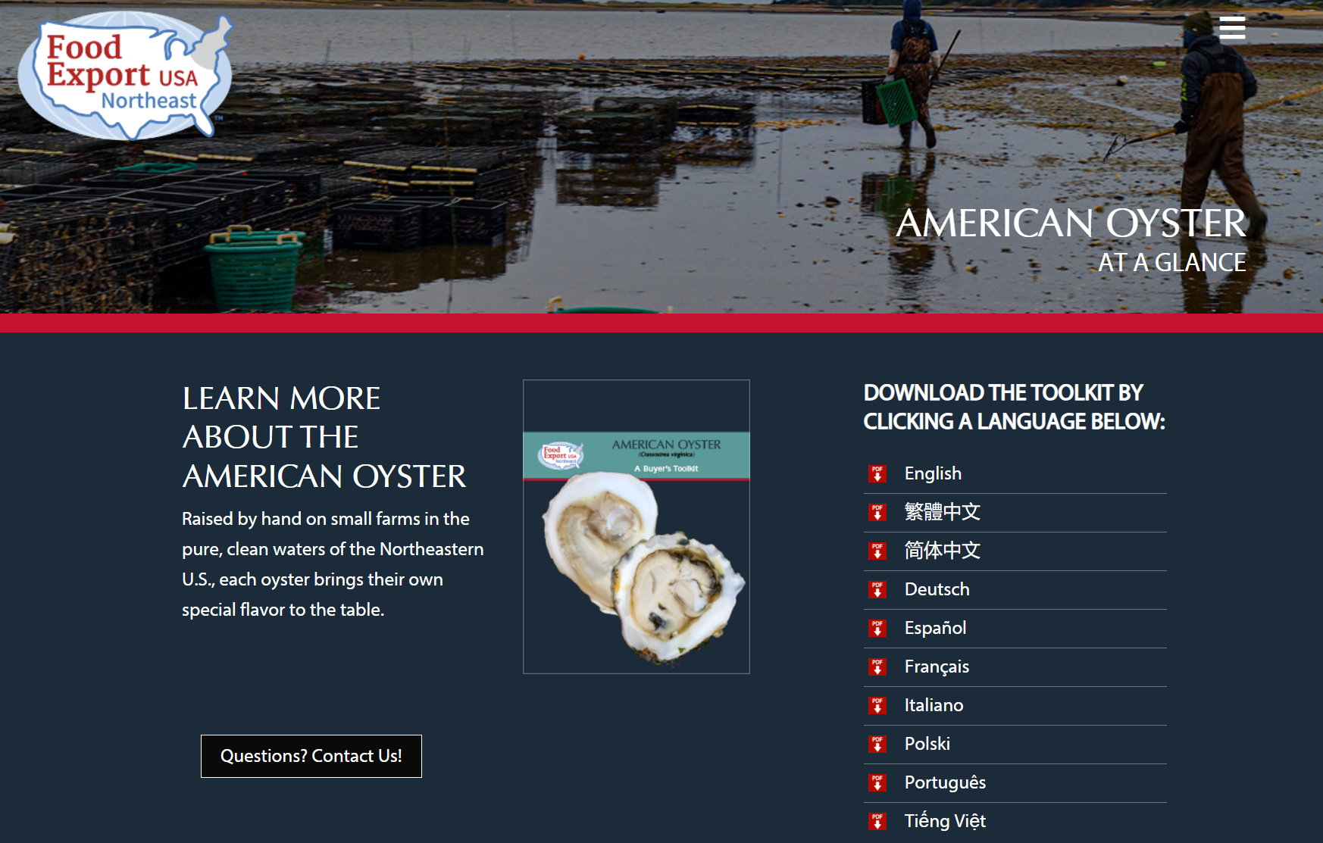
Oyster Buyer’s Toolkit seafoodbuyersguide.foodexport.org/oyster/

Slide 15
Guidance for Exporting Shellfish
MA and WA can sell into the EU
Spain & the Netherlands can sell into the U.S.
Dealer permit:
https://www.mass.gov/how-to/apply-for-a-seafood-dealer-permit
FDA guidance for the EU, China, UK, Saudi Arabia:
https://www.fda.gov/food/food-export-lists/seafood-exports-european-union-and-china
Register for the EU shippers list: https://www.fda.gov/media/112092/download

Slide 16
Questions?
Sean Bowen
Aquaculture Specialist
225 Turnpike Road
Southborough, MA 01772
617-869-7178
Sean.Bowen@mass.gov
Bonita Oehlke
Export Market Development
100 Cambridge Street, 9th Floor
Boston, Massachusetts 02114
617-910-7960
Bonita.Oehlke@mass.gov

