Slide 1
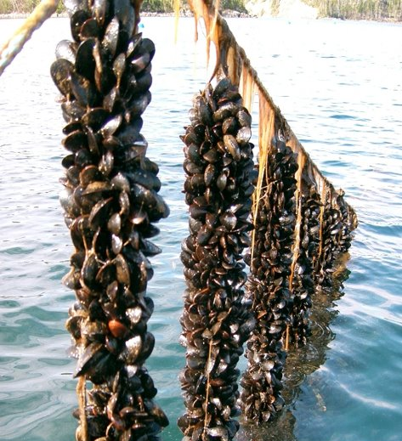
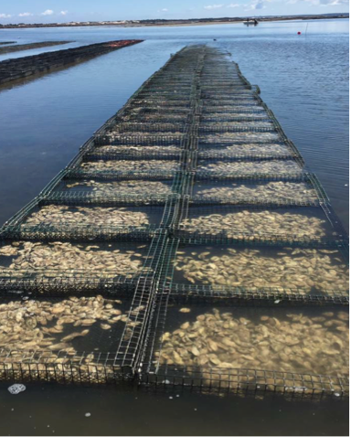
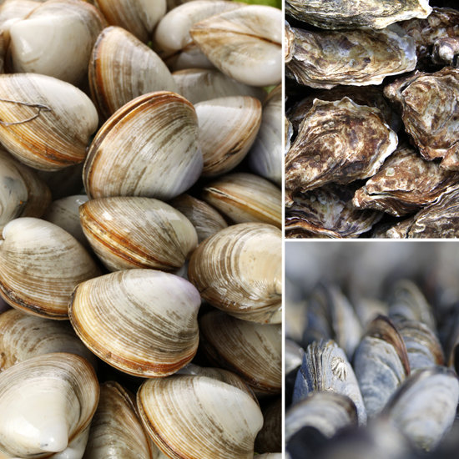
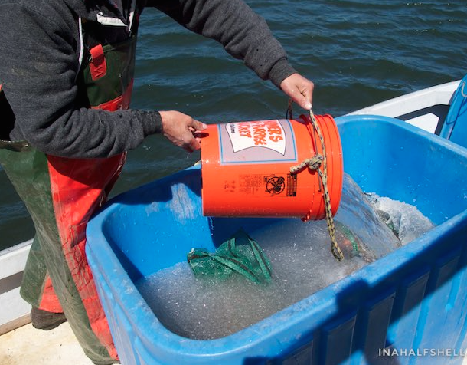
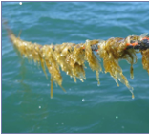
Division of Marine Fisheries Update
Matthew Camisa, Alex Boeri
Shellfish Sanitation & Management Program

Slide 2
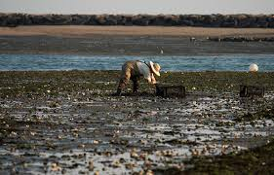
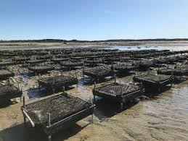
Update and Recent Events
Personnel Changes
Hydrographic Modeling around WWTP Outfalls
Emergency CSO closures
Program Element Evaluation Reports (PEERs)
GA (Growing Area)
RARM (Risk Assessment Risk Management)
2023 Shellfish Aquaculture Landings
2024 Vibrio Illnesses
2024 New Site and Permit Statistics
Permitting

Slide 3
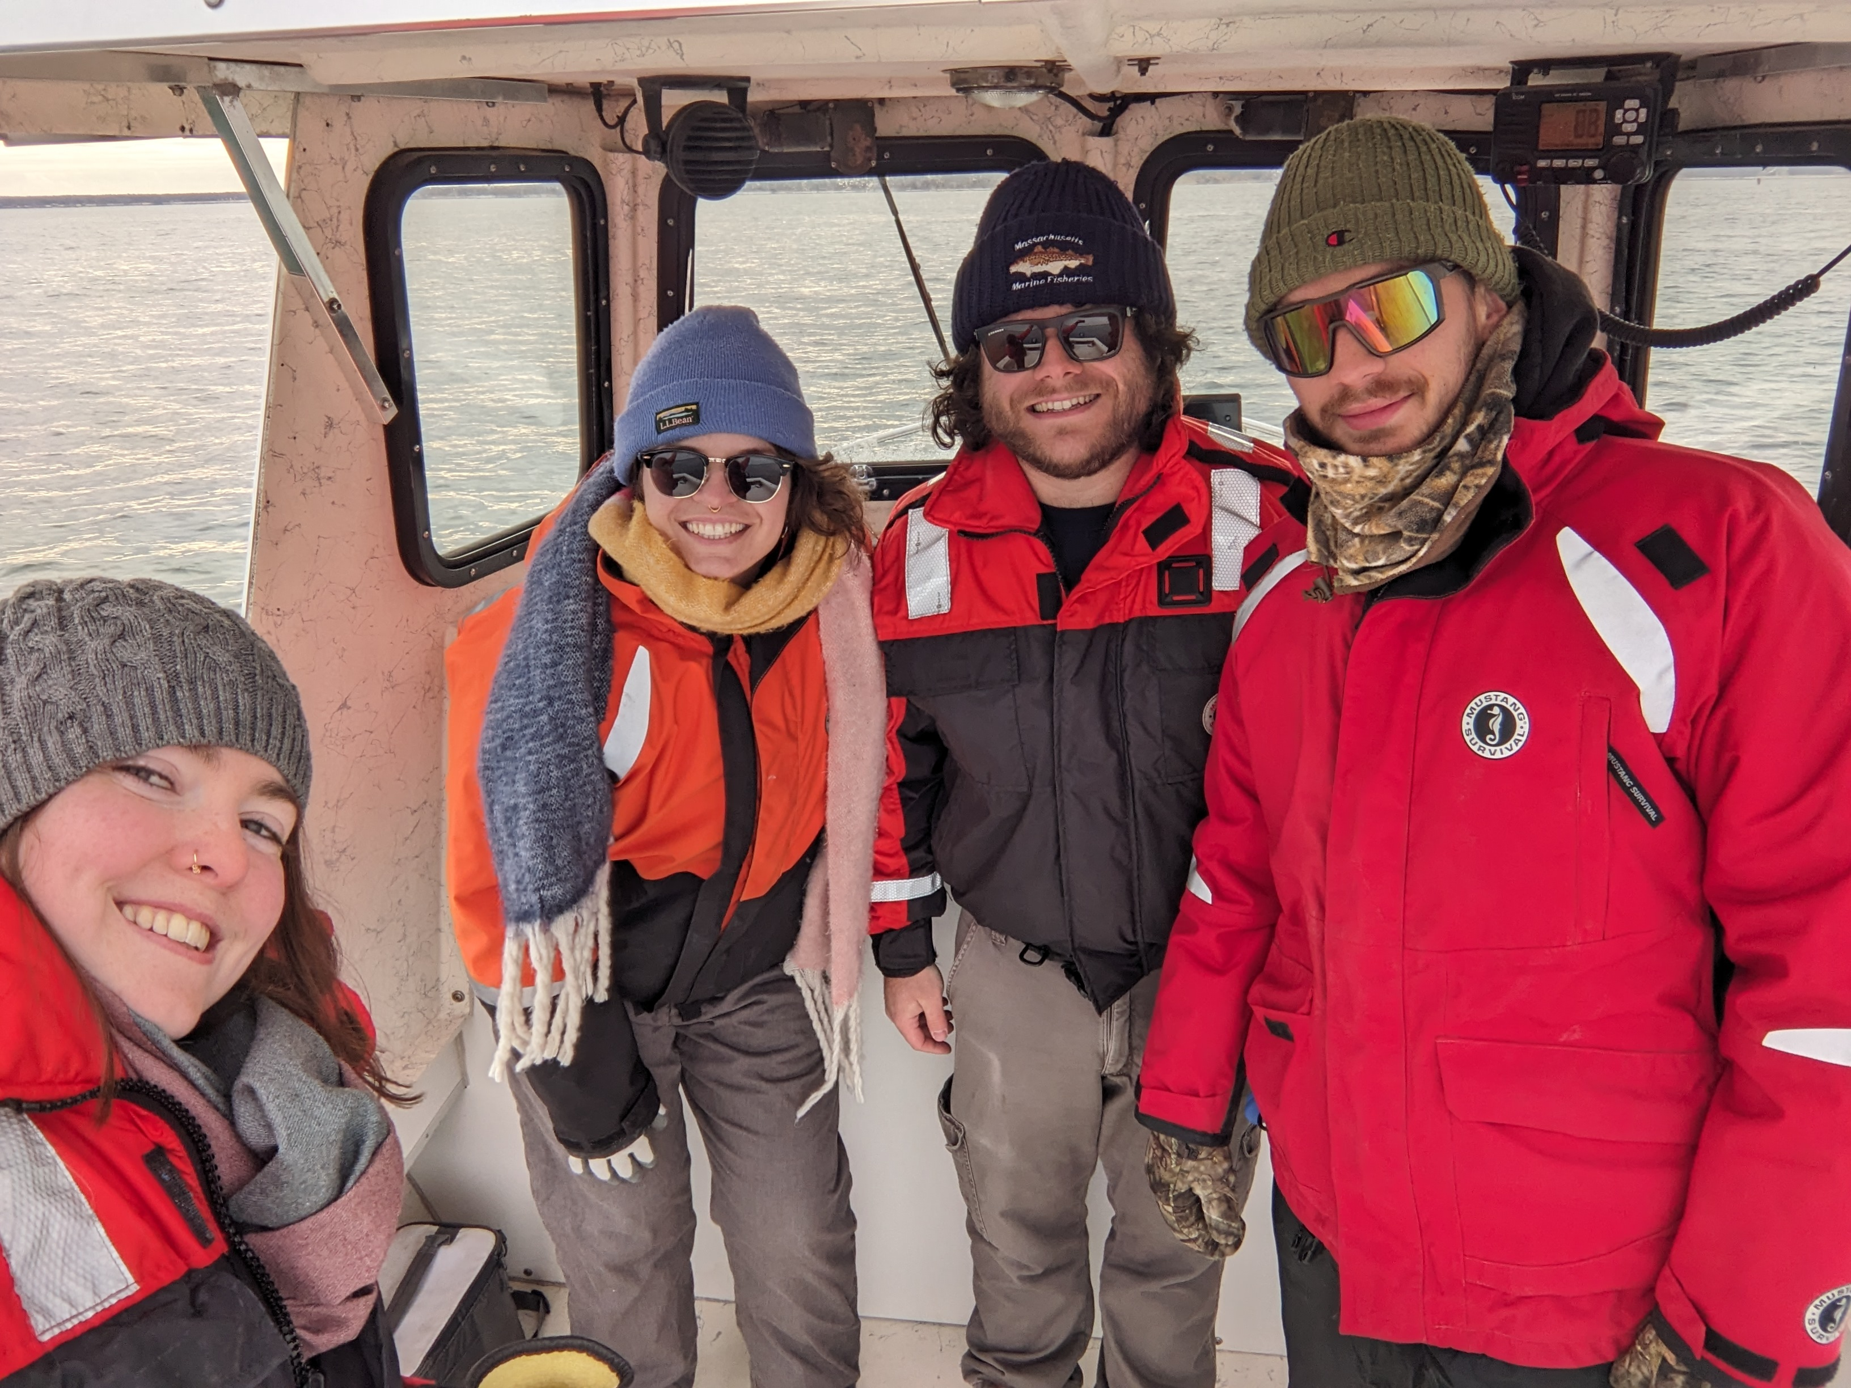
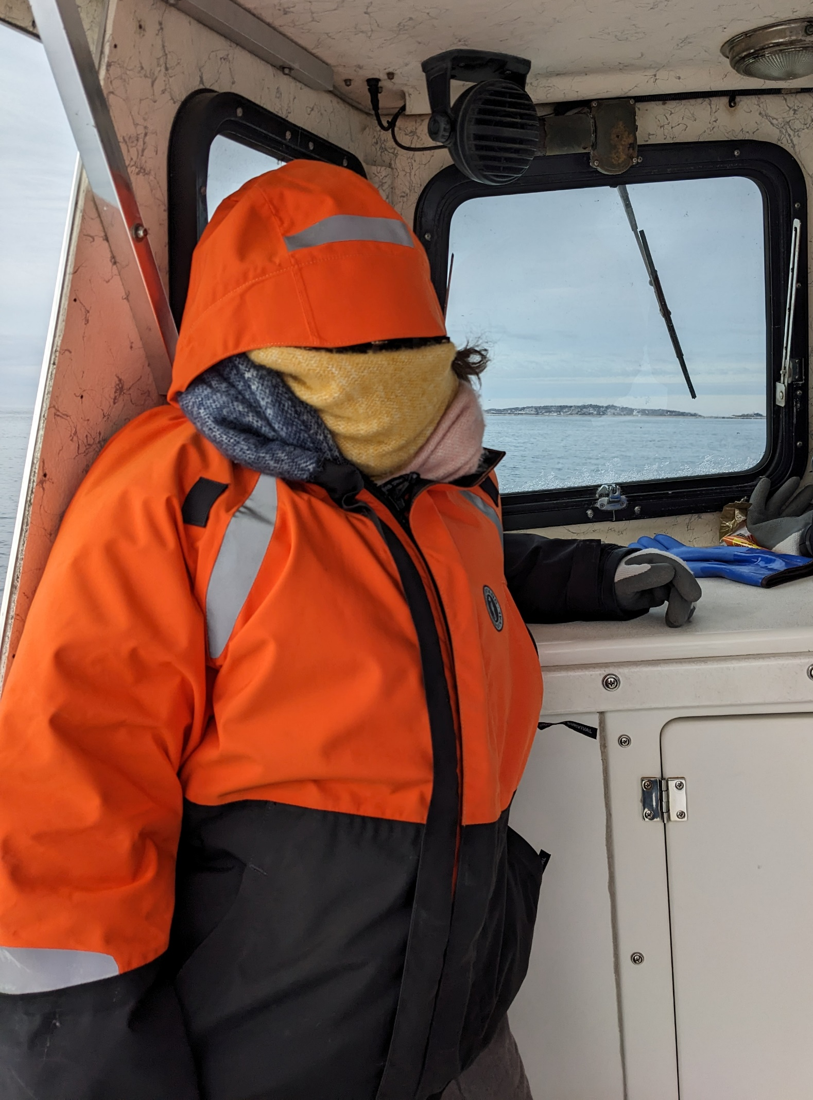
Personnel Changes
Mitchell Parizek - Shellfish Area Biologist hired/March New Bedford​
Emma Gallagher - Shellfish Area Biologist hired/March New Bedford​
Amber Woolfenden - Bacteriologist full-time/April Gloucester​
John Mendes - Shellfish Area Biologist retired/April New Bedford​
Jake Madden - Lab Supervisor promoted/June Gloucester​
Matt Camisa - Regional Shellfish Supervisor promoted/June New Bedford​
Allie Myers - Shellfish Area Biologist hired/June New Bedford​
John Mendes - Shellfish Area Biologist contract/July New Bedford​
Terry O’Neil - Classification Supervisor promoted/July New Bedford
Gabe Lundgren – Shellfish Biologist​ promoted/Jan New Bedford
MAA DMF Update February 7, 2025
Slide 3

Slide 4
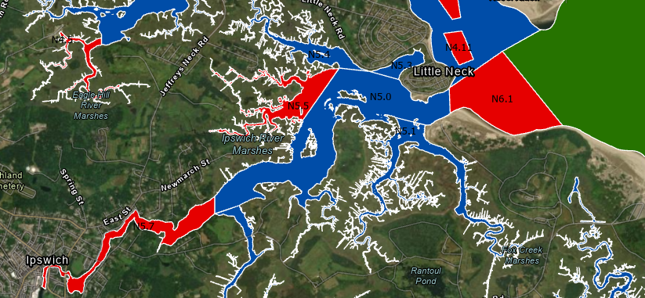
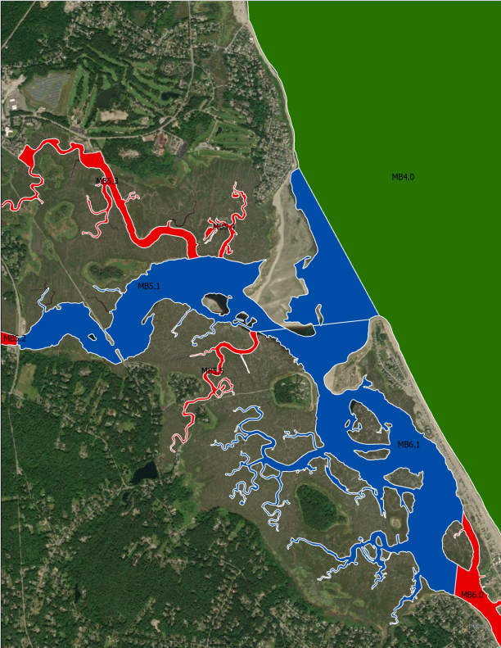
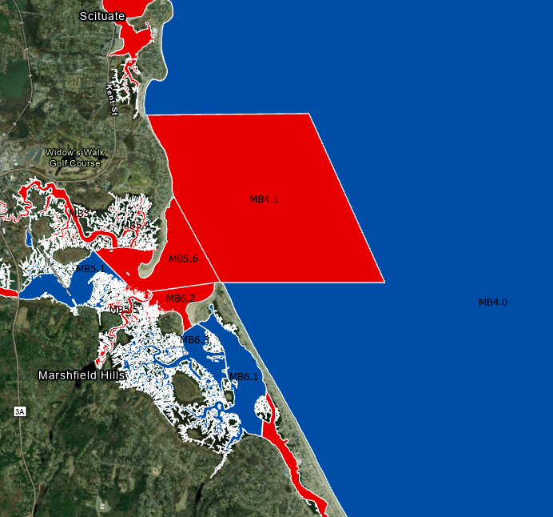
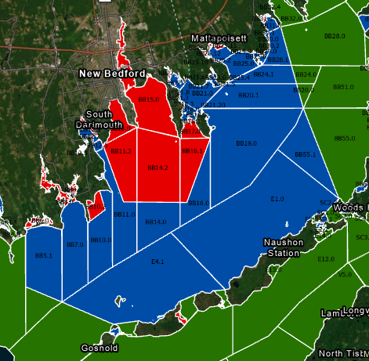
Hydrographic Modeling
Scituate 2022
New Bedford/Fairhaven 2023
Dartmouth/Ipswich 2024
??? 2025
MAA DMF Update February 7, 2025
Slide 4

Slide 5
Hydrographic Modeling
Impacts to wild harvesters
Possible impact to Dealers
No Closures for Aquaculture due to WWTP modeling and reclassifications!
MAA DMF Update February 7, 2025
Slide 5

Slide 6
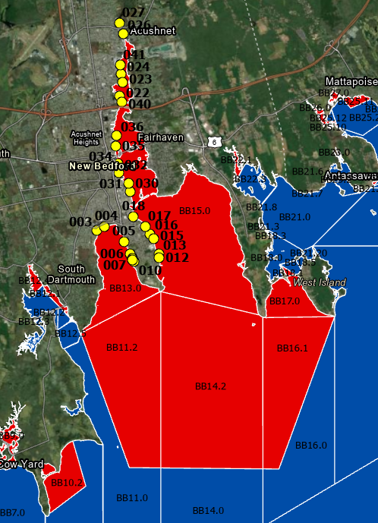
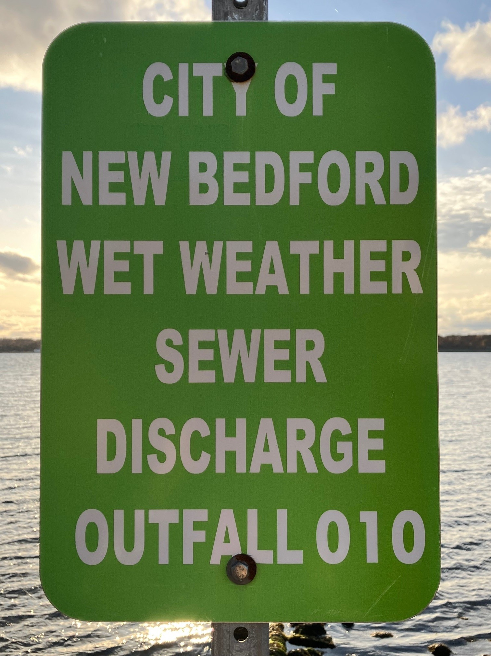
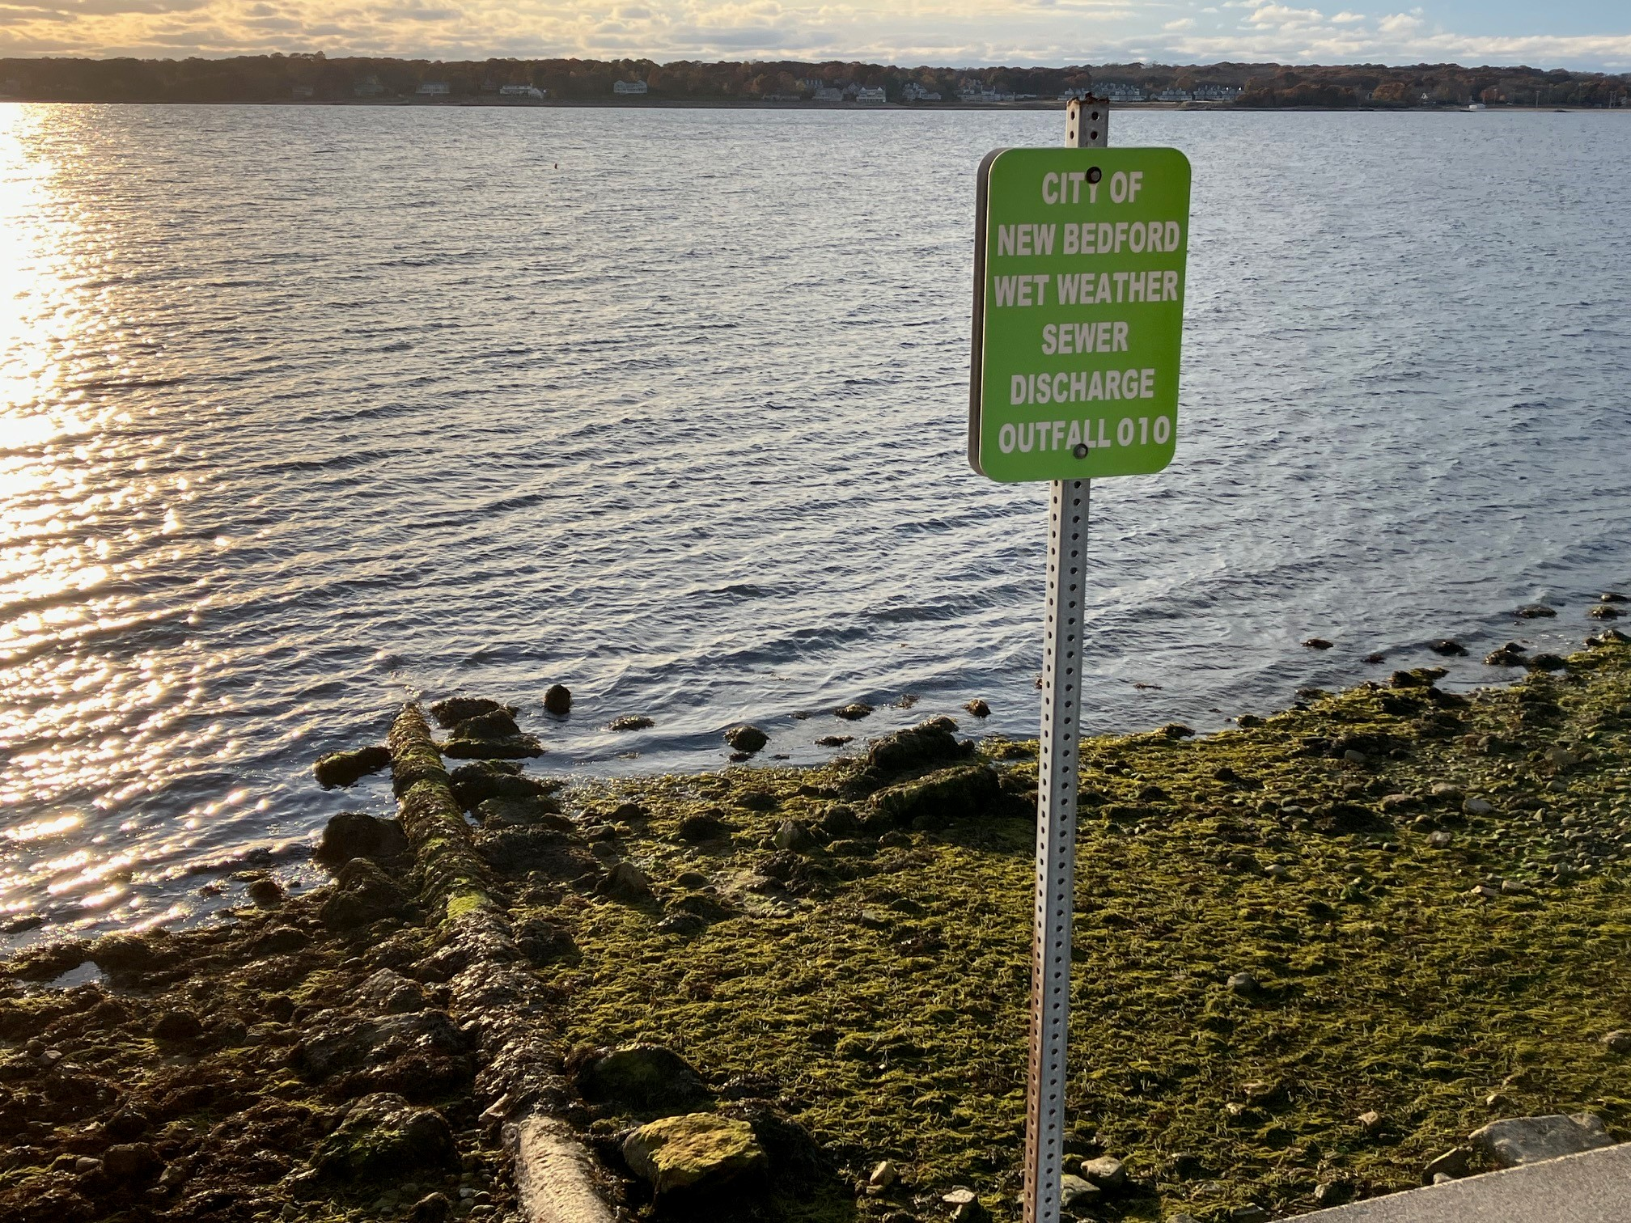
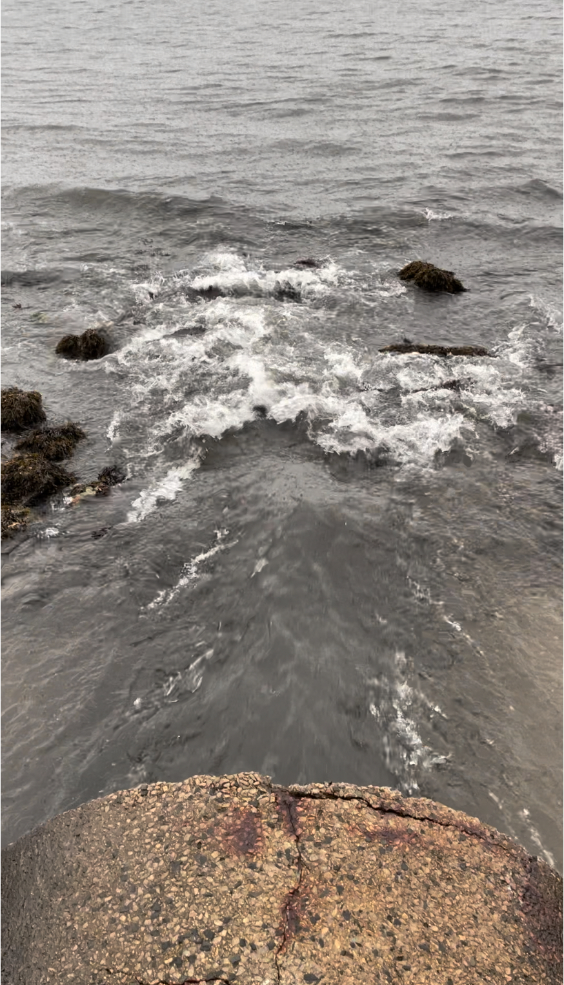
New Bedford CSO Activity 2024
27 CSOs (194 CSOs statewide)
60 rain events
465 CSO Activations
639 Million Gallons Released
MAA DMF Update February 7, 2025
Slide 6

Slide 7
Emergency Closure Requirements
Emergency closure
Ch.IV @.03 A (1) Growing Area Classification
(1) Emergency Conditions. A growing area or a portion of a growing area (harvest area) shall be placed in the closed status under Section @.03 A. (5) when pollution conditions exist which were not included in the data used to classify the area. If it is determined that an emergency condition or situation exists, then the growing area or harvest area will be immediately (within twenty-four (24) hours) placed in the closed status.
Ch. IV @.03 A (5) (b) Growing Area Classification
(b) Closed Status. Any classified growing area or harvest area may be closed because of:
(i) An emergency condition or situation;
Optional MSC test to reopen after 7 days
Ch. IV @.03 A (5) (d) (iv) Growing Area Classification
(iv) For emergency closures of harvest areas caused by the occurrence of raw untreated sewage or partially treated sewage discharged from a sewage collection system or WWSD:
a. The MSC analytical sample results in shellfish shall not exceed MSC levels established in Chapter IV @.02 E (4) or
b. Pre-determined MSC levels in shellfish established by the Authority based on studies conducted on regional species under regional conditions from shellfish samples collected no sooner than seven (7) days after contamination has ceased and from representative locations in each growing area potentially impacted or
c. Until the event is over and twenty-one (21) days have passed;
MAA DMF Update February 7, 2025
Slide 7

Slide 8
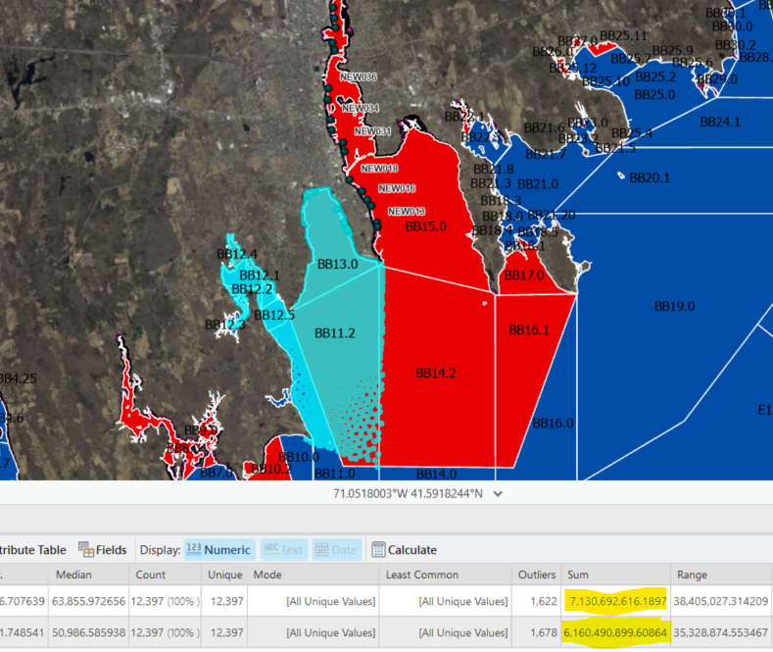
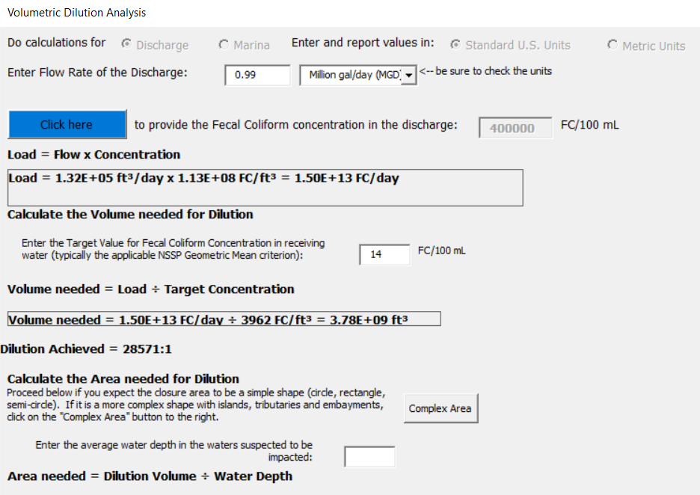
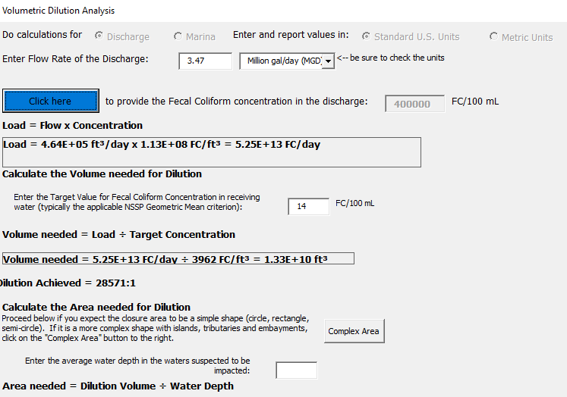
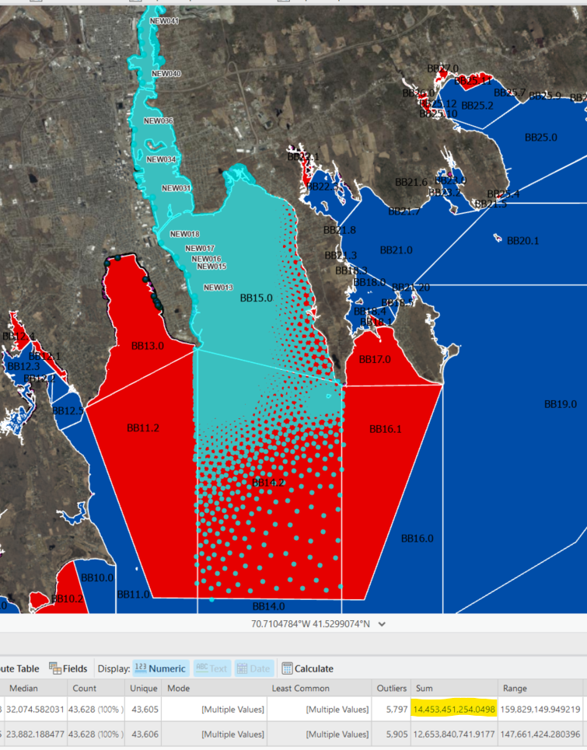
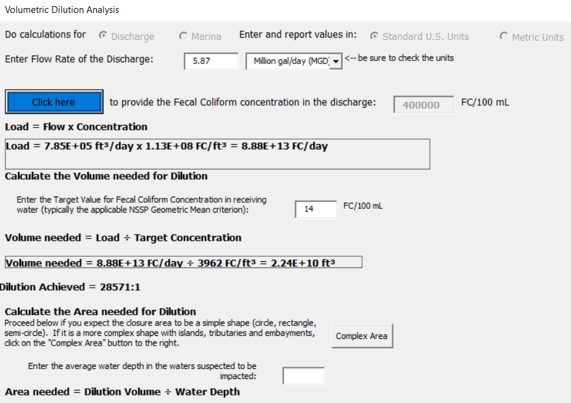
Dilution Analysis
Receiving Water | Outfall | Outfall Location | Reporting Method | Start Time | End Time | Duration | Volume (million gallons) | Event Rainfall (inches)
Inner Harbor | 31 | Inner Harbor West by Conway St | Sensor | 10/07/2024 11:25 AM EDT | 10/07/2024 03:50 PM EDT* | 4.42 | 0.43 | 0.91
Outer Harbor | 17 | Outer Harbor by East Rodney | Sensor | 10/07/2024 02:10 PM EDT | 10/07/2024 03:40 PM EDT* | 1.5 | 0.82 | 0.91
Outer Harbor | 18 | Cove St. and East Rodney | Sensor | 10/07/2024 11:30 AM EDT | 10/07/2024 03:30 PM EDT* | 4 | 0.44 | 0.91
Clarks Cove | 3 | Clarks Cove Padanaram St. | Sensor | 10/07/2024 09:55 AM EDT | 10/07/2024 03:30 PM EDT* | 5.58 | 0.99 | 0.91
Inner Harbor | 23 | Coffin Ave. and Riverside Ave. | Sensor | 10/07/2024 10:25 AM EDT | 10/07/2024 03:20 PM EDT* | 4.92 | 3.98 | 0.72
Inner Harbor | 035/036 | Acushnet River by Herman Melville Blvd | Sensor | 10/07/2024 10:15 AM EDT | 10/07/2024 02:55 PM EDT | 4.67 | 0.2 | 0.72
Existing closure of BB11, 12, 14,16, issued on 9/21/24 reset. Dilution calculation conducted on volumes in Clarks Cove and the Outer Harbor that occurred while the tide was flooding east showed that there was enough dilution in the Prohibited area prior to reaching Nasketucket Bay. Called Costa from New Bedford to confirm that manual discharge CSO 004 had not been discharged and would not be discharged due to this rain event. Emergency CSO closure was lifted for BB18, BB21-BB23 as of 7:30 AM on 10/8/24. |  |  |  |  |  |  |  |  | Dilution Volume needed
 |  |  |  |  |  | Harbor | 5.87 |  | 2.24E+10
 |  |  |  |  |  | Clarks | 0.99 |  | 3.78E+09
 |  |  |  |  |  | Total Discharge | 6.86 |  | 2.62E+10
MAA DMF Update February 7, 2025
Slide 8

Slide 9
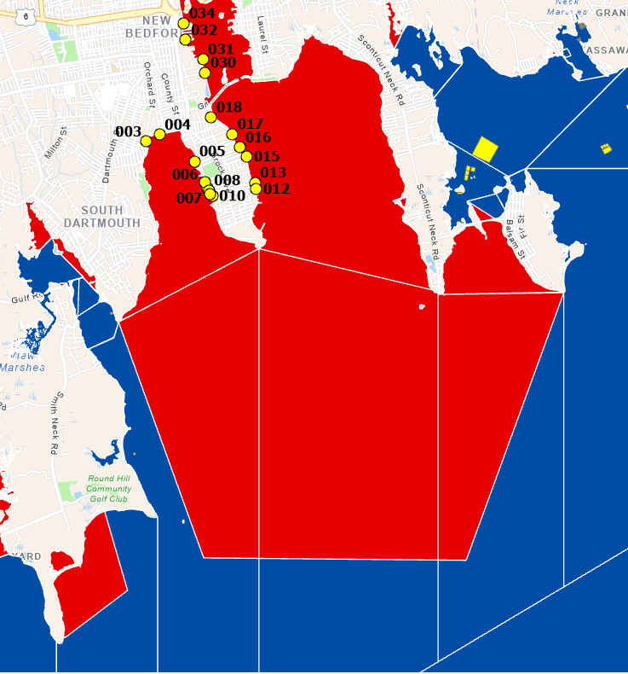
Emergency CSO Closures
~ 18 closures/expansions
Multiple resets
~175-210 days closed
Westport, Dartmouth, New Bedford, Fairhaven, Mattapoisett, Marion, Falmouth and Gosnold
MAA DMF Update February 7, 2025
Slide 9

Slide 10
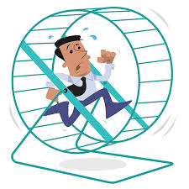
DMF Response to CSO Activations
24-hour monitoring of CSO activities and dilution analysis
Sampling CSOs during activations
Updates through large text group
21 day closures with MSC testing after 7 days
DMF staff digging and collecting
Transport samples to Newburyport
Gloucester lab staff report to plant
Extra sampling to monitor MSC levels
Method verification in NB and GL
Coordinate clean samples from other municipalities
Present our actions and findings to municipalities, industry, environmental groups and politicians
Working with Woods Hole Sea Grant to deploy sensors
MAA DMF Update February 7, 2025
Slide 10

Slide 11
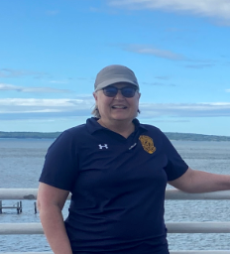
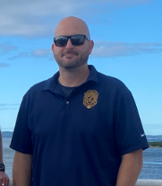
Growing Area Updates
2024 PEER Results (8/5/24 -8/12/24)
9 south shore areas / 5 north shore areas.
No new deficiencies!!!
Birds observed on gear in Plum Island Sound
Resolution of Past Deficiencies
Signed MOU (DMF/DPH/MEP)
Cleansing Studies in rainfall areas
2025 PEER Scheduled for August 2025
13 south shore areas
Buzzards Bay – Wings Cove, Weweantic River, Fishermen Cove, Buttermilk Bay
Mount Hope Bay – Lees River, Cole River
Nantucket– Nantucket Harbor West, Polpis Harbor, Madaket Harbor
South Cape – Eel Pond, Waquoit Bay, Little and Great Rivers, Lewis Bay
MAA DMF Update February 7, 2025
Slide 11

Slide 12
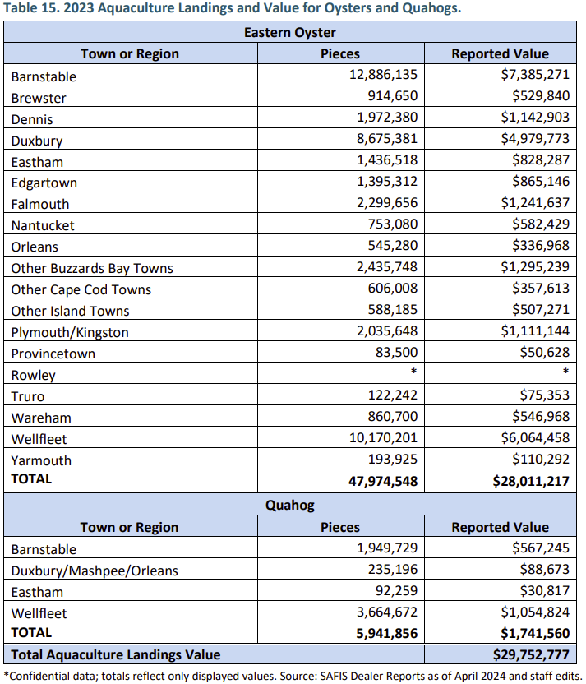
2023 Aquaculture Statistics
MAA DMF Update February 7, 2025
Slide 12

Slide 13
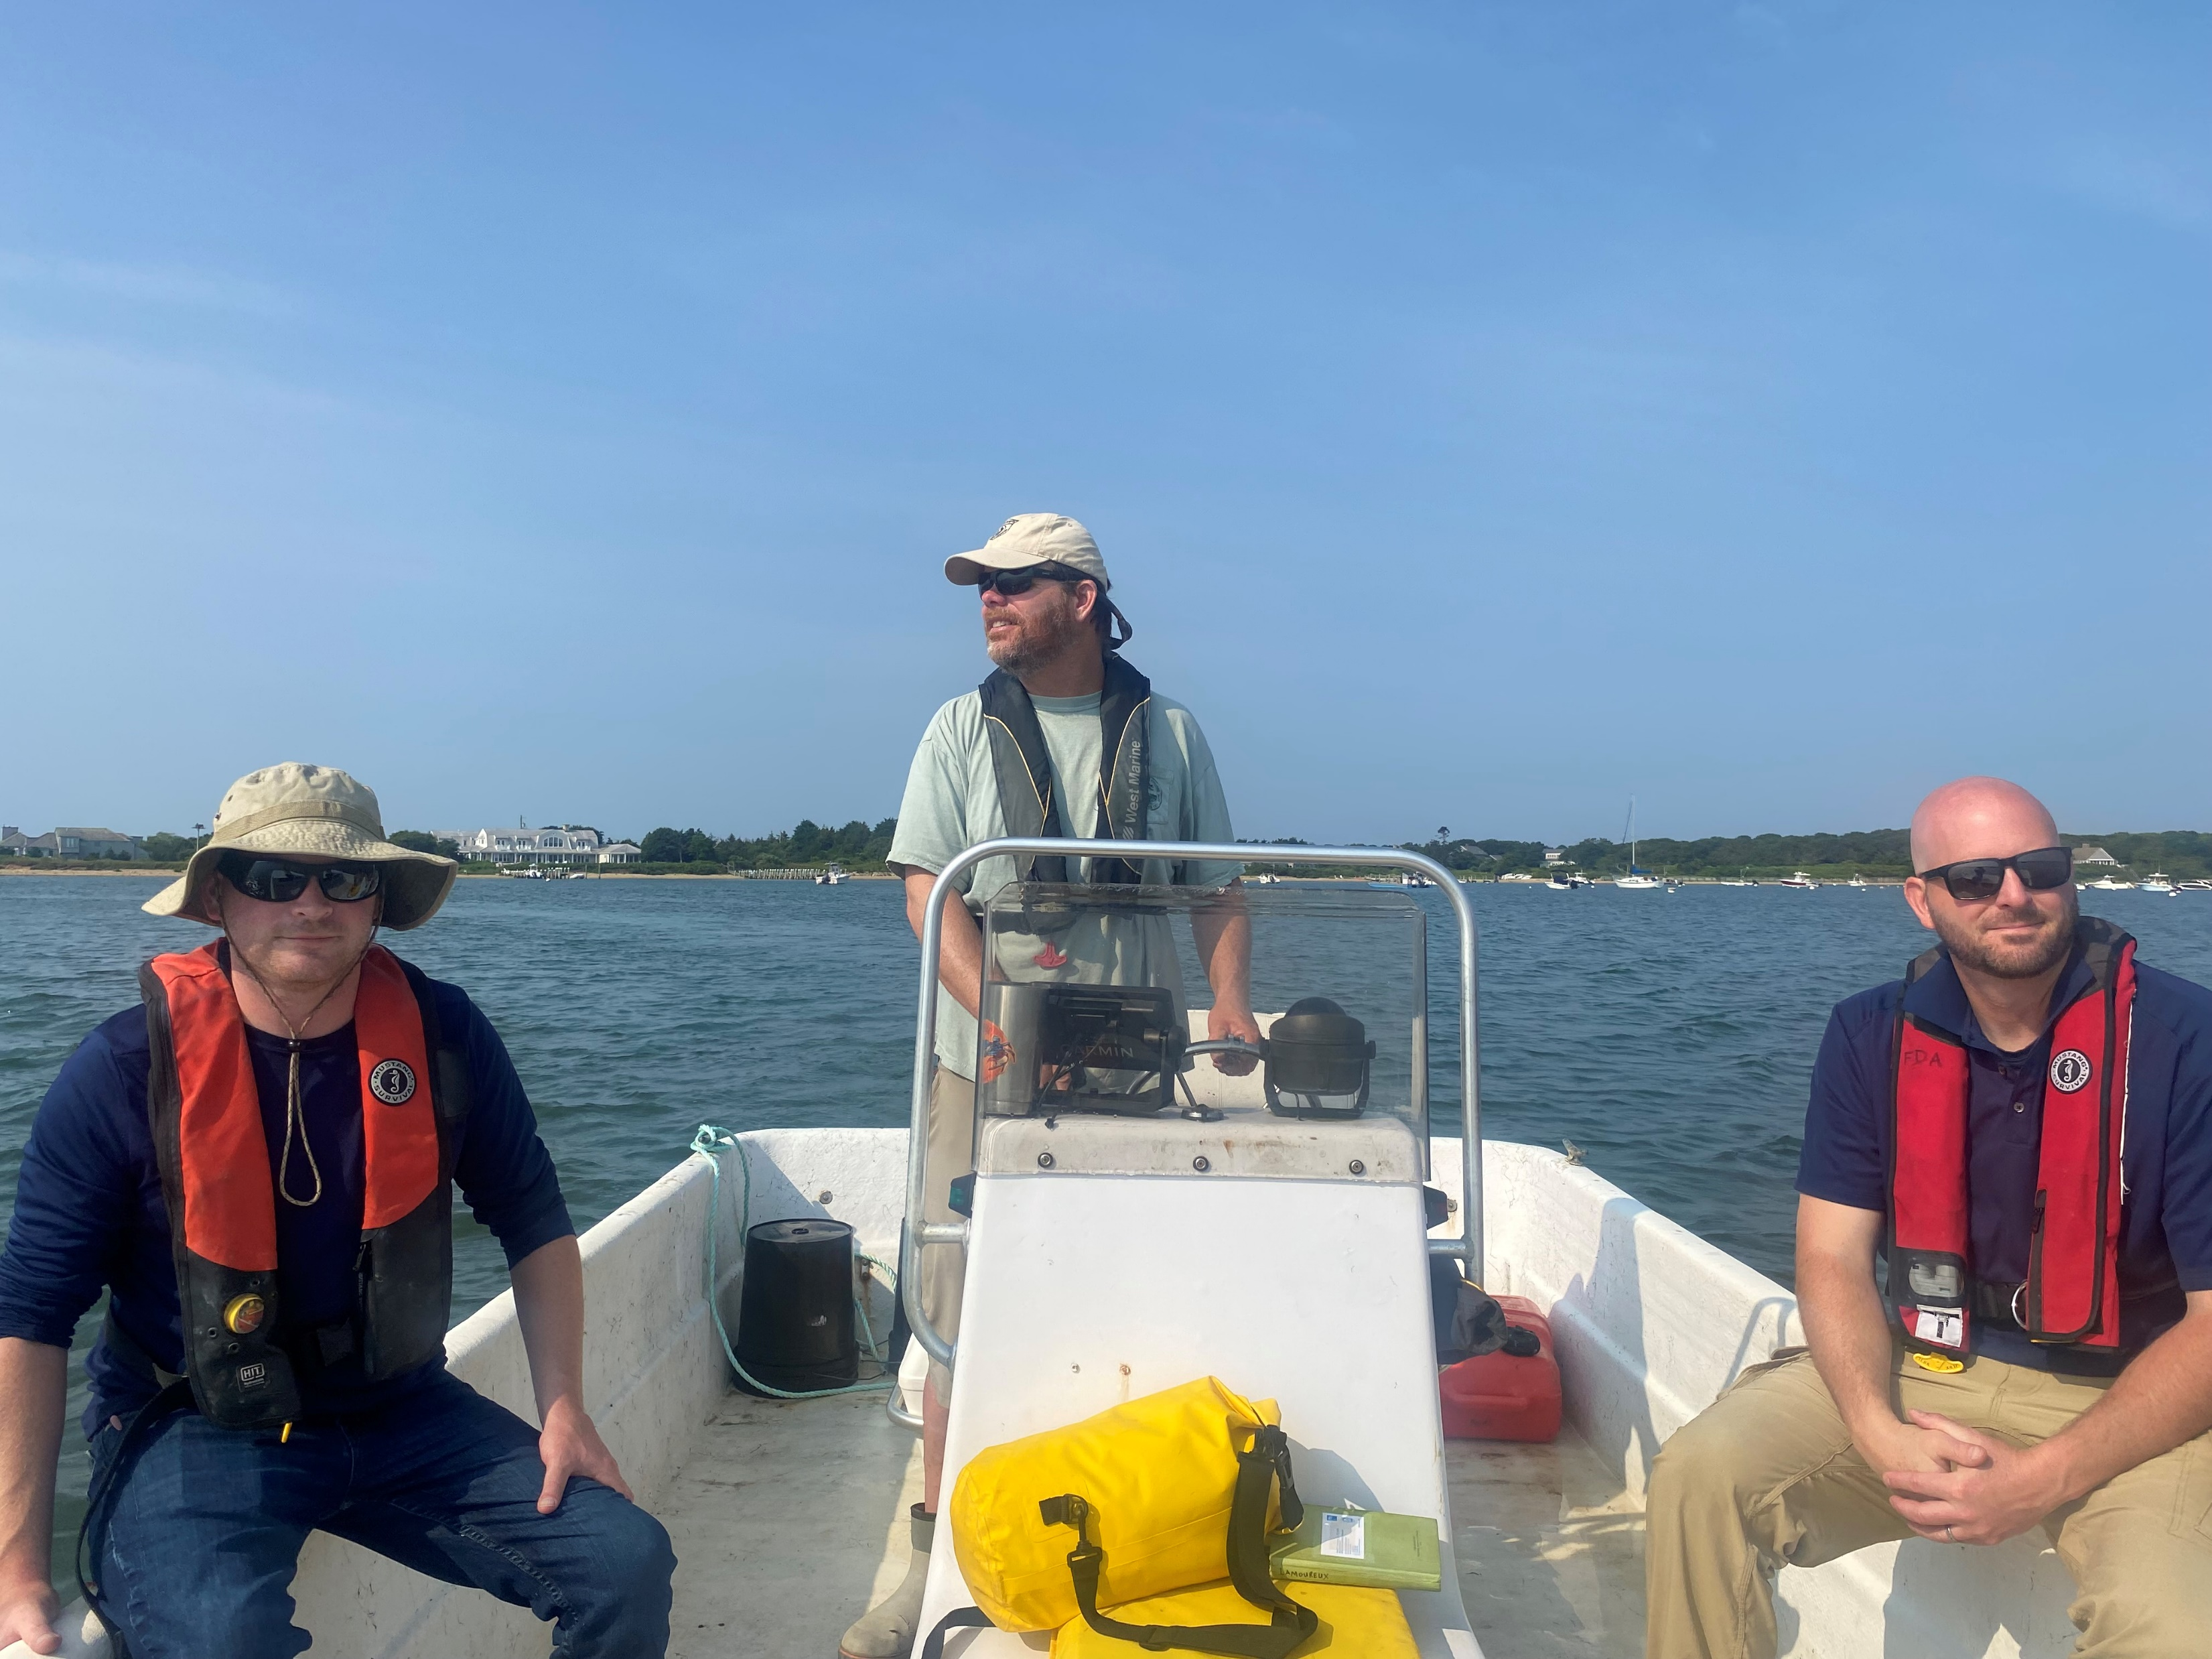
RARM (Risk Assessment/Risk Management)
Conducted June 26-28, 2024
No issues observed with Vibrio compliance
FDA recommended more ice use on hot days
FDA recommended DMF inspection of private ice machines
FDA observed birds on one aquaculture site during PEER
MAA DMF Update February 7, 2025
Slide 13

Slide 14
2024 Season
Confirmed Vp Multi-Source (15):
Confirmed Vp Single Source (10):
Consumption Date | Implicated Food | Harvest Areas
6/29/2024 | Raw Oysters | SC50-Chatham, SC28-Yarmouth
7/2/2024 | Raw Oysters | CCB14, CCB23, CCB31, OC5, Canada
7/14/2024 | Raw Oysters | CCB31-Barnstable, CCB14-Wellfleet
7/26/2024 | Raw Oysters | CCB31-Barnstable, WA
7/26/2024 | Raw Oysters | CCB9-Eastham, CCB45-Duxbury
7/27/2024 | Raw Oysters | BB3-Westport, CCB45-Duxbury
7/31/2024 | Raw Oysters | SC61-Orleans, CCB11-Wellfleet, CCB45-Duxbury
8/4/2024 | Raw Oysters | CCB11-Wellfleet, Canada
8/13/2024 | Raw Oysters | CCB14-Wellfleet, CCB31-Barnstable, ME
8/24/2024 | Raw Oysters | CCB23, BB21, BB18, NH, Canada
8/29/2024 | Raw Oysters | CCB45-Duxbury, WA
8/31/2024 | Raw Oysters | CCB20-Brewster, BB37-Wareham
9/7/2024 | Raw Oysters | BB36-Wareham, Canada
9/9/2024 | Raw Oysters | CCB45-Duxbury, ME
10/1/2024 | Raw Oysters | CCB31-Barnstable, NY, ME
Consumption Date | Implicated Food | Harvest Area
5/12/2024 | Raw Oysters | BB4-Westport
7/20/2024 | Raw Oysters | CCB45-Duxbury
7/22/2024 | Raw Oysters | CCB11-Wellfleet
7/27/2024 | Raw Oysters | BB23-Mattapoisett
8/7/2024 | Raw Oysters | BB36-Wareham
8/9/2024 | Raw Oysters | CCB31-Barnstable
8/22/2024 | Raw Oysters | CCB23-Dennis
9/1/2024 | Raw Oysters | SC50-Chatham
9/13/2024 | Raw Oysters | SC21-Barnstable
9/28/2024 | Raw Oysters | BB36-Wareham
Confirmed Vibrio sp. Single Source (11):
Consumption Date | Implicated Food | Harvest Area
5/4/2024 | Raw Oysters | CCB45-Duxbury
6/29/2024 | Raw Oysters | CCB9-Eastham
7/6/2024 | Raw Oysters | BB36-Wareham
7/7/2024 | Raw Oysters | CCB14-Wellfleet
**7/8/2024 | Raw Oysters | BB36-Wareham
7/13/2024 | Raw Oysters | V2-Chilmark
8/6/2024​ | Raw Oysters​ | SC61-Orleans​
8/10/2024 | Raw Oysters | BB23-Mattapoisett
8/23/2024 | Raw Oysters | SC50-Chatham
8/24/2024 | Raw Oysters | CCB45-Duxbury
9/13/2024 | Raw Quahogs | OC4-Eastham
Confirmed Vibrio sp. Multi-Source In-State (7):
Consumption Date | Implicated Food | Harvest Areas
**7/5/2024 | Raw Oysters | SC21, BB37, CCB45, CT
8/9/2024 | Raw Oysters | CCB31-Barnstable, SC22-Barnstable
8/22+8/23/2024 | Raw Oysters | CCB42, CCB11, CCB45, BB3, CCB23, out of state
*8/22+8/23/2024 | Raw Oysters | CCB45-Duxbury, out of state
8/29/2024 | Raw Oysters | CCB43-Kingston, Canada
**9/27/2024 | Raw Oysters | CCB45-Duxbury, out of state
10/3/2024 | Raw Oysters | CCB45-Duxbury, other unknown oysters
*Vibrio vulnificus **Vibrio cholera Some additional self-harvest cases

Slide 15
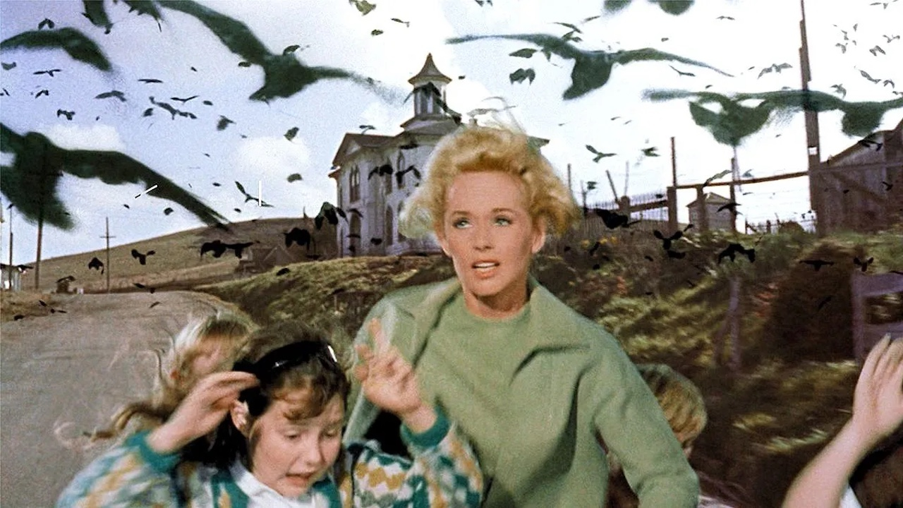
Campylobacter in SC28 & NT5
Outbreak due to oysters consumed from one restaurant
Oysters sent to RI lab for testing 4 times
Tested positive for Campylobacter lari
Lewis Bay (SC28) closed for nearly a month
FDA issued advisory on August 5th due to recall issues
Additional 3 illnesses from Nantucket – no closure required
MSOA DMF Update October 24, 2024
Slide 15

Slide 16
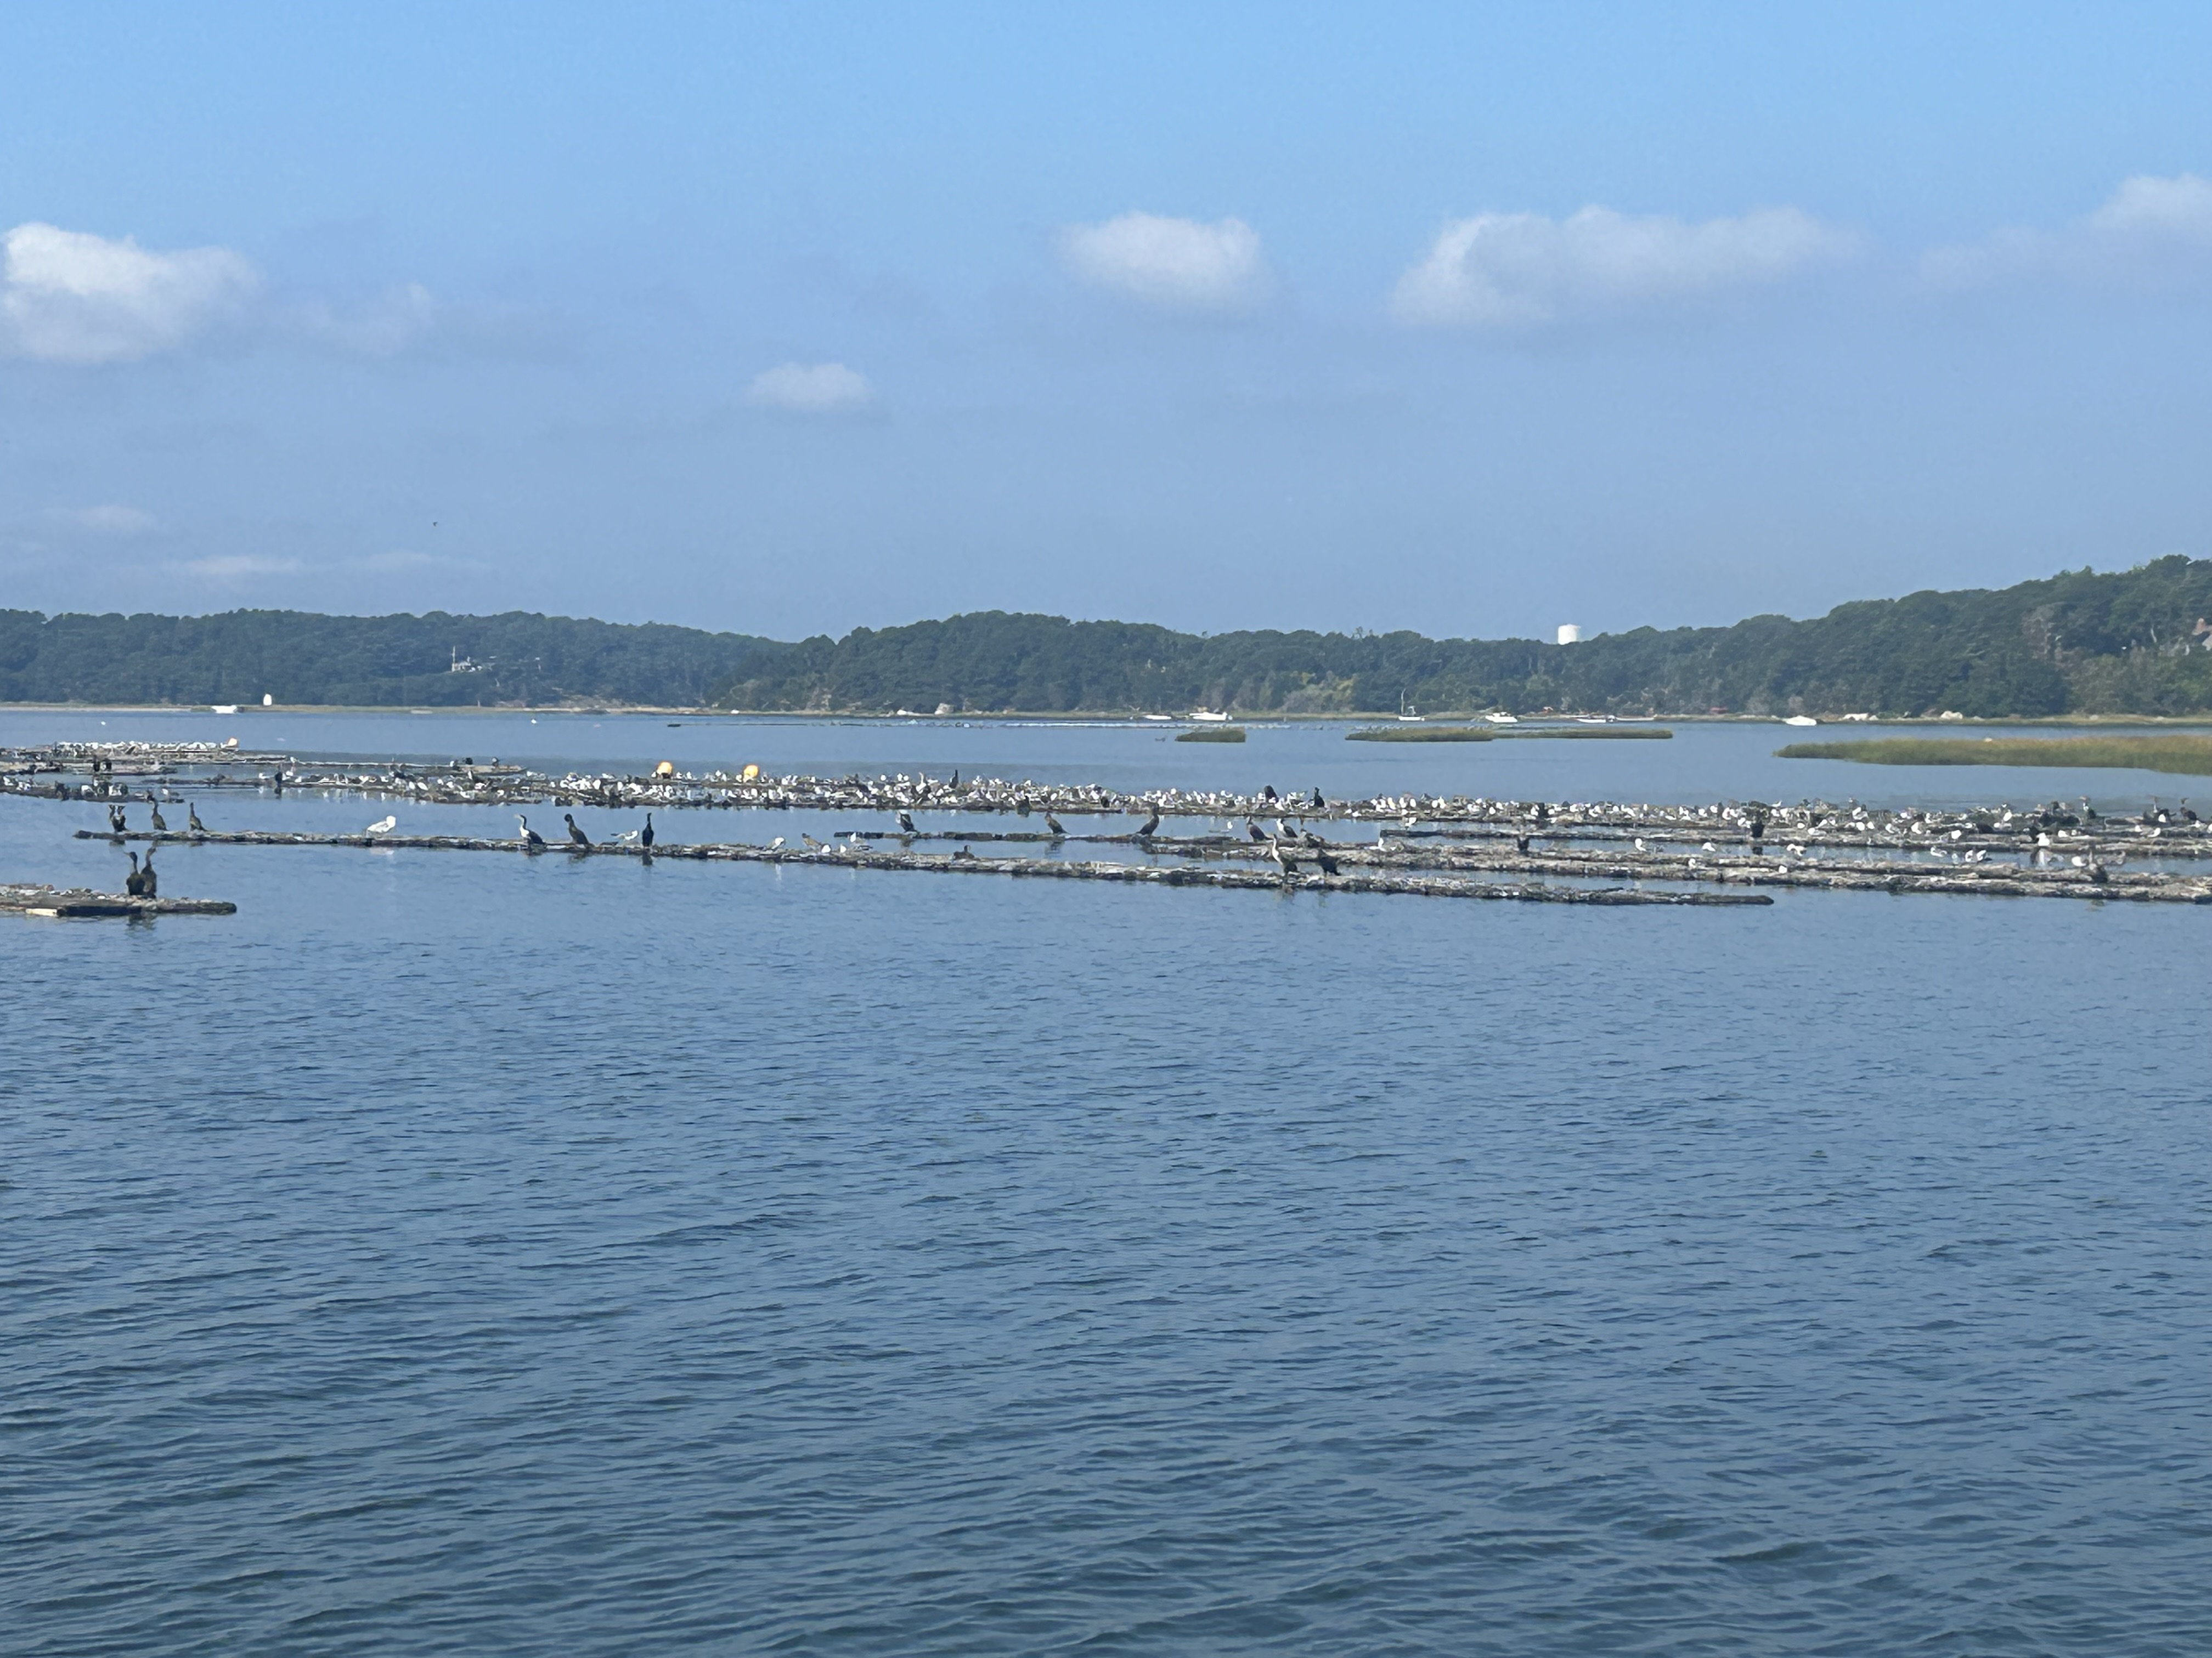
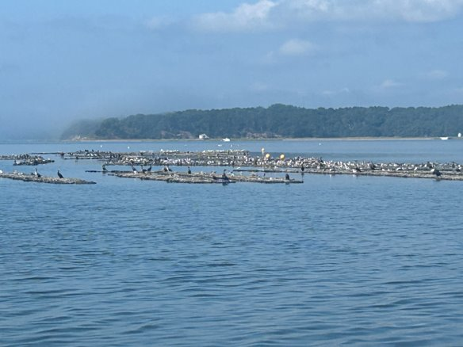
MSOA DMF Update October 24, 2024
Slide 16

Slide 17
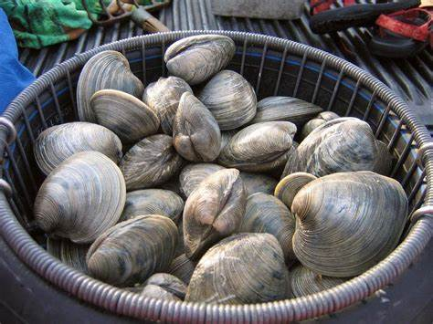
Quahog Vibrio Illnesses
Two illnesses linked to quahogs harvested from V11
Quahogs were from a single harvest event by recreational harvester
Would have been considered an outbreak if commercial harvest
MSOA DMF Update October 24, 2024
Slide 17

Slide 18
Extensions and New Site License Certifications in 2024
Town | License Sites | Acres
Falmouth | 2 | 7
Mashpee | 1 | 1.1
Plymouth | 3 | 6.5
Provincetown | 2 | 2
Rowley | 1 | 2
Yarmouth | 1 | 3
Total | 10 | 21.6
Existing Permit holders:
388 Propagation Permit Holders
3 Aquaculture Permit Holders
2 kelp
1 horseshoe crab
4 Hatchery Permits

Slide 19
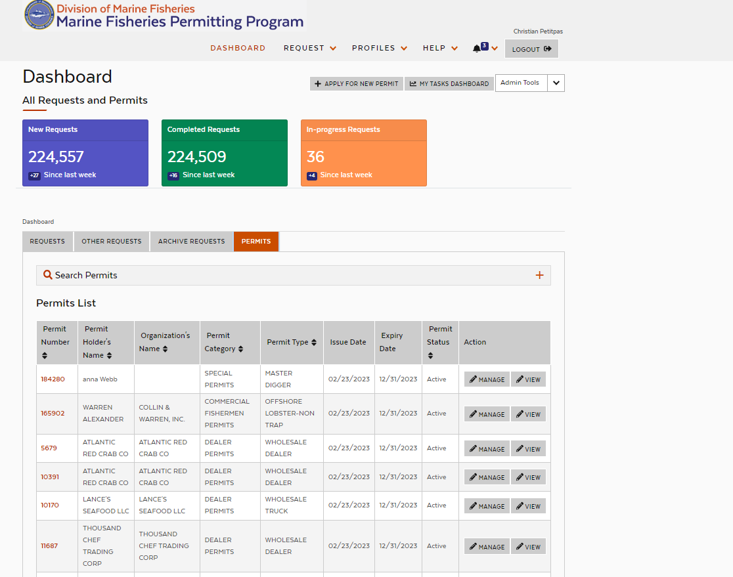
Permitting System Rebuild
MAA DMF Update February 7, 2025
Slide 19

Slide 20
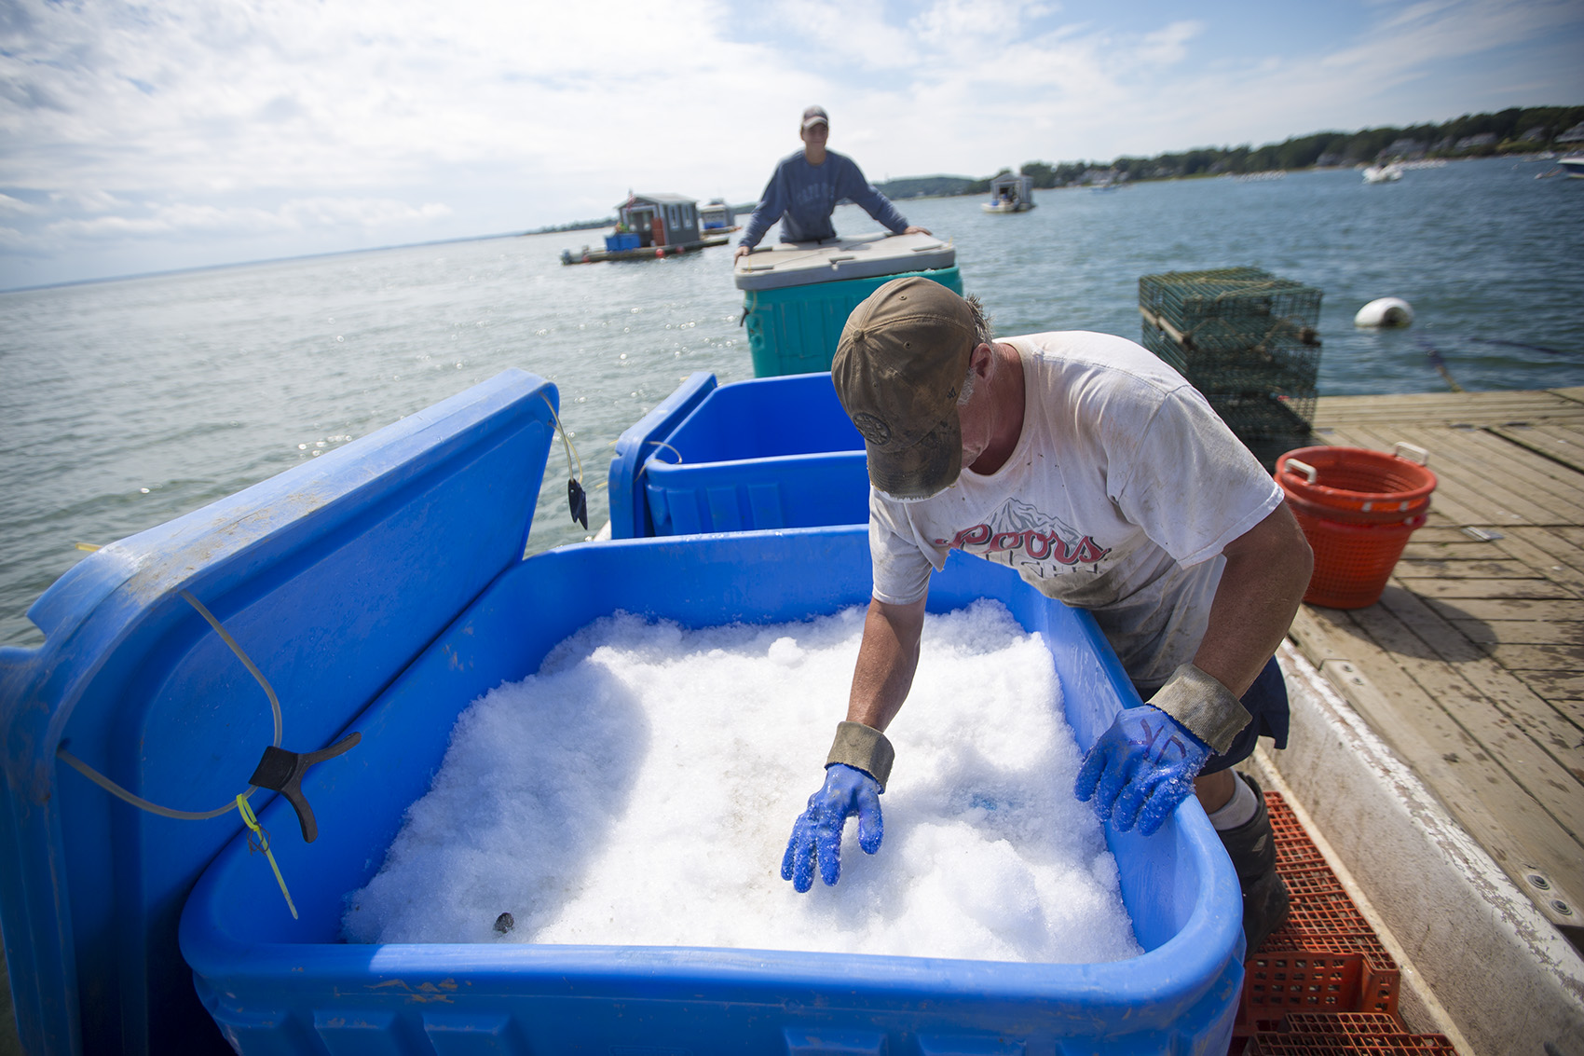
Ice Machine Update:
Two funded in 2024
Cape Cod Oyster
Wellfleet
MAA DMF Update February 7, 2025
Slide 20

Slide 21
Questions
Future questions may be directed to Alex Boeri: alex.boeri@mass.gov or Gabriel Lundgren: gabriel.lundgren@mass.gov

