Slide 1
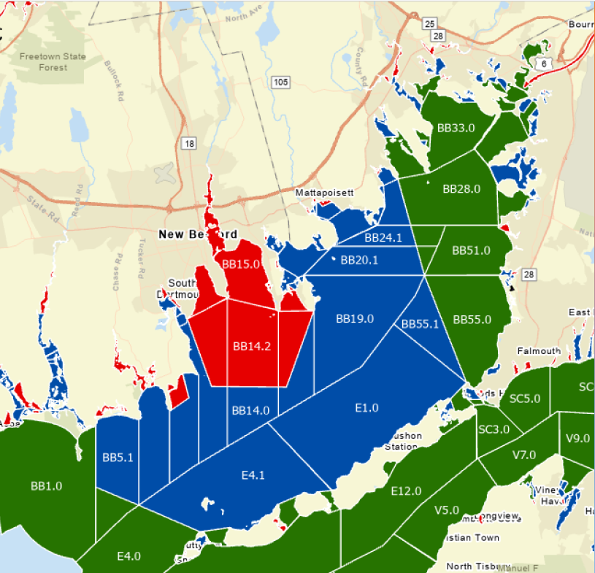
A Grower’s Perspective on Changes to MA Growing Area Classification and the Impacts of the CSOs to Buzzards Bay Growers
Dale Leavitt
Blue Stream Shellfish LLC

Slide 2
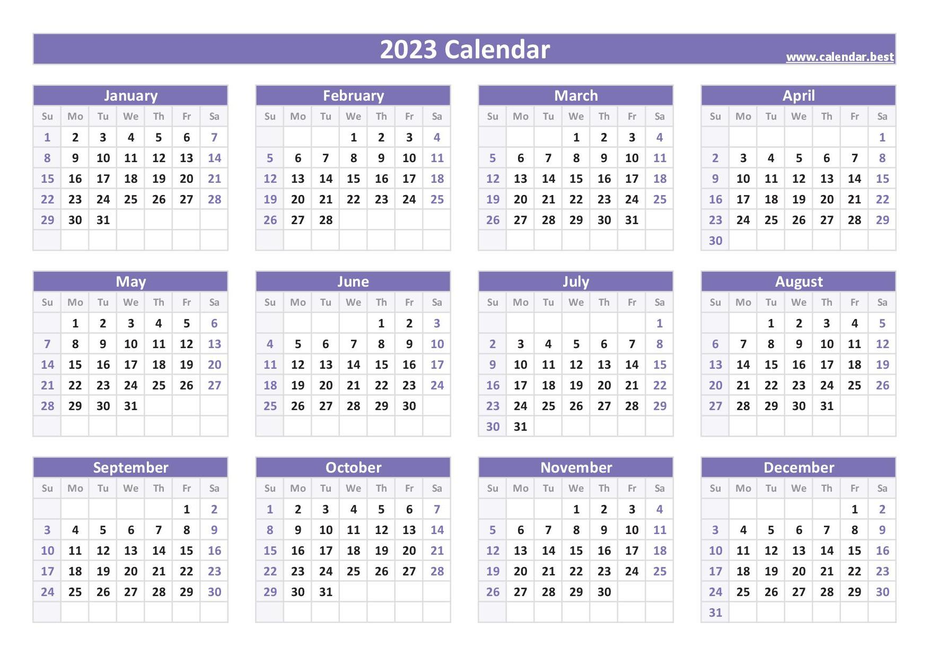
Closed to harvest

Slide 3
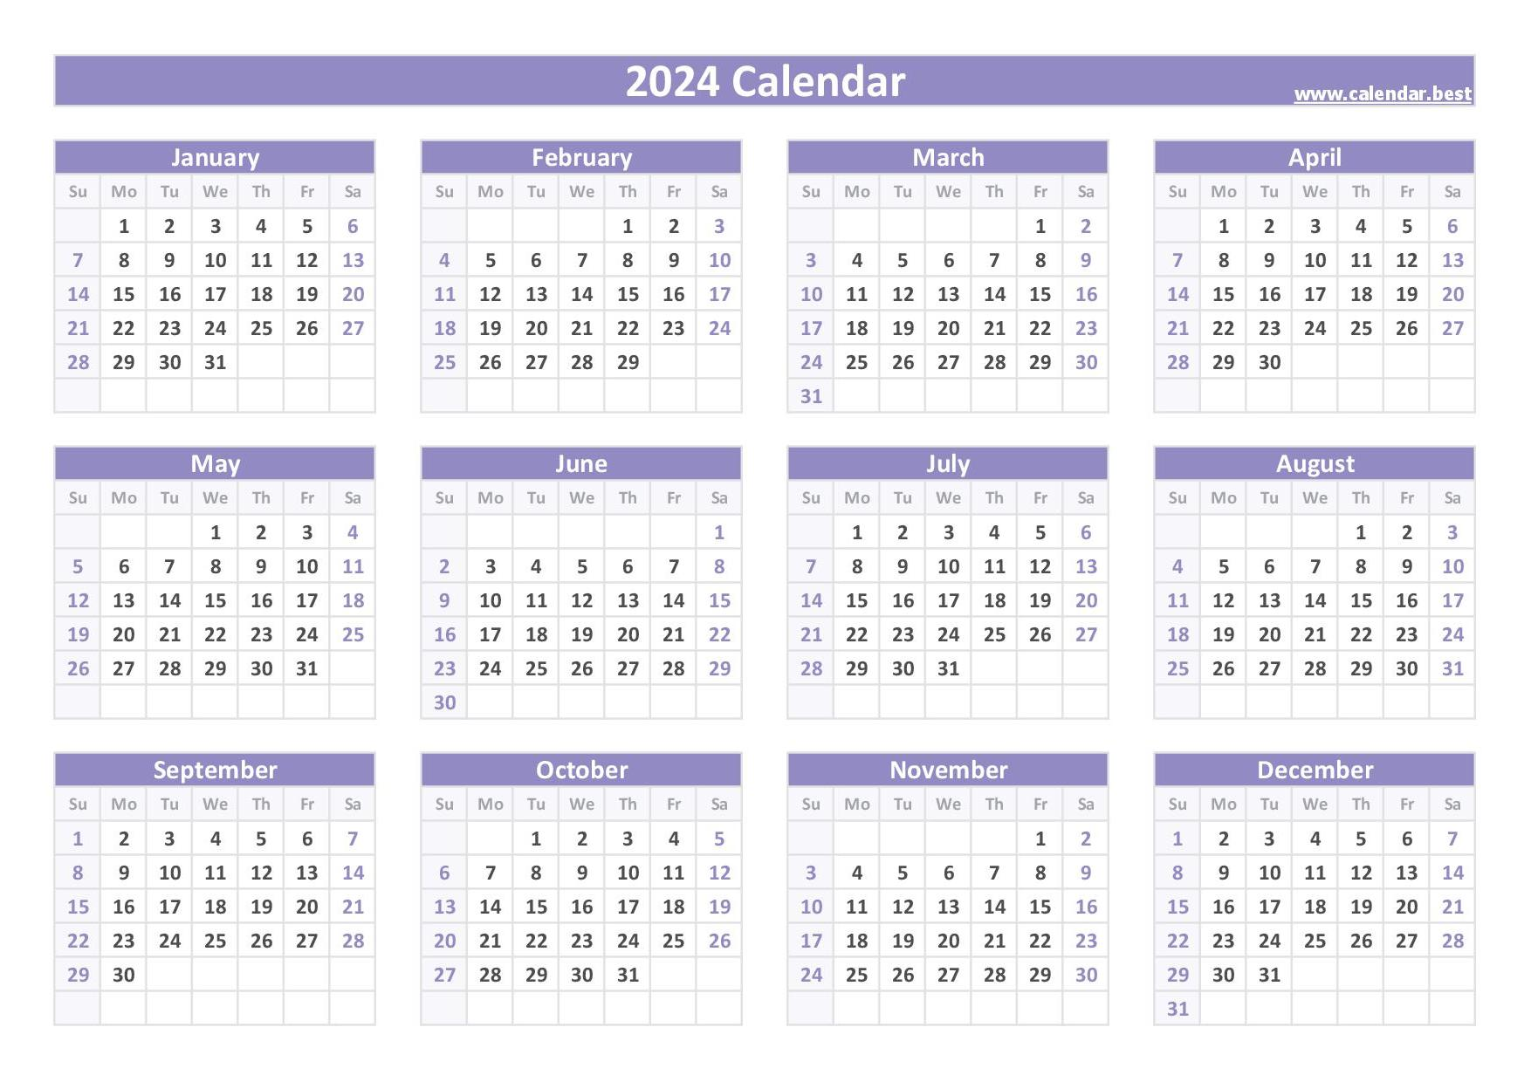
Closed to Harvest
BB11 & BB12 = 210 days or 57.4% of the year
BB18 & BB21 – 182 days or 49.7% of the year
Closed to harvest

Slide 4
Closed to harvest

Slide 5
What happened in 2024?
Reclassification of a large percentage of Buzzards Bay from “Approved” to “Conditionally Approved” status
  Increased oversight
Expanded awareness of the discharge from Combined Sewage Outfalls (CSOs) in New Bedford
  Public website

Slide 6
National Shellfish Sanitation Program (NSSP)
The National Shellfish Sanitation Program (NSSP) is the federal and state cooperative program recognized by the U. S. Food and Drug Administration (FDA) and the Interstate Shellfish Sanitation Conference (ISSC) for the sanitary control of shellfish produced and sold for human consumption.
The purpose of the NSSP is to promote public health protection and improve the sanitation of bivalve molluscan shellfish moving in interstate commerce through federal and state cooperation and uniformity of state shellfish programs.
NSSP Guide for the Control of Molluscan Shellfish: 2023 Revision
  Section 2 - the Model Ordinance (MO)

Slide 7
Interstate Shellfish Sanitation Conference (ISSC)
27 member states
  Each state has representatives from the regulatory agencies (DMF & DPH) and shellfish industry members
  Federal representatives (FDA, EPA, NOAA)
  Academics
The Model Ordinance (MO) is developed within the ISSC by its members
  The MO provides guidance to the states in the management of their shellfish resources, primarily to protect human health
  All submissions to the MO are vetted through FDA before inclusion
FDA evaluates each state for compliance with the MO on an annual basis
  If state does not comply with the MO then the FDA intercedes
  Lose right for interstate commerce in shellfish

Slide 8
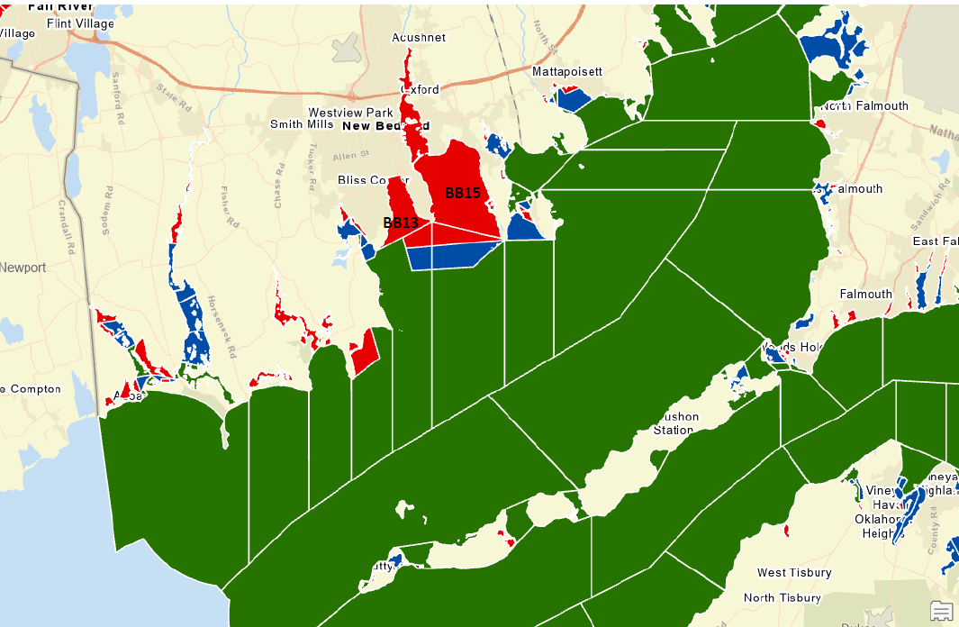
Reclassification of a large percentage of Buzzards Bay
1 October 2023

Slide 9
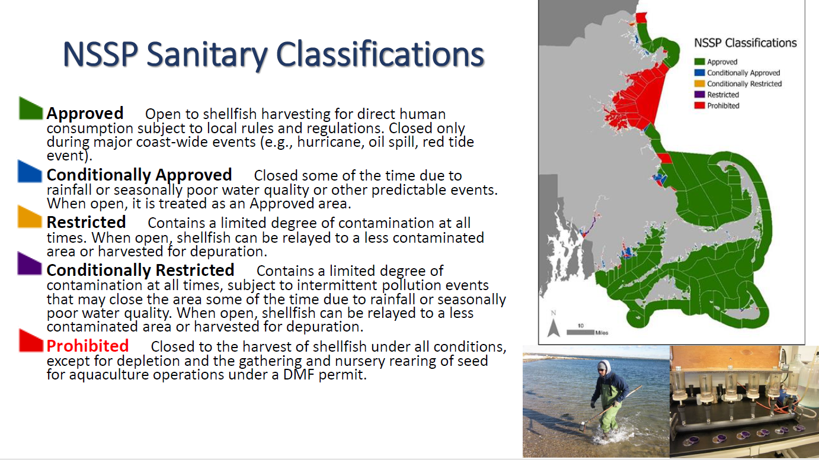
National Shellfish Sanitation Program (NSSP)

Slide 10
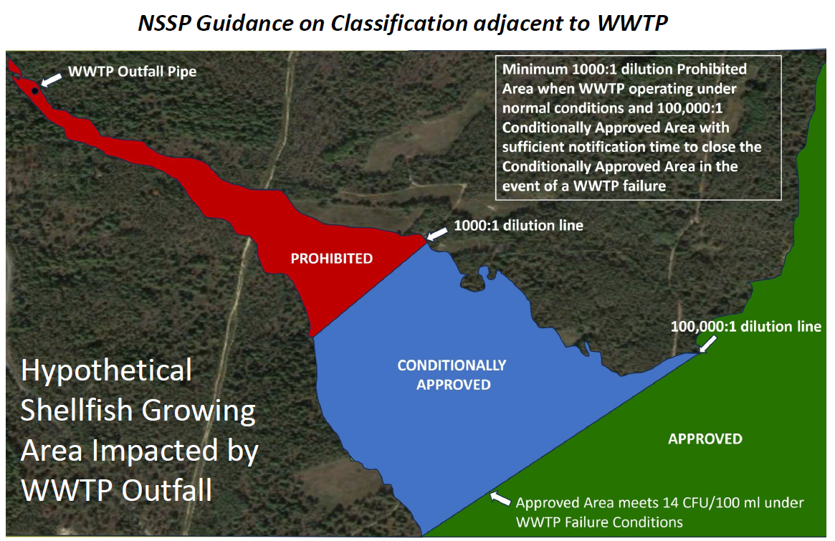

Slide 11
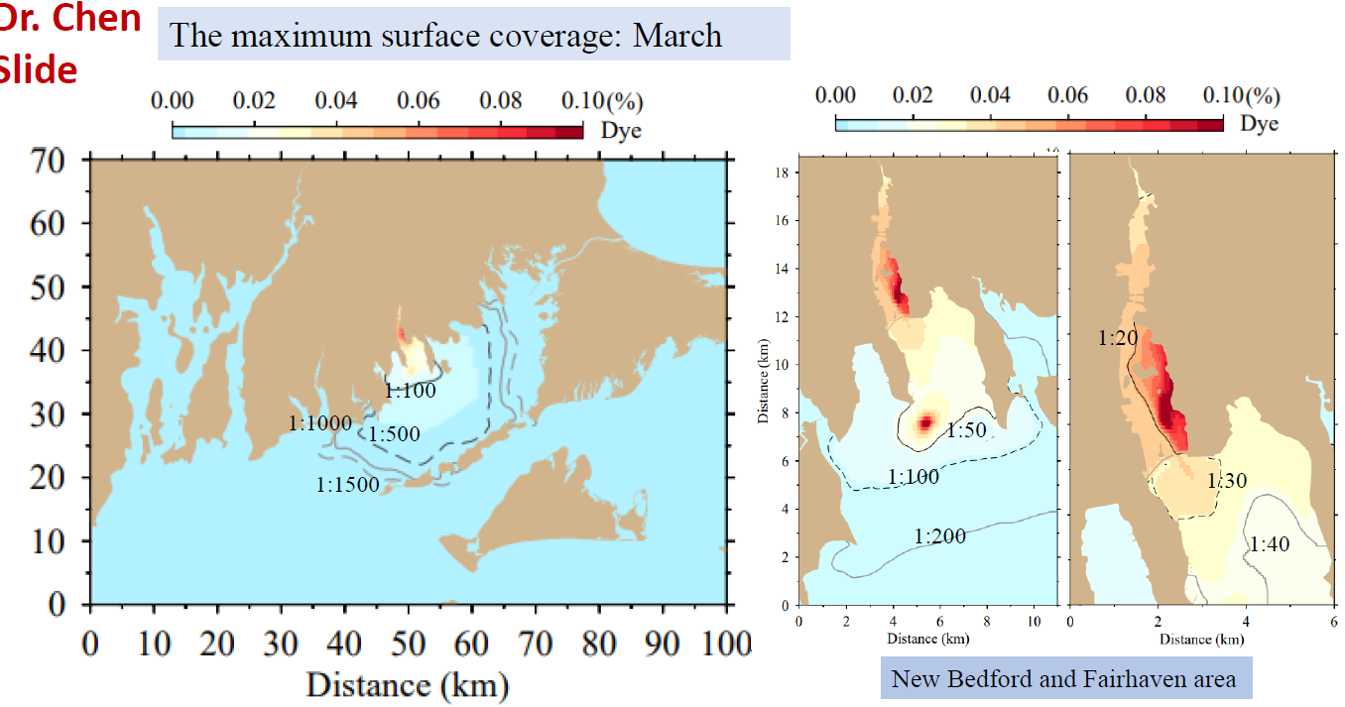
FVCOM Hydrodynamic model
Dr. Changsheng Chen (SMAST)

Slide 12
Classification as of 1 Oct 2023

Slide 13
Current reclassification

Slide 14
Model Validation
Questions we have posed concerning the model
  With any model, the output is only as good as the input (GIGO) – what data were used to construct the model?
  Has the model output been peer-reviewed?
  We noticed some geographic inconsistencies in model that needed to be fixed and that may influence model outcome for Nasketucket Bay.
  How does tracking inert particles in the model translate to the biological characteristics of the indicator organisms (Fecal coliform bacteria and Male-specific coliphage viruses) or actual human health risk?
Model currently being reviewed by an independent scientific panel
  Thank you Josh, Jennie and Matt - Woods Hole Sea Grant!

Slide 15
Discharge from Combined Sewage Outfalls (CSOs) in New Bedford
Heightened awareness of discharges from CSOs in the New Bedford area
  January 2021, the Governor signed An Act Promoting Awareness of Sewage in Public Waters into law
  CSO discharge information required to be available within 2 hours of a discharge
NB-WWTP has automated public notice
  https://www.newbedford-ma.gov/public-infrastructure/wastewater/new-bedford-cso-report/

Slide 16
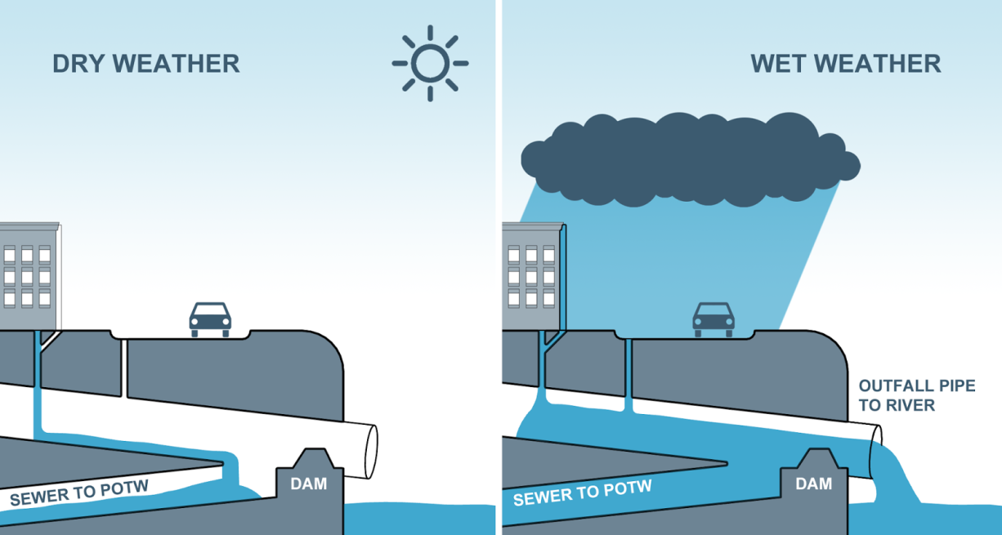
Combined Sewage Outfall
CSOs are designed to carry both sanitary sewage and storm water in the same pipes
  CSOs have regulator structures that allow overloaded systems to discharge into the bay
When there is not a lot of storm water, this mix is transported to a wastewater treatment plant where it is processed.
However, after heavy rainfall or snowmelt, storm water and sewage overload the system
  Newer sewer systems were built with separate systems for sanitary and storm water flows

Slide 17
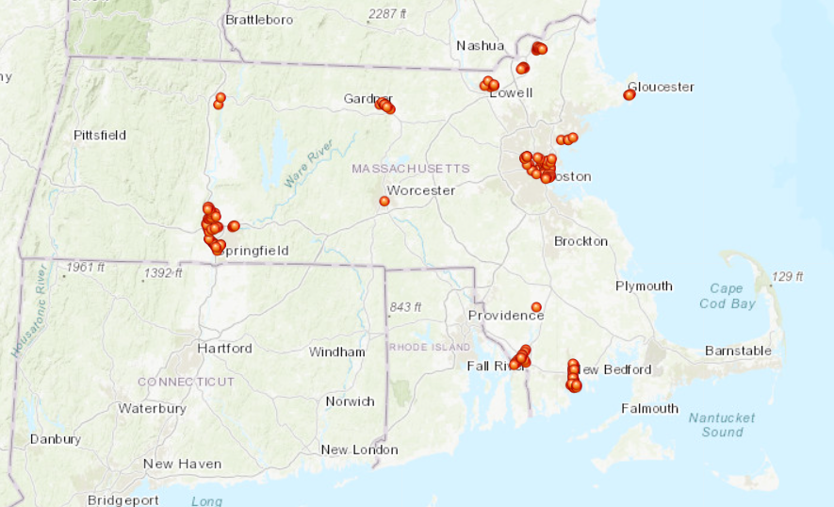
CSOs in Massachusetts

Slide 18
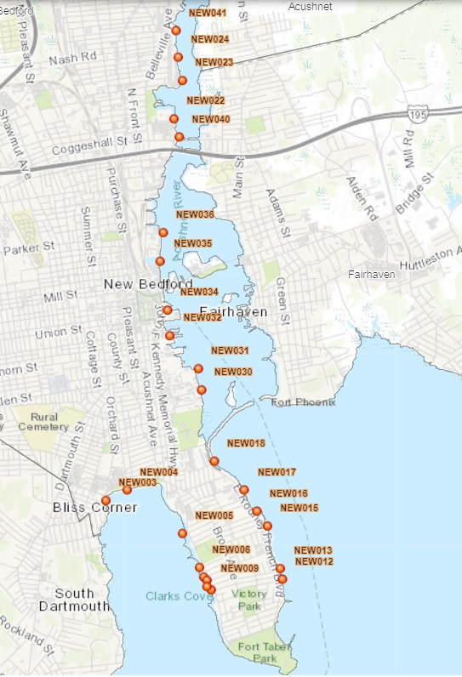
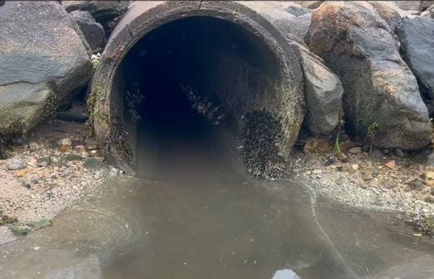
Combined Sewage Overflows (CSOs)
In New Bedford, DMF estimates that 25% of the CSO discharge is raw sewage!

Slide 19
2024
Rainfall & CSO Discharge

Slide 20
2024
CSO discharge vs. Rainfall

Slide 21
5 CSOs are responsible for 75% of the CSO discharge – with 3 directly into Buzzards Bay

Slide 22
The worst CSO offenders

Slide 23
Discussion Counterpoints to Closures
In the past 10+ years, we have served millions of raw oysters from farms currently closed - without a single illness
  Yet DMF has implemented CSO closures only since January 2024
Testing for fecal coliform over the past 5 years has not had any detections above 14 CFUs/100 ml
  5 of the 10 samples collected in 2024 were during closure events
As a condition to reopening following a closure, DMF tests our oysters for sewage indicator microbes (Male-specific coliphages – MSC)
  Each time, our oysters have been well below threshold (50 PFUs/100 g oyster tissue)
FDA uses a draconian version of the “Precautionary Principle” to guide their regulations with a one size fits all attitude
Modifying the MO guidance via the ISSC takes 4 to 8 years

Slide 24
Current actions
Marine Policy Center at Roger Williams University Law School (Alex Tamburrino) is reviewing the Model Ordinance to look for a means to “push back” at FDA with real data over current practices
A UMassD professor (Sarah Donelan) is analyzing the rainfall versus fecal coliform samples over the past 40 years to generate info on human health risk around our farms
DMF is working with Woods Hole Sea Grant to investigate the real-time presence of fecal coliforms in the vicinity of an active CSO

Slide 25
Current Needs
DATA!
Model validation with ground-truthing and including adjustments for biological characteristics of human pathogens and indicators
DATA!
Critical analysis of the current MO thresholds for shellfish area classifications – ONE SIZE DOES NOT FIT ALL!
DATA!
Ability to adjust reclassification and closure thresholds based on actual human health risk
DATA!

Slide 26
My Take Home Thoughts
This has been frustrating as all hell from both a logical and financial standpoint!!!!
There has been a huge amount of support from:
  Regulators (DMF – Matt Camisa, Chrissy Petitpas, Terry O’Neal & Alex Boeri)
  State Representatives (Paul Schmid & Mark Silvia)
  Towns (Tim Cox & Issac Perry)
  Researchers (Sarah Donelan, Erin Bromage & Kevin Stokesbury)
  Farmers (Scott Soares, Mike Ward, Bob Fields, Matt Loo & us)
We have a ways to go to figure this out
Reclassification will not be limited to the area around New Bedford

Slide 27
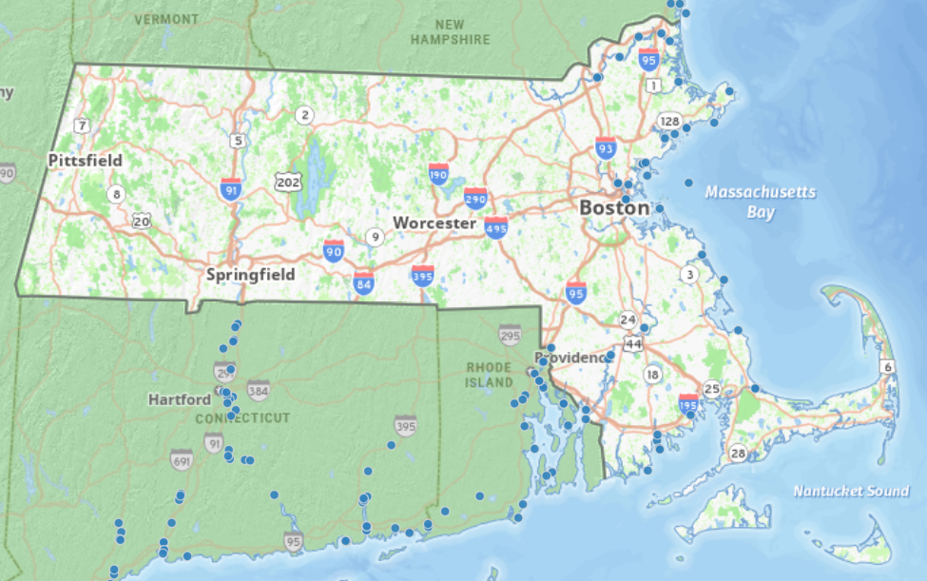
WWTP outfalls

Slide 28
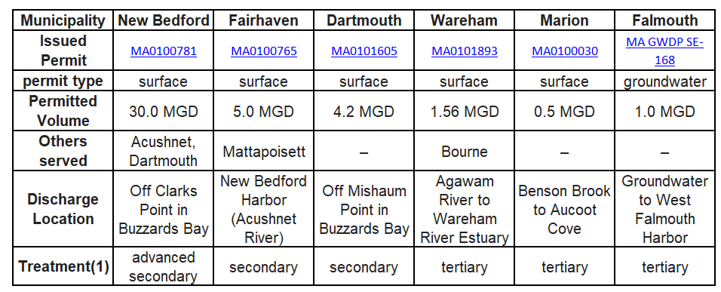
Coming to a community near you!

Slide 29
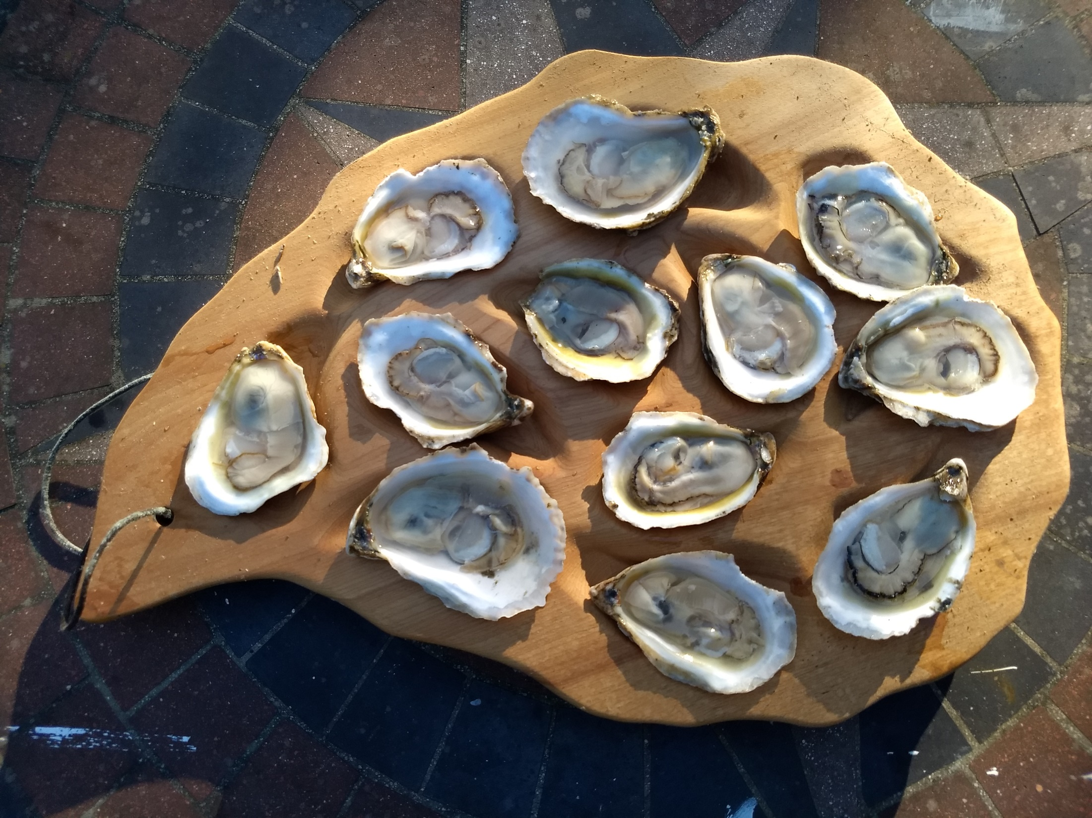
Discussion?

