Slide 1
Farmer-supported restoration
Steve Kirk, Dan Goulart
The Nature Conservancy

Slide 2
AGENDA (~30 min)
Intro to TNC
Funding for Aquaculture
Our Goals
Discussion
SOAR Overview

Slide 3
COAstal program @ TNC
Habitat Restoration
Aquaculture
SOAR
Ecosystem services work
Social science work
Denitrification
Bringing restoration and industry together
Notes:
Climate adaptation work as well. – adjacent to this work, living shorelines.
Perceptions of aquaculture research – predictor of support is impact to local economy and education level about aquaculture
Research to understand waterquality impacts of restoration and aquaculture around DNF.
Additional efforts – interplay between aquaculture and eelgrass.

Slide 4
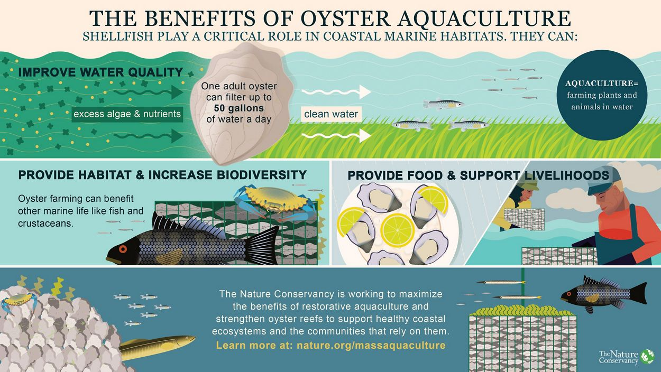
Notes:
We’d like to play the role of trusted (non-industry) advocate for benefits of aquaculture
Develop materials for local decisionmakers?
Education roadshow?
Have to keep this type of activity up – turnover at local level

Slide 5
SOAR: Supporting oyster aquaculture and restoration
Overview and Focus on MA

Slide 6
SOAR PROJECT OVERVIEW
Overall to 2022
Over 3.5 million oyster purchased
125 shellfish farming companies supported
Over 450 jobs sustained over seven states
~40 acres of shellfish reefs supported across 25 restoration sites
MA to date
Bourne, Fairhaven, Edgartown
~600,000 oysters purchased
12 farms
Notes:
Biosecurity
DMF LOA

Slide 7
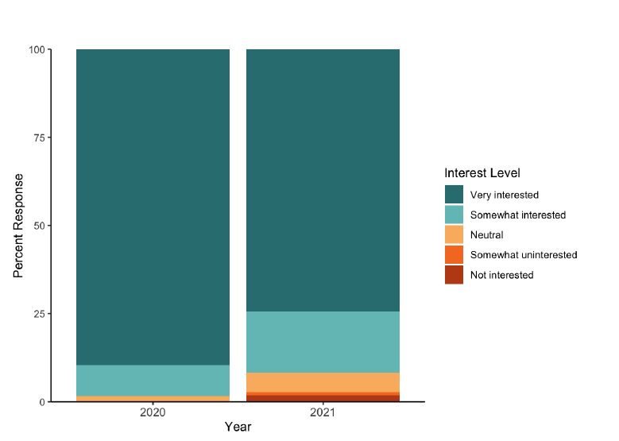
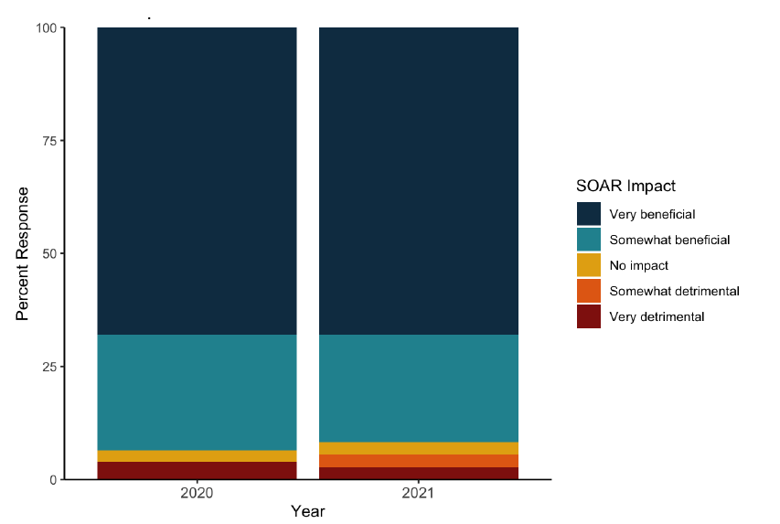
Socioeconomic DATA
PERCENT OF FARMS THAT BENEFITED FROM SOAR
RELATIVE INTEREST IN FUTURE SOAR PROGRAMS

Slide 8
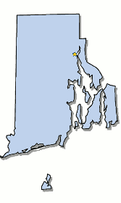
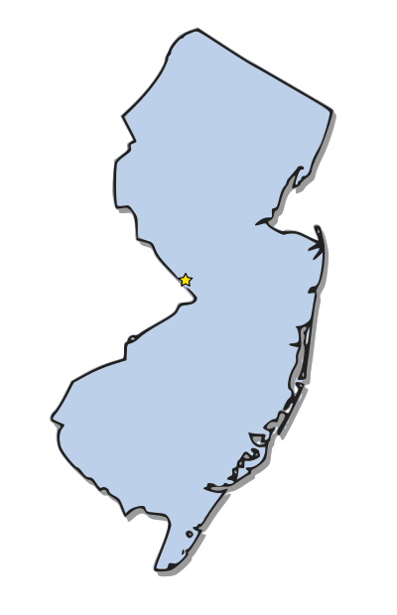
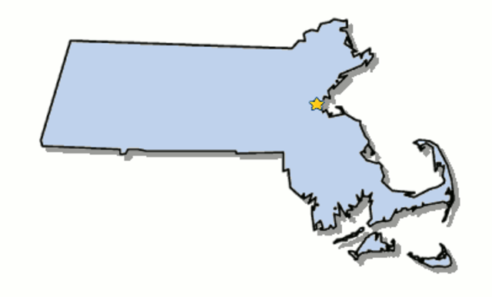
USDA - Natural Resources Conservation Service
Aquaculture = funding priority for NRCS
Currently funding similar programs in other states (RI, NJ)
Expanding into MA
Practice 643 Restoration of Rare and Declining Species
EQIP in RI
RCPP in NJ
NRCS Award in MA
Notes:
As of 2024, this practice is available in MA
NRCS contract with growers to cultch and plant oysters on sites

Slide 9
NRCS – Conservation Innovation Grant – More Sites
MAA partner - Mashpee
MA-Wide Coastal Habitat Restoration Plan
Notes:
Three habitat types
DMF newly created habitat restoration coordinator
ID and prioritize sites
Policy review including rewrite of shellfish planting guidelines – siting and enforcement issues
Updating folks via Shellfish Advisory Panel

Slide 10
NRCS GRANT TIMELINE
Schedule meetings with stakeholder groups
In field, higher resolution site suitability analysis
Begin report writing, track progress
Secure permits, complete deliverables, close out award
DEC 2022
SPRING/SUMMER 2023
FALL 2023
SUMMER 2024
WINTER/SPRING 2023
SUMMER 2023
WINTER/SPRING 2024
Desktop analysis of restoration site suitability
Final site selection and initiation of permit process
Conference/meeting presentations, outreach/education, final report writing
YEAR 1
YEAR 2
SITE SELECTION
PERMIT ACQUISITION
Notes:
Partner responsibilities

Slide 11
Discussion/questions
Notes:
Questions:
What price should we buy the oysters at?
Which products are going to be acceptable to us for restoration purposes?
How do we approach the risk of disease issues?
Which genetic lines are most suitable for this project vs industry?
What is missing from this list, and what are other questions/topics we should we be considering to support industry buy-in?
Comments: 1. Plan to work with MAA membership but don’t want to be exclusive to other growers

Slide 12
THANK YOU NRCS, DMF, MAA
Contact:
Steve Kirk
stephen.kirk@tnc.org
Dan Goulart
Daniel.goulart@tnc.org
More information:
www.nature.org/massaquaculture

