Slide 1
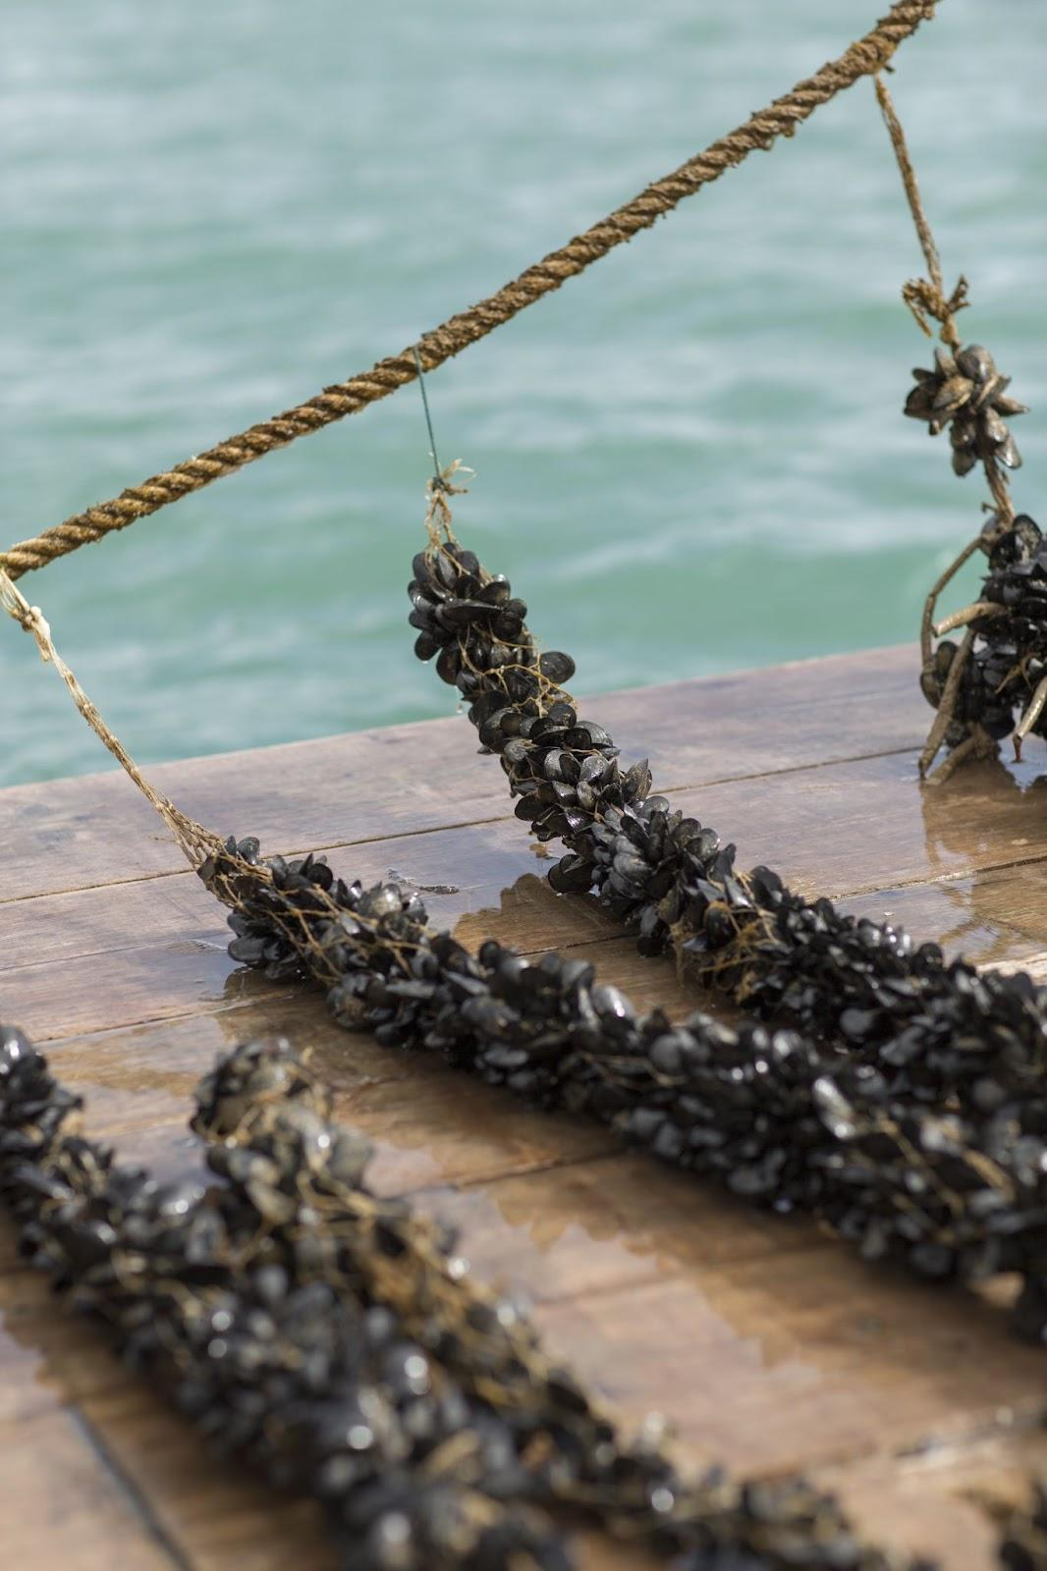
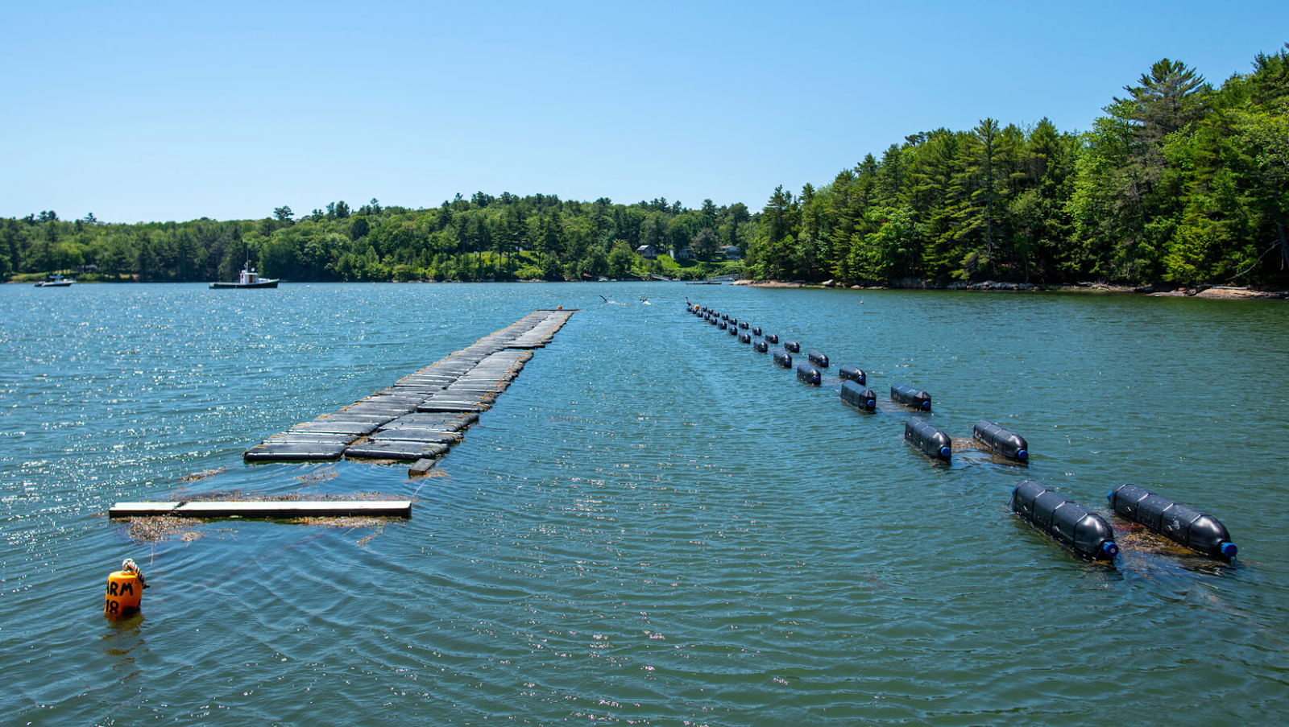
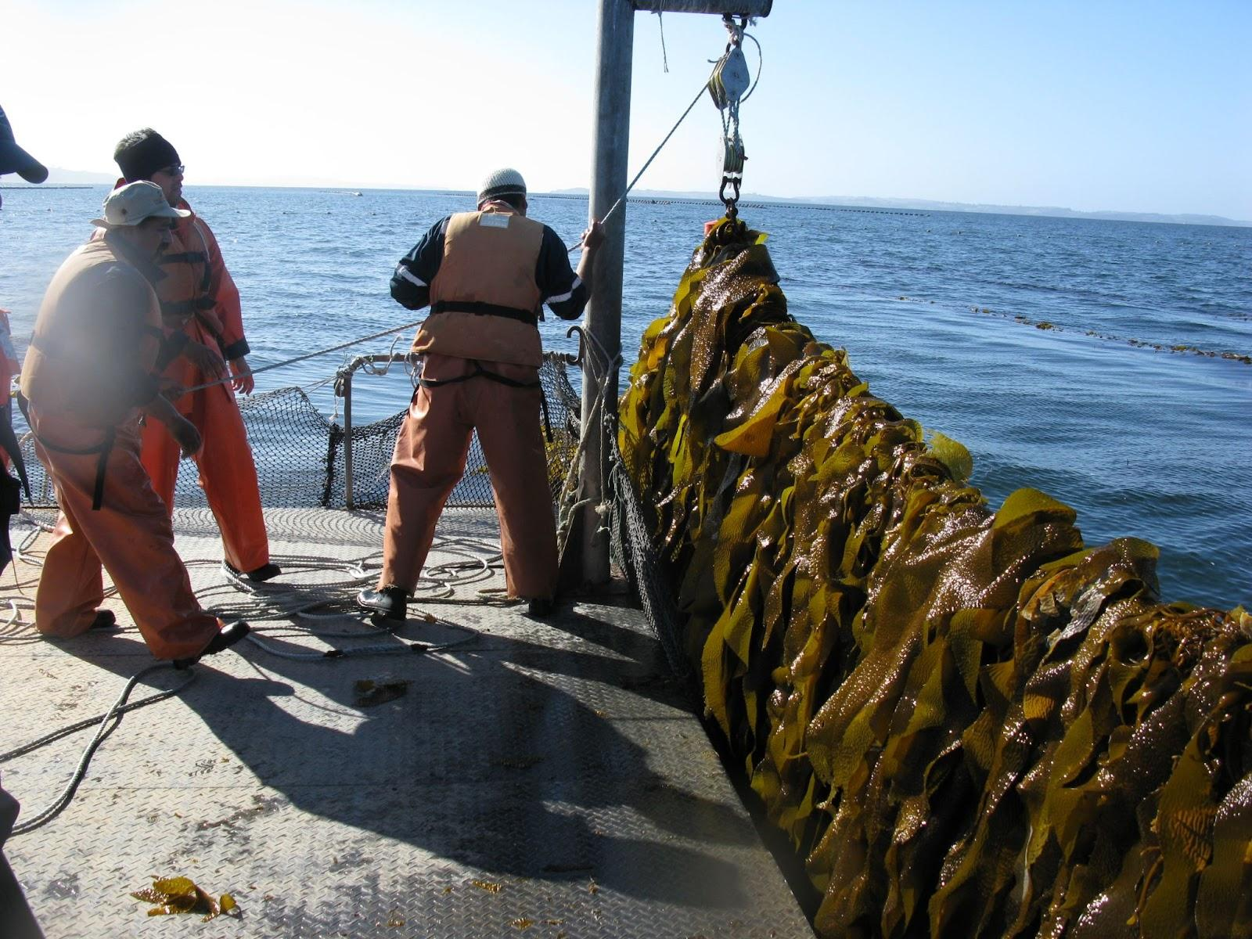
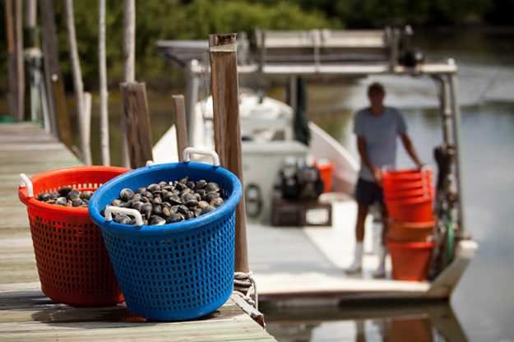
NOAA Fisheries Aquaculture
- Greater Atlantic Region
MA Aquaculture Association
February 7th, 2025
Anoushka Concepcion

Slide 2
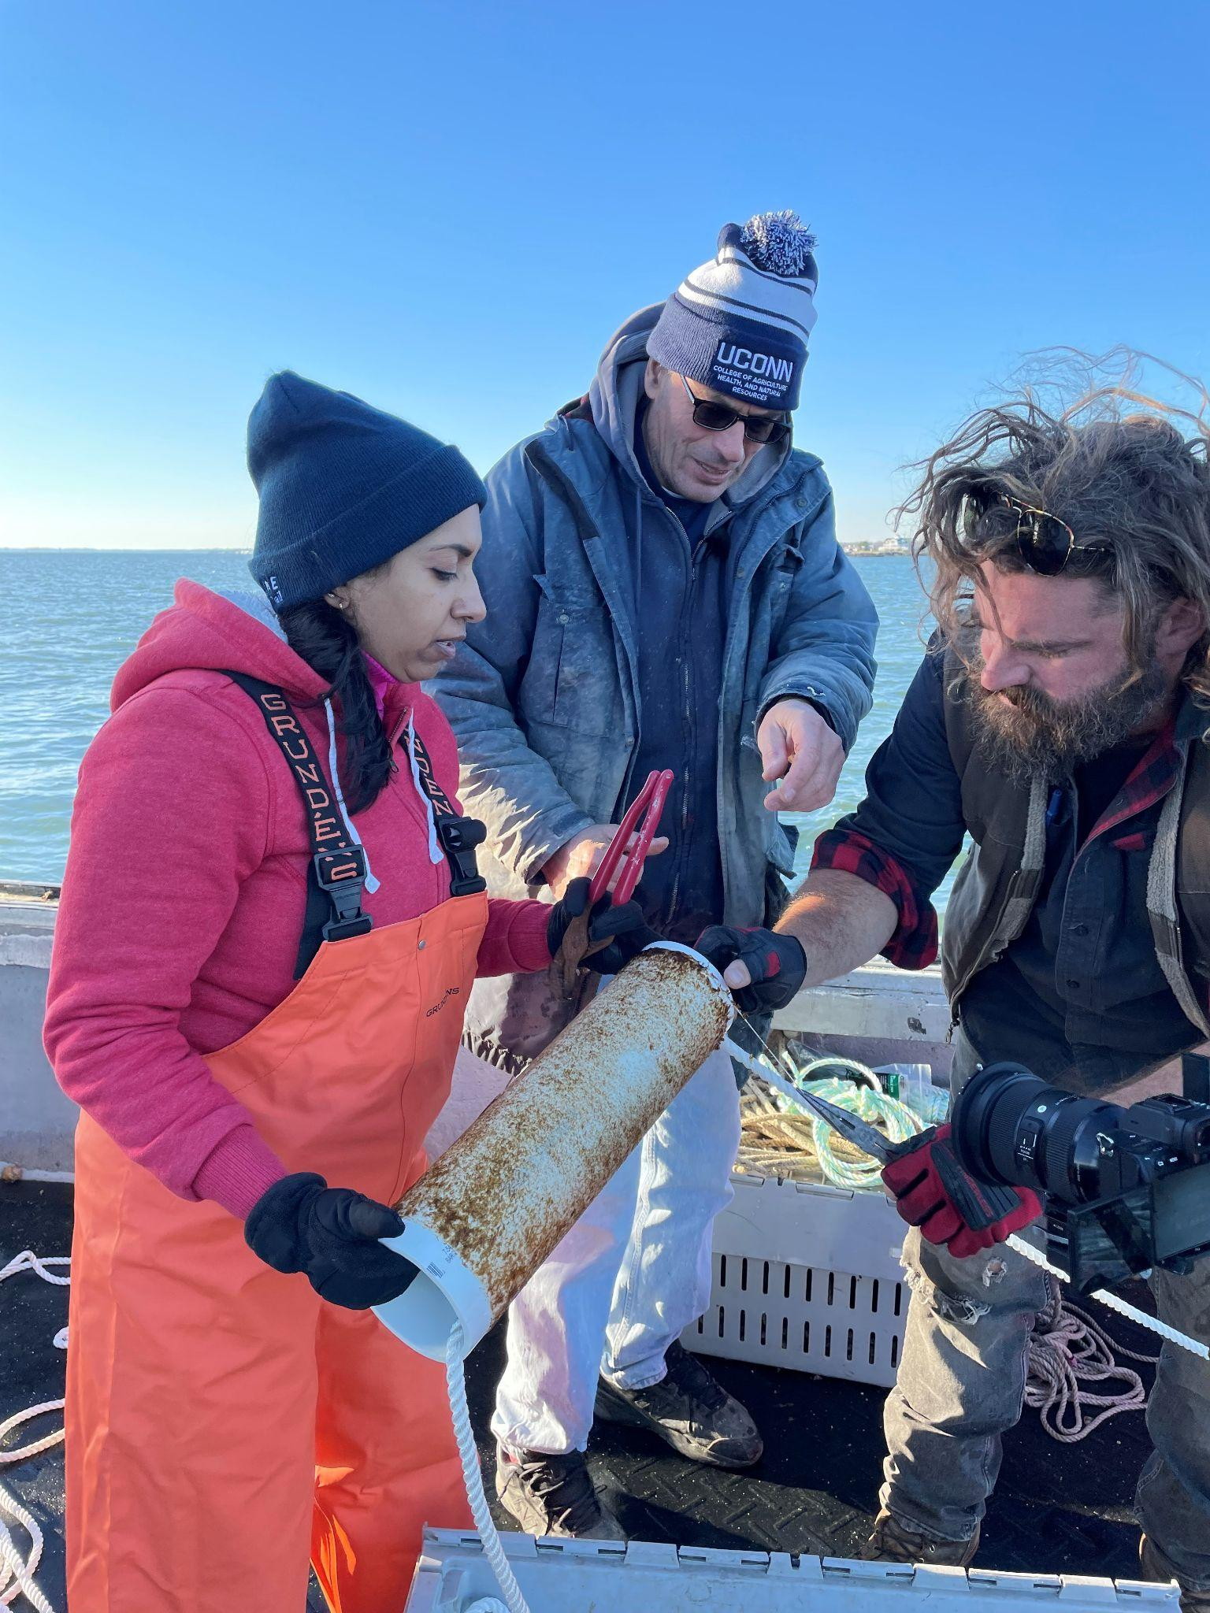
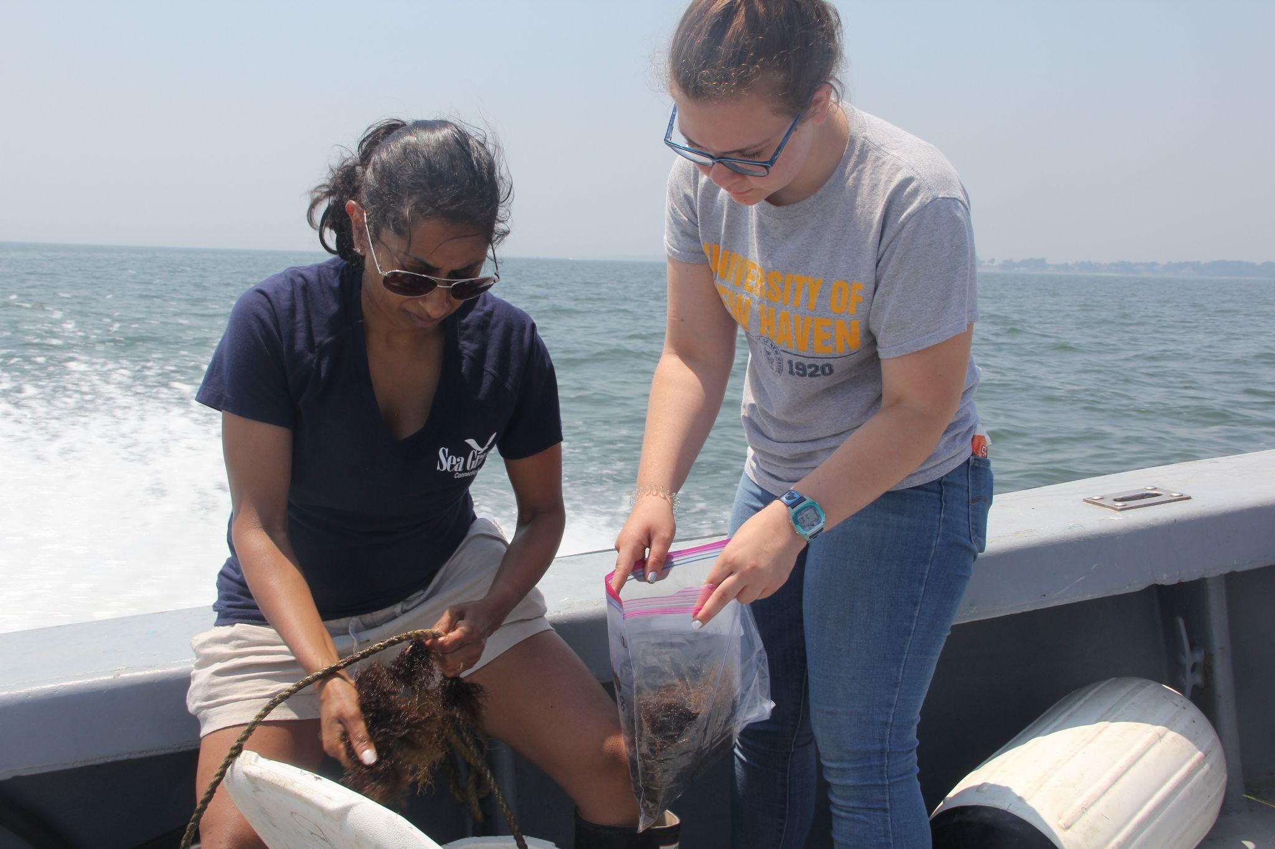
A Little About Me
26 years in the aquaculture sector
Shrimp, microalgae, finfish, shellfish, and macroalgae
UNC Wilmington
URI - FAVS
CT Sea Grant Extension
Direct marketing for oysters
Seaweed
Food safety
National Seaweed Hub

Slide 3
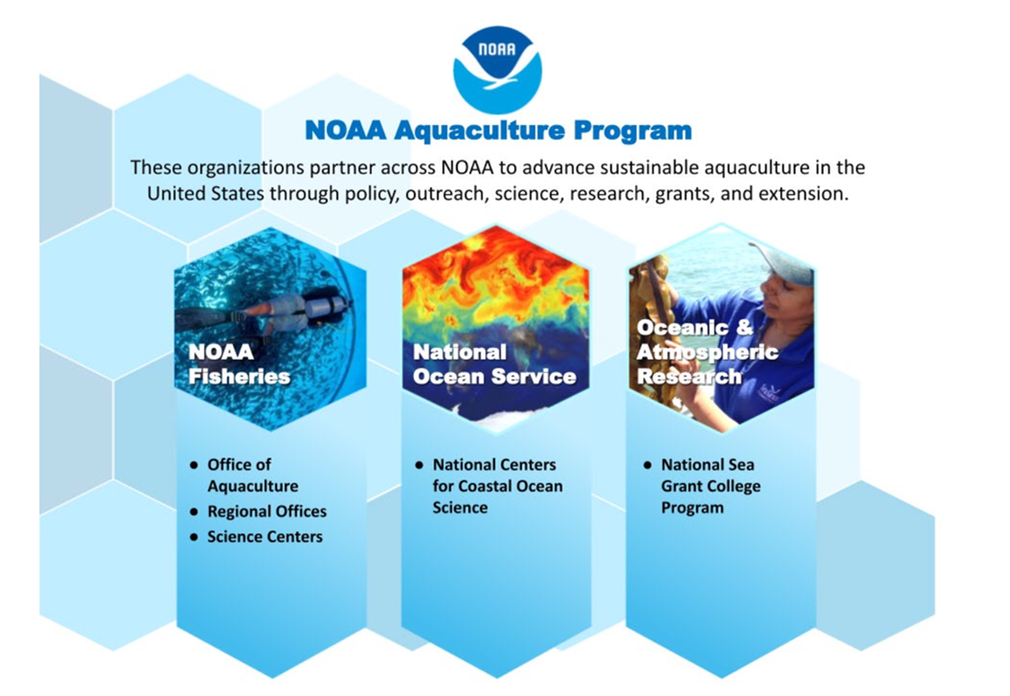
Notes:
NOAA Fisheries: Policy/regulatory, aquaculture outreach, science for sound aquaculture development
NOS: spatial planning and siting, ecosystem services, environmental monitoring and modeling
OAR: external grants, extension and education for coastal and great lakes aquaculture

Slide 4
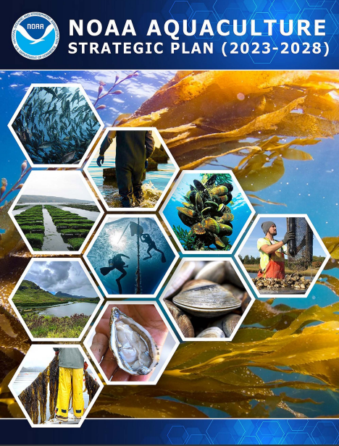
Ensuring U.S. aquaculture is developed sustainably, in concert with healthy, productive, and resilient coastal ecosystems through
Goal 1:MANAGE SUSTAINABLY AND EFFICIENTLY
Goal 2:SCIENCE FOR SUSTAINABILITY
Goal 3: EDUCATE AND EXCHANGE INFORMATION
Goal 4: SUPPORT ECONOMIC VIABILITY AND GROWTH

Slide 5
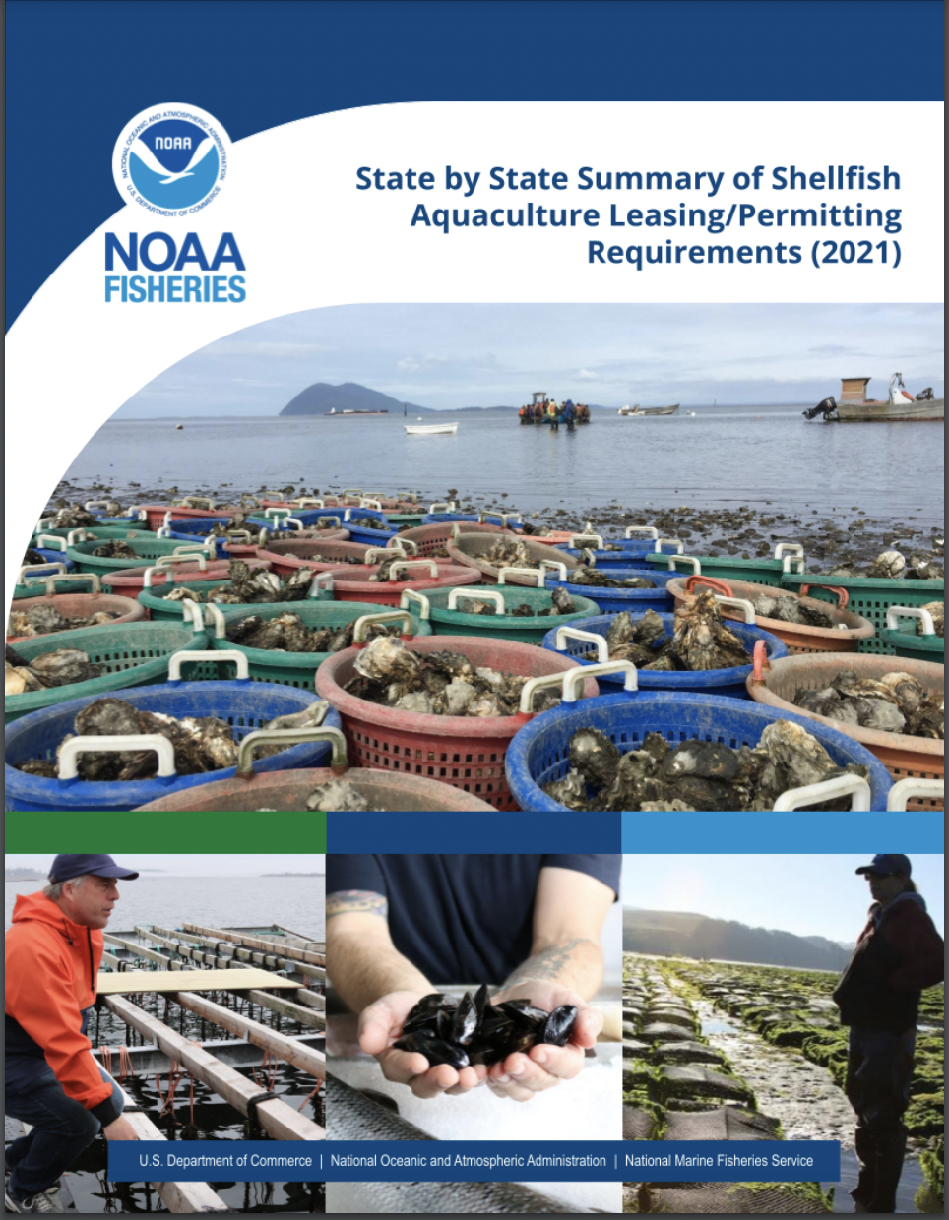
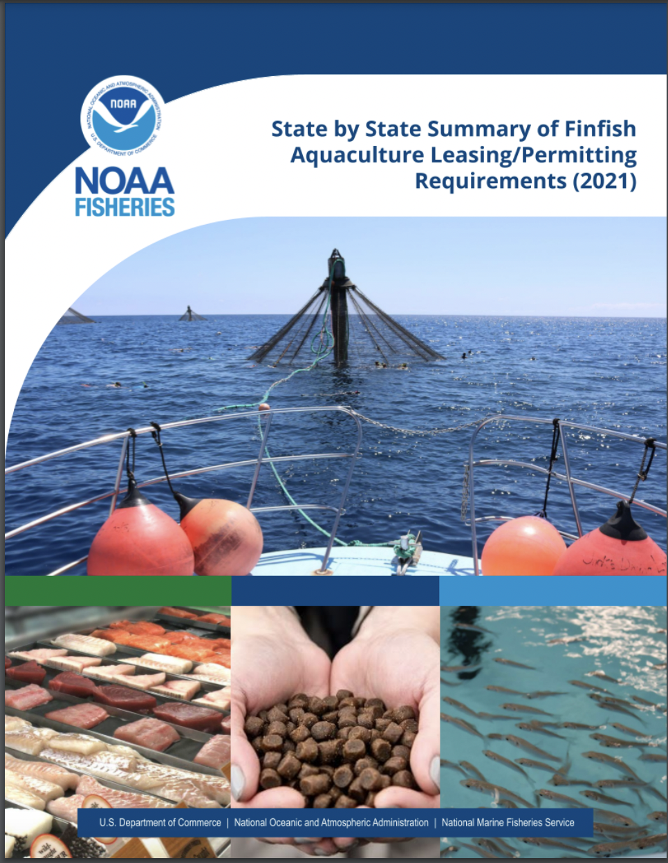
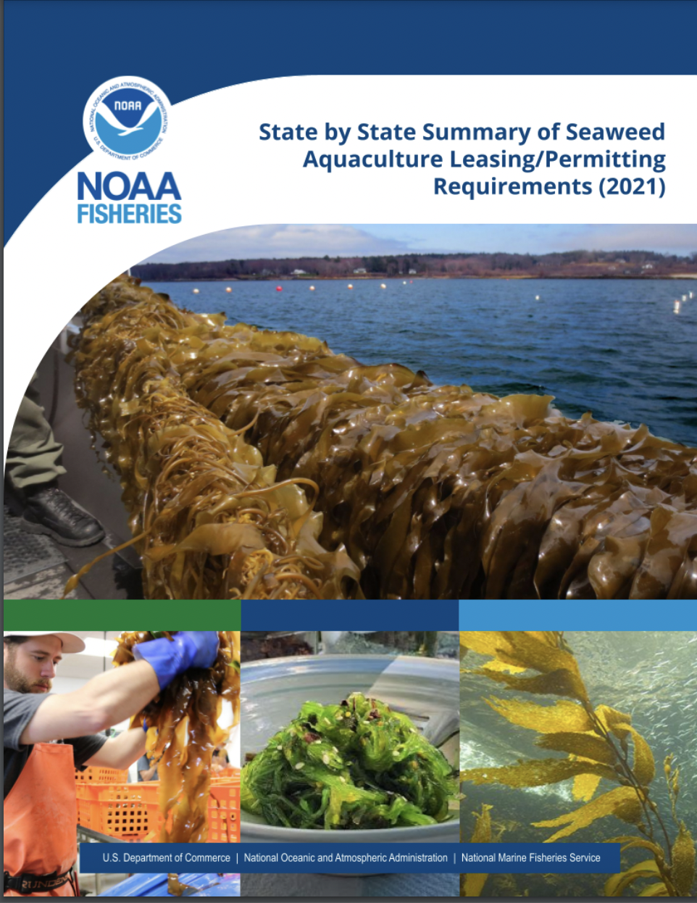
Updated State-by-State Permitting Inventories
fisheries.noaa.gov/feature-story/office-aquaculture-updates-state-aquaculture-regulatory-inventory-resources

Slide 6
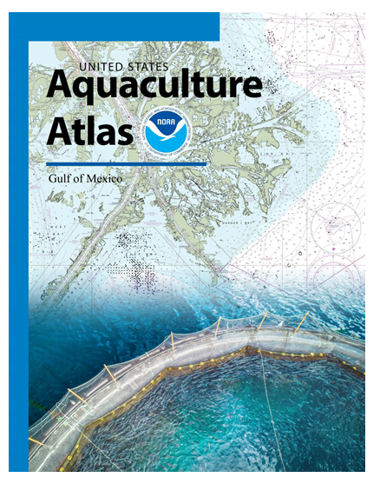
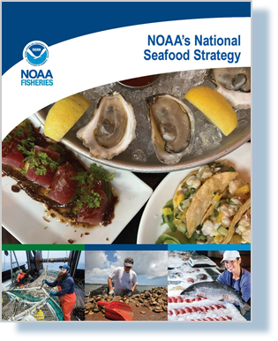
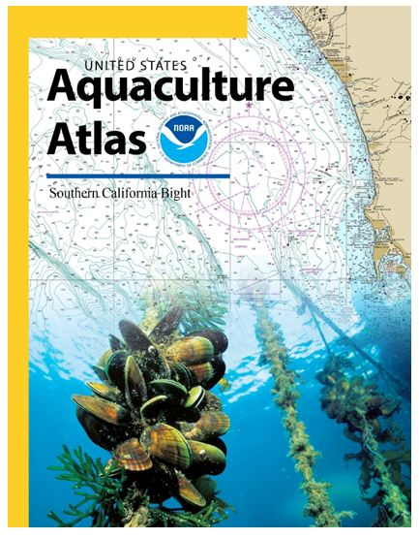
Atlases for Gulf of Mexico and Southern California published in November 2021 - AOAs
National Seafood Strategy

Slide 7
NOAA NMFS - Regional Aquaculture Coordinators
Works within NOAA and with partner federal, state, and local agencies, industry, and members of the scientific, academic, and NGO communities on a variety of marine aquaculture issues

Slide 8
NMFS RAC
Sea Grant
Support regulatory efficiency and transparency
Works with SG, industry and agencies on applied research and other projects
Conducts regional outreach activities
Identify funding opportunities
Identify, develop, distribute resources
Liaison btwn. GARFO and OAQ
Coordination with fisheries management entities
Conducts applied research and monitoring programs
Work with local resource managers - constables and state level
Provide technical assistance
Local outreach programs
Provide educational opportunities
Conduit between local and regional
Help researchers find appropriate partners, interface with farmers
Respond to industry needs
Notes:
Serves and liaison between OAQ and GARFO to support economic development of aquaculture and implement federal mandates as they relate to aquaculture
Attends and/or facilitates meetings with private, federal, state, local, and tribal entities to improve coordination, efficiency and effectiveness of aquaculture regulatory processes and public understanding of aquaculture issues
Coordinates with the fisheries management entities (i.e., fishery management councils and commissions) to seek consistency with their aquaculture policies.
Funding opportunities
Identify, develop, and distribute NOAA and NMFS reports and other informational materials, publications, and fact sheets related to aquaculture

Slide 9
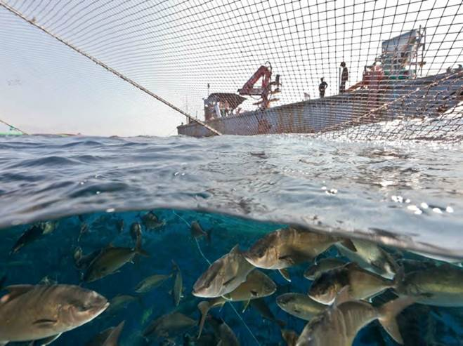
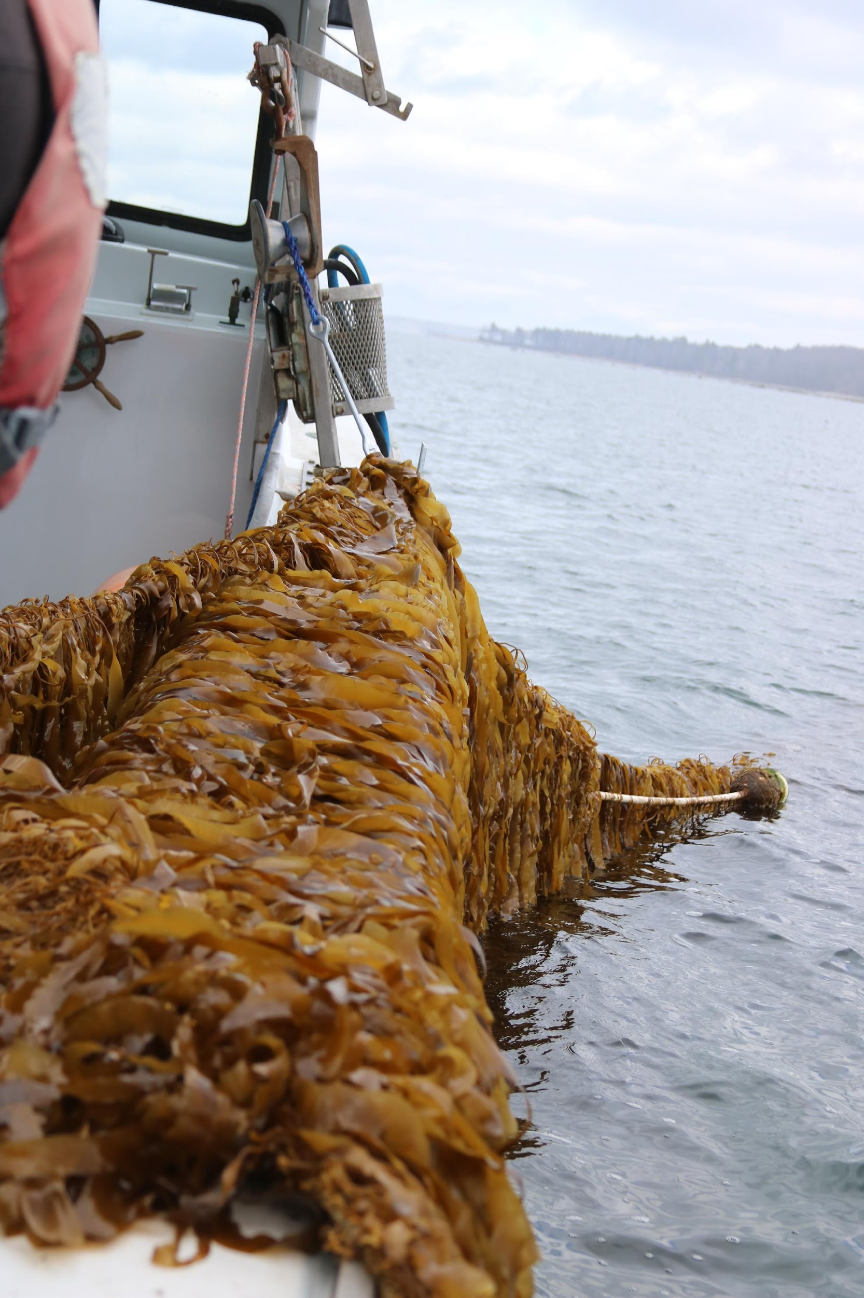
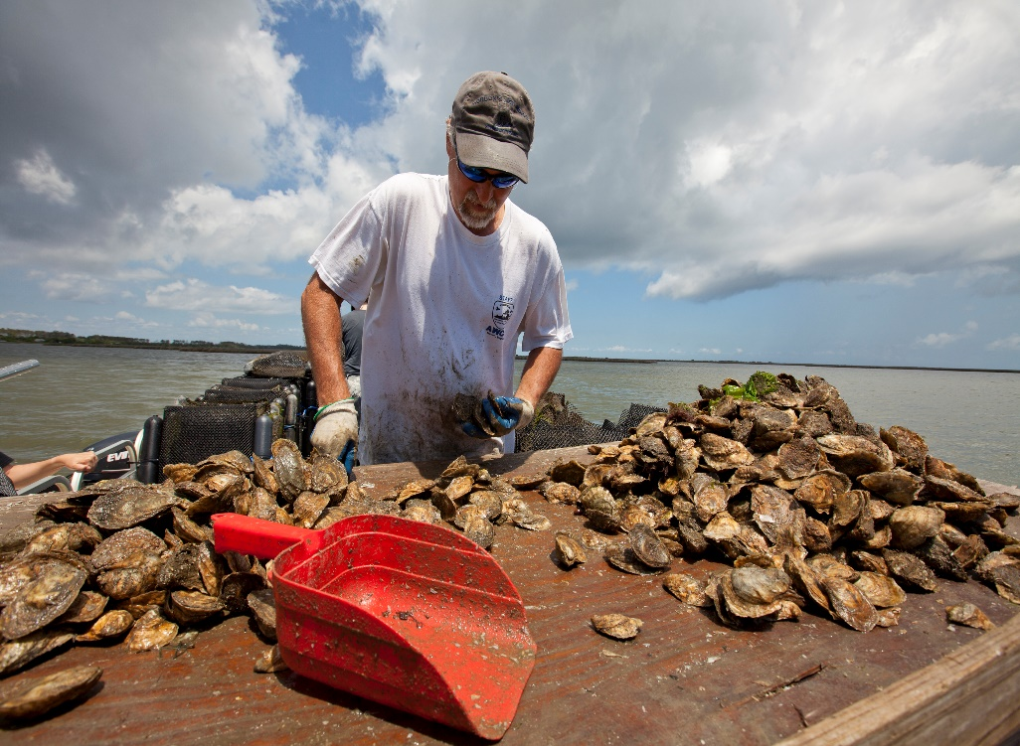
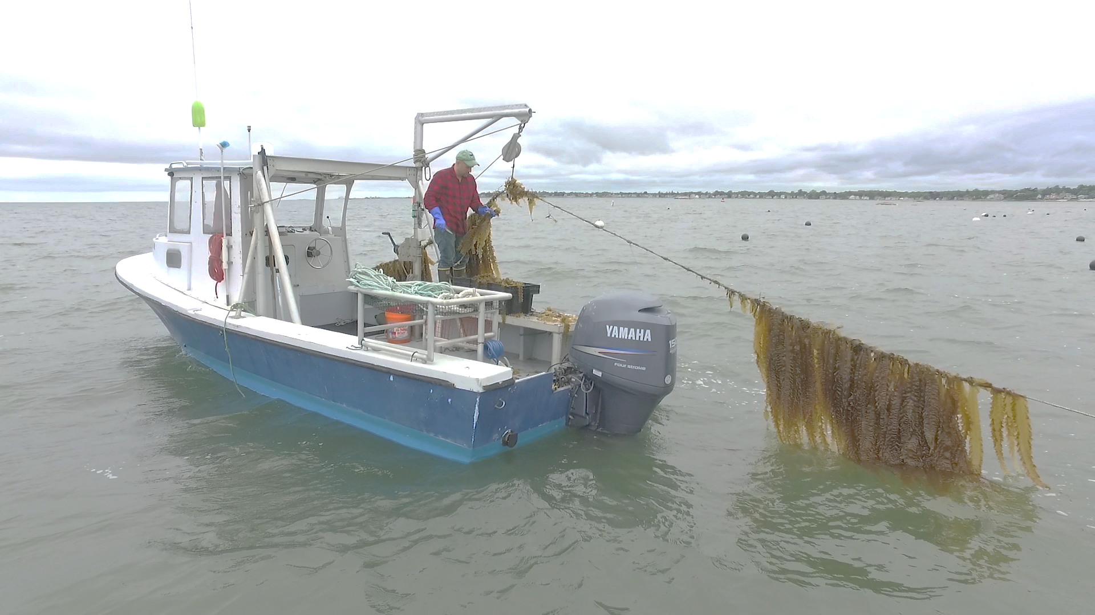
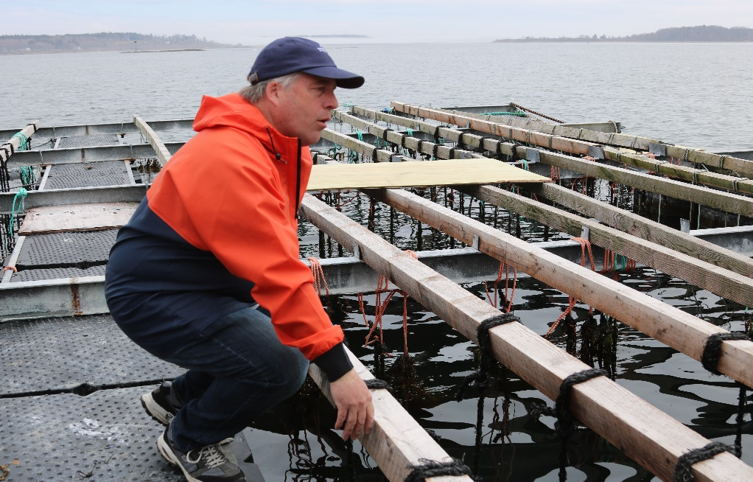
anoushka.concepcion@noaa.gov

