Slide 1
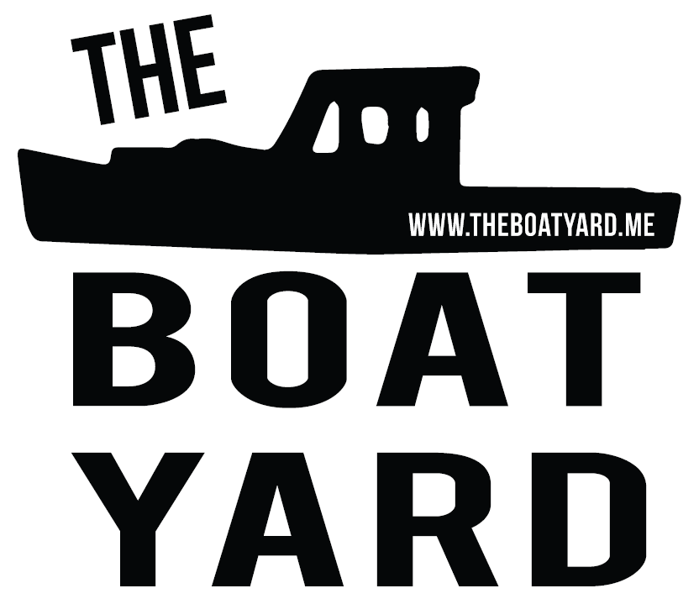
Nick Planson
nick@shredelectric.com
(917) 667-3860
www.shredelectric.com
Chad Strater
chad@theboatyard.me
(207) 632-5996
www.theboatyard.me

Slide 2
We’re building
carbon-neutral sea farms,
electric work boats,
and solar-powered refrigeration.

Slide 3
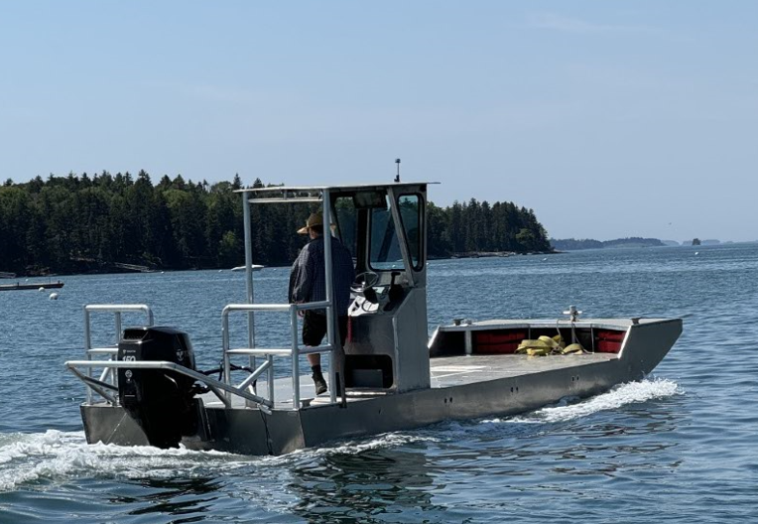
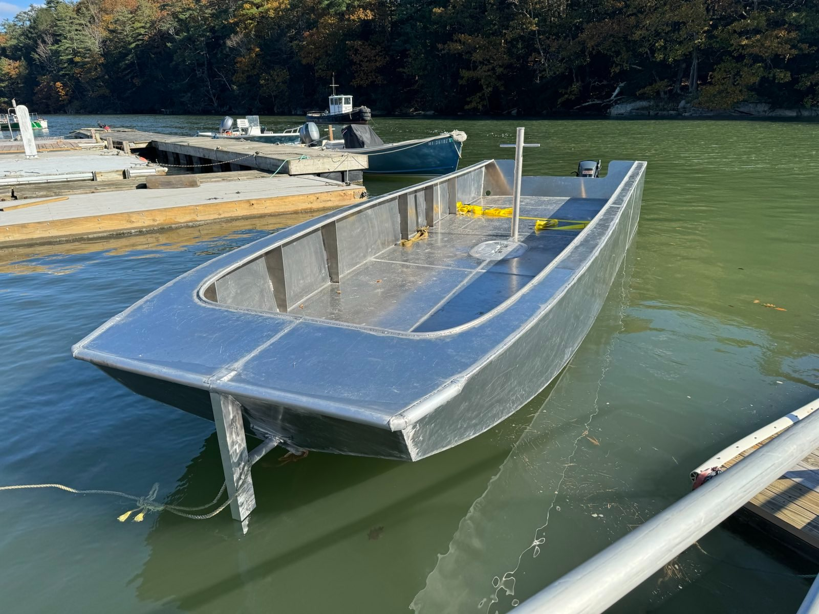
We build aluminum boats – ready to work!
Optimized for heavy-duty marine work
Self-bailing
Fast barges and skiffs
Repairable and recyclable
USDA SBIR project underway to design aquaculture workboats optimized for electric propulsion

Slide 4
We power sea farms with batteries and renewables.
Blackstone Point Oysters, Damariscotta, ME
Nauti Sisters Sea Farm, Casco Bay, ME

Slide 5
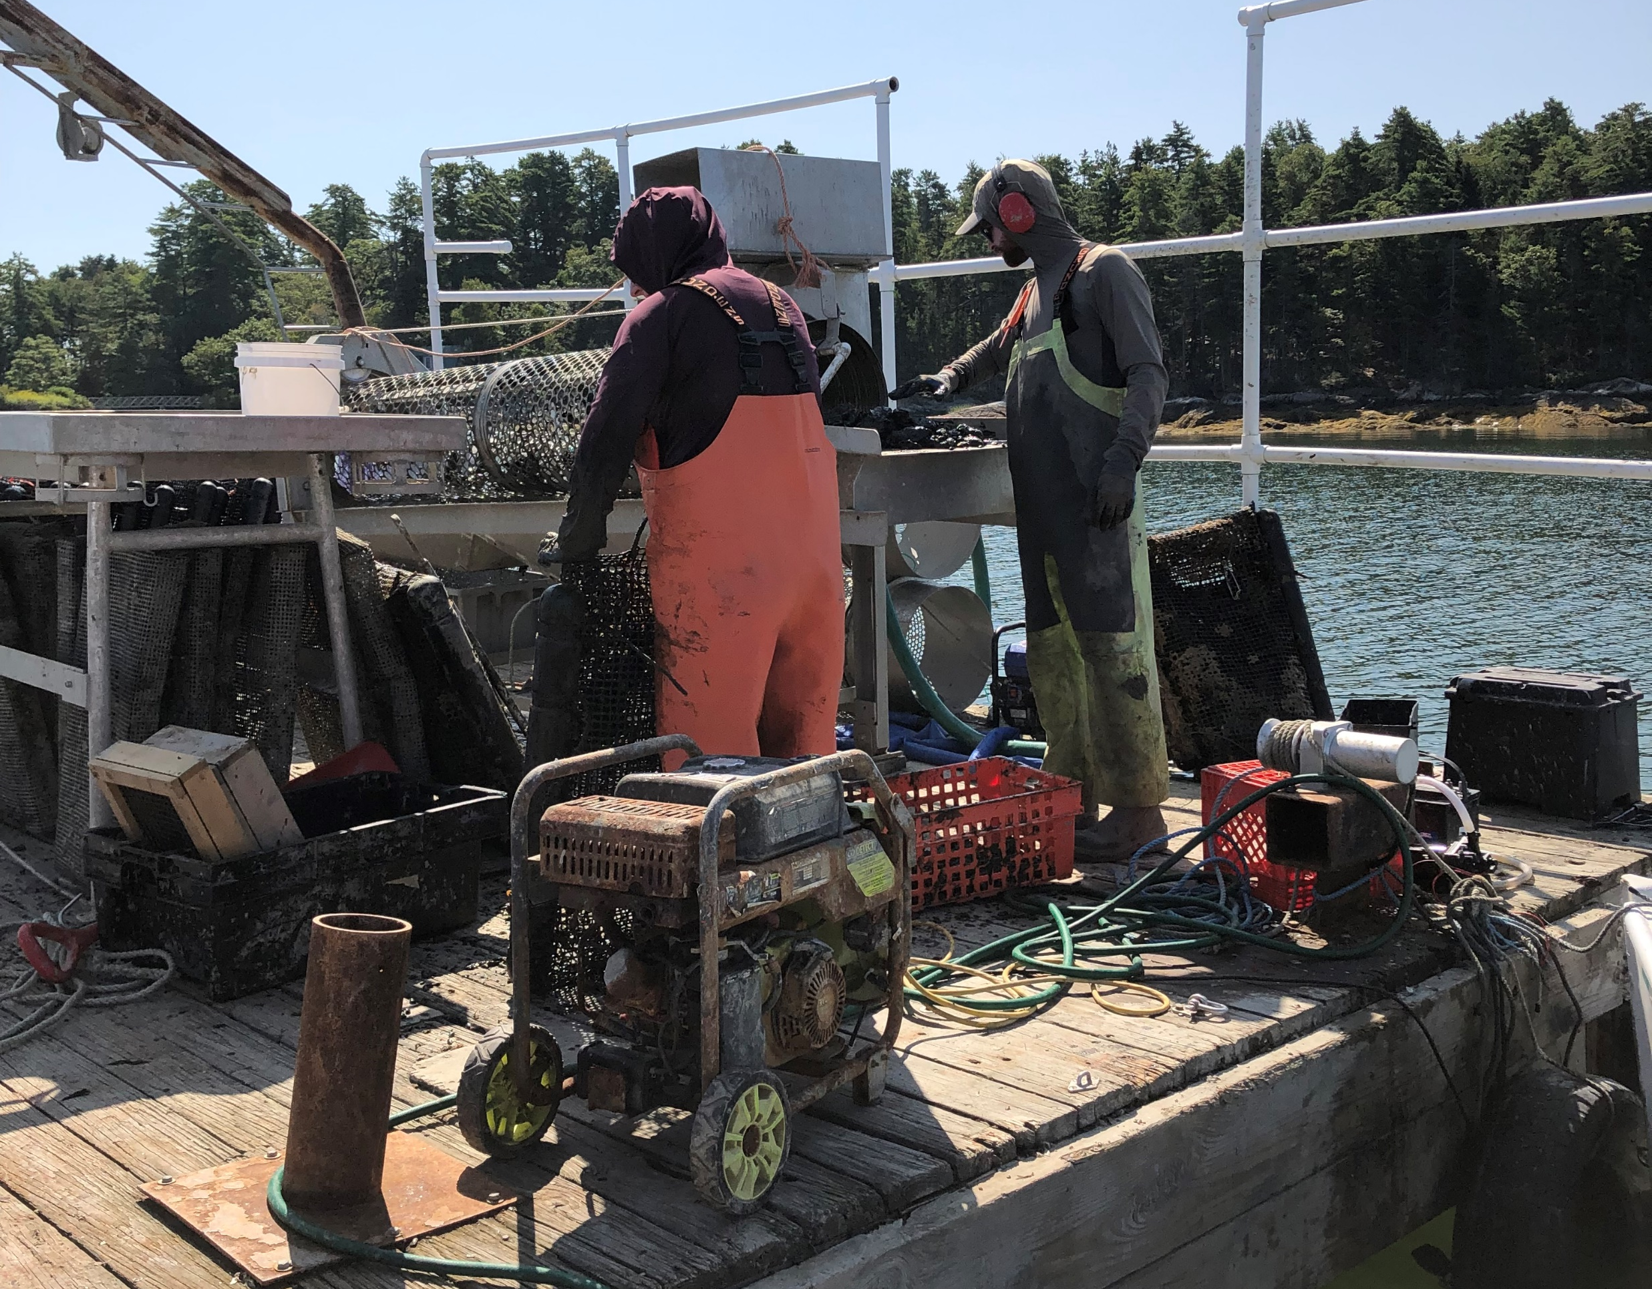
The Problem
CONFIDENTIAL
Most equipment on sea farms is powered by gasoline generators
and pumps.
These machines are loud, they rust quickly, and they pollute heavily.
They’re cheap, but they’re a pain!

Slide 6
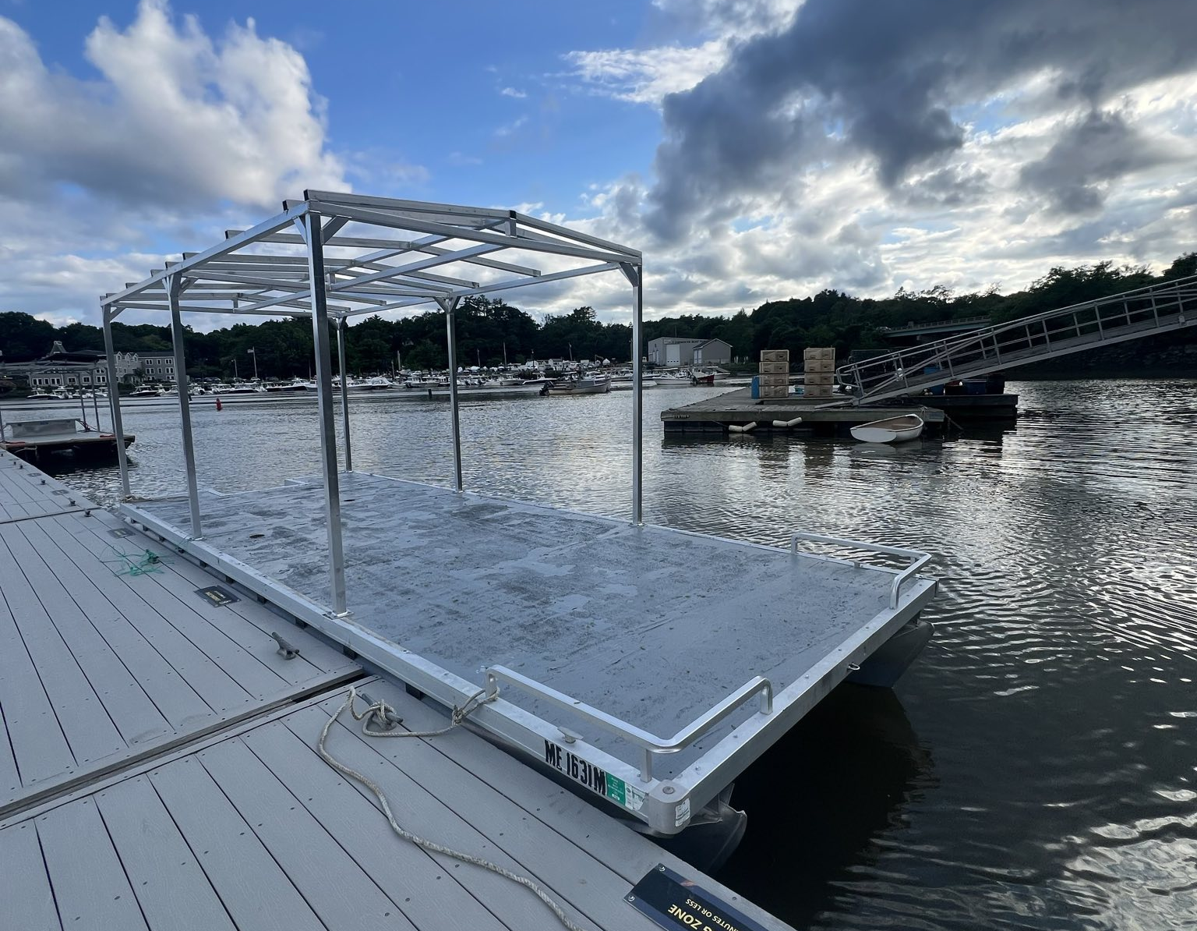
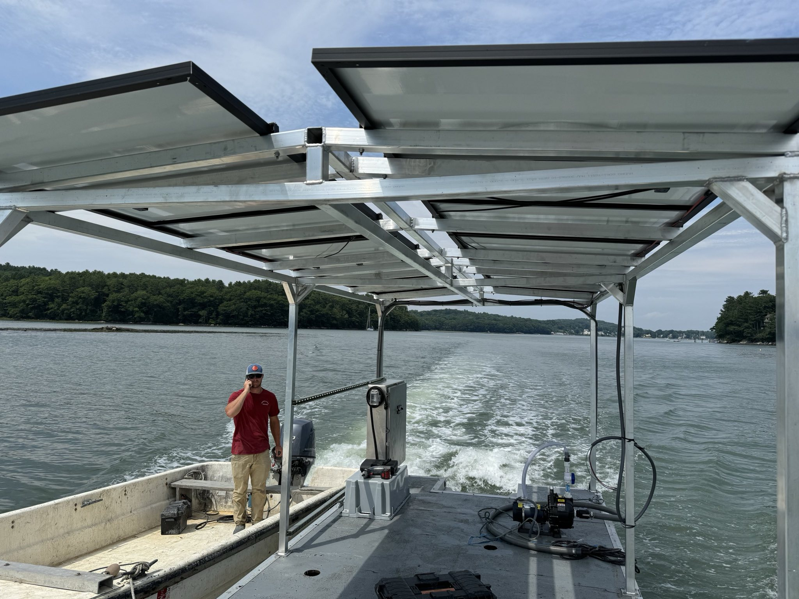
The Solution
1) We build standardized aluminum racking for floats and workboats.

Slide 7
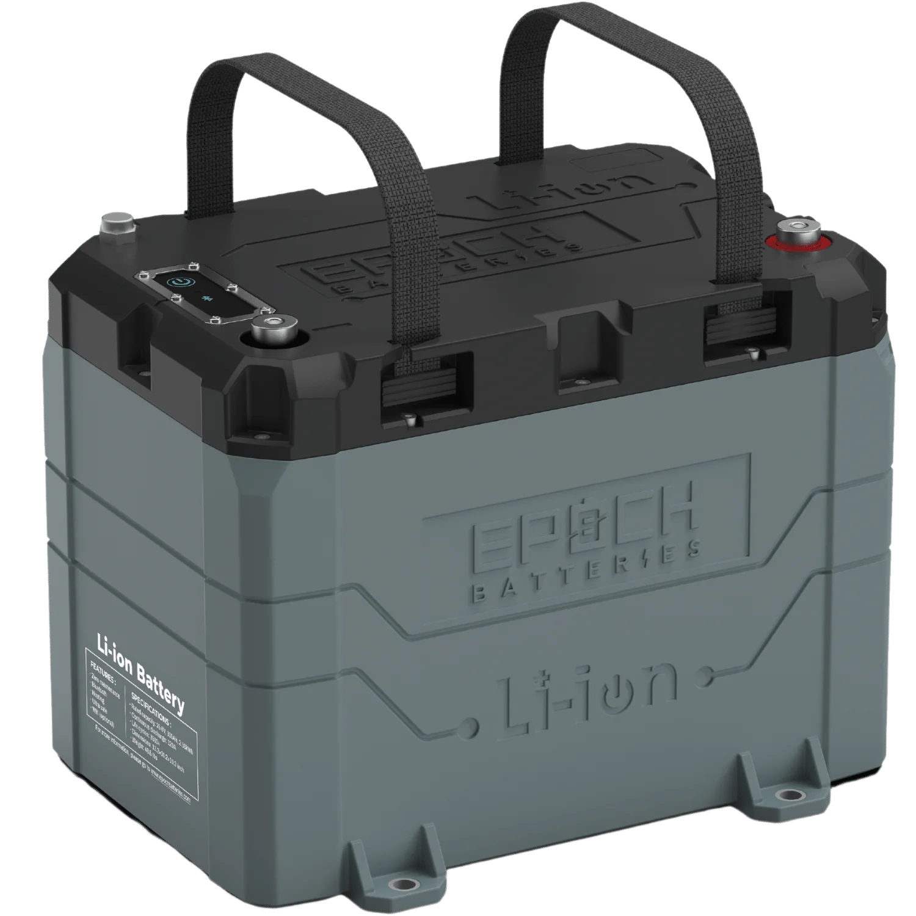
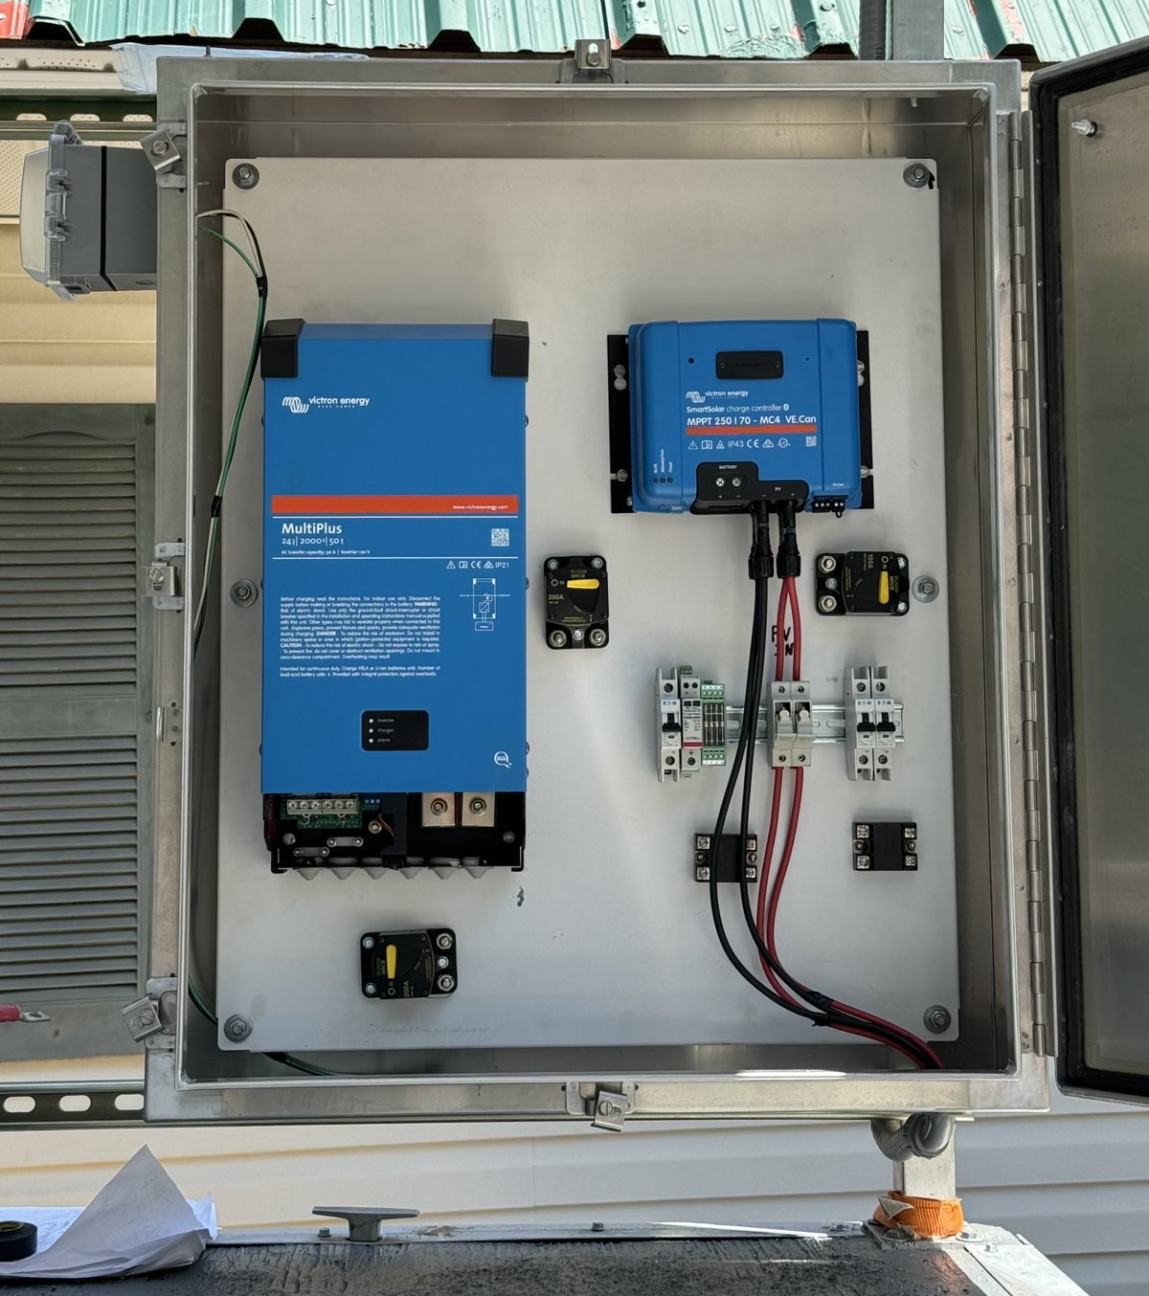
Waterproof Batteries
Top-Notch Components
2) We build power systems in weatherproof enclosures with:
Marine-grade lithium-ion batteries with 11-year warranties
Industry-best energy management equipment
Redundant safety systems

Slide 8
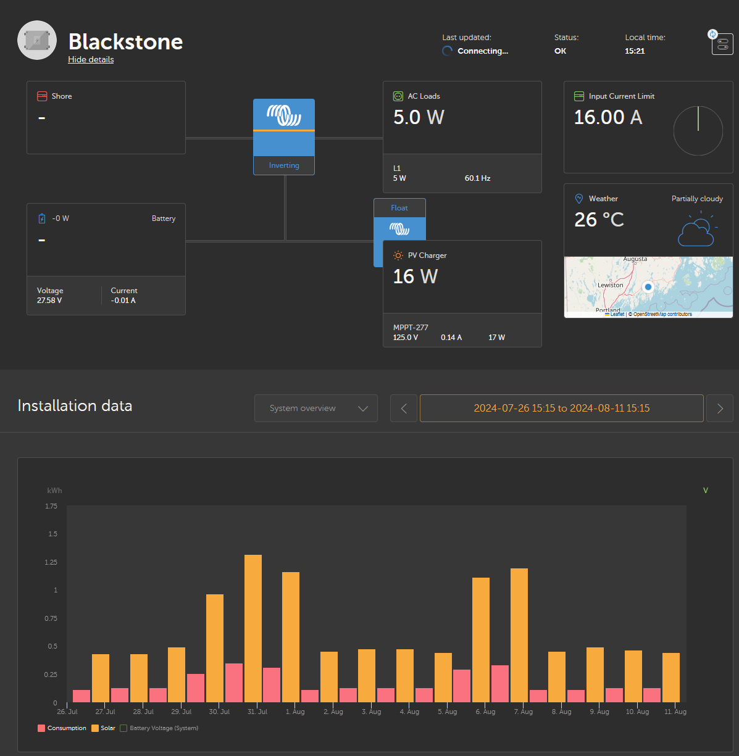
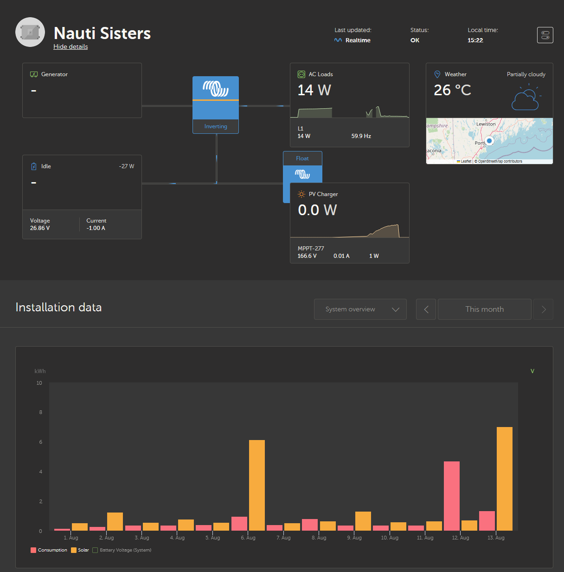
Cloud Based Monitoring
3) We connect the systems to the cloud to monitor and control them remotely and via API integration to other platforms.

Slide 9
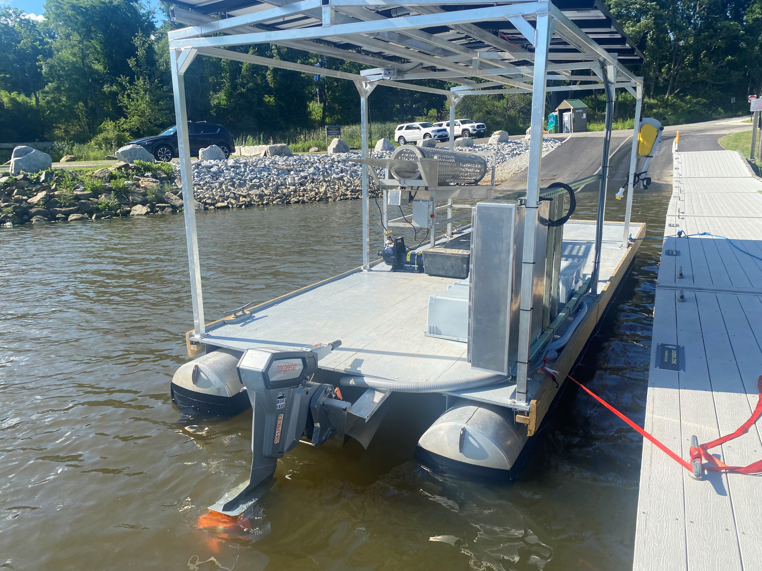
Solar Oyster Barges, Floats, and Upwellers
Pontoon barge, float, or boat
Aluminum rack
Solar panels
Energy management system
Two-Four Batteries
Electric oyster tumbler
Electric washdown pump
Electric hauler
Optional electric outboard motor
All are charged on the farm by the on-board solar.

Slide 10
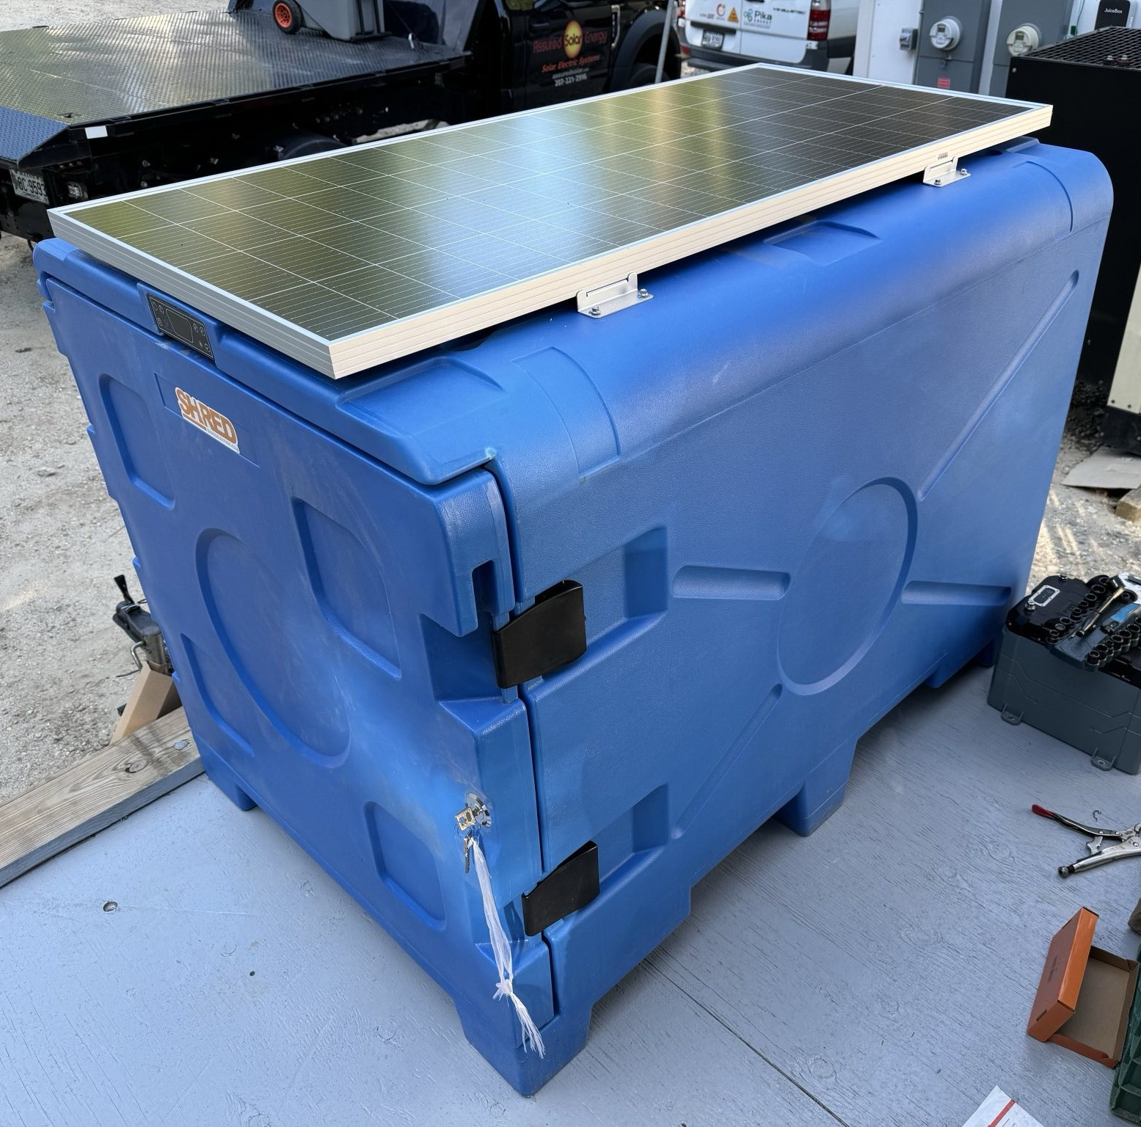
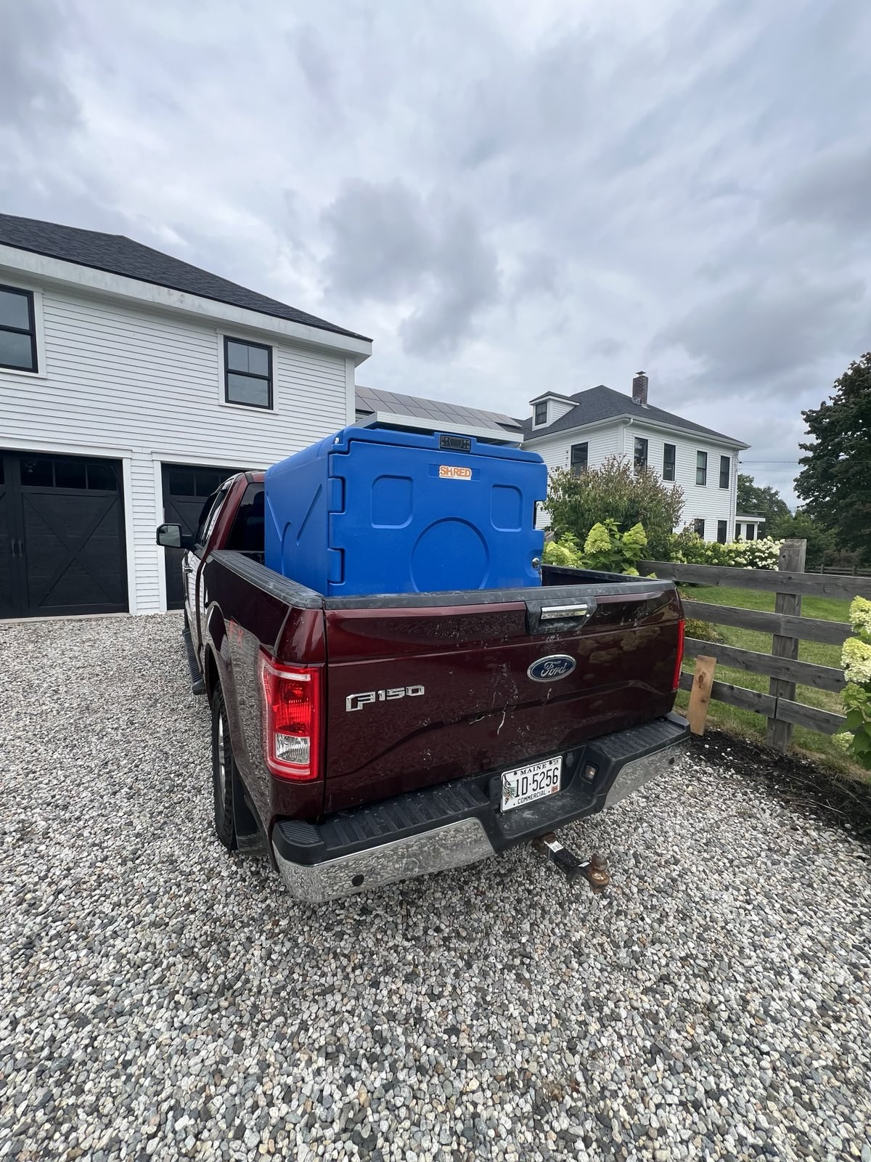
Solutions
ShredConnect™
US Patent Pending
Hardware and software solution
To optimize sources and loads
Easy to use with safe waterproof plugs
Remote app-based monitoring
ShredCube™
Self-powered refrigeration/freezer box
Built-in battery, solar panel, and AC power adapter
Enables EV transportation for cold-chain products
Fill it on the farm, drive it to the barn

Slide 11
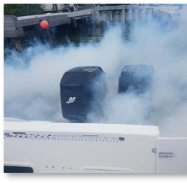
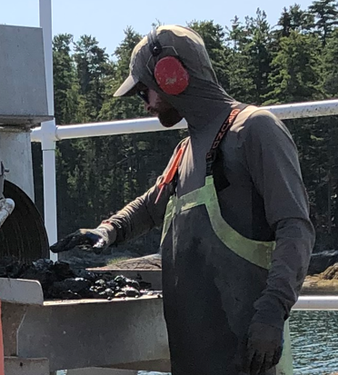
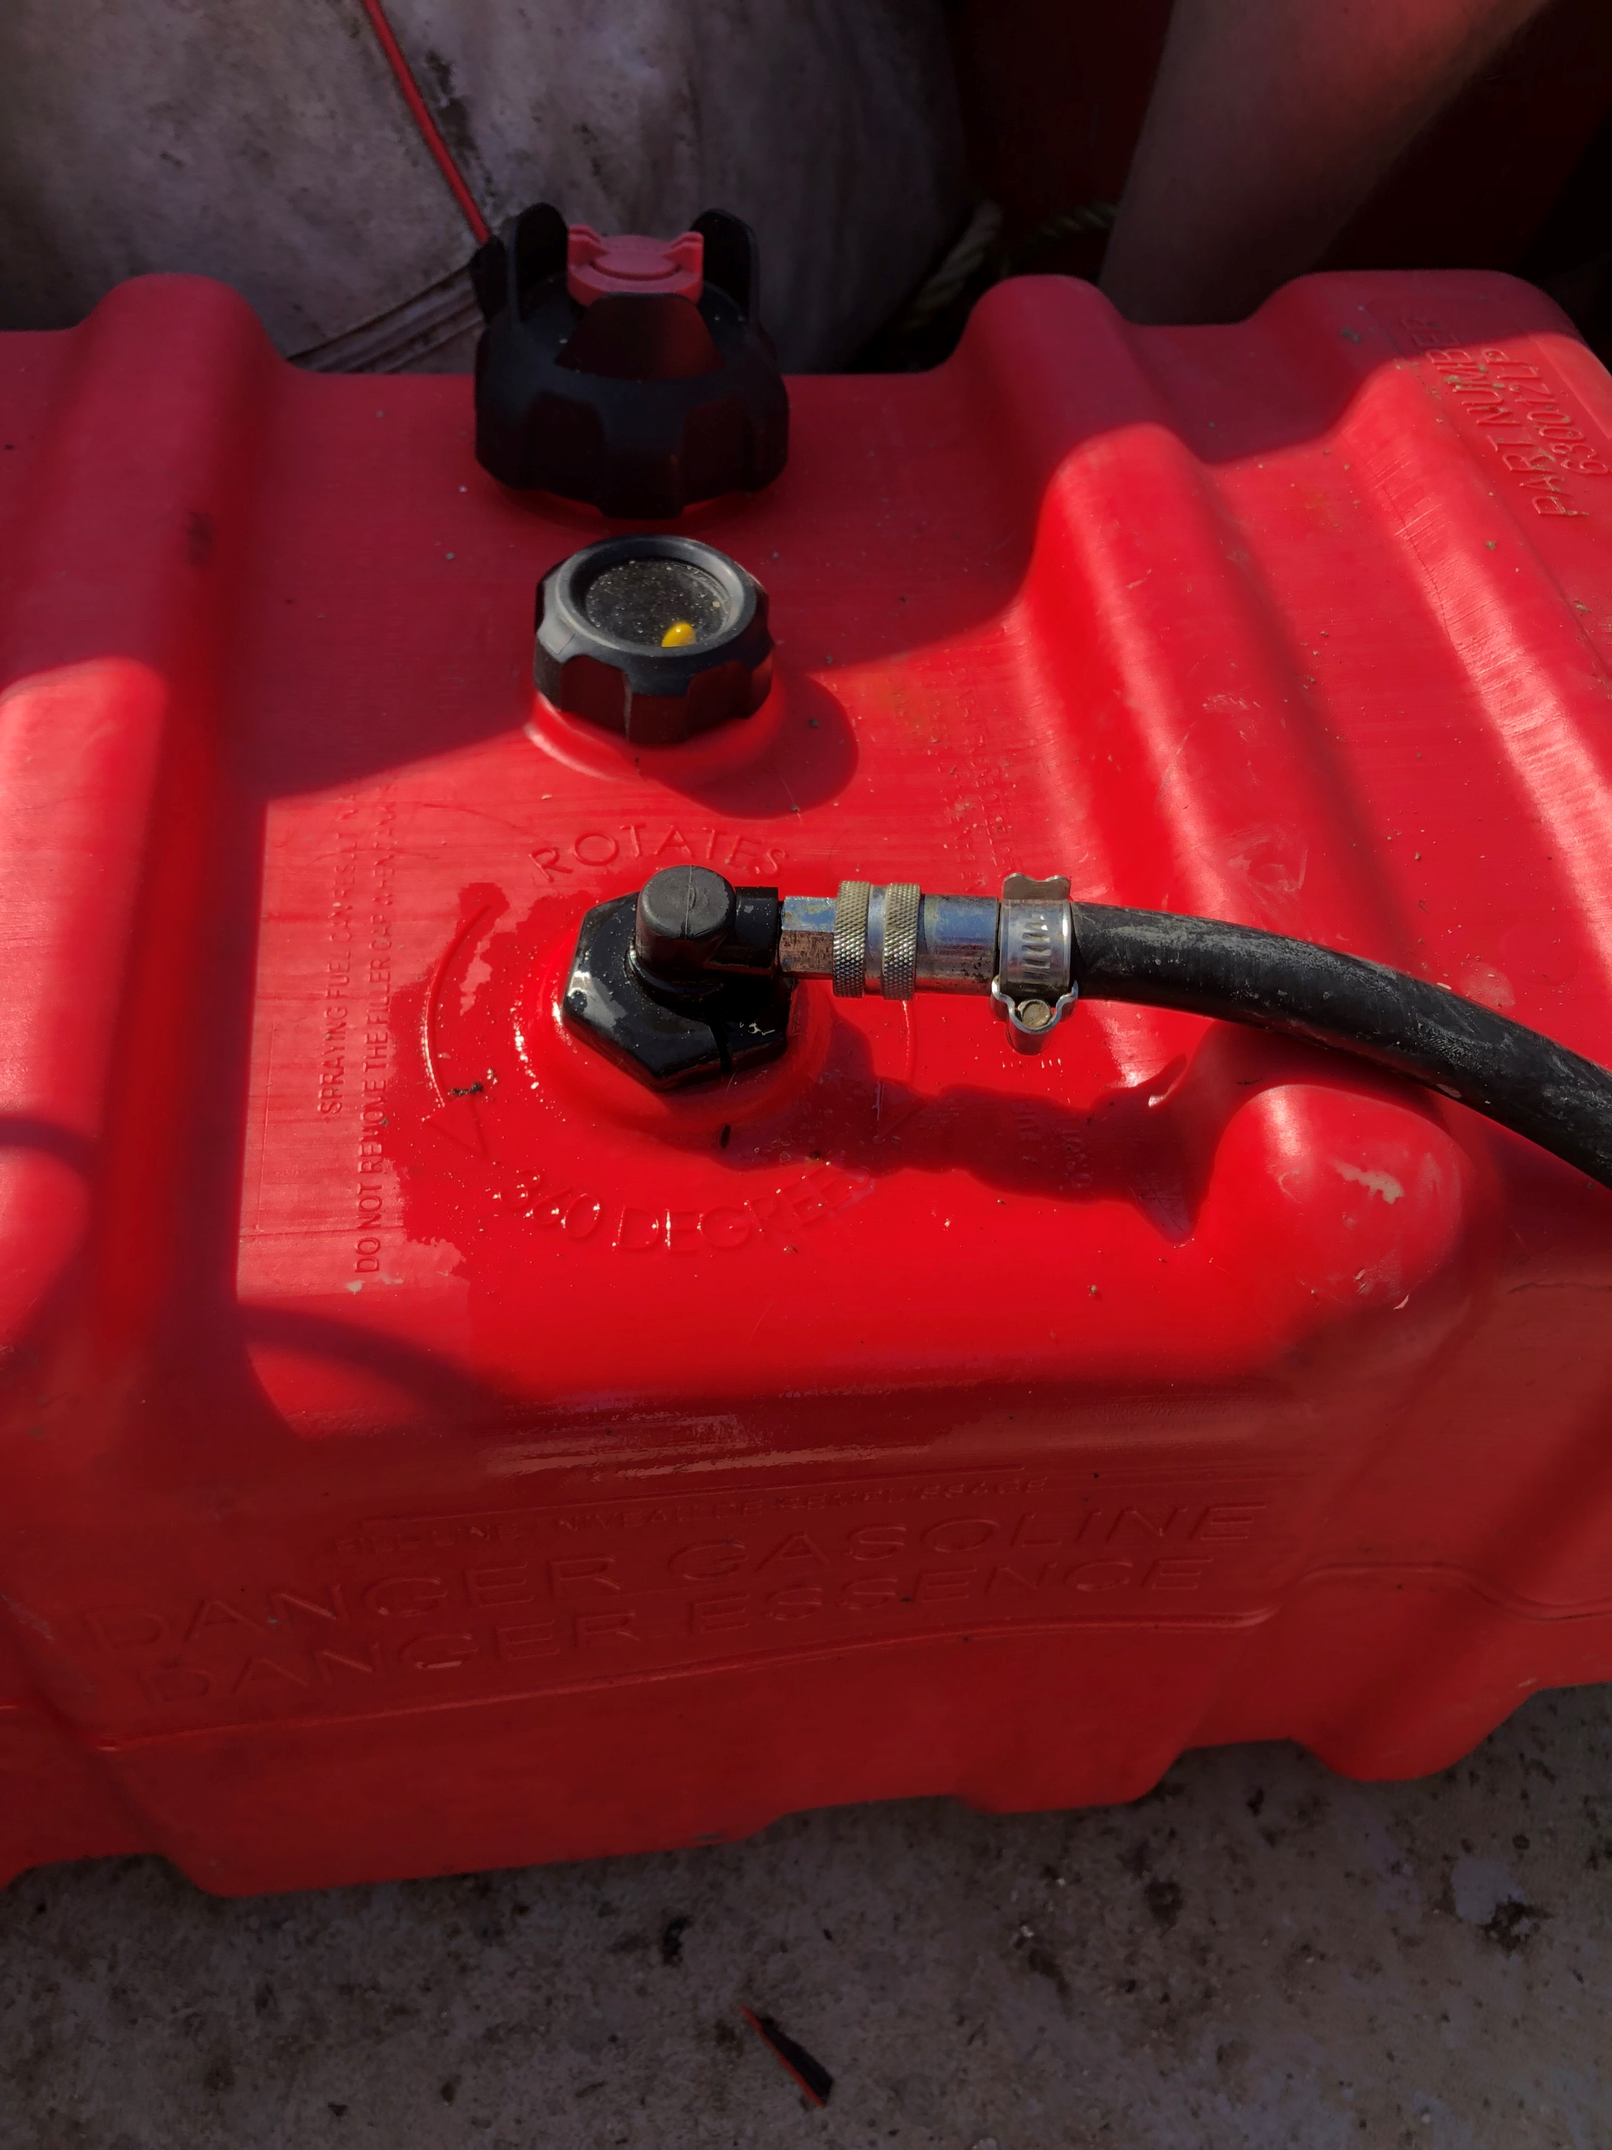
Impacts
Reduces GHG emissions on sea farms
Vastly reduces noise
Eliminates gasoline spills and motor oil leaks
Saves money
Notes:
There’s a lot great focus on aquaculture outputs (the oysters, kelp, mussels, scallops, etc.) – we’re cleaning up what equipment is used to grow them. It’s been really interesting to learn that eliminating the noise from gasoline machines is the driving factor for why farmers want our gear.

Slide 12
Nick Planson
nick@shredelectric.com
(917) 667-3860
www.shredelectric.com
Chad Strater
chad@theboatyard.me
(207) 632-5996
www.theboatyard.me

