Slide 1
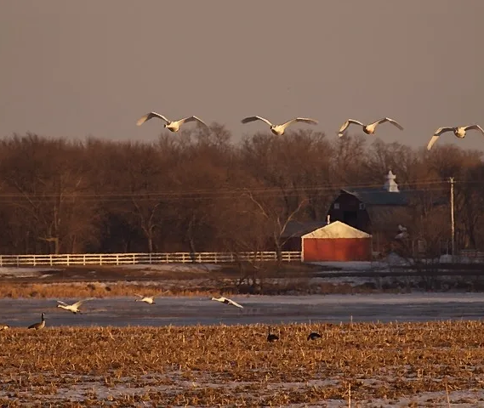
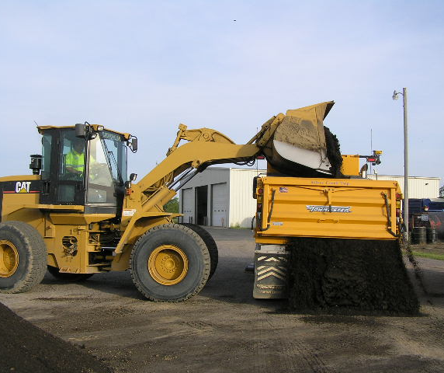
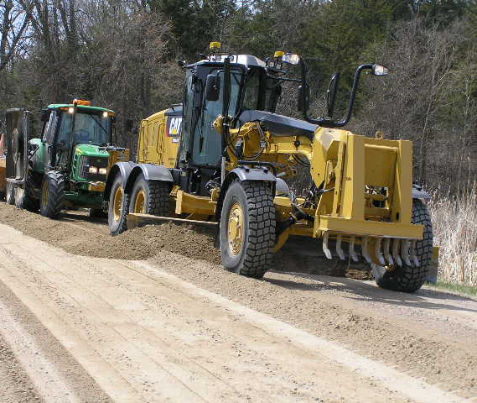
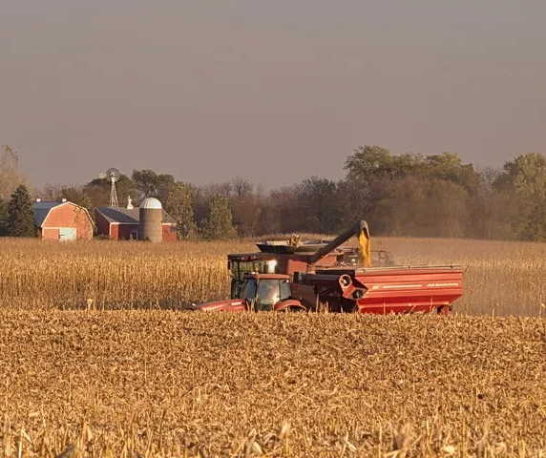
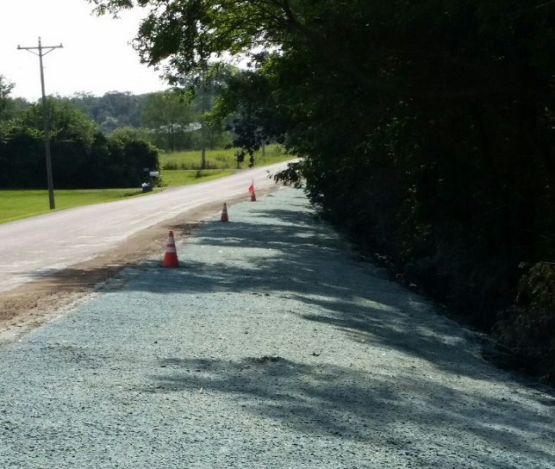

Slide 2
Silver Creek Township Annual Meeting March 11, 2025 7:00PM
Review 2024
Preview 2025
Propose 2026

Slide 3
Township Supervisors, Members, and Staff
Board of Supervisors
Sandy Forsman (2028)
Mike Helman (2028)
Andy Christensen (2028)
Brandon Geyen (2026)
Ryan Nelson (2026)
Planning & Zoning Members
Jesse Dickinson
Mark Egge
Justin Hall
Chris Klein
Tom Vanek
Clerk-Treasurer
Alana Paumen (Aug 14)
Deputy Clerk (open)
Maintenance
Chris Klein
Blake Paumen (June 26)
Tom Vanek- As needed
Jamie Albrecht- As needed

Slide 4
General Fund
This fund pays for all Township expenses related to
Compensation: Board of Supervisors, P&Z Members, Clerk-Treasurer, and Deputy Clerk
Professional Services: Attorney, Assessor, Audit
Insurance: Township, Property, Workers Comp, Unemployment
All Township buildings: Maintenance, repairs, utilities
Elections: Equipment, materials, judges
Office Operations: Computer equipment, supplies, postage
Township Resident Recycling
Donations, dues, and memberships
Clean-up Day
Playground

Slide 5
Road and Bridge Fund
This fund pays for all Township expenses related to
Professional Services: Engineer, Contractors
Road Maintenance and Updates: Grading, gravel hauling, pit royalties, snow plowing, salt/sand, road repairs, asphalt, chipseal
Right Of Way Maintenance: mowing, brush removal, tree trimming, weed control, debris clean-up
Chloride for gravel stabilization & dust control, road signs, culverts and other related items
Compensation: Full-time and part-time Maintenance Staff
Equipment: purchase, maintenance and repair, fuel

Slide 6
Review 2024
Road Improvements
Asphalt Overlay
Chipseal
Road Maintenance
Chloride Used: 38,000 Gallons
Gravel Hauled: 6,700 Yards
Asphalt for crack filling: 16,500 lbs.
Regular road/ditch maintenance
Major Ditch Cleaning on Baker
119th, 120th, Blackwood, Baker, Banyon
156th, Meridian, 105th, 97th, Amery, 101st, 94th

Slide 7
Review 2024
IT Infrastructure Improvements
ARPA Funds used for IT Infrastructure Improvements
Computer Equipment
Cyber Security
Microsoft Office Products

Slide 8
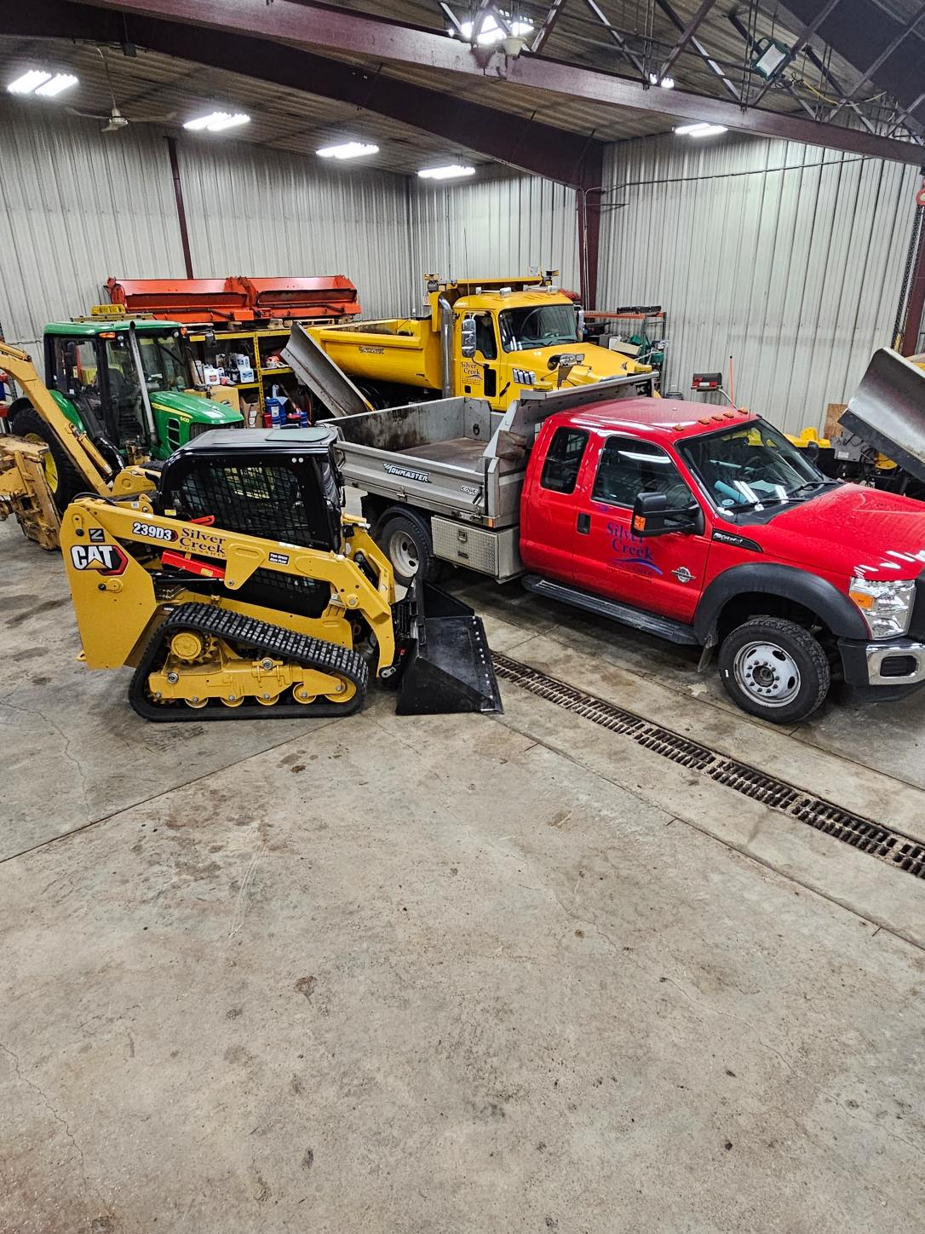
Review 2024
Sold 2003 Chevy 3500 w/plow at auction for $6,336.00
Road and Bridge Equipment Investments
2013 F550 w/dump bed
Cat Skid Steer
Tilt deck Trailer

Slide 9
Review 2024
Xcel Energy Siren removal Project
11 Sirens in Township (next slide shows map)
Xcel petitioned to Feds to stop maintaining sirens and use other electronic communication to notify residents.
Xcel wanted to donate Sirens to Cities and Townships
Board could not justify the cost associated with the upkeep of all 11 sirens, approved to accept the donation of two sirens (W-22 and W-24).

Slide 11
Siren Locations

Slide 12
Hwy 25 Corridor

Slide 13
Sheriffs Report 2024
Silver Creek Township- Crime Calls
Assault 3
Burglary 3
Court Order Violation 8
Criminal Damage to Property 4
Drugs 10
Fraud Complaint 10
Homicide 0
Robbery 0
Sex Related 0
Theft 15

Slide 14
Sheriffs Report 2024
Silver Creek Township- Quality of Life Calls
Alarm 48
Animal 32
Check Welfare 22
Citizen Aid 13
Civil 22
Disorderly 1
Domestic Disturbance 9
Harassment 10
Juvenile Complaint 4
Lost - Found Property 2
Medical 95
Neighborhood Dispute 12
Noise 12
Suspicious Activity 52
Threats 4
Unwanted Person 5

Slide 15
Sheriffs Report 2024
Silver Creek Township- Traffic Calls
DUI 13
Motor Vehicle Crashes 56
Parking 12
Traffic - Complaint 39
Traffic - Hazard 10
Traffic - Stop 640

Slide 16
Fire Report

Slide 17
SUMMARY OF RECIEPTS, DISBURSEMENTS, AND BALANCES
 | YE2023 | Receipts | Disbursements | YE2024
General Revenue Fund | $147,517.35 | $265,788.57 | $252,253.06 | $161,052.86
ARPA Fund | $13,772.51 | $0 | $13,772.51 | $0
Road & Bridge Fund | $511,884.91 | $1,165,727.23 | $1,145,599.26 | $532,012.88
Total Levy Funds | $673,174.77 | $1,431,515.80 | $1,411,624.83 | $693,065.74

Slide 18
SUMMARY OF RECIEPTS, DISBURSEMENTS, AND BALANCES
 | YE2023 | Receipts | Disbursements | YE2024
Fire Fund | $49,774.27 | $88,750.37 | $45,325.00 | **$93,199.64
Contingency Fund | $9639.25 | $15,010.86 | $0 | $24,650.11
Total Non-Levy Funds | $59,413.52 | $103,761.23 | $45,325.00 | $117,849.75

Slide 19
SUMMARY OF RECIEPTS, DISBURSEMENTS, AND BALANCES
 | YE2024
Total Balance | $810,915.49

Slide 20
Equipment List AS OF 12/31/2024
Reporting Year | 2013 Cat 140M2 Motor Grader | 1998 Cat 938G Loader | 2010 JD 6430 Tractor Mower | 1998 JD F935 Lawn Mower | 2003 Chev 4x4 ¾ ton w/plow | 2015 Mack Dump Plow Truck | 2019 Mack Dump Plow Truck | 2024 Cat Skid | Ford F-550
2021 | 3261 hrs | 5239 hrs | 4354 hrs | 892 hrs | 189600 mi | 44322 mi | 16855 mi | - | -
2022 | 3710 hrs | 5726 hrs. | 4833 hrs | 901 hrs | 199000 mi | 50723 mi | 25798 mi | - | -
2023 | 4053 hrs | 5982 hrs | 5252 hrs | Broken HRS Meter | 207949 mi | 53327 mi | 32013 mi | - | -
2024 | 4441 hrs | 6260 hrs | 5500 hrs | - | 218752 mi | 60296 mi | 42297 mi | - | -
2025 | 4801 hrs | 6438 hrs | 6,268 hrs | - | Sold | 63,350 mi | 47,963 mi | 7.4 hrs | 92,366 mi

Slide 21
Cost Changes
Professional services, contracts, and operating expenses all continue to increase.
Cost changes throughout 2020 – 2025
2020 2021 2022 2023 2024 2025
Assessor $17,626 $30,590 $12,418 $26,160 $26,265 $27,000
Auditor $7,125 $7,475 $22,790 $17,703 *$2,160
Recycling $49,500 $56,392 $52,566 $54,814 $69,360 **$73,000
* 2023 Audit was not completed in 2024; remaining balance will be paid in 2025 along with the cost of the 2024 Audit.
** Anticipated recycling cost for 2025.
.

Slide 22
Recycling
What are SCORE funds
SCORE funds in Minnesota are grants that support recycling programs, waste reduction, and solid waste management. The funds come from the state's solid waste management tax (SWMT) on garbage services.
No more SCORE money for 2025, County is keeping it to help build the new recycling center off County Rd 37/County Rd 14.
Will the funds return in 2026, that hasn’t been answered yet.
SCORE credits can also be recorded if a resident/farmer puts recycled materials on their fields.
Last payment received Spring 2024 for $4,070.05, loss of approx. 12k.
We are not required to have recycling by law, only Cities are.
Only 30% is recycled the other 70% is put into a landfill.
County wants a task force to see if its feasible to have multiple Townships with one bid for garage and recycling for a potential cost savings-waiting on communication from the County.
There is an increasing cost to this service. Recycling estimated at $73,000 FY2025 and will increase no more than 4% annually for the next 4 years.
Future renewal and reduce cost, the Town could consider:
Monthly recycling curbside service
Having a recycling dumpster placed at the town hall and remove curbside bins.
End recycling all together.

Slide 23
Plans for 2025
Road projects
134th Culvert replacement
Locke Lake Hydraulic study
Continue in slope / ditch work with clay from yard pile
Shouldering asphalt roads
Crack Filling asphalt roads
Graveling gravel roads
Brush and Tree Trimming and Removal from Right of Ways
Pit Reclamation
Potential Salt Shed repairs-Depending on bid proposals.
Asphalt overlay
$360,000 requested bids
Chipseal
$140,000 requested bids.

Slide 24
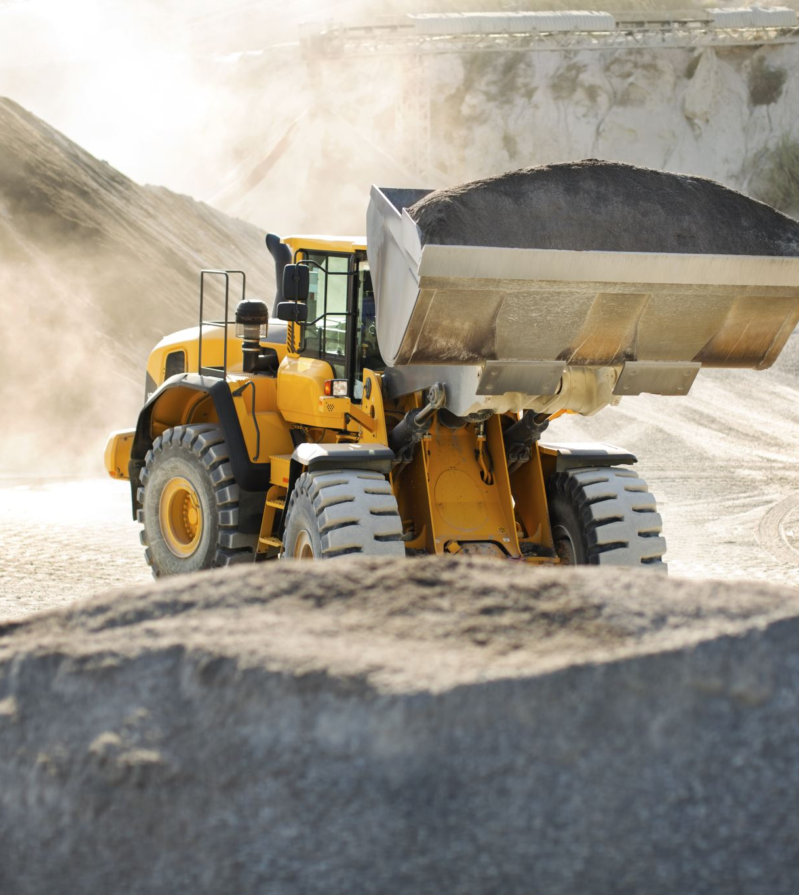
Plans for 2026
Purchase gravel & hauling
John Deere Tractor replacement or Front End Loader
Chipseal all overlays that were completed in the last 3 years.

Slide 25
5 Year Historical Levy (2020 - 2024)
Determining the 2026 Levy is based on review of past years history, receipts, and expenditures from activities in FY2020 - FY2024.
 | 2020 | 2021 | 2022 | 2023 | 2024
General | $145,000 | $160,000 | $160,000 | $160,000 | $220,000
Road & Bridge | $645,000 | $840,000 | $740,000 | $1,040,000 | $1,040,000
Total Levy | $790,000 | $1,000,000 | $900,000 | $1,200,000 | $1,260,000

Slide 26
Proposed 2026 LEVY $1,314,671
 | 2024 |  | 2025 | 3% | 2026 | 3%
General Fund | 220,000 | 37.5% | $226,600 |  | $234,000
Road & Bridge | 1,040,000 | O% | $1,071,200 |  | $1,103,300
Total Levy | 1,260,000 |  | $1,297,800 |  | 1,314,671

Slide 27
General Fund Expenditures for 2026
The Board of Supervisors is requesting that Township Citizens approve expenditures of funds for memorials and recognitions, etc., and for lunch for workers at the annual Township cleanup day. The request is for a maximum of $800.00 accumulated total for all such expenses for the year. This has been approved since 2014.
As required by law, this request must be approved by vote
at the annual Township meeting.

Slide 28
2026 Annual Meeting
March 10, 2026
Silver Creek Town Hall
3827 134th Street NW, Monticello, MN 55362
In case of inclement weather meeting will be one week later, March 17, 2025.

Slide 29
THANK YOU FOR ATTENDING
Motion for Adjournment

