Slide 1
VO2 Max from a Doctors perspective
Dr. Rob McNab FACP FACOI DipABLM
McNab Wellness- Foundational Health Care
McNabWellness@gmail.com

Slide 3
Why is VO2 max important for Doctors?

Slide 4
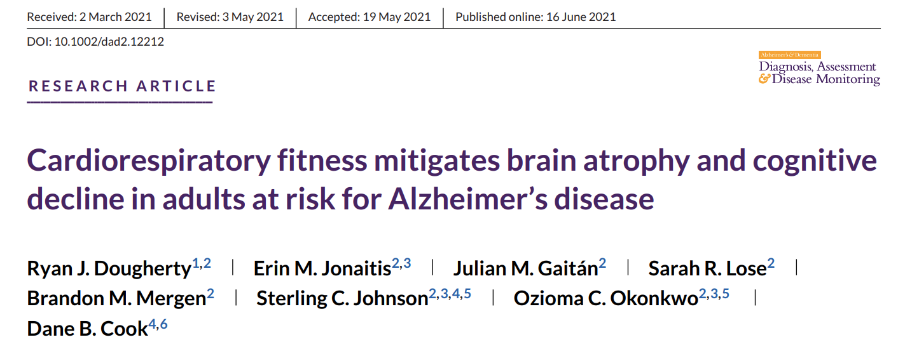
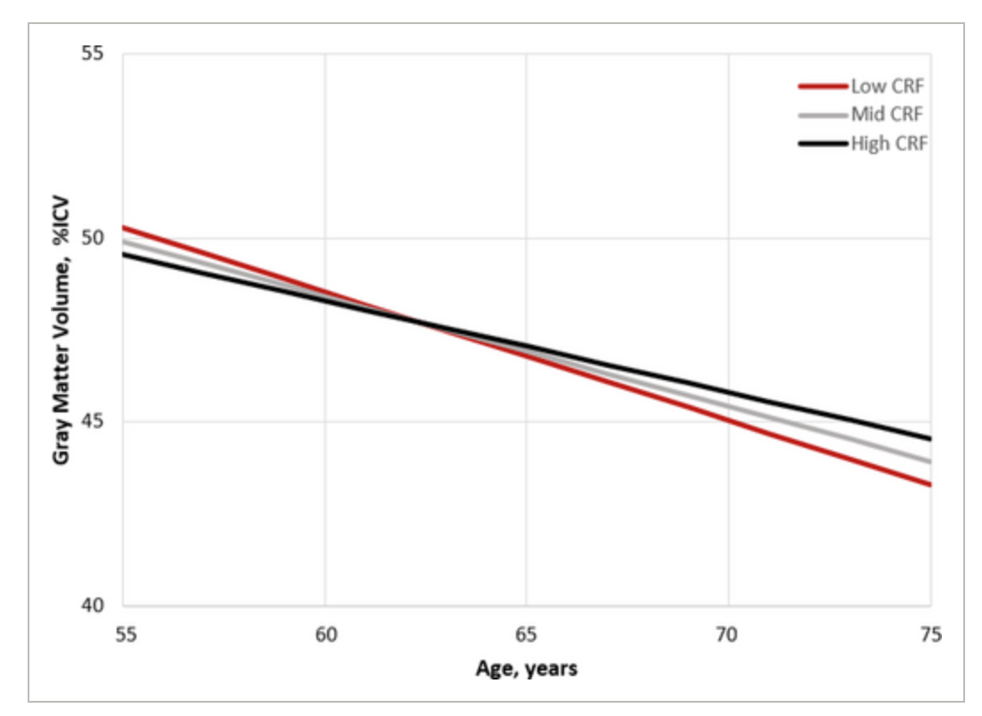
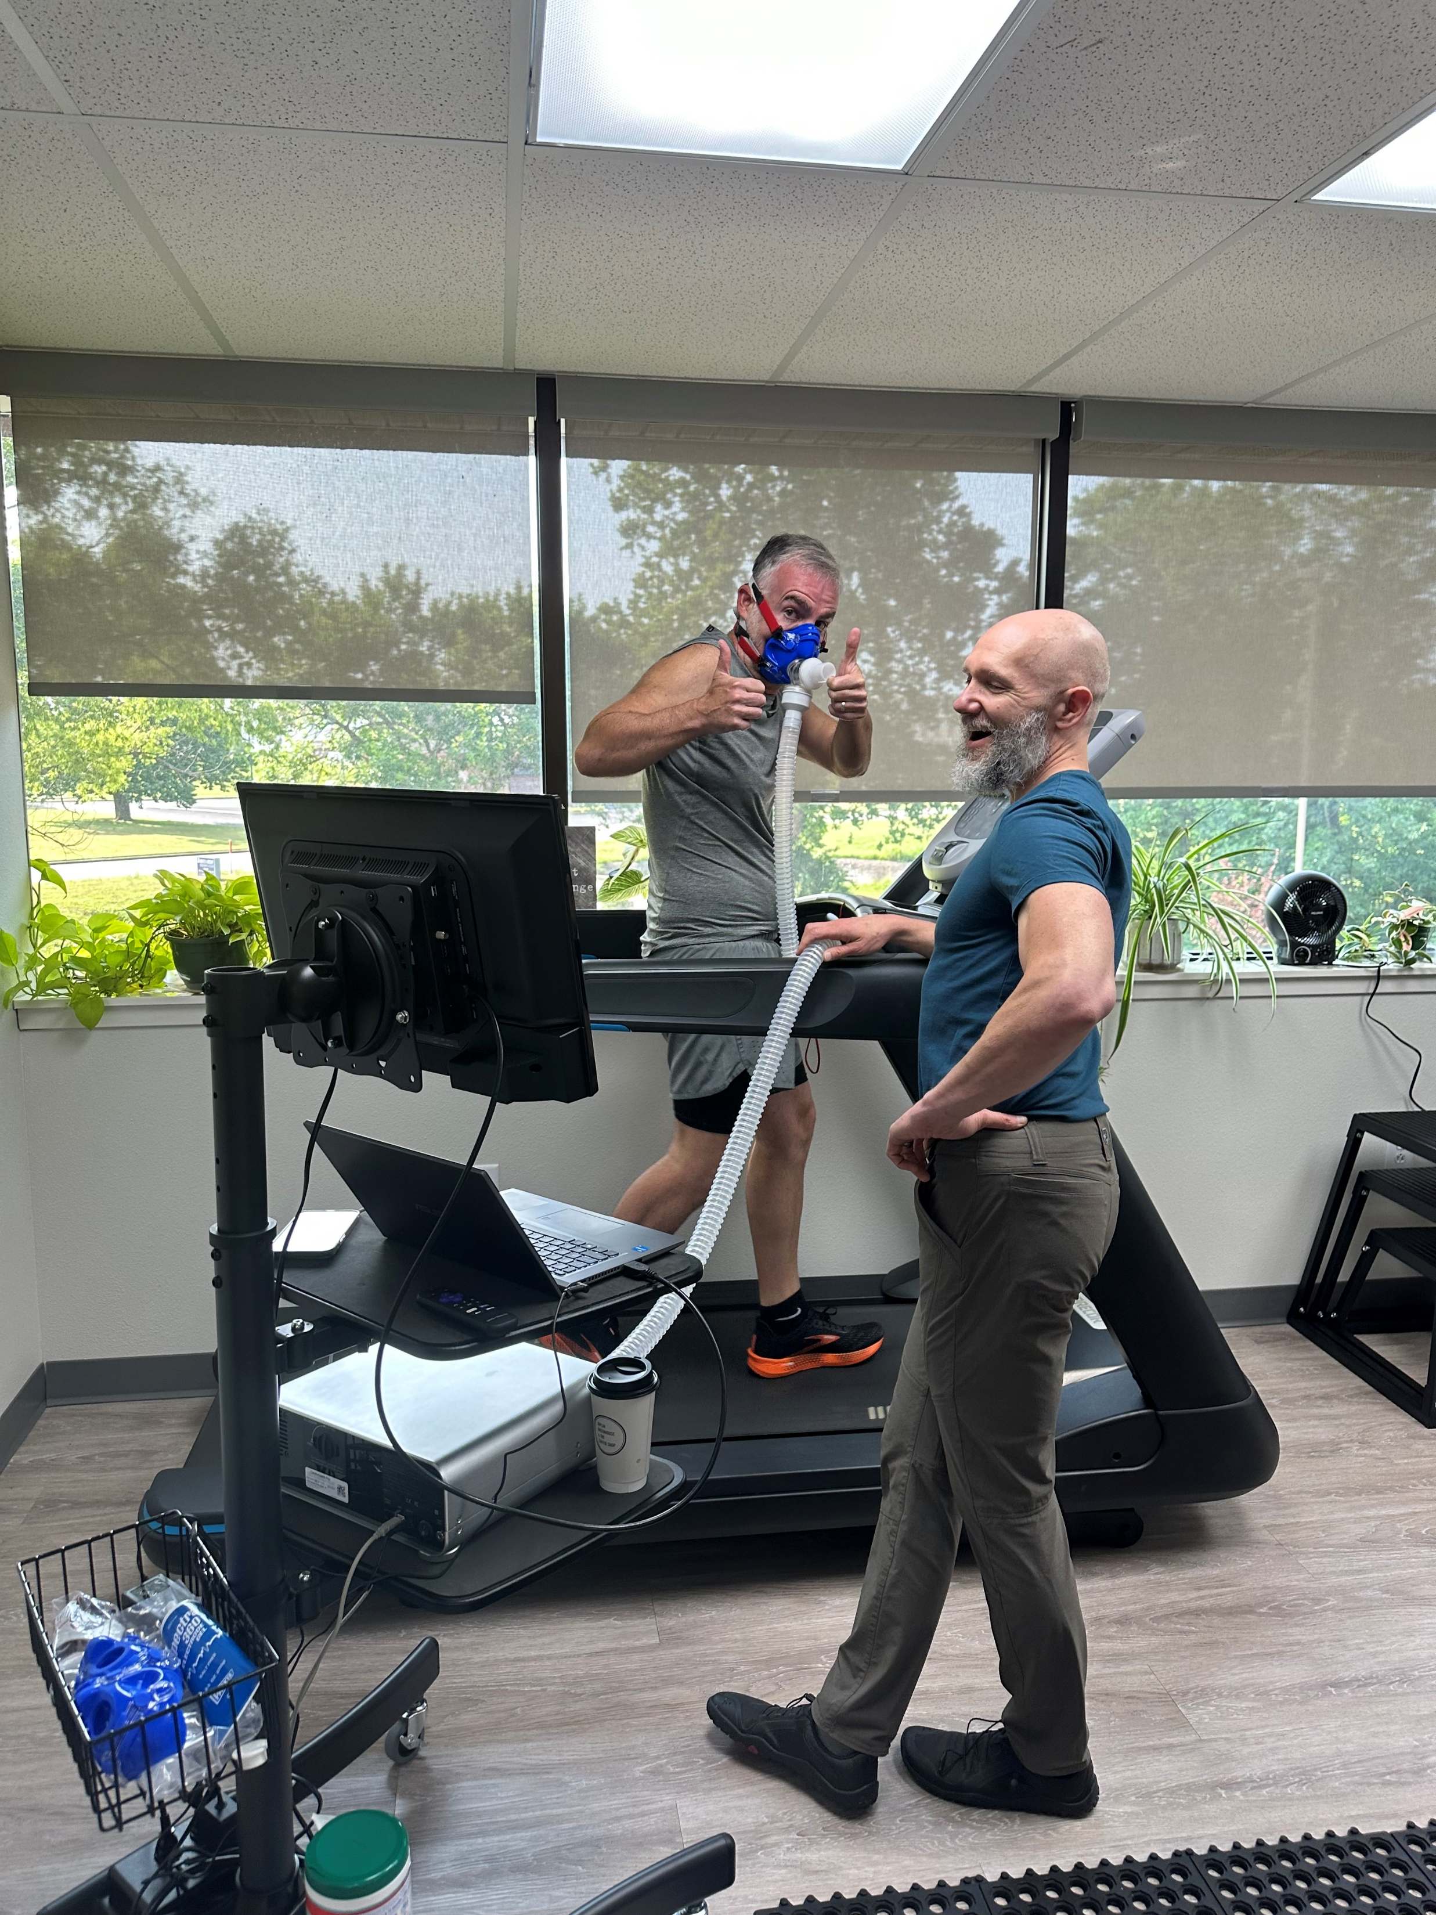
VO2 and CNS Function and Cognition

Slide 6
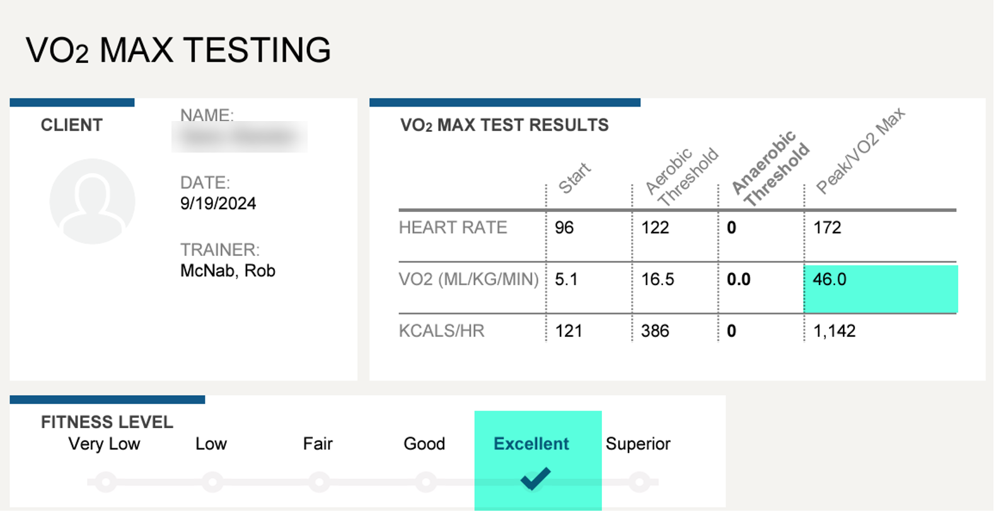
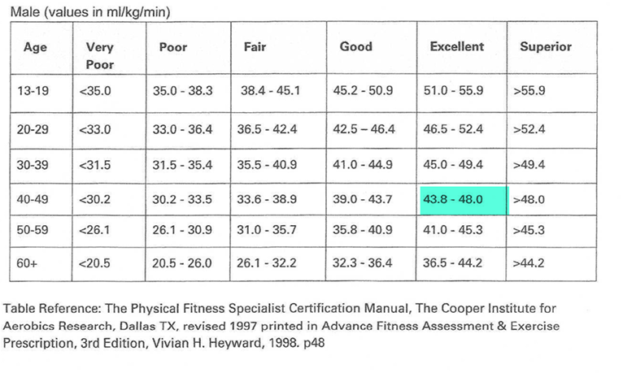
Moving the Needle

Slide 7
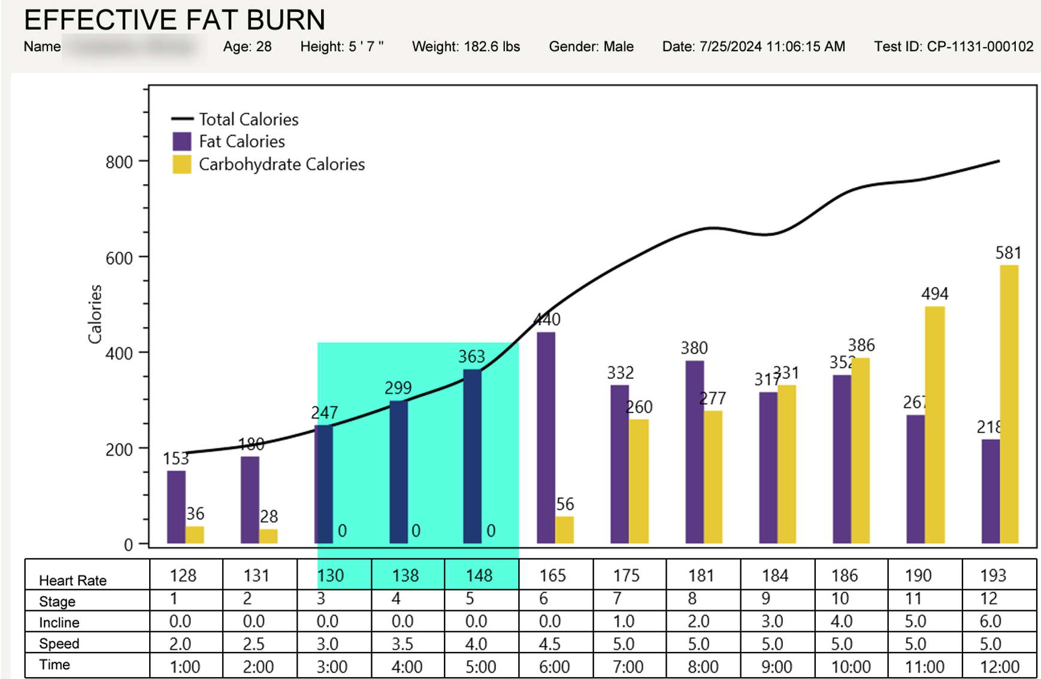
Very poor engine- Good metabolic flexability

Slide 8
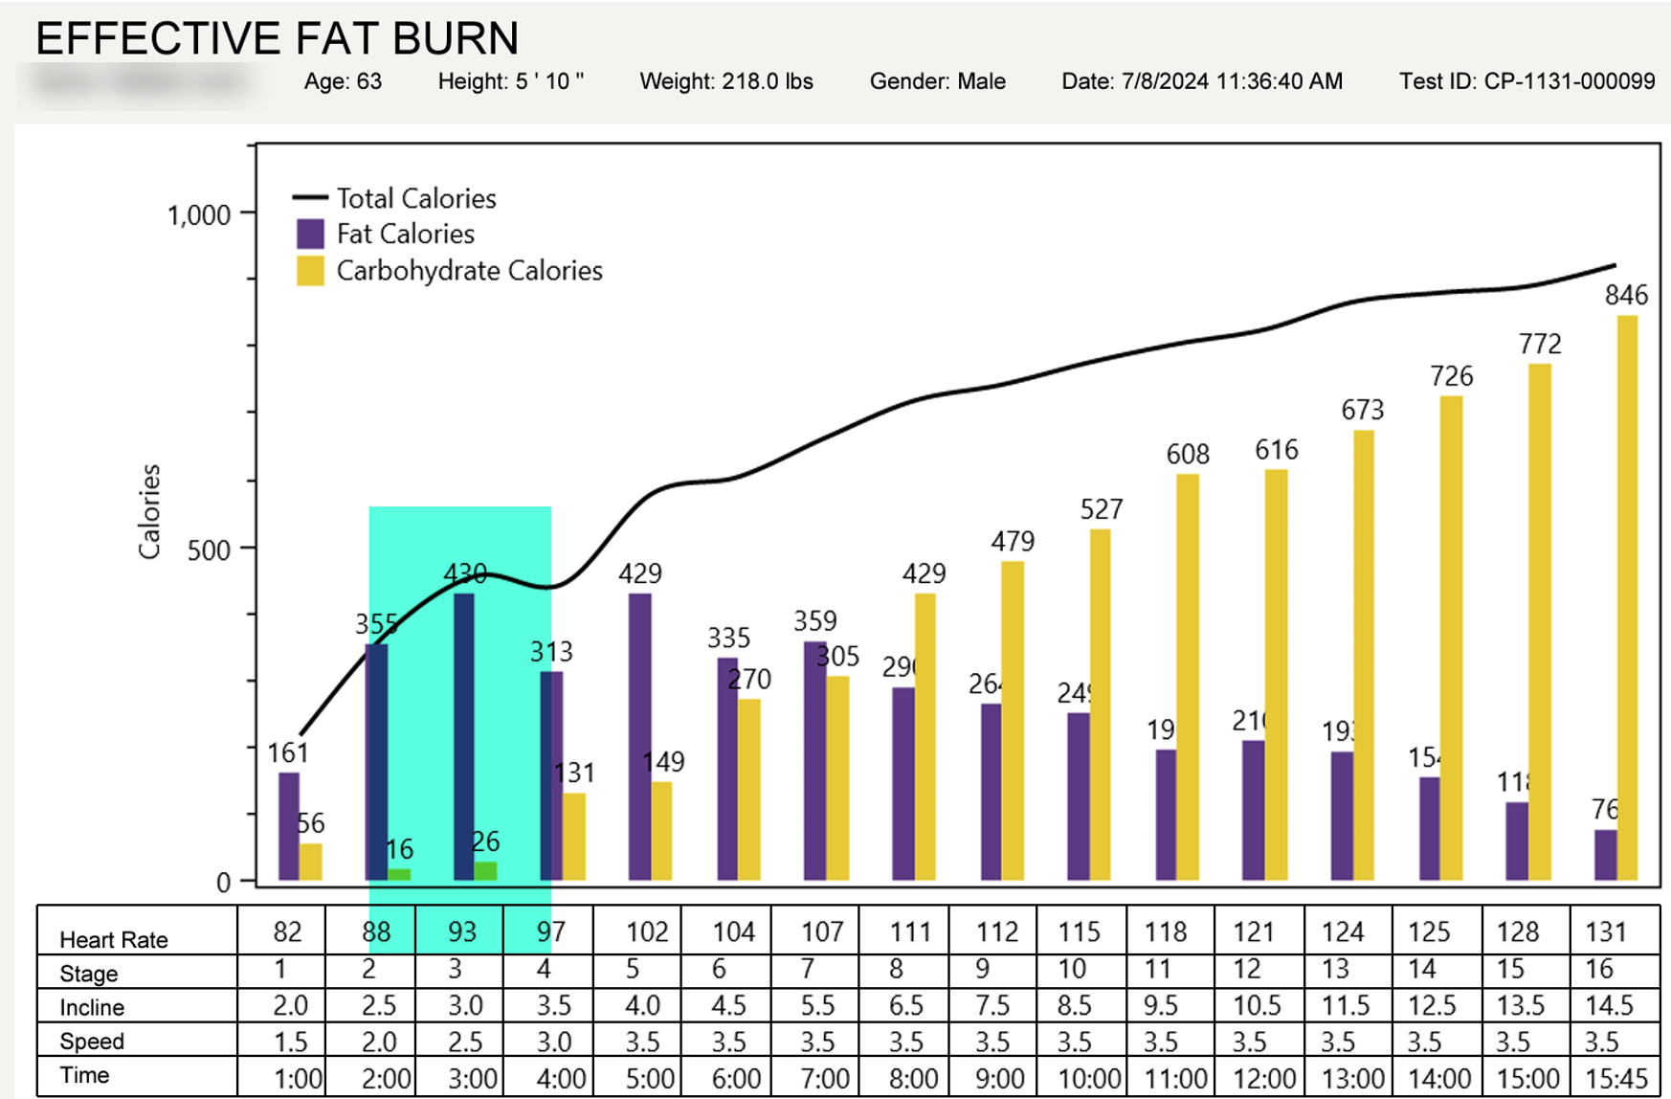
Med. Engine- Poor metabolic flexibility

Slide 9
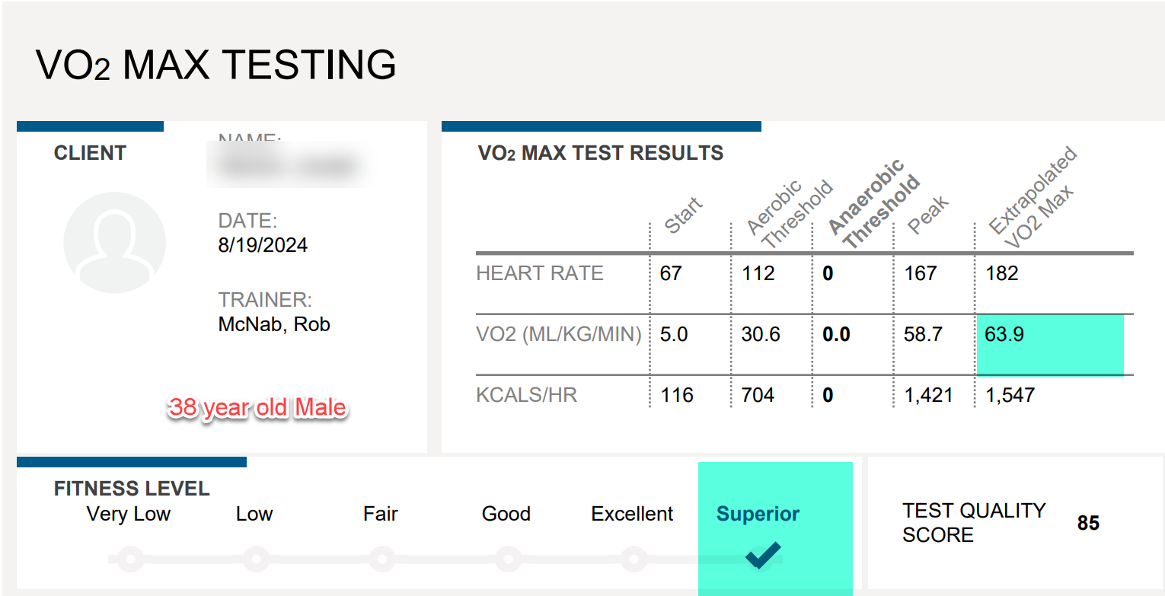
Great Engine AND Great Metabolic flexability

Slide 10
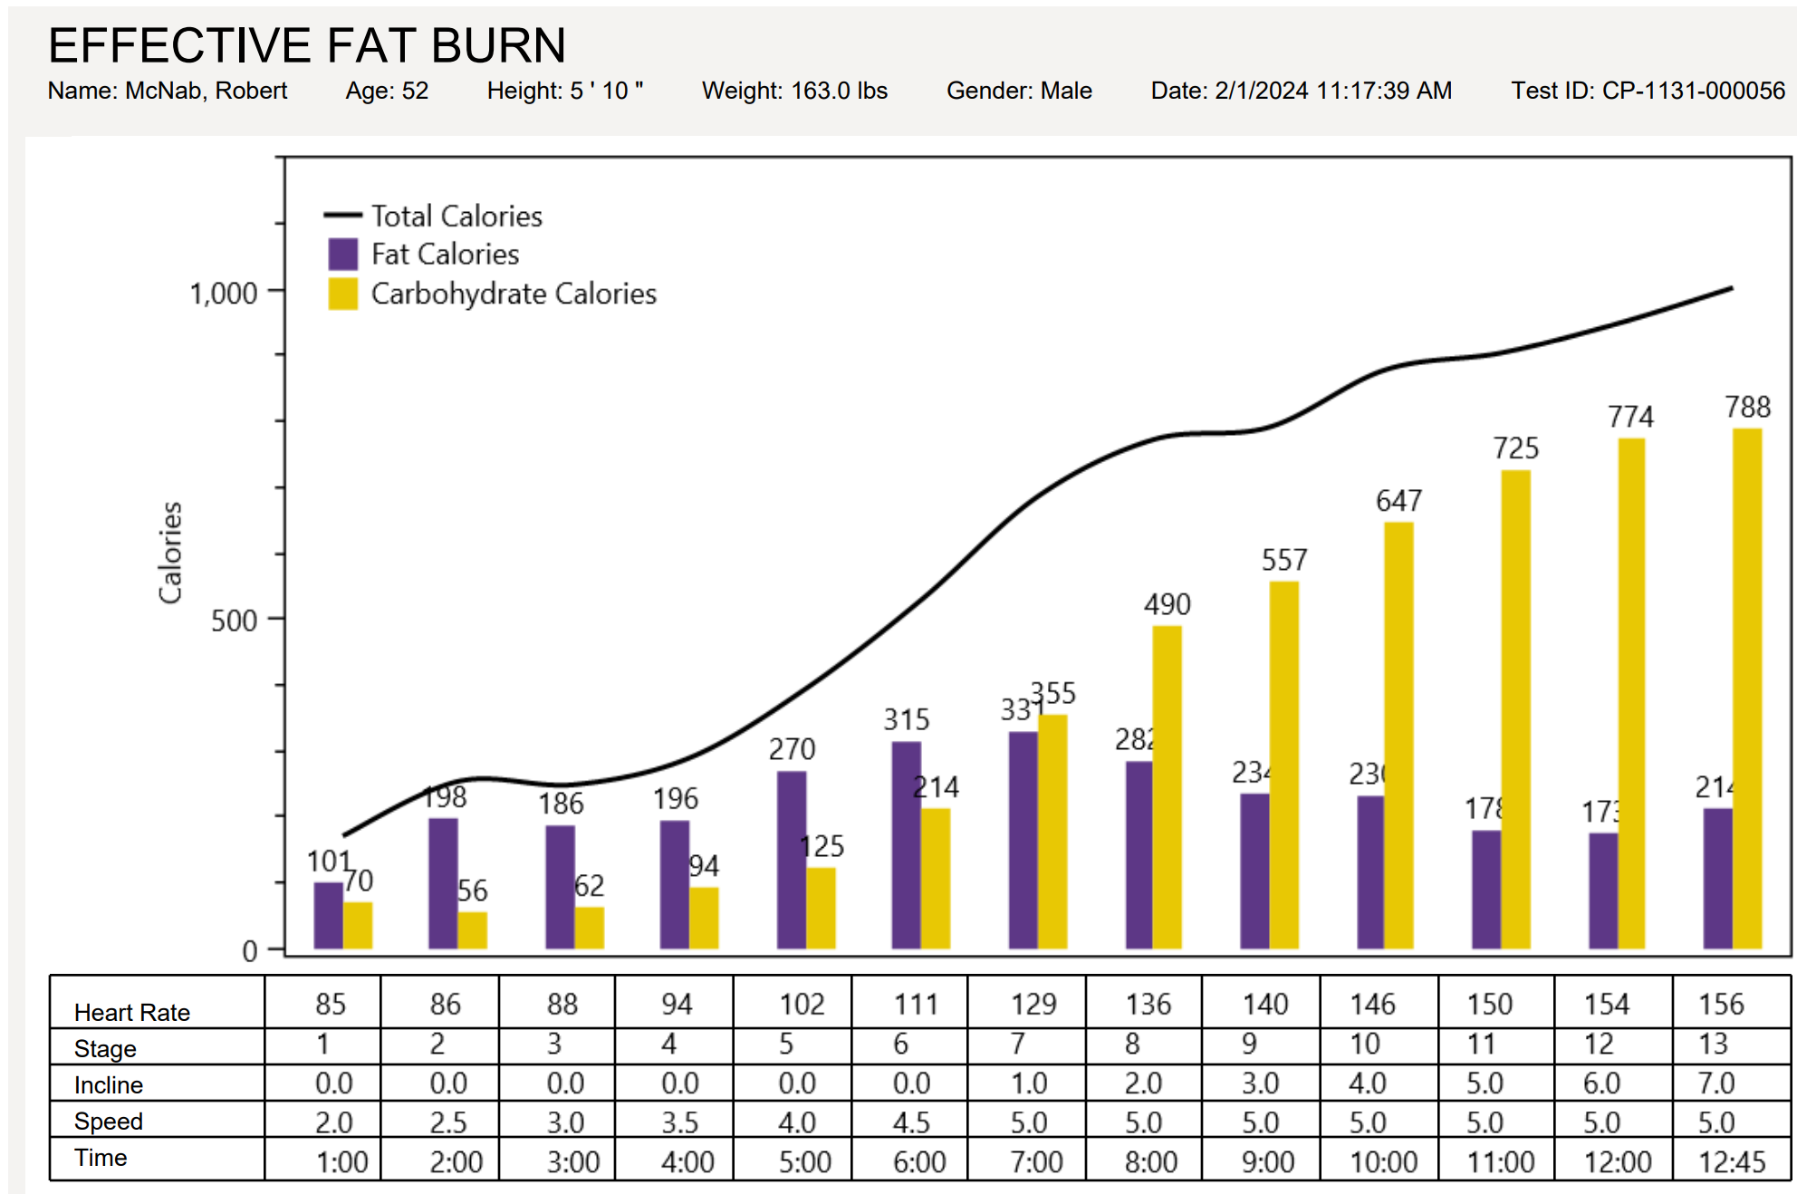
A Cautionary tale!!!!

Slide 11
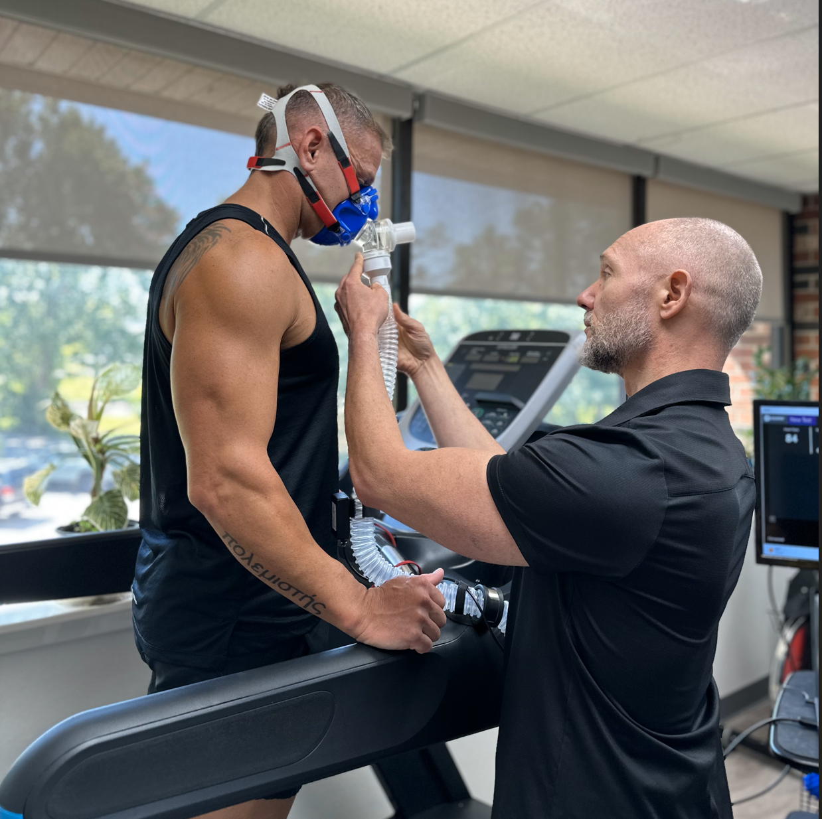
The benefits of VO2 Max Training
Improved Performance
Improved Health Span
Improved Lifespan
Improved Brain function

Slide 12
Please reach out to me if you have any questions I can help you with!
Dr. Rob McNab FACP FACOI DipABLM
McNab Wellness- Foundational Health Care
McNabWellness@gmail.com

