Slide 1
ELECTRONIC VOTING FOR CONDOMINIUMS
Notes:
Denise- Introduction

Slide 2
Who remembers…….
Notes:
Denise- Introduction

Slide 3
Traditional Methods of Voting
Notes:
Denise/Danielle

Slide 4
Ballots
Proxies
A Show of Hands

Slide 5
History of the Condominium Proxy
Proxy Voting, but no required Proxy Forms
Ministry introduces “suggested” Proxy Forms in the Regulations to the Condominium Act, 1998
Ministry introduces mandatory proxy form
Ministry introduces revised mandatory proxy form and instruction guides
Pre-2001
2001
November 2017
May 2018
Notes:
Denise

Slide 6
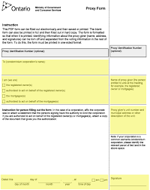
Challenges with the Proxy Form
Fraud and Manipulation
Complicated Forms
Notes:
Danielle – Fraud and Manipulation/Complicated Proxy Forms
Stephanie – Proxy Integrity

Slide 7
Electronic Proxies?
Better, but not the solution!
Notes:
Danielle – discuss electronic proxies and the issues – has anyone tried?

Slide 8
Challenges with Quorum
AGMs
25% of units in the corporation if it is the first or second attempt to hold the meeting
15% of units in the corporation if it is the third or subsequent attempt to hold a meeting
By-laws
For most by-laws, 50% plus 1 of unit owners in the corporation to vote in favour of confirming the by-law
For some by-laws, majority of unit owners at the meeting (either in person or proxy) need to vote in favour of confirming the by-law
Approval of Substantial Changes
Requires owners of at least 66 2/3% of the units in the corporation to vote in favour of approving
Notes:
Denise

Slide 9
Solution to Quorum and Proxy Challenges?
Notes:
Denise

Slide 10
ELECTRONIC VOTING
Notes:
Denise

Slide 11
What is Electronic Voting?
Introduced in November 2017 by changes to the Condominium Act, 1998
Permits votes to be cast by a recorded vote that is “indicated by telephonic or electronic means, if the by-laws so permit”
Why did the Ministry introduce this?
Accessibility
Participation from apathetic unit owners
Prevent proxy fraud and manipulation
Notes:
Denise

Slide 12
Who Votes Online?
Who votes online?
Political party leadership races
Unions
Municipalities (144 in Ontario and Nova Scotia)
Indigenous groups (especially off-reserve populations)
Expats (Switzerland, Estonia)
Buzzfeed articles
Homeowner Associations (Condominiums) in over 20 states in the United States and in Australia
Notes:
Stephanie

Slide 13
How Electronic Voting Works
Notes:
Danielle – Introduce topic and go into step 1

Slide 14
Step 1: Pass Electronic Voting By-law
Available from CondoVoter https://condovoter.com/
Lower Threshold to Pass than Other By-laws
Only requires a majority vote of those units represented in person or by proxy at an owner’s meeting, with quorum
Once by-law is passed, you do not need consent from unit owners to receive emails for e-voting
Notes:
Danielle

Slide 15
Step 2: Contact CondoVoter
Select Representative from your Condo to connect with CondoVoter (i.e. usually Manager)
CondoVoter will create:
Voting site and email with condominium corporation name
Banner for voting site/emails; and
Provide links for voter registration package
Condo to Provide CondoVoter with:
Owner’s List: Name, unit, one email address per unit
Meeting Information
Owner-Occupied Vote
Information for Ballots: Start and end dates and times
Candidate Information for Election: Bios and/or resumes, candidate disclosure form, candidate photos
Notes:
Denise

Slide 16
Step 3: Owner’s Receive an Invitation Email to E-Vote
Owner receives an email with an encrypted link.
Links only used one time and expire once meeting ends
Owners who don’t have an email address or access to a computer can be provided with a registration code to vote online
Notes:
Denise

Slide 17
The Invitation Email
Notes:
Denise

Slide 18
Step 4: E-Voting Period Begins
Voting can start as soon as the notice goes out
Owner views the ballot online and makes their selection
Multiple Ballots
Ballot may include candidate names/bios and issues to be voted on (i.e. by-laws or yes/no votes) and candidate disclosure forms
Secret Ballots
Notes:
Denise

Slide 19
Choose Vote Option – Full Ballot
Vote on 1 item and for up to 4 candidates (counts toward quorum)
Vote for quorum only (not voting on item or candidates)
Notes:
Denise

Slide 20
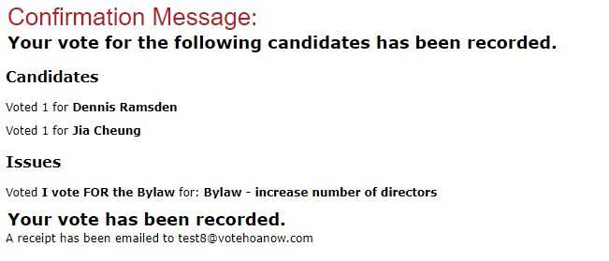
Step 4: E-Voting Period Begins
CondoVoter instantly records the vote
Owners receive confirmation onscreen and via email that their vote has been confirmed and copy of how they voted:
Notes:
Denise

Slide 21
Step 5: During the E-Voting Period
CondoVoter sends reminder emails regularly to owners until owner submits an e-vote
Weekly results sent to Manager
Condo can modify email messages to owners as needed to assist in getting responses
Notes:
Denise

Slide 22
Step 6: Closing the E-Vote
The e-voting usually closes before the meeting takes place
Final results sent to Manager when the vote closes in a Final Report
Final Report will include a detailed spreadsheet showing who voted and who did not vote, but does not show how unit owners voted.
Notes:
Denise

Slide 23
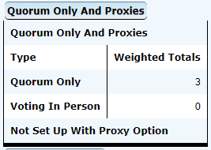
Real-Time Results
Notes:
Denise

Slide 24
Detailed Report Spreadsheets
Candidate Results – SECRET
Item Results
Who Voted
Notes:
Denise

Slide 25
Step 7: Post-Meeting
Final Report is the Ballot
Final Report is required to be kept by condominium as a record for 90 days after the meeting
Notes:
Denise

Slide 26
Privacy, Security and Other Concerns
Only owners of record can vote
No miscounted votes
Ballots will not be invalidated because of too many selections
Can only vote one time
One email address per unit.
If owner wants to vote at meeting, don’t do e-vote
Can’t withdraw or change e-vote
Notes:
Denise and Stephanie (E-Voting Integrity)

Slide 27
Online Voting Benefits and Success Stories
Save time and money
Increase participation of owners
Secure, third-party management
Real-time results with detailed reports
Achieve quorum online before the meeting
Notes:
Denise to give examples of success stories

Slide 28
Contact us
https://condovoter.com/
Telephone: 1-844-223-9334
Email: info@condovoter.com

Slide 29
Questions?

