Slide 1
Reliance.Healthcare
Brand Kit
2021

Slide 2




Logos
LOGO 1
LOGO 2
LOGO 3
For apps and .fav

Slide 3
Brand Colors
R: 21 G: 106 B:6
Hex: #156A06
R: 143 G: 207 B:133
Hex: #8FCF85
R: 233 G: 245 B:231
Hex: #E9F5E7
R: 6 G: 32 B: 2
Hex: #062002
R: 255 G: 153 B: 0
Hex: #FF9900
R: 221 G: 186 B: 151
Hex: #DDBA97

Slide 4
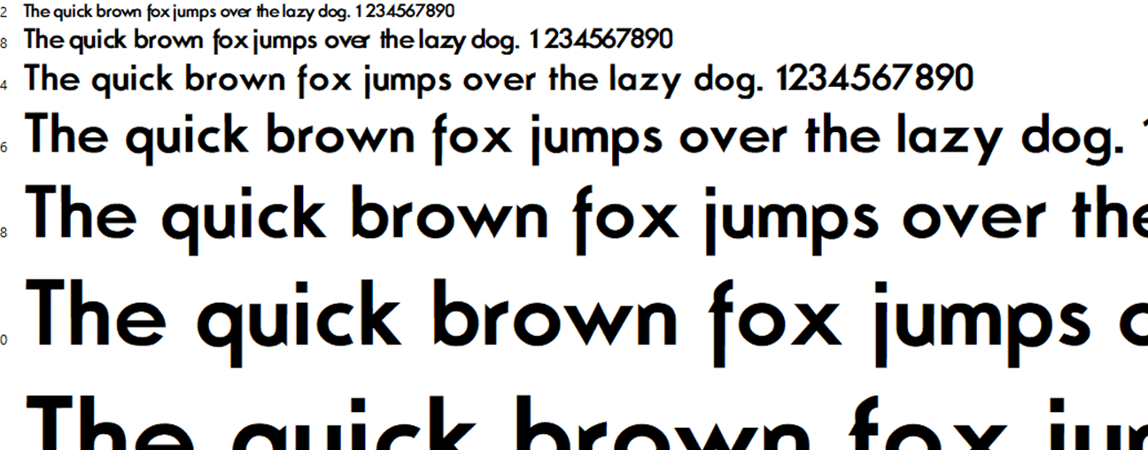
Font
N.O. Movement

