Slide 1
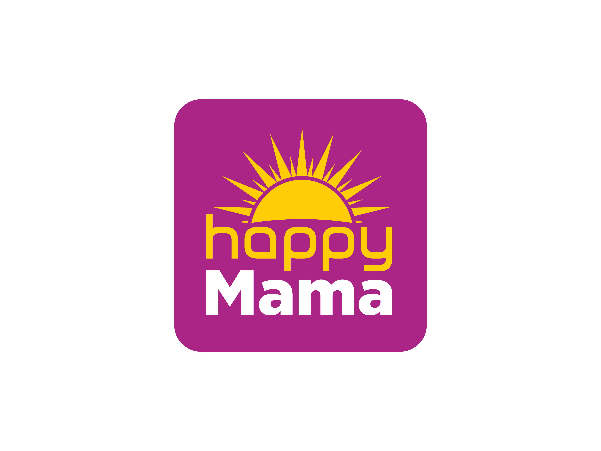
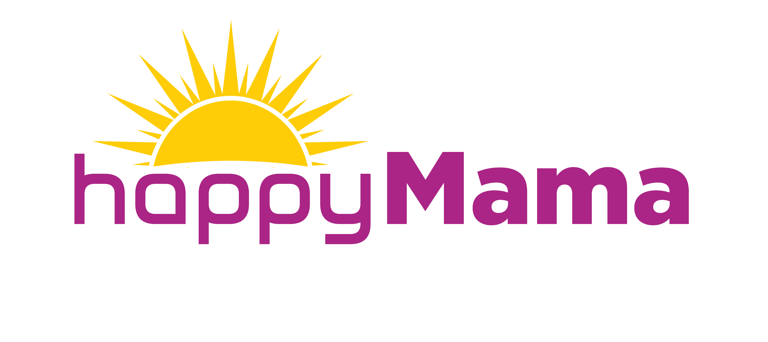
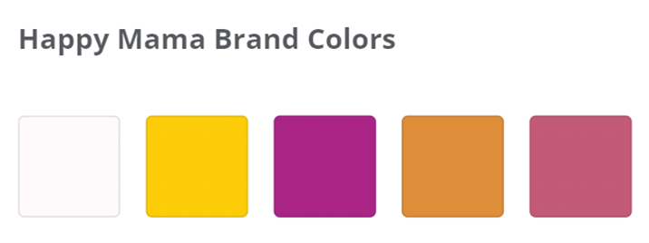
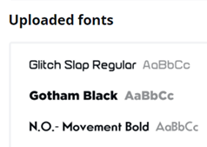

Happy Mama Brand Kit
#FEFAFC
#FDCC08
#AA2485
#DE8D38
#C35A75
Happy
Font name: Glitch Slap
Version: Version 1.00;December 12, 2017;FontCreator 11.0.0.2408 64-bit
OpenType Layout, Digitally Signed, TrueType Outlines
Mama
Font name: Gotham Black
Version: 001.000
OpenType Layout, PostScript Outlines

Slide 2
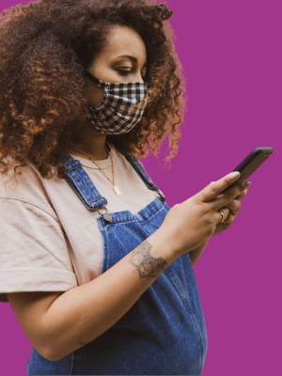


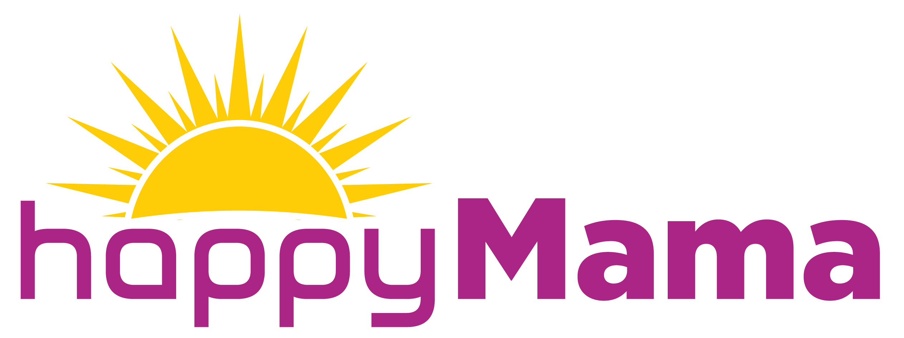
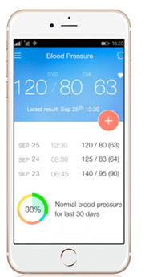
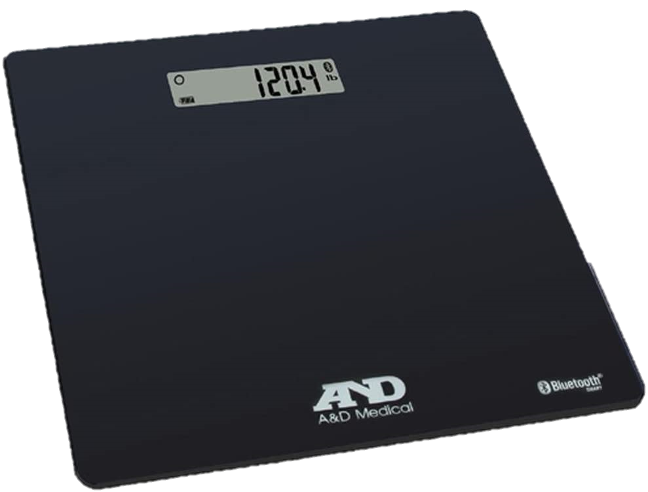
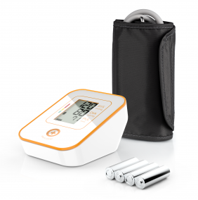
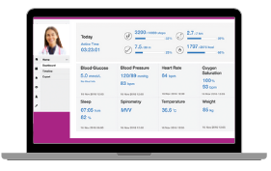
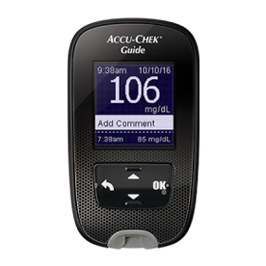

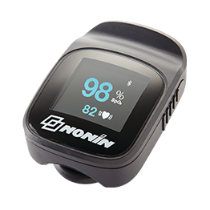

Education & Early Intervention
Connect
Communicate
Collaborate
Clinical Dashboard
KIT
Fully Interoperable Integration

