Slide 1
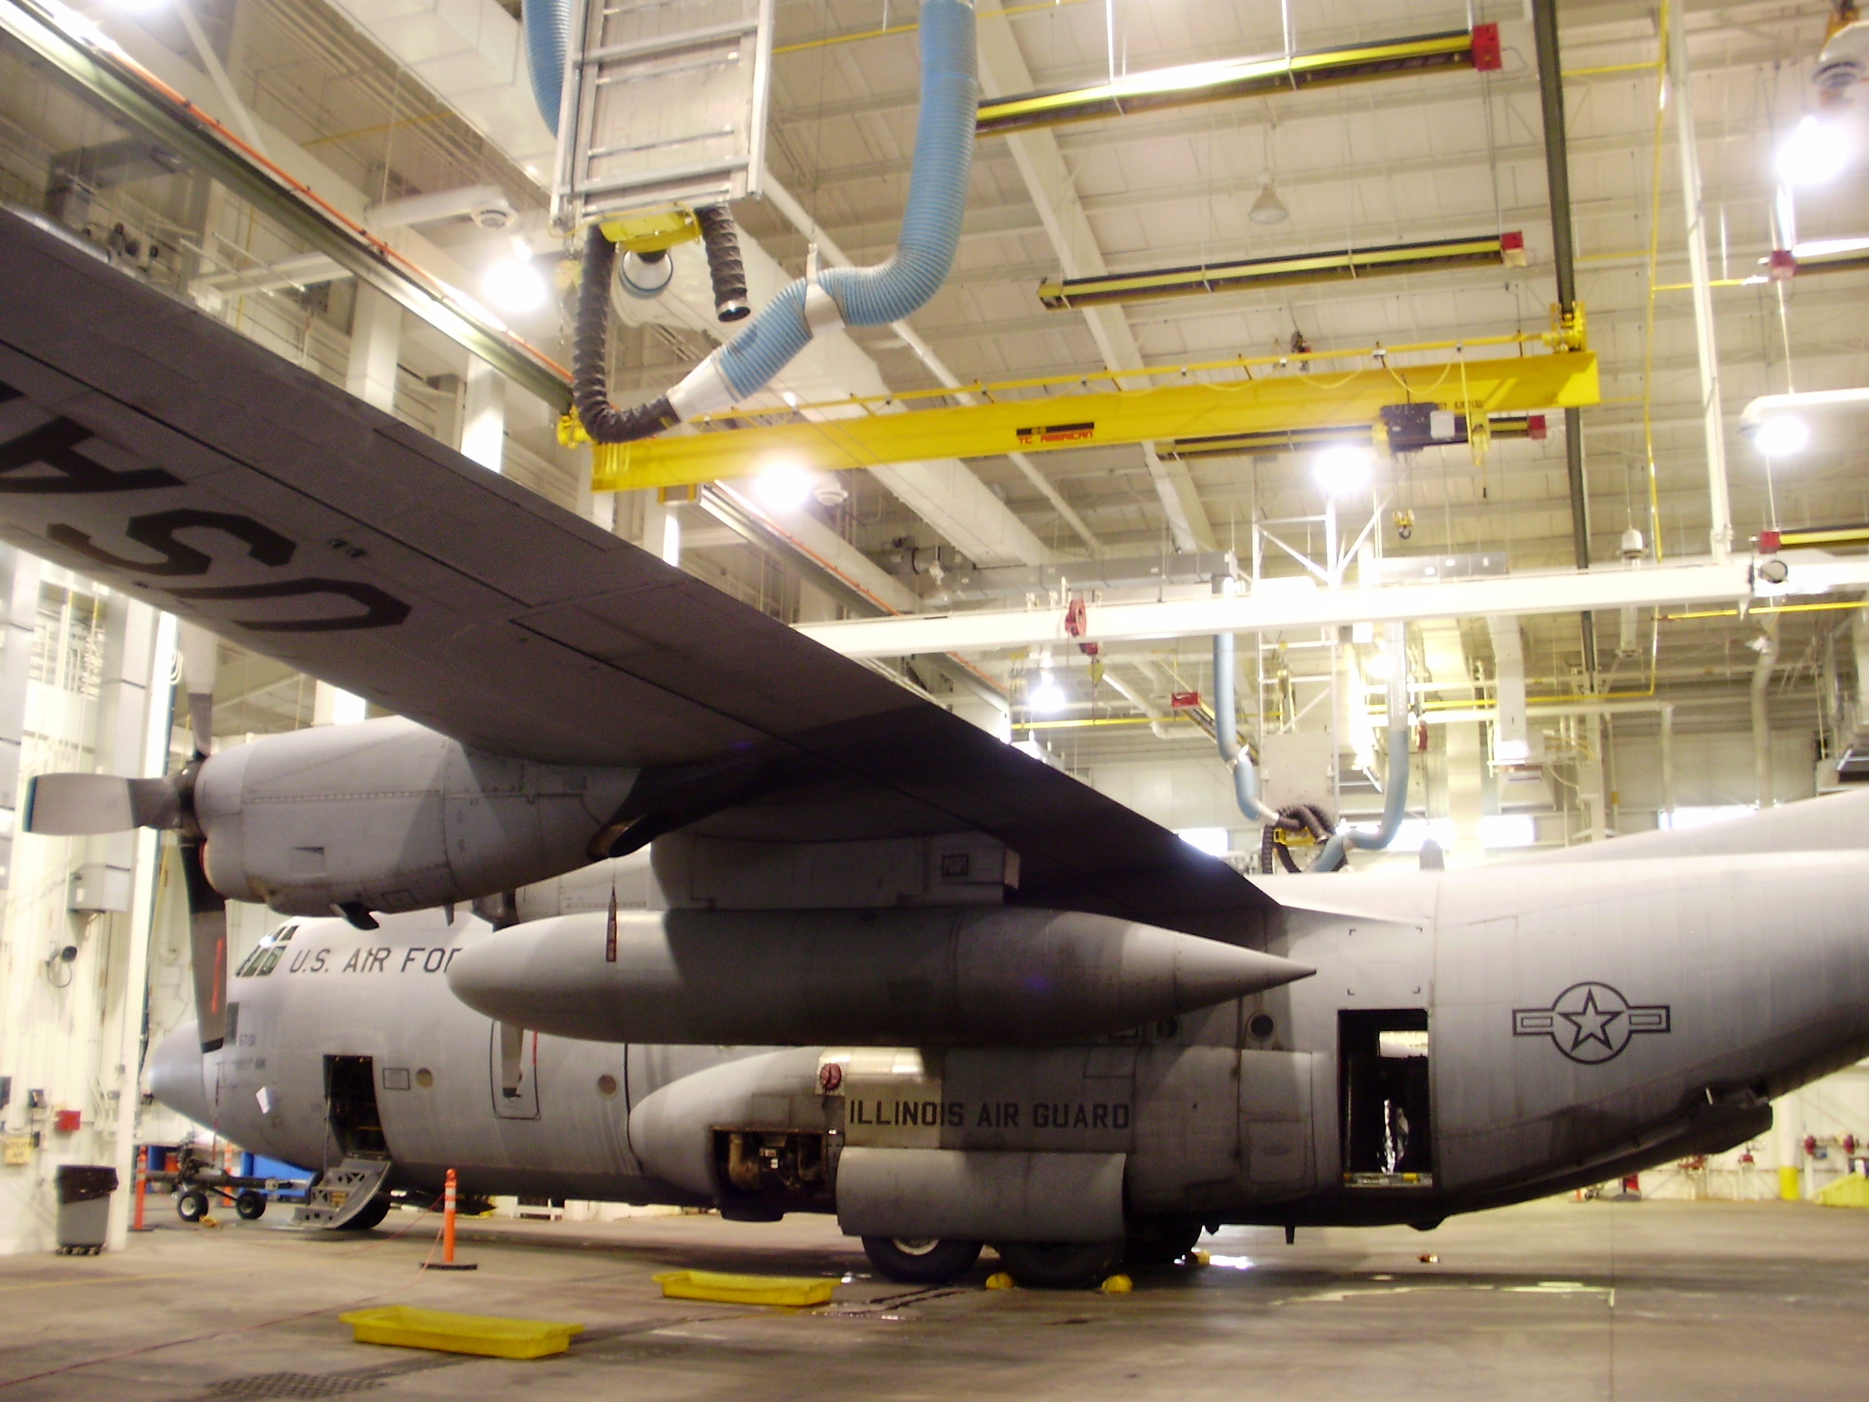



Transforming energy efficiency
in high volume buildings

Slide 2
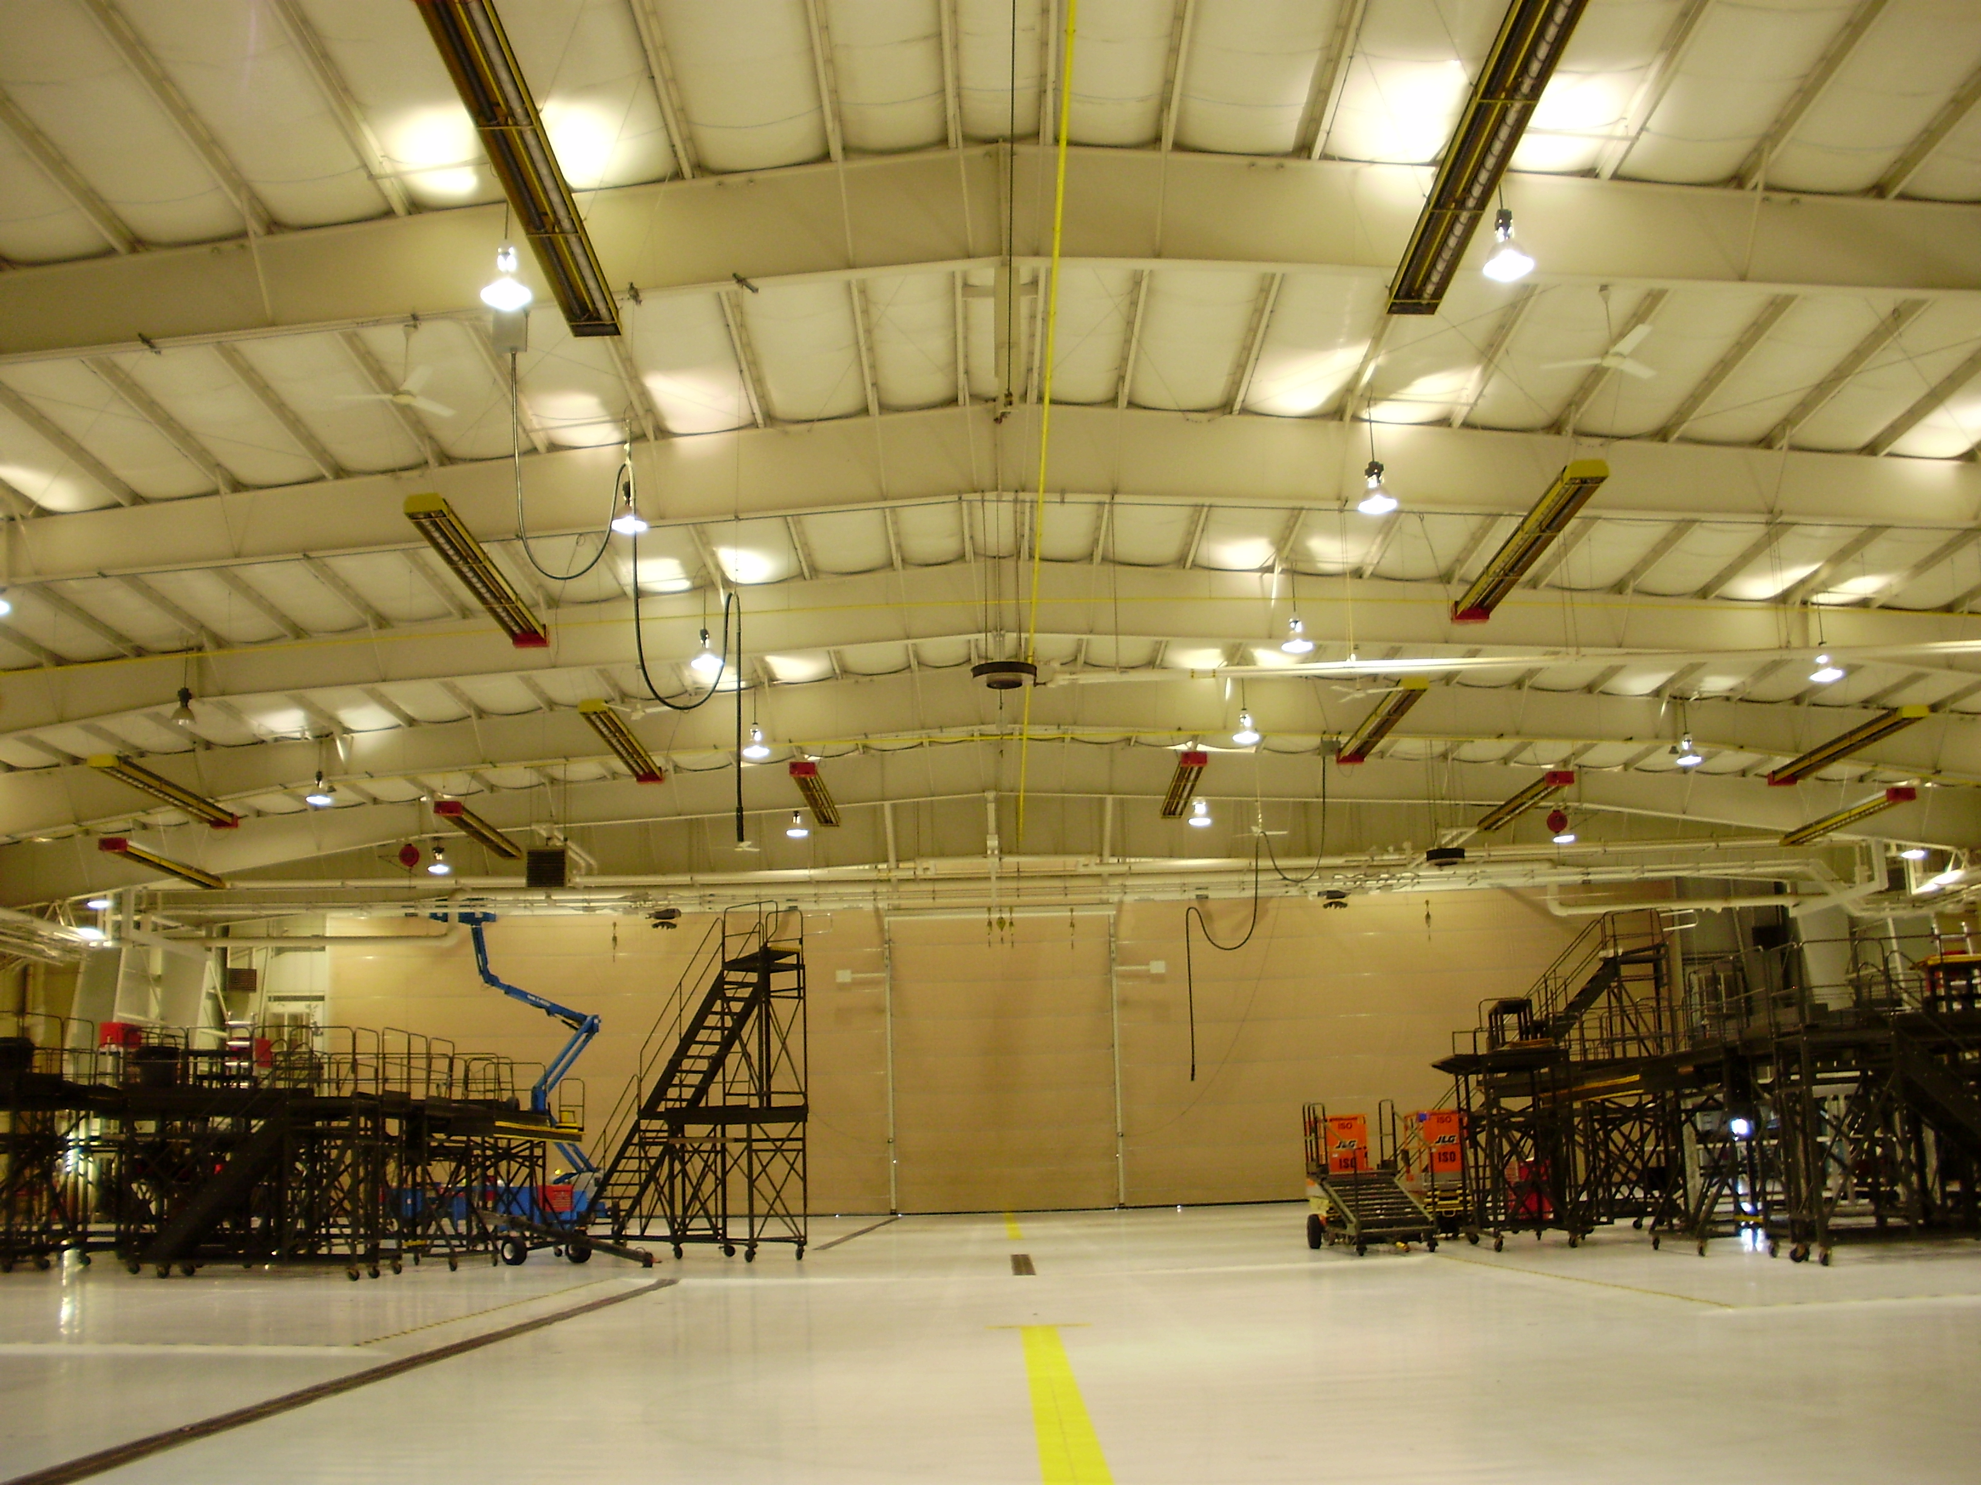
Introduction
Thermocharge has developed a breakthrough technology for saving enormous amount of energy in large buildings like:
Factories
Airports
Warehouses
Logistics Centers

Slide 3
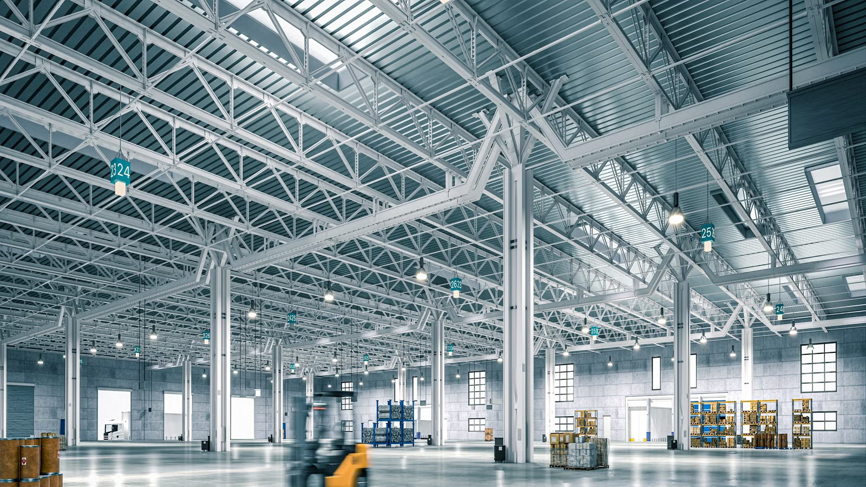
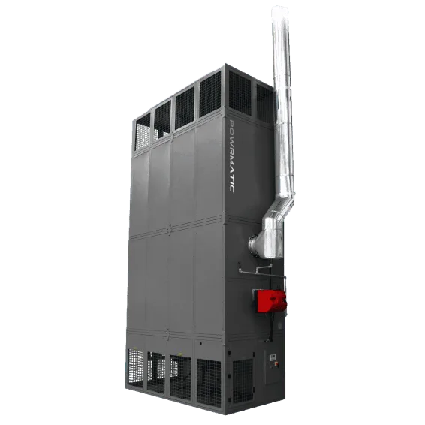
The problem of heating large buildings
Heat accumulates here
As is well known, heat rises, and standard systems do not overcome this. The roof area is usually many degrees warmer than ground level where the heating is needed. As a result, 60-80% of all heat is wasted.

Slide 4
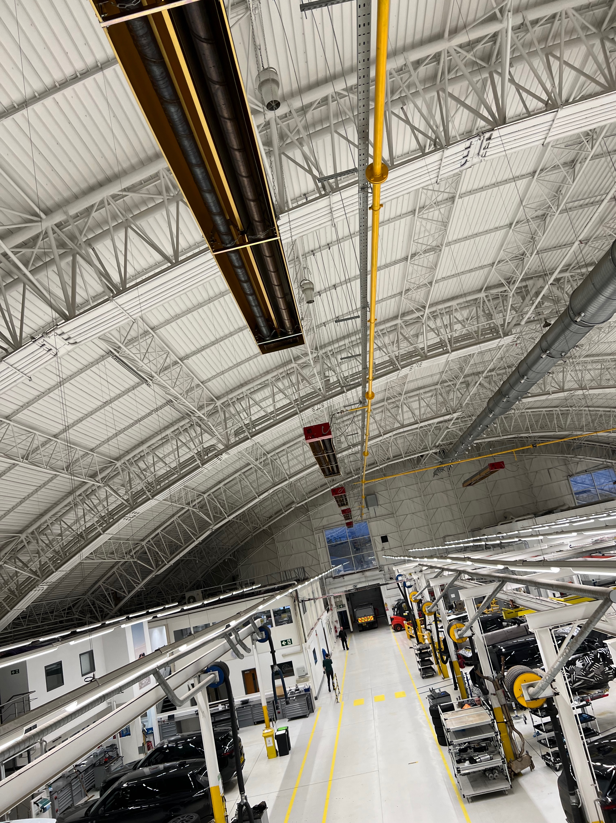
Our technology is based on high level Infra-red Style heating
A good technology – poorly executed.
Infra-red heating has the advantage of directing the radiation to the objects at ground level. However, standard IR radiators are not designed well enough for use in high-volume buildings and struggle to perform

Slide 5
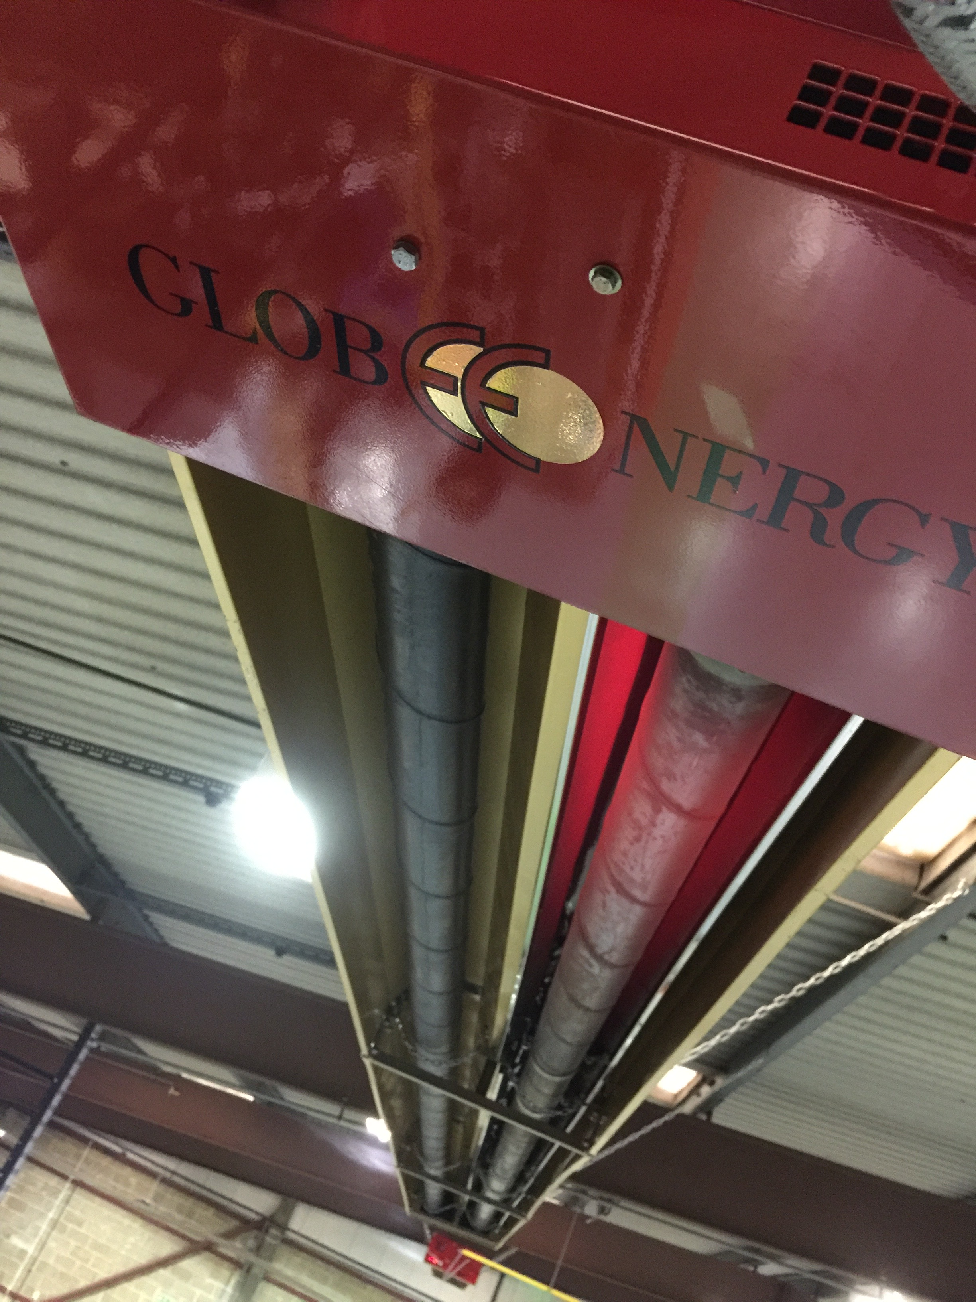
We have changed everything
Novel emitter design
Heat recycling
features
Unique Reflector shape
Unique Reflector materials
Over a development period of more than 15 years, we have completely revised every feature of the IR radiator to transform it into a highly efficient heating element.
The result 86% radiant efficient

Slide 6
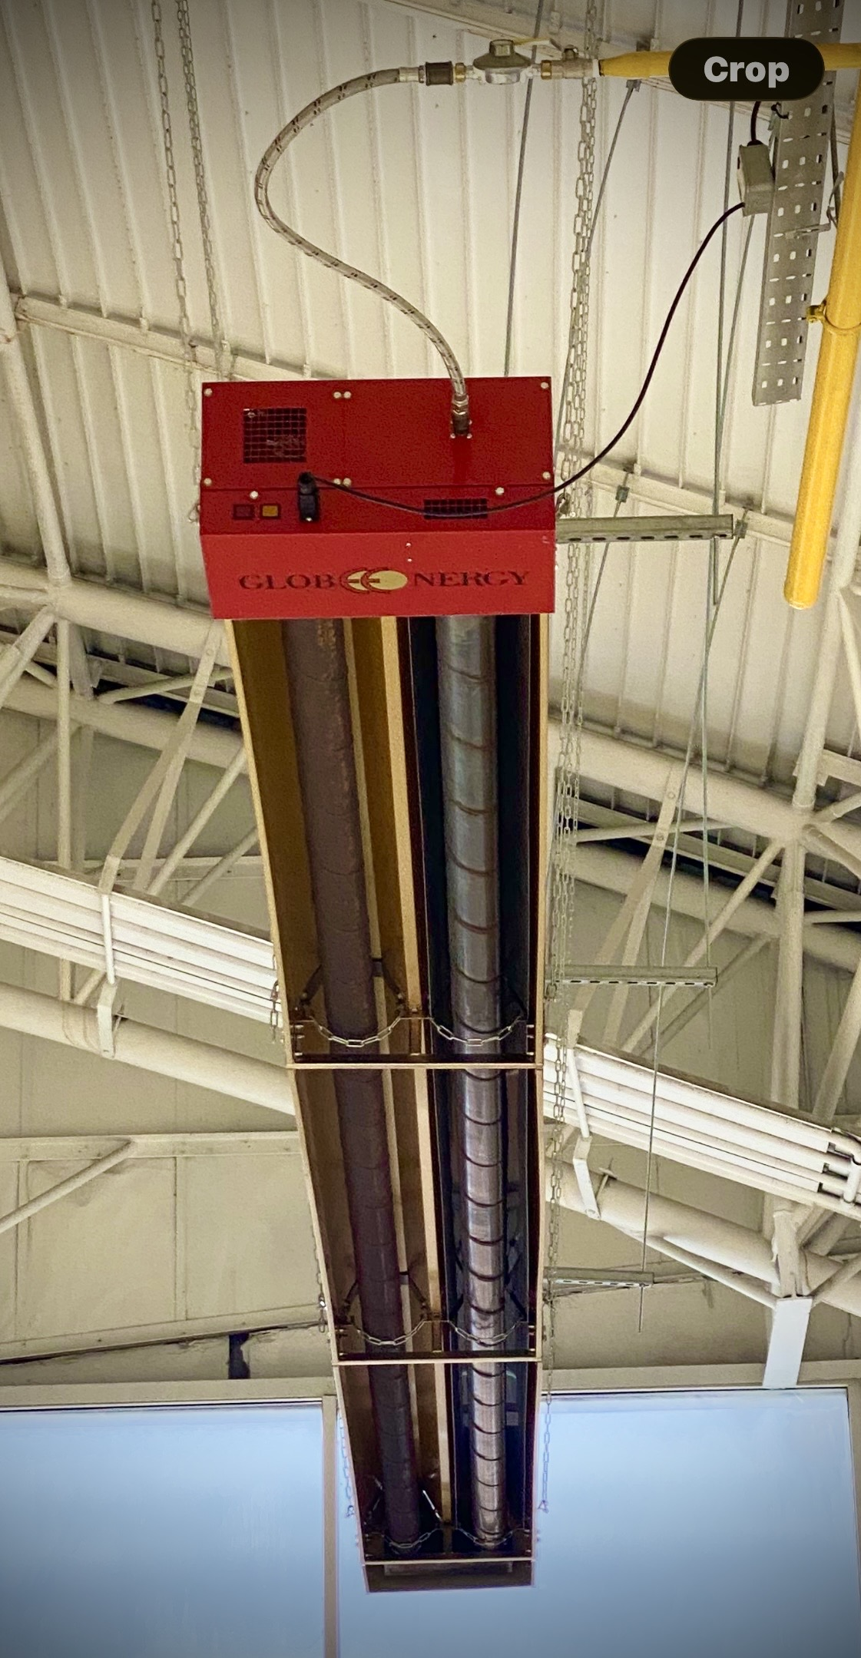
The result is a heating system which puts the heat where it is
needed and the principal problem of heat stratification disappears.
68⁰F
68⁰F

Slide 7
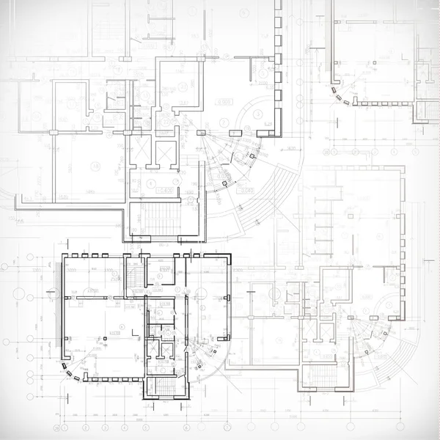
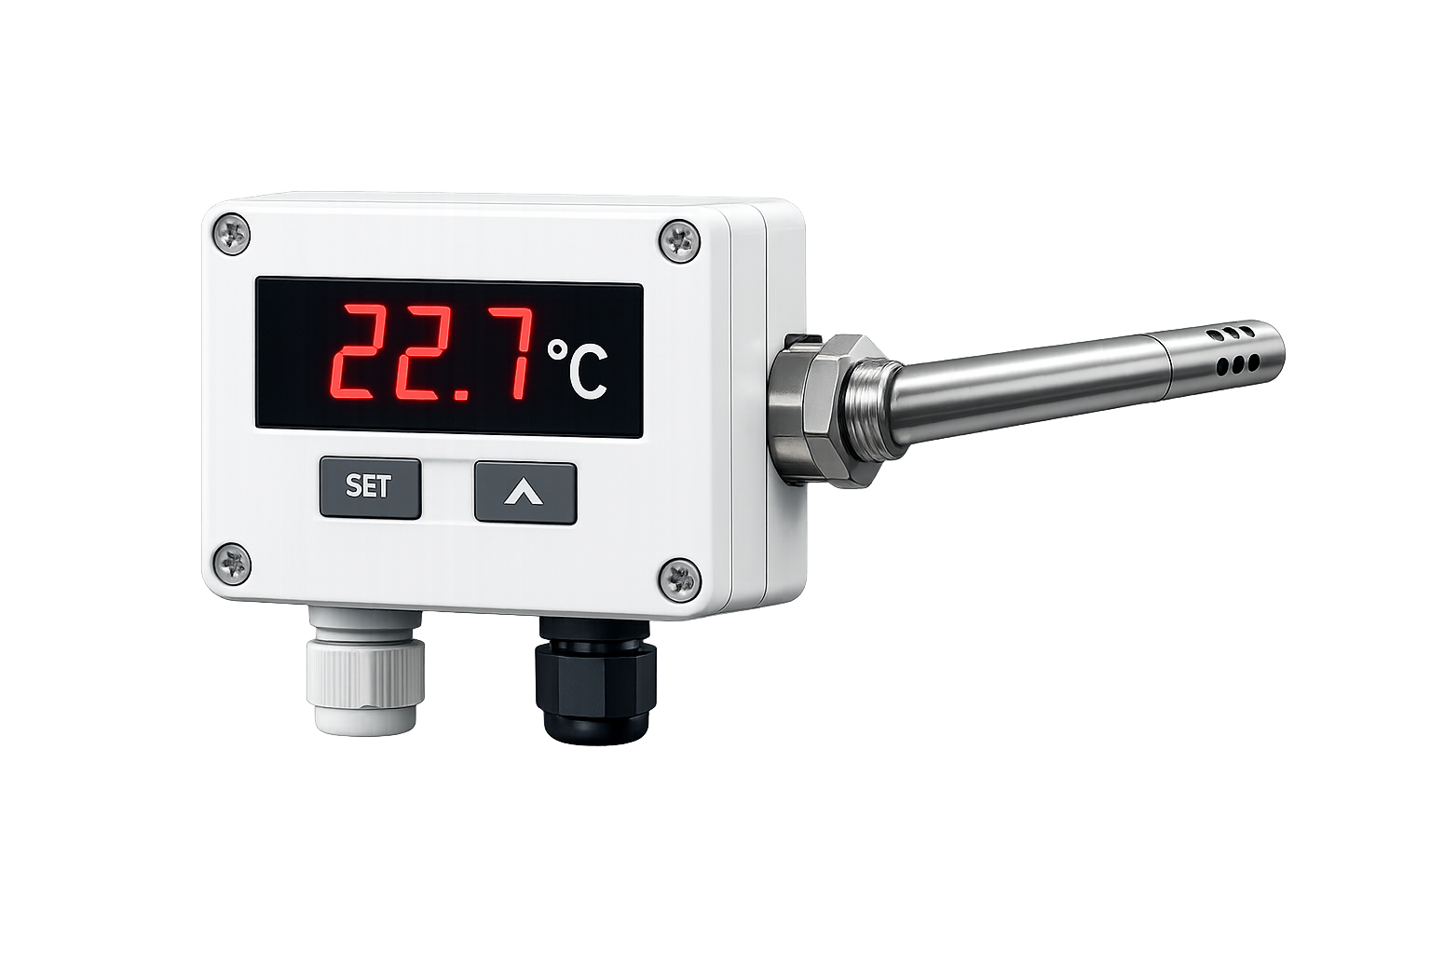
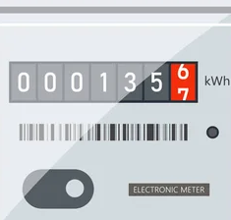
s
In addition – Sophisticated AI control.
Our TCS Thermocharge Heating Control System divides up the building into zones which can each be heated and ventilated according to work schedules and temperature requirements. Sensors pick up data and Ai makes changes as needed. The data goes through to the cloud and fine-tunes the system, foresee maintenance time and schedule servicing effectively.
2
1
4
3
Temperature sensors placed at strategic places both inside and outside the building
Energy meters

Slide 8
More on tech.
Thermocharge tech is based on a deep understanding of physics, engineering and architecture plus years of practical experimentation In particular there are 3 areas of technical expertise which has enabled us to achieve our phenomenal results
Radiation physics
Optimum temperature balancing radiation against convection. This is a very precise tradeoff connecting an object's temperature to its radioactive output.
Result
All heaters are 100% efficient at converting chemical energy into heat, but ours is 3x better at getting the heat where we want it, in a way that makes it most useful for the human occupants and materials.
Advanced metallurgy
Allows thermal energy to be emitted without melting the device.
Fluid dynamics
Adjusting the gas flow such that the temperature is forced downwards.

Slide 9
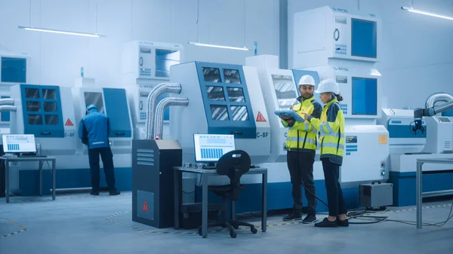
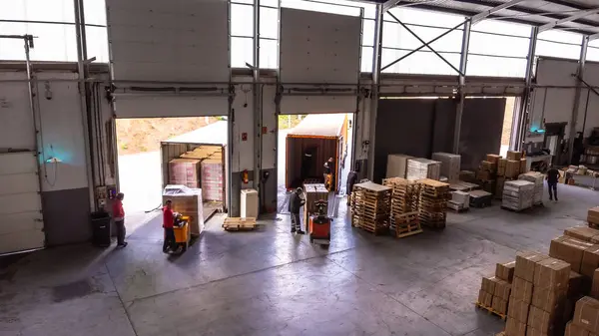
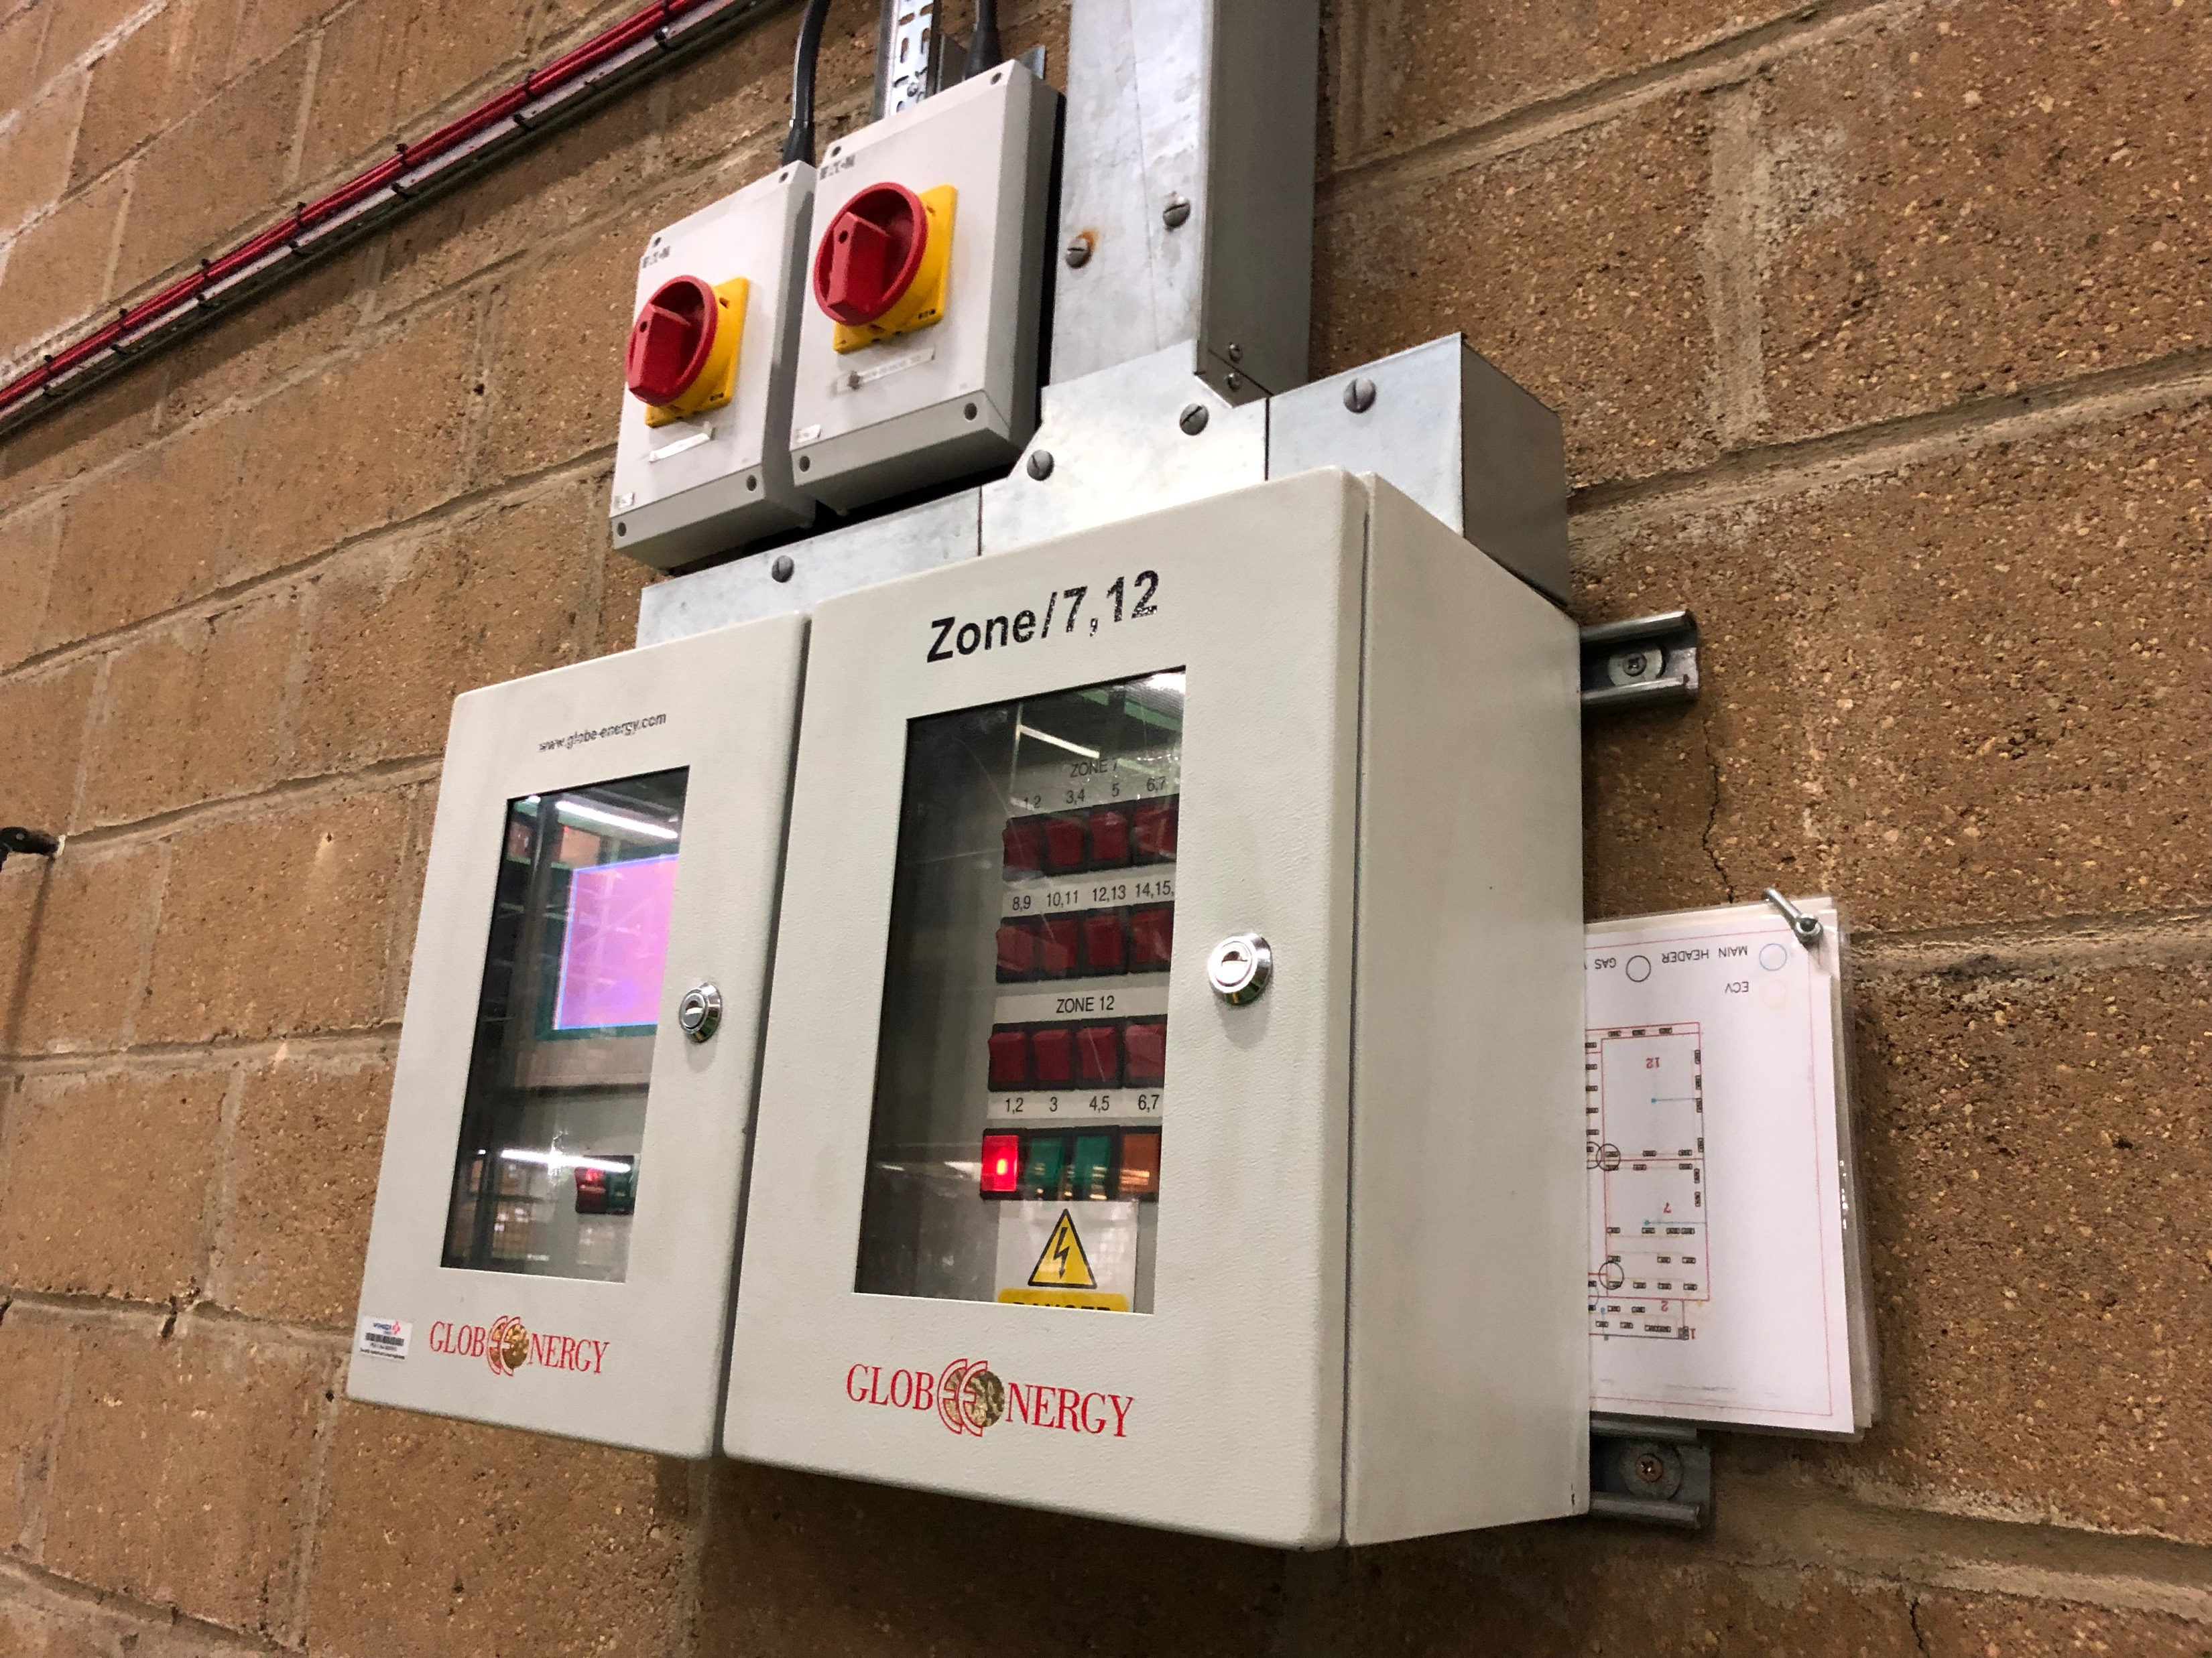
Side Benefits
Cleaner air. Less dust and pollution. Less CO2 in the building.
Resulting in better working conditions
Very fast heat-up and recovery time.
No need to pre-heat building before occupancy, super fast heat recovery if a door has to be opened
Resilient . Small zone design - a single failure doesn't freeze the whole warehouse and repairs and servicing can be done without whole-system downtime

Slide 10

Size of our market - heating high (HV) volume buildings
We estimate $5.0billion is spent on heating and ventilation energy of large buildings in North America alone every year.
We can save at least 50% or $2.5 billion in energy costs
Target – 10% of market in 4 years
- €60 million ARR . Company value €0.3billion
TAM
$5.0b
SAM
$2.5b
SOM
$250m
This amounts to 48 TWh of gas per year &
9.8 million tonnes of CO₂ emissions avoided annually

Slide 11





Some of our successful installations
Case Studies
Thermocharge has been installed at a range of industrial sites, resulting in significate energy savings ranging from 75-87% including
Mercedes Benz
200 Thermochargers
Ford Engine Plant
500 Thermochargers
Jaguar Land Rover
20 Thermocharger Demo
McIntire Air Force Base in the United States 30 Thermochargers Demo
Mettis Aerospace
200 Thermochargers
Vauxhall/GM
30 Thermocharger Demo

Slide 12
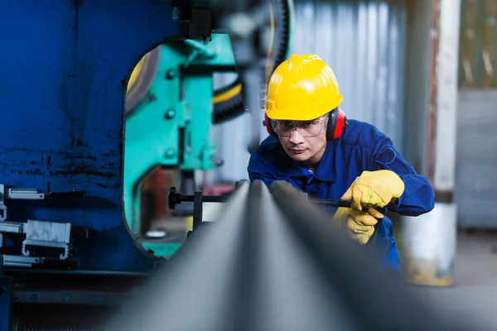

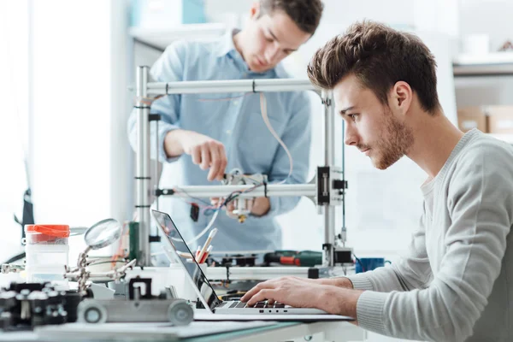
Our unusual history
Founders Product development University
Founder Retirement
1980’s
2024
1980-2024
2026
Continued Development, System manufacture and sales
New Beginning, New Management and Latest Developments

Slide 13
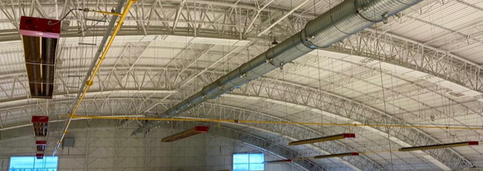
Comparing our tech with competition
An example Building
Jaguar-Landrover
Cost of the heating elements, pipework and cabling for Gas and Electrical Systems, all assembly, installation, labor, design, and commissioning will cost for a competitor system like Powermatic at around $300,000.
Their solution would Retail at around $600,000. Our total cost would be a little at around $650,000.
The big difference is in the Energy consumption: Thermocharge Yearly Running Cost $98,000
Powermatic Yearly Running Cost $500,000
A saving of more than 80%

Slide 14



Note on competitive systems
The most advanced competitive systems use something called high-velocity warm air technology, which is based on a burner and fan system with extensive ducting.
We are very familiar with the pricing , costing, and energy efficiency of this technology.

Slide 15

Special Business Models
The enormous energy savings allow for attractive Zero risk business models
Retrofit
We install System Free of upfront charge- Zero customer capex
Customer pays us 70% of the previous energy and maintenance costs
Contracts are upwards of 10 years. Monthly payments includes system running, service and maintenance. Customer saves 30% costs and 70-80% emissions
New build
We sell at cost – half the price of standard price list
Customer pays monthly fee for energy, service and maintenance
Building owner sells/rents low emissions building
Customer saves 50% on typical costs and 70-80% on typical emissions

Slide 16

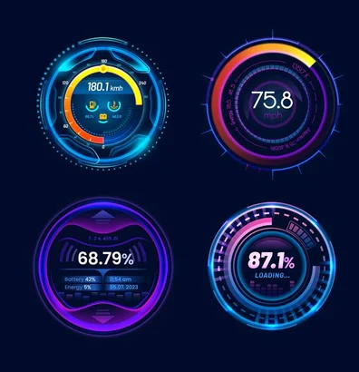
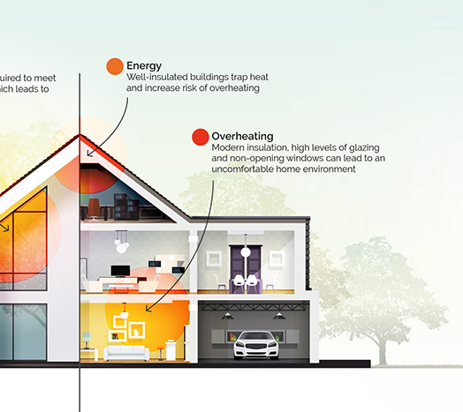
Our go-to-market
We will partner with heating system contractors and energy suppliers
We will be approaching new customers, our partners customers and customers who express interest
We will have a US Launch with strong positive National presence
We take sales materials seriously: good web site, good explanatory documents – case studies and diagrams.
We use our TDS
Thermocharge Design System which enables quick quotations for the customer buildings allowing faster roll out
We have simulation software showing the positioning of our heaters and the temperature distribution, taking into account any previous building heating issues or concerns

Slide 17
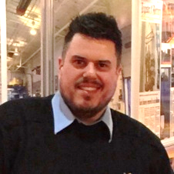
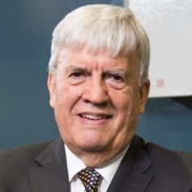
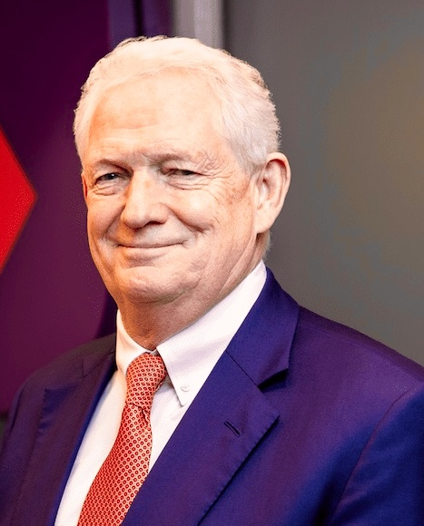
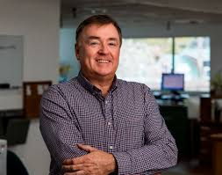

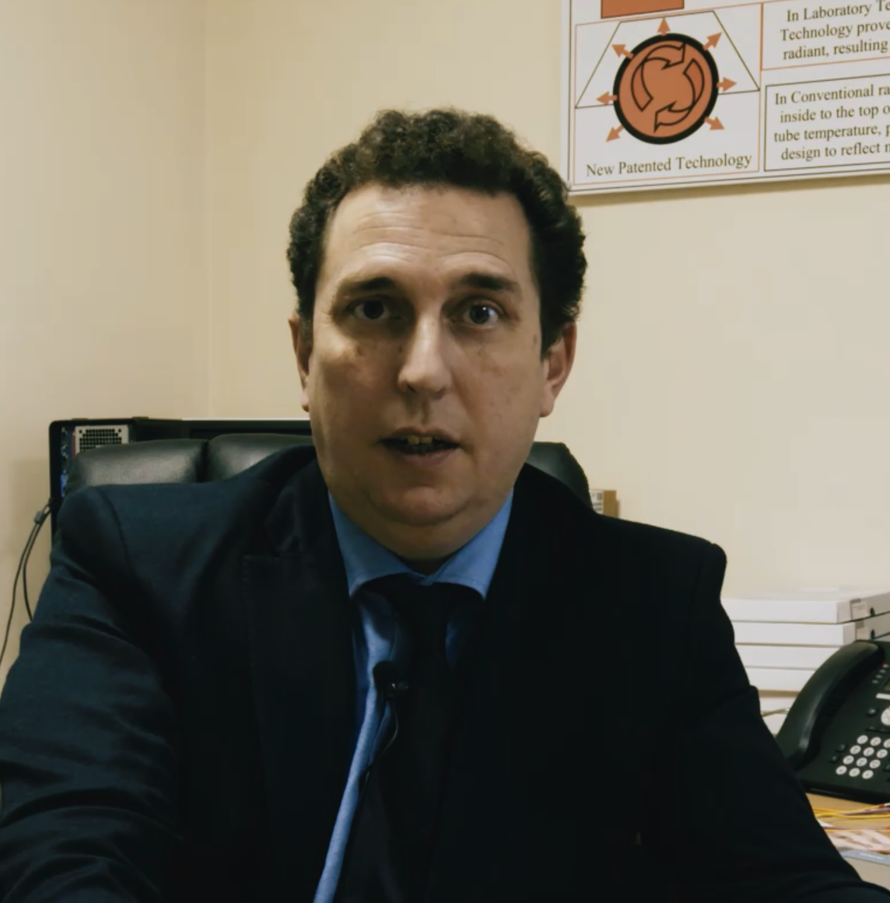
Management Team
Expert support
The company is led by it CEO Davy Jones. He is well versed in all aspects of the business from Thermocharge design, development to company leadership. He is a highly skilled engineer and Project Manager. He has vast experience in procuring and leading teams installing successful multi million dollar energy saving systems.
The original inventor, David Jones, devoted
many years to developing and refining the
technology . A lifelong inventor and leader in the
field of innovative technology for energy saving,
holding vast worldwide experience in developing,
designing and installing award winning systems.
Sales and marketing is driven by Doug Twyford. Holding huge experience in leading several energy companies, driving Global Sales and development. He holds over 35 years experience in developing and overseeing growth in business to scale them to their full potential.
Marketing and strategic support is also
provided by Richard Haythornthwaite, a
highly successful corporate executive. He
has a longstanding interest in the technology,
and continues to provide support the company
Scientific support is provided by Richard
Neill, lecturer in Natural Sciences at
Cambridge. He is not only supportive of the technology
but passionate about it and will contribute to future
product development.
System control development is lead by Justin Jones,
with experience of unique systems developed to
allow the Thermocharge technology to perform to its
full potential. Justin is at the forefront of energy saving
software

Slide 18
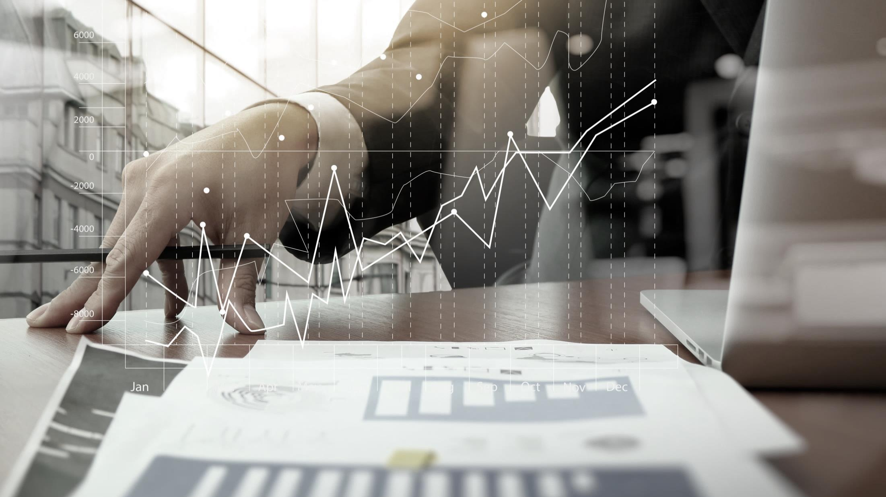
Sales growth
# of customers and revenues over
Year | 2027 | 2028 | 2029 | 2037
# of sales USA | 1 | 5 | 10 | 100
Revenues $m | 5.0 | 25.0 | 50.0 | 500.0
Average Service revenue per site - $6 million over 10 years

Slide 19
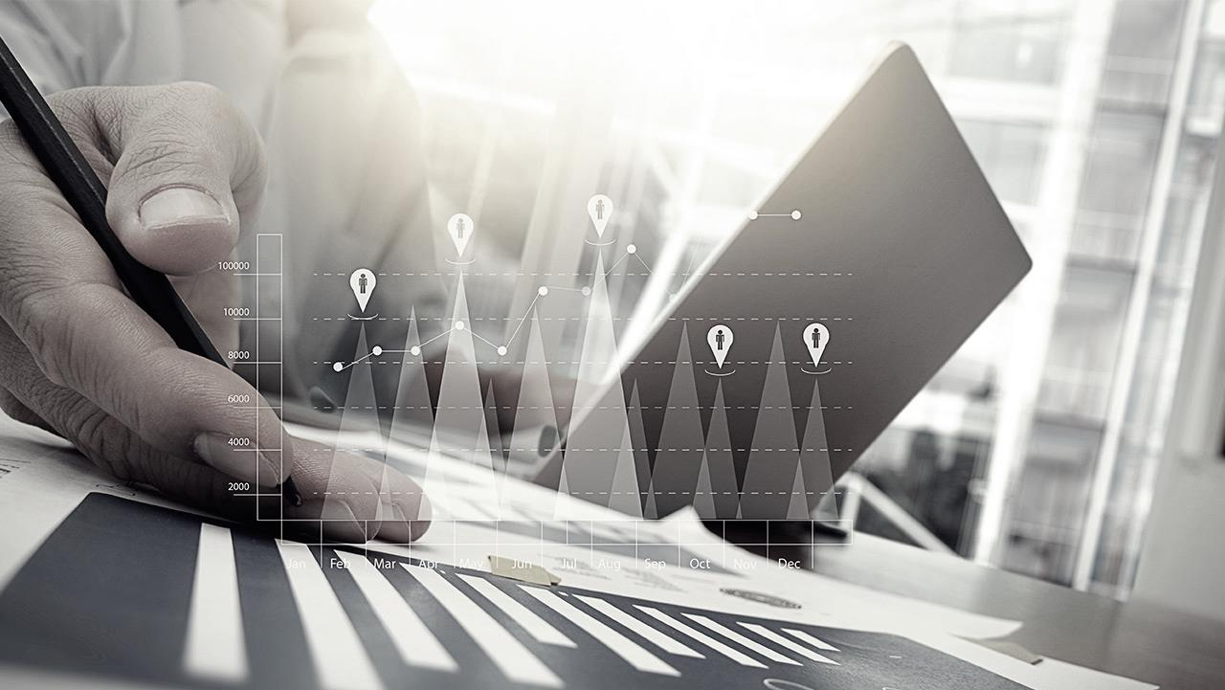
Some Planning
Total $5m
Investment needed
Production
Installs
Production set-up
Salaries
Overhead
Regulation
Marketing
Development
Timetable
Month | 1 | 2 | 3 | 4 | 5 | 6 | 7 | 8 | 9 | 10 | 11 | 12 | 13 | 14 | 15 | 16 | 17 | 18
Production set-up
Regulation
Production
Sales and marketing
Install

Slide 20
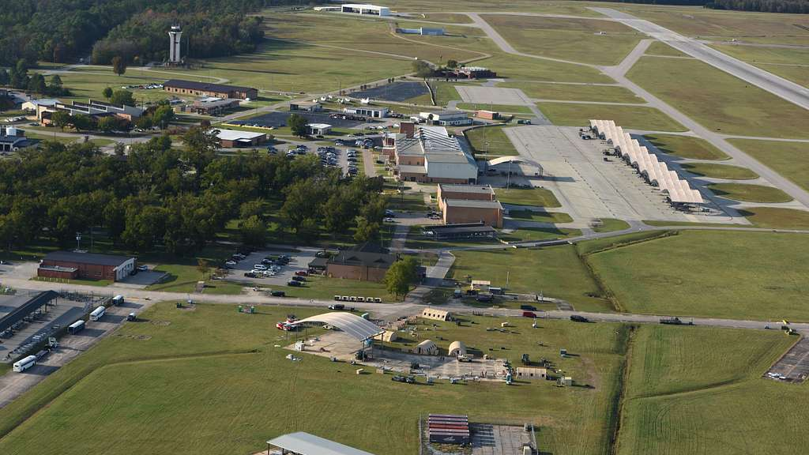
Notes on the market:
USA Market size: The Accessible Market is Large
Our target building size - Buildings 50,000 to 1.5 million Square feet
USA –350,000 target Buildings including Small bay, Mid size and Big box
The Demand for High Efficiency Energy-Saving Systems is currently at a an all-time high in The USA
Due to pressure on cost, sustainability and environmental responsibility
However, there is nothing of any real saving value available for the high volume building sector, most new heating options are based on 1950’s technology. Other options such as electricity are far too costly to put into practice with running costs 10 times of natural gas heating high volume buildings

Slide 21
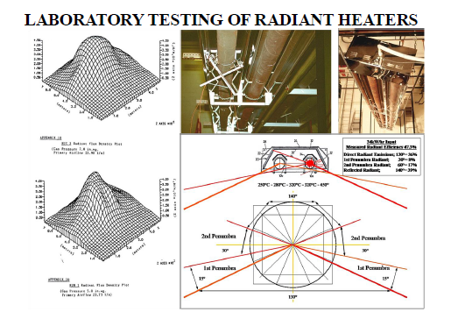
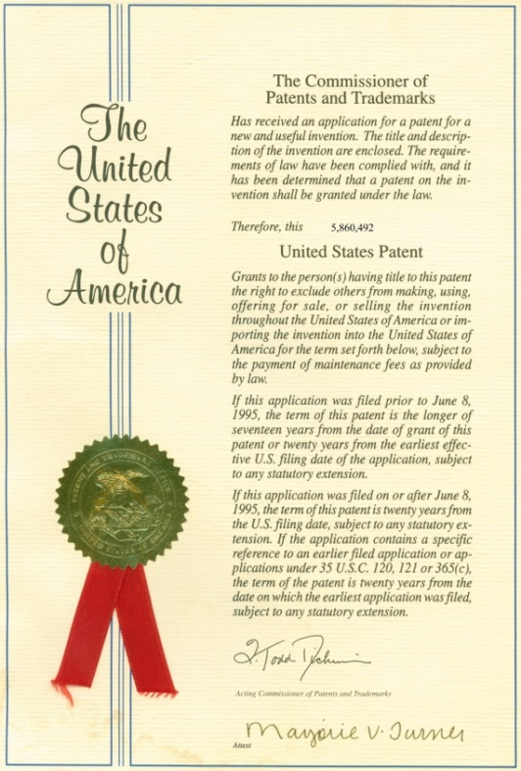
Patented and fully tested
During the last 4 years we have been awarded 2 patents
https://patents.google.com/patent/US11486584B2/en?oq=US+11%2c486%2c584+B2
https://patents.google.com/patent/US11022301B2/en?oq=US+11%2c022%2c301+B2

