Slide 1
Awqaf Properties Investment Fund (APIF)
A Model for Sustainable Development and Infrastructure Finance
Islamic Financial Sector Development Department

Slide 2
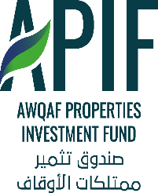

Background on Awqaf
The Awqaf Properties Investment Fund (APIF)
Relevance of APIF to Infrastructure Finance
Financial Resources
Project Cycle
Performance of APIF Since Inception
Success Stories
Areas of Engagement with APIF

Slide 3
I. Background on Awqaf
      Waqf (plural: Awqaf) is defined as a perpetual endowment.
      Creating a waqf involves setting aside certain assets and preserving them so that benefits continuously flow to the beneficiaries
      The corpus (endowed asset) of a waqf can be kind (e.g. real estate, shares etc.) or cash
      Major historical role in supporting Muslim World’s social infrastructure and major contemporary role in the West (e.g. Harvard’s endowment at approx. USD 40 billion)
      Religious and philanthropic incentives to give – capturing private savings and transmitting inter-generationally as social wealth

Slide 4
II. The Awqaf Properties Investment Fund (APIF)
      Operationalizing Awqaf support via an Impact Investment Fund
      Uses an Islamic mode of financing to promote a form of Islamic social finance – Awqaf (Islamic Charitable Endowments)
      Commenced operations in 2001
      Started providing financing for the development of idle Waqf lands
      Has become a unique fund/development model in MDBs
      Helps achieve financial sustainability through financing the establishment of charitable endowments (Awqaf Ministries, NGOs, etc.) (2nd-degree development)

Slide 5
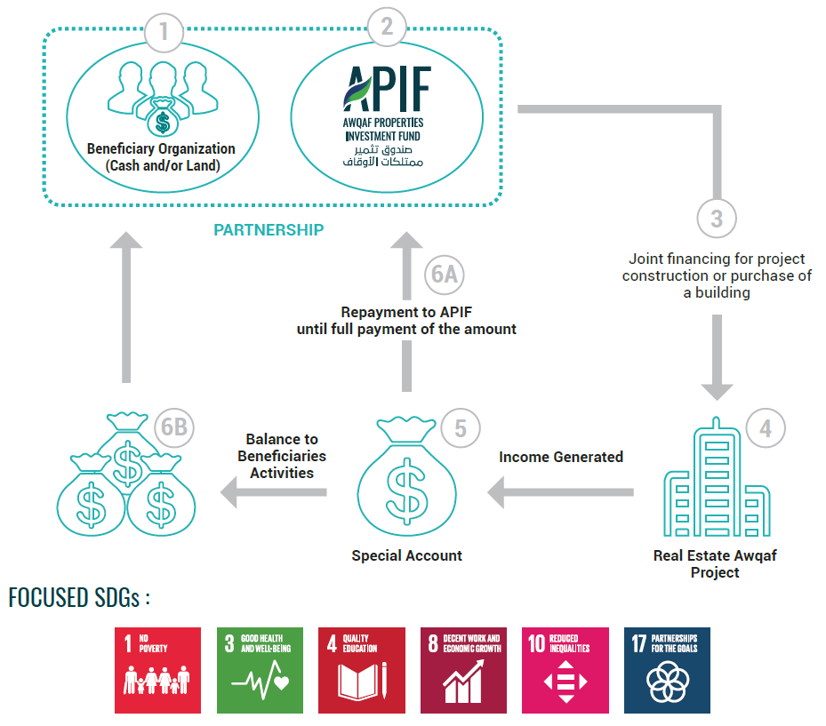
APIF Schematic and SDGs

Slide 6
III. Relevance of APIF to Infrastructure Finance
      Beyond the traditional scope of infrastructure projects, Awqaf decentralize the funding of post-completion operations and maintenance expenses, relieving fiscal pressures
      There is great potential for Waqf as a component of other infrastructure projects, especially social infrastructure
      Private management and incentive structure to support public services – relieving fiscal pressures on governments
      APIF projects have successfully supported non-profit social infrastructure facilities in areas of fragility and conflict (e.g. through establishing Awqaf assets in other stable countries)
      APIF, as an impact investment fund, can help mobilize private investment to ultimately support public services/social infrastructure otherwise unattractive to private investment (e.g. in Rural/distant areas)

Slide 7
IV. Financial Resources

Slide 8
V. Project Cycle for Waqf Projects
Identification and Official Request
(Sovereign or not)
Legal Clearance
Concept Clearance
Preparation & Appraisal
Official Request could be:
Sovereign from MCs
Non-sovereigns (e.g. charitable organizations)
Approval of IsDB Management
Signing of Financing Agreements
Post Evaluation
Completion & Closure
Implementation & Disbursement
Declaration of Effectiveness

Slide 9
Types of Projects Financed by APIF
  Revenue-generating real estate endowment projects, including:
      Residential buildings
      Commercial buildings
      Mixed-use development
  Projects may be:
  New construction
  Extension of existing buildings
  Renovation/rehabilitation of existing buildings
  Purchase and conversion of existing buildings to waqf properties

Slide 10
General Terms of Financing and Requirements
      Project size - US$ 5.0 million (minimum)
      Minimum contribution by beneficiary - 25% of total project cost or project land
      Financing Tenor – Between 5-15 year
      Good IRR and DSCR

Slide 11
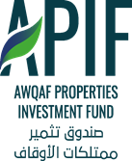
VI. Performance
APIF Approvals Since Inception
55 Projects
29 Member & Non-Member Countries
Total Value US$ 1.1 Billion

Slide 12
Summary of APIF Projects by Region

Slide 13
Summary of APIF Projects by Beneficiary Sector

Slide 14
Financial Performance of APIF
Financial Performance of the Fund
      Dividends paid: Average 3.5% p.a. of the paid-up capital for the last 16 years with a minimum of 2.5% p.a. (including during the financial crisis of 2008-2009)
      2019 Dividend: 3.0% and targeting 4.0%.

Slide 15
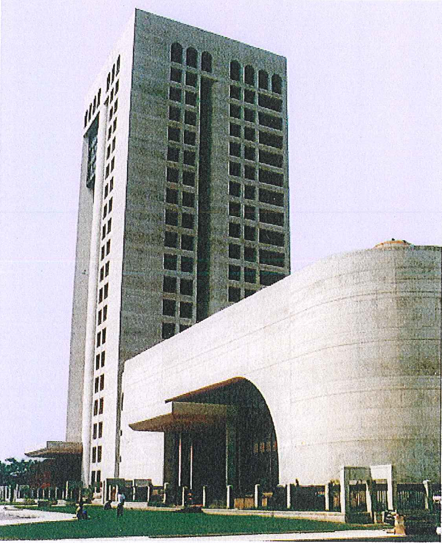
VII. Success Stories (1) IsDB-BISEW
Project: Bangladesh Islamic Solidarity Education Waqf (IsDB-BISEW)
Approval date: 1997
Financial assistance to enhance technical & educational capabilities of youth
INPUTS
Land from the Government US$ 10 Mn IsDB Grant US$ 3.2 Mn IsDB Ordinary Financing
OUTPUTS
Office Building Computer Mall/City
IMPACT
>12,000 Student sponsored for IT scholarship alone >7,000 successful job placements
OUTCOMES
Providing the following: IT Scholarship Vocational Training Madrasah Support Orphans Care

Slide 16
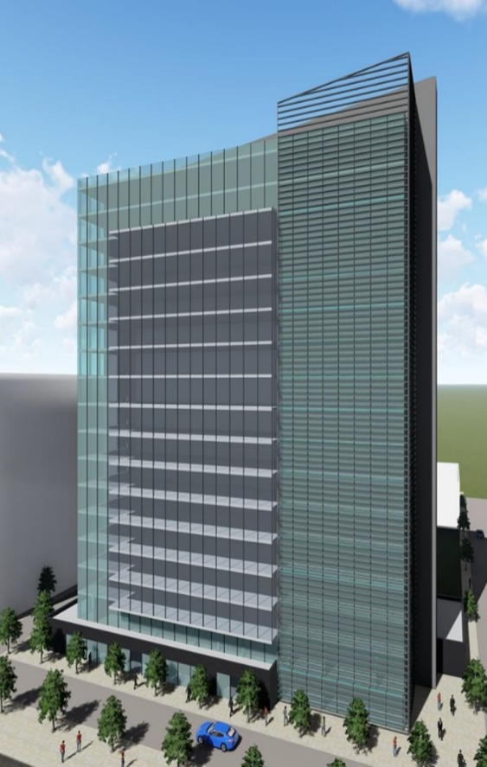
(2) Daras Senegal
Project: Mixed-use Waqf Building in Dakar Senegal for the benefit of Daras Schools
Approval date: 2019
Financial assistance to the activities of Daras Schools in Senegal
INPUTS
US$ 0.3 Mn from Government of Senegal US$ 3.7 Mn land from Government of Senegal US$ 16.2 Mn IsDB Ordinary financing
OUTPUTS
16 Floor Residential Building in prime location in Dakar
IMPACT
>12,500 Students supported > Financial sustainability ensured Paved way for Waqf regulatory framework
OUTCOMES
Providing financial support for: 64 Quranic Schools (Daras)

Slide 17
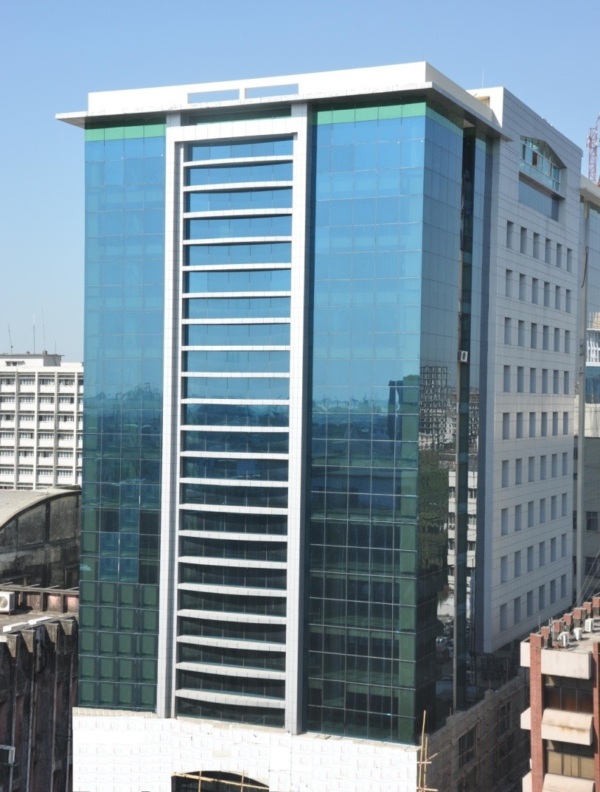
(3) IIUCT Bangladesh
Project: Waqf Office Tower for the benefit of International Isl. University Chittagong, Bangladesh
Approval date: 2006
Opening the doors for needy students to brighten their future
INPUTS
US$ 1.5 Mn Beneficiary Contribution US$ 4.0 Mn IsDB Financing (Leasing)
OUTPUTS
Waqf Office Tower in Chittagong
IMPACT
Improved higher education in Bangladesh
OUTCOMES
Financial assistance to 250 students for accommodation, food, books, etc. 30 university staff already obtained PhD

Slide 18
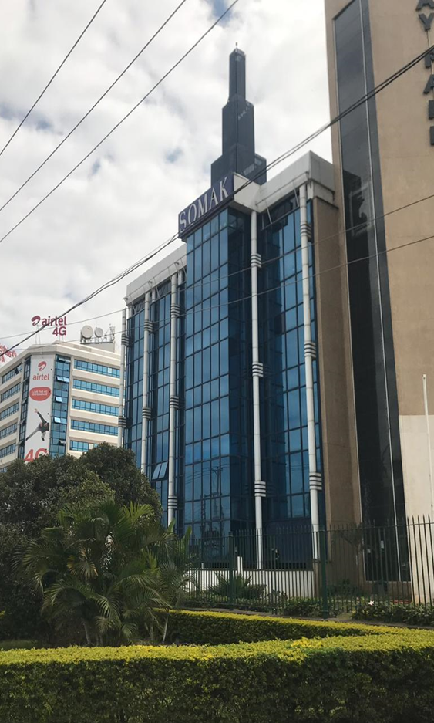
(4) Towfiq Welfare Society (TWS) Somalia
Project: Purchase of Office Building in Kenya for the benefit of TWS, Somalia
Approval date: 2015
Financial assistance to the educational and health activities of Al-Tawfeeq Charity Organization, Somalia
INPUTS
US$ 0.75 Mn from TWS US$ 2.75 Mn IsDB Ordinary financing
OUTPUTS
Purchase of 7 Floor fully rented Office Building in Nairobi, Kenya
IMPACT
> 4,000 Students supported > 1,130 Orphans helped 200 Wells drilled Model for supporting regions of fragility
OUTCOMES
Providing financial support for: 5 Schools in Kismayo Al-Ansar Orphanage University and Hospital Drilling of Wells

Slide 19
Areas of Engagement with APIF
      Investing in APIF’s capital
      Co-financing specific projects
      Providing grants/donations to the fund or a specific project
      Requesting financing for a waqf project
      Contacts:
Dr. Mohamed Ali Chatti
Acting Director of the Islamic Financial Sector Development Department
+966(12)646-7448
+966581422200
mchatti@isdb.org
Yoseph Ataa Alsawady
Islamic Financial Sector Development Department +966(12)646-7166
+966507567300
yalsawady@isdb.org

Slide 20
Thank You!

