Slide 1
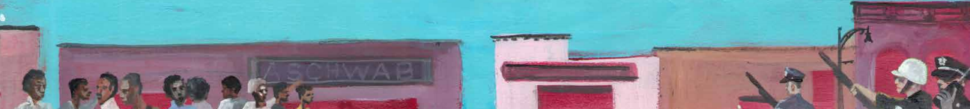
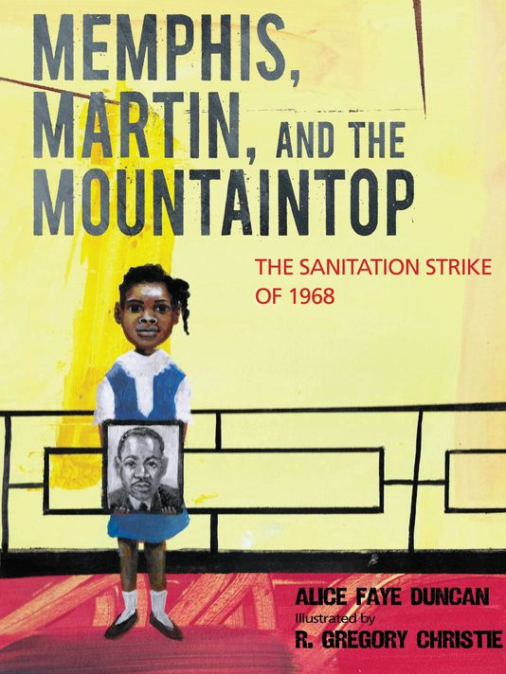
DO NOW (5 min)
What do you notice about the book’s cover?
What do you wonder?
What predictions can you make about the book?
Notes:
Give students three minutes to respond to the questions. For two minutes, call on students to respond to the questions. This activity is intended to gather ideas; it is not necessary to inform students if they were correct or not. Make sure a copy of the book is available for students who want to read the entire book following this lesson.

Slide 2
Objective (2 min)
Today I am… closely reading the picture book MEMPHIS, MARTIN, AND THE MOUTAINTOP,
So I can…identify figurative language and its impact on the meaning and tone of the text.
I’ll know I’ve got it when…I answer text-dependent questions based on the text.
Notes:
Today / So / Know language helps students to break down the lesson’s purpose and the activities they will complete. Feel free to reword the standards to your personal or school’s expectations for learning target language.

Slide 3
Objective (5 min)
Today I am… closely reading the picture book Memphis, Martin, and the Mountaintop,
…so I can… identify figurative language and its impact on the meaning and tone of the text.
I’ll know I’ve got it when… I answer text-dependent questions based on the text.
Notes:
Ask students to turn and talk to their neighbor to discuss what figurative language is. Then, get students to share out what they discussed. Students will likely give examples of figurative language (e.g., alliteration, personification), but remind students that figurative language is anything that is worded in an imaginative or unusual way. Write student responses on chart paper or board to create an anchor chart of what you expect students to know about figurative language. Keep in mind that there are definitions on the following slide that should be added to the chart. Also, depending on your students, you may need to point out that it is not always as important to identify the type of figurative language as it is to analyze its impact on the meaning of the text.

Slide 4
Tone and Figurative Language Notes (8 min)
Metaphor- word or phrase applied to an object that is not literal
  Example from text: The strike was a mountain climb.
Tone – the speaker’s attitude toward someone or a situation
Alliteration – repetition of consonant sounds at beginning of words
  Example from text: Memphis, Martin, and the Mountaintop
Personification – making something not human appear more human
  Example from text: Fire, smoke, and ashes ravaged midnight cityscapes.
Onomatopoeia – sound words
  Example from text: I had skipped outside to splash and play on the sidewalk
Simile – comparing two unlike things using the words like or as
  Tall like a giant and stubborn like a mule, Mayor Loeb said no to a pay increase
Notes:
Review the notes with students and invite them to take notes. It is suggested that you print these in advance to save instructional time. Common Core-aligned questions usually do not ask students to identify the type of figurative language in a passage; however, it is still beneficial for students to know the major types.

Slide 5
Guided Practice / Stop-and-Jot (20 min)
We will analyze three passages from Memphis, Martin, and the Mountaintop
Before sharing out, silently and independently write down your responses
Then, you will share with your partner or group
Last, we will share our answers with the whole class
Notes:
Go over directions for guided practice. Adjust the language in the third bullet point to fit your seating arrangement (e.g., shoulder partners, pairs, or groups).

Slide 6
Figurative Language in “Mud Puddles”
According to my daddy, a packer blade malfunctioned, crushing his friends. Daddy told Mama, “It ain’t right to die like that.” Mama shook her head, and I saw a new storm rising up. I saw it in their eyes.
What does the speaker mean by “a new storm rising up”?
What type of figurative language is used here?
How does it impact how the narrator feels about the situation?
Notes:
Reread the excerpt to students. Ask students each question, giving them one to two minutes to write down their answers before sharing out. Then, invite students to share their answers with a neighbor or group. Last, cold-class students to share their responses with the whole class.
Students should recognize that this is not an actual storm, but a metaphor that the speaker used referring to an internal struggle.
For question two, students should recognize that the narrator uses this figurative language to compare her mother’s anger to a storm. It shows that the speaker, Lorraine, understands the anger and pain that her mother is experiencing. Her pain was “stirring” like a storm.

Slide 7
Figurative Language in “Marching Orders”
Tall like a giant and stubborn like a mule, Mayor Loeb said no to a pay increase. He did not acknowledge the workers’ labor union... To insult the men even further, Mayor Loeb gave little assistance to the Cole and Walker families.
1. What does the speaker mean when she compares Mayor Loeb to a giant and a mule?
2. How does this simile affect the tone of the passage?
Notes:
Reread the excerpt to students. Ask students each question, giving them one to two minutes to write down their answers before sharing out. Then, invite students to share their answers with a neighbor or group. Last, cold-class students to share their responses with the whole class.
Students should recognize that the speaker was emphasizing that the mayor seemed menacing or scary and would not compromise. The speaker feels helpless because the mayor will not help these men.

Slide 8
Figurative Language in “Silver Rights”
“I did not plainly comprehend the trouble I saw in 1968. Wisdom came slowly over the mounting years. But when I look back now, I understand. The Memphis struggle was an economic fight.”
What is a synonym or short definition of the word mounting in this context? What word(s) helped you find the meaning?
What is the effect of using the word mounting in this context?
How does this word choice affect the meaning of the passage?
Notes:
Reread the excerpt to students. Make note with students that the tile here is also a literary mechanism. “Silver Rights” is a metaphor representing “economics.” Then go on to ask students each question, giving them one to two minutes to write down their answers before sharing out. Invite students to share their answers with a neighbor or group. Last, request students to share their responses with the whole class.
Students should recognize that mounting here means growing, later, or future. The word “slowly” and the phrase “look back now” should have helped them find the meaning. The word mounting emphasizes the idea that the speaker was young when she experienced these events and did not fully comprehend the seriousness of what was happening yet.

Slide 9
Exit Ticket (10 min)
Answer the text-dependent questions on the handout.
Written responses should be in complete sentences. Be sure to answer all parts of the question.
Notes:
Distribute the text-dependent questions that accompany this lesson. Students should complete this independently. Students can complete for homework if necessary.

Slide 10
Writing Prompt Extension
Compose a personal narrative essay where you write about strike events and emotions portrayed in Memphis, Martin, and the Mountaintop. You can write from point of view of Dr. King, a striker, Lorraine, the mayor or Coretta Scott King. Your character can be based on a real life person or a fictional character.
Your personal narrative should contain the following:
Figurative language (at least 2 types discussed in our lesson)
A consistent point of view (1st person)
Details from the book (specific dates and activities found in the timeline)
Dialogue (people talking)
Proper grammar and punctuation
Notes:
This is a narrative writing prompt that can be used to extend the unit on the picture book. Before presenting to your class, consider providing students with a rubric that aligns to your respective state test.
Tennessee’s narrative writing rubric can be found here:
https://www.tn.gov/education/assessment/tcap-writing-rubrics.html
Also, students would benefit from a mentor text like all of Lorraine’s personal narratives in MEMPHIS, MARTIN AND THE MOUNTAINTOP. Consider sharing other strong narrative texts for your grade leve.

