Slide 1

MCAA Spring Meeting
Hotel Valuation Considerations for Assessors
Erich Baum
April 17, 2025

Slide 2






Hotel Valuation Considerations for Assessors
Data Request
Rooms Revenue Factors
Income Analysis
Rushmore Approach
Other Value Approaches

Slide 3
Data Request
Hotel Valuation Considerations for Assessors
1.
Historical P&L Statements
4.
STAR Reports
2.
Capital Expenditure History
5.
Budgeted Future Year P&L
3.
Product Improvement Plan (PIP)

Slide 4
Rooms Revenue
Hotel Valuation Considerations for Assessors
1.
Historical Results / Penetration Factor (STAR Report)
4.
Brand (Franchise) Issues
2.
Property Age / Life Cycle Stage
5.
External Events (Pandemic)
3.
Renovation History / Plan (PIP)

Slide 5
STAR Reports
Hotel Valuation Considerations for Assessors
1.
Calculating RevPAR
2.
Calculating Penetration Factors
3.
Identifying Trends

Slide 6
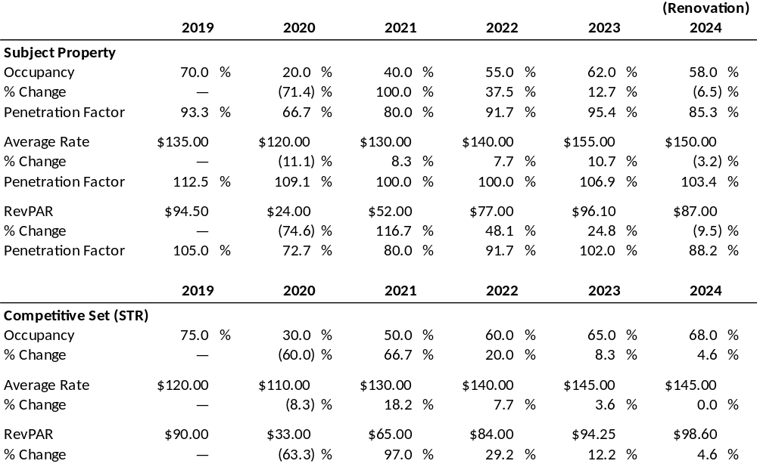
STAR Report Data – Case Study

Slide 7
Income Analysis
Hotel Valuation Considerations for Assessors
1.
Standardize the P&L Data
4.
Property-Specific Items (e.g., Franchise Fees, Rent)
2.
Adjust to Market
5.
Owner-Specific Items (e.g., Asset Management, Legal, Ground Lease
3.
Account for Service Level

Slide 8
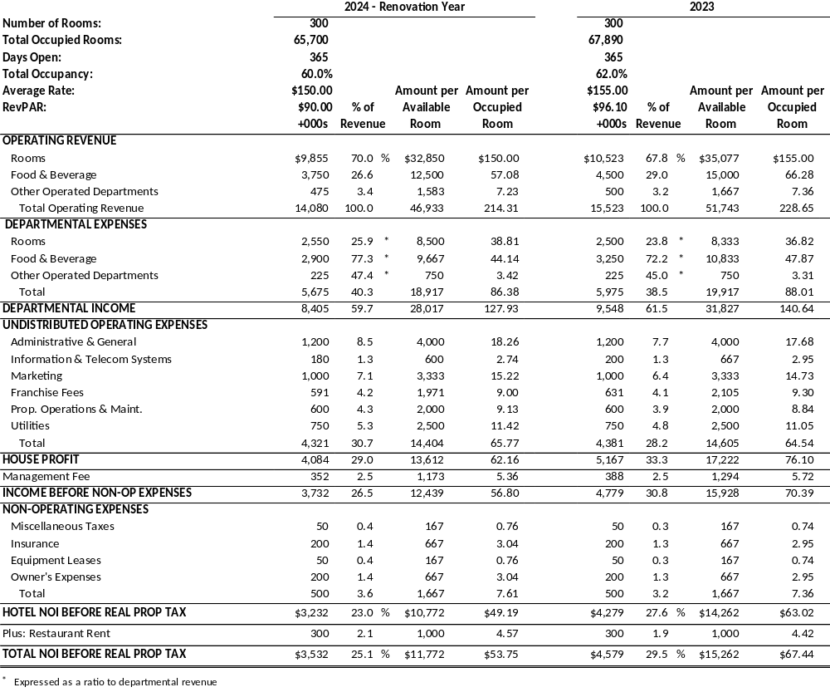
Historical P&L Data

Slide 9
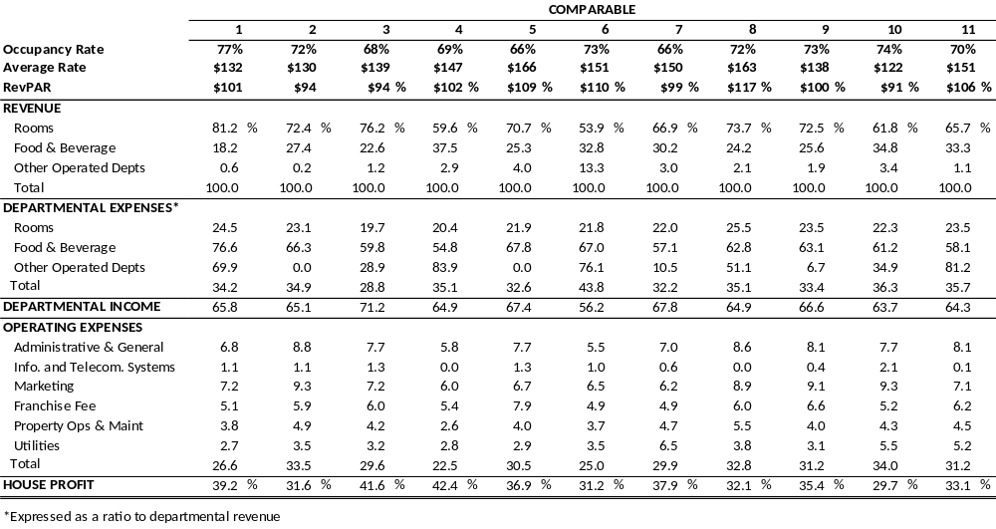
Comparable Data

Slide 10
Rushmore Approach
Hotel Valuation Considerations for Assessors
1.
Stabilized Net Income
4.
Return “on” Personal Property
2.
Capitalization Rate Selection
5.
Capital Deduction
3.
Return “of” Personal Property

Slide 11
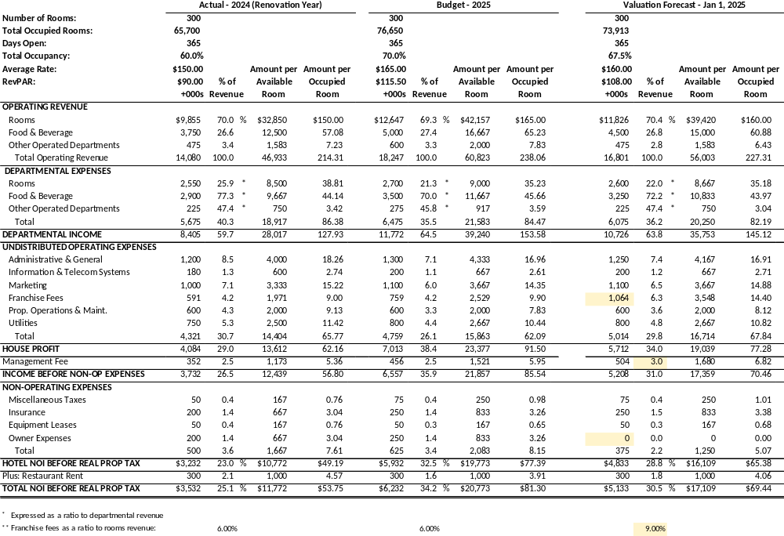
Valuation Forecast

Slide 12
Cap Rate Selection
Hotel Valuation Considerations for Assessors
1.
Comparable Sales Data
2.
Investor Surveys
3.
Band of Investment

Slide 13
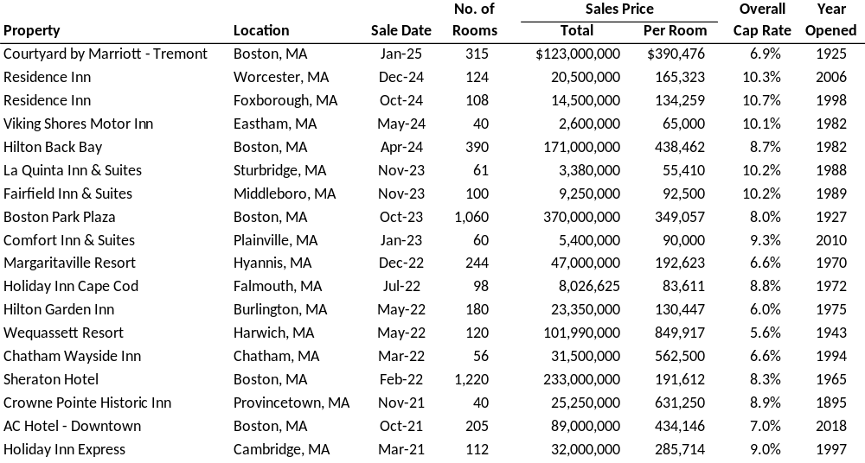
Comp Sales with Calculated Cap Rates

Slide 14
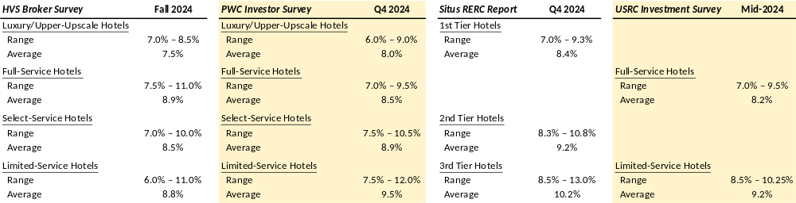
Investor Surveys

Slide 15
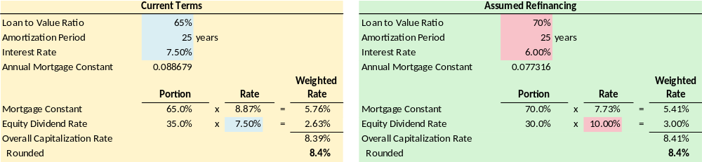
Band of Investment Technique

Slide 16
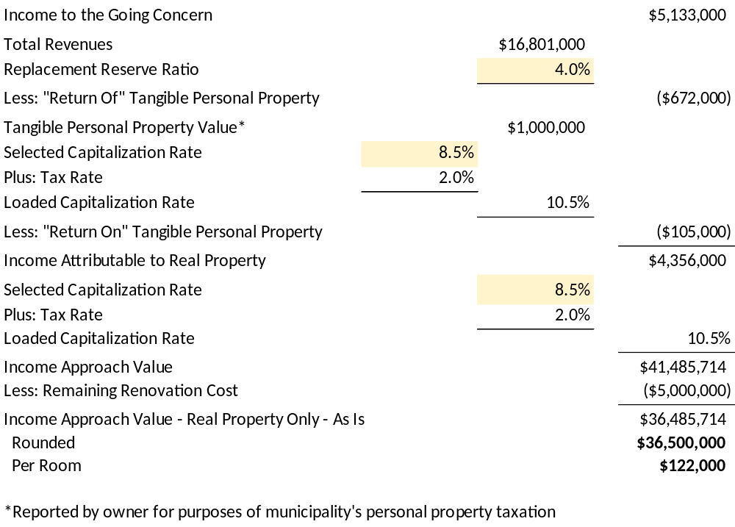
Rushmore Approach

Slide 17
Other Valuation Approaches
Hotel Valuation Considerations for Assessors
1.
Sales Comparison Approach
2.
Cost Approach

Slide 18

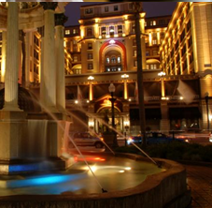

Erich Baum, Senior Vice President
ebaum@hvs.com
+1 603 502-6625

