Slide 1

Commonwealth of Massachusetts
Supporting a Commonwealth of Communities
LA3 Tips for MCAA
Rebecca A. Boucher AAS, MAA
Field Advisor, Bureau of Local Assessment
09/28/2022

Slide 2
The LA3 - Sales Analysis Period
LA3 Tips for MCAA by Division of Local Services, Bureau of Local Assessment
Assessment Date is always the January 1, preceding the Fiscal Year. The Base Year of sales that must always be used are from the prior calendar year.
Example: LA3 for FY2024
Assessment date 01/01/2023
The calendar year preceding the assessment date – (2022 sales) are used as the “Base Year”
To determine if 24 months of sales are needed; review total property class counts and sale counts by class.
2% of the class OR minimum of 10 sales, whichever is greater
Example: Class 104 has 330 parcels and 8 valid sales occurring in calendar year 2022.
2% of the parcel count is 7 sales, however 7 < 10,
so 24 months of sales are needed
Notes:
Alternate Example class 130 has 856 parcels and 12 sales in calendar year 2022. Yes, they have at least 10 sales but 12 sales out of 856 is only 1.4% of that class, therefore 2 years of sales are needed.

Slide 3
The LA3 - Sales Time Periods
LA3 Tips for MCAA by Division of Local Services, Bureau of Local Assessment
When 24 months of sales are required there are 2 options:
A. Use sales from the Base Year and 12 months before the Base Year;
In our example for FY2024
The calendar year before the Base Year of 2022 is 2021
Sales analysis period 01/01/2021 to 12/31/2022
or B. use Base Year and the 6 months of sales immediately before the base year and 6 months immediately after the base year;
In our example for FY2024 this would be
July 2021 to December 2021 and January 2023 to June 2023
Sales analysis period 07/01/2021 to 06/30/2023
There can be several factors to consider when selecting which time period to add the additional 12 months of sales from (when required). In rapidly changing markets, the oldest sales may contain the most dramatic differences from the assessment date and the current market. Also, using the most recent sales data may show that market increases or decreases are continuing.
Must use the same sales analysis period for all classes requiring 24 months of sales.

Slide 4

Sales Verification Resources
LA3 Tips for MCAA by Division of Local Services, Bureau of Local Assessment
Sale Inspections- BLA still recommends to go physically measure and inspect sale properties as close to the sale date as possible- Get Outside!!!
Deeds, Certificates of Title
Interviews with buyers, realtors, sellers, builders, appraisers
Online sale listing, Google, “Search it Up”, News articles
Sale Questionnaires- make them easy to return, tailor to property use
Multiple Listing Service, Cape Cod and Islands MLS, Berkshire County MLS
Realtor.com, Loopnet, CoStar, Zillow, etc.
Secretary of State Corporate Database https://corp.sec.state.ma.us/corpweb/corpsearch/CorpSearch.aspx
Things you hear from neighbors or in town hall (try to verify)
Income and Expense Returns, Building Permits, Business Certificates/Use Permits

Slide 5
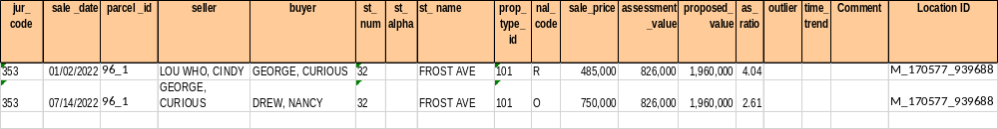

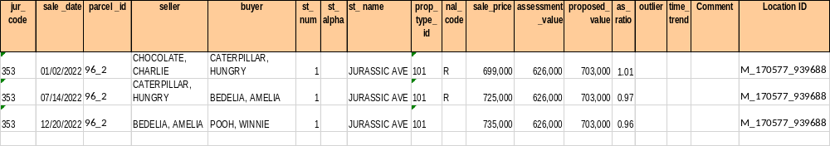

LA3 Common NAL Sale Coding Helpful Hints- NAL R Code Resales
LA3 Tips for MCAA by Division of Local Services, Bureau of Local Assessment
Used when there are multiple VALID sales of the same parcel in the sales analysis period. Code out all the valid sales in the sales analysis period except the sales closest to the assessment date. Do not use in cases with NAL sales.
3 Ways to Review: LA3 Macros- Green Check
In Gateway, use Search/Update/Delete screen and check Repeat Sales Only
Manually sort sales in Excel file by Parcel ID and then by date
Example of correct use for NAL R

Slide 6


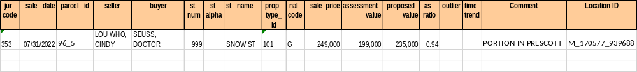

LA3 Common NAL Sale Coding Helpful Hints- G and V Codes
LA3 Tips for MCAA by Division of Local Services, Bureau of Local Assessment
G is a piece or part of the assessed unit and V is a package or bulk sale of multiple parcels
G vs. V
G- sale of a portion of the assessed unit. Common use is when a sale parcel is located in multiple municipalities.
Sale comment recommended.

Slide 7

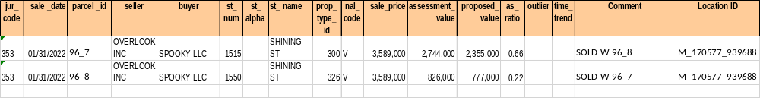

LA3 Common NAL Sale Coding Helpful Hints- G and V
LA3 Tips for MCAA by Division of Local Services, Bureau of Local Assessment
V- Sale of multiple parcels. Same comment recommended. List other parcels included in the sale.
Sort by buyer name to find if you have a V sale without a pair.
All V sales that occur in the base year of the sales analysis period should have at least 1 companion.
Example of a sale in base year 2022 without a pair
Here is the missing companion sale- this sale needs to be V coded and comments should be used on both sales
Here is an example of a correct use of the V code

Slide 8
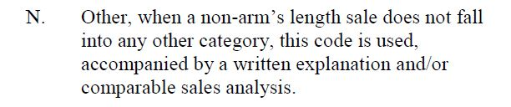

LA3 Common NAL Sale Coding Helpful Hints- N
LA3 Tips for MCAA by Division of Local Services, Bureau of Local Assessment
N= Non Arms Length sale but No other code fits
N= Needs a Note; must have a sale comment to explain
Do NOT use N if another NAL code will work
Don’t be afraid to use N if you really feel in good faith that the sale is not valid
Do NOT enter “SOLD AS IS” as a sale comment.

Slide 9
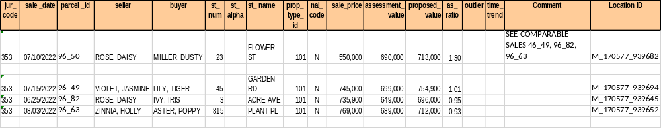
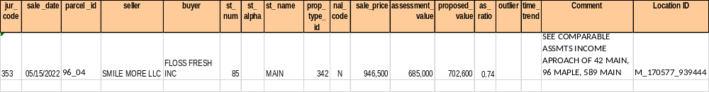
LA3 Common NAL Sale Coding Helpful Hints- N
LA3 Tips for MCAA by Division of Local Services, Bureau of Local Assessment
When the assessors has exhausted reasonable sales verification efforts and still feels the sale is not valid.
Residential Sales
Can use the N code and list 3 comparable sales to support
Commercial/ Industrial Sales
Can use the N code and list other 3 parcels valued with similar income and expense data

Slide 10


LA3 Common NAL Sale Coding Helpful Hints- B
LA3 Tips for MCAA by Division of Local Services, Bureau of Local Assessment
NAL B: An intra-corporation sale, e.g between a corporation and its stockholder, subsidiary, affiliate, or another corporation whose stock is in the same ownership
Subsidiary: company that belongs to another company, AKA a parent or a holding company. Generally the parent owns 50% of more of the subsidiary.
If a corporation owns less than a 50% stake, the corporation is referred to as an associate or affiliate company.
Use corporate databases and internet to verify validity of sales.
Example of incorrect use of NAL B; here the sale parties are unaffiliated with each other:
Correct use of NAL B.

Slide 11


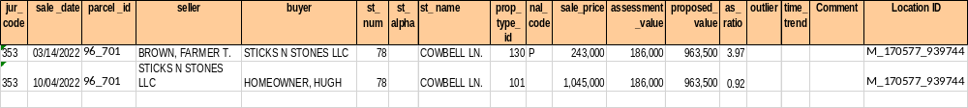

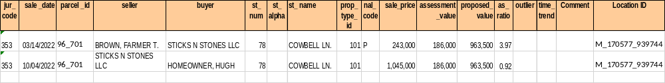

NAL P
LA3 Tips for MCAA by Division of Local Services, Bureau of Local Assessment
NAL P is a sale of a property with a change in use when compared to its use on the assessment date.
The Property Type ID (Use Code) on the LA3 must always be the current use, not the use at the time of sale.

Slide 12
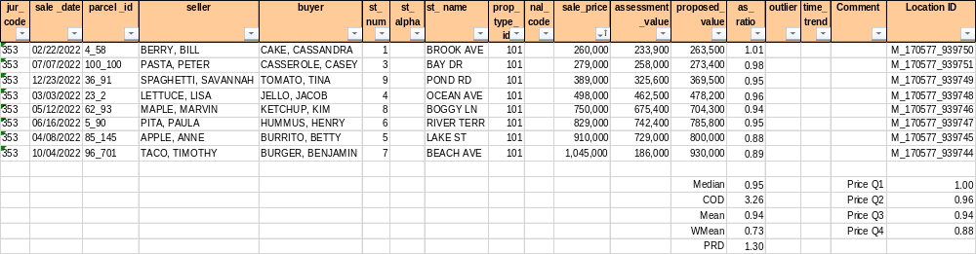
Price Quartiles
LA3 Tips for MCAA by Division of Local Services, Bureau of Local Assessment
Price Quartiles- show Regression or Progression. Demonstrate the consistency of the level of assessment by stratifying by pricing groups.
Quartiles- 40+ sales Halves- 20 to 40 sales
Simplified example (sample size is insufficient) to demonstrate regression:
Price Quartiles statistics should be between 90 to 110% and be within 5% of the class median.
How to check your price quartiles:
Run in your CAMA system reports, in the LA3 Macros, or upload your LA3 and run in DLS Gateway.
All 3 may have slightly varying calculations however note that Gateway is what we use to determine the price quartile statistics.
Notes:
Talk about when there is a large spread between any quartiles

Slide 13
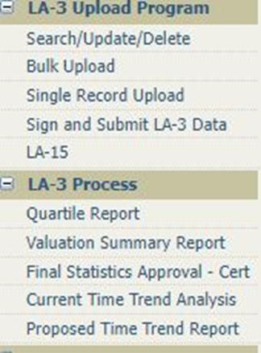
Date Quartiles
LA3 Tips for MCAA by Division of Local Services, Bureau of Local Assessment
Date Quartiles- show how the market changed over the sales analysis period.
Helps to see if a time adjustment to sale would be helpful.
The Current Time Trend Analysis is used by BLA to check that the trend you used to time adjust the sale prices in your LA3 is acceptable.
The Proposed Time Trend Report is used by the Assessor to analyze the unadjusted sales and develop a time trend.

Slide 14

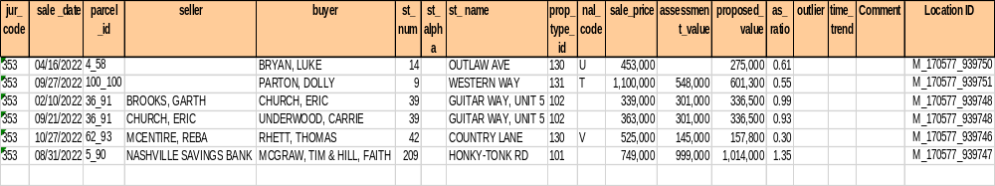
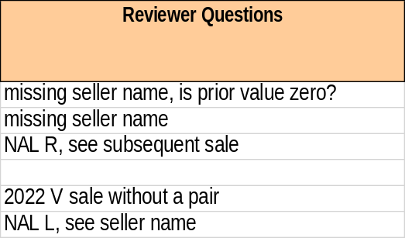
LA3 Review Tips
LA3 Tips for MCAA by Division of Local Services, Bureau of Local Assessment
Use the DLS LA3 macros to check.
BLA Advisors appreciate sale comments! Make them relevant and understandable.
No blanks in the LA3 cells- check new condos and new parcels for:
Current assessed values can’t be blank; must enter as zero “0”
No blanks or “n/a” as seller/buyer names; all sales need grantor and grantee!
Read and review each valid sale, line by line. Looking at the buyer and seller names is an easy double check.
Notes:
Go thru Example and ask audience what is wrong with each row

Slide 15
The LA3 – Points to Ponder
LA3 Tips for MCAA by Division of Local Services, Bureau of Local Assessment
More than 1 NAL code may fit a sale
It shows us what values changed and what values did not change. Statistics tell BLA how much the sale and non-sale properties increased or decreased.
We can see how much the non-sale properties increased or decreased by looking at the NAL sales and the LA4 comparison Report. Unless you had a lot of new homes and condos, these changes should be similar.
The LA3 data also can show us some of your growth
Make sure your CAMA system tables for NAL and Use codes reconcile to our latest update to the Classification Code Booklet!
Whose job? Assessor or Vendor
Remember where the process all starts: GIGO (Garbage In, Garbage Out)
The person entering the deeds and certificates of title should be trained as the “sales investigator”. If that’s the Assessors Clerk or an Administrative Assistant, then they should be fully trained on the LA3.
Buyer and Seller names should be entered in the CAMA system following a standard protocol for the ownership type: Last, First not First Last, also when property in trust, life estate, multiple owners, etc.
Notes:
Sale chasing

Slide 16

Producing your LA3
LA3 Tips for MCAA by Division of Local Services, Bureau of Local Assessment
Find the correct LA3 report in your CAMA system.
Extract the report in Excel for the dates of the sales analysis period for all classes.
Remember to include the GIS Loc ID and any sale comments
Sort the report by class (property type id) and sale date to remove the additional 12 months of sales in classes that did NOT require more than the base year for the analysis.
Review and proof the LA3 - see tips in this presentation
Save the file. Make a note of file name and where you saved it!
Copy each sale row into the LA3 upload template then bulk upload into DLS Gateway
Know how many sales records you should have!
Your LA3 must contain columns
A – R
Ready for Review

Slide 17
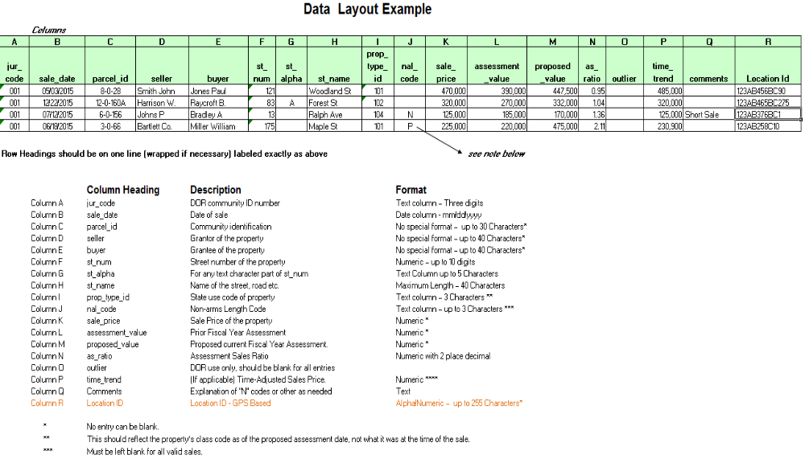
The LA3 Format
LA3 Tips for MCAA by Division of Local Services, Bureau of Local Assessment
Found in Classification Code Book

Slide 18
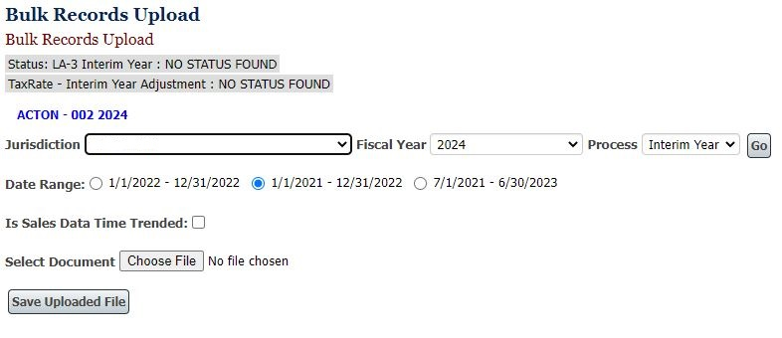
Bulk Upload of the LA3
LA3 Tips for MCAA by Division of Local Services, Bureau of Local Assessment
Open your Excel sales file that was exported from your CAMA system.
Copy all the sale rows in the LA3 Upload Template
Name and save the LA3 Upload Template to your desktop
Log into DLS Gateway and click the LA3 tab. Click Bulk Upload from the menu on the left.

Slide 19
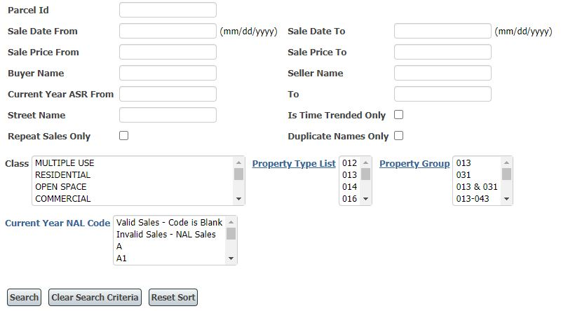
Editing Sales in the LA3
LA3 Tips for MCAA by Division of Local Services, Bureau of Local Assessment
Your advisor has flagged a few sales that you need to make edits on.
Make the changes in your CAMA system
Make the changes in your sales file (Excel file)
Make the changes in DLS Gateway to your uploaded and unlocked LA3 using the Search/Update/Delete tool
Notes:
Talk thru searching and editing in gateway using examples from slide 14

Slide 20
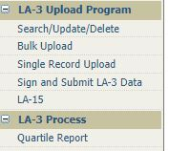


How to delete LA3 from Gateway
LA3 Tips for MCAA by Division of Local Services, Bureau of Local Assessment
Sometimes you need to start over with a new sales file.
Your advisor can unlock the LA15 and LA3.
You have to delete the old sales file from 2 places in Gateway:
1st Delete the sale records from the Search/Update/Delete page
In Search/Update/Delete page, click Search
After all your sale records come up, scroll to the bottom of the page and click
2nd Delete the Uploaded File from the Bulk Upload page.
Click
1st
2nd
Notes:
If you only have a few edits, those are easy enough to make. If you have to adjust value to update your sales analysis, a new LA3 file is needed.

Slide 21

The Interim Year Approval Process
LA3 Tips for MCAA by Division of Local Services, Bureau of Local Assessment
Update your communities Local Officials Directory and do the Assessors Certification with your Town/City Clerk for the fiscal year you will be working on
Revised and Omitted and Audited Personal Property
Amended New Growth LA13A
LA3
LA15- auto populated by the LA3.
LA4 with a copy of your CAMA system LA4 uploaded in the Current Documents and Board of Assessor Authorization/Signatures
LA13 with New Growth Template uploaded to Current Documents
Classification Hearing
Tax Rate
Make life easier on your office- Submit all your
Gateway Reports early for your Advisor to review,
including your LA3!

