Slide 1

CITY OF SEDONA
TOURISM OFFICE
Lodging Council Meeting
October 13, 2026 Meeting

Slide 2
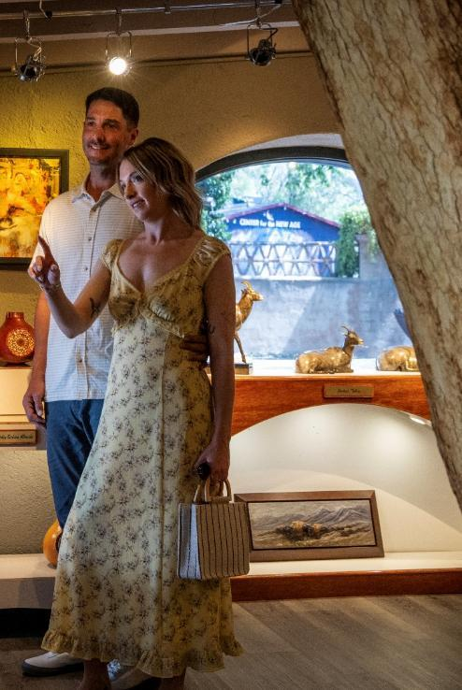

Agenda
  Destination marketing campaign update
  FY27 trade show calendar
  Sedona lodging performance review
  Monthly tourism research
TOURISM OFFICE

Slide 3
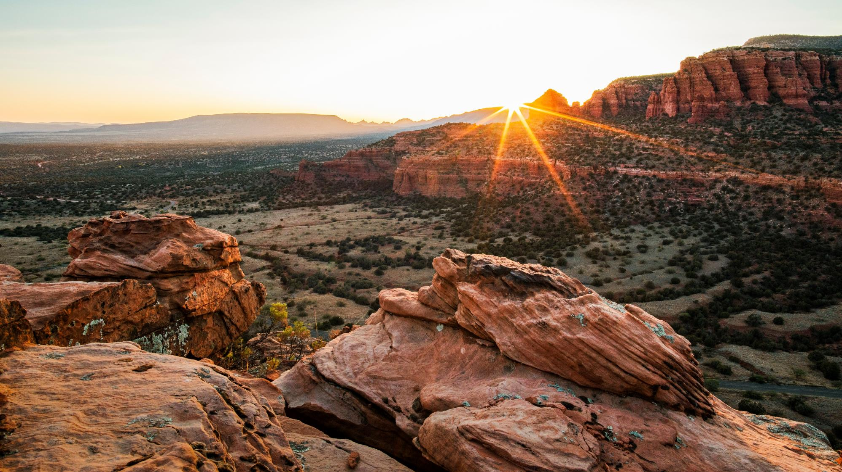
Destination Marketing Campaign Updates
TOURISM PROGRAM

Slide 4
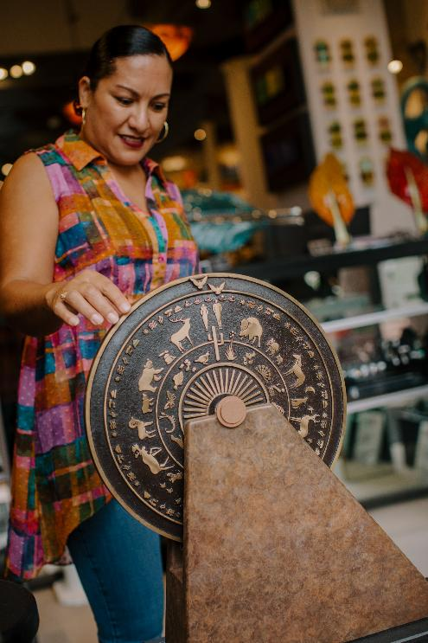
Campaign Launch Update
  We launched our Winter 2026/2027 campaign and our year-round high-net-worth audience campaign:
    Flight markets: October 1, 2026 to February 1, 2027
    Drive markets: October 15, 2026 to February 15, 2027
    High-net-worth audience will remain in flight
  Drive markets
    Phoenix
    Tucson
    Los Angeles
    San Diego
    Las Vegas
  Flight Markets
    Denver
    Seattle
    Chicago
    San Francisco
    Minneapolis
    New York
TOURISM OFFICE

Slide 5
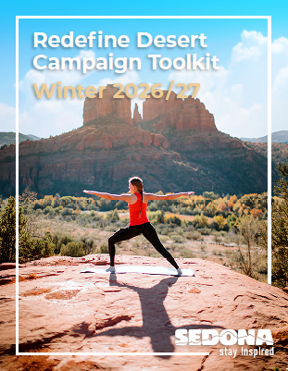
Partnership Opportunities
  Please send us your updated deals
  Utilize our social media toolkit to amplify the campaign
TOURISM OFFICE

Slide 6
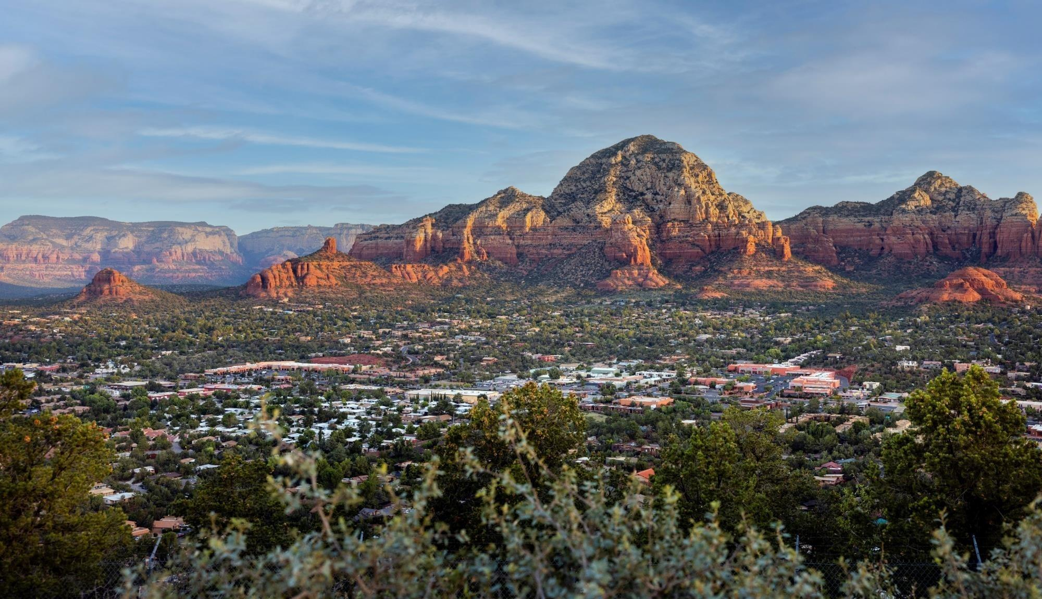
FY27 Trade Show Schedule
TOURISM PROGRAM

Slide 7

FY27 Trade Show Schedule
  MPI Hosted Buyer Event: December 1
  IITA Summit: January 31 – February 3
  AOT France/UK/Ireland Mission: February 15-19
  Go West Summit: February 28 – March 3
  Travel Classics West: April 1
  Smart Meetings: Small & Boutique Meetings: April 25-27
  IPW: May 2-6
TOURISM OFFICE

Slide 8
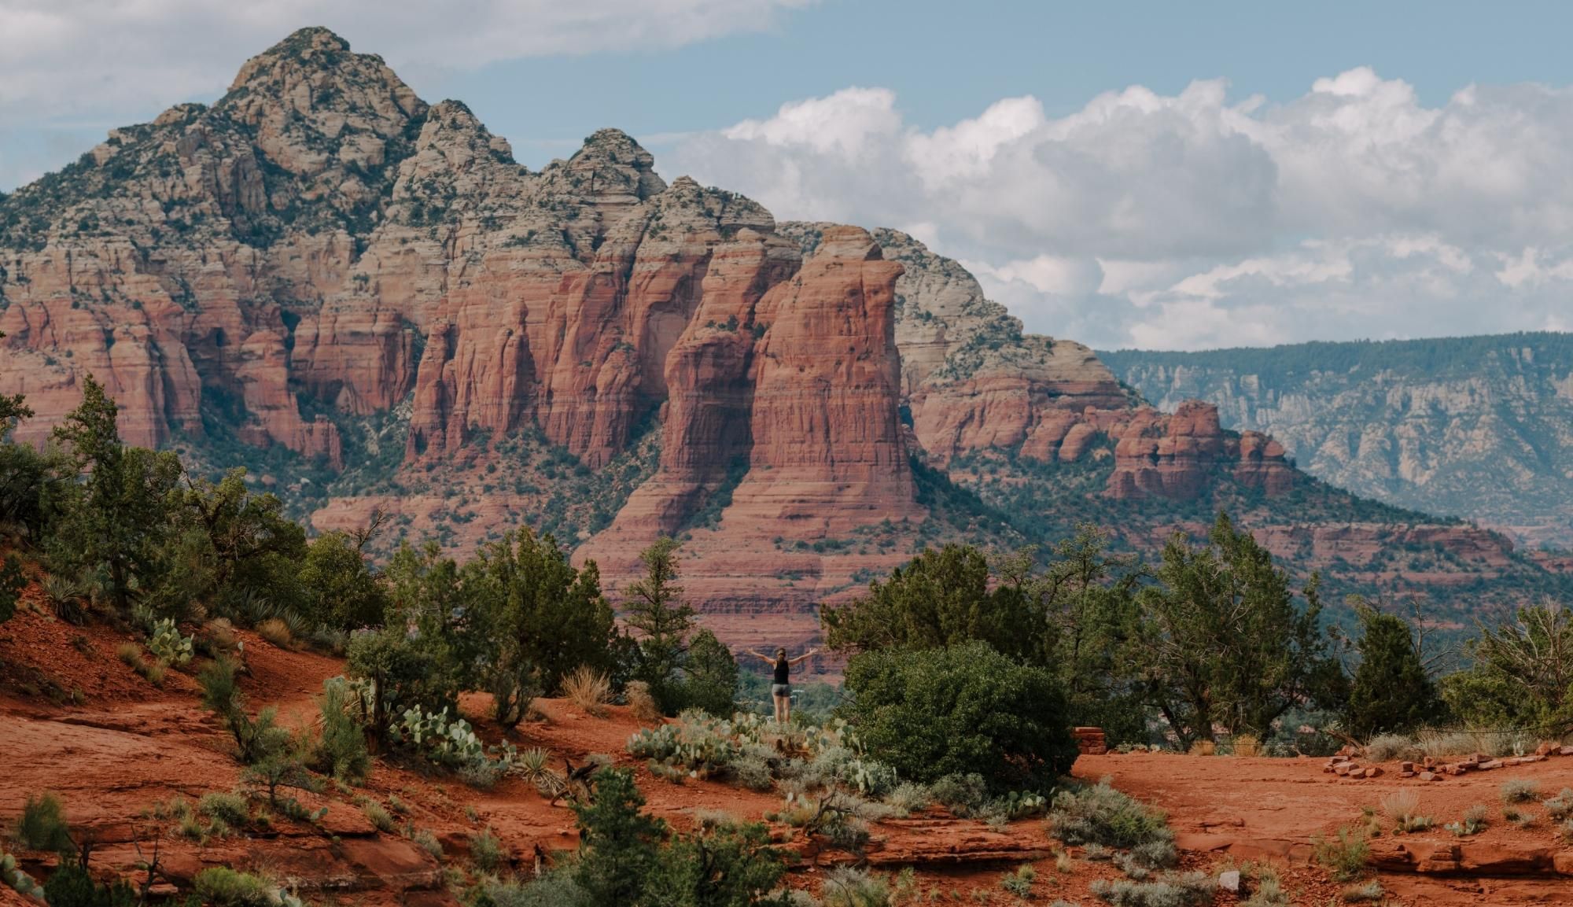
2027 Calendar Year Planning
TOURISM PROGRAM

Slide 9
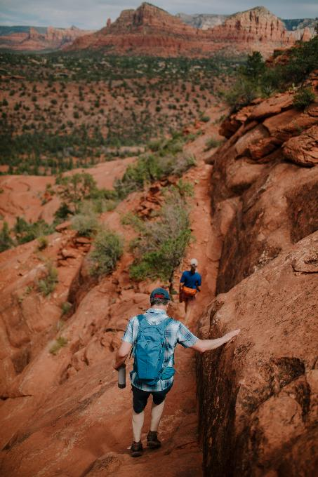
Planning For 2027
  Submit your 2027 rates to the B2B inventories
  A few hotels reached out for an industry forecast
  Although this isn’t something we provide, our team pulled together some information for everyone
TOURISM OFFICE

Slide 10
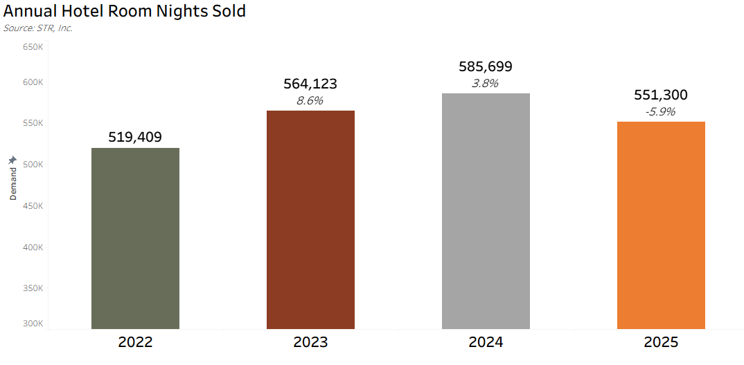
TOURISM OFFICE

Slide 11
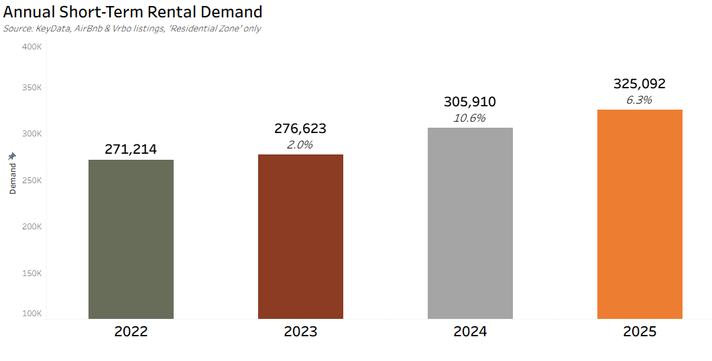
TOURISM OFFICE

Slide 12
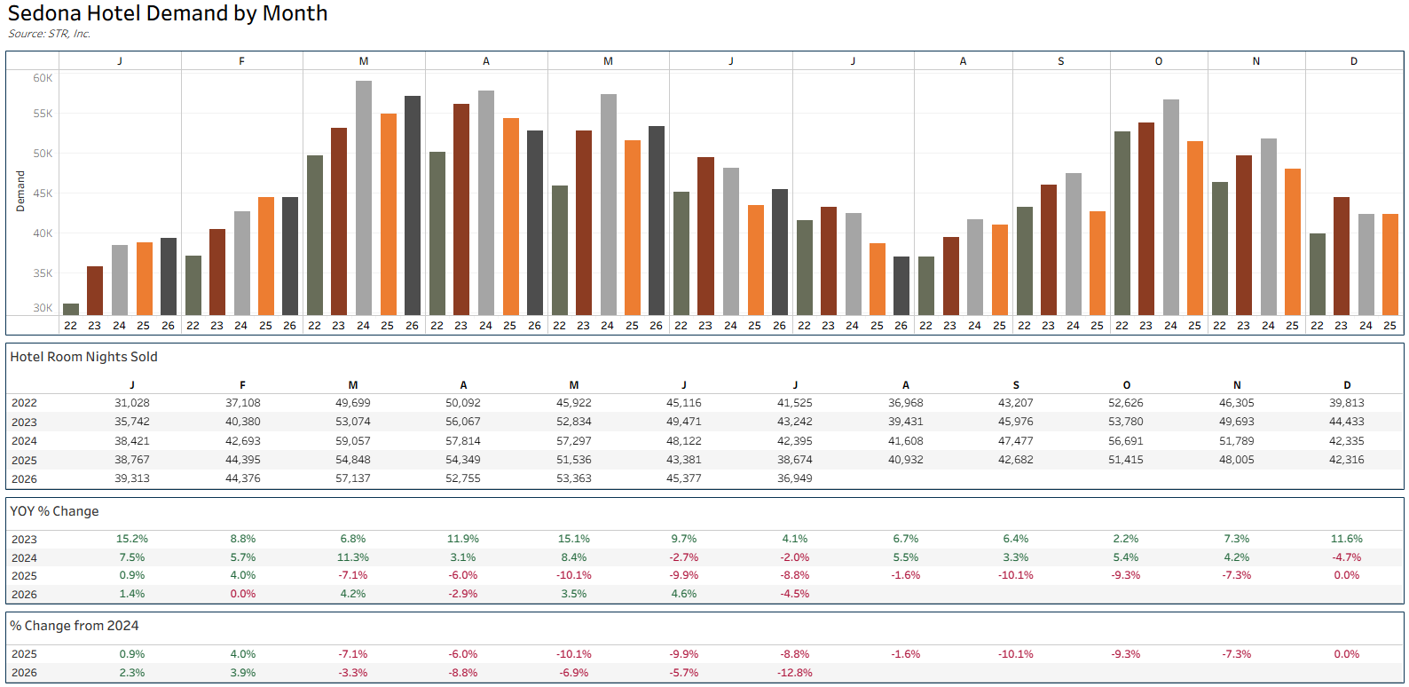
TOURISM OFFICE

Slide 13
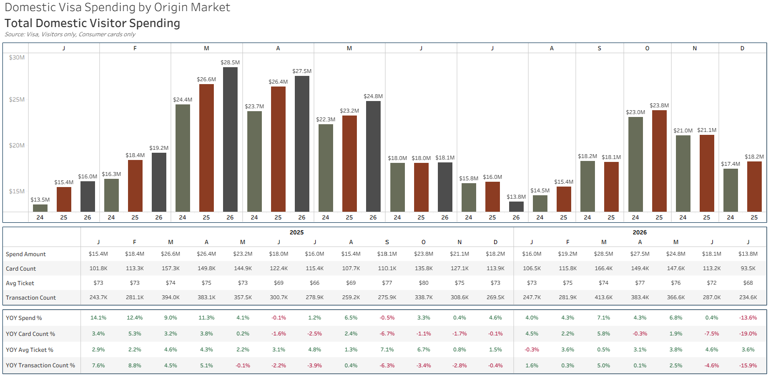
TOURISM OFFICE

Slide 14
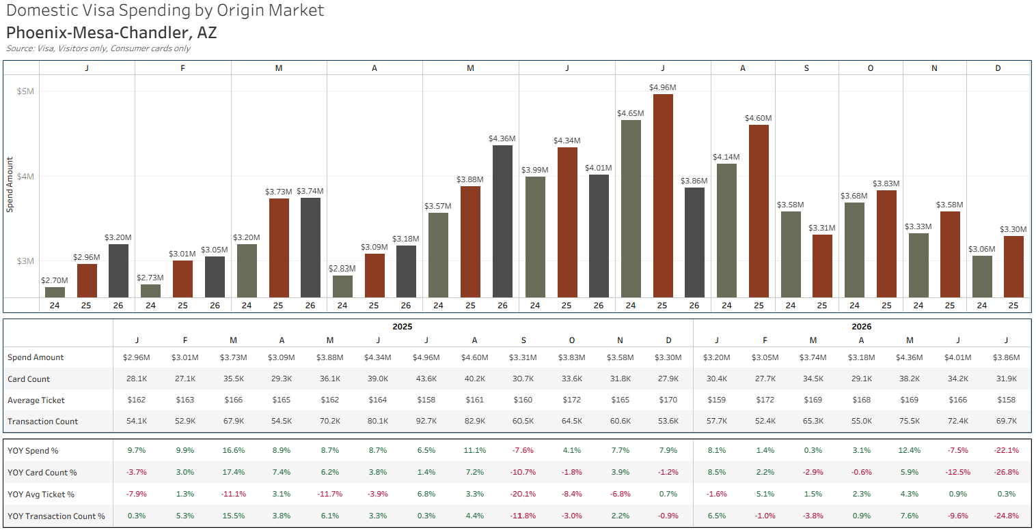
TOURISM OFFICE

Slide 15
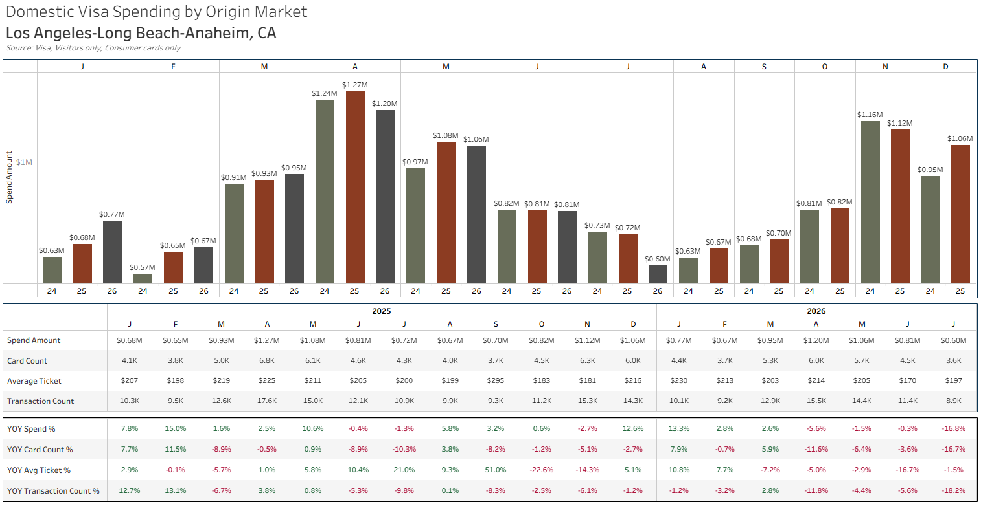
TOURISM OFFICE

Slide 16
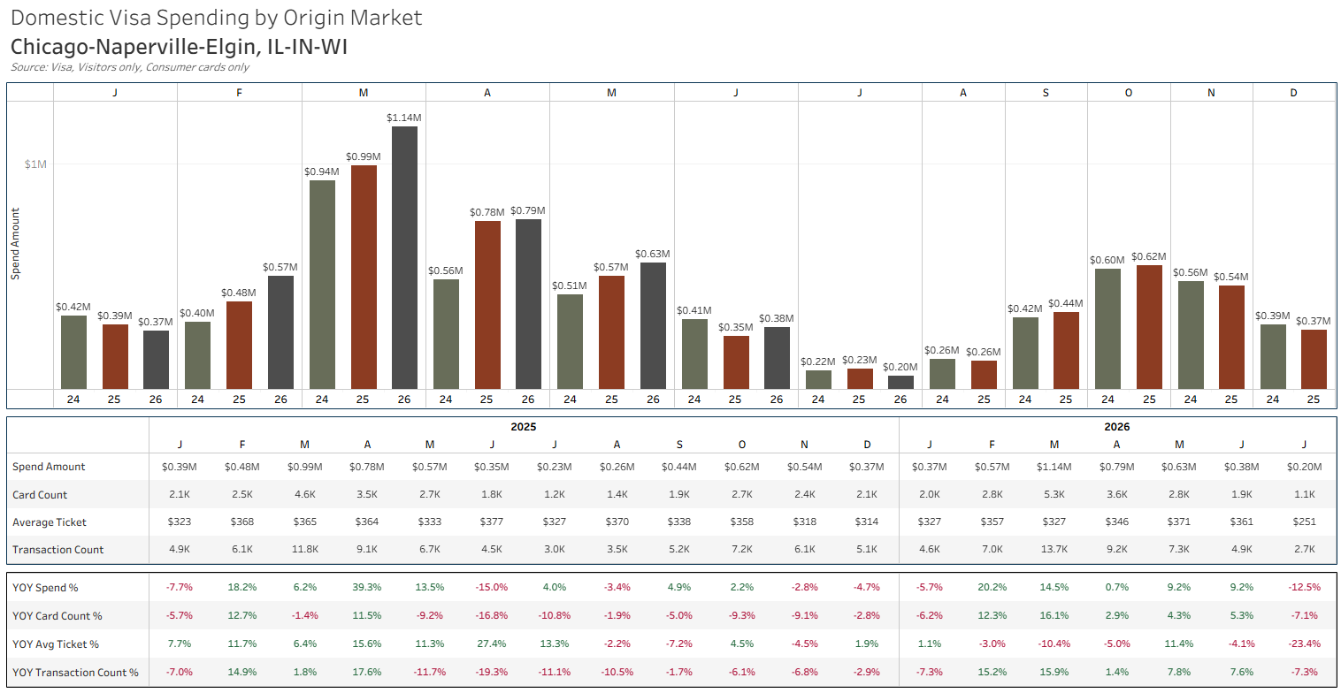
TOURISM OFFICE

Slide 17
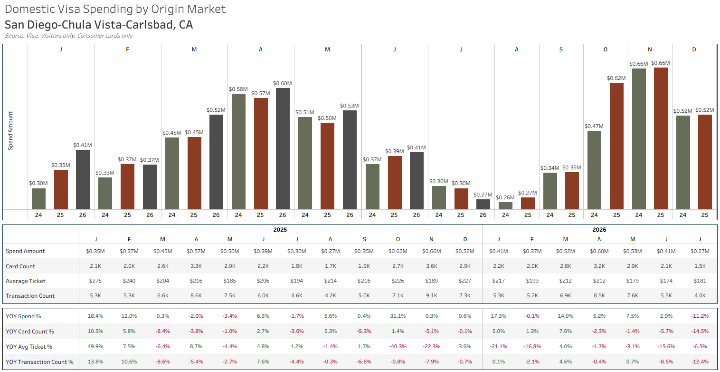
TOURISM OFFICE

Slide 18
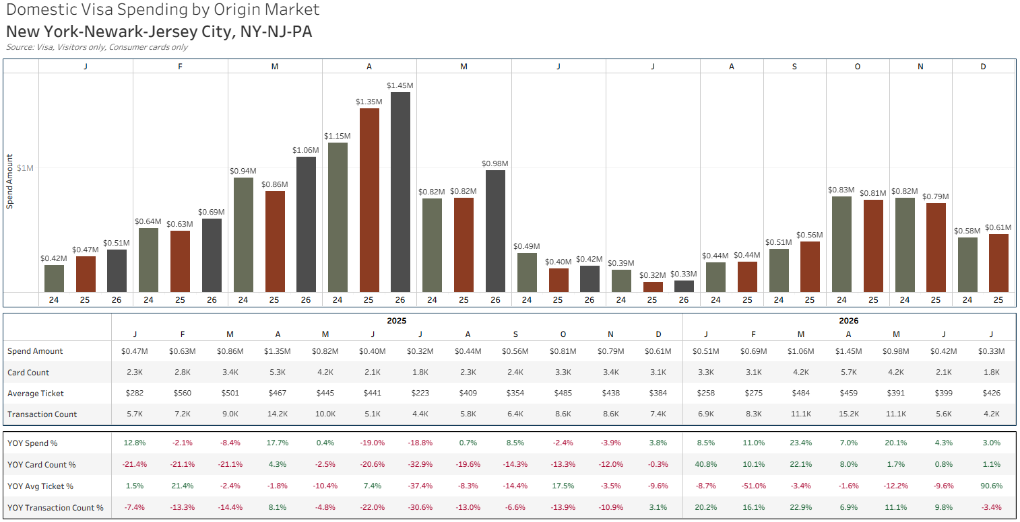
TOURISM OFFICE

Slide 19
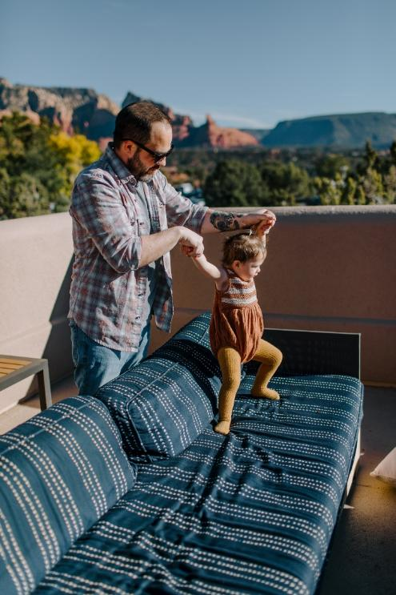
Planning For Increased Hotel Room Supply
  We have ~200 hotel rooms coming online
    Ambiente: Creekside = 36 rooms
    Senoa Resort = 70 rooms
    The Darling = 100 rooms
  Additional rooms have been discussed with the Best Western Arroyo Roble, Sky Ranch Lodge, and a local church
TOURISM OFFICE

Slide 20
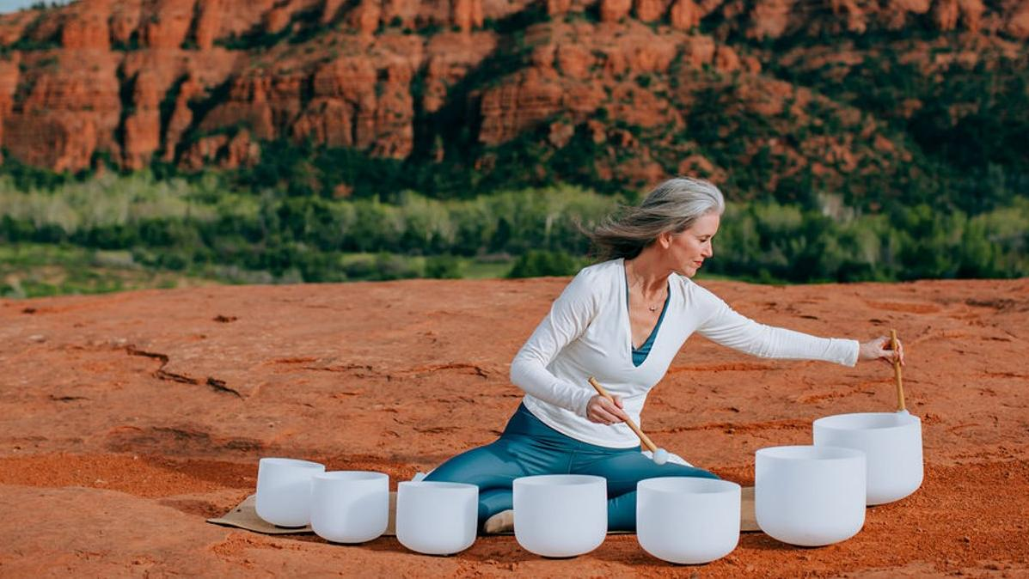
Monthly Tourism Research
TOURISM OFFICE

Slide 21
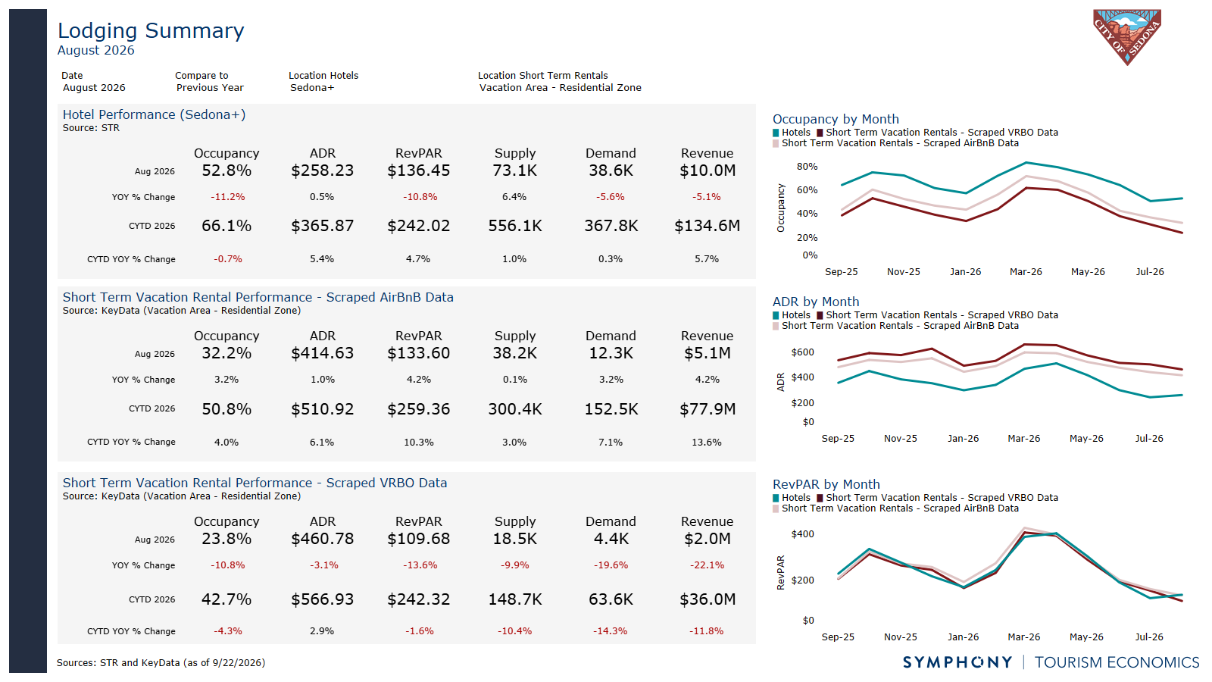

Slide 22
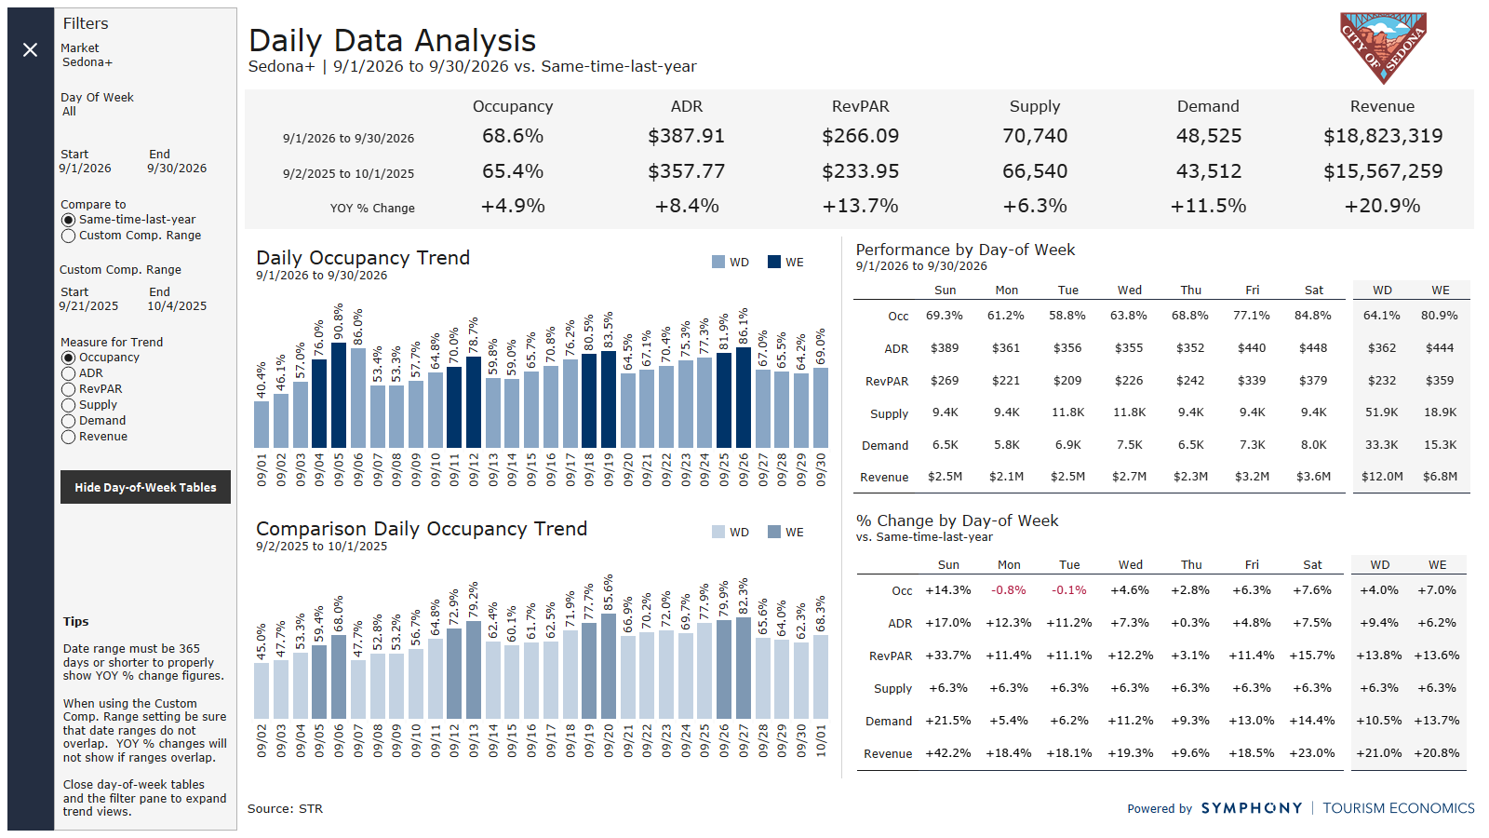

Slide 23
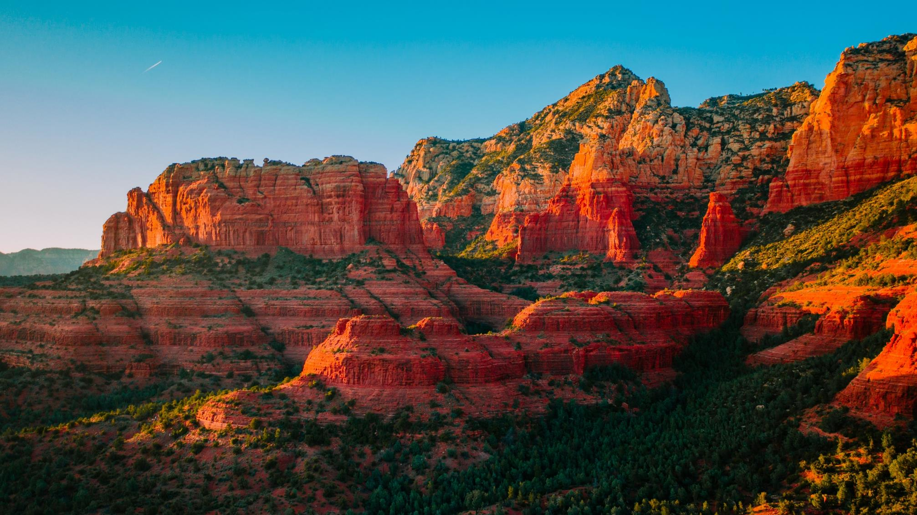


THANK YOU

