Slide 1
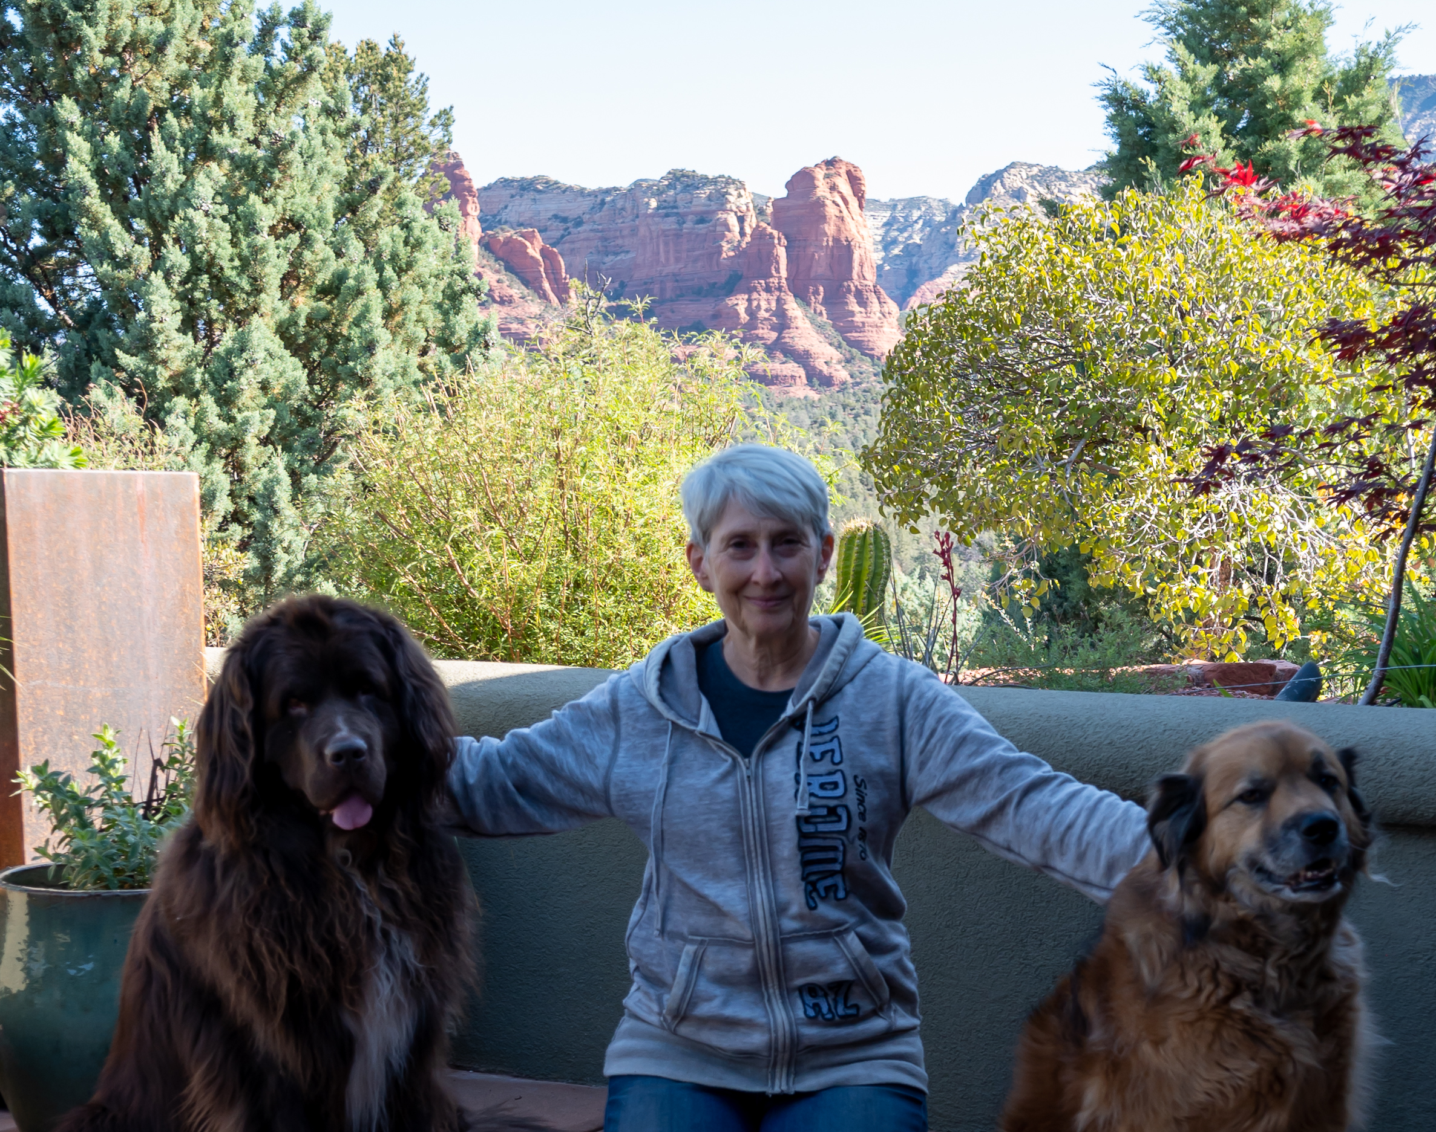
Melissa Dunn
How I see Sedona's Future
A Sedona that is vibrant, affordable, innovative, artistic, and thriving with young families, entrepreneurs, seniors, and visitors from around the globe. Surrounded, nurtured, and inspired by the Red Rocks of Coconino National Forest.
I believe in us and what we can accomplish. Together.
Any expression of opinion that may be read into this content can only be attributed to me as the author and does not necessarily represent the position or opinion of the City Council or City Staff

Slide 2
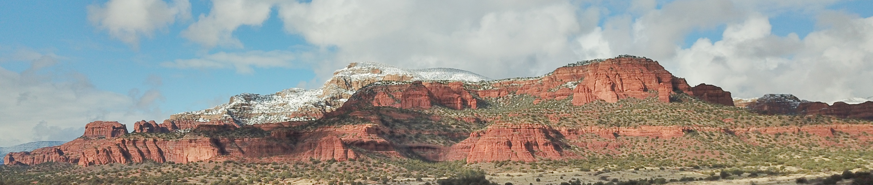
Community
Improve existing & create new community and neighborhood spaces
Redefine “neighborhood” through neighborhood connections
Foster neighborhood and town-wide gatherings through a community calendar
Stabilize our population through the attraction and retention of families
Promote affordable housing, “starter homes” creating an affordability cycle
Foster open dialogue between residents, council & staff

Slide 3
Environment
Taking cars off the road reduces air pollution, reduces noise pollution, reduces impact on roads, reduces commute times, reduces accidents, and improves quality of life for residents
Improve Trailhead and On Demand Shuttles
Keep Sedona clean, green, and sustainable
Protect our natural resources and provide a serene and beautiful place to live

Slide 4
Accountability
Transparency is the key to accountability
New Enterprise Resource Planning Software
Council initiated performance metrics working group
Dashboard easily accessible to all of us
Professional audit of the performance metrics

Slide 5
About Me
Professional Information:
www.linkedin.com/in/MelissaDunnSedona
Campaign Website
www.melissadunnsedona.com
I’m a problem solver ​
I love Sedona and I love living here ​
I’m well-educated
I have had an extensive career in Technology ​
I am people led and data driven​
I believe that to predict the future, we need to create it ​

Slide 6
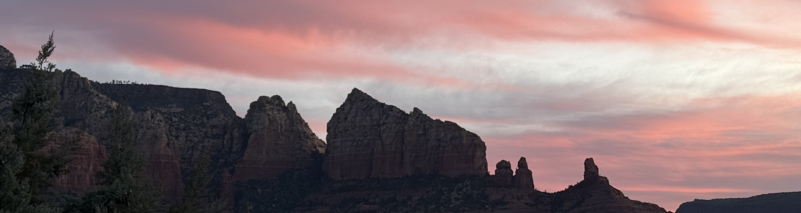
Together We Are Sedona

